Slide 1
Distribution & Contamination Assessment of potentially harmful elements (As, Pb, Ni, Cd) in the topsoil of Penang Island, Malaysia
By: Alexis Bilas-Imperial

Slide 2
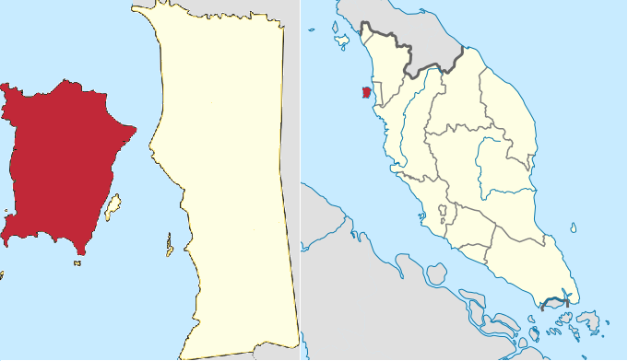

Slide 3
Purpose of study
“Determine concentration & distribution of As, Pb, Ni, Cd
“Predict source of respective metals by comparison of their mean concentrations”
“Assess contamination level of these elements”

Slide 4
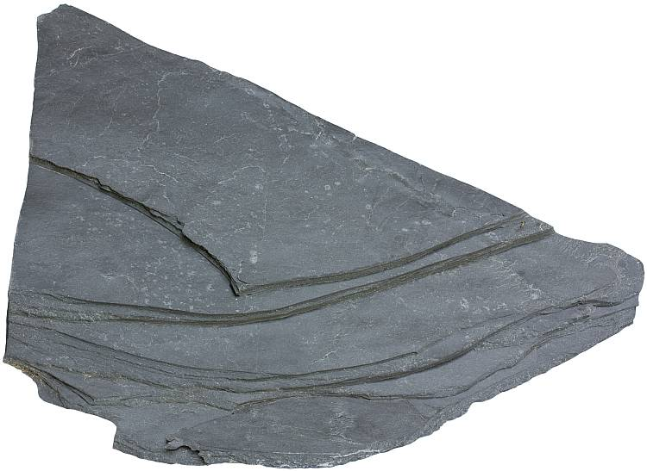
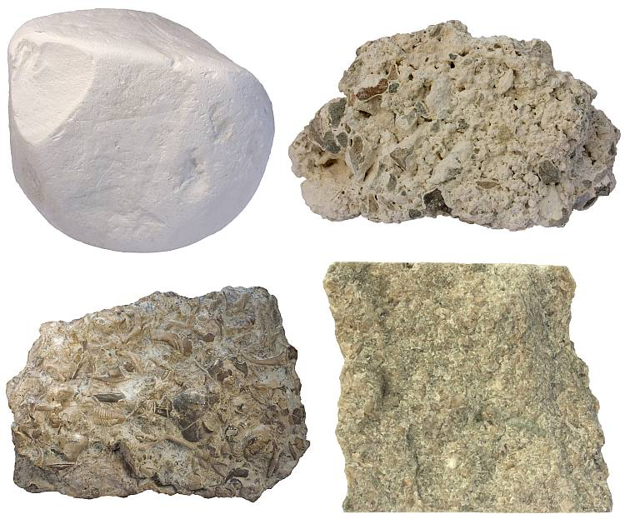
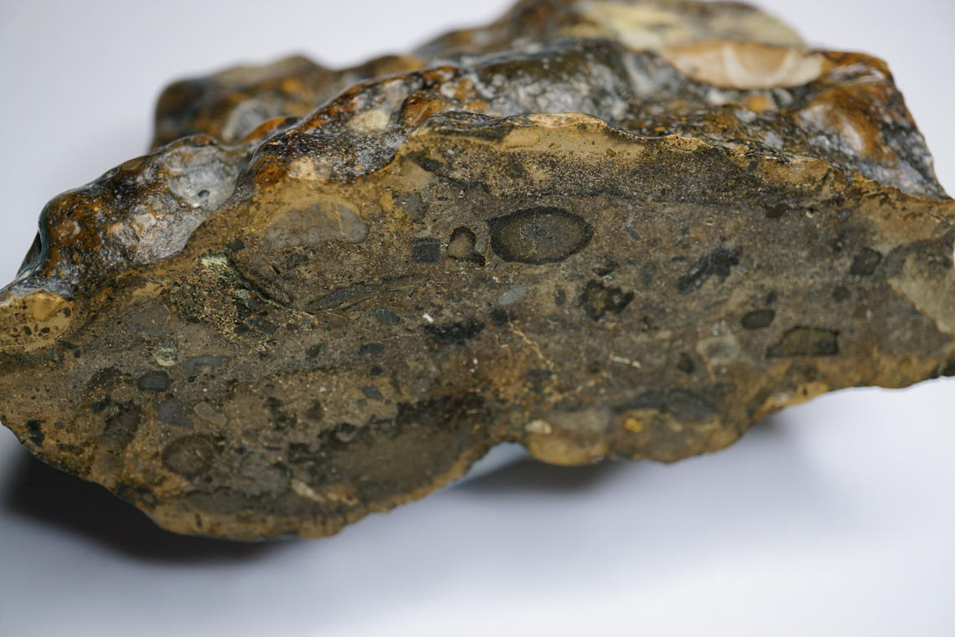
Where these elements are derived from naturally
Parent rock:
Black shales (As, Pb, Ni, Cd)
Limestones (Pb, Ni, Cd)
Phosphorites (Pb, Ni, Cd)
Ultra-mafic rocks (Ni)
Sedimentary ironstones (As, Pb, Ni)

Slide 5
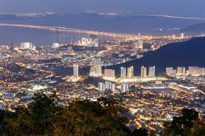
High carbon footprint?
Urbanization started early 1800s
1st British port town in S.E. Asia

Slide 6
Anthropogenic sources of elements
Arsenic (As)
Dust from ores melting, pesticide manufacturing, coal combustion, geothermal plant power, sulfide ore & smelting, wood preserving agents, & pig & poultry sewage
Lead (pb)
Industrial emissions, high-temp processes in smelter, lead acid batteries, previously used leaded patrol, erosion, chemical weathering from coal mines
Nickel (Ni)
Thermal power plant, metal processing operation, combustion of coal & oil, sewage sludge, phosphate sludges
Cadmium (Cd)
Phosphate fertilizers, by-product of mining, battery production, stabilizers for plastic & traffic emissions

Slide 7
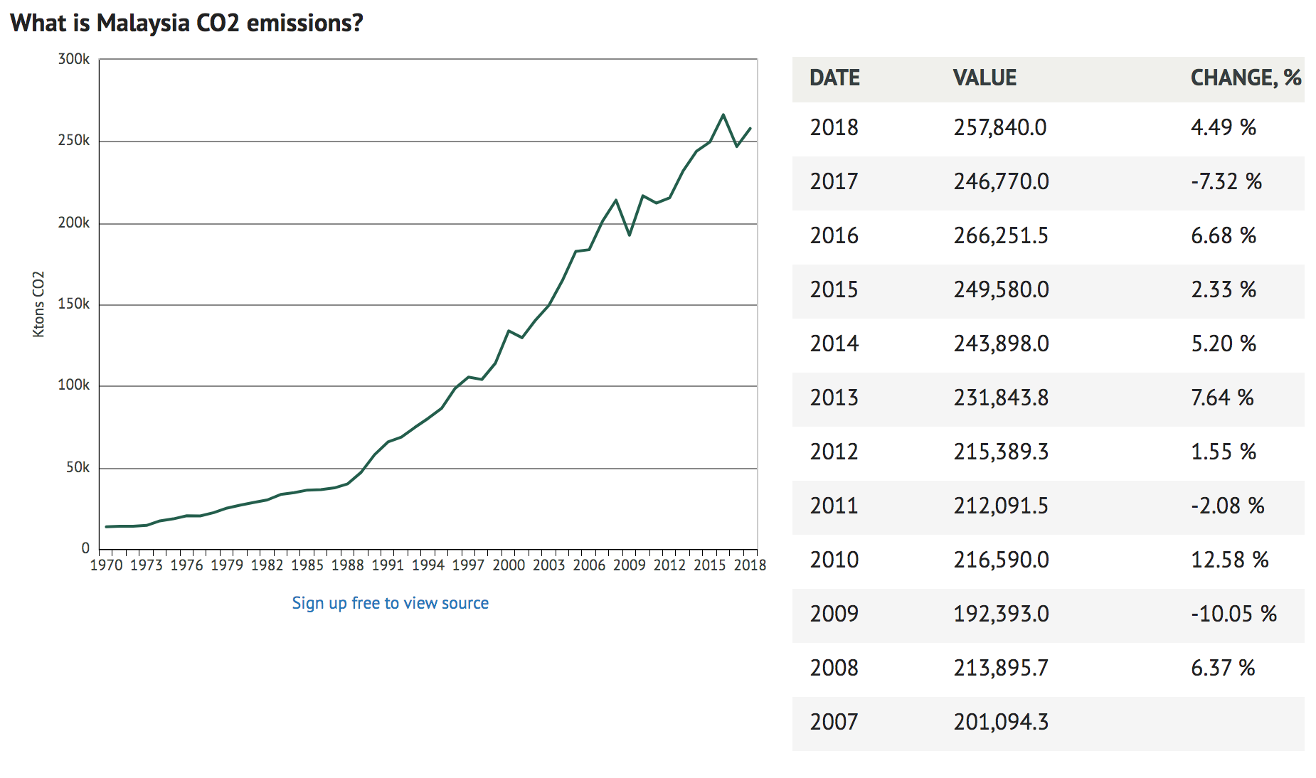
Kdkdkd
https://knoema.com/atlas/Malaysia/CO2-emissions

Slide 8
Rock Deposits
Types of rock deposits in Penang Islands
Penang Island is made up of Quaternary deposits and granitic rocks..
The North Penang
orthoclase to intermediate microcline granite,
The South Penang
Pluton exhibits microcline granite
Quaternary deposits of Penang Island
Simpang Formation
Beruas Formation
Gula Formation
)

Slide 9
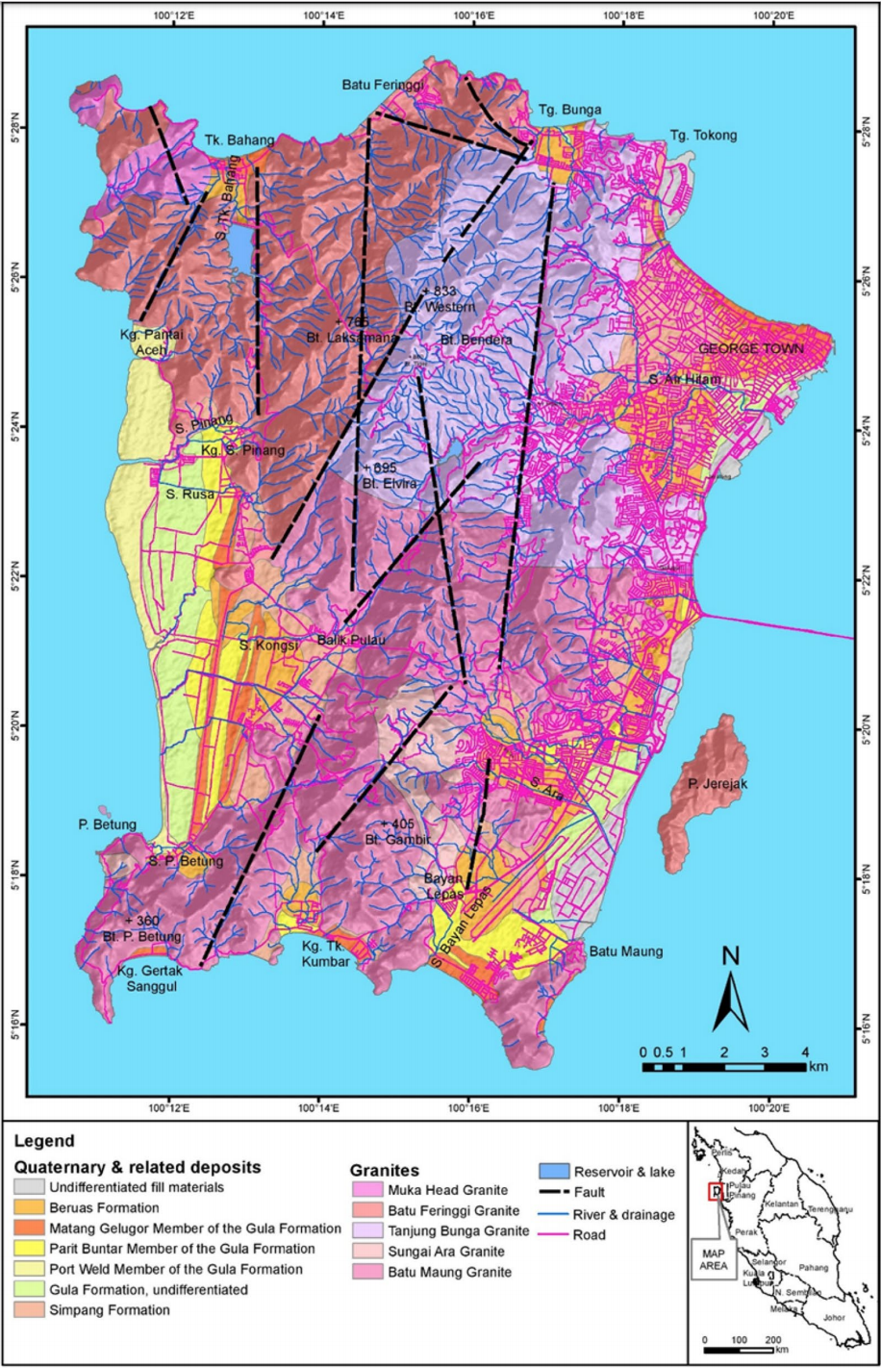

Slide 10
Methods & sampling
31 top soil samples were collected
19 from quaternary deposit topsoils
12 from granite residual top soils
From the collected samples
CEC (cation exchange capacity)
SOM (soil organic matter)
ICP-MS (Plasma Mass Spectrometry)

Slide 11
More Methods
Soil contamination assessment
CF (contamination factor)
Cf = Ci ∕B
If Cf
<1 = no element enrichment
Between 1 & 3 moderate contamination
Between 3 & 6 considerable
>6 high contamination

Slide 12
Results

Slide 13
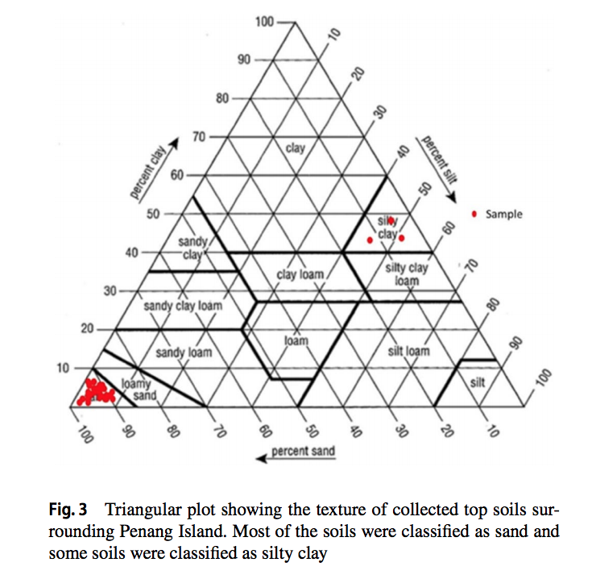
Results
Soil texture = mostly sand (some silty clay)
pH = 3.84 - 8.30
Because mostly acidic values , derived from granite
Related to acid sulfate marine deposits
The more higher values (close to basic) showed results from urbanization

Slide 14
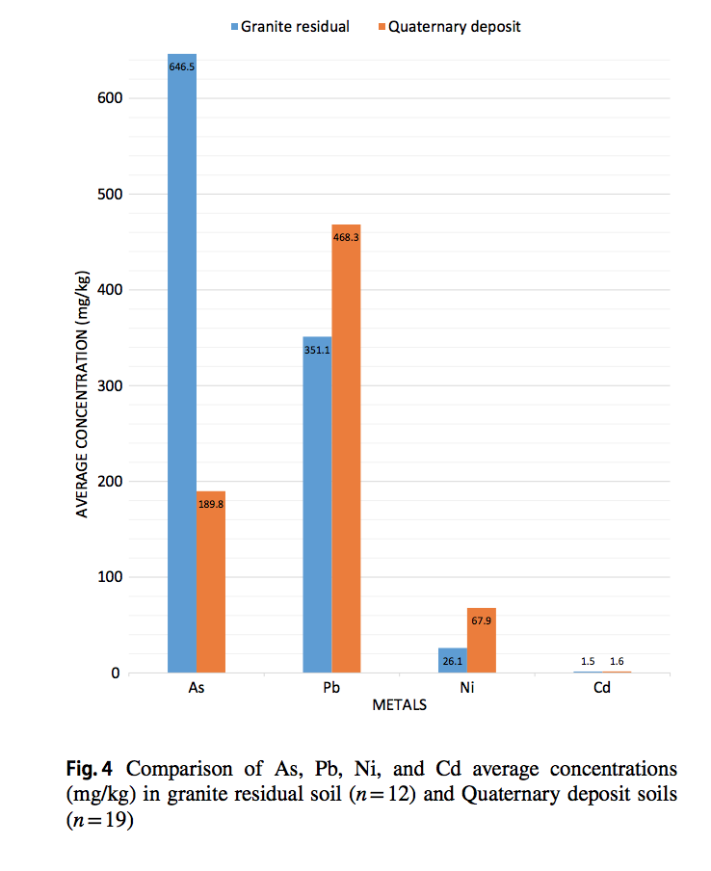

Slide 15
Citations
AbdulHamid2019_Article_DistributionAndContaminationAs

Slide 16
Summary of Article
Quality of soil has been a growing concern around the world
This is due to the increase of fossil fuels primarily, but many factors are taken into consideration.
Article uses the distribution and contamination levels of elements As, Pb, Ni, and Cd in the topsoil of the penang island.
Findings : Pb>As>Ni>Cd. soils derived from quaternary deposit have higher mean concentration of Pb, Ni, and Cd. (not my words)
As, Pb, Ni, and Cd are mainly concentrated in the north-to-north eastern areas of Penang Island and near to the main city. suggesting that the anthropogenic source is the main contributor to the As, Pb, Ni, and Cd in the topsoil of Penang Island (not my words)

