Slide 1
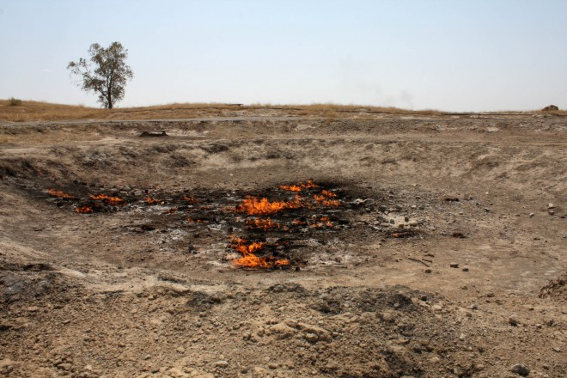
Iraqi Pollution Indices
The Kirkuk Case Study
Michael Burke - 2019

Slide 2
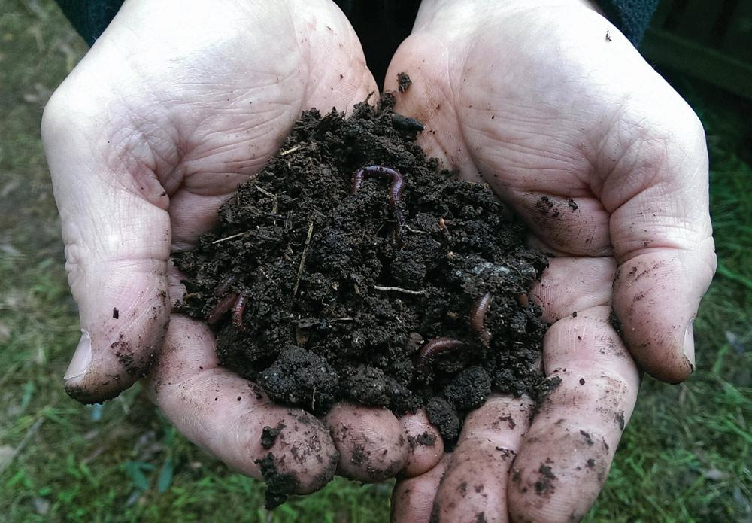
Experiment Context
Soils affected by activity, industry and human population
Urban soils possibly a sink for metals and other forms of contamination
Impact on soils unclear due to constant land changes and human activity
What are the long term effects of metals and other trace elements in soil? How does their distribution and concentration factor into the pollution index? What are the differences in soil pollution in one region?

Slide 3
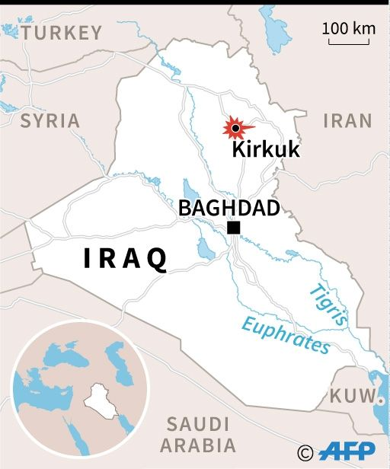
Kirkuk, Iraq
Region rich in oil - Manufacturing plants of oil and cement
Cement dust, vehicle exhaust, and oil trash burning supposed main pollution factors
Exhaust and oil burning - heavy soil metals
Kirkuk Oil Refinery sourced as air polluter
Khassa River as city’s sole water source

Slide 4
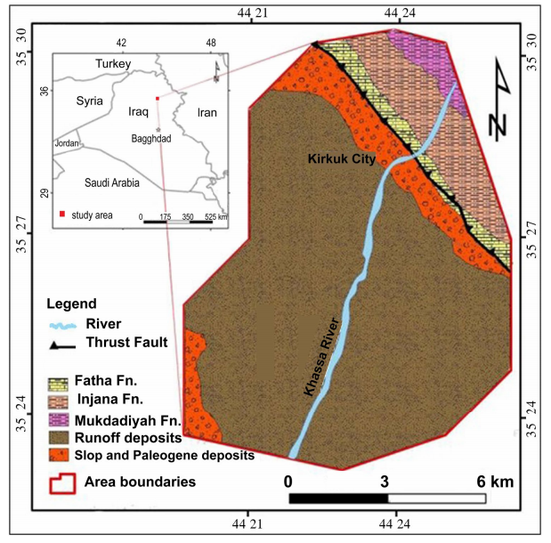
Geological Background
Fatha Formation - Gypsum, anhydrite, and salt
Limestone and marl interbedding
Injana Formation - Sandstone and Siltstone
Traces of limestone and gypsum
Al Mukdadyia Formation - Main aquifer of region
Sandstone, mudstone, and gravel
Sheet Runoff Deposits - Clay, silt, sand, and gravels over a broad and flat majority of the area
Metals tested: Cr, Co, Ni, Cu, Zn, As, Ag, Cd, Pb

Slide 5
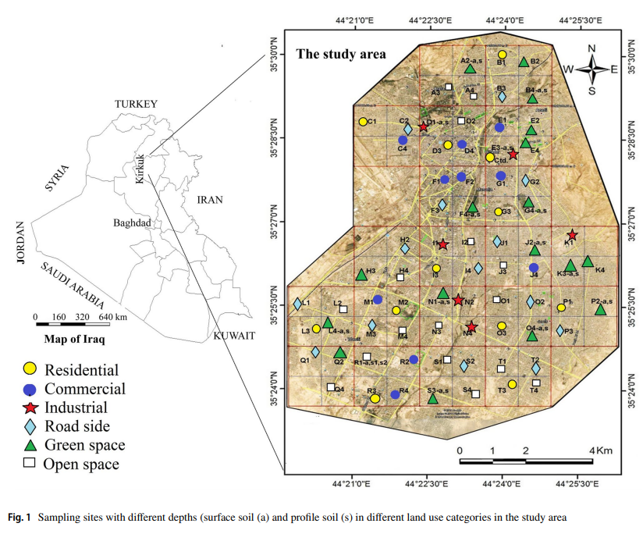
Experiment Procedure
75 surface samples collected - 0 to 20 centimeter depth
15 subsurface samples - 35 to 50 centimeter depth
6 rural soils - In consideration to prevalent wind
Soils collected and sieved to gather metallic fragments

Slide 6
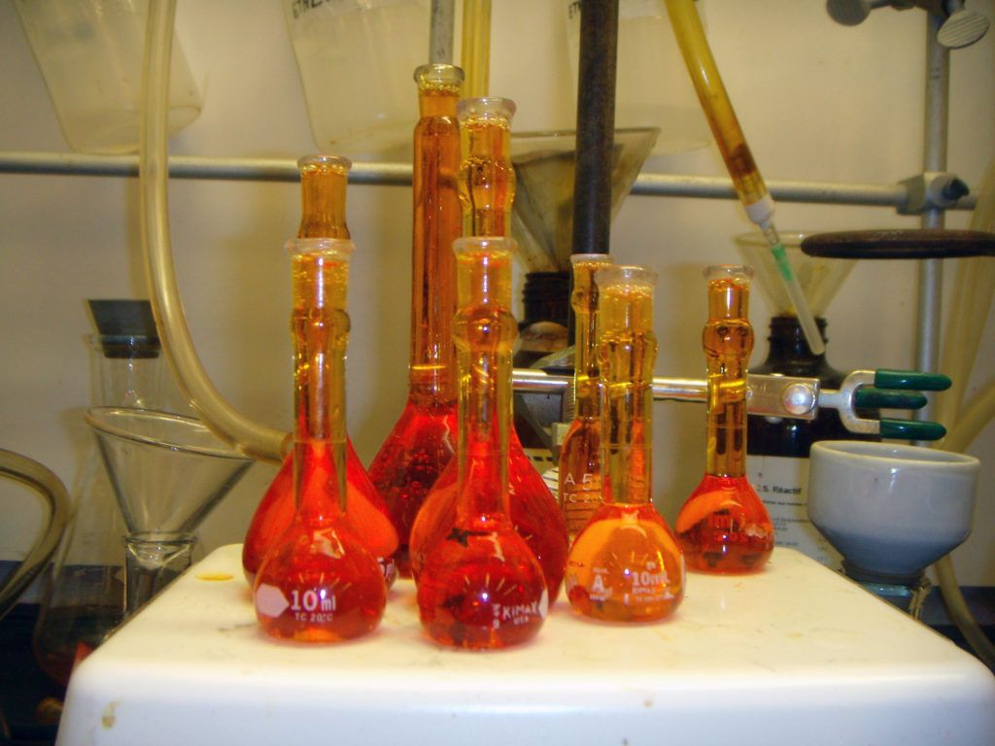
Experiment Procedure (cont.)
Collected soils tested via aqua regia digestion method
Corrosive reagent-based dissolution
Heavy metals recovered and rates recorded
Concentrations measured by Inductively Coupled Plasma Mass Spectrometry
ICP-MS
pH levels measured by soil suspension via centrifuge
Pollution Index used to determine soil quality
PI = C_{n} / B_{n}
Geochemical Background of Tested Metal
Tested Metal Concentration

Slide 7
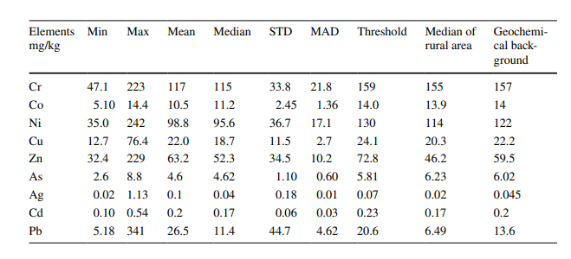
Geochemical Background
GB based on concentration of a metal in given area and compositional/mineralogical characteristics of parent material
Concentration of element in an area with compositional factors

Slide 8
Pollution Index Procedure
PI calculations notated in terms of contamination levels as:
Low - PI ≤ 1
Moderate - 1 < PI ≤ 3
High - PI > 3
IPI (Integrated Pollution Index) measured as mean value of PIs

Slide 9
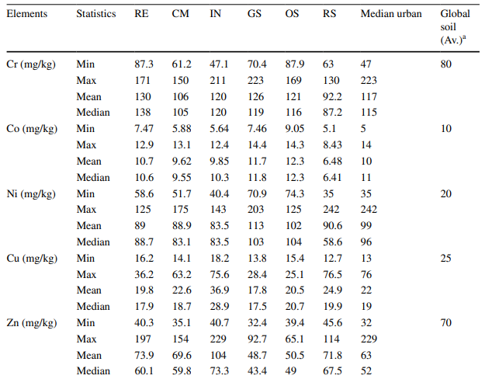
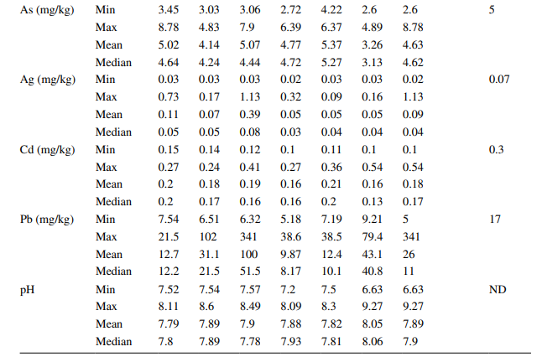
Concentration Results
Concentrations compared to global soils

Slide 10
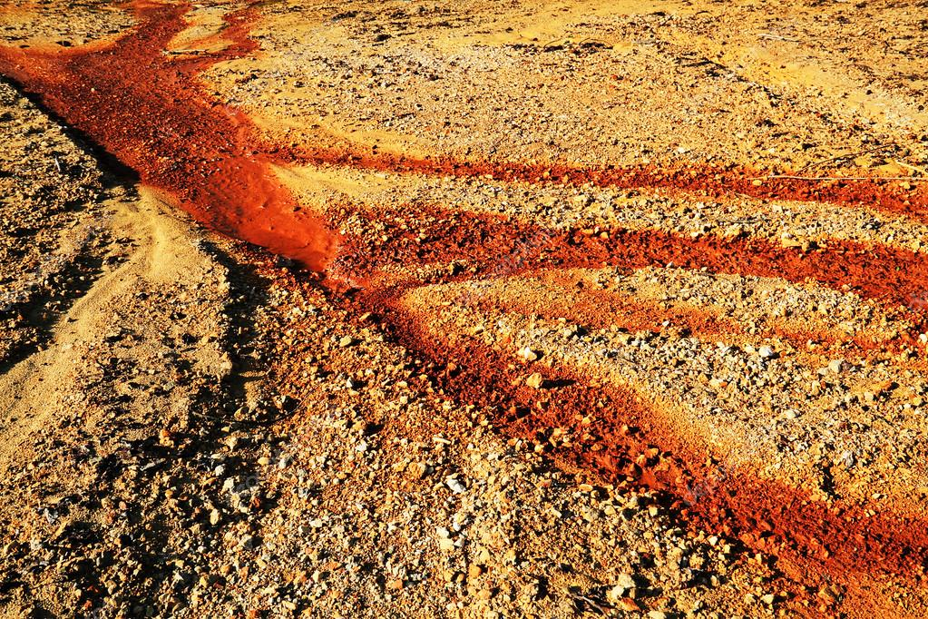
Analysis of Results: Soil Quality and Pollutants
Parts per Million (ppm) and pH values of the tested metals in soil samples compared to global averages
Minimum, maximum, median, mean, and global average percentage comparison
Tested Regions include:
Residential (RE)
Industrial (IN)
Commercial (CM)
Green Space (GS)
Open Space (OS)
Road Space (OS)
Cobalt concentrations have high averages when compared globally
Result of fossil fuel combustion products

Slide 11
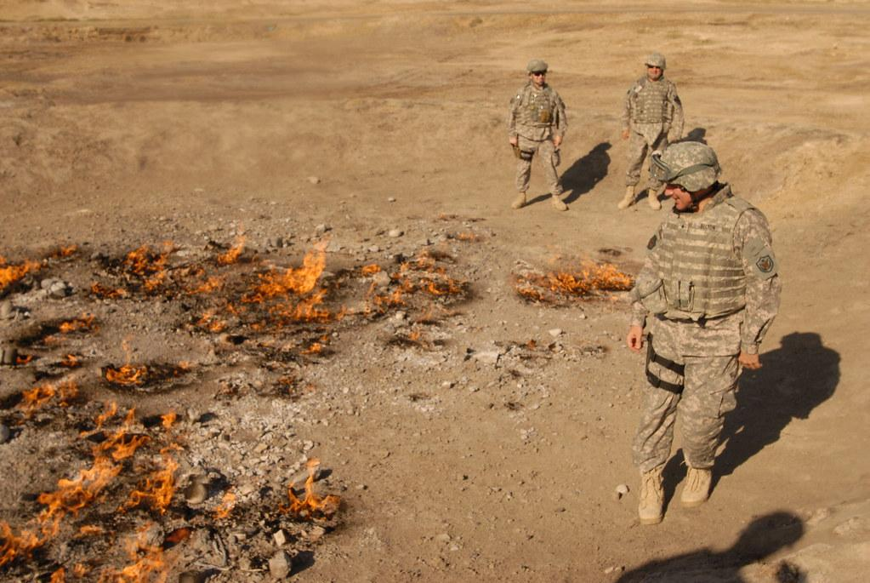
Other Pollutant Evaluations
Burning of oil trash from Kirkuk Oil Refinery determined as source
Cobalt-laden sludge and phosphate fertilizers also sources
Very close to Khassa River and near agricultural areas
Concentration of nickel, lead, and arsenic all linked to industrial activities in IN zones
Garages, metal workshops, and waste dumps yield high amounts of lead

Slide 12
Soil pH Impact on Metal Pollutants
Plays major role in dissolution and precipitation processes
High temperature climate accelerates dissolution process
Most soil tested to be slightly or moderately alkaline
Heavy metals precipitate under alkaline conditions under:
Phosphate
Hydroxide
Oxide
Carbonate
Kirkuk soil’s high permeability contain metal due to the absorption of running water in response to the alkaline pH levels

Slide 13
Conclusions: Levels of Pollution
Experiment determined concentrations and roles/sources of metal pollutants in select soil types
Open Space - High nickel, cobalt, and arsenic amounts
Green Space - Affected by wastewater and used for agriculture
Residential - High concentrations of chromium, cobalt, and nickel
Commercial - Heavy lead pollution
Industrial - Oil burning and cement dust emit pollutants
Road Side - Burning emissions and exhaust
Low
Moderate
High
Open Space
Green Space
Road Side
Commercial
Residential
Industrial

Slide 14
Sources
Al-Jumaily, Hassan. (2018). Heavy Metals Concentrations in Surface Soils of the Haweja Area South Western of Kirkuk, IRAQ. 10.13140/RG.2.2.10669.59361.
Awadh, S. M., & Jawdat Abdul Jalil M. Zaki Al-Hamdani. (2019). Urban geochemistry assessment using pollution indices: a case study of urban soil in Kirkuk, Iraq. Environmental Earth Sciences, 78(20). doi: 10.1007/s12665-019-8615-3
Gaudino, S., Galas, C., Belli, M. et al. Accred Qual Assur (2007) 12: 84. https://doi.org/10.1007/s00769-006-0238-1

