Slide 1
Groundwater Systems in Bare & Covered Karst Aquifers
Evidence from Tracer Tests, Hydrochemistry, and Groundwater Ages
By
Guanghui Jiang, Fang Guo, and Changyuan Tang
Article by Environmental Earth Sciences (2019)
An overview by Chris Leary

Slide 2
The Area
East Guilin region of (southern) China
Developing rural region with variable karst terrain
Multiple degrees of terrain
Present human settlement (mostly in plains)
Significant agriculture and water use
Extensive free-range pastureland with roaming stock
Karst topography makes for highly variable surface and ground water systems
Terrain types differ between bare and covered karst aquifers (loose sediments) with 3066 recorded subterranean rivers
Significant riparian zones along Lijiang River and tributaries (Xiao Dong Jiang & Chao Yang Rivers)
Average annual air temperature 18.9ᵒC and environment humid

Slide 3
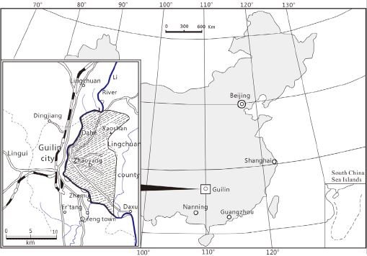
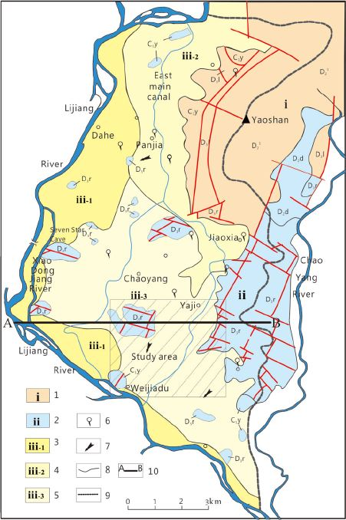

Slide 4
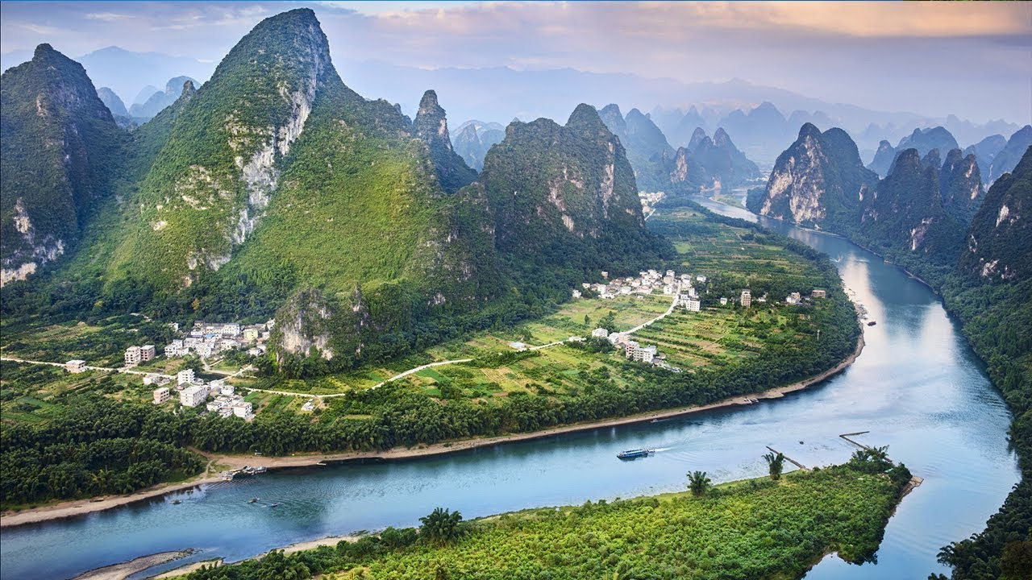

Slide 5
Fenglin
Fengcong

Slide 6
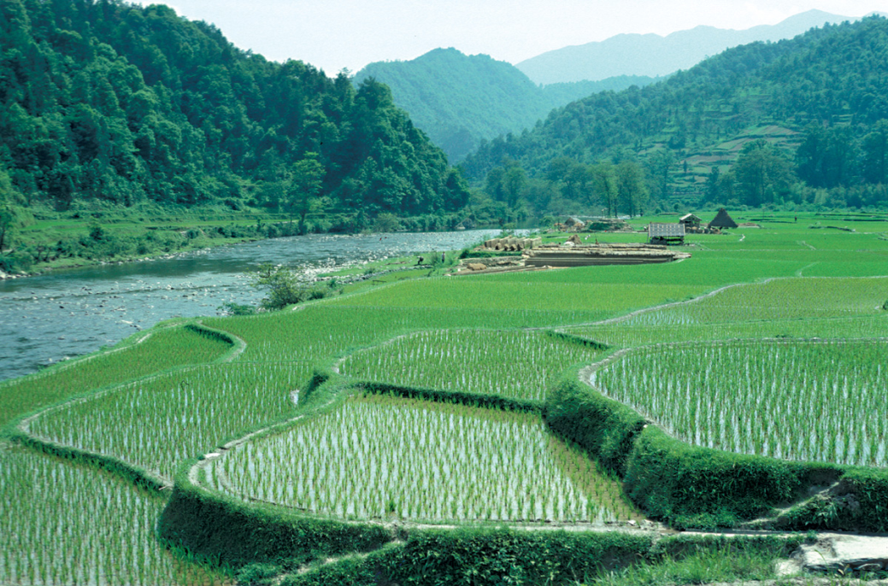
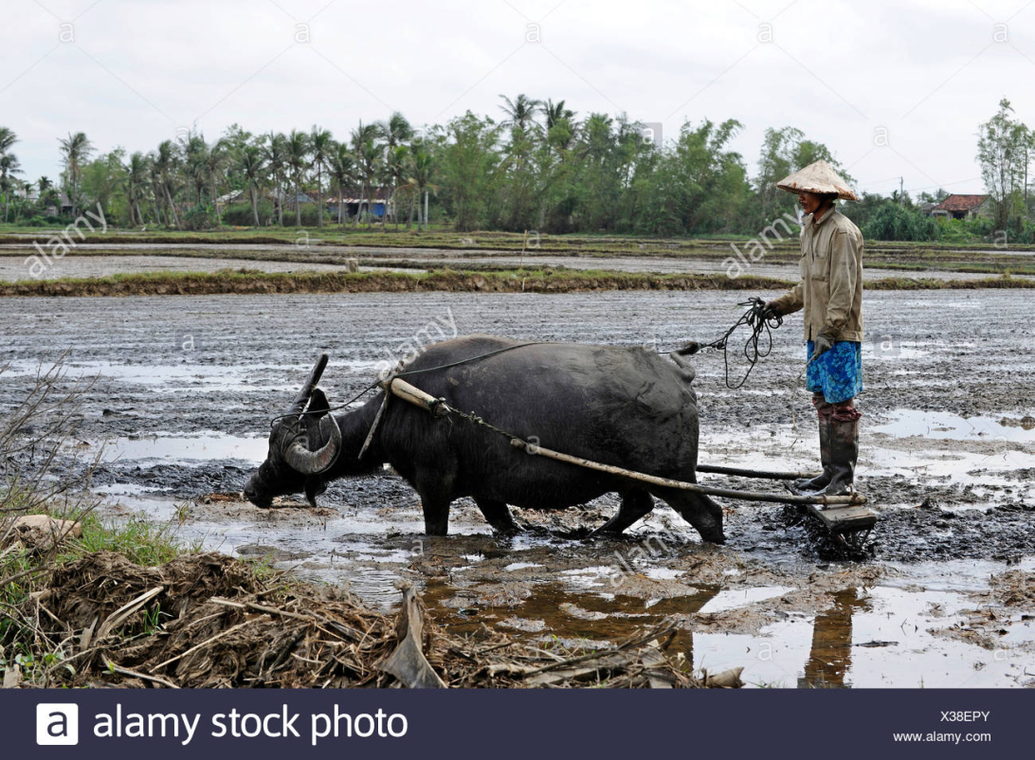
Current & Historical Issues
Deforestation
Agriculture
Industrial (rubber, brick, tile, etc.)
Numerous abandoned wells
High risk of groundwater pollution
Open livestock grazing

Slide 7
Objective
Exploration of groundwater and solute movement in the different hydrogeological sub-regions (tracer tests & hydrochemistry)
To describe the groundwater flow and age between two neighboring but distinct geomorphic karst water systems
Provide data for decision-making in effective groundwater management within bare/covered karst aquifers

Slide 8
Methods and Procedure
Sample area 136 km²
Tracer Dye tests with ¹⁴C, CFCs, SF₆
Carbon-14 used to detect old water (up to 40,000 years)
CFCs used to assess younger waters (only up to 60 years)
SF₆ used for groundwater age estimation (this case 10 years, variable by location)
Solute Migration via Nitrate analysis
Variable locations from surface holes to depths up to 50 m
Sample period over 5 years, many shorter tests performed in-between

Slide 9
Methods Continued
Tracer samples gathered in 100 ml brown glass bottles
Bottles pre-cleaned by heat-treating @450ᵒC for 2 hours
Submersible stainless-steel bottles used to house glass bottles
Closed-valve system when submerged to avoid air contamination
Cations analyzed with ICP-OES, anions with Ion Chromatography
CFC concentration determined with gas Chromatography (GC-ECD) and Electron Capture Detection (GC-14B)
Limit of detection at 0.01 pmol/kg and precision 1%
Data evaluated with USGS-modified Excel

Slide 10
Composition & Challenges
Highly variable terrain, in both topography and ecology
Some areas are exposed rock facies while others have sediment coverage
Variable ecology ranges from dense forest/jungle to open plains and exposed outcrops
Bedrock is primarily sandstone and carbonate rock
Many abandoned wells in the area that allow deep water mixing
Porous bedrock and sandy clay make for a heterogenous environment

Slide 11
Regional Cross-section

Slide 12
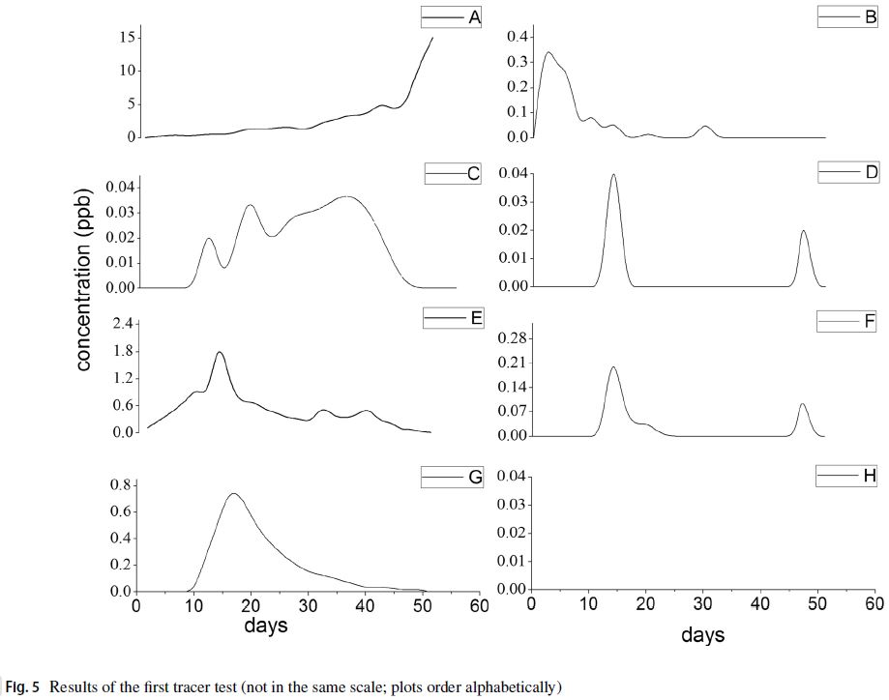
Test Sites,Flow Direction, Tracers

Slide 13
Test Comparison & Uses
Dye Tracers
Hydrochemistry
Most effective in transition zone
Results may not be satisfactory
Unusable in plain zone
Results obtained in the field
Uranine injection with down-flow sampling at multiple sites
CFCs also used
Might produce good results in plain zone
Results obtained in the lab post-sampling
NO₃⁻ selected for local contamination (livestock, agriculture)

Slide 14
Results
Confirmed primary flow path of study area via Uranine tracer tests
Average flow velocity of 85 m/day based on variation
Only two sites within study yielded clear results, all others invalid
Apparent groundwater age determined by CFC partial pressure comparison, GW age also not necessarily representative of age of contamination (from mixing processes within karst matrix)
DO & ORP used to determine potential geochemical alteration of CFCs
Levels suggest anoxic environment (>1 mg/L & 150-500 mV)

Slide 15
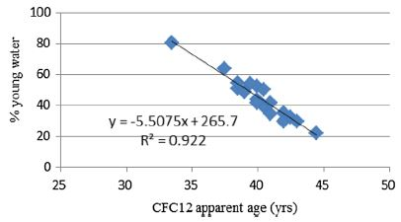

Slide 16
Conclusion/Discussion
Many seeming contradictions
Groundwater flow system of bare-covered karst area is difficult to determine
Combined techniques obtained a greater understanding of the karst groundwater flow pathways and flow regime
Age dating from CFCs indicates groundwater is old (37-40 yr)
Fracture flow slow in bare karst mountains, resulting in higher age
Dye tracer tests indicate GW movement slows in transition zone
In peak forest-plain zone, GW recharged by diffuse flow
CFC ages vague in areas with complex hydrology and fracture flow
Still contradiction between CFCs and dye tracers
Impact of CFCs on hydrogeology needs more tests

Slide 17
Personal Takeaways
Pros
Cons
Detailed analysis with definitive and precise measurements
Clear evaluation of data
Good description of terrain and groundwater systems
General history of area well understood
Relevant techniques (ICP-OES) subject material in class
High volume of data analysis
Diagrams and captions difficult to interpret
Considerable data detailed in text
Variable terrain and water system made data analysis less reliable
Overall inconclusive results, more study required

