Slide 1
Phosphorus fractions and speciation in rural and urban calcareous soils in the semiarid region of Sulaimani city, Kurdistan, Iraq
Sean Mooney

Slide 2
Sulaimani city, Iraq
Semi arid climate with hot and dry summers, cool and wet winters.
Located in northern Iraq
Population of 677,000
Known as Zamwa until 1784 when the city was established.

Slide 3
Introduction
Assessed impact of urbanization on Phosphorus contents in the region of Sulaimani City, Iraq.
Assessed using topsoil samples
Topsoil samples were taken from different regions surrounding the area with different levels of human impacts on the land.
Topsoil samples were taken from calcareous soils in the area.

Slide 4
Phosphorus
Essential nutrient for agricultural productivity and growth of crops.
Naturally derived from weathering of parent rock in calcareous soils.
Artificially derived from fertilizers.
Plants require high amounts of phosphorus in young stages.
Important to understand the impact of land use on Phosphorus to avoid excessive phosphorus use as well as reduce environmental pollution

Slide 5
Soil Sampling
Collected from within the Sulaimani city, surrounding natural areas, and near natural areas.
35 different sites with varying land use were selected.
4-5 topsoil samples were taken from 8 different sites including: Near natural mountain areas, Extensively grazed grass areas, the Qiliasan stream, the Tajero River, Roadsides of high traffic areas as well as industrial areas within the sulaimani city.

Slide 6
Methods of Analysis
Soil pH was measured in soil suspension using a glass electrode.
Cation exchange Capacity was measured after cation exchange with BaCl₂ at pH 8.1
Gas chromatography was used to measure total Carbon as well as total Nitrogen
Total Phosphorus was measured by Acid Digestion using a pressure digestion vessel.
X-ray Diffraction was used to cover the different land uses and different patterns of Phosphorus fractions on a subset of 10 different samples.

Slide 7
Results
Soil Texture ranged from silty clay loam and sandy loam; material is coarser in urban soils.
Significantly higher OC content in Industrial areas than in rural areas.
Industrial areas also contained higher C/N ratios of 21.7, higher than any other soil tested.
The mineral composition of the soils was mainly illite, but also contained mica and albite.
Small amounts of kaolinite and chlorite clay were found as well.
Smectite was found in all samples, prominent in grassland and arable sites.
Gypsum was found in one industrial site.
According to the FAO Classification All soils in the region are extremely calcareous

Slide 8
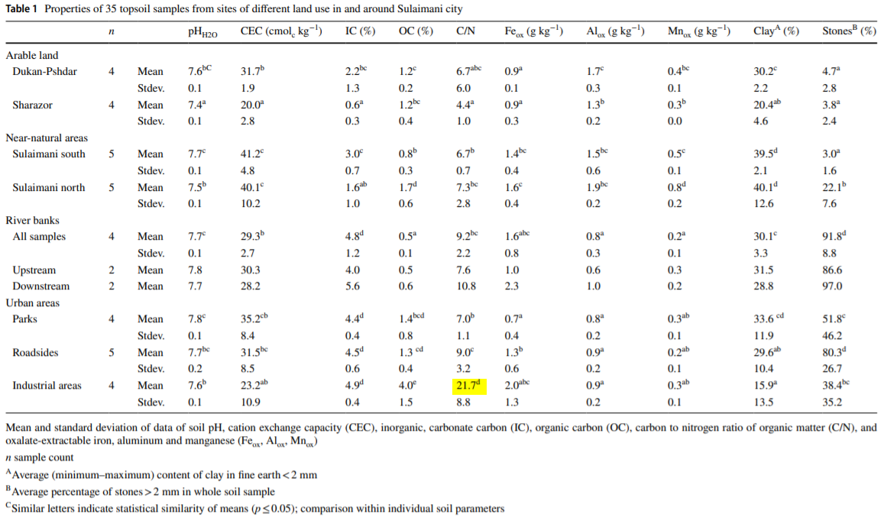

Slide 9
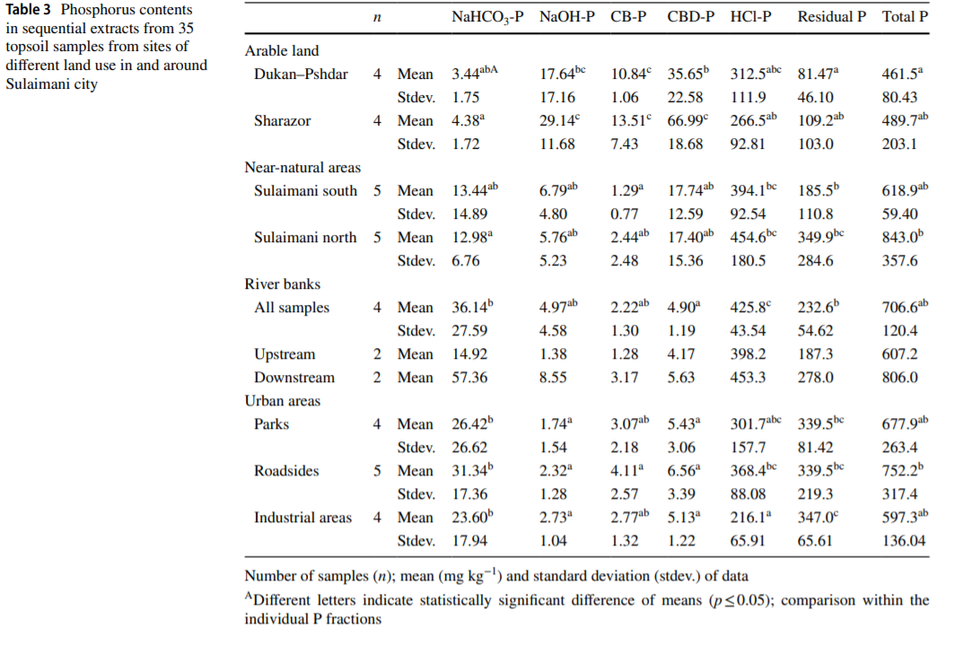

Slide 10
Results (continued)
Fertilizers use in the parks, gardens, as well as brake dust from cars increases the labile Phosphorus fraction (NaHCO₃-P).
Asphalt, wood, and cement from construction materials increase the stable inorganic form (Residual P).
Up and down stream of the rivers show signs of increased labile P, this can result in increased soil moisture in the semiarid climate.

Slide 11
Conclusions
Land use does not necessarily alter total Phosphorus.
Patterns of P-species is typical in calcareous soils.
This pattern is affected by human impacts by arable and urban land use.
Impact of urban soils is a long-term process, and sulaimani is too young and not strong enough to show differences of phosphorus in the urban areas.
Further research is needed to determine organic Phosphorus species in urban areas vs rural soils.

Slide 12
References
Said Hamma Khorshid, Mohammad. Phosphorus Fractions and Speciation in Rural and Urban Calcareous Soils in the Semiarid Region of Sulaimani City, Kurdistan, Iraq. Springer-Verlag GmbH, 2019.

