Slide 1
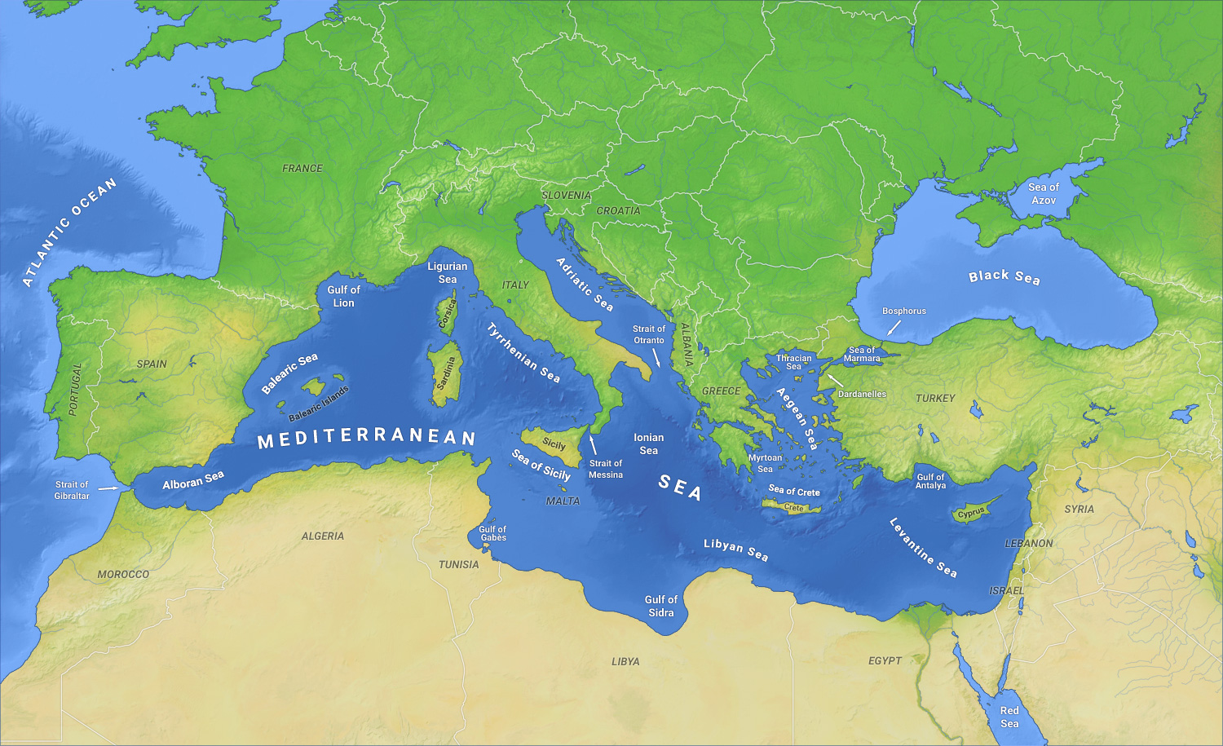
An investigation of Trace metals in Olive Oils of Northern Cyprus.

Slide 2
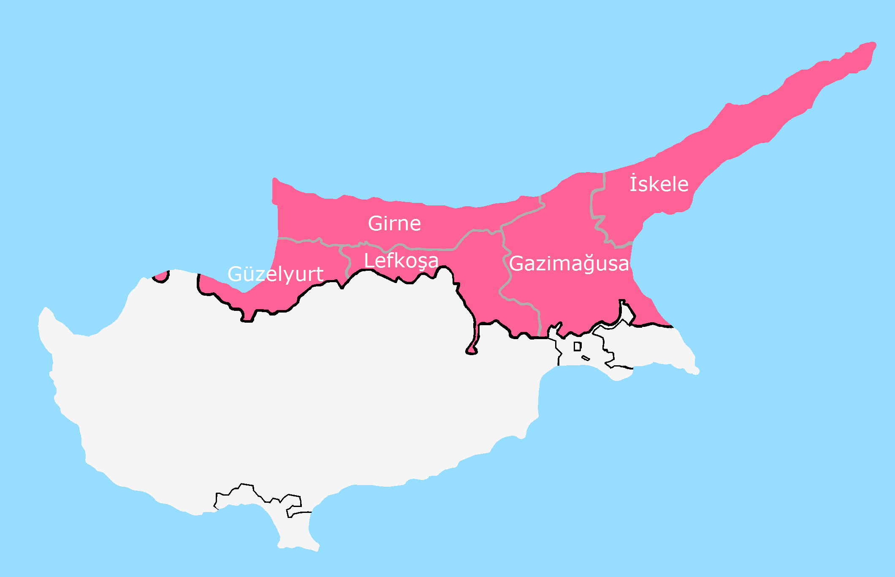
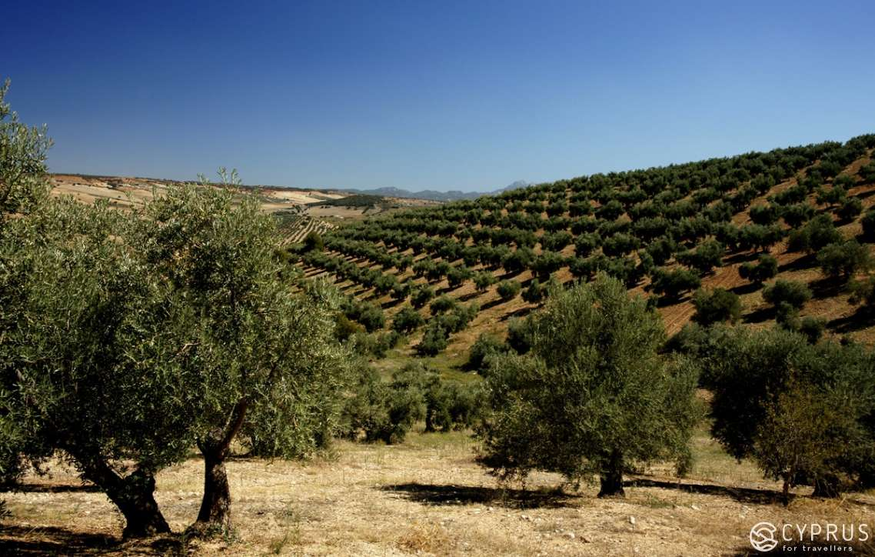

Slide 3
Introduction:
The Olive Tree
Olive oil is a fat from the fruit of the olive tree. (But somehow a vegetable oil)
Source of vitamin E.
Lower incidence of coronary heart diseases and some types of cancer.

Slide 4
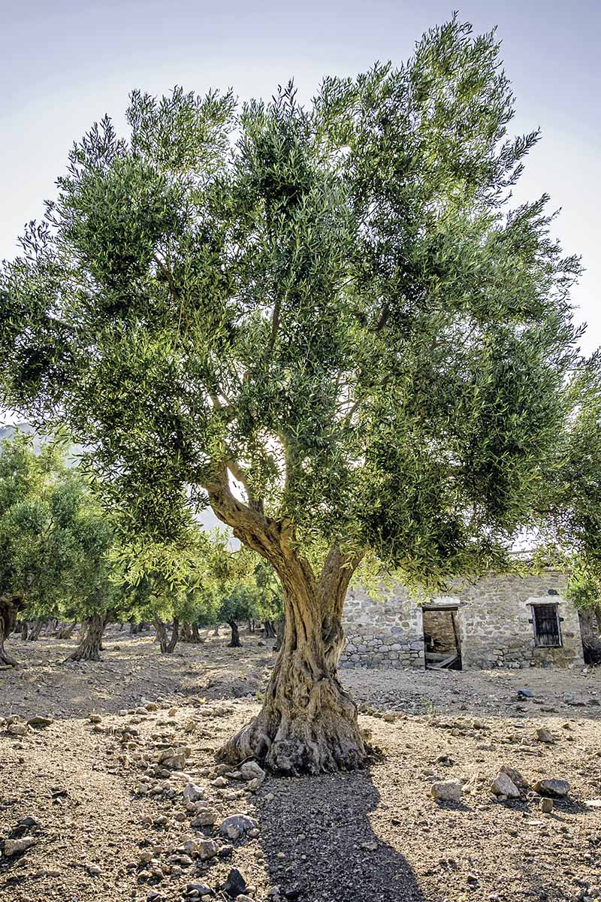
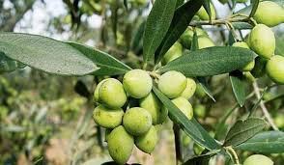
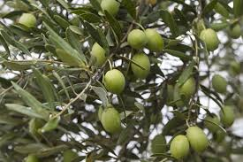

Slide 5
Trace metals:
Heavy metal consumption is a major
Health concern.
Cu, Cd, Cr, As, Pb, Ni
Importance of this knowledge cannot be overstated in the context of this study.

Slide 6
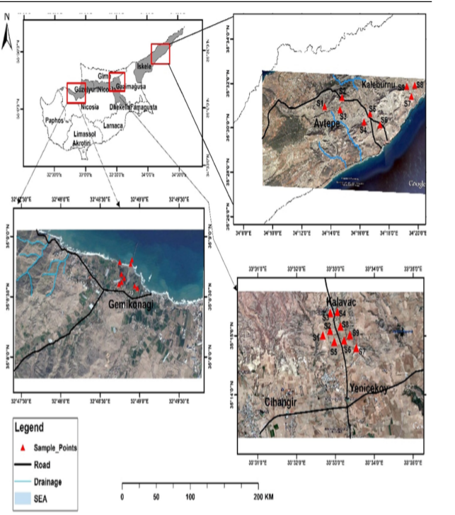
Sample collection:
Samples collected from Northern Cyprus
Oils and fruits
Fruits seeds extracted
Oil was separated and stored at
room temperature.

Slide 7
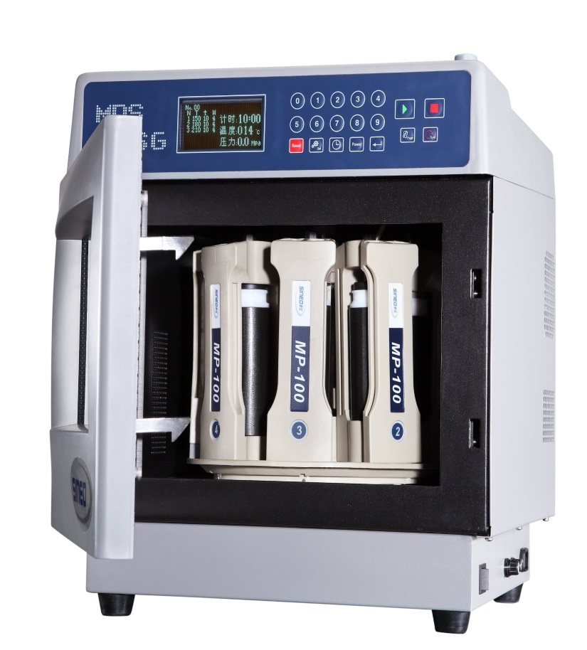
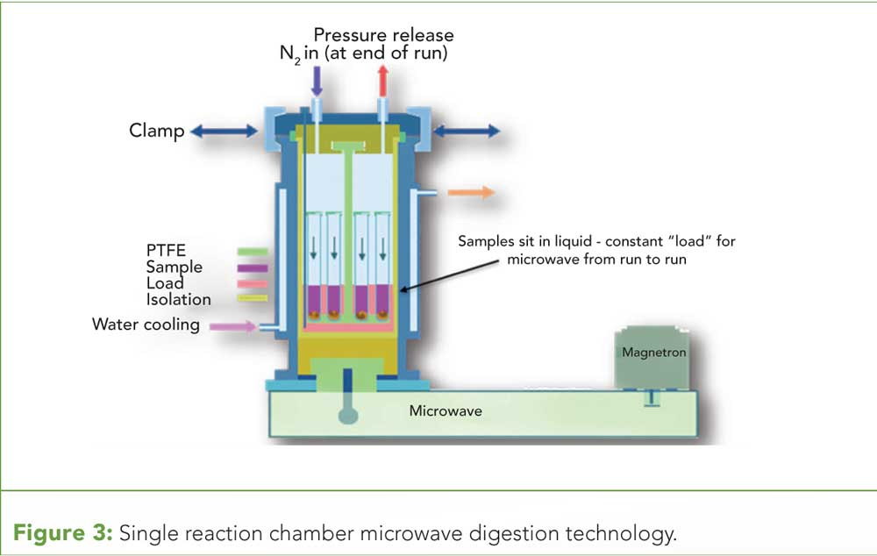
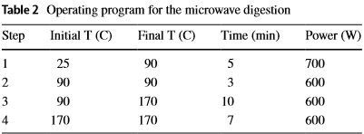
Microwave Digestion:

Slide 8
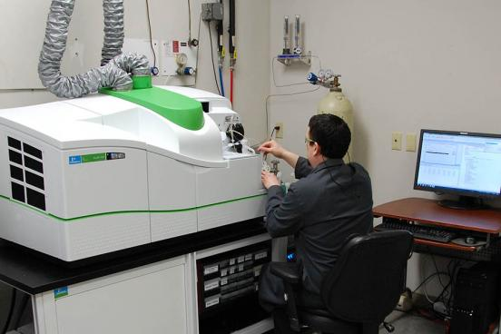
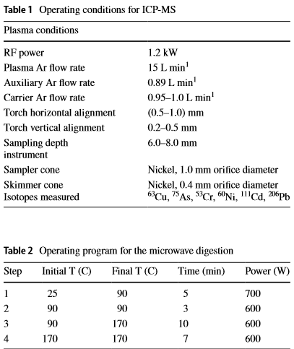
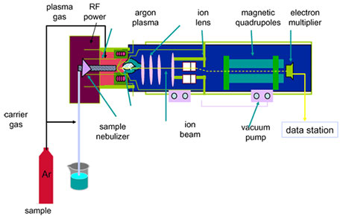
ICP-MS:
Elemental and isotopic analysis

Slide 9
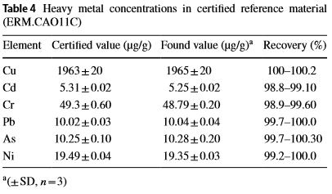
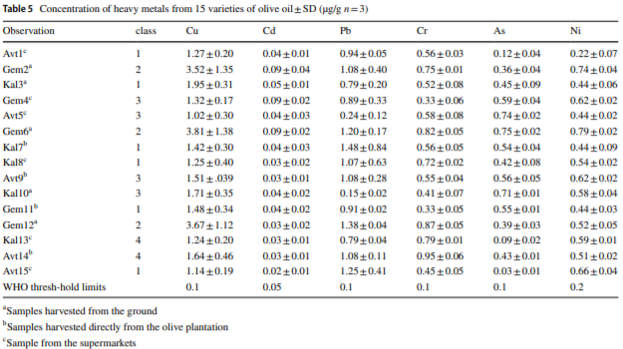
Results and conclusions:
(PCA) Principal Component analysis
(AHCA) Agglomerative hierarchical clustering analysis

Slide 10
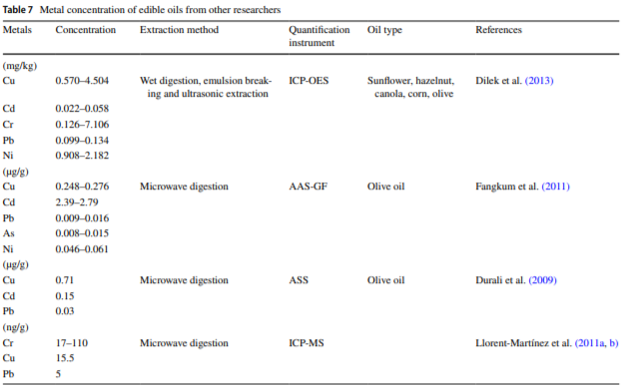

Slide 11
Possible study deficiencies:

Slide 12
Solution

