Slide 1
Arsenic in the waters and sediments of the Humboldt River
Brittany Segill

Slide 2
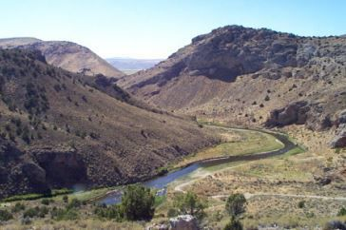
Where?
This study is taking place in Nevada, with particular interest in the Humboldt River and Humboldt River basin
This basin has various metallic and non-metallic economic deposits and is a leading producer of gold, silver, copper, mercury and tungsten in the US
The River and Basin also play a huge role in providing valuable sources of water for mining, construction, power plants, and municipal water supply

Slide 3
Why?
Many previous studies have reported elevated concentrations of arsenic in multiple surrounding river waters of the Humboldt River Basin but not specifically the Humboldt River
Carson River
Walker River
North Fork Humboldt River
This Arsenic has accounted for weathering of geologic material, hydrothermal sources and drainage through mined waste rocks
This study’s goal is to understand the processes controlling arsenic distribution between sediments and waters of the Humboldt River

Slide 4
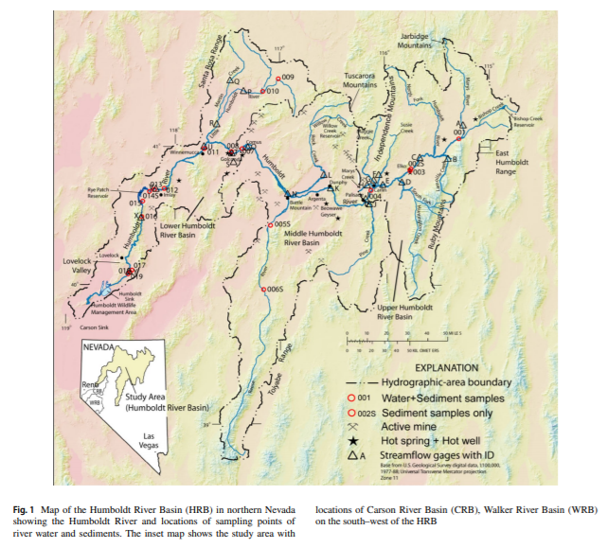
Sample sites
Many samples were taken nearby the intersection of highways and the river
Samples were taken during the dry season

Slide 5
Background Geology of the area
The Upper Humboldt River has Miocene volcanic and sedimentary rocks with some pre-tertiary volcanic rocks
The Middle Humboldt River contains relatively widespread tertiary volcanic and cenozoic sedimentary rocks and widespread quaternary, alluvium, and lacustrine deposits
There are several geothermal hot springs in the Lower Humboldt River region
The Lower Humboldt River consists of quaternary alluvium and playa deposits, lake evaporites and lacustrine deposits
Notes:
There are several geothermal hot springs in the Lower Humboldt River region
There are several geothermal hot springs in the Lower Humboldt River region
The Lower Humboldt River consists of quaternary alluvium and playa deposits, lake evaporites and lacustrine depositsThe wer Humboldt River consists of quaternary alluvium and playa deposits, lake evaporites and lacustrine deposit

Slide 6
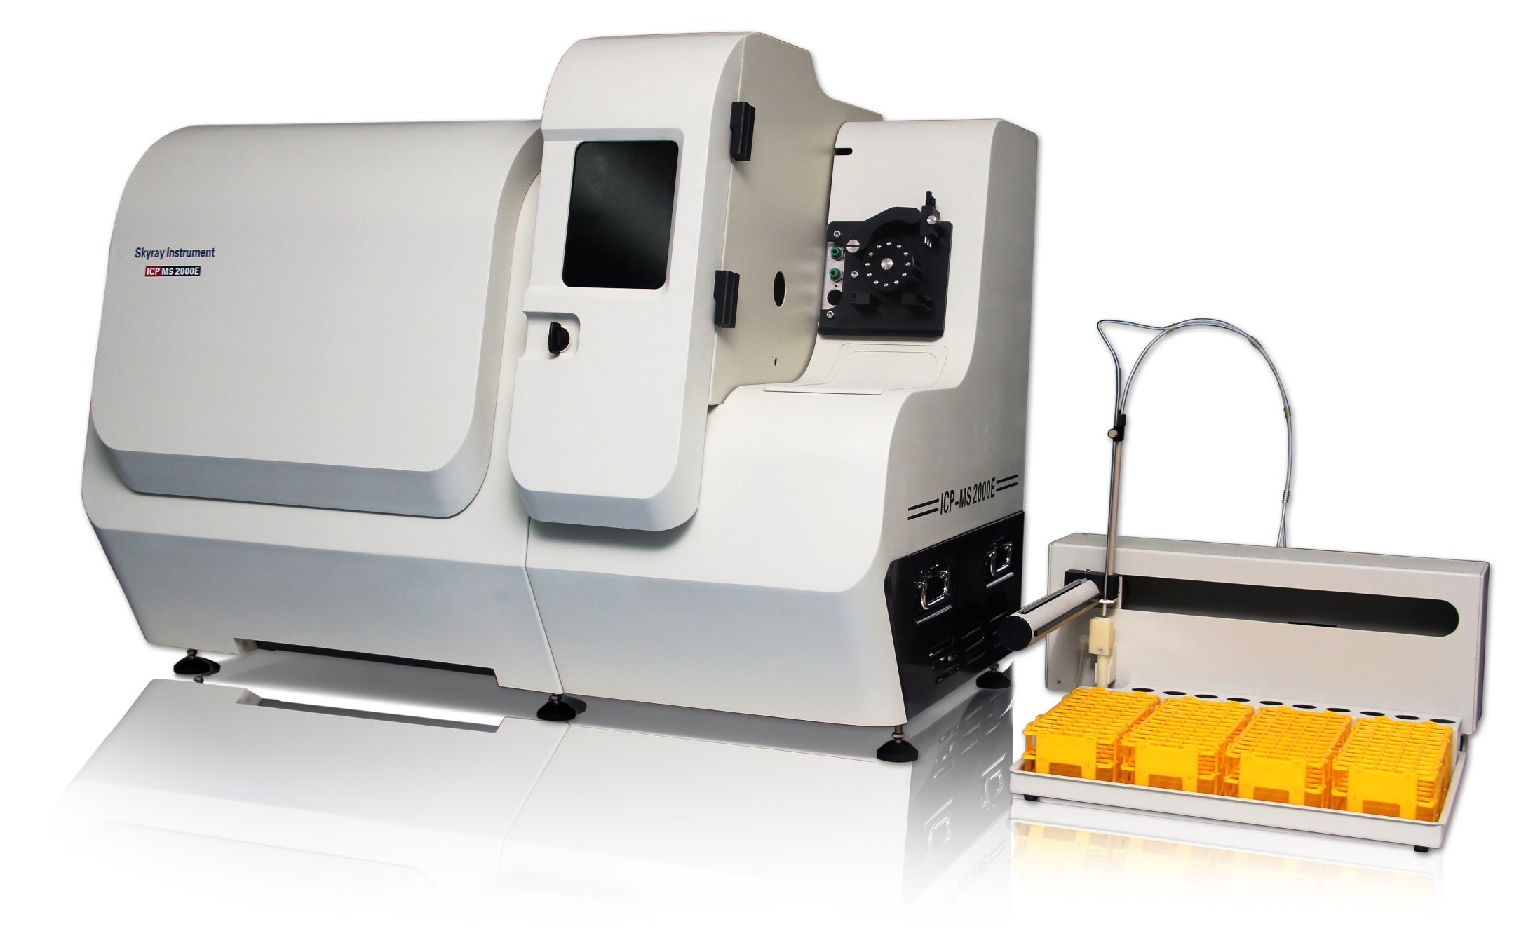
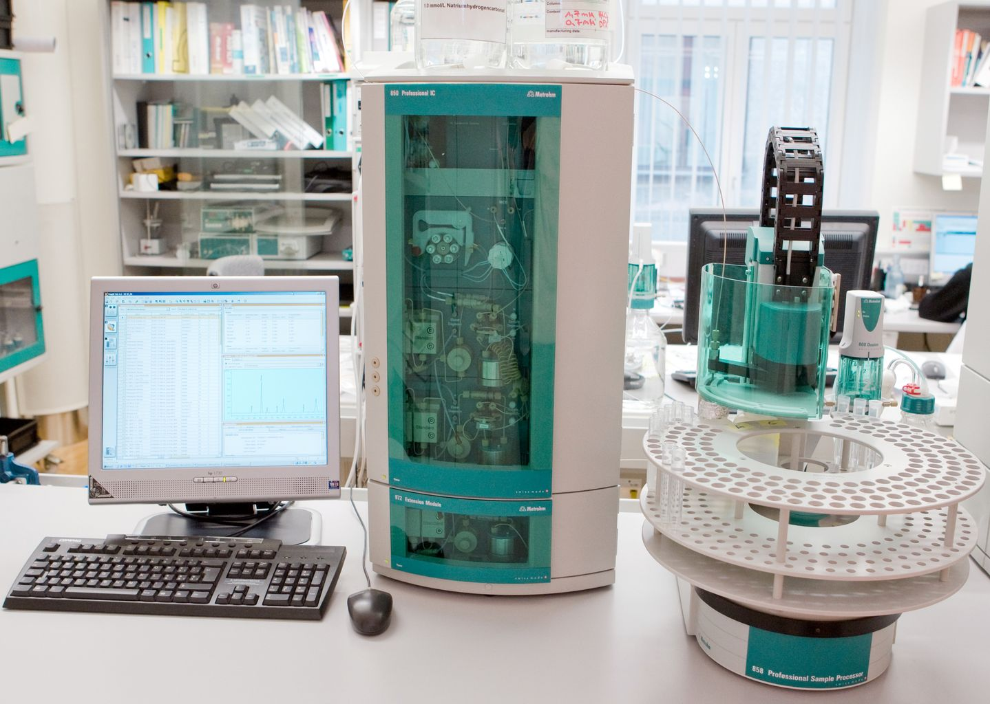
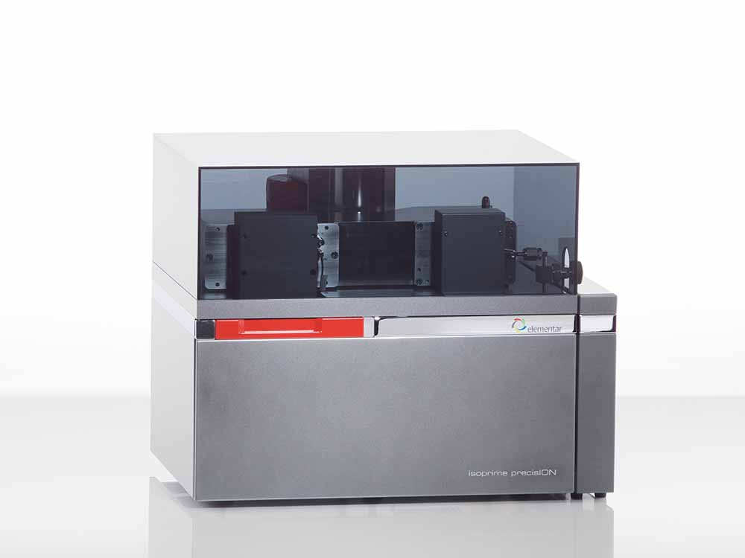
Testing Methods
Inductively Coupled Plasma-Mass Spectrometer (ICP-MS)
Used to analyze major cations and trace elements
For concentrations of total elements in sediment samples
Ion Chromatography
To analyze major anions
Micromass Iso Prime stable isotope ratio mass spectrometer
For stable isotope analysis for Deuterium and Oxygen-18

Slide 7
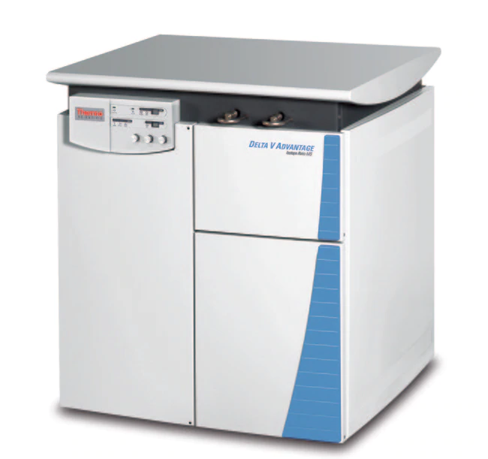
Testing Methods continued
Eurovector elemental analyzer interfaced to a MIP stable isotope ratio mass spectrometer
For sulfur-34 of dissolved sulfate analysis
X-ray powder diffractometry and Scanning Electron Microscopy
Used to determine mineralogical associations in samples that contained high or low concentrations of arsenic
Web Based Hydrograph Analysis Tool
Used to determine the fractions of direct runoff and groundwater inflows from the streamflow data

Slide 8
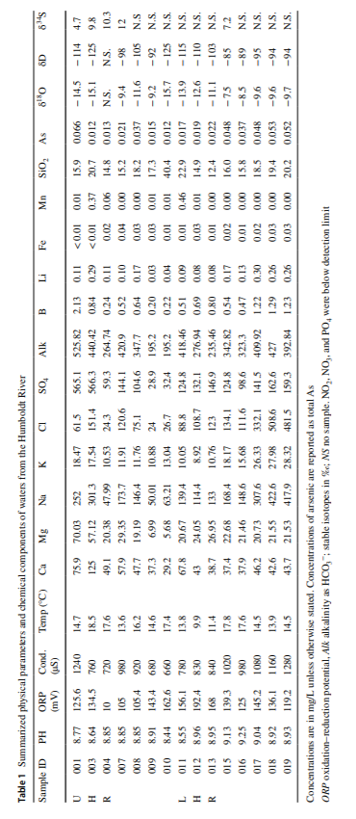
Test results

Slide 9
More in depth results
The river water is alkaline and oxic
pH of 8.64-9.13 (Basic)
Oxidation-reduction potential is 10-192.4 mV
Conductivity of 720-1280 μS/cm
Concentrations of Arsenic range from 0.012 to 0.066 mg/L with an average of 0.03 mg/L
Stable isotopes range from -7.5 to -15.7‰ for Oxygen-18 and -85 to -125‰ for deuterium

Slide 10
In depth results continued
The most abundant minerals are quartz, orthoclase feldspar, calcite, biotite, and muscovite
Further testing showed some silicate and detrital aluminum silicate clay minerals
About 83% of total Arsenic is extracted from the residual fraction, which corresponds to silicate and clay minerals
The relative dominance of Al (64%), Ca (70%), and Fe (82%) in the residual fraction can be accounted for silicate and clay minerals

Slide 11
Arsenic in Sediments
The occurrence of the arsenic is because of the As-bearing iron oxyhydroxides which naturally occur in many parts of the world
The occurrence of As in Fe-Mn oxides and hydroxides have been previously reported in other studies close to this area
However, As in silicate minerals in the river sediments, which is near-surface and oxidizing, has not been reported previously
The results found in this study suggest that silicate mineral phases predominantly control As distribution in the Humboldt River sediments

Slide 12
Arsenic in Water
The As levels were compared to when it is low-flow season to high-flow season
The concentrations of As are not affected significantly so changes in As concentrations in different parts of the Humboldt River reflect different geochemical and physical processes without significant seasonal perturbations
Another study in the region suggested oxidation of mined waste rocks containing As-bearing sulfide minerals as the primary source for high dissolved As and SO4 in the waters

Slide 13
Conclusions
The primary source for dissolved As in the upper Humboldt River is due to the oxidation of As-bearing sulfide minerals from metal-ore deposits
Dilution of As and SO4 in the middle Humboldt River is due to subsequent mixing of river water with discharging groundwater
Localized mixing of geothermal and As-rich groundwater increases dissolved As concentrations in the waters in the Lower Humboldt River

Slide 14
Conclusions
Dissolved As occurs from evaporative enrichment of the lower river region because of the favorable arid and temperate climate
As distribution in the river sediments is controlled by partitioning onto silicate clay minerals
This implies the risk for potential immobilization of As in groundwater with change in geochemical conditions to reduce conditions. This warrants future studies to investigate the region

Slide 15
Any Questions?

Slide 16
References
Mohammad, Shahnewaz, and Regina N. Tempel. “Arsenic in the Waters and Sediments of the Humboldt River, North-Central Nevada, USA: Hydrological and Mineralogical Investigation.” Environmental Earth Sciences, vol. 78, no. 17, 2019, doi:10.1007/s12665-019-8552-1.

