Slide 1
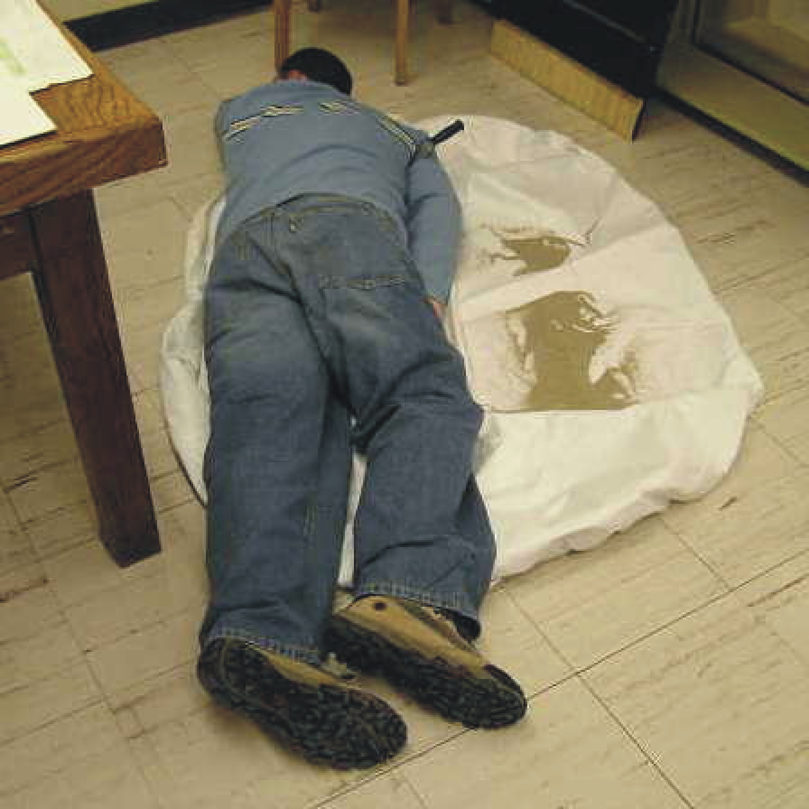
Forensic Geology
Solving Crimes Most Foul
Using Geological Principles and Methods
Department Environmental, Earth, & Atmospheric Sciences

Slide 2
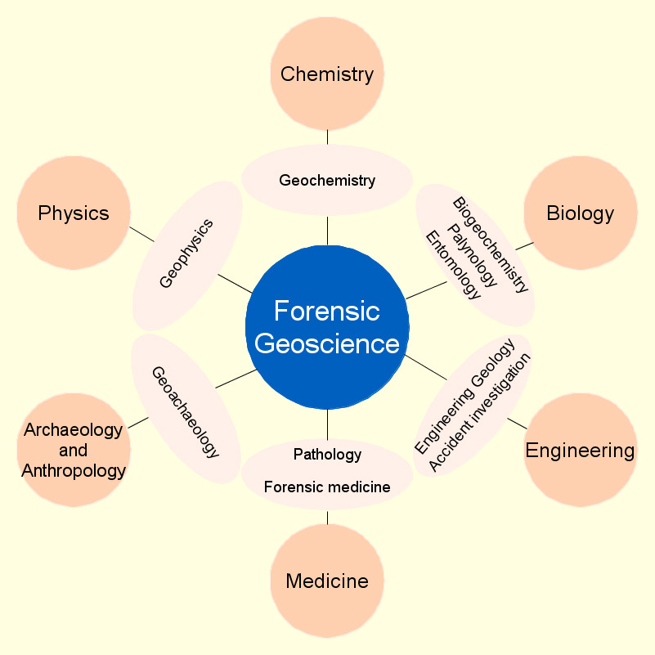
Department Environmental, Earth, & Atmospheric Sciences

Slide 3
HISTORY
Hans Gross – 1893
Georg Popp - 1908 Filbert Case
Edmond Locard - 1910 Exchange Principle
FBI Laboratory - 1935
Walter McCrone - 1916 to 2002
Department Environmental, Earth, & Atmospheric Sciences
Notes:
3

Slide 4
Sherlock Holmes consulting detective
Department Environmental, Earth, & Atmospheric Sciences

Slide 5
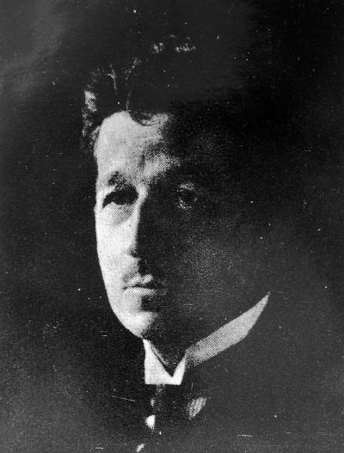
Edmond Locard
Department Environmental, Earth, & Atmospheric Sciences

Slide 6
LOCARD-THE EXCHANGE PRINCIPLE
Whenever two objects come in contact, there is always a transfer of material. The methods of detection may not be sensitive enough to demonstrate this, or the decay rate may be so rapid that all evidence of transfer is vanished after a given time. Nonetheless, the transfer has taken place.
Department Environmental, Earth, & Atmospheric Sciences
Notes:
6

Slide 7
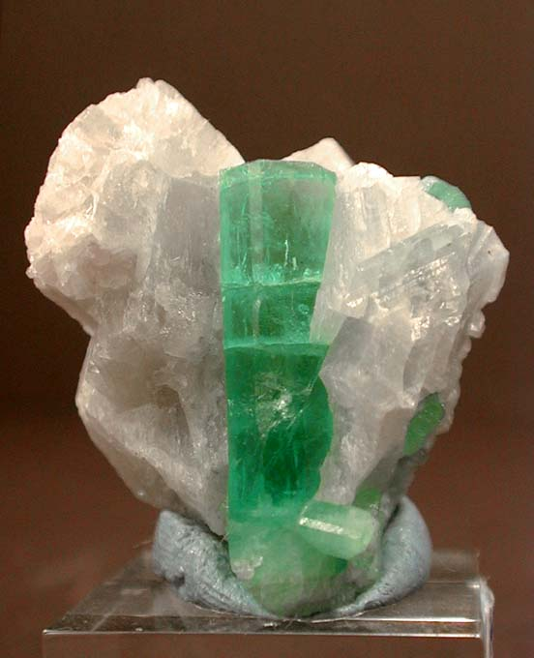
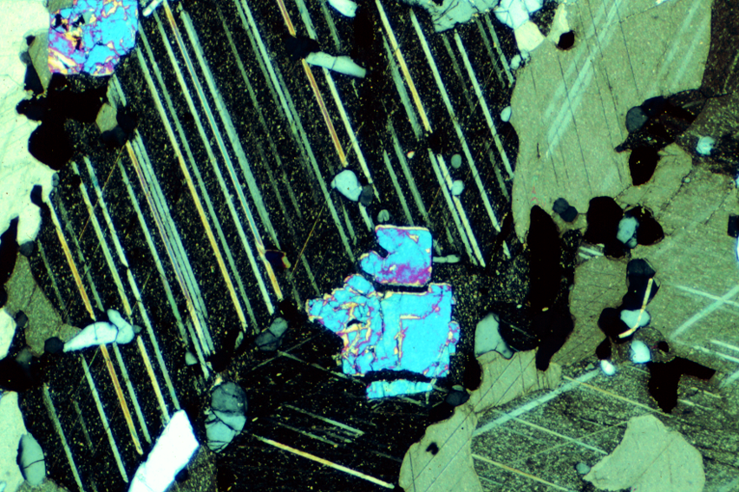
Minerals
Identification and Forensic Applications
Department Environmental, Earth, & Atmospheric Sciences
Niocalite (blue) in sovite (calcite + apatite). Oka carbonatite complex. Crossed-polars. Width = 5.4 mm
Transparent emerald, the green variety of beryl, on calcite matrix

Slide 8
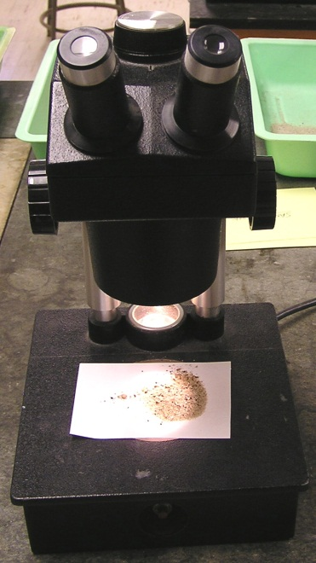
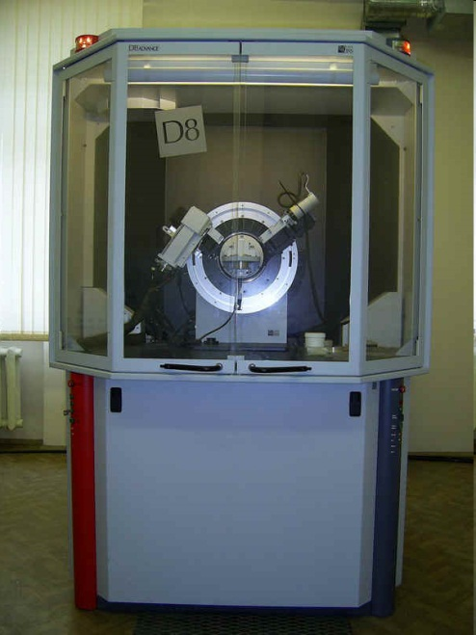
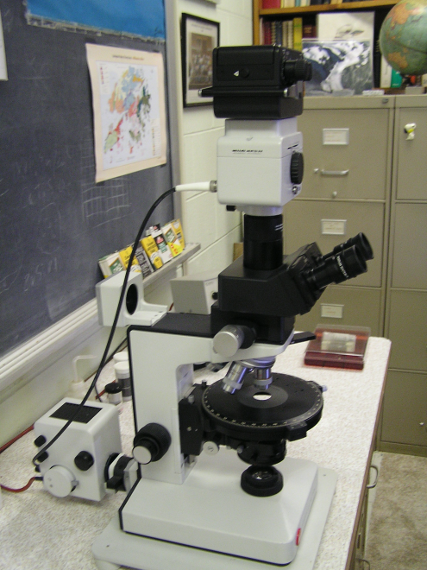
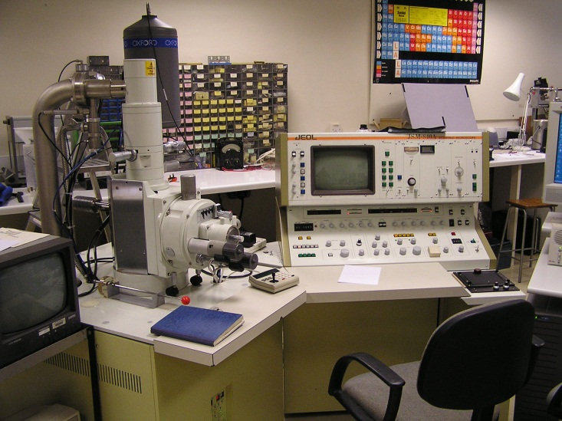
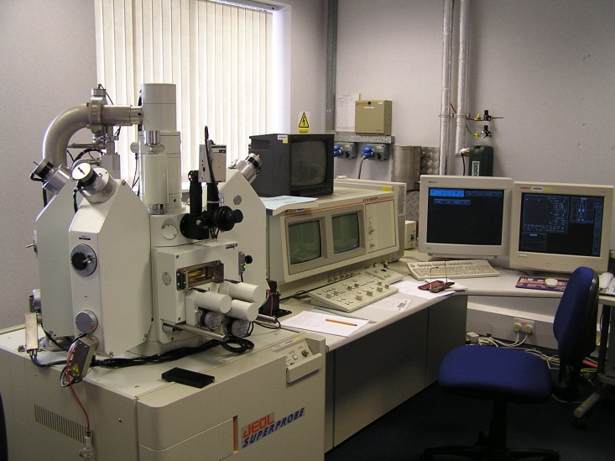
Tools for Identification and Characterization of Minerals
Department Environmental, Earth, & Atmospheric Sciences
Stereomicroscope
XRD
PLM
SEM
EMP

Slide 9
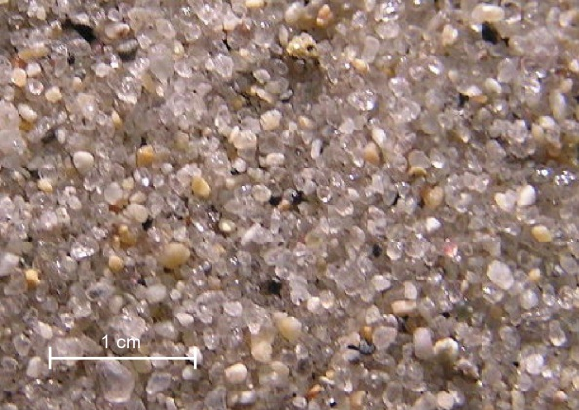
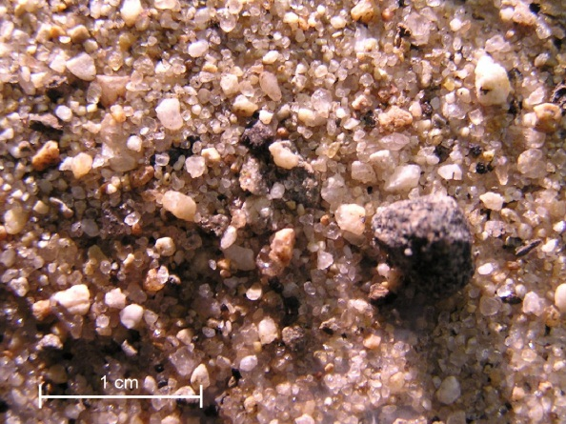
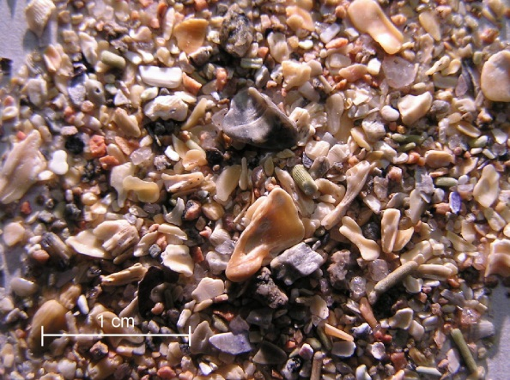
Stereomicroscopy
Mineralogy and texture
Beach sand
Department Environmental, Earth, & Atmospheric Sciences
Stream sand
Carbonate sand

Slide 10
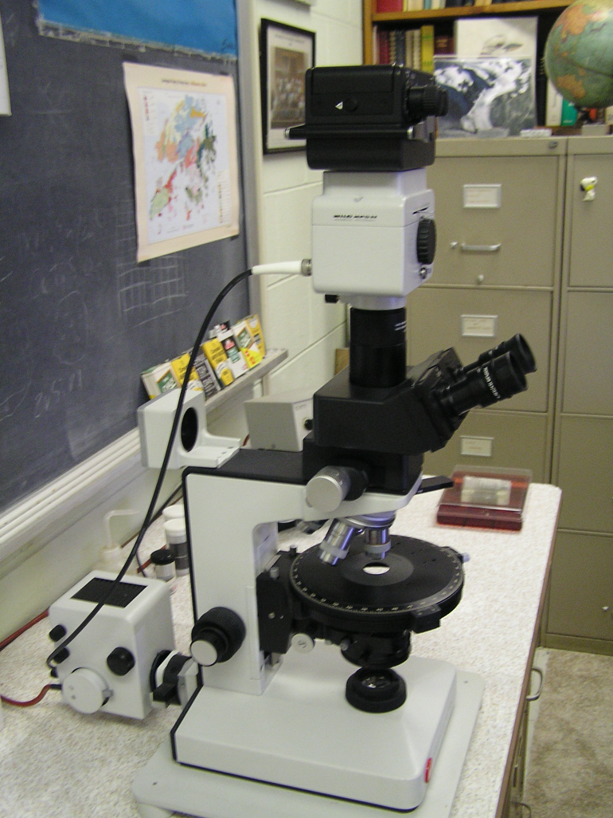
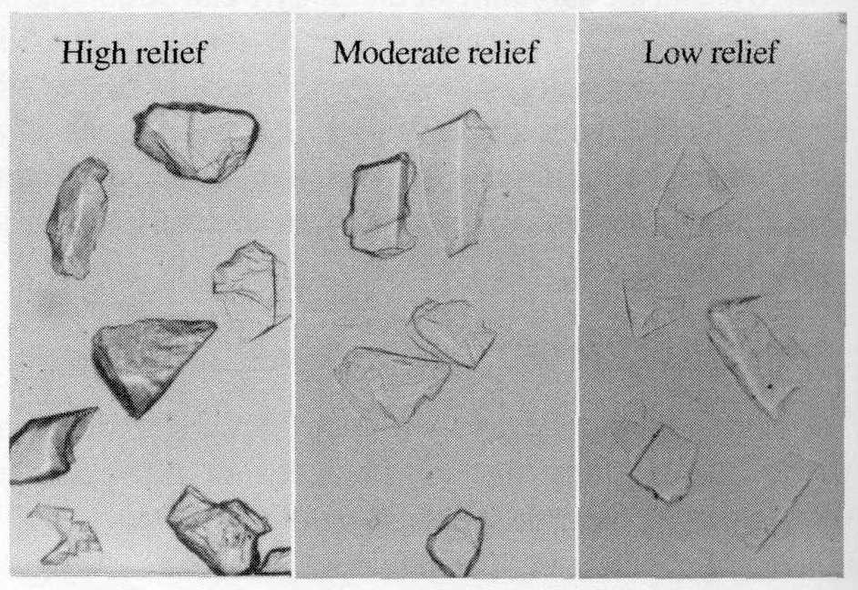
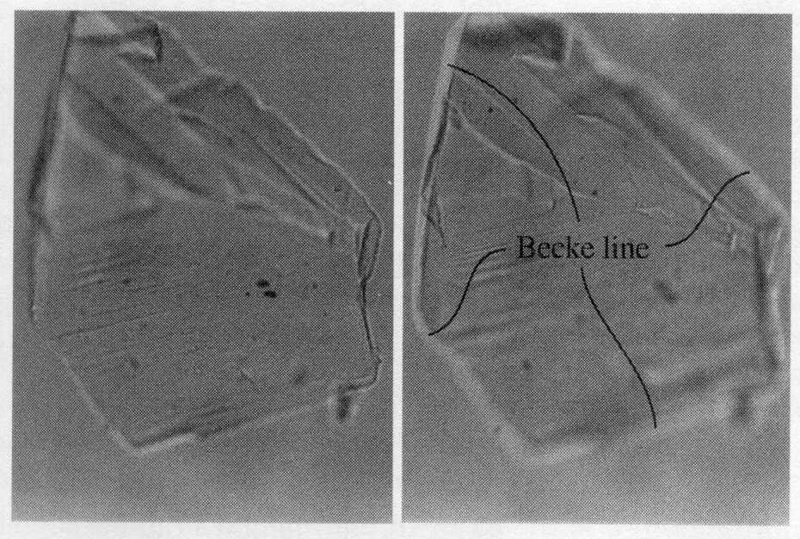
Polarizing Light Microscopy (PLM) – a forensic workhorse
Use various optical properties to characterize materials
Index of refraction
Higher relief means a greater difference in the refractive index of the material relative to the mounting media or index oil.
Department Environmental, Earth, & Atmospheric Sciences
The Becke line method is used to determine if material has a higher or lower refractive index then the mounting media or index oil.

Slide 11
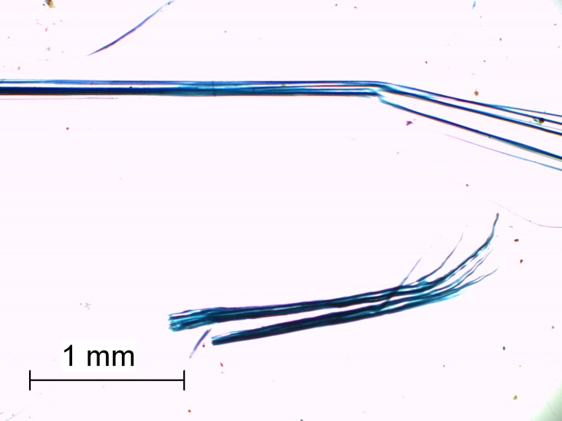
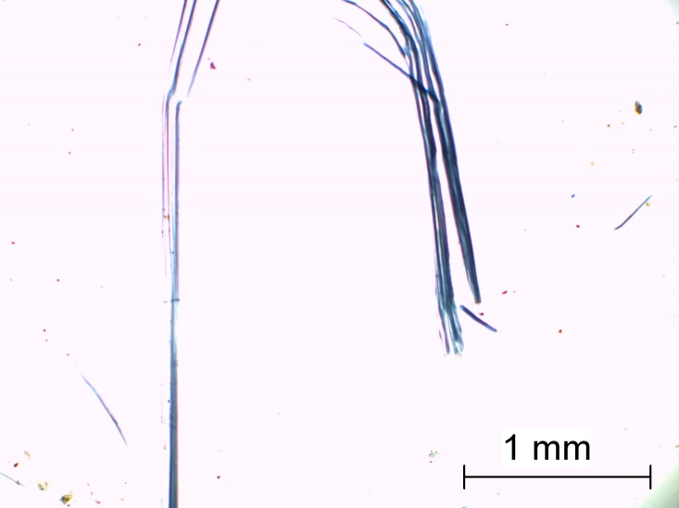
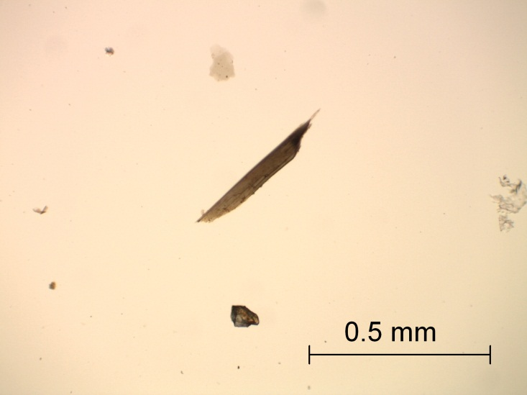
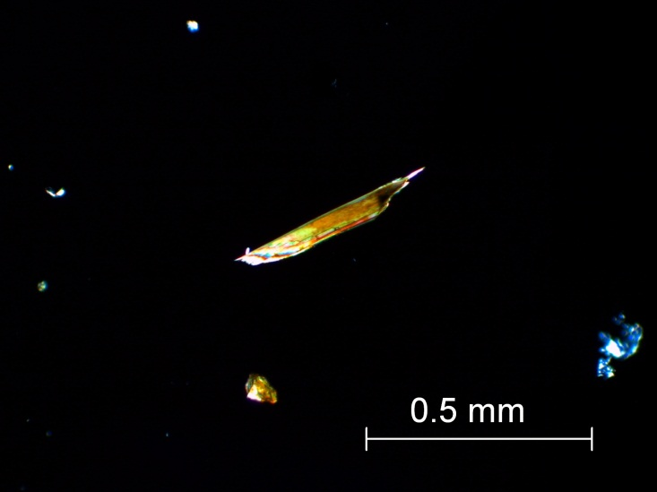
Polarizing Light Microscopy (PLM) – a forensic workhorse
Pleochroism – color changes as stage is rotated – polarized light
Crocidolite
Department Environmental, Earth, & Atmospheric Sciences
Birefringence – color changes under crossed-polars due to retardation
Biotite
Plane polarized light
Crossed-polars

Slide 12
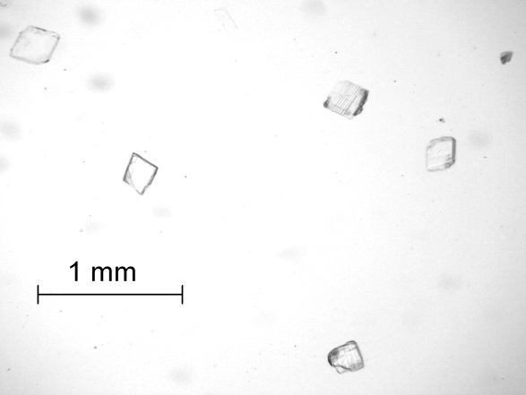
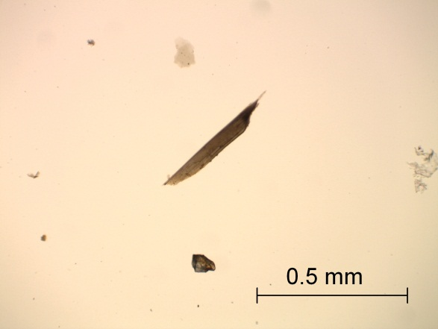
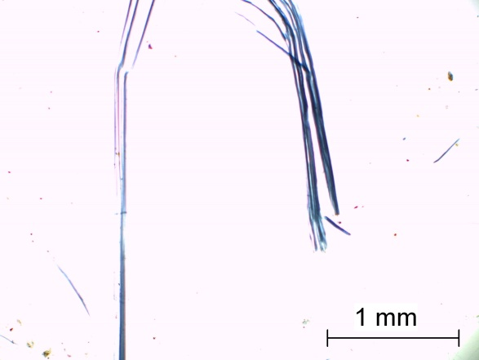
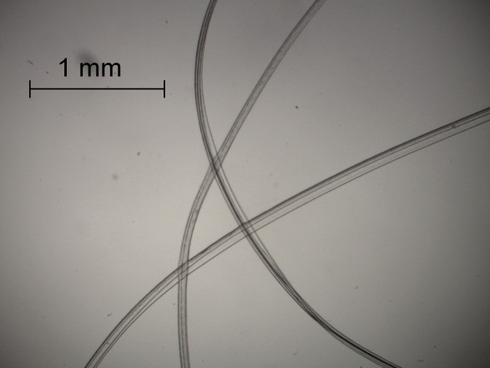
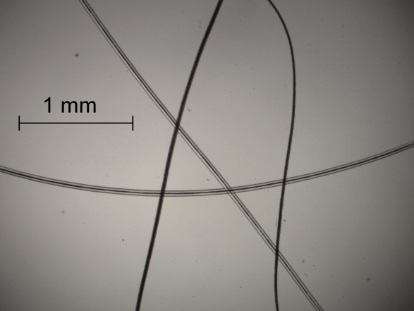
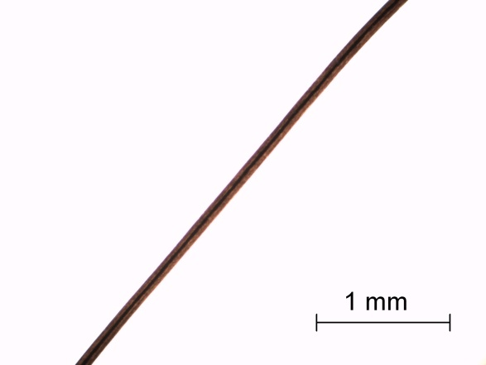
Polarizing Light Microscopy (PLM) – a forensic workhorse
Morphology and “habit”
Calcite - rhombohedral
Biotite flake
Crocidolite fiber
Department Environmental, Earth, & Atmospheric Sciences
Fiber characteristics
Dynel
Dog’s hair
Human hair (mongoloid)

Slide 13
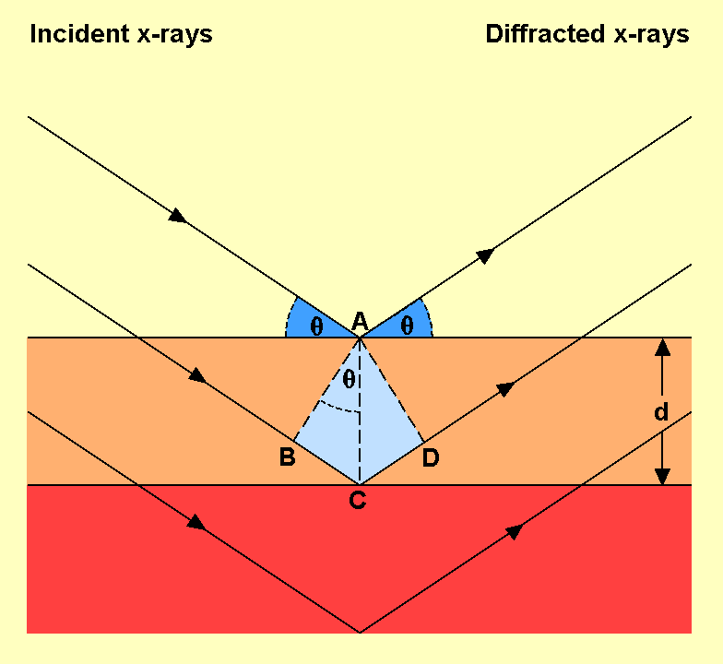
X-ray Diffraction (XRD)
A powerful way to identify crystalline materials. The physical basis is Bragg’s Law (a Nobel prize for simple trigonometry). The angles required for diffraction and the intensity of the diffracted wavelengths can be used to identify the material.
Department Environmental, Earth, & Atmospheric Sciences
Diagram illustrating Bragg’s law.  = angle of incidence and diffraction when Bragg’s law conditions are met. d = inter-planar spacing.
X-ray diffractometer

Slide 14
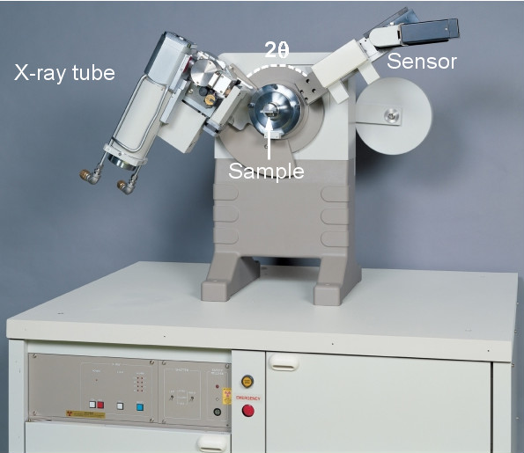
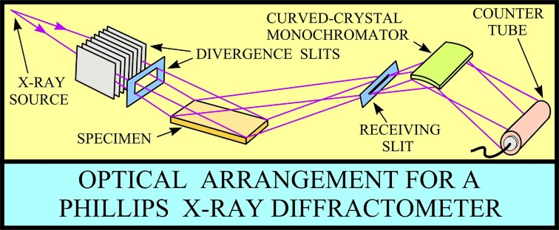
Configuration for a typical X-ray powder diffractometer.
Department Environmental, Earth, & Atmospheric Sciences

Slide 15
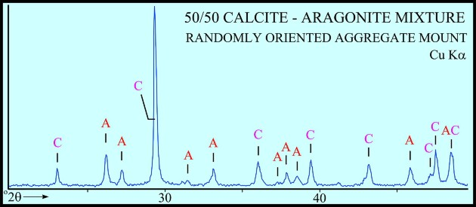
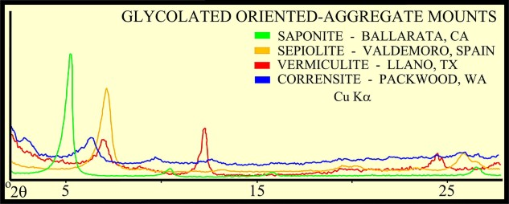
Mineral X-ray diffraction patterns
Department Environmental, Earth, & Atmospheric Sciences

Slide 16
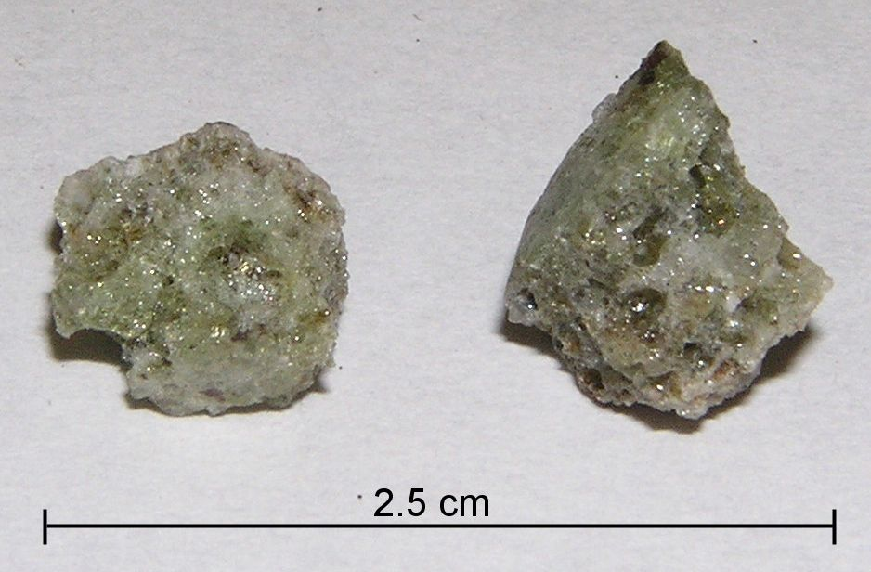
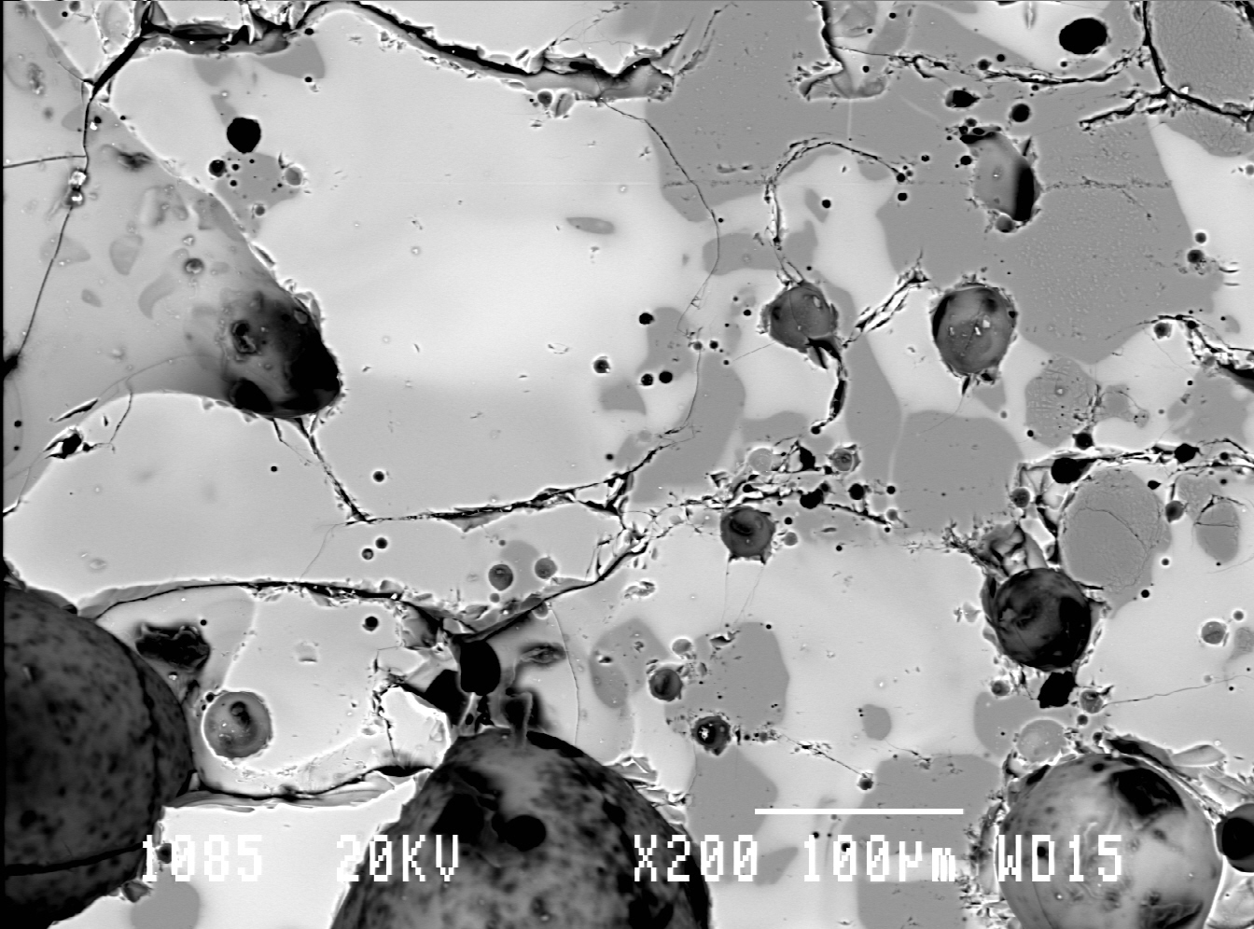
Scanning Electron Microscopy (SEM) with EDAX
Can be used to characterize materials at the micron level.
Department Environmental, Earth, & Atmospheric Sciences
The material illustrated here is tinitite, the glass formed from the desert sand at Alamogordo when the first atomic bomb was detonated. The shades are related to the atomic number of the elements. Areas with lower atomic number elements are darker. Using EDAX, quantitative elemental abundances can be determined.
Back scatter electron image

Slide 17
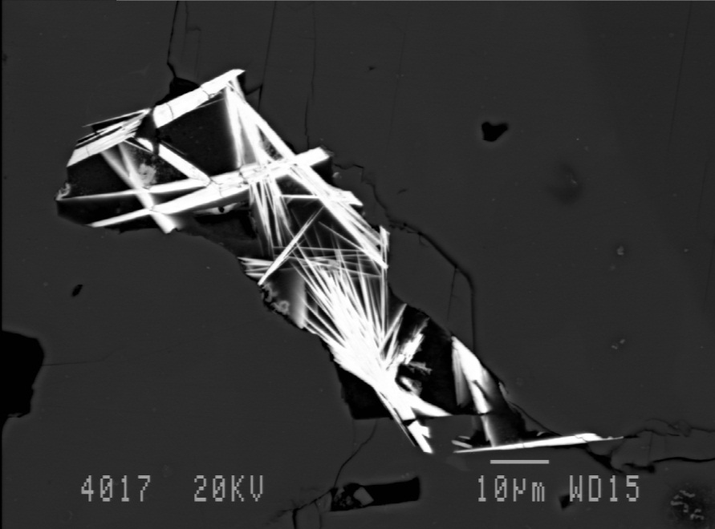
The Electron Microprobe (EMP)
This instrument is not commonly used in forensic investigations, but it can be used to determine the abundance of a variety of elements on areas as small as one micron in diameter. There may be specific cases where such data would be useful.
Rare-earth carbonate minerals in carbonatite. Analyses were done on 1 micron diameter spots.
Department Environmental, Earth, & Atmospheric Sciences

Slide 18
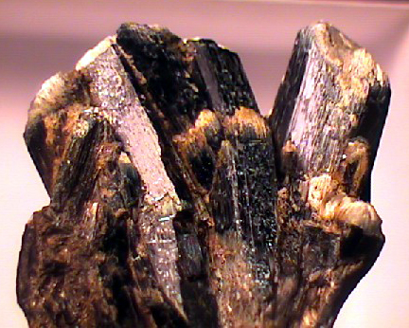
First Forensic Geology Case
In October of 1904 the strangled body of Eva Disch was found near Frankfurt, Germany
When Georg Popp was called in he examined a filthy handkerchief found at the scene that contained bits of hornblende, snuff and, coal
Department Environmental, Earth, & Atmospheric Sciences

Slide 19
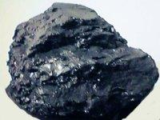
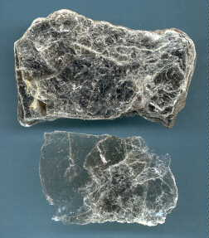
First Forensic Geology Case
A suspect, Karl Laubach, used snuff, worked at the coal-burning local gas works and at a quarry that had hornblende bearing rocks
The suspect also had mica in the cuffs of his trousers that matched mica at the murder scene
Department Environmental, Earth, & Atmospheric Sciences

Slide 20
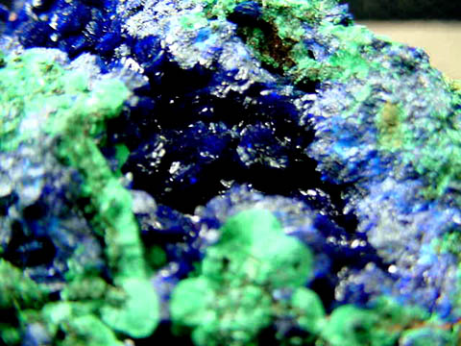
Junger Case
Location: Front Royal, Va.
Crime: Homicide
Evidence: Soil on the
Suspect’s vehicle
compared with soil from
the crime scene at a river
crossing. Samples contained
Malachite and Azurite from an
abandoned copper mine just up stream. The soft copper minerals were not found a short distance downstream.
(thanks to Ray Murary)
Department Environmental, Earth, & Atmospheric Sciences

Slide 21
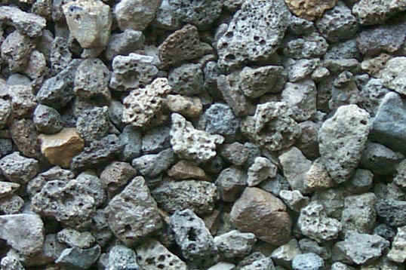
The Reeves Murder Case
In September of 1958 a woman’s body was found at the edge of the Anacostia River in Washington, D.C. A peculiar black sand was found on the victim, in a suspects car, and at the murder scene. Geologic investigation showed that the sand was blast furnace slag that had been spread on a small section of highway to test it for use in the control of snow and ice.
(Block, 1979 p.149-152)
Department Environmental, Earth, & Atmospheric Sciences

Slide 22
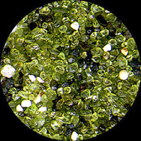
Commercial Foundry Sand
Sands of heavy minerals, olivine, zircon, etc. are used in foundry work
In a breaking and entering case at a foundry in Toronto, Canada a suspect’s shoes had grains of olivine sand
Because olivine sand is not found in place in that part of Canada the sand on the shoes indicated that the suspect had been at the foundry. (Murray and Tedrow, 1992 , p. 79)
Department Environmental, Earth, & Atmospheric Sciences

Slide 23
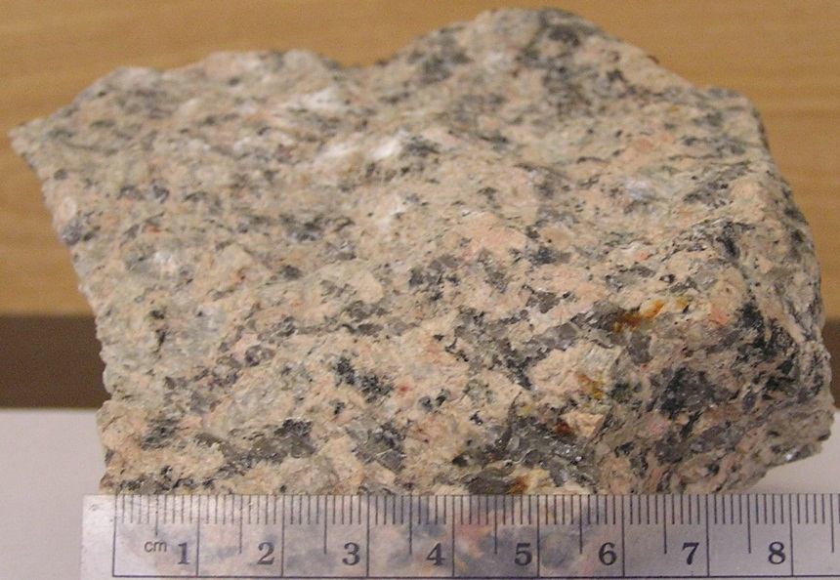
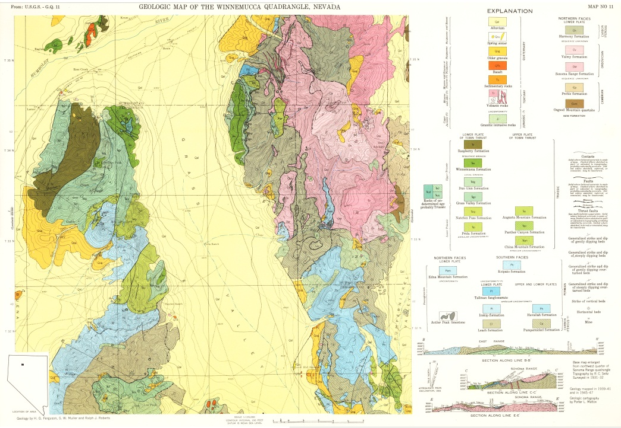
Rocks, Geologic Maps, and Building Materials
Rocks
Department Environmental, Earth, & Atmospheric Sciences
Department Environmental, Earth, & Atmospheric Sciences
Geologic maps

Slide 24
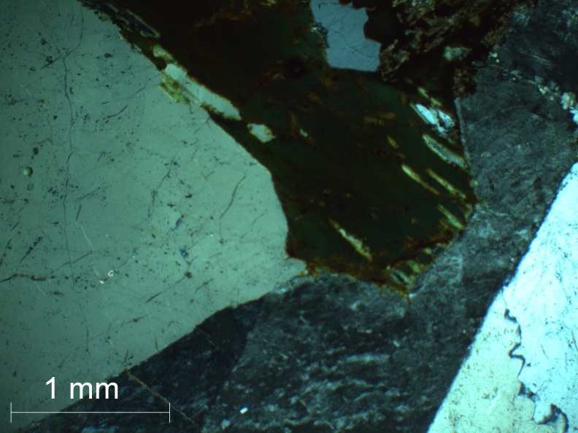
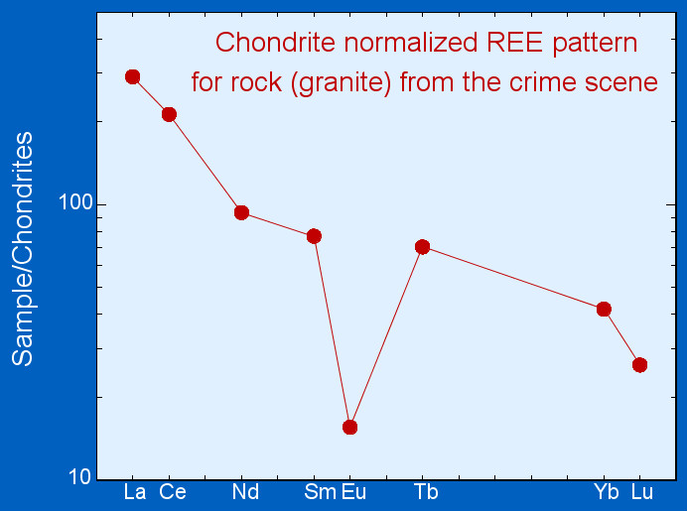
Rock Identification
Quartz
Feldspar
Biotite
Department Environmental, Earth, & Atmospheric Sciences
Rock chemistry
SiO₂ | 74.89
TiO₂ | 0.13
Al₂O₃ | 12.02
Fe₂O₃ | 1.11
FeO | 1.27
MnO | 0.06
MgO | 0.02
CaO | 0.69
Na₂O | 3.61
K₂O | 4.89
Department Environmental, Earth, & Atmospheric Sciences

Slide 25
The identification of a rock and linking the sample with a particular location using a geologic map can be useful in solving certain kinds of crimes
Department Environmental, Earth, & Atmospheric Sciences
Department Environmental, Earth, & Atmospheric Sciences

Slide 26
Mysterious Glacial Boulders
At a gas works in Massachusetts igneous boulders showing up in the coal the plant was importing were damaging plant equipment
When the rocks were examined they were found to be of local origin
In turned out that a shovel operator who drank on the job was scooping the coal with too deep a setting and picking up the local glacial boulders in the soil under the coal pile
(thanks to Ray Murray )
Department Environmental, Earth, & Atmospheric Sciences
Department Environmental, Earth, & Atmospheric Sciences

Slide 27
Rocky Scotch Whiskey Case
When a Canadian importer opened some cases of expensive scotch whiskey he found that the whiskey had been replaced with limestone rocks
The rocks were traced to their point of origin in central England in a specific limestone quarry
A specific worker for the liquor company had access to the quarry and had been seen taking rocks home (thanks to Ray Murray)
Department Environmental, Earth, & Atmospheric Sciences
Department Environmental, Earth, & Atmospheric Sciences

Slide 28
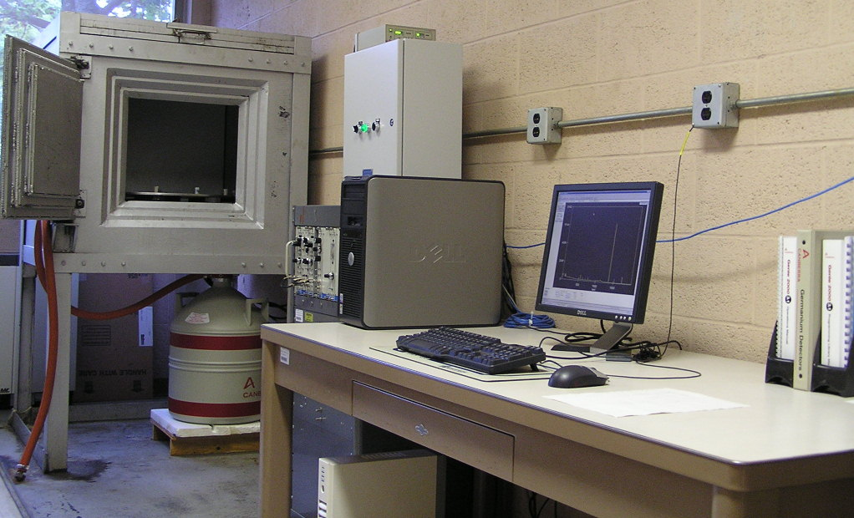
Instrumental Neutron Activation Analysis (INAA) and X-ray Fluorescence (XRF) Analysis – Forensic Applications
Philips PW2400 Sequential Wavelength Dispersive X-ray Fluorescence Spectrometer – Department of Geological Sciences, University of Canterbury, NZ
Department Environmental, Earth, & Atmospheric Sciences
Department Environmental, Earth, & Atmospheric Sciences
Instrumental Neutron Activation Analysis Laboratory – University of Massachusetts, Lowell, USA

Slide 29
Elements analyzed by combined INA-XRF Analysis
INA | XRF | INA | XRF | INA | XRF | INA | XRF | INA | XRF
Na | Na | Cr | Cr | Rb | Rb | Nd | Nd | Ta
 | Mg | Mn | Mn | Sr | Sr | Sm |  | W
 | Al | Fe | Fe |  | Y | Eu |  | Au
 | Si | Co | Co | Zr | Zr | Gd |  |  | Pb
 | P | Ni | Ni |  | Nb | Tb |  | Th | Th
K | K |  | Cu | Sb |  | Ho |  | U
 | Ca | Zn | Zn | Cs |  | Tm
Sc |  |  | Ge | Ba | Ba | Yb
 | Ti | As |  | La | La | Lu
 | V | Se |  | Ce | Ce | Hf
Department Environmental, Earth, & Atmospheric Sciences
Department Environmental, Earth, & Atmospheric Sciences
*Bold Italics – preferred method

Slide 30
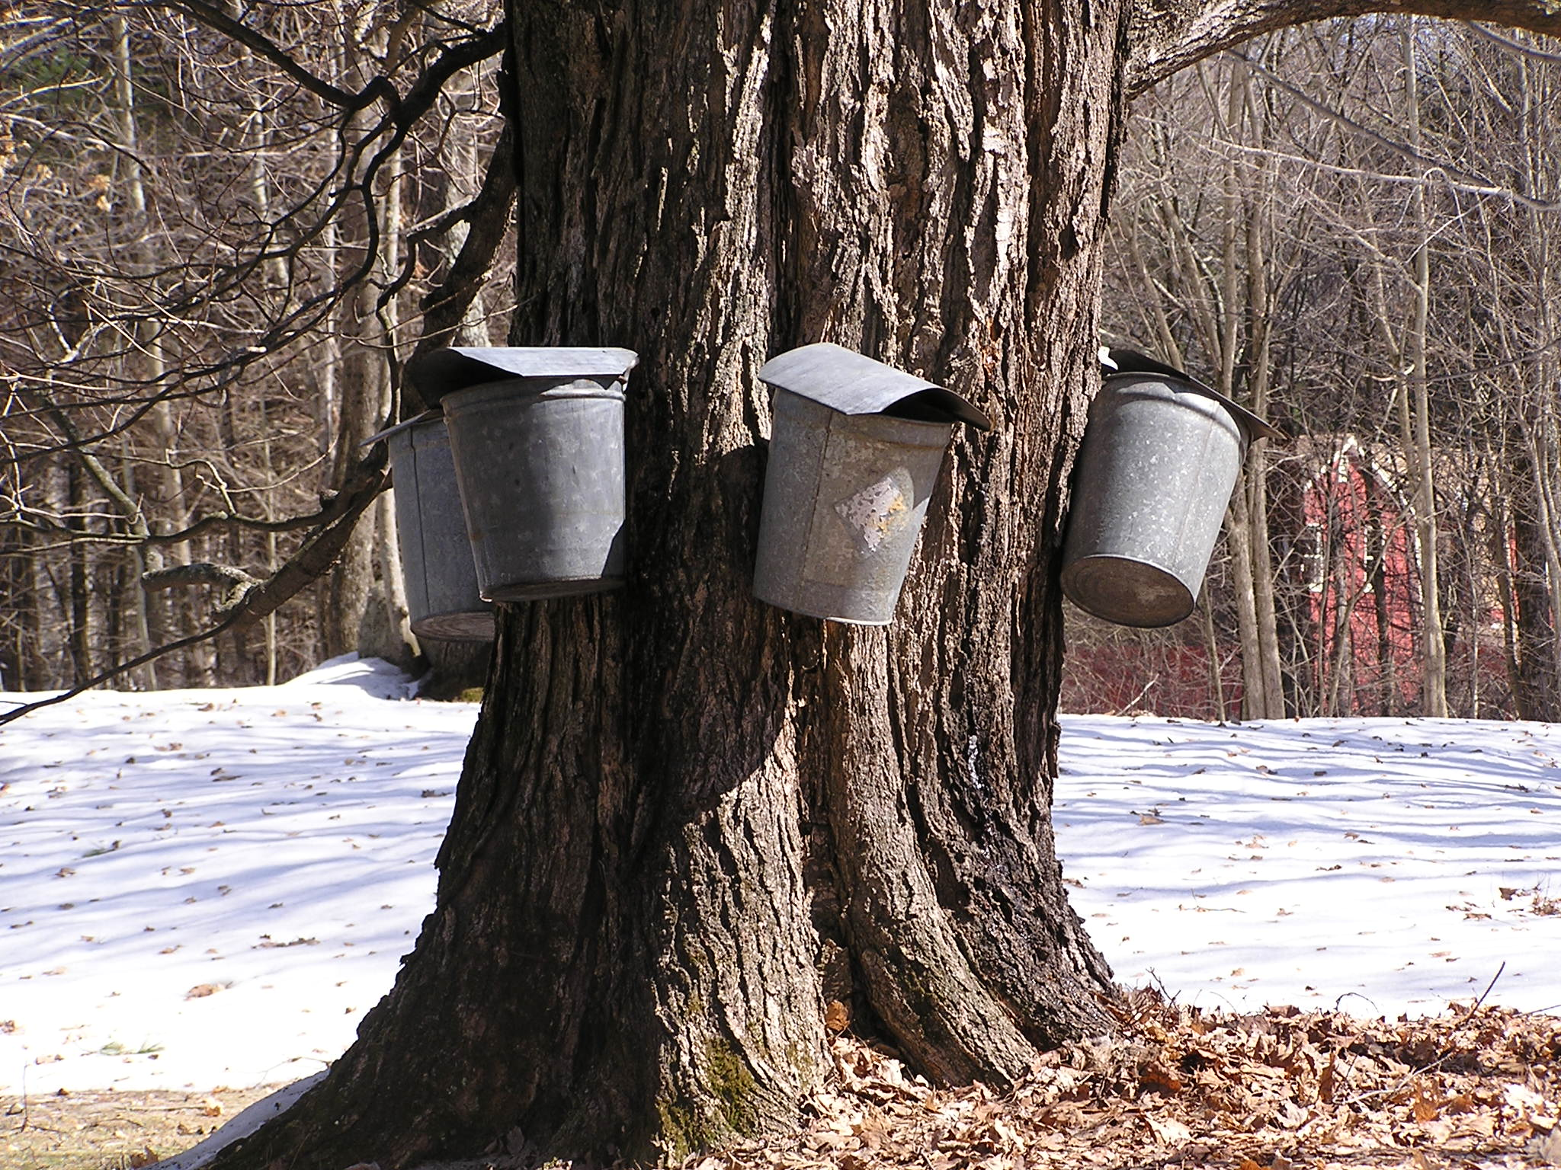
Forensics – Source of the Maple Syrup
Department Environmental, Earth, & Atmospheric Sciences
Department Environmental, Earth, & Atmospheric Sciences
Collecting sap the old fashioned way

Slide 31
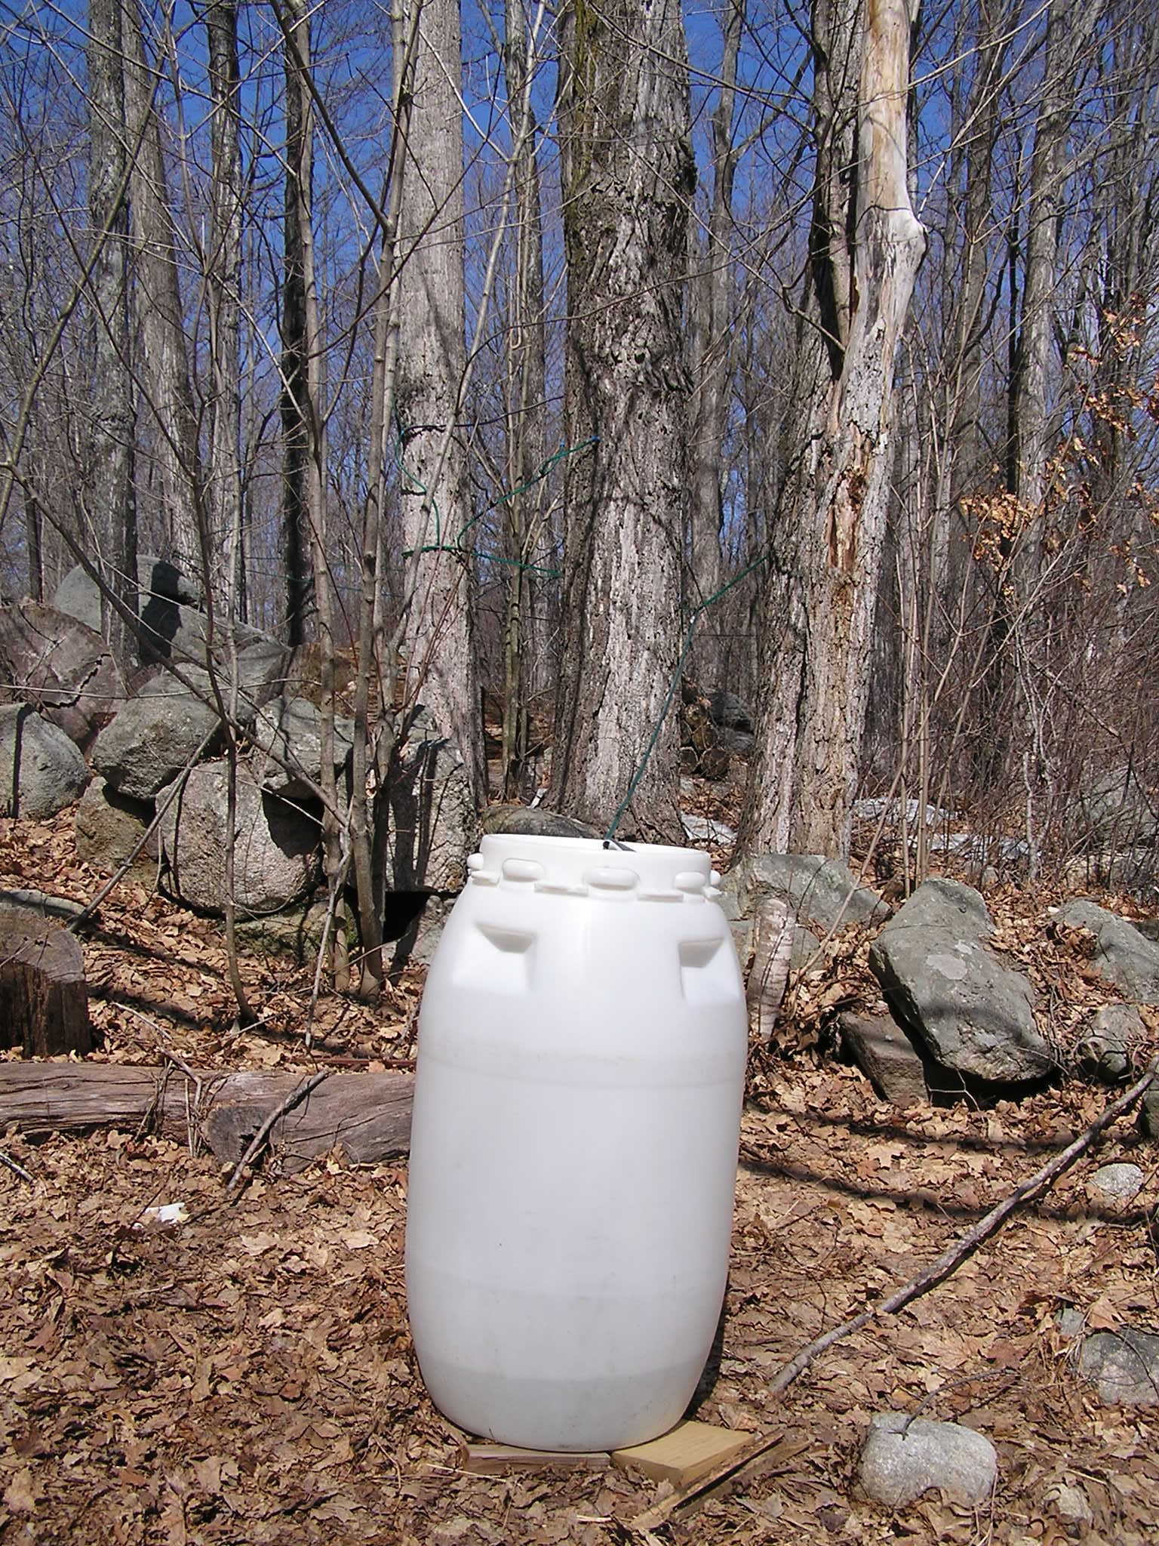
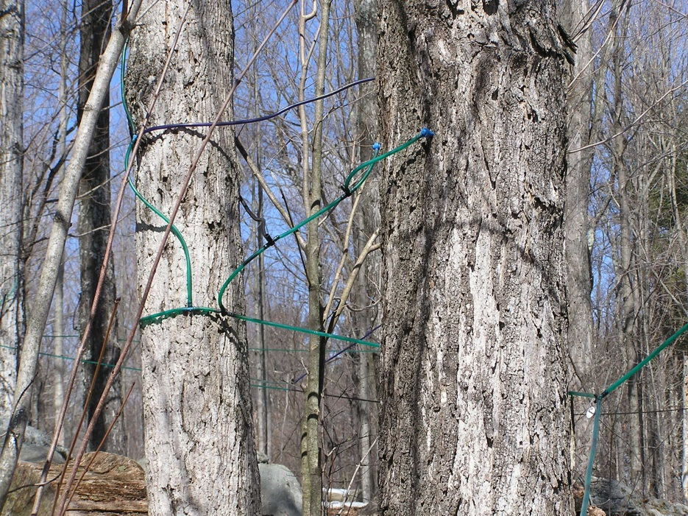
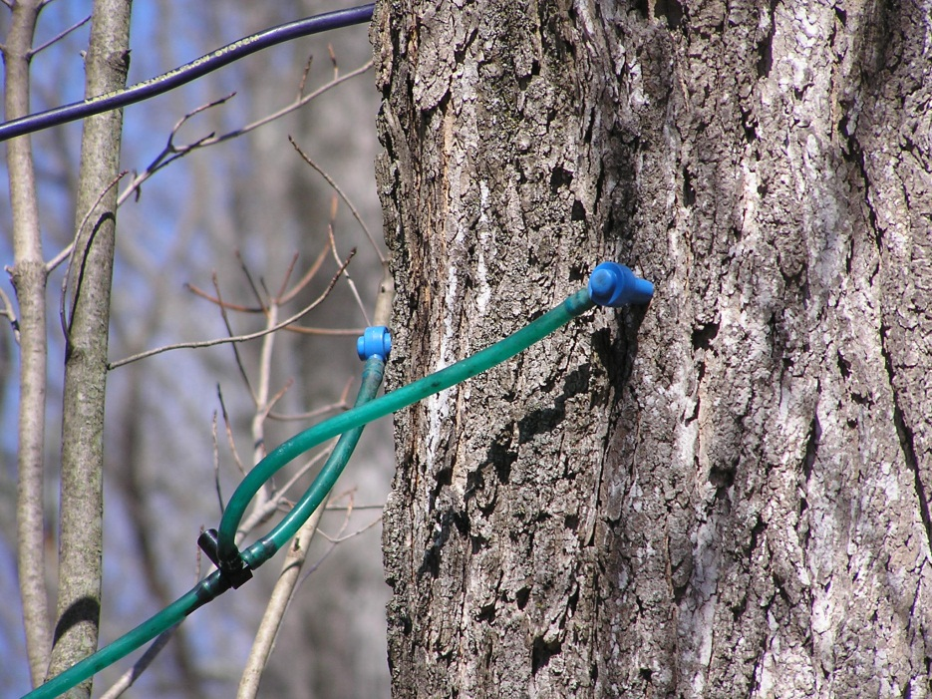
Collecting sap the modern way. Plastic barrels and polyethylene tubing.
Department Environmental, Earth, & Atmospheric Sciences
Department Environmental, Earth, & Atmospheric Sciences

Slide 32
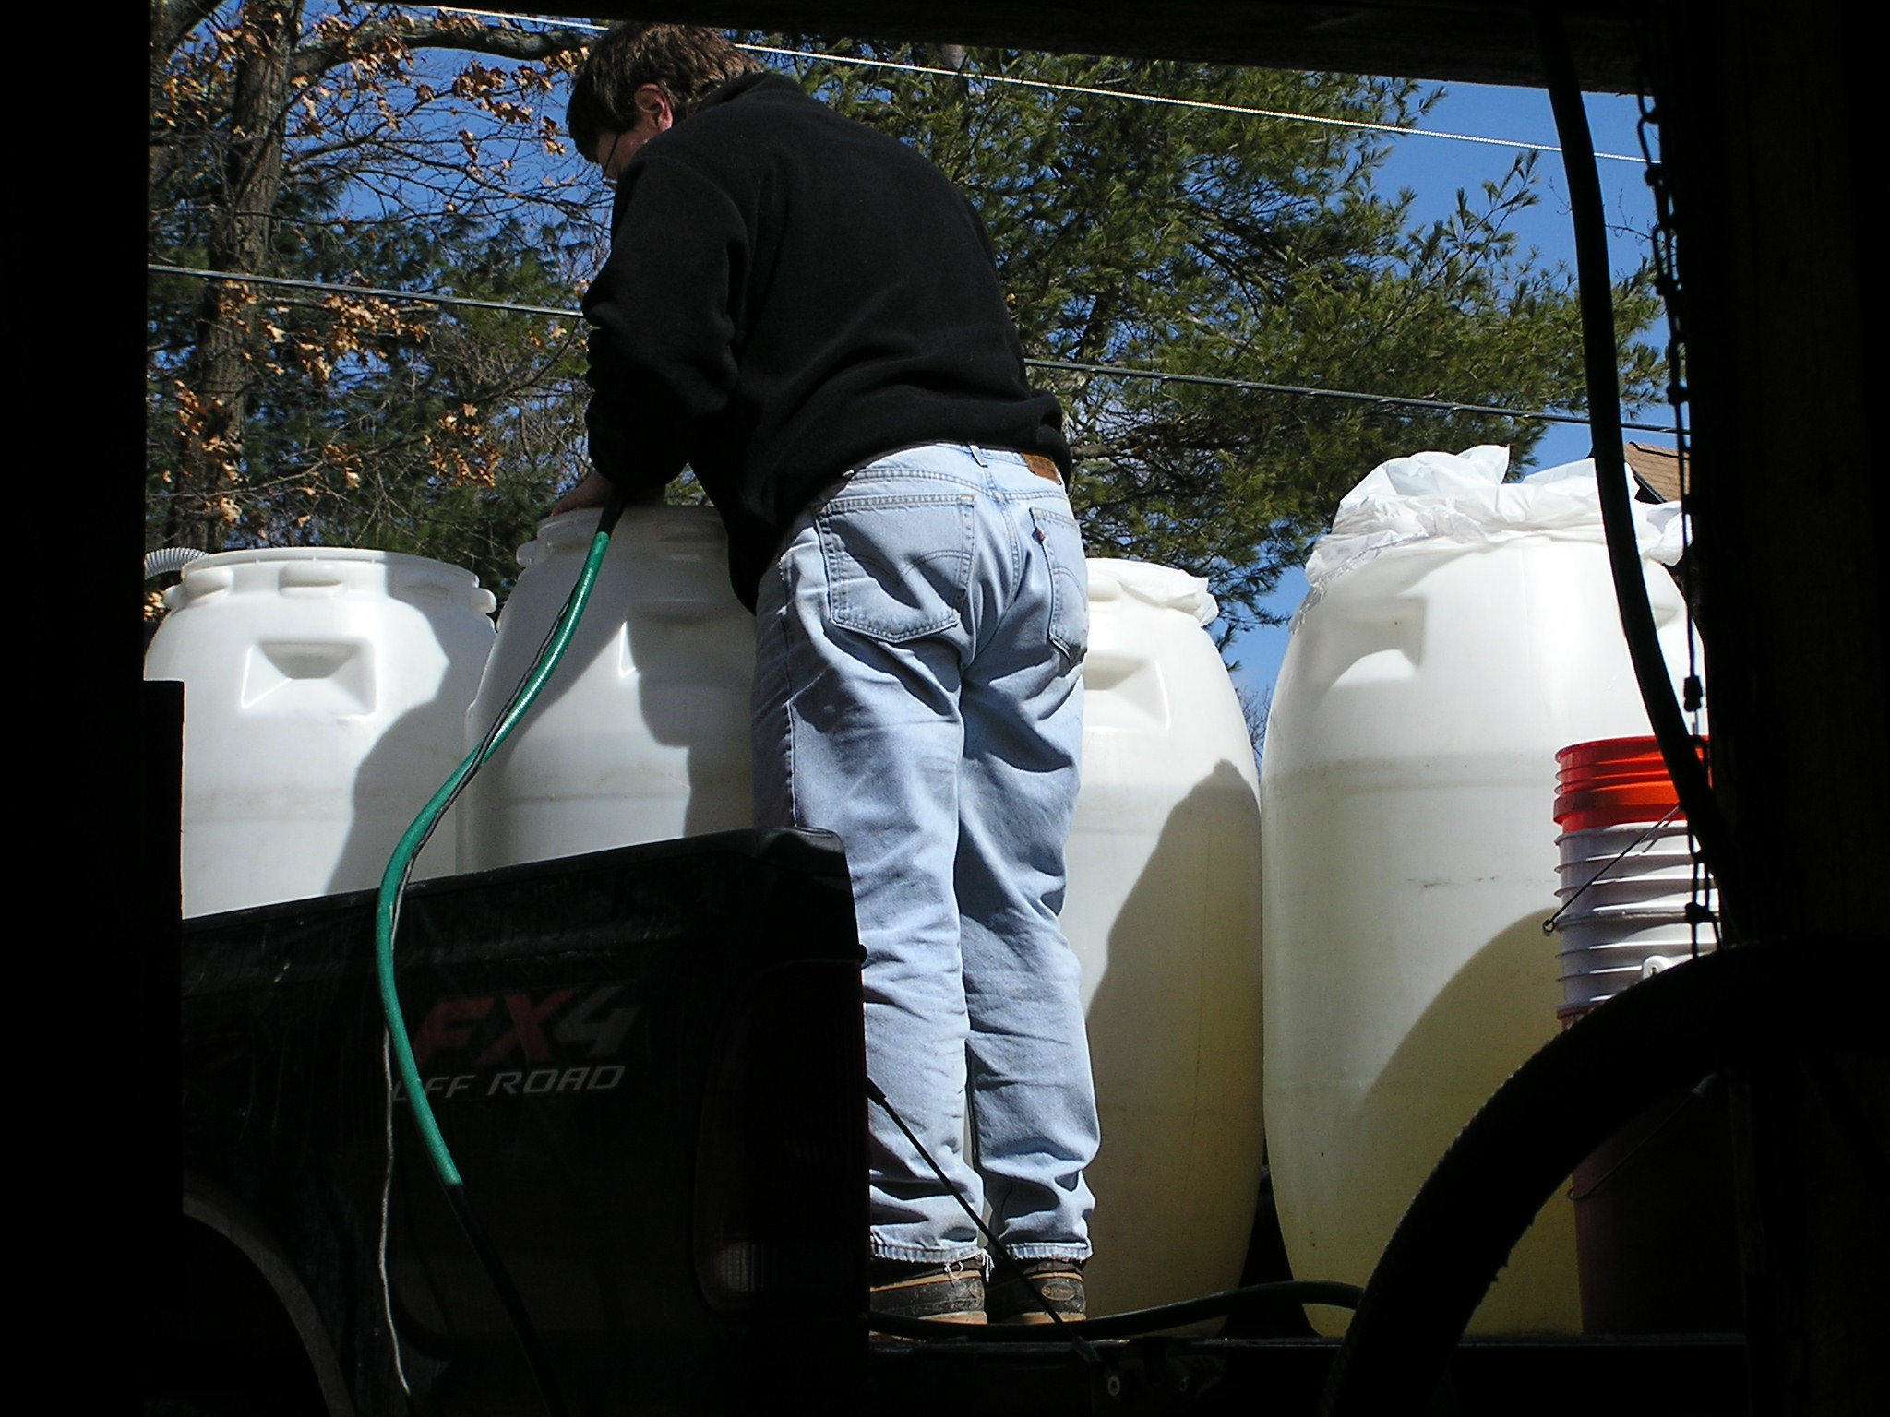
Transferring sap to the sugar house
Department Environmental, Earth, & Atmospheric Sciences
Department Environmental, Earth, & Atmospheric Sciences

Slide 33
Sap holding vats
Department Environmental, Earth, & Atmospheric Sciences
Department Environmental, Earth, & Atmospheric Sciences

Slide 34
Boiling down the sap
Syrup production line
Main boiler
Department Environmental, Earth, & Atmospheric Sciences
Department Environmental, Earth, & Atmospheric Sciences
Secondary boiler
Finish boiler

Slide 35
Final step – filtering the product
During the production of maple syrup there are numerous opportunities for trace constituents to be added to the product.
In the original sap from trace metals in the soil
During transport
During boiling of the sap – metals from the evaporators
During the final filtration
Department Environmental, Earth, & Atmospheric Sciences
Department Environmental, Earth, & Atmospheric Sciences
These added constituents can be used to “fingerprint” maple syrups from different sources.

Slide 36
Concentrations (ppm) and ratios of trace metals in Maple Syrup
 | Newton | Winsor | Parker A | Parker B | W MA | VT | Quebec
Sc | 0.010 | 0.009 | 0.004 | 0.008 | 0.006 | 0.002 | 0.030
Cr | 0.67 | 0.71 | 0.83 | nd | 0.87 | 0.136 | 1.67
Co | 0.094 | 0.064 | 0.073 | 0.046 | 0.057 | 0.078 | 0.119
Zn | 9.3 | 13.1 | 50.6 | 19.4 | 76.3 | 5.5 | 19.4
Rb | 7.5 | 3.1 | 10.2 | 5.7 | 15.7 | 7.5 | 9.0
Sr | 28.6 | 13.7 | 10.7 | nd | 8.3 | 10.5 | 17.5
As | 0.029 | 0.014 | 0.022 | nd | 0.010 | 0.016 | 0.016
Sb | 0.018 | 0.010 | 0.034 | 0.004 | 0.010 | 0.002 | 0.009
Se | ppb | nd | nd | nd | nd | nd | 8.72
Zn/Cr | 13.9 | 18.5 | 61 | nd | 88 | 40 | 11.6
Rb/Cs | 642 | 363 | 433 | nd | 175 | 356 | 419
Ba/Sr | 0.59 | 0.18 | 0.76 | nd | 1.29 | 2.26 | 0.37
As/Sb | 1.59 | 1.50 | 0.64 | nd | 2.24 | 8 | 1.91
Department Environmental, Earth, & Atmospheric Sciences
Department Environmental, Earth, & Atmospheric Sciences

Slide 37
Department Environmental, Earth, & Atmospheric Sciences
Department Environmental, Earth, & Atmospheric Sciences
Location map for Tanzania National Parks

Slide 38
Serengeti plains
Department Environmental, Earth, & Atmospheric Sciences
Serengeti Grasses
Digiteria
Sporobolus
Themeda

Slide 39
Sample Locations and Geology
Conglomerate
Quartz reef
Department Environmental, Earth, & Atmospheric Sciences
Department Environmental, Earth, & Atmospheric Sciences
Marble
Quartzite

Slide 40
Trace element distributions for grasses from geographic areas with different bedrock geology.
Department Environmental, Earth, & Atmospheric Sciences
Department Environmental, Earth, & Atmospheric Sciences

Slide 41
Summary of Materials Used in Glazes
Material | Chemistry
Bentonite | ((Na,Ca)_{0.33}(Al,Mg)₂(Si₄O₁₀)(OH)₂·nH₂O
Cryolite | Na₃AlF₆
Dolomite | CaMg(CO₃)₂
Epsom salts | MgSO₄·7H₂O
Fluorspar | CaF₂
Gerstley borate | 2CaO.3B₂O₃.5H₂O
Kaolin (Kaolinite) | Al₂Si₂O₅(OH)₄
Lepidolite | K(Li,Al)₃(Al,Si)₄O₁₀(F,OH)₂
Lithium carbonate | LiCO₃
Nepheline syenite | Various Na-K-Al silicate minerals
Potash feldspar (K-spar) | KAlSi₃O₈
Silica (Quartz) | SiO₂
Soda feldspar (Albite) | NaAlSi₃O₄
Whiting (Calcite) | CaCO₃
Wollastonite | CaSiO₃
Zircopax (Zircon) | ZrSiO₄
Colorant Oxides
Cobalt | Co
Copper carbonate | CuCO₃
Hematite | Fe₂O₃
Rutile | TiO₂
Department Environmental, Earth, & Atmospheric Sciences
Department Environmental, Earth, & Atmospheric Sciences

Slide 42
Gamma ray spectrum for Ceramic 6
5-days after irradiation
Department Environmental, Earth, & Atmospheric Sciences
Department Environmental, Earth, & Atmospheric Sciences
4-weeks after irradiation

Slide 43
Department Environmental, Earth, & Atmospheric Sciences
Department Environmental, Earth, & Atmospheric Sciences

Slide 44
Department Environmental, Earth, & Atmospheric Sciences
Department Environmental, Earth, & Atmospheric Sciences

Slide 45
Department Environmental, Earth, & Atmospheric Sciences
Department Environmental, Earth, & Atmospheric Sciences

Slide 46
Trace elements and Forensic Science
The important point is that for numerous reasons similar materials can have different trace element concentrations. These differences can potentially be used to distinguish between items in a class and either match or eliminate the item.
For example: The grass on a suspect’s shoe is the same species as that found at a crime scene. But different trace element content for the grass at the crime scene compared to that on the suspect’s shoe indicates that the grass on the shoe did not come from the crime scene.
Department Environmental, Earth, & Atmospheric Sciences
Department Environmental, Earth, & Atmospheric Sciences

Slide 47
Stable Isotopes
Laboratory set-up for determining stable isotope abundances
Department Environmental, Earth, & Atmospheric Sciences

Slide 48
Stable Isotopes Used in Forensic Applications
Element | Isotope | Atom %
Hydrogen | ¹H | 99.985
 | ²H | 0.015
Carbon | ¹²C | 98.9
 | ¹³C | 1.1
Nitrogen | ¹⁴N | 99.63
 | ¹⁵N | 0.37
Oxygen | ¹⁶O | 99.762
 | ¹⁷O | 0.038
 | ¹⁸O | 0.2
Department Environmental, Earth, & Atmospheric Sciences

Slide 49
Stable isotopic fractionation takes place during
Physical,
Chemical, and
Biological processes
Department Environmental, Earth, & Atmospheric Sciences
The partitioning of the isotopes is a function of the mass differences and occurs because the isotopically lighter molecule has a greater velocity or a higher vibrational energy.

Slide 50
Department Environmental, Earth, & Atmospheric Sciences
Plot of D versus ¹⁸O illustrating the mean global meteoric water line and local meteoric water lines.

Slide 51
Isotopic Composition of Water in the USA
Department Environmental, Earth, & Atmospheric Sciences

Slide 52
Forensic Stable Isotope Cases
Gasoline Isotopes
Gasoline from leaky service station tanks is a frequent ground water contaminant
A professor at Penn State woke up one night to a popping sound in his basement
It turned out to be gasoline leaking into his sump pump from a leaky gas station up the hill from his house
The gasoline was exploding every time the pump came on
Department Environmental, Earth, & Atmospheric Sciences

Slide 53
There were two gasoline stations up hill from the professor’s house. Which one was the source of the gasoline leaking into the sump pump?
Department Environmental, Earth, & Atmospheric Sciences
The station dispensing Brand A gasoline was the source.

Slide 54
You Are What You Eat & Drink
The isotopic content of both food and water vary from place to place
People and animals eating and drinking in different places take on the isotopic signatures of their environment
Your travel history is in your hair, teeth, bones, etc.
Department Environmental, Earth, & Atmospheric Sciences

Slide 55
Department Environmental, Earth, & Atmospheric Sciences

Slide 56
Forensic Geology
Stable isotopes can be used to identify the geo-location of heroin (and morphine) and cocaine.
Ehleringer et al. (1999)
Department Environmental, Earth, & Atmospheric Sciences

Slide 57
Search for Buried Materials
Department Environmental, Earth, & Atmospheric Sciences

Slide 58
Air photo interpretation
Department Environmental, Earth, & Atmospheric Sciences
Body may have been dumped in a stream. Identify access points and locations (point bars) where the body may have lodged. Narrow search area to these locations.

Slide 59
A – disturbed sediment indicated where body had been dragged into the pond.
B – illegal race track visible in air photo.
C- possible access points converge on a single location where the body was found.
Department Environmental, Earth, & Atmospheric Sciences

Slide 60
Determination of relative age of ground disturbance.
Department Environmental, Earth, & Atmospheric Sciences

Slide 61
GPR and Identification of Burials
Department Environmental, Earth, & Atmospheric Sciences

Slide 62
Nuclear Forensics
Dawn of the Atomic Age
Detonation of the Trinity “gadget”
Monday, 16 July, 1945 at 5:29 AM MWT
Cloud height – 50,000 to 70,000 feet
Yield 20 to 22 kilotons
Of the 6 kg of Pu-239 in the bomb, it is estimated that only 1.2 kg was consumed during the explosion.
Average fireball temperature = 8430 K

Slide 63
Trinitite glass forms the dark layer with radiating spikes around ground zero.
Ground zero
100-ton test shot

Slide 64
Types of Trinitite
Pancake trinitite
Red trinitite
Underside
Top
Green trinitite glass
Green trinitite beads

Slide 65
Radioactivity in trinitite
Pu and U (used in the tamper) from the bomb
Fission products – Ba, Cs, LREE
Activation products – measurable today: Co, Eu

Slide 66
Trinitite protoliths
Arkosic sand
Quartz
Microcline
Albite
Muscovite
Actinolite
Rock frags
Dune sand
Quartz
Microcline
Albite
Actinolite

Slide 67
Photomicrographs of Trinity arkosic sand
The presence of carbonate grains in the sand most likely accounts for the relatively high Ca content of the Trinitite glasses.
Fossiliferous Limestone fragment.
Arkosic sand showing quartz (Qtz), microcline (K-spar) and
plagioclase (Plag). The feldspars are partially sericitized. Limestone
(calcite - Cal) fragments (carbonate grains) are also observed.

Slide 68
Chemical changes from source material (sand) to trinitite
Trace metals, Sc, Co and Ni increase in the trinitite.
Fission products, Ba, La, etc. increase in the trinitite.
 | Trinite Fragments | Trinitite Beads | Fine sand | Dune sand
Sc | 4.48 | 4.9 | 1.9 | 2.16
Co | 4.7 | 5.34 | 1.86 | 2.63
Ni | 23 | 21 | 8.8 | 7.0
Sr | 179 | 176 | 126 | 80
Ba | 808 | 740 | 694 | 432
La | 24.13 | 22.67 | 14.74 | 11.84
Gd | 3.5 | 3.3 | 2.7 | 1.25
Yb | 2.16 | 1.97 | 2.33 | 1.1
Hf | 6.91 | 5.19 | 4.96 | 4.06
Ta | 0.78 | 0.67 | 0.44 | 0.35
Th | 9.15 | 8.59 | 6.99 | 2.01
U | 2.7 | 2.62 | 1.8 | 0.75
Th and U increase in trinitite probably from bomb. U was used in the tamper.
HREE are similar in trinitite and sand. Not added during the nuclear detonation.

Slide 69
XRD patterns for trinitite fragments and beads
The only crystalline phase found in trinitite is alpha-quartz. All other phases were melted during the detonation.

Slide 70
Red trinitite – bits of the first atomic bomb

Slide 71
Trinitite Dumbbell
Glasses are MgO rich. TDB3 and TDB4, in terms of chemical composition, roughly correspond to Mg-Gedrite. Some of the other compositions suggest dilution by melted quartz grains plus feldspar. TDB1, which has the highest SiO2, is immediately adjacent to a partly melted quartz grain which supplied the SiO2.
 | TDB1 | TDB2 | TDB3 | TDB4 | TDB5 | TDB6
SiO2 | 70.53 | 64.41 | 47.52 | 47.15 | 64.25 | 66.32
TiO2 | 0.19 | 0.39 | 0.33 | 0.43 | 0.35 | 0.22
Al2O3 | 11.38 | 12.27 | 16.05 | 16.49 | 11.95 | 11.68
FeO | 1.50 | 2.22 | 2.33 | 2.34 | 2.08 | 2.03
MnO | 0.02 | nd | nd | 0.05 | nd | 0.06
MgO | 10.66 | 15.50 | 31.17 | 30.88 | 15.44 | 13.68
CaO | 1.01 | 1.21 | 1.56 | 1.55 | 1.04 | 1.10
Na2O | 2.26 | 1.84 | 0.45 | 0.54 | 1.77 | 1.85
K2O | 3.15 | 2.66 | 0.63 | 0.58 | 2.77 | 3.07
Total | 100.68 | 100.52 | 100.05 | 100.02 | 99.66 | 100.00

Slide 72
Trinite Bead
Back-scatter image and element maps showing intimate layering at the 10 to 100 micron scale. Brighter areas are Ca-rich. Note fine banding shown by the Al map and spot silica concentrations (probably remnant quartz grains) shown on the Si map. Relatively high potassium concentrations indicated by the K map suggest that K-feldspar was an important component in the formation of this bead.

Slide 73
What can we learn from trinitite (or any glass produced by a nuclear detonation)?
Type of weapon – determined from the radioactive products produced by the detonation
Source of the weapon – may be determined from the mix of nuclides and elemental composition. Compare glass chemistry to that of local materials to determine bomb components.
Source of the detonation which can be determined from the variation in the activity of the radioisotopes produced via neutron activation. The closer to the source, the greater the activity per unit mass of the activated element.

Slide 74
Acknowledgements
Case studies and some of the graphics used in this talk were graciously provided by Jack Crelling, Southern Illinois University, and Ray Murray, University of Montana.
Other tables and graphics are from:
Eby, G.N. (2004) Principles of Environmental Geochemistry. Thomson.
Department Environmental, Earth, & Atmospheric Sciences

