Slide 1
Physics I
95.141
LECTURE 23
5/10/10

Slide 2
Exam Prep Question
A mass of M=5kg is attached to a horizontal spring of a frictionless surface. A m=50g bullet is shot into the spring with a velocity of 200m/s, and the spring compresses a maximum distance Δx=10cm.
  a) (5 pts) What is the velocity of the mass/bullet after the collision?
  b) (5 pts) What is the total energy of the spring/mass system immediately after the collision?
  c) (5pts) What is the spring constant k of the spring?
  d) (5pts) What is the amplitude of oscillation of the spring mass system after the collision?
  e) (10pts) Give the equation of motion for the spring mass system.
v=200m/s

Slide 3
Exam Prep Question
A mass of M=5kg is attached to a horizontal spring of a frictionless surface. A m=50g bullet is shot into the spring with a velocity of 200m/s, and the spring compresses a maximum distance Δx=10cm.
  a) (5 pts) What is the velocity of the mass/bullet after the collision?
  b) (5 pts) What is the total energy of the spring/mass system immediately after the collision?
v=200m/s

Slide 4
Exam Prep Question
A mass of M=5kg is attached to a horizontal spring of a frictionless surface. A m=50g bullet is shot into the spring with a velocity of 200m/s, and the spring compresses a maximum distance Δx=10cm.
  c) (5pts) What is the spring constant k of the spring?
  d) (5pts) What is the amplitude of oscillation of the spring mass system after the collision?
v=200m/s

Slide 5
Exam Prep Question
A mass of M=5kg is attached to a horizontal spring of a frictionless surface. A m=50g bullet is shot into the spring with a velocity of 200m/s, and the spring compresses a maximum distance Δx=10cm.
  e) (10pts) Give the equation of motion for the spring mass system.
v=200m/s

Slide 6
Administrative Notes
Physics I Final:
  TUESDAY 12/14/10
  Olney 150 (HERE)
  8:00 A.M.
8 total problems, 1 multiple choice
Review Session TBD
Practice Exams Posted
10-20 problems posted on-line. 3+ will be on the Final.

Slide 7
Outline
  Work by Constant Force
  Scalar Product of Vectors
  Work done by varying Force
  Work-Energy Theorem
  Conservative, non-conservative Forces
  Potential Energy
  Mechanical Energy
  Conservation of Energy
  Dissipative Forces
  Gravitational Potential Revisited
  Power
  Momentum and Force
  Conservation of Momentum
  Collisions
  Impulse
  Conservation of Momentum and Energy
  Elastic and Inelastic Collisions2D, 3D Collisions
  Center of Mass and translational motion
  Angular quantities
  Vector nature of angular quantities
  Constant angular acceleration
  Torque
  Rotational Inertia
  Moments of Inertia
  Angular Momentum
  Vector Cross Products
  Conservation of Angular Momentum
  Oscillations
  Simple Harmonic Motion
Pendulums
Damped and Forced Harmonic Motion
What do we know?
  Units
  Kinematic equations
  Freely falling objects
  Vectors
  Kinematics + Vectors = Vector Kinematics
  Relative motion
  Projectile motion
  Uniform circular motion
  Newton’s Laws
  Force of Gravity/Normal Force
  Free Body Diagrams
  Problem solving
  Uniform Circular Motion
  Newton’s Law of Universal Gravitation
  Weightlessness
  Kepler’s Laws

Slide 8
Review of Lecture 22
Discussed, qualitatively, oscillatory motion of spring mass system: shifting of energy between elastic potential energy (spring) and kinetic energy (mass)
Quantitative description of motion of an object with constant restoring force
Developed description of motion of spring mass from the differential equation
Used this to determine velocity and acceleration functions
Energy of a SHO

Slide 9
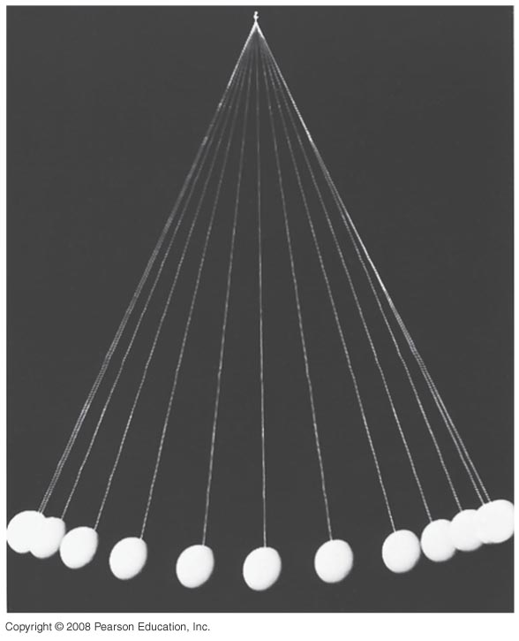
The pendulum
A simple pendulum consists of a mass (M) attached to a massless string of length L.
We know the motion of the mass, if dropped from some height, resembles simple harmonic motion: oscillates back and forth.
Is this really SHO? Definition of SHO is motion resulting from a restoring force proportional to displacement.

Slide 10
Simple Pendulum
L
We have an expression for the restoring force
From this, we can determine the effective “spring” constant k
And we can determine the natural frequency of the pendulum
θ
Δx

Slide 11
Simple Pendulum
L
If we know
We can determine period T
And we can the equation of motion for displacement in x
…or θ
θ
Δx

Slide 12
Damped Harmonic Motion
If I let the pendulum swing, would it keep returning to the same original displacement?
In the real world there are other forces, in addition to the restoring force which act on the pendulum (or any oscillator).
The harmonic motion for these real-world oscillators is no longer simple.
Damped Harmonic Motion

Slide 13
Damped Harmonic Motion
Suppose there is a damping force acting on the oscillator which depends on velocity
  This is a Force which acts against the oscillator, opposite the direction of motion.
The force equation now looks like:

Slide 14
Damped Harmonic Motion
The solution to this differential equation is trickier, but let’s try the following solution:
Natural frequency decreases
Amplitude of oscillations decreases exponentially.

Slide 15
Simple Harmonic Oscillation

Slide 16
Damped Harmonic Oscillation

Slide 17
Damped Harmonic Oscillation

Slide 18
Damped Harmonic Oscillation

Slide 19
Damped Harmonic Oscillation
But this is only one type of damped motion
  Underdamped
If then the system is referred to as “critically damped”
  Reaches equilibrium fastest
  Ideal if you are trying to get rid of oscillations
If then the system is referred to as “over-damped”, takes a long time to return to equilibrium

Slide 20
Forced Harmonic Motion
In addition to damping, one can apply a force to an oscillator. If that external force is sinusoidal, the Force equation looks like:
The solution to this differential equation is:

Slide 21
Forced Harmonic Motion

Slide 22
Forced Harmonic Motion

Slide 23
Forced Harmonic Motion

Slide 24
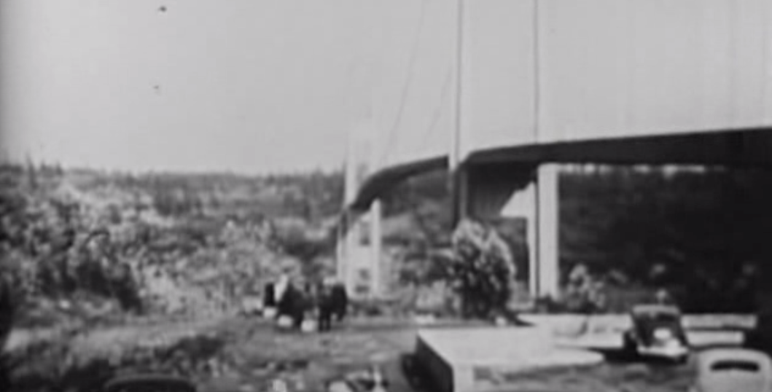
In the real world?

Slide 25
Waves (Chapter 15)
A wave is a displacement that travels (almost always through a medium) with a velocity and carries energy.
  It is the displacement that travels, not the medium!!
  The wave travels over large distances, the displacement is small compared to these distances.
  All forms of waves transport energy

Slide 26
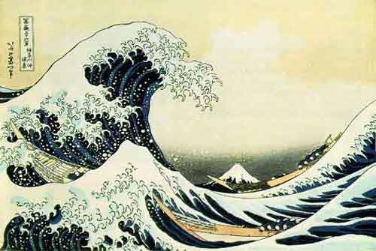
Waves (Water Waves)
Example which most frequently comes to mind are waves on the ocean.
  With an ocean wave, it is not the water that is travelling with the lateral velocity.
  Water is displaced up and down
  This displacement is what moves!

Slide 27
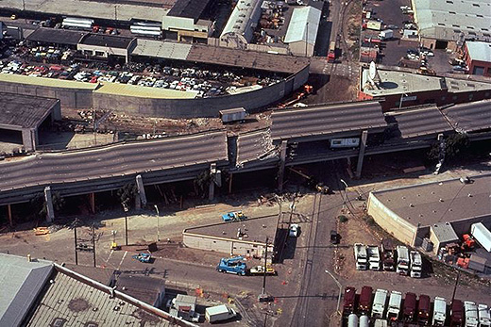
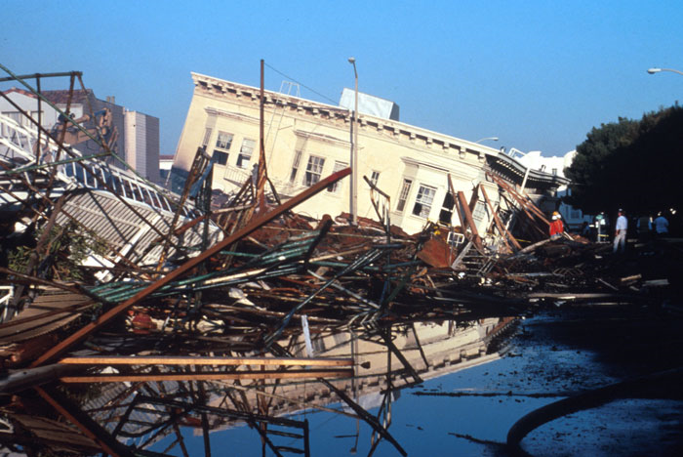
Waves (Earthquakes)
Earthquakes are waves where the displacement is of the surface of the Earth.
  Again, the Earth’s surface is not travelling with any lateral velocity. It is the displacement which travels.
  The surface of the Earth moves up and down.
  Obviously a lot of Energy is transported!

Slide 28
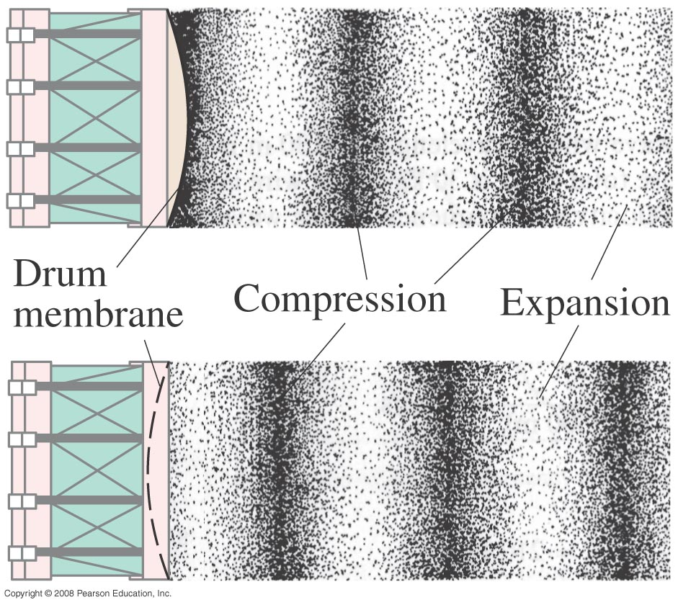
Waves (Sound Waves)
Sound is also a form of wave.
  The displacement for a sound wave is not an “up and down” displacement. It’s a compression.
  The air is compressed, and it is the compression which travels through air.
  Sound is not pockets of compressed air travelling, but the compression of successive portions of air.

Slide 29
Waves (Light)
Light is also a type of wave
  The displacement of a light wave is a change in the Electric and Magnetic Fields.
  This propagates through space with the speed of light
  Light can carry energy:
    Solar power
    Radiative heating
    Lasers

Slide 30
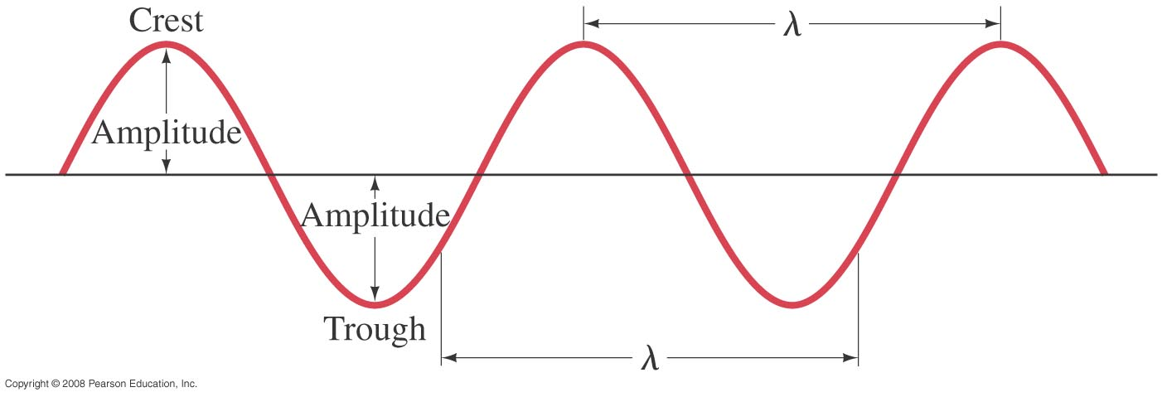
Characteristics of Waves
A continuous or periodic wave has a source which is continuous and oscillating
  Think of a hand oscillating a piece of rope up and down
  Or a speaker playing a note
This vibration is the source of the wave, and it is the displacement cause by the vibration that propagates.
If we freeze that wave in time (take a picture)
x

