Slide 1
Technology& the CJS: March 24, 2015 Professor James Byrne
An Overview of the U.S. Courts’ Structure, Purpose,&Cost:
The Emerging Role of Court Technology

Slide 2
An Overview of the Structure, Purpose, and Budget of the U.S. Court System
Federal Courts: What do they do? How are they structured?
Focus: U.S. Supreme Court
State Courts: structure and purpose
Focus: Mass Court System
The Cost of Courts and Corrections: Impact of New Court Technology?

Slide 3
Structure of the Court System

Slide 4
Federal Courts
What kinds of cases can a federal court hear?
The court must have jurisdiction:
“The power, right, and authority to interpret the law.”
Two types of federal-court jurisdiction:
Federal-question jurisdiction.
Diversity jurisdiction.

Slide 5
Federal Question Jurisdiction
Case involves:
Federal statute or law.
U.S. constitution.
A Few Recent and Not So Recent Examples:
Roper v. Simmons, 543 U.S. 551 (2005), was a landmark decision in which theSupreme Court of the United States held that it is unconstitutional to impose capital punishment for crimes committed while under the age of 18
Johnson vs California, 2008 ( race-based classification of prisoners)
Furman vs. Georgia, 1972 and Gregg vs.Georgia, 1976 ( death penalty)

Slide 6
2012 Supreme Court Case: Miller v Alabama
Supreme Court rules it’s unconstitutional to sentence juveniles to life in prison without parole for murder
Case of Miller vs. Alabama: The decision came in the robbery and murder cases of Evan Miller and Kuntrell Jackson. Miller, then 14, was convicted in 2006 of capital murder for beating a man with a baseball bat and leaving him to die in a burning trailer after stealing his baseball card collection and $350.
Mass State Supreme Court today: ruled that juvenile defendants have rights to court appointed attorneys and to have access to expert witnesses at parole hearing

Slide 7
Diversity Jurisdiction
Federal courts can hear questions of state law, IF:
The parties are citizens of different states, AND
The value of the case EXCEEDS $75,000 (the “amount in controversy” requirement).

Slide 8
Federal Court - Levels

Slide 9
U.S. District Courts
91 U.S. district courts.
Arranged geographically; at least one within each state; but NOT connected with state government.
Information technology and federal district courts:
PACER(Public Access to Court Information Technology and the Federal Courts Electronic Records)
https://www.pacer.gov/

Slide 10
U.S. District Courts
EXAMPLE: United States District Court for the Middle District of Florida.
Parties:
Plaintiff (initiates action).
Defendant (person being sued).
One judge presides over the case.
Case may be tried to a jury or may be a “bench trial.”

Slide 11
Federal Court - Levels

Slide 12
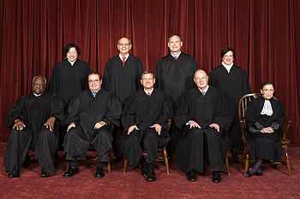
Who is on The U.S. Supreme Court?
http://www.supremecourt.gov/about/biographies.aspx
Chief Justice: John Roberts appointed by President with Senate confirmation
Associate Justices: 8 appointed by President for life( Senate confirmation )
)

Slide 13
Technology and the U.S. Supreme Court
US Supreme Court is a low technology court
No video or cameras allowed at oral arguments
Audio and Transcripts are available on their website, but there is a delay
According to the Chief Justice, they are low tech for a reason: no clear link to improved performance
http://www.washingtonpost.com/blogs/the-switch/wp/2015/01/02/courts-choose-to-lag-behind-on-tech-says-chief-justice-roberts/

Slide 14
U.S. Courts of Appeals
Party who loses in district court has an AUTOMATIC right to an appeal.
13 U.S. Courts of Appeals.
12 are geographic.
One is a specialty court (Federal Circuit).
EXAMPLE: United States Court of Appeals for the Eleventh Circuit (“Eleventh Circuit”).

Slide 15
U.S. Courts of Appeals
Parties:
Appellant
Appellee
Three judges (“the panel”) hear legal arguments only.
No jury.
No new evidence/no witnesses.

Slide 16
U.S. Courts of Appeals
Types of relief:
Affirms = agrees with decision in trial court.
Reverses = disagrees with decision in trial court.
Remands = sends back to trial court for further proceedings (probably with some instructions).
What happens to the party who loses in the appellate court?

Slide 17
U.S. Supreme Court
Loser in U.S. Court of Appeals may file a Petition for Writ of Certiorari.
Supreme Court does not have to hear the case (“cert. denied”).
Only a small percentage of all writs( 1%) are accepted for review each term
The court denies the vast majority of petitions and thus leaves the decision of the lower court to stand without review; it takes roughly 80 to 150 cases each term. In the term that concluded in June 2009, for example, 8,241 petitions were filed, with a grant rate of approximately 1.1 percent.
http://www.supremecourt.gov/
If it does hear the case:
Nine JUSTICES hear the appeal.

Slide 18
Current Supreme Court Cases
Facebook threats case considered by US Supreme Court: Elonis v US
http://www.cnn.com/2014/12/01/politics/supreme-court-elonis-vs-u-s-free-speech/
A list of upcoming cases:
http://thinkprogress.org/justice/2014/09/23/3569923/what-to-expect-when-the-supreme-court-returns-to-work-next-week/

Slide 19
State Courts
Each state has its own, independent judicial system.
Cannot be bound by the federal courts.
One state system cannot bind another court system.Structurally, each is a bit different.
But, most have three levels.

Slide 20
Trial Courts
State courts can hear any kind of case, unless a federal statute states otherwise.
Limited v. general jurisdiction.
Geographic: Usually by county.
One judge.
Parties = Plaintiff and defendant.

Slide 21
Intermediate Appellate Courts
Loser has an appeal as a right.
Three judges hear case.
Parties = appellant and appellee.

Slide 22
State Supreme Courts
May or may not have to hear the case.
Justices (odd number).
In Massachusetts, the Governor nominates the Justices( lifetime terms)
Ralph D. Gants is the Chief Justice of the Supreme Judicial Court. Chief Justice Gants was appointed as an Associate Justice of the Superior Court in 1997 by Governor William Weld. Governor Deval Patrick first appointed him as a Justice to the Supreme Judicial Court in January 2009.

Slide 23
Case Processing in Federal and State Courts: A look at the Numbers
Are We Really Incarceration Nation?
Can we use technology to reduce incarceration?

Slide 24
State Court Case Processing
Felony defendants
In the nation's 75 largest counties, an estimated 58,100 defendants were charged with a felony offense in 2006.
PRIORS: More than three-fourths of felony defendants had a prior arrest history, with 69% having multiple prior arrests.
PRE-Trial Release: Fifty-eight percent of felony defendants in the nation's 75 largest counties were released prior to adjudication and about a third of the released defendants committed some form of pretrial misconduct.
CONVICTIONS: About two-thirds of felony defendants were eventually convicted and more than 95% of these convictions occurred through a guilty plea.
Seventy percent of defendants convicted were incarcerated in a state prison or local jail.

Slide 25
Sentencing in Federal and State Courts
Felony convictions
State and federal courts convicted a combined total of nearly 1,145,000 adults of felonies in 2004. Of these felony convictions, an estimated 1,079,000 adults were convicted in state courts and 66,518 were convicted in federal courts, accounting for 6% of the national total.
In 2004, 70% of all felons convicted in state courts were sentenced to a period of confinement in a state prison (40%) or a local jail (30%). Jail sentences are short-term confinement (usually less than 1 year) in a county or city facility. Prison sentences are long-term confinement (usually 1 year or more) in a state facility.
Prison sentences handed down by state courts in 2004 averaged almost 5 years (Time served 2.5 years).

Slide 26
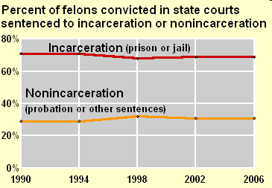
State Court Sentencing

Slide 27
Federal Case Processing
Summary findings From October 1, 2007 through September 30, 2008—
175,556 suspects were arrested and booked by the U.S. Marshals Service for a federal offense.
178,570 matters were received by U.S. attorneys for investigation.
91,835 defendants in criminal cases commenced in federal court.
82,823 offenders were convicted in federal court.
78% of convicted offenders were sentenced to prison, 12% to probation, and 3% received a fine only.
120,053 offenders were under federal community supervision.
178,530 offenders were in federal prison on September 30, 2008.

Slide 28
Plea Bargains
Of the estimated 1,079,000 felons convicted in state courts in 2004, the vast majority (95%) of those sentenced for a felony pleaded guilty.
The remaining 5% were found guilty either by a jury (2%) or by a judge in a bench trial (3%). See Felony Sentences in State Courts, 2004.

Slide 29
Technology and Case Processing and Decision Making
Information technology and Pretrial Release: Risk Assessment Tools
Hard technology and Pretrial Release: Electronic monitoring, drug testing
Information technology and case processing: data warehouses, e-filing, automated case management systems
Hard technology in the courtroom: computers, video
Information Technology and Sentencing: Sentencing Support Tools
Federal and State Sentencing Guidelines: Simulation Modeling of the impact of guidelines reform

Slide 30
Federal and State Sentencing Guidelines
Federal Sentencing Guidelines
http://www.federalcharges.com/what-are-federal-sentencing-guidelines/
Massachusetts Sentencing Guidelines
http://www.mass.gov/courts/docs/admin/sentcomm/fy2013-survey-sentencing-practices.pdf

Slide 31
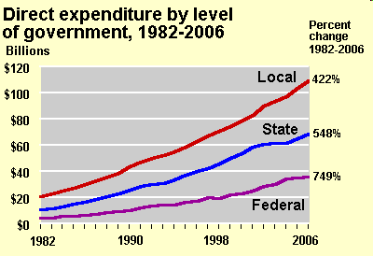
The Cost of Justice

Slide 32
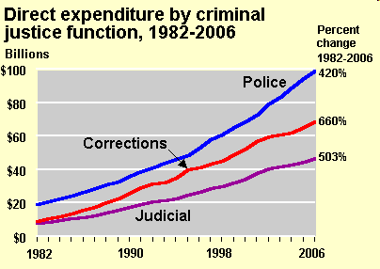
Police, Courts, and Corrections

Slide 33
Jobs in Justice
Justice Employment Highlights
Nationwide, there were 2.4 million justice employees working at the federal, state, and local levels during 2006.
Over the decade--1997 to 2006—overall growth in justice employment for federal, state, and local governments remained relatively stable
Police protection had the largest number of state and local justice employees.

Slide 34
Court Costs
Judicial and Legal Expenditure: Federal, state and local governments spent about $46 billion for judicial and legal services nationwide.
Employment: Over half (54%) of employees working in judicial and legal capacities served at the local level of government, 34% at the state level, and 11% at the federal level.

Slide 35
Cost of Courts and Corrections in Massachusetts
Probation: 112 Million
Parole: 20 Million Independent executive agency
State Corrections: 590 Million; 5,400 staff, 15 prisons
County Corrections: Varies from county to county
Judiciary: In Mass, Probation is a Judicial Function
http://www.mass.gov/eopss/agencies/doc/faqs-about-the-doc.html

Slide 36
How much do we spend on court technology?
It is difficult to break out the percentage of the Court’s budget devoted to technology, but we can look at costs for specific technology needs
Examples of the new technology currently being used across the country include:
Hard Technology in the courtroom
Soft, information technology needs

Slide 37
The New Technology of Law and Courts
Hard Technology
The high tech courtroom (computers, video, cameras, design features of buildings)
Weapon detection devices
Video conferencing
Electronic court documents
Drug testing at pretrial stage
Soft Technology
Case flow management systems
Radio frequency identification technology
Data warehousing
Automation of court records
Sentencing Support tools
Problem-oriented courts with unique information system requirements( drug, reentry, gun, domestic violence, and community courts)

