Slide 1
The Police and New Technology
Professor James M. Byrne
University of Massachusetts, Lowell

Slide 2
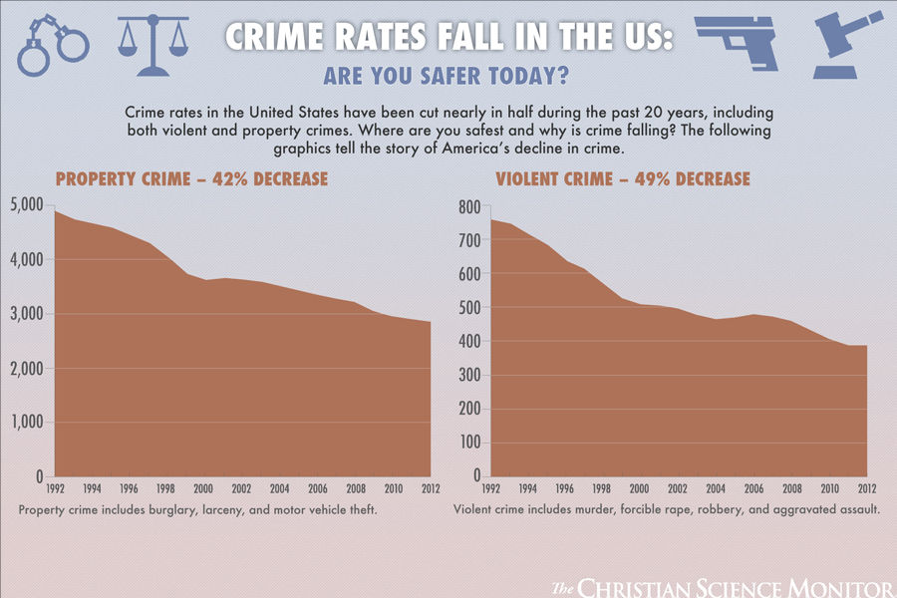
Crime Rates and Police Effectiveness: Are they Linked?

Slide 3
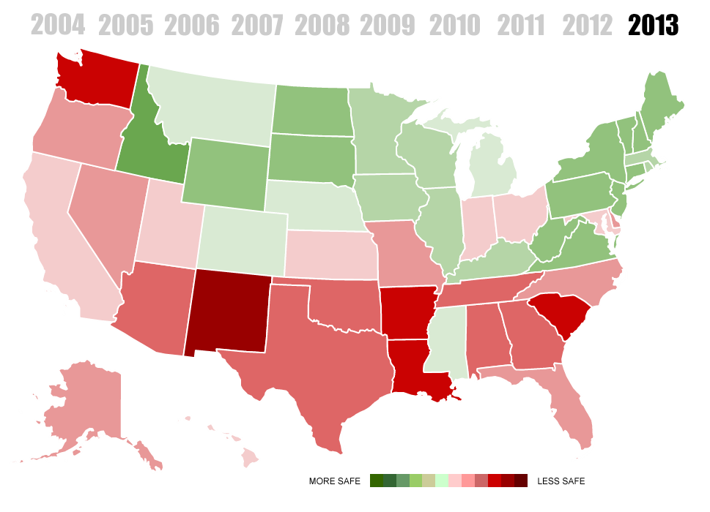
Changes in Crime Rates over time: http://www.movoto.com/blog/opinions/crime-maps-over-time/

Slide 4
Clearance Rates as a Measure of Police Effectiveness
http://www.npr.org/2015/03/30/395799413/how-many-crimes-do-your-police-clear-now-you-can-find-out
Using the above link, you can look at the clearance rate for any city in the USA

Slide 5
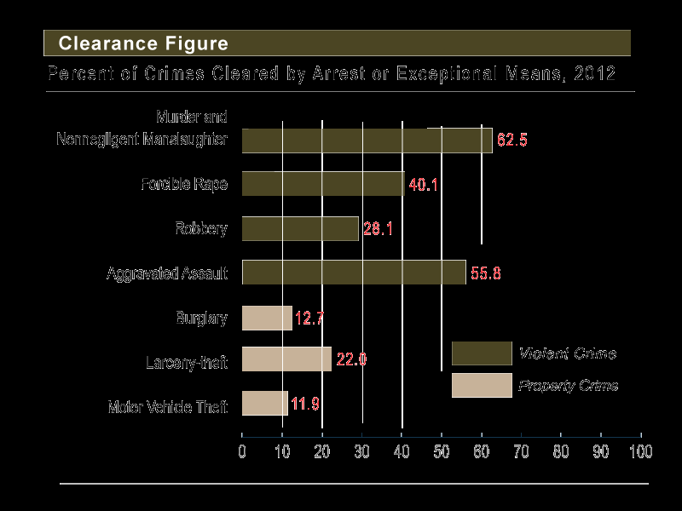
Clearance Rates in 2012

Slide 6
Changes in the Size of Police and in Police Personnel Prior to 9/11
Among large city police departments, 1990-2000, changes included --
The number of residents served increased by 10%, resulting in a 7% increase in the number of full-time sworn personnel per 100,000 residents.
The number of UCR violent crimes decreased 34%, the number of UCR property crimes decreased 31%, and the number of full-time local police officers increased 17%
The representation of Hispanics among officers increased from 9% to 14% in 2000, blacks from 18% to 20%, and women from 12% to 16%.
The percent of departments requiring new officers to have at least some college rose from 19% to 37%, and the percent requiring a 2-year or 4-year degree grew from 6% to 14%.

Slide 7
Longer Term Changes in Police personnel: 1987-2013
Diversity among police officers has increased in the last two decades.
In 2013, 27% of police officers were members of racial or ethnic minority groups, compared to 15% in 1987.
About 130,000 minority local police officers were employed in 2013, an increase of about 78,000 since 1987. Hispanics or Latinos accounted for 60% of the increase since 2007.
An estimated 12% of officers were Hispanic or Latino in 2013, which was more than double the estimated 5% in 1987.
In 2013, 12% of local police officers were black, which was up from about 9% in 1987.

Slide 8
Changes in the Number of Police
An estimated 605,000 full-time employees worked at more than 12,000 local police departments as of January 1, 2013—a 35% increase since 1987.
Of those, about 477,000 were sworn officers with general arrest powers and 128,000 were non=sworn employees.
In addition, about a third of local police departments said they used unpaid reserve or auxiliary officers.Nationwide, there were more than 29,000 unpaid officers in 2013.

Slide 9
Education and the Police
In 2013, 32% of local police departments required new officers to have a degree or some college coursework, which was about twice as high as in 1993.
An estimated 23% of local police officers worked for a department that required entry-level officers to have a 2-year college degree in 2013, up from 7% in 2003.
Job prospects in local policing: http://www.thedailysheeple.com/police-departments-across-the-us-cant-find-enough-recruits_092015

Slide 10
Changes in Police Organization : Post 9/11
There are close to 20,000 federal, state, and local police agencies in the United States
Since 9/11 Federal Policing agencies have been reorganized in an effort to coordinate our efforts to prevent terrorism.
The Creation of the cabinet level Department of Homeland Security in 2002
The DHS united 22 agencies and 170,000 workers in the biggest government reorganization in more than 50 years.

Slide 11
Department of Homeland Security
he Department of Homeland Security issued a progress report in 2011 outlining the steps it has taken based on recommendations of the September 11 Commission to protect the country against another terrorist attack. The report noted the following accomplishments:
Expanded information sharing. The DHS created 72 "fusion centers" throughout the country to gather, share, and analyze threat-related information with federal, state, and local agencies. Internationally, the DHS encourages the sharing of information about terrorists and criminals with global partners.
The creation of the Nationwide Suspicious Activity Reporting Initiative, which trains state and local law enforcement officials to recognize behaviors and indicators related to terrorism, crime, and other threats and standardizes how the observations should be managed.
The launch of the "If You See Something Say Something" campaign to raise public awareness of indicators of terrorism and crime, and encourages citizens to report suspicious activity to law enforcement authorities.
Enhanced the screening of passengers flying into, out of, or within the U.S. and checking all passengers against government watchlists. In addition, all baggage is screened for explosives.
Implemented the Visa Security Program at 19 areas in 15 countries known for high-risk visa activity. Officials conduct targeted, in-depth reviews of visa applications and applicants before they are allowed to travel to the United States.
Improved the security of the country's cyber networks and infrastructure through the creation of the National Cybersecurity Protection System and the National Cybersecurity and Communications Integration Center.
Read more: Post-9/11 Changes By the U.S. Government | Infoplease.com http://www.infoplease.com/us/history/911-anniversary-government-changes.html#ixzz3GGsQeWLs

Slide 12
Number of police paramilitary units grow
Nearly nonexistent in the early 1960s, the number of agencies with PPUs began to grow in 1967. By 1982, nearly 60 percent of police departments had them; by 1990, 78 percent; by 1995, 89 percent.
"The bulk of the newer units were from smaller municipalities and state police agencies, [with] even more rapid growth in smaller county and municipal police departments ... serving populations between 25,000 and 50,000.“
Traditional call-outs - crisis situations such as "barricaded persons," terrorist activity, hostage situations and civil disturbances - accounted for only approximately 18 percent of the total by 1995. The remainder were largely for what police called 'high risk warrant work' - mostly drug raids

Slide 13
The Police and Hard Technology
Federal, state, and local police have applied hard technology not only in the area of individual offender apprehension, but also in the area of community-level surveillance and control.
In addition, technological innovations have been used to improve the safety and protection of police officers.

Slide 14
Hard Technology Innovations in Policing
Improvement in weaponry of police
Less-than-lethal force technology used in mob/potential riot situations
Computers in squad cars to improve criminal identification and /or for gang identification; computer-based strategies to identify criminal behavior on the internet (e.g. sex offenders, cyber crime, terrorism)
Improvements in offender/citizen identification (e.g. biometrics, fingerprints, etc.)
Improvements in police protection devices (e.g. bullet proof vests, new construction of police departments)
Cameras in police cars and body worn cameras

Slide 15
There will always be a faster gun : Aztec Two Step were correct
Improvements in police weaponry are a direct response to improvements and availability of offender weaponry.
Many police departments upgrade weapons on a regular basis.
In large departments, weapons are upgraded approximately once every five years.

Slide 16
Under the Gun : Some Facts to Consider
New York City police officers fire their weapons far less often than they did a decade ago, a statistic that has dropped along with the crime rate.
But when they do fire, even at an armed suspect, there is often no one returning fire at the officers.
Officers hit their targets roughly 34 percent of the time

Slide 17
Guns and the Police in New York: 1996-2006
Over all, the numbers show that the department’s use of deadly force has decreased along with the city’s historic drop in crime, and the drop in threats against police officers.
Picked apart closely, the reports provide a remarkable portrait of how the nation’s largest police force, with 36,000 officers, uses its guns. Every shot, from gunfight to accident to suicide, both on and off-duty, is accounted for.

Slide 18
Gun Use By Police in New York City
The number of bullets fired by officers dropped to 540 in 2006 from 1,292 in 1996 — the first year that the city’s housing, transit and regular patrol forces were merged — with a few years of even lower numbers in between. Police officers opened fire 60 times at people in 2006, down from 147 in 1996.
¶The police fatally shot 13 people in 2006, compared with 30 people a decade before.
The average number of bullets fired by each officer involved in a shooting remained about the same over those 11 years even with a switch to guns that hold more bullets — as did officers’ accuracy, roughly 34 percent.
¶In 77 percent of all shootings since 1998 when civilians were the targets, police officers were not fired upon, although in some of those cases, the suspects were acting violently: displaying a gun or pointing it at officers, firing at civilians, stabbing or beating someone or hitting officers with autos

Slide 19
Innovations in Weaponry
Power: Is bigger better?
It really depends where the officer works. Go out to LA or any high crime area, and police officers will tell you they need more firearms.
Some argue: Firepower needs to be upgraded for law enforcement officers in general. Gangs simply out power most departments when it comes to their weapons.
Bullets: Do more bullets help?
Cameras on guns: Do they improve Police performance?

Slide 20
New Guns Versus Old Guns
With the introduction of the Smith & Wesson 4006 and the Glock 23, Police Departments started switching over to the larger caliber round.
Not only is the round bigger, it provided more stopping power which is what police need.
There has been countless arguments over which gun is the better ,but the 40's seem to be weapons of choice for law enforcement now.

Slide 21
Less-than-Lethal Force Technology : An Overview
Tasers: http://www.youtube.com/watch?v=VL5GFWTxTb8
Batons
Water and Sound
Sticky Foam
Rubber and Plastic Bullets
Pepper ball Projectiles
http://www.unidir.org/pdf/articles/pdf-art2217.pdf

Slide 22
Tasers: Exent of Use by Police in the United States
According to the device’s manufacturer, Taser International, more than 345,000 Tasers have been sold to 12,750 law enforcement and military agencies in 44 countries, with 4,500 agencies distributing them to their entire forces.
In NYC, the police deploy the Taser about 300 times a year, mainly when responding to some of the 80,000 calls for emotionally disturbed people.

Slide 23
What is a Taser? A Look at NYC
about 500 Tasers are deployed in New York.
The weapon has not been fully embraced by the Police Department, the nation’s largest police force, partly because of the difficulties in maintaining the devices and in training officers
The Taser model being used in New York is the M26, which is not the newest version (that is the X26, which is 60 percent lighter and smaller). The M26 is yellow, looks like a 9-millimeter Glock, weighs about 16 ounces and costs about $400.
The weapon uses a compressed-nitrogen cartridge to launch two probes that travel 15 to 35 feet. At the end of each probe is a wire that attaches to the skin and clothing.
The Taser can work through about two cumulative inches of clothing, said Stephen D. Tuttle, a Taser spokesman. The probes deliver 3,000 volts of electrical current to the body, or 0.36 joules per pulse. (There are 19 pulses a second, and each trigger cycle lasts for 5 seconds).

Slide 24
SA-4 Pepper Ball System
The SA-4 PepperBall system launches up to four ImpactPlus projectiles that strike with 20 foot-pounds of force and release nearly four grams of extremely hot pepper powder (Capsaicin II). That's twice the impact of standard PepperBall projectiles, and with pepper powder that has been mixed to contain 3 times the active agent of our standard round. It's impressive stopping power.
This system is an ideal first choice less-lethal option in many use-of-force situations, including non-combatant military scenarios, inmate management correctional scenarios and law enforcement situations including stand-off, single or multiple suspect compliance, dispersal of gangs, bringing suspects out of hiding, busting barricades and personal defense.
The SA-4 is highly accurate at ranges up to 30 feet, with high visibility sites. A three position safety offers safe, off-safe/laser on, and off-safe laser off positions.
http://www.pepperball.com/le/products.aspx

Slide 25
Snelgrave Commission Report on The Death of Victoria Snelgrave
Less-than Lethal Force?
What went wrong?
Was it the weapon( FN303)?
Was it the training?
http://www.cityofboston.gov/police/pdfs/report.pdf

Slide 26
FN303: The Less Than Lethal Force Weapon Used by the Boston Police Department
FN 303 Less Lethal Launcher
The FN 303 is designed to be the premier system for situations requiring less lethal response. Completely dedicated to reduced lethality and liability, the basis of the FN 303 concept lies in its ammunition. The .68 caliber, 8.5 g weight projectiles utilize a fin stabilized polystyrene body and non-toxic bismuth forward payload to provide both a more accurate, greater effective range than other less than lethal weapons. The primary effect of the projectile is trauma, which directly neutralizes the aggressor. In addition, secondary effects from the projectiles can be delivered via a chemical payload depending on mission requirements. Magazines are 15 round capacity with a clear rear cover to allow for rapid ammunition payload verification. The compressed air powered FN 303 launcher is designed to fire less lethal projectiles exclusively, with an effective range of 50 meters at a point specific target for law enforcement and a maximum range of 100 meters for military applications.

Slide 27
Police Protective Gear
Bullet Proof Vests: many police officers do not like to wear them for a variety of reasons—weight, smell, appearance are three reasons
Are Bullet Proof Vests effective? It depends on the vest and the gun.

Slide 28
Body Armor: Evidence of Effectiveness
More than 3,000 police officers' lives have been saved by body armor since the mid-1970s when the National Institute of Justice (NIJ) began testing and developing body armor and performance standards for ballistic and stab resistance.
Unfortunately, there is no such thing as bulletproof armor.
Body armor can provide protection against a significant number of types of handgun ammunition, but law enforcement personnel must keep in mind that armor is categorized and rated for different threat levels.
Additional protection should be worn for SWAT team operations, hostage rescues, or Special Operations assignments, when officers may be exposed to a weapon threat greater than the protection provided by regular duty armor.

Slide 29
Computers in Police Cars
Today's cruisers are equipped with digital radios, GPS units, computers, radars, lights, sirens, etc.
Dispatch centers have become computerized, and officers on the beat and in offices access a variety of databases on a daily basis.
However, these devices are most often not designed to become a part of a system of multiple devices manufactured by different companies--in other words they are not designed with integration in mind.

Slide 30
Project 54: Hands Free Communication
http://www.project54.unh.edu/overview/about.html
Project54 system allows officers to interact with equipment such as lights and siren, radar, etc. using speech input and feedback.
The Project54 system also integrates police cruisers into state-wide data networks

Slide 31
Law Enforcement Vehicle Armor
Patrol officers are the first responders in more and more incidents involving gun use. And all too often, the firearm in question is a rifle.
PROTECH's Law Enforcement Vehicle Armor (L.E.V.A) system offers NIJ Level III for door panels and bulkheads and Level IIIA protection for door panels, windshields, bulkheads and windows.
http://www.protecharmored.com/systems/special/leva.asp

Slide 32
Improvements in Offender-Citizen Identification
Biometrics and Real ID
http://www.iqbiometrix.com/
DNA as an identification tool
Fingerprints: sometimes “old school” works better than “new school”.

Slide 33
Does Hard Technology Work in Policing?
Issues to consider:
(1)Research on the reliability of the technology?
(2)Training on the use of technology?
(3) Research on the impact of the technology on key outcome measures?
(4) Cost effectiveness of technology acquisition?

Slide 34
Other Hard Technology Police Innovations
Gunshot location Systems can identify gun firing and automatically dispatch both police and emergency vehicles to the location.
Police-operated CCTV Systems can be used to monitor targeted locations.
Newark New Jersey Police recently spent several million dollars for CCTV .

Slide 35
Research Evidence: Police Use of Taser Technology
Amnesty International said it had tracked more than 300 cases since 2001 in which people died after being shocked by a Taser. And although studies have not shown what role the devices might have played in those deaths, “extreme caution” is in order, said Larry R. Cox, the executive director of Amnesty.
http://www.less-lethal.org/docs/66/LessLethalPerformanceBasedAnalysis.pdf
http://www.nytimes.com/2008/06/15/nyregion/15taser.html?pagewanted=1&_r=2&ref=nyregion

Slide 36
Unintended Consequences of Hard Technology Innovations
New Guns designed to improve police performance end up in the hands of offenders.
Less-than-lethal Force Weaponry designed to reduce police use of guns/deadly force result in more harm to suspects because it is used in lower level police-citizen encounters.

Slide 37
Unintended Consequences
New Patrol Car Technology will change the nature and extent of police surveillance of the public—in cars and in the community.
Citizen mistrust of the police may actually increase if technological interactions replace personal interaction between police and community residents

Slide 38
People versus Thing Technology: Tipping Points
Evidence of effectiveness is mixed.
Cost of new technological innovation may result in fewer police officers in the community.
Private Sector Policing may replace public safety policing in many areas.

