Slide 1
Criminal Violence: Patterns, Causes, and Prevention Riedel and Welsh, Ch. 10 “School Violence”

Slide 2
OUTLINE
PATTERNS AND TRENDS
School as a setting for violence
Measures of school violence
EXPLANATIONS
Individual – Control Theory
Institutional – School Climate Theory
Community – Social Disorganization Theory
INTERVENTIONS
National Study of Delinquency Prevention in Schools
Prevention: What Works?

Slide 3
Normal adolescents?

Slide 4
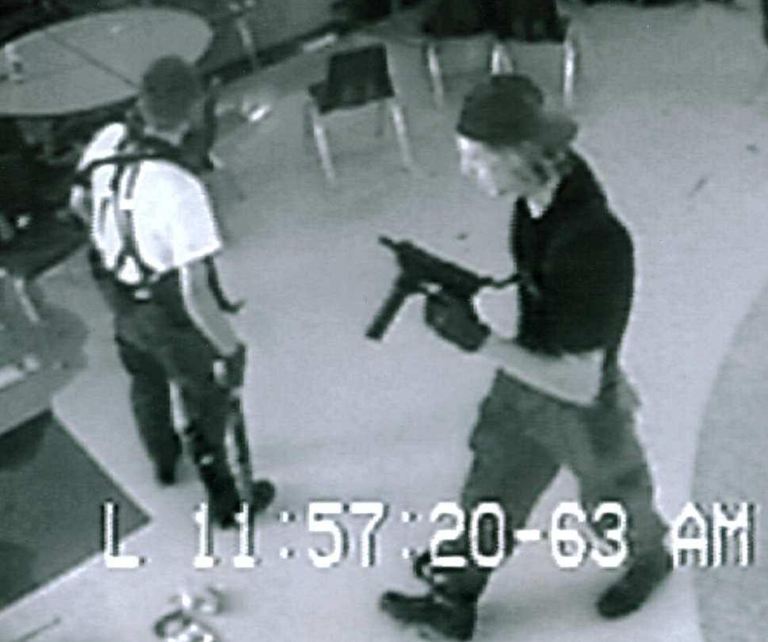
Or ….?

Slide 5
Content Warning: Extreme Violence
Documentary on Columbine from the Discovery Channel
http://www.dailymotion.com/video/x1rlvx_zero-hour-columbine-1_news
http://www.dailymotion.com/relevance/search/zero+hour+columbine/video/x1rmms_zero-hour-columbine-2_news
http://www.dailymotion.com/video/x1rmu1_zero-hour-columbine-3_news
“While public perceptions of any social problem are frequently driven by rare but tragic incidents, there is certainly cause for concern.”

Slide 6
PATTERNS
No well-defined profile of school shooters exists.
Offenders ranged in age from 11 to 21 and came from a variety of racial and ethnic backgrounds and family situations.
Their academic performance ranged from excellent to failing.
Prior behaviors ranged from no observed behavior problems to a clear history of violence and weapon use.
Identification of the characteristics of potential school shooters is difficult due to the low base rate of school shootings.

Slide 7
Patterns (cont.)
School as a Setting for Violence
In a recent analysis of juvenile offenders and victims (NCVS, 1993–2003), school was the most common setting for nonfatal violent victimizations (rape, sexual assault, robbery, aggravated assault, or simple assault) of youths aged 12–17.
53% of the victimizations of youth ages 12–14 occurred at or in school.
32% of victimizations of youth ages 15–17 occurred at or in school.

Slide 8
Measures of School Violence
FEAR AND AVOIDANCE
As student fear increases, confidence in school administrators weakens. Responses include carrying weapons to school, managing impressions by fighting, or putting on a tough “front.”
In 2003, students in urban schools were twice as likely as students in rural and suburban schools to fear being attacked at school or on the way to and from school.
Students may deliberately alter their behavior to reduce their risk of victimization.
In 2003, 5% of students aged 12–18 reported they skipped school or extracurricular activities, or avoided specific places in school because they were afraid for their safety (down from 7% in 2003).

Slide 9
School Security Data
School security responses reflect reactions to perceived disorder.
Survey of Principals: 75% of schools controlled access to school buildings during school hours by locking or monitoring doors, and 34% controlled access to school grounds with locked or monitored gates.
Most public schools (97%) required visitors to sign or check in when entering the school building.
14% of primary schools, 20% of middle schools, and 39% of secondary schools used one or more security cameras to monitor the school.

Slide 10
School Disciplinary Data
School disciplinary records (incidents, suspensions, and other disciplinary actions) often contain significant errors in teacher reporting and/or administrative recording.
Disincentives to report violent incidents include fear of appearing incompetent, legal liability, and potential loss of local and state political support.
Disciplinary records reflect individual teacher, school, and/or district policies in addition to actual rates of incidents.

Slide 11
Student/Teacher Victimization Surveys
School Crime Supplement (SCS): added to NCVS in 1989.
In 2003, students ages 12–18 were victims of about 1.9 million nonfatal crimes at school, including 1.2 million thefts and 740,000 violent crimes.
The violent crime victimization rate at school declined from 48 violent victimizations per 1,000 students in 1992 to 28 per 1,000 in 2003.
In 2003, 5% of students aged 12–18 reported being victimized at school during the previous six months: 4% reported theft; only 1% said they were victims of a violent crime.
Male students were more likely than female students to report being victims of violent crime at school (2% v. 1%), and students in urban schools were more likely than rural students to report being victims of violent crime (2% v. 1%).
In 2003, 7% of students ages 12–18 reported that they had been bullied (picked on or made to do things they did not want to do) at school during the previous 6 months.

Slide 12
Self-Reported Violence
In 2003, 33% of high school students reported having been in a fight anywhere, and 13% said they had been in a fight on school property during the preceding 12 months.
17% of males said they had been in a fight on school property, compared with 8% of females.

Slide 13
Explanations: Control Theory (Individual)
Schools provide a central venue for social bonding (or failure).
Those with poor academic or interpersonal skills are likely to experience failure and alienation in school.
They do not become attached to school because social interaction is unrewarding.
They do not become committed to educational goals because they view them as unrealistic.
They do not become involved in conventional social activities either because they are denied access or because meaningful activities are lacking.
They do not come to believe in conventional rules because they do not perceive meaningful present or future rewards for compliance.
Relationships between bonding and delinquency have been generally supported by research.

Slide 14
School Climate Theory (Institutional)
Schools have their own characteristic “personalities,” just as individuals do.
School climate includes communication patterns, norms about what is appropriate behavior, role relationships, and rewards and sanctions.
Safe School Study
In schools with the worst discipline problems:
Rules were unclear, unfair, or inconsistently enforced.
Ambiguous or indirect responses to student behavior (e.g., lowered grades in response to misconduct)
Teachers and administrators did not know the rules or disagreed on responses to student misconduct.
Schools ignored misconduct.
Students did not believe in the legitimacy of the rules.

Slide 15
Social Disorganization Theory
Crime rates vary with the capacity of a community to control the behavior of its members.
Community characteristics related to violence include:
High concentrations of poverty
High residential mobility and population turnover
High rates of family disruption
High density in housing and population
Weak local social organization (collective efficacy) -- low density of friends and acquaintances, few social resources, weak intergenerational ties in families and communities, weak control of street corner groups, low participation in community events and activities, and opportunities associated with violence.

Slide 16
Interventions
School-Based Prevention: What Works?
Wilson & Lipsey (2005): examined the effectiveness of 209 school-based programs for preventing or reducing aggressive and disruptive behavior.
Calculated effect size (ES) for different program types.
ES can vary from 0 to 1.

Slide 17
Programs fell into four basic categories:
Universal programs (n = 61): delivered in classroom settings to the entire classroom (ES = .18)
Selected/Indicated Programs (n = 103): delivered to students who were selected especially to receive treatment by virtue of the presence of some risk factor, including disruptiveness, aggressive behavior, or activity level (ES = .29)
Special Schools or Classes (n = 37): special schools or classrooms that served as the usual classroom or school for the students participating. Children were placed in these special schools or classrooms because of some behavioral or school difficulty that was judged to warrant their placement outside of mainstream classrooms (ES = .06)
Comprehensive/Multimodal Programs (n = 17): multiple treatment modalities and multiple formats, including both classroom-based and pull-out programs (ES = .06)

Slide 18
Five main treatment modalities:
1. Behavioral strategies involved the use of various behavioral techniques, such as rewards, token economies, contingency contracts, and the like to modify or reduce inappropriate behavior.
2. Cognitively oriented programs: focused on changing thinking processes or cognitive skills; solving social problems, controlling anger, inhibiting hostile attributions, etc.
3. Social skills programs: designed to help youth better understand social behavior and learn appropriate social skills. Children learn communication skills, fighting avoidance skills, group entry training skills, eye contact, “I” statements, etc.
4. Counseling, talk therapy: used traditional group therapy techniques in classroom settings
5. Peer mediation: Student mediators were trained to offer mediation services for peers who experienced interpersonal conflicts. Training generally focused on a series of conflict resolution steps.

Slide 19
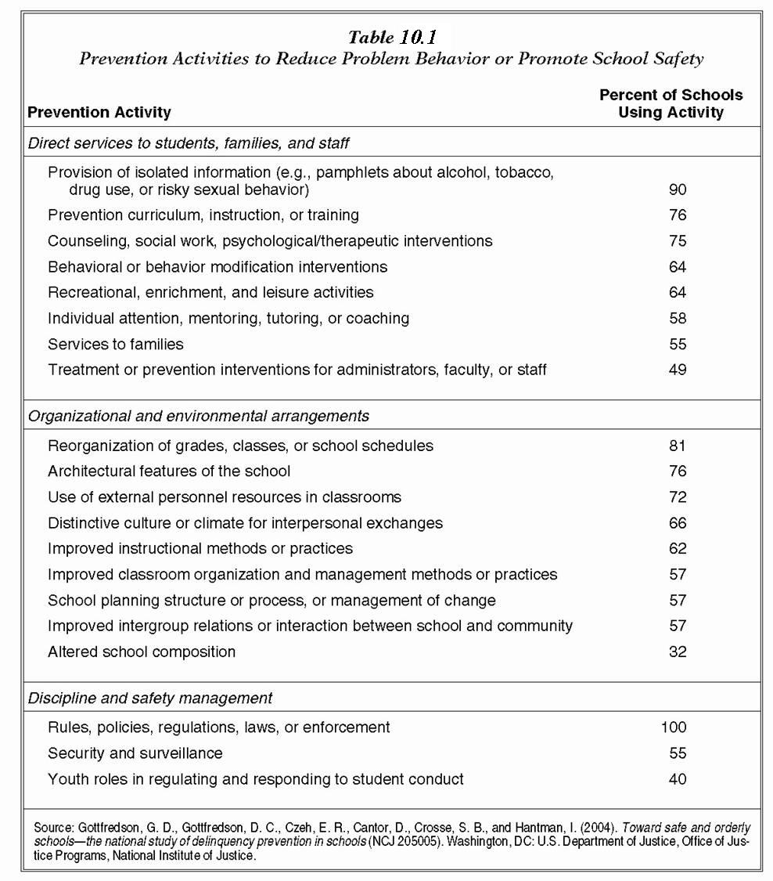
National Study of Delinquency Prevention in Schools (Gottfredson et al., 2005)
Interventions
Results indicated a low quality of implementation in the typical school.
Programs had fewer sessions and lasted for shorter periods than optimal.

Slide 20
Conclusions
Studies have indicated positive benefits from well-designed and well-implemented school-based programs, including:
conflict resolution, social skills, life skills, after-school programs, and other violence prevention programs
Empirical research suggests that many programs are targeting appropriate causal factors, although better evaluations of their effectiveness are still needed.

