Slide 1
Criminal Violence: Patterns, Causes, and Prevention Riedel and Welsh, Ch. 7 “Hate Crimes”

Slide 2
OUTLINE
PATTERNS AND TRENDS
Hate Crimes Statistics Act
EXPLANATIONS
Group Conflict Theories
Strain Theory
Social Learning Theories
INTERVENTIONS
Specialized Police Bias Units
Hate Crime Legislation (state and federal)
Civil Remedies
Teaching Tolerance

Slide 3
Hate Crime Statistics Act
A whole new category of crime was created with passage of the Hate Crime Statistics Act (HCSA) of 1990.
The HCSA required the collection of nationwide hate crime data for the first time.
The goals of the Act were to:
gather information on the frequency, location, extent, and patterns of hate crime
increase law enforcement awareness of problem and responses to it
raise public awareness of the problem
send a message that the government is concerned about hate crime

Slide 4
Hate Crime Statistics Act (cont.)
The HCSA requires the FBI to collect and report data on hate crimes involving the predicate offenses of murder, non-negligent manslaughter, forcible rape, aggravated assault, simple assault, intimidation, arson, and vandalism (p. 8).
A predicate offense means two things: (1) a criminal offense has occurred, and (2) that offense was motivated wholly or in part by prejudice.
For criminal conduct to be a hate crime, then, it must be motivated by prejudice.

Slide 5
Hate Crime Statistics Act (cont.)
HCSA defines a hate crime as “a criminal offense committed against a person or property, which is motivated, in whole or in part, by the offender’s bias against a race, religion, ethnic/national origin group, or sexual orientation group.”
Bias, according to FBI guidelines, is a performed negative opinion or attitude toward a group of persons based on their race, religion, ethnicity/national origin, or sexual orientation.

Slide 6
Trends

Slide 7
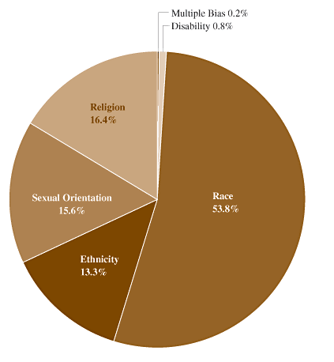
Bias-Motivated Offenses by Type, 2004
Source: Federal Bureau of Investigation, Crime in the United States, Annual Reports (1991-2004)
Racial prejudice motivated more than half of all the reported single-bias incidents (52.9%).

Slide 8
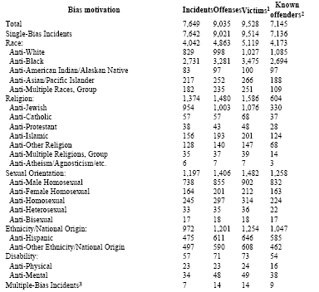
Incidents, Offenses, Victims, and Known Offenders by Bias Motivation, 2004

Slide 9
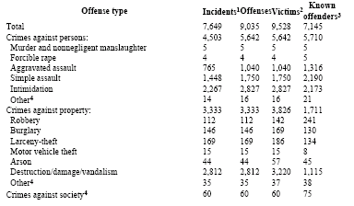
Incidents, Offenses, Victims, and Known Offenders by Offense Type, 2004
Approximately half of all bias-motivated offenses against persons involved the crime of intimidation (50.1%). Nearly all of the other offenses directed at persons involved assaults: simple assaults made up 31.0% and aggravated assaults accounted for 18.4% of the offenses.

Slide 10
Selected States with 100 or More Incidents, 2004

Slide 11
Offenders
Of those persons who committed a crime based upon their perceived biases, 60.6% were white and 19.7% were black.
12.9% were classified as unknown race.
Groups containing persons of various races accounted for 5.1% of the perpetrators, and the remainder were American Indian/Alaskan Natives or Asian/Pacific Islanders.

Slide 12
Explanations: Group Conflict Theories
Group membership serves strong individual needs for affiliation and acceptance, and intergroup conflict strongly facilitates group cohesiveness and identity.
“Social categorization” (Tajfel): All that is necessary for group conflict to occur is individual perception that others are members of a different group.
Studies have consistently demonstrated systematic in-group preferences and out-group biases even when the out-group was one whom in-group members had never met, with whom they had never interacted, and about whom they knew very little.

Slide 13
Explanations: Group Conflict Theories (cont.)
In general, experiments have shown that intergroup competition for scarce resources:
increases the level of cohesiveness within groups
increases rejection of the other group’s members
facilitates distortions of the other group’s intentions and behaviors

Slide 14
Explanations: Strain Theory
Innovation: use of illegitimate means (violence, intimidation) to eliminate competition for jobs, housing, etc., or to blame others for one’s own lack of success?
Increasing proportions of minorities (esp. Hispanic and Asian) may lead some to look for "scapegoats."

Slide 15
Social Learning Theories
Differential learning of attitudes and behaviors occurs most strongly within primary groups such as peers and family.
Mistrust, stereotypes, and animosity toward other ethnic groups are learned and reinforced through one’s interactions with intimate acquaintances and family members.
Others provide both justifications and rewards for committing acts of violence or harassment against out-group members.

Slide 16
Interventions: Specialized Police "Bias" Units
Examples: New York, Baltimore. NY formed a specialized police bias unit, while Baltimore integrated police responses into their community-oriented policing division.
Both police departments, in spite of differing practices and procedures, have been recognized as leaders in formulating responses to hate crimes.
Neither strategy is cheap, and both require substantial police resources and training.
An appropriate response by police and other agencies needs to take into consideration relevant community characteristics including demographic makeup, needs, priorities, histories, and so on.

Slide 17
Interventions: Hate Crime Legislation
State Law: Three major types of Hate Crime laws--
Substantive Laws: These are generally predicate crimes -- when motivated by prejudice, they qualify as hate crimes. State laws vary a great deal in terms of which offenses are designated as predicate crimes.
Sentence Enhancements: statutes that either upgrade an existing offense or increase the maximum penalty for offenses motivated by prejudice. In Pennsylvania, an offender is charged with a crime one degree higher than the predicate offense (thus allowing stronger penalties).
Reporting Statutes are statutes that specify requirements for hate crime data collection and reporting. The exemplar is the Hate Crime Statistics Act of 1990 (HCSA), which required the collection of nationwide hate crime data for the first time.

Slide 18
Interventions: Hate Crime Legislation (cont.)
Problems: Case attrition is high, successful prosecution is rare.
For laws to be effective, police must arrest, prosecutors must charge, juries must convict, and judges must sentence.
In Boston, of 452 cases reported to police, only 60 resulted in arrest, 38 were charged (in the other 22 cases there was insufficient evidence or diversion), 30 were convicted, and 5 were incarcerated.
Numerous difficulties may explain case attrition:
Prosecutors may be hesitant to pursue charges vigorously.
Most offenders are strangers to the victim.
Evidence is often insufficient to sustain conviction (e.g., offender motivations of bias are difficult to prove).

Slide 19
Interventions: Hate Crime Legislation (cont.)
Federal Laws: four main types—
Civil Rights Protections Against Conspiracies (e.g., neighbors conspire to keep certain ethnic groups out of their neighborhood)
Forcible Interference with Civil Rights (e.g., eating in public restaurants, enrolling in school)
Deprivations of Civil Rights Under Cover Of Law (concerns actions committed by public officials, especially police, who intentionally deprive an individual of his/her constitutional rights)
Willful Interference with Civil Rights Under the Fair Housing Act (prohibits interference with an individual's rights to buy, rent, or live in a home; includes incidents of firebombing, harassment)
Problems: Like state laws, federal statutes are only rarely enforced. Between 1987 and 1989, the U.S. Dept. of Justice prosecuted only 31 cases of racial violence.

Slide 20
Interventions: Civil Remedies
Major lawsuits by SPLC and Morris Dees intentionally bankrupted two of the most notorious, organized hate groups in U.S.
Vicarious liability: Hate groups and their leaders can be held liable for inciting violence, even if they do not explicitly participate in it.

Slide 21
Interventions: Educational Strategies
If values and attitudes conducive to committing hate crimes can be learned, then it is possible that they can be unlearned.
In-group biases and stereotypes can potentially be reduced through regulated contact between persons from each group, especially if:
the contact is between persons of equal status
the contact is in-depth and not superficial
the social climate for contact is friendly
the behavior during such contact challenges previously formed stereotypes
the contact occurs within an environment favoring cooperation rather than competition
Such principles have been used effectively to reduce conflict between various adversarial groups, including members of different ethnicities and nationalities.

