Slide 1
Criminal Violence: Patterns, Causes and Prevention Riedel and Welsh, Ch. 8 “Family Violence”

Slide 2
Patterns
National Survey of Violence Against Women (NSVAW)
Interviews with a random sample of 8,000 men and 8,000 women
About 22% of women were victims of physical assaults by their partners, in contrast to 7% of men.
Of those who reported partner assaults, 42% of women were injured, compared to 20% of the men.
Women were also more likely to require medical care.

Slide 3
Victim/Offender Relationships, NCVS, 2008
Table 6. Relationship between victim and offender, by gender of victim, 2008
Violent crime
Rape/sexual assault
Robbery
Aggravated assault
Simple assault
Relationship to victim
Number
Percent
Number
Percent
Number
Percent
Number
Percent
Number
Percent
Male victims
Total
2,626,000
100%
39,590
100%
328,690
100%
476,390
100%
1,781,330
100%
Nonstranger
1,286,170
49%
39,590
100%'
112,230
34%
241,900
51%
892,440
50%
Intimate partner*
88,120
3
8,310
21'
0
0'
37,430
8'
42,380
2
Other relative
83,630
3
0
0'
0
0'
25,560
5'
58,070
3
Friend/acquaintance
1,114,410
42
31,280
79'
112,230
34
178,910
38
791,990
44
Stranger
1,163,410
44%
0
0%'
200,150
61%
206,300
43%
756,970
42%
Relationship unknown
176,420
7%
0
0%'
16,310
5%'
28,190
6%'
131,920
7%
Female victims
Total
2,230,500
100%
164,240
100%
223,140
100%
363,550
100%
1,479,580
100%
Nonstranger
1,556,790
70%
102,950
63%
118,220
53%
250,190
69%
1,085,430
73%
Intimate partner*
504,980
23
29,060
18
34,830
16
61,170
17
379,920
26
Other relative
196,070
9
5,220
3'
33,210
15'
28,150
8'
129,490
9
Friend/acquaintance
855,740
38
68,680
42
50,180
22
160,860
44
576,010
39
Stranger
592,570
27%
52,890
32%
99,450
45%
104,410
29%
335,810
23%
Relationship unknown
81,150
4%
8,390
5%'
5,470
2%'
8,950
2%'
58,340
4%'
Note: Percentages may not total to 100% because of rounding.
'Based on 10 or fewer sample cases.
*Defined as current or former spouses, boyfriends, or girlfriends.

Slide 4
Intimate Violence in Other Countries
World Health Organization completed a survey of 10 counties and asked 24,000 women about physical and sexual violence victimization.
Most frequent form of intimate partner violence was slapping, ranging from 9% in Japan to 52% in Peru.
Being hit, dragged, threatened with a weapon, or having weapons used against her was most severe form of violence.
Rate of severe physical violence ranged from 4% in Japan to 49% in Peru.

Slide 5
Intimate Violence in Other Countries (cont.)
Percent of intimate partners forced to have sex ranged from 4% in Serbia and Montenegro to 46% in Bangladesh and Ethiopia.
Forced sex is problematic in light of the AIDS epidemic and difficulty women have protecting themselves against HIV virus.
In all settings, some women reported being forced into sexual behavior they found degrading or humiliating.

Slide 6
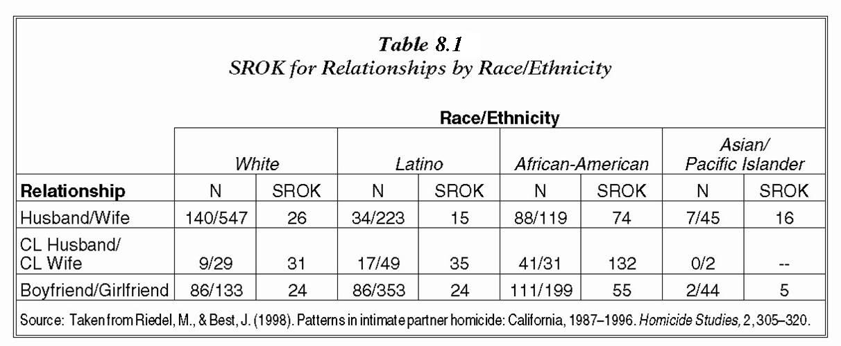
Sex Ratios of Killing (SROK) SROK = # of homicides committed by women per 100 homicides committed by men. Shows gender and cultural differences for intimate homicides Table should be 8.1, not 9.1 Also Table 8.2 next

Slide 7
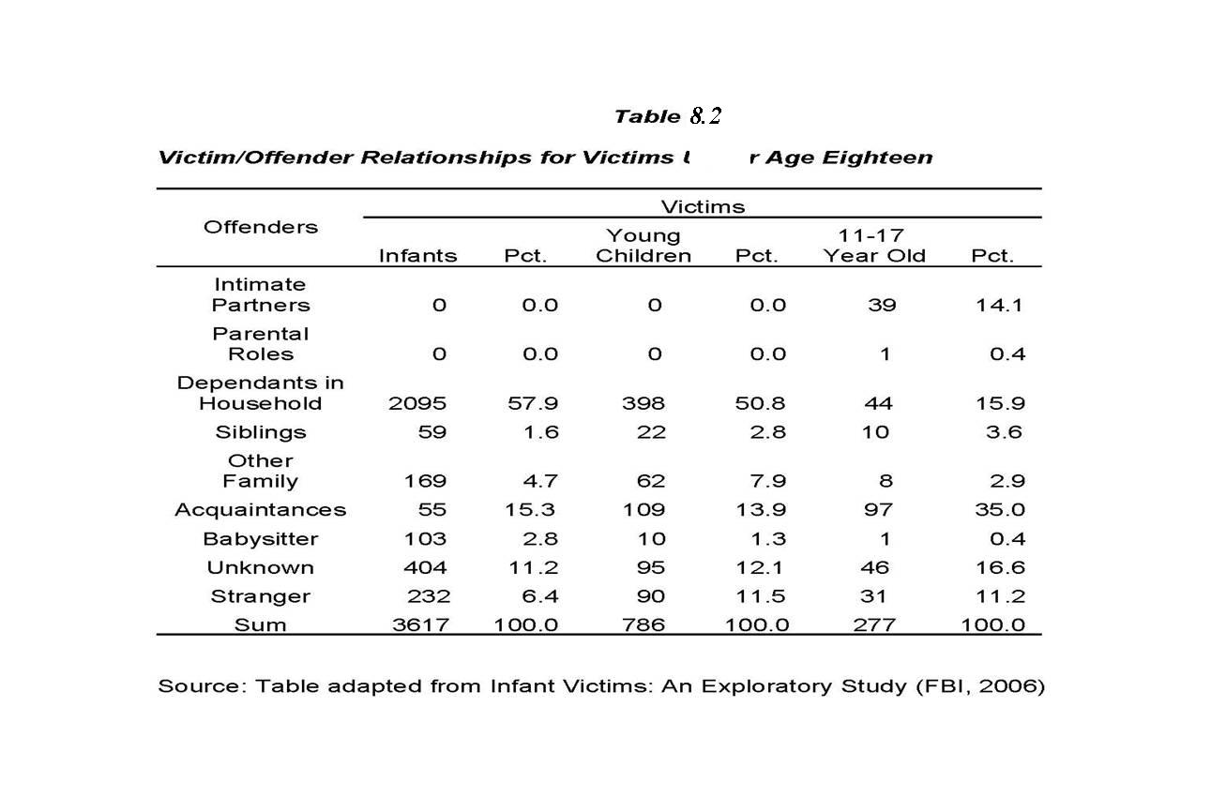
Violence Toward Other Family Members

Slide 8
Violence Toward Other Family Members (cont.)
Table 8.2 shows no frequencies for intimate partners or parents in violence toward infants
Should be viewed with caution as violence toward infants other than accidental is seriously underreported.
Conditions like Shaken Baby Syndrome difficult to diagnose
In general, the older the child, the more socially distant the relationship between victim and offender.

Slide 9
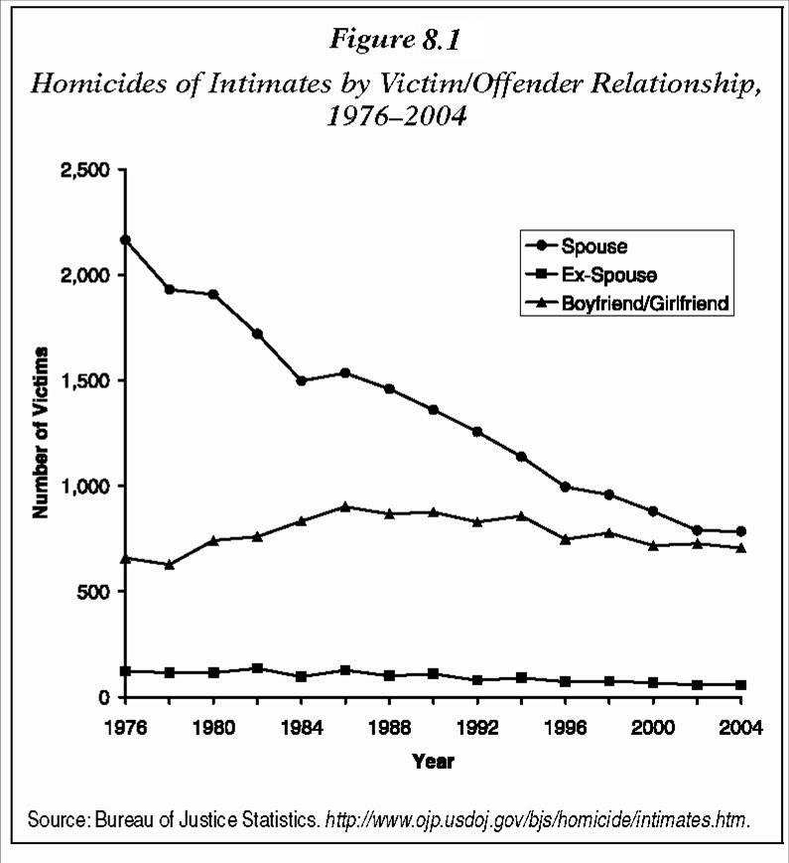
Figure 8.1: # of homicides involving intimate partners dropped significantly from 1976-2004 (spouses: -64%).
Notes:
Figure 9.1 should be Figure 8.1

Slide 10
Explanations
http://video.yahoo.com/watch/248639
Patriarchy (Feminist Theory)
Historical and physical advantages enjoyed by males facilitate greater power and control
Social Isolation
Economic Dependence
http://www.geocities.com/dvic2/wheel.html
Psychological problems (e.g., severe depression or mental illness)
Substance Abuse (strong correlation, but not a causal fact)
Social Learning
Cycle of Violence: childhood history of physical abuse predisposes the survivor to violence in later years.

Slide 11
OMIT THIS POWERPOINTWidom (2001): Cycle of Violence Updated
The “cycle of violence” hypothesis suggests that a childhood history of physical abuse predisposes the survivor to violence in later years.
http://www.youtube.com/watch?v=SPzVUGE3dds
The study followed 1,575 cases from childhood through young adulthood, comparing the arrest records of two groups:
Study group: 908 substantiated cases of childhood abuse or neglect processed by the courts from 1967 through 1971 and tracked through official criminal records over approximately 25 years
Comparison group: 667 children, not officially recorded as abused or neglected, matched to the study group according to sex, age, race, and approximate family socioeconomic status

Slide 12
Widom (2001): Cycle of Violence Updated (cont.)
OMIT NO 12 POWERPOINTAlthough many individuals in both groups had no juvenile or adult criminal record, being abused or neglected as a child increased the likelihood of:
Arrest as a juvenile (by 59 %)
Arrest as an adult (by 28 %)
Arrest for a violent crime (by 30%)
This study showed that victims of neglect were also likely to develop later violent criminal behavior.
If violence is begotten not only by violence, but also by neglect, far more attention needs to be devoted to the families of children who are abandoned and neglected.

Slide 13
Interventions
Criminal Legal Sanctions (e.g., mandatory arrest → deterrence?)
Batterer Treatment (e.g., anger control, awareness about power and control issues)
Evaluation results so far have been disappointing.
Civil Legal Sanctions (e.g., restraining orders)
Have not proven very effective in preventing violence

Slide 14
Interventions (cont.)
Exposure Reduction Theory
Factors that reduce exposure to violent relationships (e.g., higher divorce rate, lower marriage rate, greater economic independence of women) and provide alternatives to violence (e.g., shelters, hotlines, legal advocacy) have all helped to reduce domestic violence.

