Slide 1
Criminological Theory
The Search for the “Criminal Man”:
Competing Explanations and Solutions to the Problem of Crime

Slide 2
Theories and Theorists: The Early Years
Otherworldly Explanations for crime: spiritualism, and demonology
Classical Theories and theorists: Beccaria, Bentham, and Howard
Positivist Theories and theorists: Lombroso, Ferri, Garofalo, Goring, Hooton, Sheldon, and the Gluecks
Psychogenic Theories: Psychoanalytic theory (Freud), personality traits, IQ ( Binnet, Goddard),
Policy Debate: social Darwinism, eugenics movement, and positivist reform agenda—punishment vs. rehabilitation

Slide 3
Introduction
The search for explanations of criminal behavior is not easy because we constantly must guard against our biases, perceptions, and prejudices
Theories do influence the policies and practices found in criminal justice systems
Can lead to undesirable policies
Social context influences the explanations of crime

Slide 4
Bennett’s Crimewarps
Crimewarps (Bennett, 1987) was a study of what crime might look like during the next 20-50 years
Crimewarps refers to the bends in today’s trends that will affect the way we live tomorrow
The key point to take away from Crimewarps is that it is impossible to understand criminological theory outside of its social context (e.g., factors such as time and place)

Slide 5
Bennett’s Crimewarps
Crimewarps represents a set of major social transformations
For example, she predicted that the “traditional” poor, uneducated, young male criminal would be replaced by a “new” older, more upscale criminal
This has not generally been the case
Example of the difficulty in predicting crime trends accurately

Slide 6
Early Theories
Early theories of crime tended to locate the cause of crime not in demographic shifts, but rather within individuals– in their souls, their wills, or their body constitutions

Slide 7
Spiritualism
Stressed the conflict between absolute good and absolute evil; people who committed crimes were thought to be possessed by evil spirits (referred to as sinful demons)
To avoid family feuding, methods were constructed for dealing with those accused of committing crimes:
Trial by battle: Victory would go to the innocent
Trial by ordeal: Subject the accused to life-threatening or painful situations
Compurgation: Reputable people swear an oath the accused was innocent

Slide 8
Spiritualism
“Devil made me do it” explanations
When penitentiaries were constructed, they were thought of places thought of as places for penitents who were sorry for their sins
The major problem with spiritualistic explanations is that they cannot be tested scientifically or validated empirically

Slide 9
Naturalistic Explanations
Due to the inability to test spiritualistic theories scientifically, modern theory often rely on explanations based in the physical world, which are called, naturalistic explanations
Naturalistic theories and spiritualistic explanations have in common their origins in the ancient world
By focusing on the physical world of facts, naturalistic theories seek explanations that are more specific and detailed than natural explanations

Slide 10
Naturalistic Explanations
An early example of a naturalistic explanation is found in “Hippocrates’ dictum that the brain is the organ of the mind”
Naturalistic explanations persisted in spite of the spiritualistic perspective’s dominance, and by the 16th and 17th centuries, several scholars were studying and explaining humans in terms know to them

Slide 11
The Classical School: Criminal as Calculator
The most important feature of the classical school of thought is its emphasis on the individual criminal as a person who is capable of calculating what he or she wants to do (free will to do what they please)
Individuals were guided by a pain and pleasure principle calculating risks and rewards
The punishment should be suited to the offense
Basis of the U.S. legal system – equal treatment before the law

Slide 12
Cesare Bonesana Marchese de Beccaria
On Crimes and Punishment
Published anonymously due to fear of persecution from the monarchy
The social context of Beccaria’s life played a major role in his thinking
The criminal justice system of Beccaria’s Europe was planned to ruin citizens
Once arrested, the accused had few legal protections; once guilty, punishments were severe

Slide 13
Beccaria’s Argument
His argument can be summarized as the following:
To escape war and chaos, individuals gave up some of their liberty and established a contractual society
Because criminal laws placed restrictions on individual freedoms, they should be restricted in scope
The presumption of innocence should be the guiding principle in the administration of justice

Slide 14
Beccaria’s Argument (cont’d)
His argument can be summarized as the following:
The complete criminal law code should be written and should define all offenses and punishments in advance
Punishment should be based on retributive reasoning because the guilty had attacked another individual’s rights
The severity of the punishment should be limited and should not go beyond what is necessary for crime prevention and deterrence

Slide 15
Beccaria’s Argument (cont’d)
His argument can be summarized as the following:
Criminal punishment should correspond with the seriousness of the crime, the punishment should fit the crime, not the criminal
Punishment must be a certainty and should be inflicted quickly
Punishment should not be administered to set an example and should not be concerned with reforming the offender

Slide 16
Beccaria’s Argument (cont’d)
His argument can be summarized as the following:
The offender should be viewed as an independent and reasonable person who weighed the consequences of the crime
The aim for every good system of legislation was the prevention of the crime

Slide 17
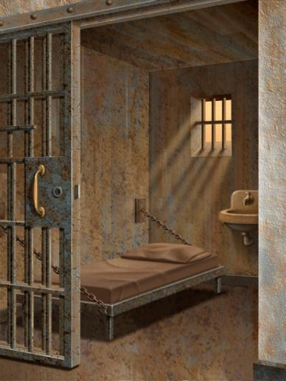
Other Scholars
Jeremy Bentham
Punishment should be a deterrent
Behavior is the result of free will and hedonistic calculus
John Howard
Credited with having influenced the passage of England’s Penitentiary Act of 1779

Slide 18
The Influence of the Early Scholars
Their ideas inspired revolutions and the creation of entirely new legal codes
The French Revolution of 1789 and the U.S. Constitution each was influenced by the Classical School
Still see calls for the law to be impartial and specific, for punishment to be for crimes instead of criminals, and the belief that all citizens should be treated fairly and equally

Slide 19
Problems with the Classical School
The argument that all criminal behavior could be explained by hedonism was weakening as the importance of aggravating and mitigating circumstances increased
The new laws did not provide for the separate treatment of children
The rather uncomplicated view of the rational man did not fully answer the question of what caused crime

Slide 20
The Positivist School: Criminal as Determined
The most significant difference between the classical school and the positivist school is the latter’s search for empirical facts to confirm the idea that crime was determined by multiple factors
The 19th century’s first positivists wanted scientific proof that crime was caused by features within the individual
Particularly the mind and body
Neglected social factors external to the person

Slide 21
The Birth of the Positivist School: Lombroso’s Theory of the Criminal Man
The modern search for multiple factor explanations of crime usually is attributed to Cesare Lombroso, the “father of modern criminology”
A “slave to facts”
For Lombroso, the objective search for explaining human behavior meant disagreement with free will and philosophy

Slide 22
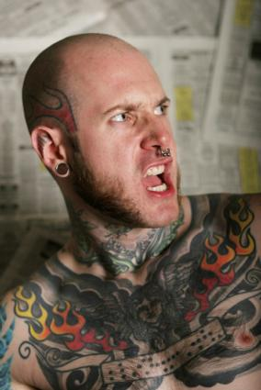
The Birth of the Positivist School: Lombroso’s Theory of the Criminal Man
Developed his interest in biological explanations when he was an army physician
Claimed diseases contributed to mental and physical deficiencies which could result in violence or homicide
Measured 3,000 soldiers to document physical differences
Role of tattooing as a distinguishing characteristic of criminals

Slide 23
On Criminal Man
Lombroso started to publish his research on the idea that biology could explain criminal behavior
By 1876, Lombroso published his findings in On Criminal Man, which contained not only a biological focus but an evolutionary one as well

Slide 24
Lombroso’s Central Tenet
Criminals represent a peculiar physical type distinctively different from that of noncriminals
Criminals represent a form of degeneracy that was manifested in physical characteristics reflective of earlier forms of evolutions
Big ears, sloping foreheads, long arms, receding chins, twisted noses
Criminals are atavistic, throwbacks from an earlier form of evolutionary life

Slide 25
Lombroso’s Criminals
Four major categories of criminals:
Born criminals: People with atavistic characteristics
Insane criminals: Idiots, imbeciles, paranoiacs, epileptics, and alcoholics
Occasional criminals/criminaloids: Explained by opportunity
Criminals of passion: Commit crime because of anger, love, or honor and are characterized by being propelled to crime by an irresistible force

Slide 26
Other Biological Explanations
Kaspar Lavater: Claimed that there was a relationship between facial features and behavior
Franz Joseph Gall: Argued that the shape of an individual’s head could explain his or her personal characteristics, also known as phrenology

Slide 27
Lombroso’s Contribution
Gave attention to a multiple-factor explanation of crime that included not only heredity, but also social, cultural, and economic variables
Credited with pushing the study of crime away from abstract meta-physical, legal, and juristic explanations of as the basis of penology “to a scientific study of the criminal and the conditions under which he commits crime”
Showed the importance of examining clinical and historical records
Took the topic of the causes of crime away from sin and placed it in the realm of science

Slide 28
Enrico Ferri
The Theory of Imputability and the Denial of Free Will
Attack on free will arguments and contained a theoretical perspective that was to characterize Ferri’s later work
Emphasized the interrelatedness of social, economic, and political factors that contribute to crime
Crime could be controlled by social changes (e.g., advocated subsidized housing, birth control, freedom of marriage, divorce, and public recreation facilities)

Slide 29
Ferri’s Political Life
After nearly 50 years as a socialist liberal, Ferri changed his philosophy and endorsed fascism as a practical approach to reform
Reaffirmed the state’s authority over excessive individualism
Individuals must be legally responsible for their actions instead of morally responsible to God
Made a call for the state to act “scientifically” in matters of social policy

Slide 30
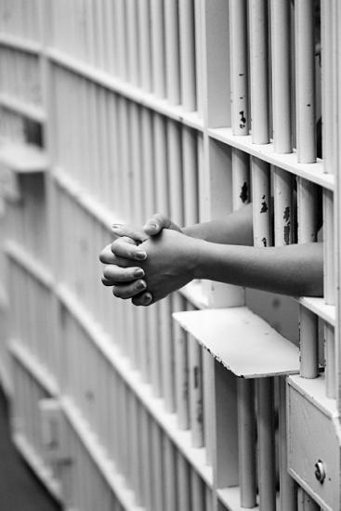
Ferri’s Classes of Criminal
The born or instinctive criminal
The insane criminal
Clinically defined as mentally ill
The passion criminal
Crime was the result of prolonged or chronic mental illness or an emotional state
The occasional criminal
Product of family and social conditions
The habitual criminal
Acquired the habit from the social environment
The involuntary criminal

Slide 31
Raffaele Garofalo
Last major contributor to the positivist or Italian school of criminology
Pursued practical solutions to concrete problems located in the legal institutions of his day
His theoretical arguments on the nature of crime and on the nature of criminals were consistent with social Darwinism
The rules of nature were the rules of right conduct revealed to humans through their reasoning

Slide 32
Raffaele Garofalo
Identified acts that no society could refuse to recognize as criminal and repress by punishment
The acts violated two basic human sentiments that appear in “all civilized society” : Probity and Pity
Pity: The sentiment of revulsion against the voluntary infliction of suffering on others
Probity: The respect for the properties of others

Slide 33
Raffaele Garofalo
True criminals had psychic or moral anomalies that could be transmitted through heredity
Lacked properly developed altruistic sentiments
Four criminal classes:
Murderers: Totally lack pity and probity
Lesser criminals: Lack either pity or probity
Violent criminals: Lacked pity
Thieves: Lacked probity
Cynics or sexual criminals: Some classified among violent criminals because they lack pity

Slide 34
Raffaele Garofalo
Because true criminals’ actions reveal an inability to live by the basic human sentiments necessary for a society to survive, they should be eliminated
Their deaths contribute to the survival of society
For lesser criminals, he proposed that elimination take place in the form of life imprisonment or overseas transportation

Slide 35
Raffaele Garofalo
Favored “enforced reparation” and indeterminate sentencing
Individuals represent but a cell in the social body that could be exterminated without much loss to society
Willing to sacrifice individual rights to the opinions of “scientific experts”

Slide 36
Goring
The work of the Italian positivists suffered from methodological research problems
Attempted to resolve this problem with his study of 3000 English convicts and a control group of non-convict males
Concluded that there were no significant differences between criminals and noncriminals except for stature and body weight
Criminals slightly smaller
Claimed criminals were biological inferior but did not find a physical criminal type

Slide 37
The Continuing Search for the Individual Roots of Crime
Kretschmer’s study identified four body types
Asthenic: Lean and narrow
Athletic: Muscular and powerful
Pyknic: Soft and stubby
Mixed unclassified types
Asthenic and athletic builds were associated with schizophrenic personalities, whereas the pyknics were manic depressives

Slide 38
Mohr and Gundlach
Found that pyknics were more likely than asthenics or athletics to have been convicted of fraud, violence, or sex offenses
Asthenics and athletics were more likely to have been convicted of burglary, robbery, or larceny

Slide 39
Ernest A. Hooton
Harvard anthropologist
Examined more than 17,000 criminals and noncriminals
Criminals are inferior to civilians in nearly all of their bodily measurements
Low foreheads indicated inferiority and “a depressed physical and social environment determines Negro and Negroid delinquency to a much greater extent than it does in the case of Whites”

Slide 40
William Sheldon
Shifted attention away from adults to delinquent male youths
Two hundred males between ages 15 and 21 years of age
Produced an Index to Delinquency to measure problems
A score of 10 was the most severe and required institutionalization

Slide 41
William Sheldon
Classified physiques into three categories:
Endomorphy: Soft and fat
Mesomorphy: Muscular and athletic
Ectomorphy: Skinny and flat
Concluded the factors that produce delinquency were inherited

Slide 42
Sheldon and Eleanor Glueck
A comparative study of male delinquents and nondelinquents
The delinquents were found to have narrower faces, wider chests, larger and broader waists, and bigger forearms and upper arms
Most delinquents were mesomorphic (≈ 60%)
These findings neglected the importance of sociological phenomena

Slide 43
Psychogenic Causes of Crime
The psychogenic school seeks to explain crime by focusing attention on the personality and how it was produced
This school of thought developed along two distinct lines
Psychoanalysis
Personality traits

Slide 44
Psychoanalysis
Based off of Freud’s work
Tensions exist between the unconscious id, which is a great reservoir of aggressive biological and psychological urges, and the conscious ego, which controls and molds the individual
The superego is the force of self-criticism that reflects the basic behavioral requirements of a particular culture

Slide 45
Psychoanalysis
Crime is a symbolic expression of inner tensions that each person has but fails to control
Crime results when the ego and/or superego fail to develop or a delinquent ego forms

Slide 46
Personality Traits
The search for personality traits was started by attempting to explain mental faculties biologically
Feeblemindedness, insanity, stupidity, and dull-wittedness were thought to be inherited
The Jukes
The Kallikak Family

Slide 47
IQ
Alfred Binet first pursued intelligence testing in laboratory settings
With Theodore Simon, Binet revised his IQ tests and concluded that individuals should have a mental age that could be identified with an intelligence quotient or IQ score
Through the administration of the IQ test, Goddard concluded that most inmates (29%-89%) were feebleminded

Slide 48
The Positivist School and the Control of the Biological Criminal
The most obvious orientation displayed by positivists was their placement of the causes of crime primarily within individual offenders
Many of the theorists were trained in medicine, law, or both

Slide 49
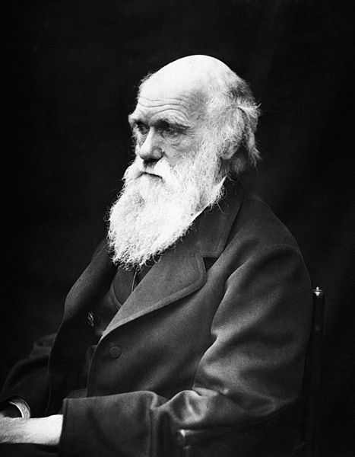
Social Darwinists
Social Darwinists generally agreed that the theory’s policy implications were politically conservative
It was argued that any policies that advocated government sponsored social change would be an interference with nature
“Let nature take it’s course”

Slide 50
Scientifically Justified Forms of Control
The “born criminal” legacy produced a penal philosophy that stressed incapacitation
Remove offenders from the community
Rehabilitation was based on medical reasoning that viewed individuals as biological objects that needed treatment
This allowed some of the most repressive state policies in the history of American penology (e.g., eugenics)

Slide 51
Eugenics Movement
The study of eugenics claimed that inheritance could explain the presence of simple and complex human behavioral characteristics
It reinforced ideas of biological determinism
Between 1911-1930, more than 30 states established laws requiring sterilization for behavioral traits thought to be determined genetically

Slide 52
Eugenics Movement
Many states passed laws permitting psychosurgeries, including the frontal lobotomy
Allowed for the introduction of miscegenation laws and the Immigration Restriction Act of 1924
The practices of sterilization and psychosurgery continued in the U.S. until the 1970s
The real reason for sterilization was not feeblemindedness, but rather class

Slide 53
The Positive School and Criminal Justice Reform
The positivist school helped usher in an approach to policy that was reformative rather than punitive
As biologically oriented theories began to diminish, new approaches argued that the troubles of criminals could be rectified through counseling or by fixing the social environments
Drew from sociology and psychology

Slide 54
The Positive School and Criminal Justice Reform
Reformers, called Progressives, argued that the system should be arranged not to punish offenders but rather rehabilitate them
More indeterminate sentencing
Parole boards
Probation implemented widely
Individual treatment of offenders
Establishment of a separate juvenile court system

Slide 55
The Positive School and Criminal Justice Reform
Controversy exists whether the policies instituted in the name of rehabilitation made the criminal justice system more humane or more repressive
DNA technology now allows the storing of genetic footprints
Ruled a violation of human right to privacy in Britain

Slide 56
Conclusion
Criminology is not a value-free, objective science
Theorists can attribute or project their own perceptions onto criminals
One of the most important tasks for criminologists is to expose, critique, and condemn such usage wherever it is found

