Slide 1
The Measurement of Crime
UCR
Victimization surveys
Self-report data

Slide 2
Official Crime Data: UCR
Begun in 1930’s
The U.S. Department of Justice instituted the compilation (by FBI) and publication
FBI receives data from more than 17, 000 state, county, city law enforcement agencies (voluntarily)
Coverage: 90% in cities, 87% in rural areas

Slide 3
Relationship b/w crimes committed and official statistics
Crimes Committed Undiscovered
Crimes Discovered
Crimes Reported
Crimes Recorded

Slide 4
Structure of UCR
Index Crimes (“Part I”)
Murder
Forcible rape
Robbery
Aggravated assault
Burglary
Larceny-theft
Motor vehicle theft
Arson
Non-Index Crimes (“Part II”)
Simple assault
Forgery
Fraud
Embezzlement
Buying, receiving, and possessing stolen property
Carrying/possessing weapons
Prostitution
Sex offences Drug use violation
Gambling
Offense against family/children

Slide 5
UCR tabulates
The number of offenses
The offense rate per 100,000 population
The percentage change from the previous year
The offense rate by region (South, North, Midwest, Northwest)
The nature of the offense (age, gender, race of offenders and victims)
The arrest (or clearance) rates of offenses

Slide 6
UCR provides data
Crime rates for individuals states, cities, and towns of varying size
Crime rate =(number of crimes*100,000)/population
http://www.fbi.gov/ucr/ucr.htm

Slide 7
Example

Slide 8
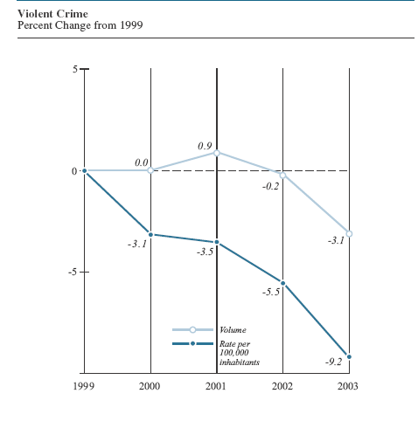

Slide 9
Assessment of UCR data
Unknown, probably massive amount of crime that goes unreported to the police (“dark figure” of crime)
Participation in the UCR is voluntary, not all police departments send crime reports to the FBI
UCR does not include federal crimes (blackmail), white collar crimes

Slide 10
Assessment of UCR data
In any single event, the most serious crime is reported (”hierarchy rule”)
The UCR’s Crime Index Total misrepresents the crime rate at any given year
Decrease in the number of larcenies cancels out an identical increase in the number of homicides (constant crime rate)

Slide 11
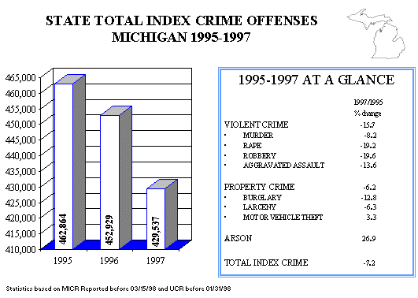

Slide 12
Assessment of UCR data
UCR data are, more valid indicators of the behavior of the police than of offenders (Barkan, 1999)
Decision whether to record
Do not believe the victim’s account (Block, 1990)
May be busy to do the paperwork to record it (especially if the crime is not serious)
If there is no record = there is no crime

Slide 13
Assessment of UCR data
Police departments have a dilemma (more crime=more resources, less crime=good work)
Poor, nonwhite males are more likely to be arrested
Public is more likely to report
Research suggests that police personnel and funds are concentrated in nonwhite poor neighborhoods (more arrests in these areas)
Arrest data gives a distorted picture of the “typical offender”

Slide 14
Assessment of UCR data
Official number of crimes might change artificially (citizens become more or less likely to report offenses committed against them)
Example: increased number of reported rapes in the last two decades partly reflect growing awareness by women and police

Slide 15
Assessment of UCR data
Police in various communities have different understanding and definitions of crimes
One study found that Los Angeles police recorded any attempted or completed sexual assault as rape, while Boston police recorded a sexual assault as a rape only if it involved completed sexual intercourse (Chappell, 1980)
Result: Boston’s official rape rate was much lower than that for Los Angeles

Slide 16
National Incident - Based Reporting System (NIBRS)
Information on each incident and arrest
More crimes: blackmail, embezzlement, drug offenses
Gather more detailed information for Part I and Part II Crimes
Relationship b/w offenders and victims
Use of alcohol immediately before the offense

Slide 17
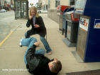
The National Crime Victimization Survey (NCVS)
Begun in early 1970’s to avoid the police reporting problems and bias
Provide more detailed information than UCR
Context of crime such time of day and physical setting in which it occurs
Characteristics of crime victims (gender, race, income, age, extent of injury, and relationship with their offenders)
Characteristics of the offenders
Whether victimization has been reported to the police

Slide 18
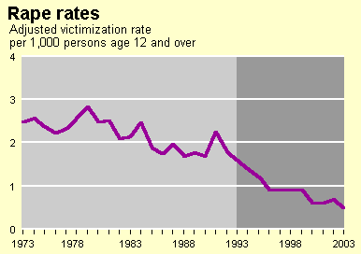
Victimization data

Slide 19
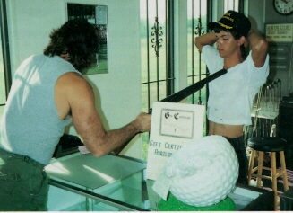
The National Crime Victimization Survey (NCVS)
Every six months the Census Bureau interviews about 110,000 residents
age 12 and older
50,000 randomly selected households
Aggravated and simple assault, rape and sexual assault, robbery, burglary, larceny-theft, motor vehicle theft
No homicide, arson, commercial crimes, white collar crimes
Crimes are described to respondents

Slide 20
NCVS provides data
Only 39% percent of all NCVS crimes were reported to the police
Males have higher victimization rates then females for all violent crimes except rape/sexual assault
African Americans had higher violent victimization rates than whites or other races
Females and African Americans were more likely to report a crime to police than were males and whites

Slide 21
Do rape victims know their offenders?
For both completed and attempted rapes, about 9 in 10 offenders were known to the victim (boyfriend, ex-boyfriend, classmate, friend, acquaintance, or coworker)

Slide 22
When does sexual victimization occur?
The vast majority of sexual victimizations occurred in the evening (after 6 p.m.).
51.8 percent of completed rapes took place after midnight, 36.5 percent occurred between 6 p.m. and midnight, and only 11.8 percent took place between 6 a.m. and 6 p.m.

Slide 23
Where does sexual victimization occur?
60% of the completed rapes that occurred on campus took place in the victim's residence
31% occurred in other living quarters on campus
10.3% took place in a fraternity.
Off-campus sexual victimizations, also occurred in residences
Incidents also took place in settings such as bars, dance clubs or nightclubs, and work settings.

Slide 24
Do women report victimization incidents to the police?
Few incidents were reported to the police
In about two-thirds of incidents, the victim did tell another person about the incidents (most often to a friend)
Reasons for not reporting: incident was not serious enough or it was not clear that a crime was committed
Lack of proof, fear of reprisal by the assailant, fear of being treated with hostility by the police

Slide 25
UCR and NCVS
UCR data are based on reported criminal acts (offender characteristics)
NCVS data based on individuals actually victimized (characteristics of victims)

Slide 26
Assessment of NCVS
Document a massive amount of crime that goes unreported
Underestimate crime rate
Insignificant crimes tend to be forgotten
Victims of several crimes may also forget about all the crimes
Females do not report victimization if her abuser live in the same household
Whites and college graduates are more likely to report being victimized

Slide 27
Assessment of NCVS
NCVS respondents are interviewed every six months (7 interviews)
Reported victimization rates usually decease with each interview (awareness of victimization)
Overestimation of some crimes
Respondents might mistakenly interpret some noncriminal events as crimes
“Telescoping “ effect

Slide 28
Self-reports data
Created to complement UCR and NCVS
Interviews or questionnaires
Demonstrate the prevalence of offending (the proportion of respondents who have committed a particular offence)
Incidence of offending (the average number of offences per person in the study)

Slide 29
Samples for self-reports
Adult inmates of jails and prisons
Adolescents, usually high school students
The most important finding: delinquency is very common
Middle-class youth commit as much crime as working-class youth
Testing criminological theories (Example of NYS)

Slide 30
Assessment of self-report studies
Focus on minor and trivial offenses (truancy, running away from home, minor drug and alcohol use)
Although recent studies (NYS) asked subjects about rape and robbery
Respondents might not to tell the truth (reliability issues)

Slide 31
If respondents lie….
Self-report data can be checked against police records, school records, interviews with teachers and parents
The use of, or threat of , polygraph validation (20% change their initial responses when threatened with a “lie detector”)
Subsequent interviewing of subjects permits probing regarding the details and context of acts
Use of “lie scales”

Slide 32
Example of lie scale
I always tell the truth
Sometimes I tell lies
Once in a while I get angry
I never feel sad
Sometimes I do things I am not supposed to do
I have never taken anything that did not belong to me

Slide 33
Assessment of self-report studies
Several self-report studies included only boys (no female offending data)
Overestimation of some crimes
Ignore white collar crimes

Slide 34
UCR, NCVS, and self-reports
None of the three is perfect
For the best estimates of the actual number of crimes, NCVS data are preferable
For the best estimates of offender characteristics, self-reports and NCVS are preferable
UCR are superior for understanding the geographical distribution of crime

Slide 35
