Slide 1
44.390: Research Methods Week 1: Thinking critically about crime & criminal justice
Professor James Byrne
School of Criminology and Justice Studies
UML

Slide 2
Opening Question: How would you define assault in prison setting?
Week 2: Thinking critically about crime and criminal justice
Choose a criminal justice intervention to focus on for assessment.
Available topics include:
Prison assault/violence reduction strategies
Justice reinvestment
Treatment programs for substance abuse in institutional vs. community settings
Juvenile boot camps: targeting at-risk youth vs. known delinquents
CCTV
Drug courts
Hotspots policing
Electronic monitoring of sex offenders
Reentry programs
Probation

Slide 3
Readings
Require textbook:
Maxfield, M.G. & Babbie, E.R. (2012). Research Methods for Criminal Justice and Criminology (7th Edition). U.S.: Cengage.
Weekly readings –
Week 1: Chapters 1 & 2
Week 2: Chapter 4
Week 3: Chapters 5 & 6

Slide 4
By next week
Choose your CCJ intervention
Explain why you’ve chosen it
Start discussing research questions for assessment 1
What is a researchable question?
Where to start to looking for information

Slide 5
Overview of Presentation
Some Thoughts on Performance Measurement Evidence-based Research Reviews: Separating Science from Non-science (or nonsense)
Emerging Trends and New Directions

Slide 6
Thoughts on the Performance of Corrections Programs
Most research studies measure the effectiveness of corrections programs by examining recidivism during a specified follow-up period (1 year, 2 years, 3 years).
Only a subgroup of these studies meet minimum quality review standards.
There is a debate about what we can conclude about correctional performance based on a review of these studies.
Some argue that a number of high performance corrections programs can be identified, while others that the vast majority of corrections programs perform poorly.
Who is correct?

Slide 7
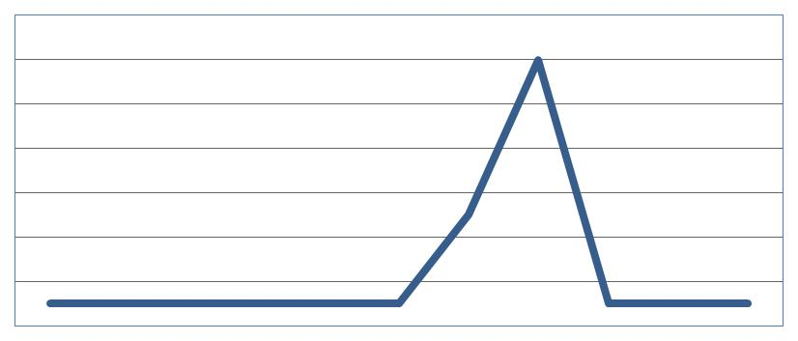
Some thoughts on Performance: A Shark fin Graph would fit if most Criminal Justice Programs were successful

Slide 8
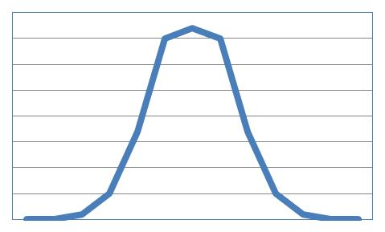
But It is Possible that the Distribution Looks More Like a Bell-Shaped Curve

Slide 9
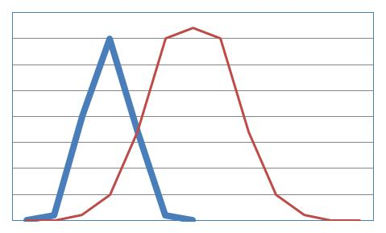
Some Argue that Most Criminal Programs are Actually Unsuccessful

Slide 10
Measuring Performance and Identifying High Performance and Low Performance Corrections Programs is a Challenge
Most corrections programs do NOT get evaluated.
Consider Drug Courts: There are over 1,600 adult drug courts currently operating in the United States, but only 92 have been formally evaluated using minimum review standards; only 3 of these evaluations were experiments.
The situation is even worse in the area of probation: despite the fact that we have over 4 million offenders on probation, only a handful of research studies (and 1 experiment) have been conducted over the past thirty years.
Because of this research shortfall, it is currently impossible to identify and rank the performance of various corrections programs.

Slide 11
The Use and Misuse of Systematic Evidence-based Reviews
Before we can conduct an evidence-based review, we need evidence.
Unfortunately, the necessary quality evaluation research on the effectiveness of specific corrections programs has not been completed.
Legislators and Policy-makers have embraced the concept of evidence-based practice, and many academic researchers have tried to tell them the truth: the effects of most correctional intervention—in both prison and community settings—are currently unknown.
However, other academics have jumped on the evidence-based bandwagon and told these same legislators what they think they want to hear: we know what works, with whom, and why.

Slide 12
Research Design—What are we researching?

Slide 13
How to ask the RIGHT questions: Reading, Reviewing, and Writing your research questions
Step 1: Choose a topic
Step 2: Find the research
Step 3: Systematically Review the Research
Step 4: Select a research question in your topic area

Slide 14
Step 1: Choose a Topic
Available topics include:
Prison assault/violence reduction strategies
Justice reinvestment
Treatment programs for substance abuse in institutional vs. community settings
Juvenile boot camps
CCTV
Drug courts
Hotspots policing
Electronic monitoring of sex offenders
Reentry programs
Probation

Slide 15
Step 2: Find the research
Where to look? Lets start with a review of the top three tier 1 journals in criminology over the past 10 years( 2004-2014):
Criminology
Criminology and Public Policy
Justice Quarterly

Slide 16
Step 3: Systematically Review the Research
Two types of reviews:
Systematic, evidence-based reviews of all studies during a wide review period.
REA: Rapid Evidence Reviews focusing on a subset of all studies during a narrow review period
Website for systematic evidence based reviews: Campbell Collaborative webpage and CrimeSolutions.gov

Slide 20
Systematic Evidence-based Reviews of Corrections Research Underscore the Need for More—and higher quality—Evaluation Research
Campbell Collaborative Reviews have only been conducted on a small number of corrections programs.
These reviews utilize a relaxed review standard to assess what works, what doesn’t work, what is promising, and what is unknown.
If you used the same Gold standard ( at least two experiments) employed in the hard sciences and medicine, we would have very little to say about corrections program performance.
Lets take a closer look on how these reviews are conducted.

Slide 21
How to Conduct a Systematic, Evidence-based Review?
THE EIGHT STEPS OF A C2 REVIEW
Formulate Review Question
Define Inclusion/Exclusion Criteria
Locate Studies
Select Studies
Analyze Study Quality
Extract Data
Analyze and Present Results
Interpret Results

Slide 22
What is Evidence-based Practice?
It is the development and implementation
of programs based on a systematic review of “what works”
There are three basic approaches to Evidence-based practice

Slide 23
What is Evidence-based Practice? (Con’t)
Examples:
The systematic reviews conducted by the Campbell Collaboration Crime and Justice Group (Sherman et. al, 2005; Sherman, et. al, 1997)
The systematic reviews using meta-analytic methods including experimental and quasi-experimental research (Gendreau, et. al, 1990)
Strategy 1: Conduct a comprehensive
review of all available
research on a particular
topic

Slide 24
What is Evidence-based Practice? (con’t)
e.g. Farrington and Welsh’s recent
review of all randomized experiments
(2005)
Strategy 2: Examine only a subset of all
available research studies,
using randomized field
experiments as the
“Gold Standard”

Slide 25
What is Evidence-based Practice? (con’t)
Reexamine/reposition scientific reviews
Only include a subset of all available research, often supporting either liberal or conservative ideology (Farabee, 2005; Cullen, 2002)
No specific identification of review procedures, inclusion/exclusion criteria, etc.
Strategy 3: Conduct a nonscientific review,
simply say “evidence based”,
and then offer your own listing
of best practices.

Slide 26
What Review Criteria are Used in The Campbell Collaborative Systematic Reviews?

Slide 27
Study Inclusion Criteria For Systematic Reviews
The scientific methods scale ranks evaluation studies from 1=weakest to 5=strongest on overall internal validity:
What Works: For a program to be classified as working, there must be a minimum of two level 3 studies with significance tests showing effectiveness and the preponderance of evidence in the same direction.
What Does Not Work: For a classification of not working, there must be a minimum of two level 3 studies with significance tests showing ineffectiveness and the preponderance of evidence in the same direction.
What is Promising: For the classification of promising, at least one level 3 study is required with significance tests showing effectiveness and preponderance of evidence in support of the same conclusion.
What is Unknown: Any program not classified in one of the three above categories is considered to have unknown effects.
Source: Welsh and Farrington, (2003: 169-170)

Slide 28
The evidence in favor of rehabilitation:
Found in systematic reviews of correction research
that estimate that the provision of treatment (in
sufficient dosages and duration) is cost-effective
and results in modest offender change (10%
reduction).
The evidence opposed to rehabilitation:
Found in these same systematic reviews, which
reveal that the vast majority of individual research
studies do not find statistically significant
differences between experimental and control
groups in recidivism.

Slide 29
Evidence-Based Reviews in Adult Corrections: A Look at the Campbell Collaborative Collection
Prison-related Topics:
2 reviews:
Effects of Cognitive-Behavioral Programs for Criminal Offenders:
by: Mark W Lipsey, Nana A. Landenberger, Sandra Jo WilsonPublished: 13.08.2007 Studies: 58 research studies, including 13 well designed experiments, 6 in real world settings. Key Finding: 10% absolute overall reduction in recidivism( .40 vs. .30)
The Effectiveness of Incarceration-Based Drug Treatment on Criminal Behavior:
by: Ojmarrh Mitchell, Doris Layton MacKenzie,
David Wilson Published: 16.10.2006 Studies: 53 research studies, but many were methodologically weak; 20 studies post 1999. Key Finding: 7% absolute overall reduction in recidivism( .35 vs. .28)
2. Jail-related Topics: no reviews

Slide 30
Key Study Findings: The effectiveness of drug treatment varied by type of treatment
Boot camps aimed at drug involved offenders were ineffective in reducing re-offending and drug relapse.
Narcotic maintenance programs did not exhibit reductions in re-offending or drug use, but the evidence in this area was scant.
Group counseling programs exhibited reductions in re-offending but not drug use.
Therapeutic communities (TCs) exhibited the strong and consistent reductions in drug relapse and recidivism.

Slide 31
3. Sentencing Topics: 3 Reviews:
Domestic Violence Interventions:
by Lynette Feder, Sabrina Austin, David Wilson Published: 30.08.2008
Studies: a total of four experimental studies and six quasi-experimental studies were identified as meeting the eligibility criteria.
Key Finding: While additional research is needed, the meta-analysis does not offer strong support that court-mandating treatment to misdemeanor domestic violence offenders reduces the likelihood of further reassault.
The Effects of Custodial vs. Non-Custodial Sentences on Re-Offending:
byMartin Killias, Patrice Villettaz, Isabel ZoderPublished: 30.11.2006
Studies: 23 studies met review criteria, including 5 experiments
Key Finding: Noncustodial interventions fared better overall, but no difference in subgroup of 5 experiments
Boot camps: David Wilson, Doris Layton MacKenzie, Fawn Ngo MitchellPublished:10.07.2005
Key Finding: No Effect; Issue: did results vary by type of boot camp?
4. Community corrections topics:
Traditional Probation: no reviews
Intensive Probation Supervision: no reviews
Day Reporting Centers: no reviews
Community Service: no reviews
Reentry: no reviews
Residential Community Corrections: no reviews
Electronic Monitoring/ House Arrest; 1 protocol by Marc Renczemma

Slide 32
Evaluation Research On Electronic Monitoring: A Technology in Search of a Program
Evidence-based review
Renzema and Mayo-Wilson(2005) reviewed over 119 studies of the effects of electronic monitoring programs, but only 19 of these studies met even minimum review standards( 7 focused on low risk and 12 on high risk offenders). Findings were inconclusive and the authors recommend that we consider other options.
New Quasi-experimental Research
On the impact of electronic monitoring in Florida by Bales( 2010) reveals that electronic monitoring (both GPS and RF) had a significant recidivism reduction effect.

Slide 33
Review of non-custodial employment programs: Impact on recidivism rates of ex-offenders Christy A Visher, Mark B Coggeshall, Laura Winterfield03.07.2006
Studies: 8 experimental studies were identified; mostly pre-2000.
Findings: The analyses show that employment-focused interventions for ex-offenders in these studies did not reduce recidivism.
Limitation: this group of random assignment studies is highly heterogeneous both in the type of employment program delivered and the individuals enrolled in the program.
Targeting: Do high risk offenders skew findings?
Policy Issue: Triggering and Employment

Slide 34
Evaluation Research on Treatment in Institutional and Community Settings
Prison Treatment
Several studies reveal significant, but modest reductions in subsequent recidivism( 10% during 1 year following release) among offenders receiving various forms of treatment-related programs while in prison.
Community Treatment
Similar findings reported for offenders receiving treatment for drug problems in community settings.
These findings have been questioned by critics who point out that the majority of programs showing positive effects were conducted by the program developer.

Slide 35
Current evidence-based reviews highlight the limitations inherent in offender-based change strategies:
Only incremental, short-term changes in offender behavior should be expected from the full implementation of evidence-based practices in adult and juvenile corrections.
Even this limited finding only applies to a handful of institutional and community-based corrections programs, because the necessary research has yet to be conducted.
If we are interested in long-term offender change, we need to focus our attention on the community context of offender behavior
There is a growing body of research on the need to integrate individual and community-level change strategies (Sampson, et. al. 2005; Bursik, 2005; Carr, 2003).
However, we know very little about the effectiveness of community change strategies.

Slide 36
Next Steps: Do the Research Identify High Performance Programs, and Share the Results with Policy makers and the Public
We need to measure the performance of a broad range of corrections programs currently operating in both institutional and community-based settings.
Once a sufficient number of evaluations have been completed, evidence-based reviews of the research should be completed, using the gold standard for review.
Using these reviews, we need to publicly identify both high performance and low performance correctional programs.
It can be done: a review of the recent advances in medical research on Cystic Fibrosis, various forms of Cancer, and other serious life threatening illnesses underscores this point.

Slide 37
Emerging Trends and New Directions for Corrections
Trend 1
Justice Reinvestment: There is an emerging consensus that we need to reallocate correctional resources in ways that maximize community safety and minimize cost.
Research Need
Can the impact of Justice reinvestment strategies be estimated using simulation modeling techniques?
Should we target resources on high risk offenders, high risk locations, and high risk times( for re-offending)?
What is the role of technology—and the private sector-- in offender targeting, offender location, offender control, and offender change?
How can technology be used to manage low risk offenders?

Slide 38
Emerging Trends and New Directions
Trend 2
Offender change is possible, but not probable, without community change.
Recognition of the limitations of individual level change strategies. We can not expect to change offenders unless we also change the communities where offenders reside.
Research Need
What would a treatment-oriented prison and community corrections system look like?
What new classification and treatment technology will be needed?
How can we use technology to assess the community context of crime?

Slide 39
Emerging Trends and New Directions
Trend 3
Performance Measurement is the first step toward an evidence-based corrections system
New recognition that correctional performance matters and that we can do better.
Research Need:
How should the performance of institutional and community corrections systems be measured?
Can high performing( positive deviants) and low performing institutional and community corrections programs be identified?

Slide 40
Emerging Trends and New Directions
Trend 4
Supervision in cyberspace: New recognition of the fundamental change in social interactions due to the popularity of internet social networking sites.
Technology Need
How will we monitor offenders activities on these sites?
Do we need new software to monitor offenders or do we ask community corrections officers to monitor offenders directly by accessing these sites?
How will the emergence of cloud technology affect the internet behavior of offenders?

Slide 41
Emerging Trends and New Directions
Trend 5
The New technology of offender change: Emerging recognition of the limitations of control-focused community control strategies, that do not provide adequate treatment opportunities and recognize the importance of informal social controls.
Research Need
What will persuasive technologies designed to motivate offenders to change look like?
How can electronic monitoring systems be redesigned to support offender change?

Slide 42
Emerging Trends and New Directions
Trend 6
Serendipity
Searching for the floppy eared rabbit
The private sector keeps on finding new applications for existing technology.
Research Need: Public-Private Partnerships
Example: How can technology used to create fraud alerts and/or find people we’ve lost contact with be adapted to monitor the activities of parolees in general or registered sex offenders in particular?

