Slide 1
Can global corrections performance measures be developed? Lessons from Australia
Professor James Byrne
Director, Global Centre for Evidence-based Corrections and Sentencing (GCECS)
School of Criminology and Criminal Justice, Griffith University
Dominique de Andrade, Post-doctoral Research Fellow, GCECS
Jessica Ritchie, Research Fellow, GCECS
2nd International Conference on Governance, Crime and Justice Statistics, Mexico City, 18-21 June 2014
Notes:
Abstract: Recently, Australian Corrections agencies have made a decision to shift their focus towards results-driven corrections management, which has required the development of concrete measures of both correctional efficiency and effectiveness. There is much to be learned by looking closely at Australia’s attempt to measure and rank the performance of its institutional and community corrections system across states.
We report the findings from a national performance review of the corrections systems in the eight states and territories of Australia. Measures of efficiency, effectiveness, and outcome performance were constructed, and analysed, using available agency-level data. Each state's corrections system - both institutional and community corrections-- was then ranked, and both high performance and low performance state corrections systems were identified.
Findings show agencies that are high performing on efficiency measures are generally low performing on effectiveness measures and vice versa. The limitations of current performance measurement strategies are discussed, and next steps in both national (Australia-specific) and global corrections performance measurement are identified, including the need for more comprehensive and appropriate national and global measures.

Slide 2
(1) High Quality Corrections and Sentencing Research Agenda- the Centre will develop research projects focusing on evaluating the impact of current corrections and sentencing strategies (adult/juvenile) in Queensland, throughout Australia, and internationally.
(2) Knowledge Exchange Seminars and Systematic, Evidence -based Policy Reviews -To translate research into practice, the Centre will develop a series of executive session seminars and workshops highlighting corrections and sentencing issues in each global region.
(3) Global Evidence-based Corrections and Sentencing Network Development: The Centre—through the Centre’s state of the art website-- will become a global clearinghouse for high quality, evidence-based corrections research, and a primary source of information on global corrections performance, and innovative corrections and sentencing policies and practices.
WEBPAGE: WWW.GCECS.EDU.AU

Slide 3
Balancing Efficiency & Effectiveness
If you don’t define what performance is, then someone else will define it for you.
Case in point: Lets look at the Performance Measures for Australian Corrections included in the recent review: Government Services 2013
In Australia, corrections performance is monitored across the eight Australian States/territories in the following areas:
Efficiency, Equity, Outputs, and Outcomes
Utilizing these data elements, an overall performance ranking of each Australian state/territory’s corrections system is possible.

Slide 4
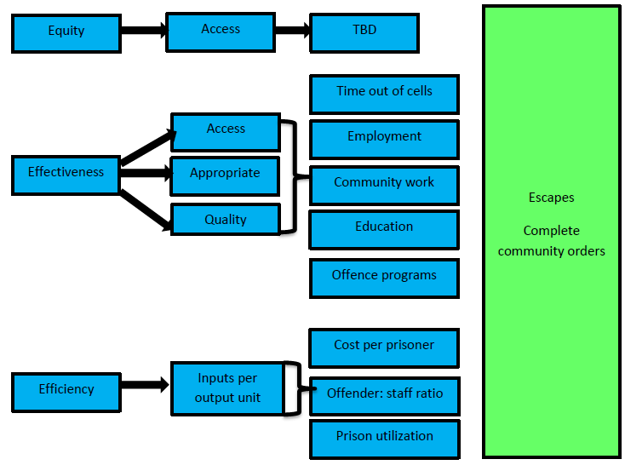
Corrective services performance indicator framework

Slide 5
Equity as a Performance Measure
Indicator of Access to Appropriate Correctional Programs/Services (not developed yet)
Likely measures would compare access for male and female offenders in prison or under community supervision
In addition, age-appropriate, culture-appropriate, and problem-appropriate program placements would be reviewed.
It is also possible that measures of procedural justice will be developed to gauge system responsiveness to prisoner and staff grievances.

Slide 6
Correctional Services Effectiveness Measures
OUTPUTS | OUTCOMES
Assaults in custody Apparent unnatural deaths Time out of cells Employment Community work Education Offence related programs (undefined) | Escapes Completion of community orders

Slide 7
Modified Correctional Services Effectiveness Measures
OUTPUTS | OUTCOMES
Assaults in custody Apparent unnatural deaths Time out of cells Employment Community work Education Offence related programs (undefined) | Assaults in custody Apparent unnatural deaths Escapes Completion of community orders Recidivism: Prison Community corrections

Slide 8
Efficiency as a performance measure
Cost per prisoner/offender
Total net operating expenditure and capital costs per prisoner/offender per day.
Offender to staff ratio
Daily average number of offenders divided by the number of fulltime (equivalent) staff employed in community corrections.
Prison utilization
Extent to which prison design capacity meets demand for prison accommodation.
Total daily average prisoner population divided by average prison design capacity.
Notes:
Operational definitions as per Report on Government Services (2014)

Slide 9
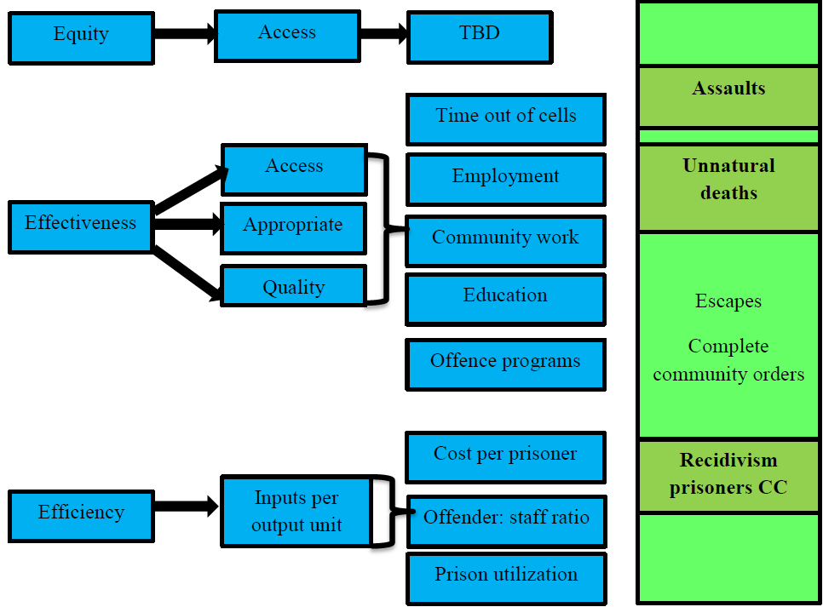
Revised performance indicator framework

Slide 10
Key findings from this review
Can global performance be measured?
There is a relationship between efficiency and effectiveness:
high efficiency = low overall effectiveness.
Performance rankings for corrections systems can be developed.
The challenge will be the development of accurate evidence-based performance measures.
The Lesson learned from Australia’s performance review : What gets measured, gets done.
Lets take a look at both the overall performance rankings and the recidivism rates across Australia

Slide 11
Revised overall performance ranking (includes recidivism)
 | Efficiency | Output | Outcome | Overall rank
NSW | 2 | 7 | 4 | 4
VIC | 7 | 2 | 8 | 7
QLD | 1 | 4 | 3 | 1
WA | 8 | 1 | 7 | 6
SA | 4 | 6 | 2 | 3
TAS | 2 | 8 | 5 | 5
ACT | 5 | 3 | 1 | 2
NT | 6 | 5 | 6 | 7

Slide 12
Australian operational definition of recidivism
The percentage of prisoners released during 2010-11 following a term of sentenced imprisonment, who returned to corrective services (prison or community corrections) with a new correctional sanction within two years.
Includes prisoners subject to correctional supervision following release (i.e. released on parole or other community corrections orders).
Includes returns to prison resulting from the cancellation of a parole order.

Slide 13
Two year post-release recidivism
 | Prisoners return to |  | Offenders returning to
 | Prison | Corrective services | Community correction | Corrective services
NSW | 48% (6) | 48% (5) | 12% (3) | 22% (3)
VIC | 37% (3) | 45% (4) | 16% (5) | 22% (4)
QLD | 38% (4) | 44% (3) | 16% (6) | 34% (8)
WA | 36% (2) | 43% (2) | 10% (2) | 14% (1)
SA | 29% (1) | 41% (1) | 16% (4) | 24% (5)
TAS | 39% (5) | 51% (5) | 20% (8) | 25% (6)
ACT | 47% (7) | 58% (7) | 17% (7) | 19% (2)
NT | 58% (8) | 58% (7) | 7% (1) | 26% (7)

Slide 14
Concluding comments
The big question:
Can global sentencing and corrections performance measures be developed?
We think that the answer is yes, but to date, we know little about global corrections performance beyond global comparisons of country level incarceration rates.
We need to begin the task of collecting the necessary data to allow the identification of high performance and low performance institutional and community corrections across countries and global regions

Slide 15
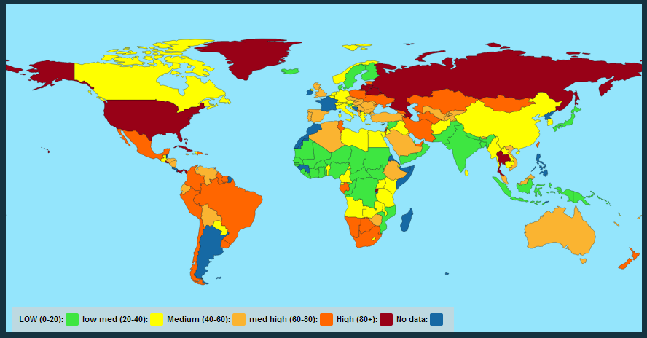
Prison population rate per 100,000 of national population

Slide 16
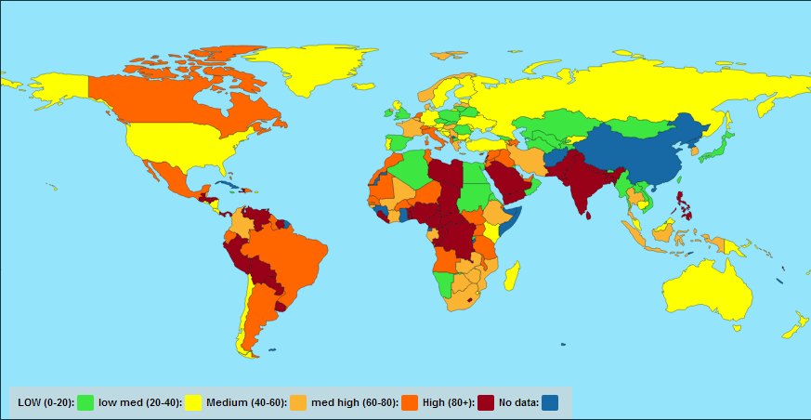
Pre Trial detainees and remand rate per 100,000 of national population

Slide 17
Global Comparison of the Use of Prison
Countries with high rates of prison use
USA ( 716 per 100,000)
Seychelles (709 per 100,000)
St. Kitts and Nevis (701 per 100,000)
Virgin Islands, USA (539 per 100,000)
Cuba ( 510 per 100,000)
Rwanda (492 per 100,000)
Anguilla, UK (487 per 100,000)
Russian Federation (479 per 100,000)
Belize (476 per 100,000)
Countries with Low rates of prison use
San Marino ( 6 per 100,000)
Faeroe Islands (17 per 100,000)
Central African Republic (19 per 100,000)
Comoros ( 19 per 100,000)
Liechtenstein (24 per 100,000)

Slide 18
Contact information
Professor James Byrne
James.Byrne@griffith.edu.au

