Slide 1
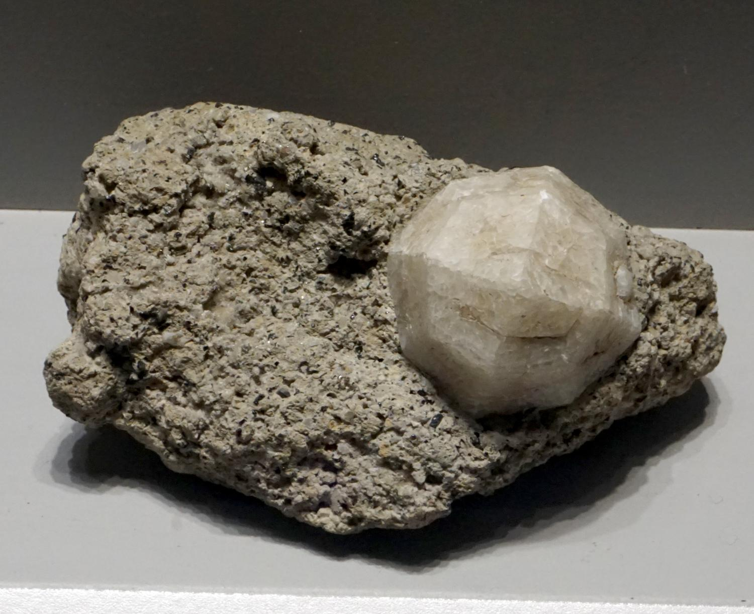
Leucite
Andrew Barakian

Slide 2
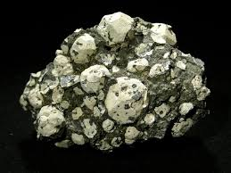
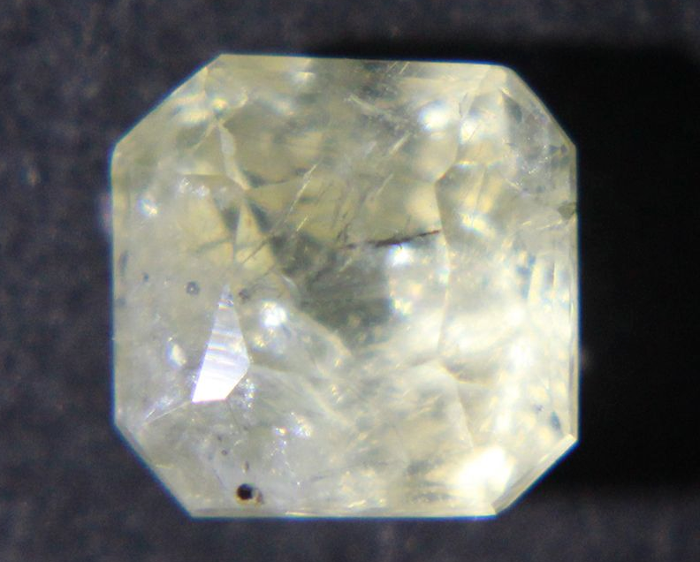
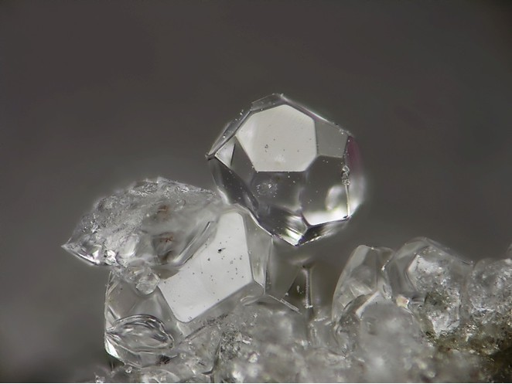
Leucite Crystal
Pure Leucite Crystal
Leucite in volcanic rock

Slide 3
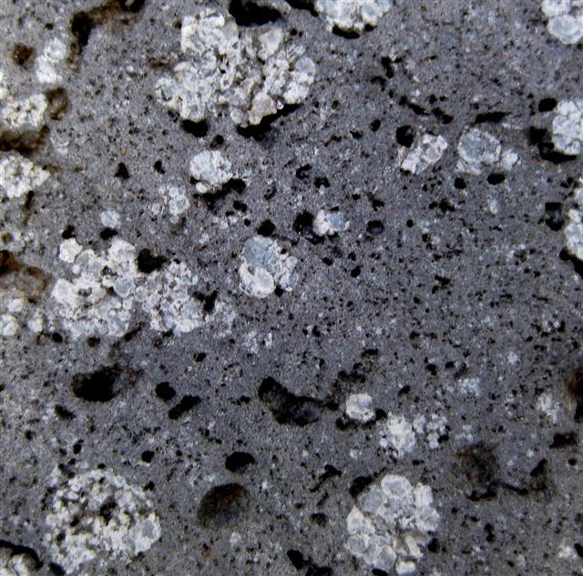
Origin
Leucite derives from the greek phrase leucos which means white
Identified in 1791 (Mount Vesuvius, Italy)
Forms in volcanic rock at high temperatures (900 °C)
Forms in low-silica environments where no quartz is present
Found in Australia, Italy, Germany and the United States

Slide 4
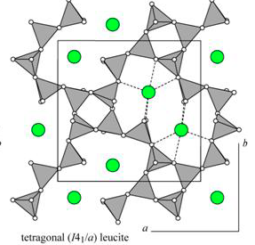
Physical Properties
Classification: tectosilicate or framework silicate
Composition: potassium aluminum silicate
Mineral Formula: K(AlSi₂O₆)
Crystal System: tetragonal
Color: white or grey, can be translucent in pure form
Luster: vitreous
Hardness: 5.5 - 6

Slide 5
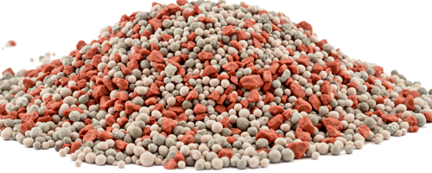
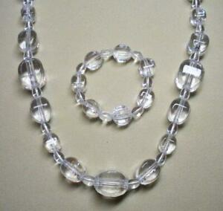
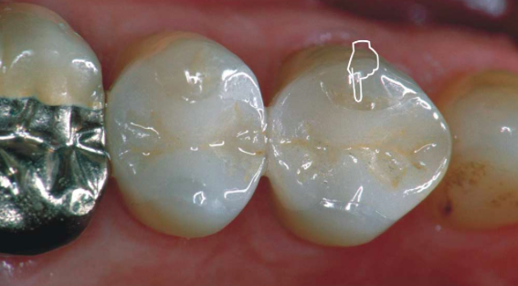
Economic Uses of Leucite
Can be used as a fertilizer
High in Potassium
Can be used for Jewelry
Its genuine crystal form is translucent and can be dyed very easily
Rare, however inexpensive
Aluminum can be extracted as a raw material
Its structure can be easily destroyed by harsh acids (Al ions are freed)
Can be used to make dental ceramics or fake teeth
Heat-pressed ceramics contain Leucite for reinforcement

Slide 6
Works Cited
IZA Commission on Natural Zeolites. (n.d.) Leucite. Retrieved from
www.iza-online.org/natural/Datasheets/Leucite/leucite.htm.
Leucite Mineral. (n.d.) In Encyclopædia Britannica online. Retrieved from
www.britannica.com/science/leucite.
Leucite: Mineral Information, Data and Localities. (n.d.). Retrieved from
www.mindat.org/min-2465.html.
The Mineral Leucite. Leucite: The Mineral Leucite Information and Pictures. (n.d.) Retrieved from
www.minerals.net/mineral/leucite.aspx.

