Slide 1
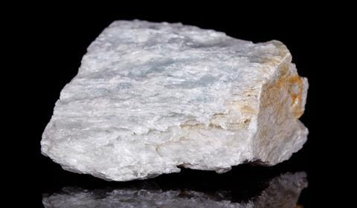
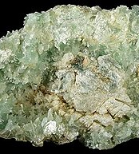
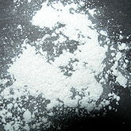
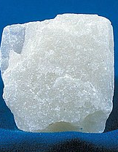
Talc
Mg₃Si₄O₁₀(OH)₂

Slide 2
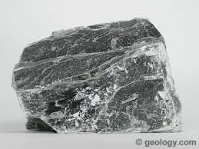
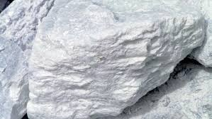
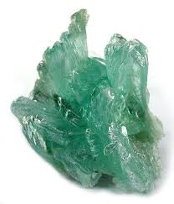
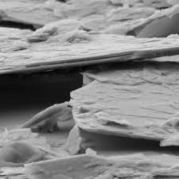
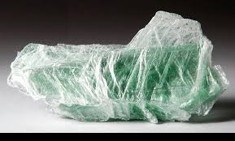
Characteristics
Color: Green, white, gray, brown, colorless
Crystal system: Triclinic, Monoclinic
Crystal habit: Foliated to fibrous mass
Hardness: 1
Luster: Sub-vitreous, Pearly, Waxy
Streak: White to Black
Cleavage: Perfect
Specific gravity: 2.58-2.83
Notes:
The key characteristics of Talc are that its typically white in its purest form, commonly known as soapstone – It can have foliated OR fibrous mass – and has a hardness of 1.

Slide 3
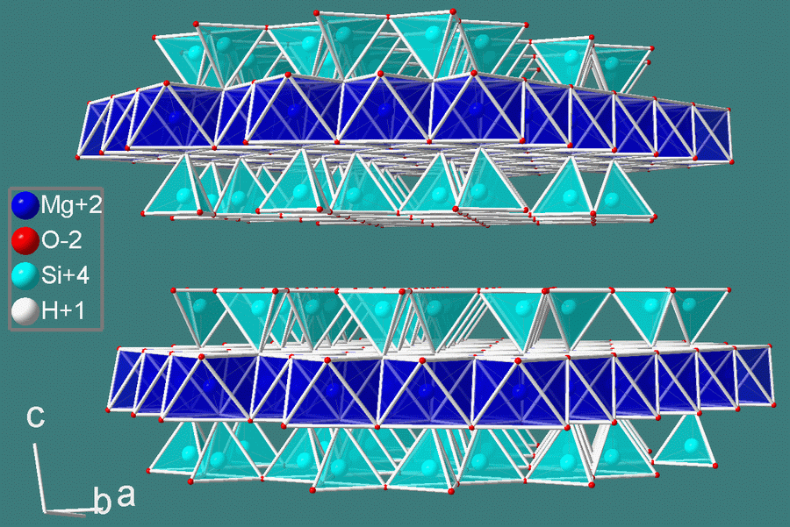
Structure
Mg₃Si₄O₁₀(OH)₂
Talc is a phyllosilicate; Its layered structure is held together only by van der Waal’s bonds.
Its layered sheets resemble that of mica.
The mineral can make the following substitutions in small quantities:
Al, Ti ←→ Si Fe,Mn,Ca,Al←→ Mg
Notes:
Talc is a monoclinic phyllosillicate. Its layered structure is held together only by Van der Waal’s bonds contributing to the softness of the material. It’s generalized chemical formula varies with ionic substitutions.

Slide 4
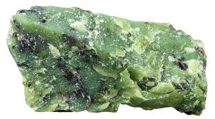
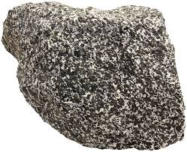
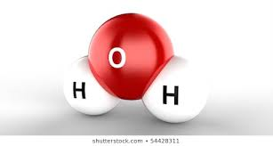
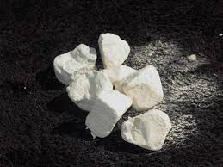
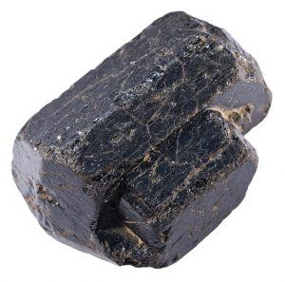
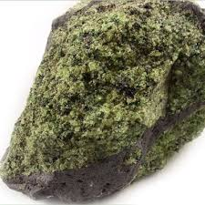
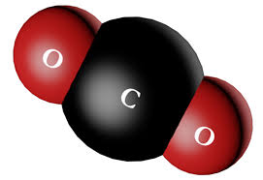
Formation
Talc forms through the metamorphism of magnesian materials.
This process is called talc carbonation or steatization.
(serpentine)2 Mg₃Si₂O₅(OH)₄ + (carbon dioxide)3CO₂ →
(talc)Mg₃Si₄O₁₀(OH)₂ + (magnesite)3 MgCO₃ + (water)3 H₂O
Another method of formation uses the reaction between dolomite and silica that commonly occurs in silica-rich metamorphic areas.
(dolomite)3 CaMg(CO₃)₂ + (silica)4 SiO₂ + (water)H₂O →
(talc)Mg₃Si₄O₁₀(OH)₂ + (calcite)3 CaCO₃ + (carbon dioxide)3 CO₂
Talc is found in ~2000MA ultramafic rock and near convergent plate boundaries.
Notes:
Talc forms through the metamorphism of magnesian materials including serpentine, pyroxene, olivine, and amphiboles in the presence of water and carbon dioxide. This process is called talc carbonation or steatization.
Another method of formation uses the reaction between dolomite and silica. in silica-rich metamorphic areas, heated waters can carry dissolved Mg and silica to dolomitic marble.
Talc is often found in metamorphic and ultramafic rocks at convergent plate boundaries.

Slide 5
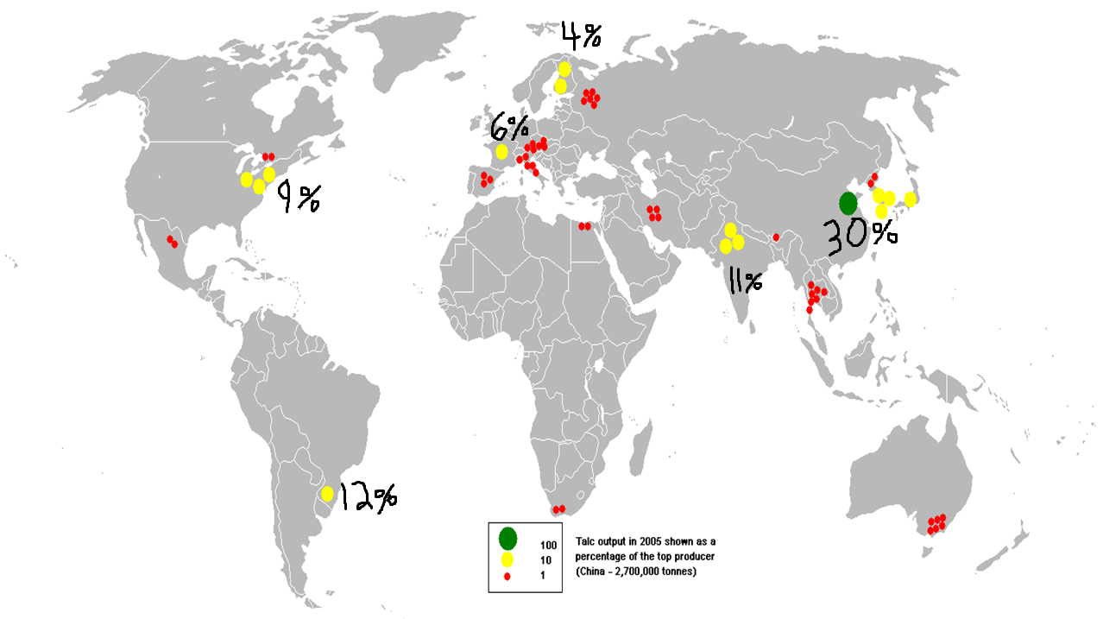
Production Distribution
China ~30%
(2.2M tonnes/yr)
Brazil ~12%
India ~11%
United States ~9%
France ~6%
Finland ~4%
Notes:
This image shows the distribution of talc output in 2005 – China is notably the largest producer in the world, mining nearly 30% of commercial talc.

Slide 6
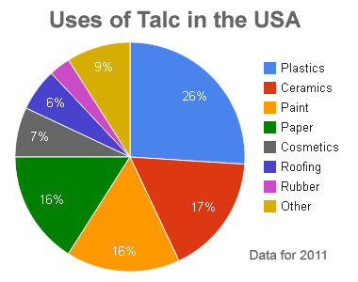
Uses
In it’s powdered form talc absorbs moisture well.
Often used as a filler in plastics and ceramics.
Due to its unusual softness it reduces friction between materials such as mechanical parts. (E.g. painting tools/sprays)
Notes:
This data is from a recent United States Geological Survey. Talc is used in a variety of products; in terms of cosmetics, talc is desirable for its ability to absorb moisture. It an also be used as a filler in plastics and ceramics, strengthening the materials.

Slide 7
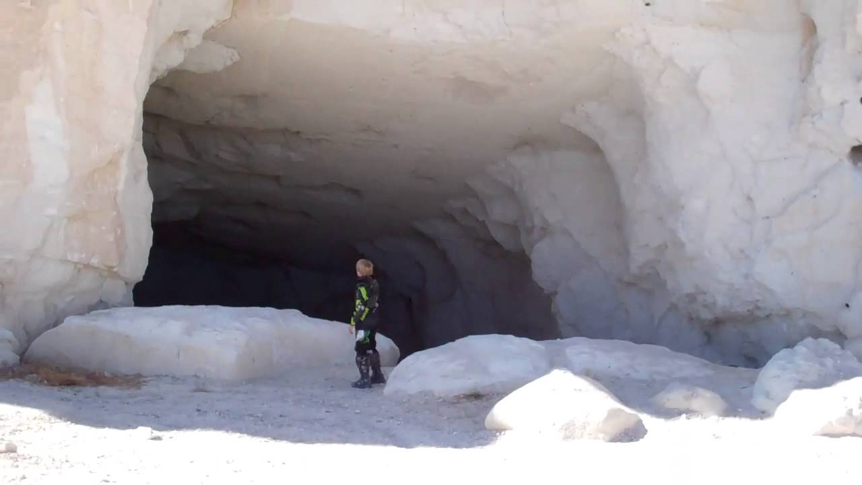
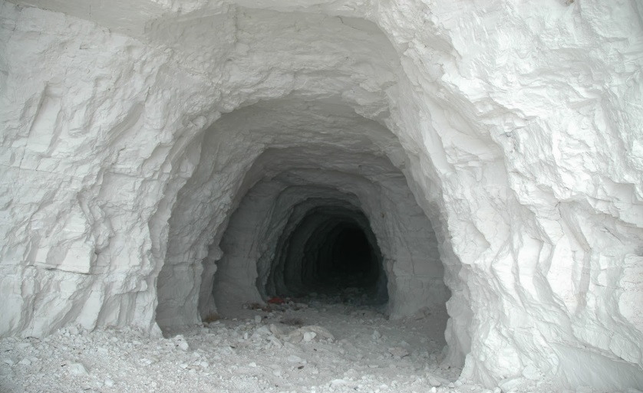
Mining
Texan Talc Mine:
https://www.youtube.com/watch?v=bOKeZBzFnf8
Afghan insurgency:
https://www.youtube.com/watch?v=z9acG6aWCoI

Slide 8
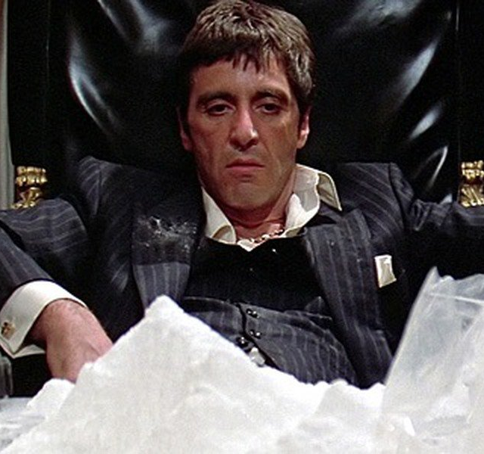
Health Risks
https://www.dovemed.com/healthy-living/first-aid/first-aid-talcum-powder-poisoning/
A study by the US National Toxicology Program ‘proved’ it cancerous.
Often used to dilute recreational drugs.
At 1000mg/m³ talc inhalation is considered lethal. Swallowing in large quantities is harmful.
Talc is often found near serpentine and amphiboles, risking exposure or contamination by asbestos.
Notes:
Talc is considered a conflict mineral so there is the possibility its used to fund conflict.
A study by the US National Toxicology Program subjected rats to 6-hours of talc inhalation, 5 days a week, for 113 weeks, and observed an increase in cancerous tumors embedded with talc particles.
Talc is used to ‘cut’ or dilute recreational drugs.
In the united states, workers are only allowed to work in conditions under 2 mg/m^3 throughout a workday. At 1000mg/m^3 talc inhalation is considered lethal.
Talc is often found near serpentine and amphiboles, risking asbestos exposure in mines and contamination in products.

Slide 9
References
“What Is Talc?” North America, Inustrial Mineral Associationn, https://www.ima-na.org/page/what_is_talc.
The Editors of Encyclopaedia Britannica. “Asbestos.” Encyclopædia Britannica, Encyclopædia Britannica, Inc., 27 Sept. 2019, https://www.britannica.com/science/asbestos-mineral.
“Talc: The Softest Mineral.” Geology, https://geology.com/minerals/talc.shtml.
Halkar, S. K. Talc - an Overview | ScienceDirect Topics, https://www.sciencedirect.com/topics/earth-and-planetary-sciences/talc.
https://www.dovemed.com/healthy-living/first-aid/first-aid-talcum-powder-poisoning/

