Slide 1
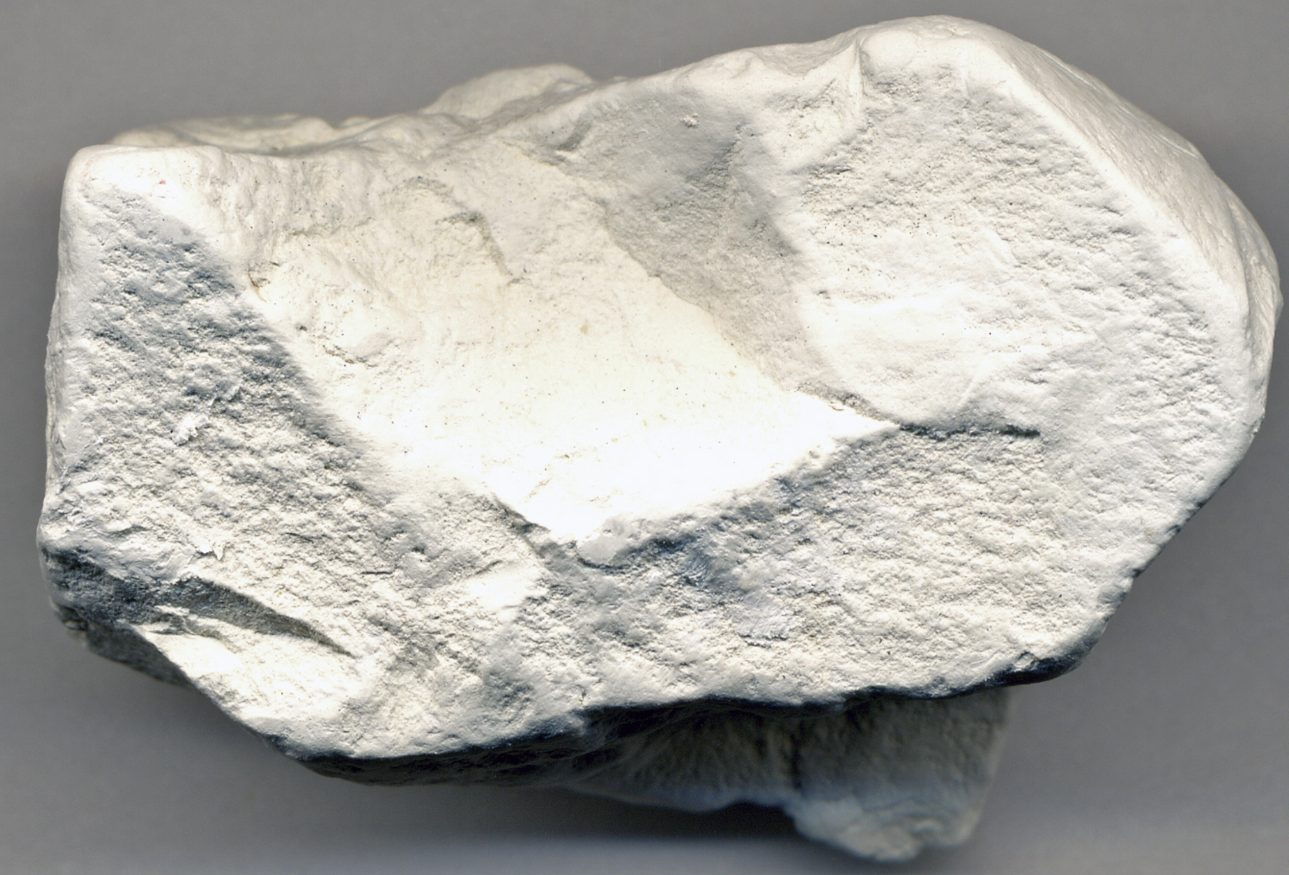
Kaolinite
Hayley Beal

Slide 2
Properties
Color: cream to white
Streak: white or paler than sample
Luster: Pearly to dull earthy
Hardness: 2-2.5

Slide 3
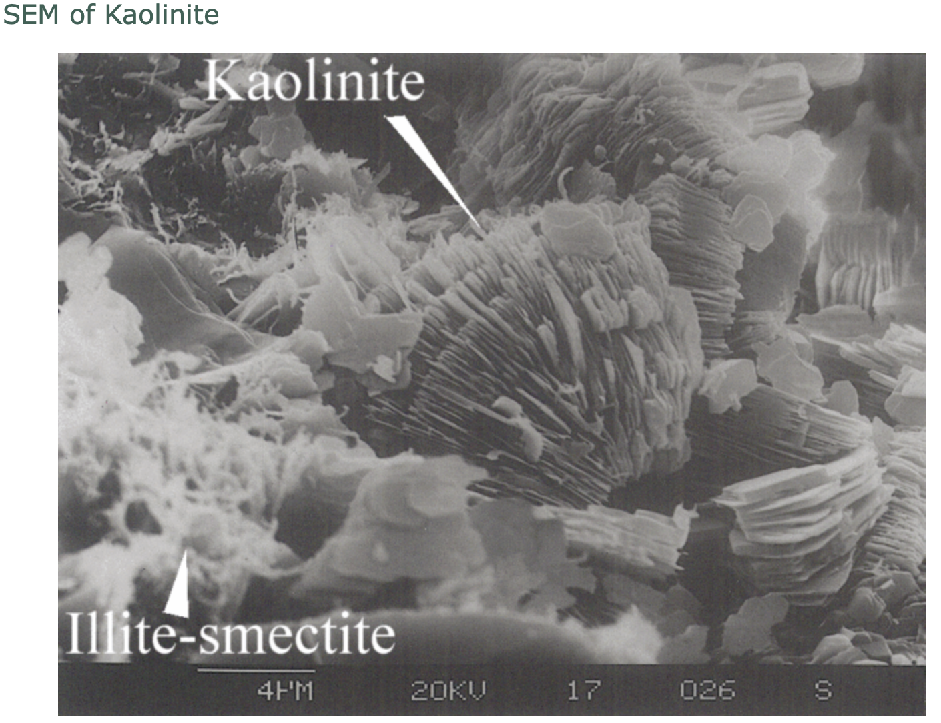
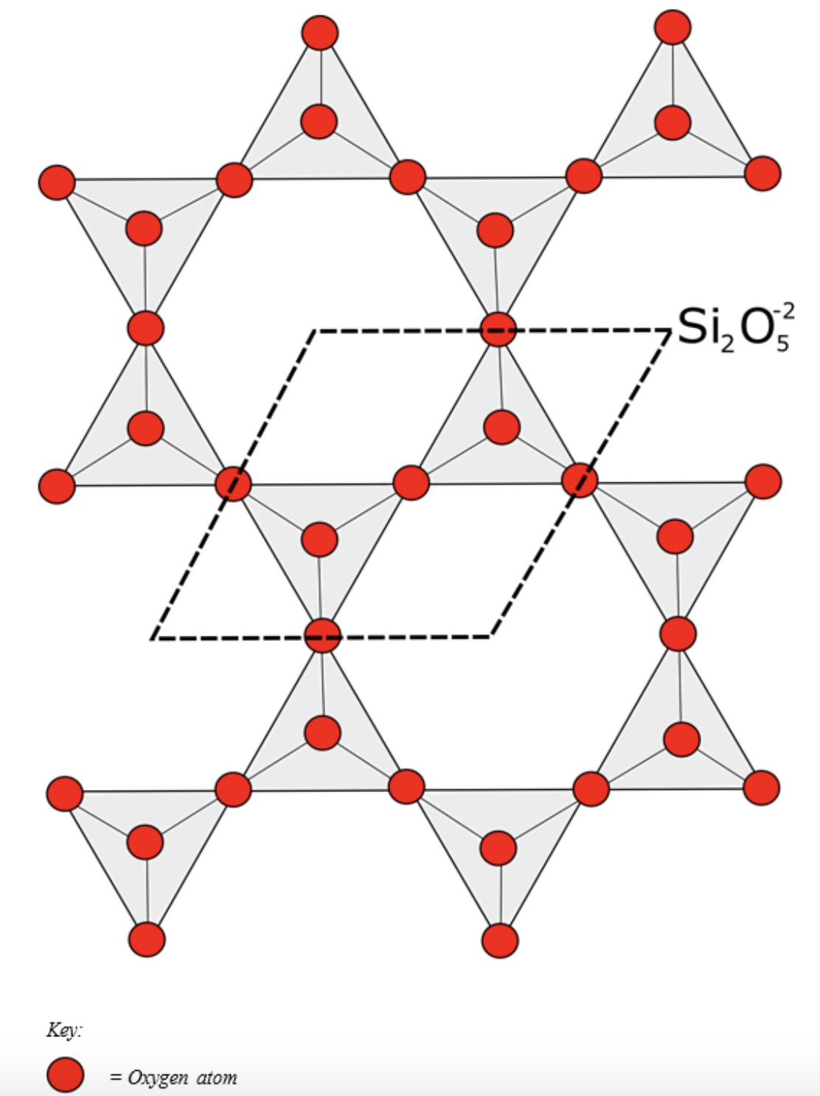
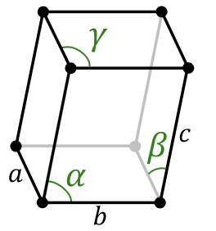
Properties
Al₂(Si₂O₅)(OH)₄
Phyllosilicate (sheet silicate)
Non- pleochroic
Crystal system: Triclinic
Perfect cleavage
Fracture: conchoidal
(a ≠ b ≠ c and α ≠ β ≠ γ )

Slide 4
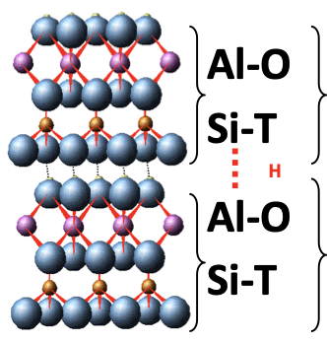
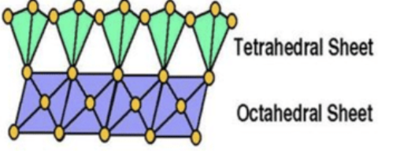
Structure
1:1 clay mineral
Non-swelling clay
Strong hydrogen bonds keep units together and prevents absorption of water.

Slide 5
Uses
In 2013:
48% of kaolin used in paper production as a coating
52% used for ceramics, paint, rubber
Other uses:
Pest control in agriculture
Active ingredients in medicine for nausea and digestive issues
Toothpaste, cosmetics

Slide 6
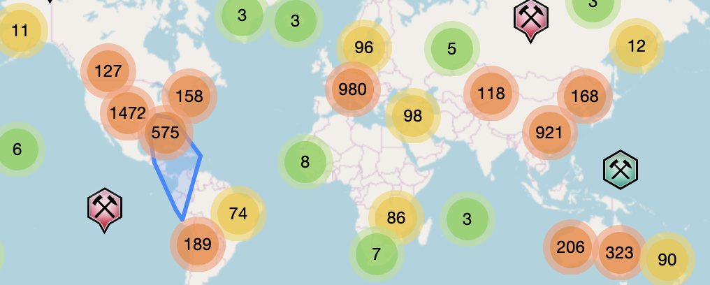
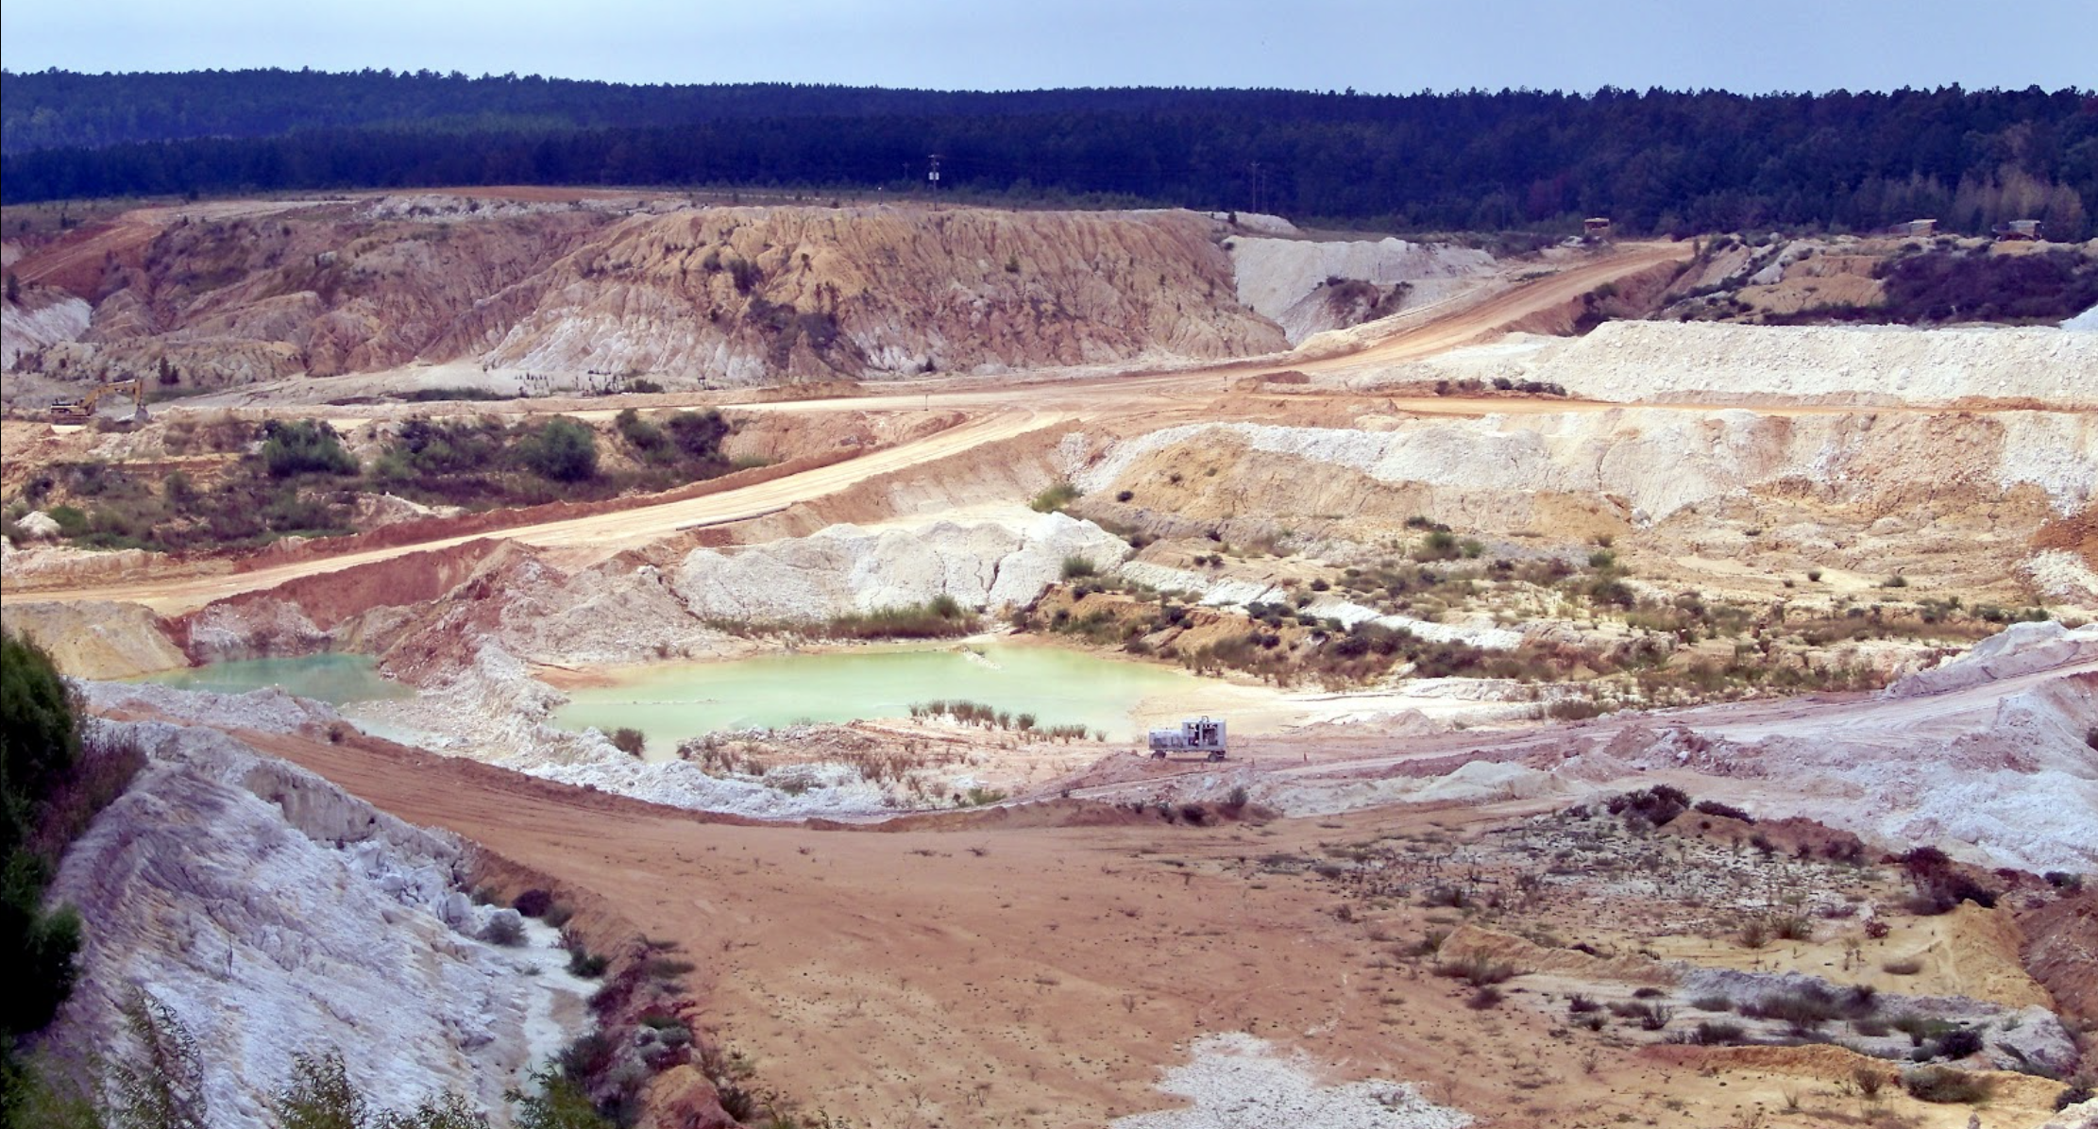
Production
Formed from weathering or alteration of aluminosilicate minerals (feldspar)
Soils in hot and humid climates
Major producers of Kaolinite are USA, Europe, Mexico, Brazil
Kaolin is one of Georgia’s largest natural resources
8 million metric tons a year worth 1 billion
Mine Localities

Slide 7
Works Cited
Kaolinite. (n.d.). Retrieved from https://mineralseducationcoalition.org/minerals-database/kaolinite/.
Kaolinite. (n.d.). Retrieved from https://www.mindat.org/min-2156.html.

