Slide 1
Spodumene
LiAlSi₂O₆

Slide 2
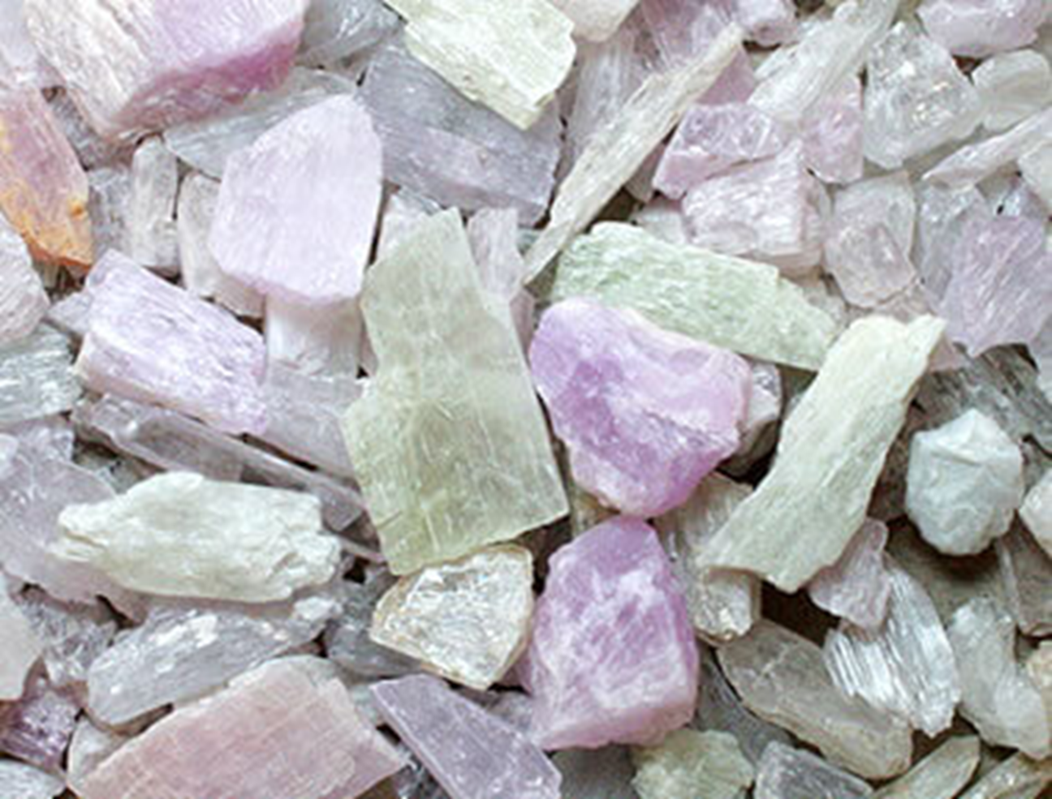
Physical and Optical Properties of Spodumene
Lustre: Vitreous, Dull
Transparency: Transparent, Translucent
Colour: Colourless, yellow, light green, emerald-green, pink to violet, purple, white, gray
Streak: White
Hardness: 6½ - 7 on Mohs scale
Cleavage: Perfect
Density: 3.1 - 3.2 g/cm³ (Measured)
Type: Biaxial (+)
RI values: nα = 1.648 - 1.661 nβ = 1.655 - 1.670 nγ = 1.662 - 1.679
2V: Measured: 54° to 69°, Calculated: 88°
Max Birefringence: δ = 0.014 - 0.018
Surface Relief: Moderate
Dispersion: weak 0.017
Notes:
Dull Glass, some can be seen through

Slide 3
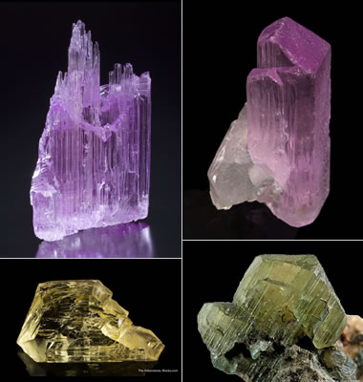
Crystallography
Crystal System: Monoclinic
Cell Parameters: a = 9.46 Å, b = 8.39 Å, c = 5.22 Å β = 110.17°
Ratio: a:b:c = 1.128 : 1 : 0.622
Unit Cell V: 388.90 Å³ (Calculated from Unit Cell)
Pyroxene Group : Clinopyroxene Subgroup
Notes:
A large group of inosilicate (chain silicate) minerals with the general formula ABSi₂O₆. It is divided into the Clinopyroxene Subgroup (monoclinic) and the Orthopyroxene Subgroup (orthorhombic).

Slide 4
Localities

Slide 5
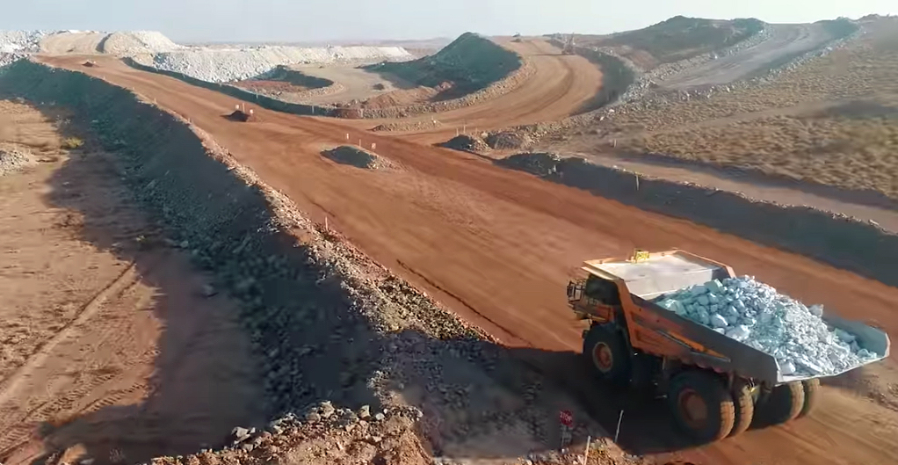
Economics
Last year, output at Australia’s hard rock mines for the first time exceeded lithium carbonate equivalent from brine producers after six new mines went into production within the space of just three years.
With a few advanced projects and at least four chemical conversion plants in the pipeline, the country is set to dominate primary lithium supply for the foreseeable future, but the expansion drive has resulted in a collapse in prices.
Producers in Australia now sell spodumene concentrate (6% lithium used as feedstock for lithium hydroxide) for $550–$620 a tonne, down by a third in 2019 and “trending towards the lower end of this range throughout the month” according to UK-based Benchmark:
https://www.mining.com/spodumene-supply-surge-sinks-lithium-prices/
Notes:
Lithium is the third element of the periodic table. It is the lightest of all solid elements has the highest specific heat capacity, the smallest ionic radius of all
the alkali metals, and a high electrochemical potential. Lithium is one of the most critical metals in modern industry. Its usages range from pharmacy
with lithium-based bipolar disorder treatment drugs to aeronautics with light aluminum/lithium alloys.
The most important usage nowadays is Lithium-ion Batteries (LiBs). The lithium production was, until
recently, dominated by the salt lake brines, because of their cheaper production cost.

Slide 6
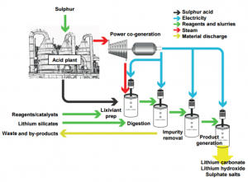
Extraction
Galaxy Resources, which mines spodumene at Mt Cattlin in Australia, first crushes and heats the ore in a rotary calcining kiln to convert the lithium crystal phase from alpha to beta. This process is referred to as decrepitation. It allows the lithium present in the ore to be displaced by sodium. The resulting spodumene concentrate is cooled and milled into a fine powder before being mixed with sulphuric acid and roasted again. A thickener-filter system then separates waste from the concentrated liquor, while precipitation removes magnesium and calcium from this solution.
Finally, soda ash is added and lithium carbonate is crystallized, heated, filtered and dried as 99% pure lithium carbonate
http://www.metalstech.net/updates/strategic-lithium-processing-partnership/
Notes:
Galaxy is currently mining pegmatite ore at Mt Cattlin and processes on site to produce a spodumene concentrate and a tantalum by-product. At full capacity, ore can be processed at a rate of 1.6 million tonnes per annum (tpa) with lithium oxide concentrate production of 180,000 tpa
Pegmatites are extreme igneous rocks that form during the final stage of a magma's crystallization. ... Pegmatites are sometimes sources of valuable minerals such as spodumene (an ore of lithium) and beryl (an ore of beryllium) that are rarely found in economic amounts in other types of rocks.
There are some 230 billion tons of lithium dissolved in the sea, and it is present in the Earth's crust at between 20 to 70 parts per million by weight—mainly in igneous rocks such as granite

Slide 7
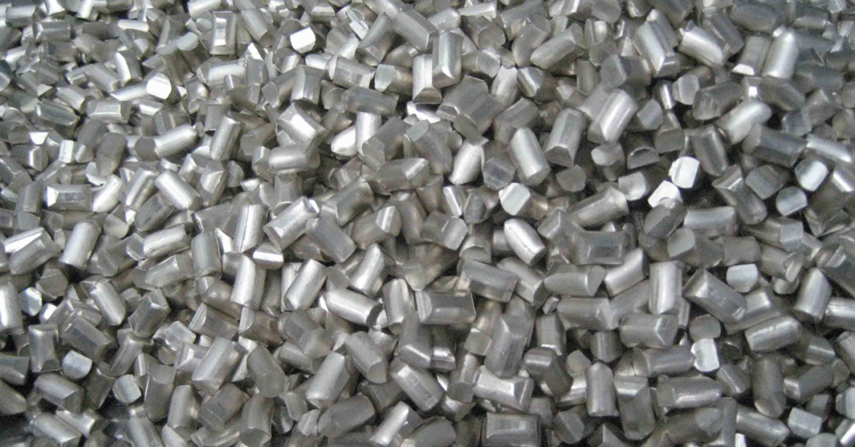
Metallurgy
Converting lithium into metal is done in an electrolytic cell using lithium chloride. The chloride is mixed with potassium chloride in a ratio of 55% lithium chloride to 45% potassium chloride in order to produce a molten eutectic electrolyte. Potassium chloride is added to increase the conductivity of the lithium while lowering the fusion temperature.
When fused and electrolyzed at about 450° C, chlorine gas is liberated while molten lithium rises to the surface of the electrolyte, collecting in cast-iron enclosures. The pure lithium produced is wrapped in paraffin wax to prevent oxidization. The conversion ratio of lithium carbonate to lithium metal is about 5.3 to 1.
https://www.thebalance.com/lithium-production-2340123

Slide 8
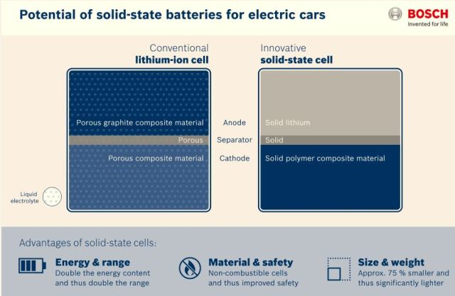
Way of the Future
Bosch is developing a solid state battery with twice the energy density of a lithium ion (Li-ion) cell, effectively doubling the range of electric vehicles with no increase in weight. A Tesla Model S equipped with an 85 kWh Li-ion battery pack has an estimated range of 426 km (265 miles). Swap out the Li-ion battery and replace it with a solid state battery and the car could go 852 km (530 miles) on a single charge. Even better, the new battery doesn’t use a flammable liquid electrolyte, so no more battery fires! And the icing on the cake: the solid state battery would come at a lower cost. Bosch claims that this next generation of batteries could be on the market in five years.
https://www.engineering.com/ElectronicsDesign/ElectronicsDesignArticles/ArticleID/10689/Solid-State-Battery-Could-Double-Electric-Vehicle-Range.aspx

Slide 9
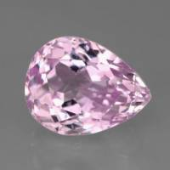
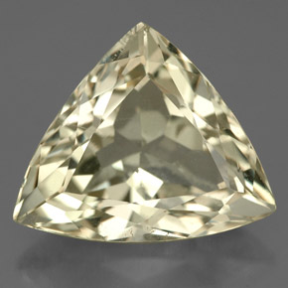
The Healing Energies, Metaphysical Properties, Legendary Uses, and Meaning
Kunzite - most popular variety, ranging in color from pale transparent pink to light violet. It is beautiful as a gemstone with a brilliant shift in color, and is a Stone of Emotion, pure in energy and joyful in nature. It opens and connects the heart to the mind and stimulates a healing communion between the two. Kunzite encourages one to release walls built around the heart for protection, and to be receptive to the experience of unconditional and abundant love.
Hiddenite or Green Kunzite - varies in color from pale green, to yellow-green, to deep emerald green. Also known as Lithia Emerald, it is rarer than Kunzite and is sometimes faceted into gemstones. Hiddenite is a Crystal of Evolution, helping individuals to grow spiritually, and to be aware of their collective responsibility for the care of the Earth. It supports new beginnings and focusing on the present, relinquishing injustices of the past or anxieties for the future.
https://www.crystalvaults.com/crystal-encyclopedia/spodumene

