Slide 1
Cuprite
Ryan Knych

Slide 2
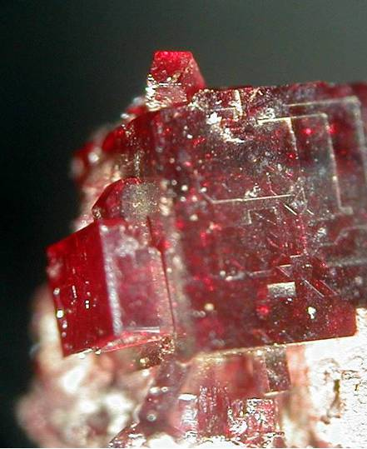
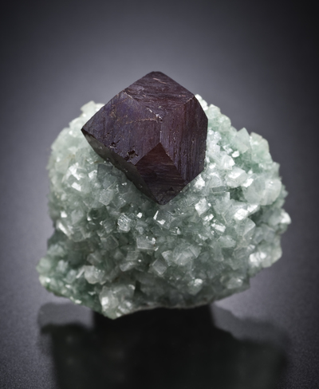
Cuprite

Slide 3
Background Information
Formula: Cu₂O
Crystal System: Isometric
Hardness: 3.5-4
Color: Dark red to cochineal red, sometimes almost black
Lustre: Adamantine, sub-metallic, earthy
Specific Gravity: 6.14
Density: 6.14 g/cm³
Streak: Shining metallic brownish-red
Cleavage: Imperfect/fair, interrupted on {111}, more rarely on {001}
Fracture: Conchoidal

Slide 4
Background Information
Named in 1845 by Wilhelm Karl von Haidinger from the Latin “cuprum,” in allusion to its composition.
Commonly found as an oxidation product of copper sulphides in the upper zones of veins.
Often associated with Native Copper, Malachite, Azurite, Limonite, and Chalcocite.

Slide 5
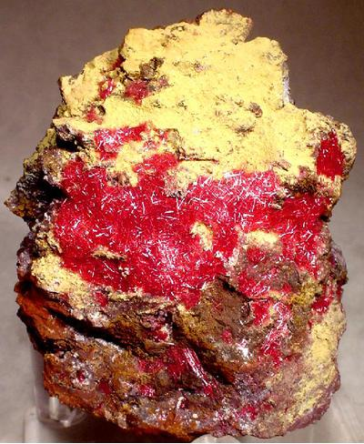
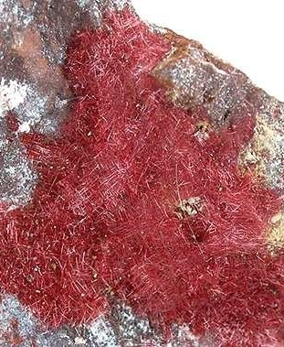
Varities of Cuprite - Chalcotrichite

Slide 6
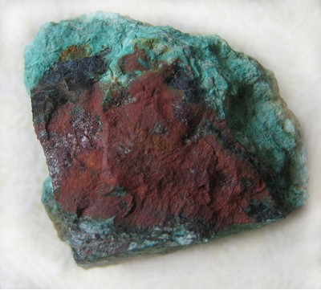
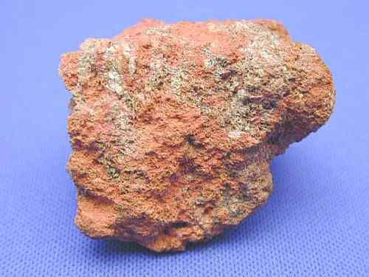
Varieties of Cuprite – Tile Ore

Slide 7
Optical Properties
Birefringence: Isotropic minerals have no birefringence
Surface Relief: Very high
Type: Anisotropic
Anisotropism: Anomalous
Colour in reflected light: Bluish white
Internal Reflections: Blood-red
Pleochroism: Visible

Slide 8
Crystallography
Crystal System: Isometric
Morphology: Crystals octahedral or cubic, rarely dodecahedral. In the variety chalcotrichite the crystals are greatly elongated [001] into capillary shapes.
Twinning: Penetration twins common

Slide 9
Localities

Slide 10
References
Barthelmy, D. (n.d.). Cuprite Mineral Data. Retrieved November 27, 2019, from http://www.webmineral.com/data/Cuprite.shtml#.Xe3S2ehKjic.
Cuprite. (n.d.). Retrieved November 28, 2019, from https://www.mindat.org/min-1172.html#autoanchor21.
The Editors of Encyclopaedia Britannica, B. (2019, January 9). Cuprite. Retrieved November 30, 2019, from https://www.britannica.com/science/cuprite.

