Slide 1
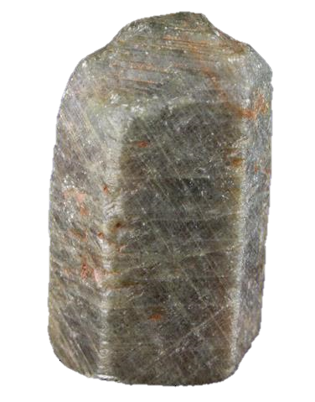
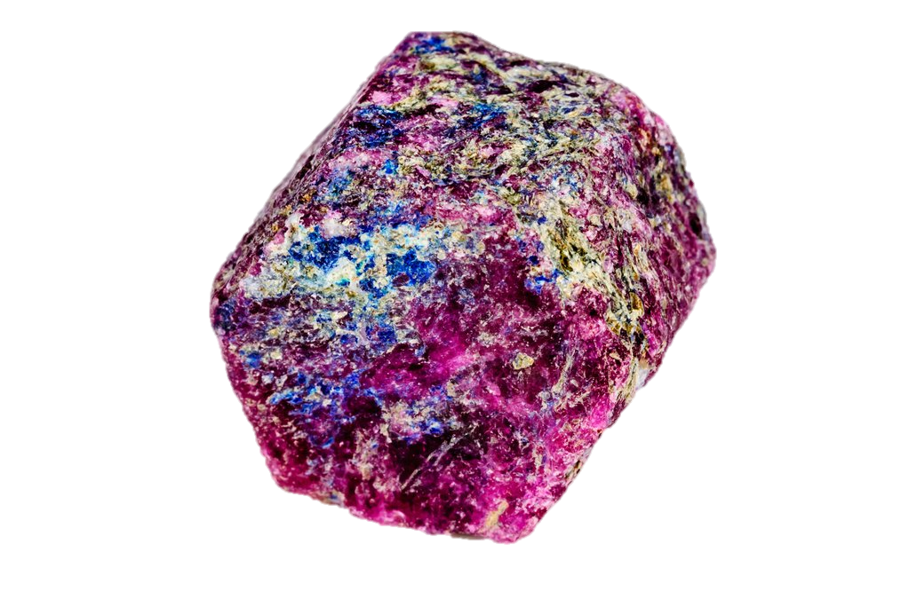
Corundum $${Al}_{2}O_{3}$$
Earth Materials I
Lisa Luchford

Slide 2
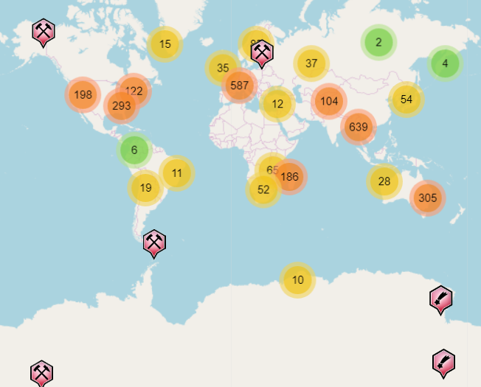
Sources
Metamorphic rocks where aluminous shales or bauxites have been exposed to contact metamorphism
Igneous rocks
Syenite, nepheline syenite, and pegmatite
Downslope soils and sediments of basalt flows
Traditional sources of rubies and sapphires: Burma, Cambodia, Sri Lanka, India, Afghanistan, Montana, and other areas
In the past few decades: Madagascar, Kenya, Tanzania, Nigeria, and Malawi

Slide 3
Chemical and Structural Properties
Aluminum oxide
Common Impurities: Cr, Fe, V, Ti
Occur as hexagonally shaped prismatic and tabular crystals, or
Occur as bipyramidal hexagons that are wider in the center and taper thinly on the ends

Slide 4
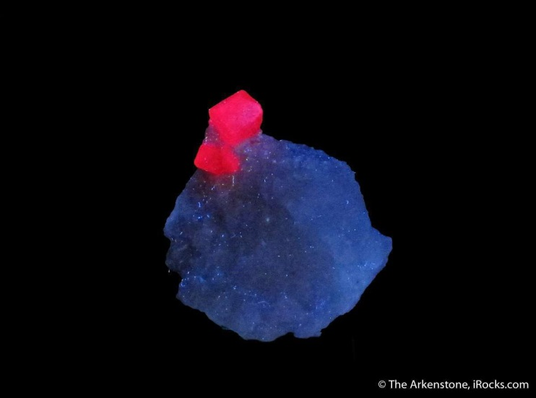
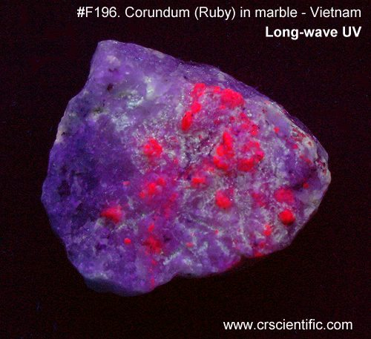
Identification
Color: colorless, blue, red, pink, purple, yellow, grey, golden-brown
Luster: vitreous, pearly, adamantine
Mohs Hardness: 9
Streak: white

Slide 5
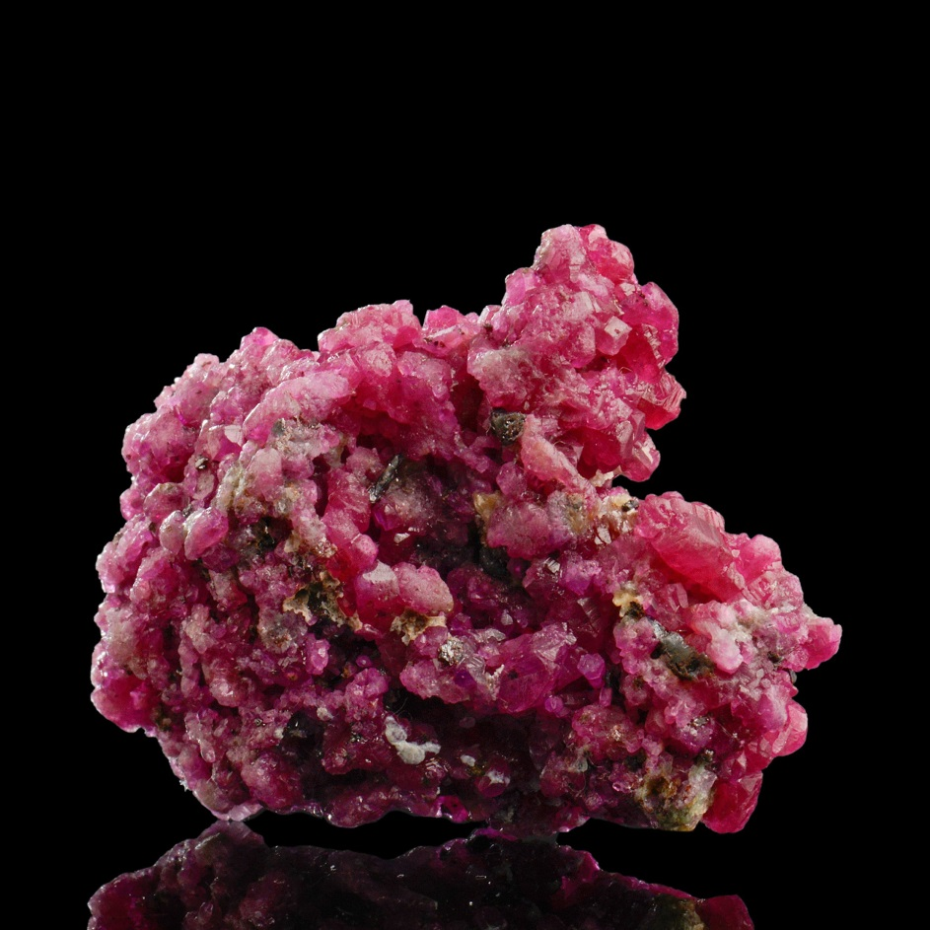
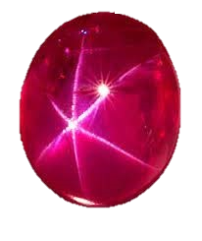
Ruby
Cr-bearing
Red
Star Ruby

Slide 6
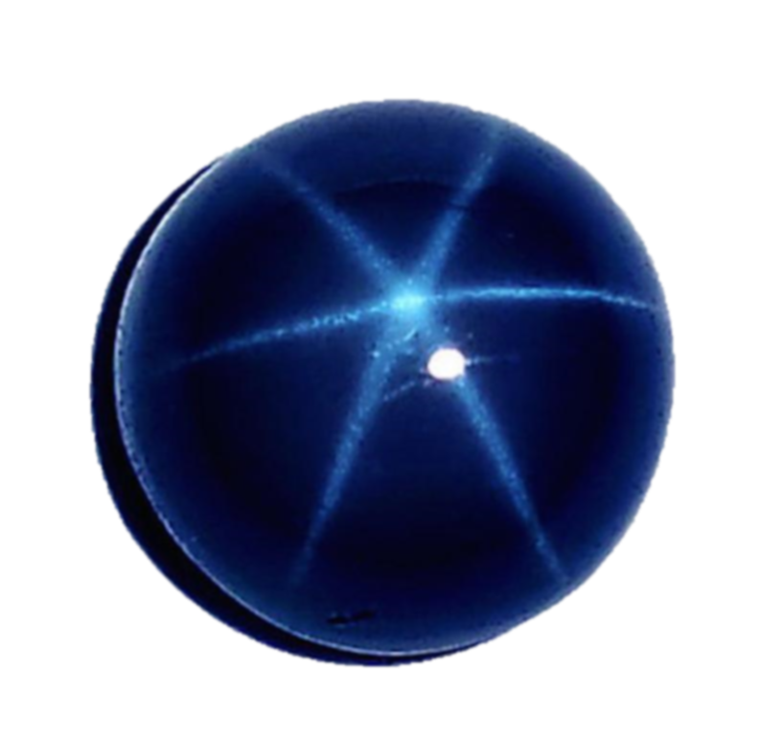
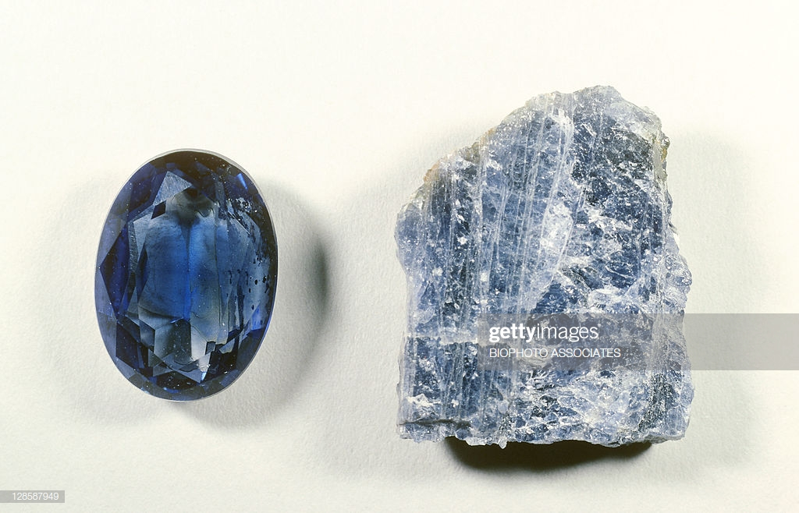
Sapphire
Fe- and Ti-bearing
Blue
Star Sapphire

Slide 7
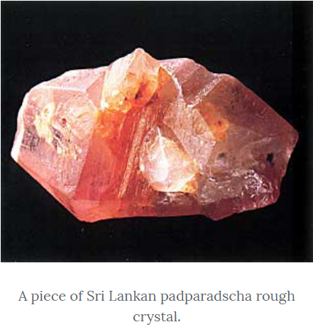
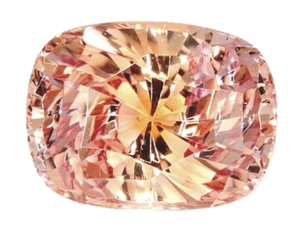
Padparadscha
Orange-pink gem variety of sapphire
Very rare and sought after

Slide 8
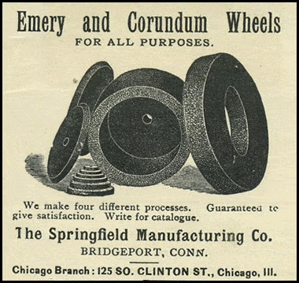
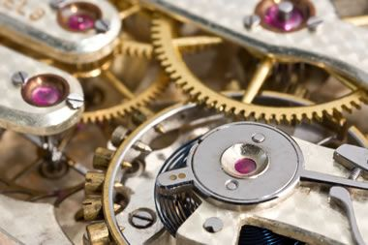
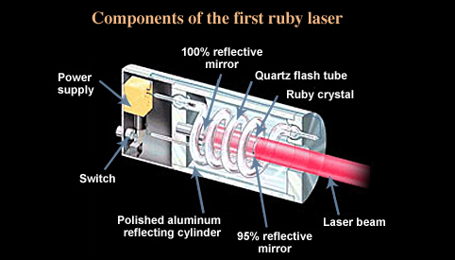
Uses of Corundum
First laser
Ruby used as gain medium (material in the laser that is the target of an intense burst of light)
Jewel bearings in watches (that are highly resistant to abrasion)
Nail files
Sandpaper
Grinding wheels
Gemstones (ruby and sapphire)
used to make windows and clear structures for electronic instruments

Slide 9
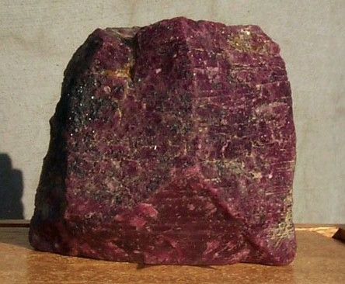
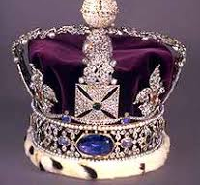
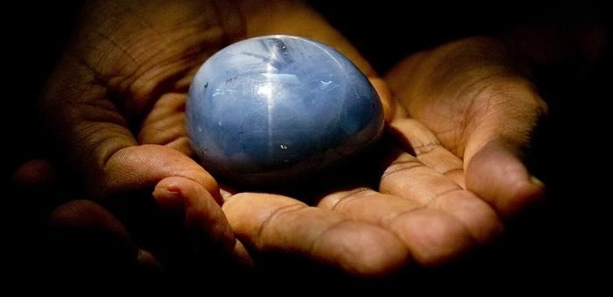
Fun Facts
The name "corundum" is derived from the Tamil-Dravidian word kurundam which means ruby and originates from a Sanskrit word (kuruvinda)
The Stuart Sapphire is part of the Royal Crown Jewels that belong to Queen Elizabeth II
The Star of Adam: largest sapphire
Star sapphire
Discovered in Ratnapura mines, Sri Lanka in fall of 2015
Just under 10 oz/1404,49 carats
125West Ruby: largest ruby in the world
8.2 lbs/18,696 carats

Slide 10
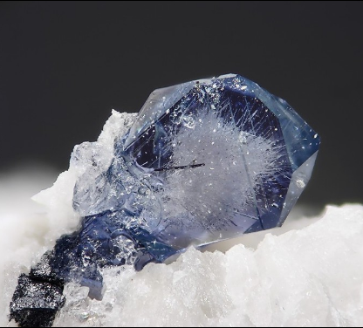
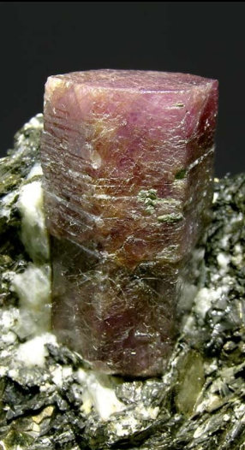
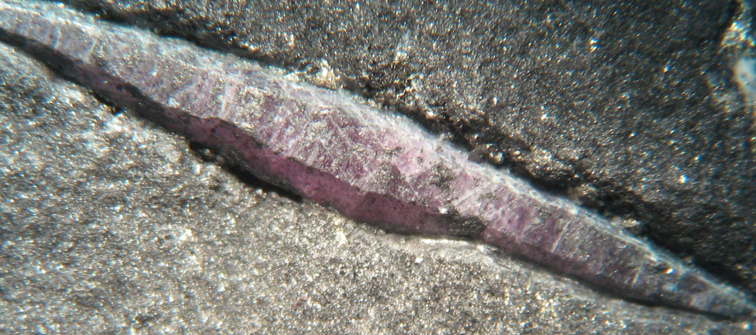
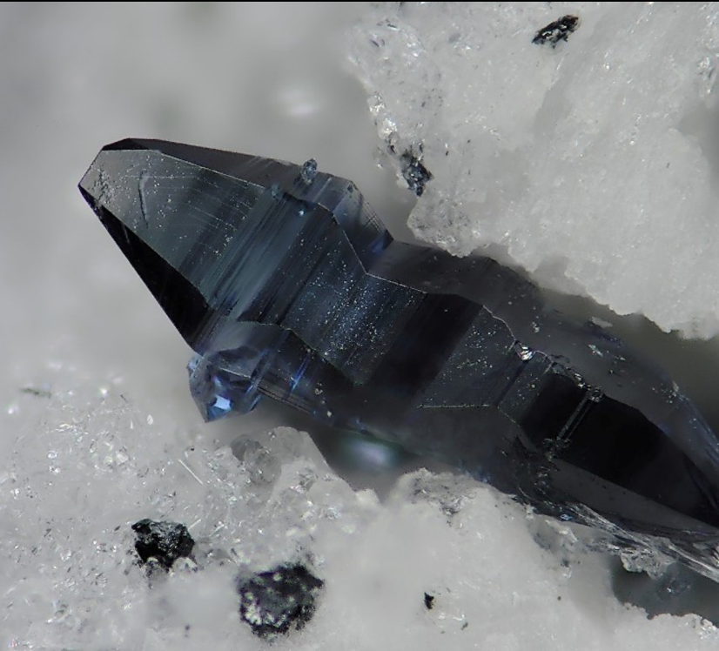
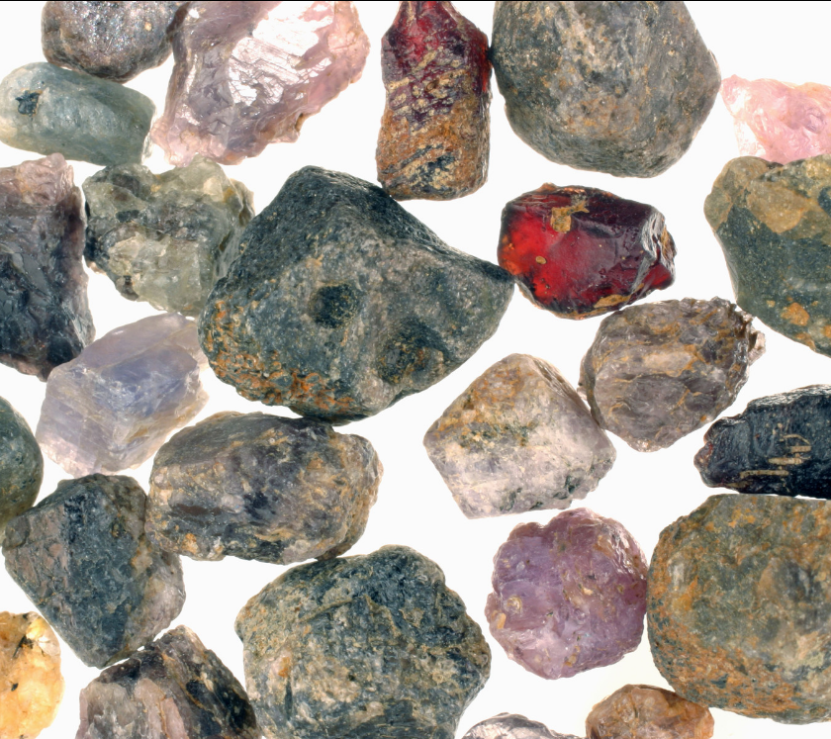
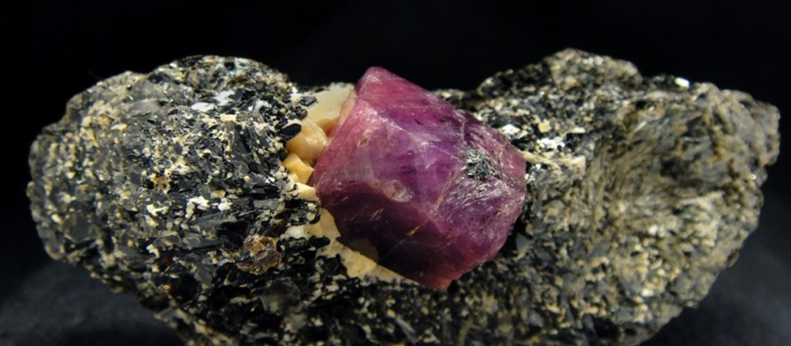
https://www.minerals.net/mineral/corundum.aspx
https://www.langantiques.com/university/corundum-2/
https://geology.com/minerals/corundum.shtml
https://www.mindat.org/min-1136.html#autoanchor6
https://www.forbes.com/sites/trevornace/2016/01/10/worlds-largest-blue-star-sapphire-found-worth-300-million/#1c95680475d1
Notes:
https://www.minerals.net/mineral/corundum.aspx
https://www.langantiques.com/university/corundum-2/
https://geology.com/minerals/corundum.shtml
https://www.mindat.org/min-1136.html#autoanchor6

