Slide 1
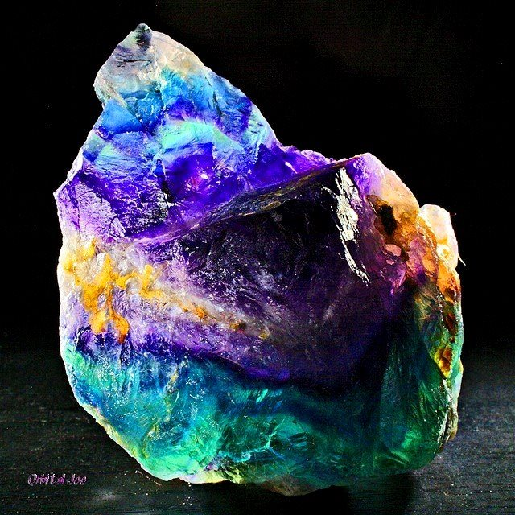
Fluorite
By Erin McGuire

Slide 2
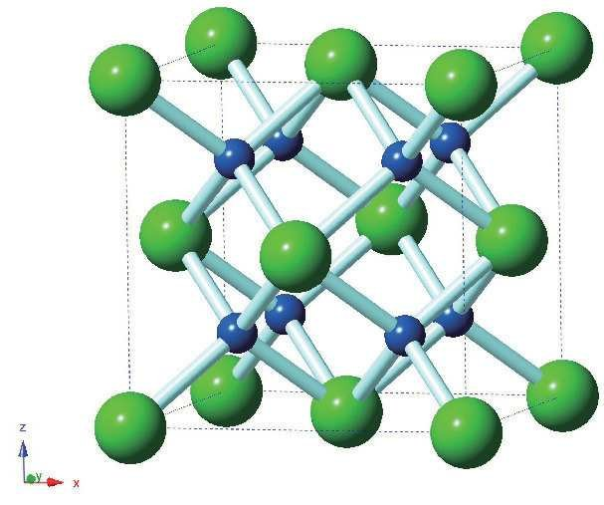
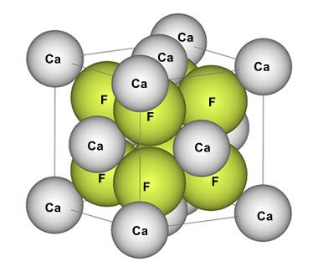
CaF2 , Isometric, Halide Mineral Group

Slide 3
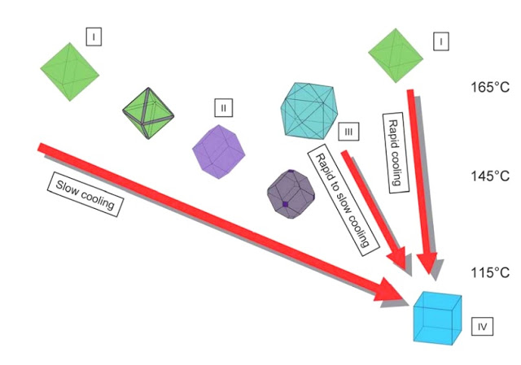

Slide 4
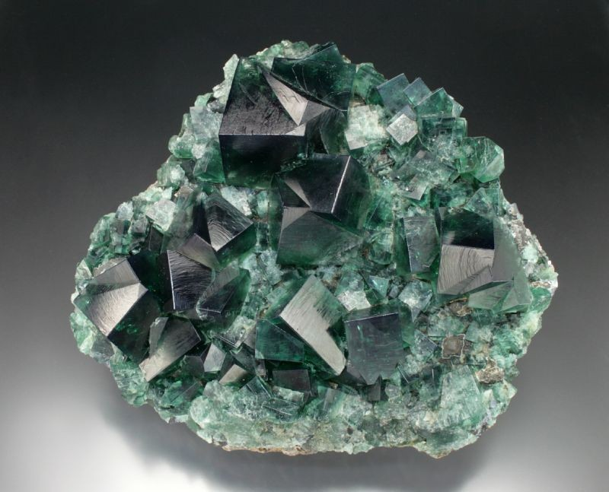
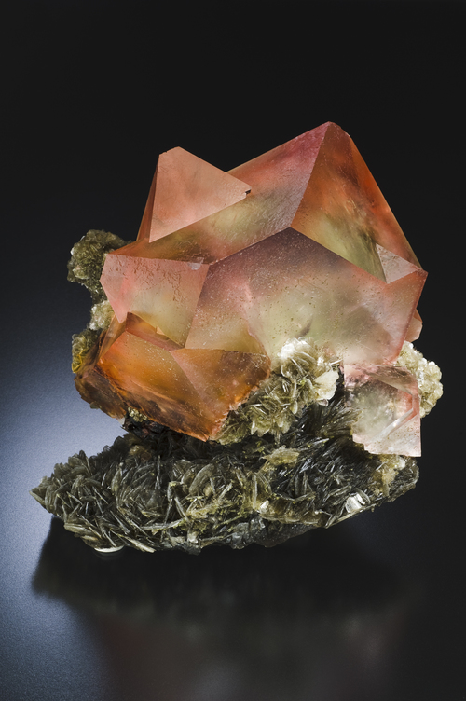
Allochromatic

Slide 5
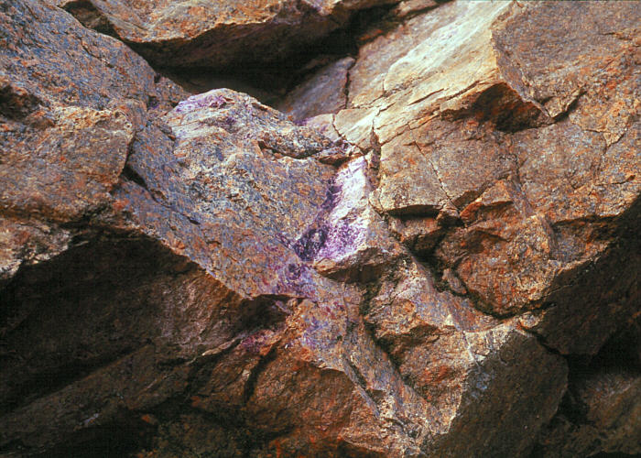
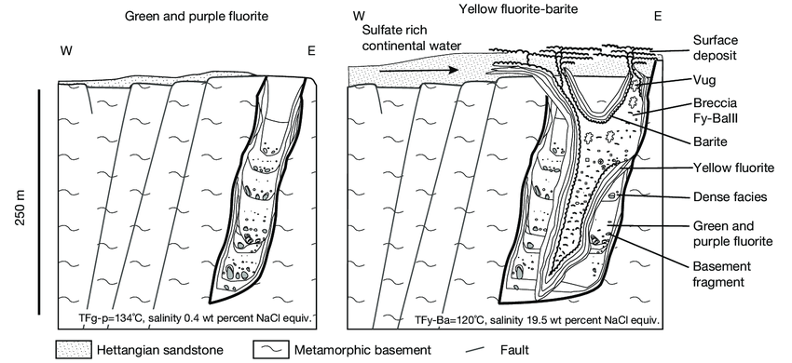
How is Fluorite formed?
Fluorite occurs as vein fillings in rocks when subject to hydrothermal activity, especially those containing lead and zinc minerals. It is also found in the fractures and cavities of limestone and dolomite structures.

Slide 6
Where do you find Fluorite?
Fluorite is common all over the world, with most of the deposits in: Argentina, Austria, Canada, China, England, France, Germany, Mexico, Morocco, Myanmar, Namibia, Russia, Spain, Switzerland, United States

Slide 7
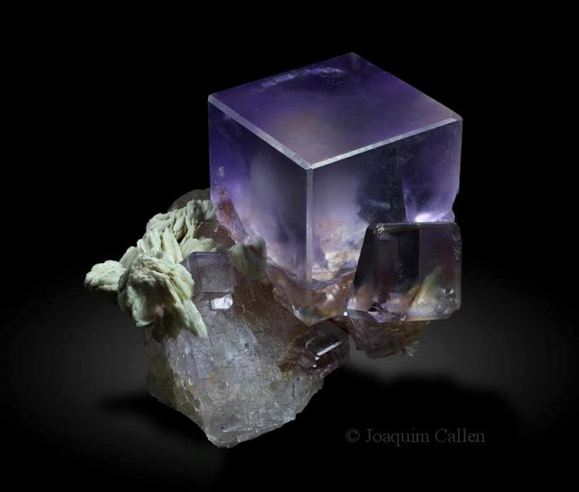
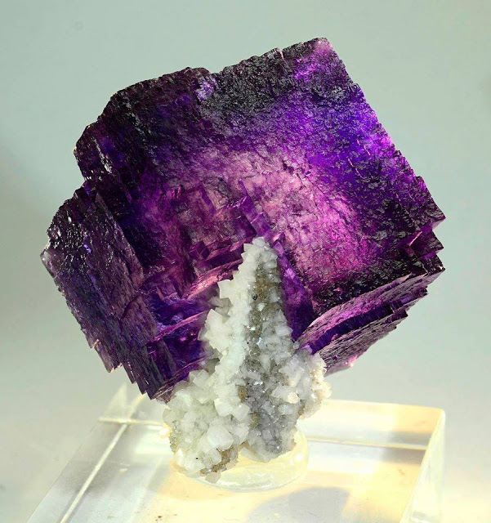
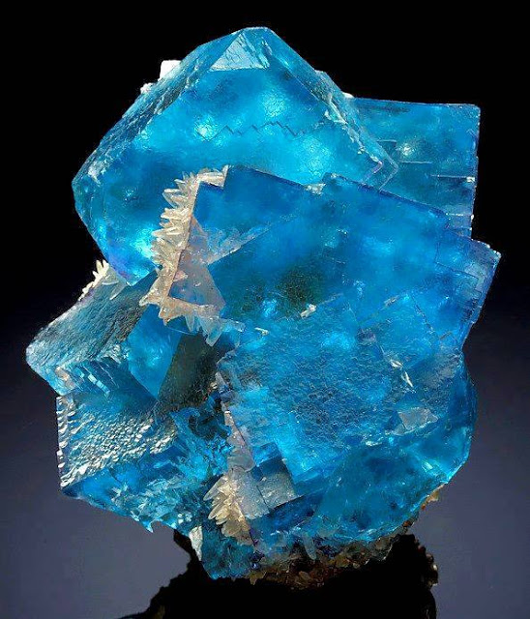
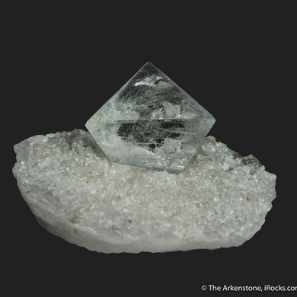
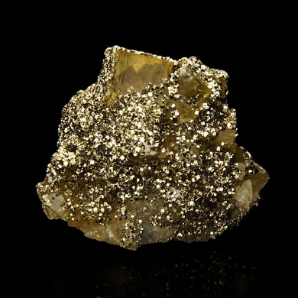
Commonly Found With:
Baryte, Calcite, Dolomite, Pyrite, and Quartz

Slide 8
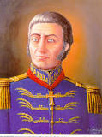
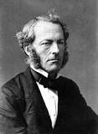
How was it named?
1797 Carlo Antonia Galeani Napione named Fluorite off of its ability to be used as a flux in metallurgy. In Latin, fleure means “to flow”.
In 1852 George Gabriel Stokes discovered the phenomenon of “fluorescence” which he named after he observed fluorite producing color “beyond the violet end of the spectrum”
Blue John, Cerfluorite, Chlorophane, False Amethyst, Ratovkite, Stink- Fluss, Strontian Fluorite, Tiffany Stone, Yttrocerite, Yttrofluorite

Slide 9
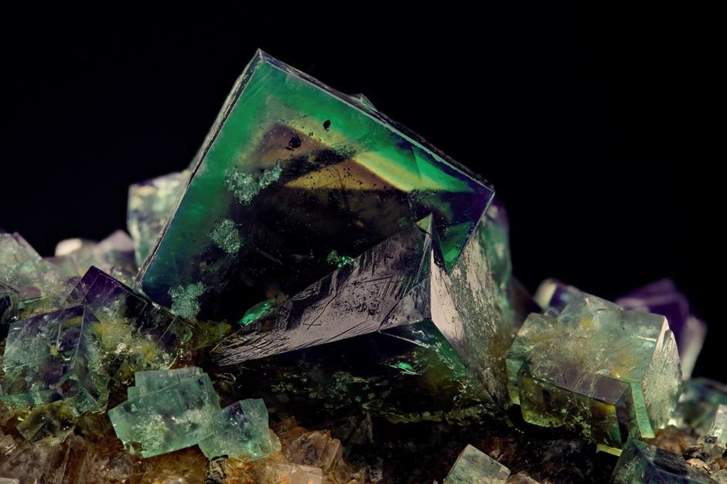
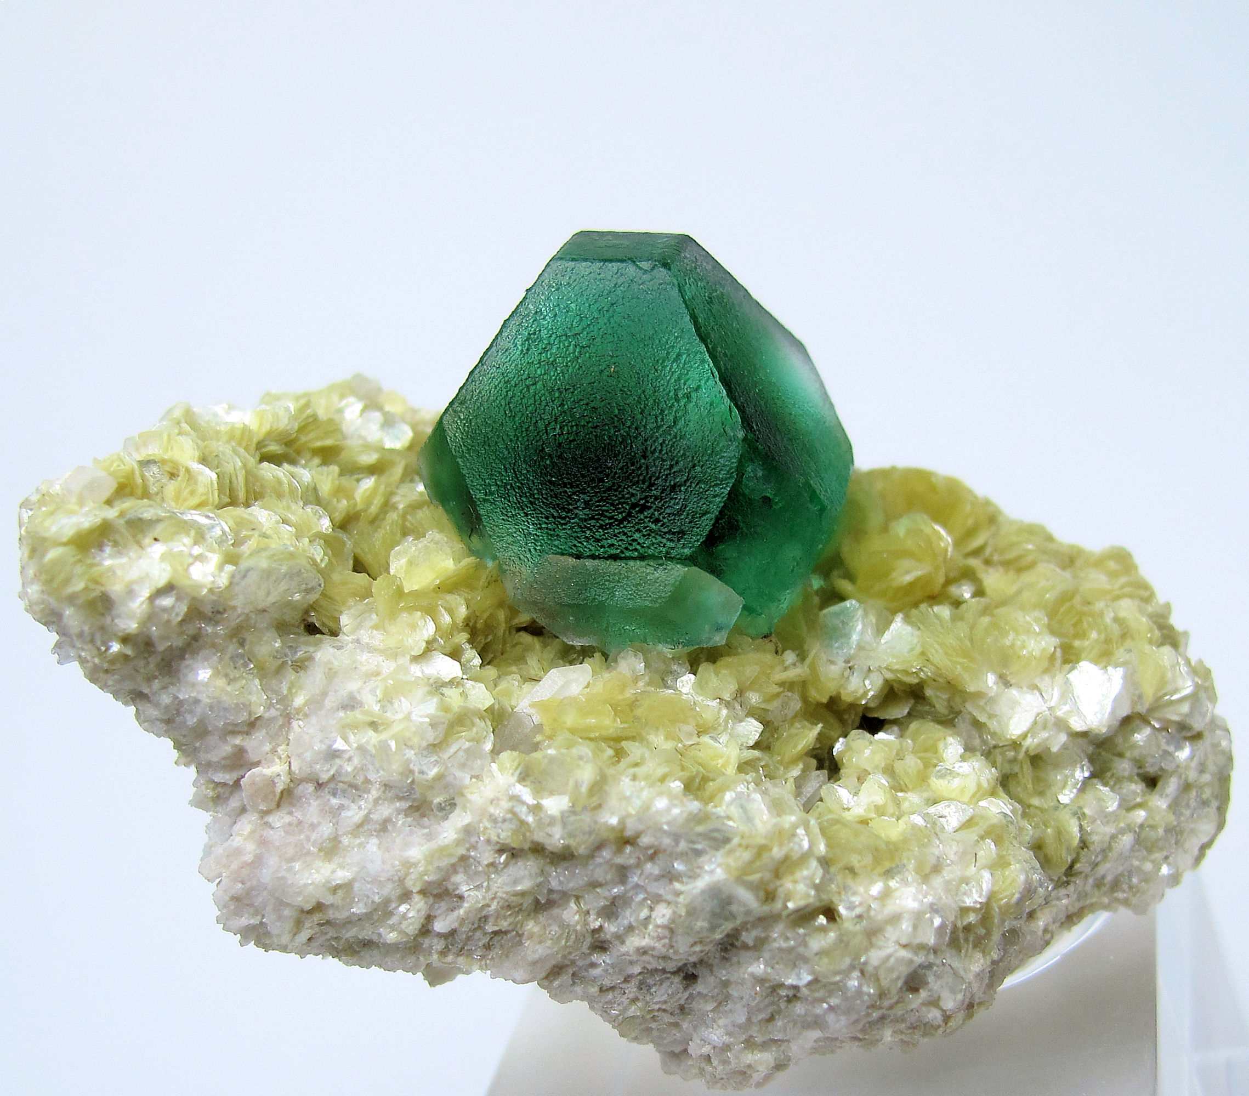
Physical Properties
Vitreous, dull
Transparent
Purple, golden-yellow, green, colourless, blue, pink, brown, champagne
White Streak
Perfect Cleavage, (0,1,1)
Splintery fracture
3.175-3.56 specific gravity- increasing density with rare earth substitution
4 on Moh’s Hardness Scale

Slide 10
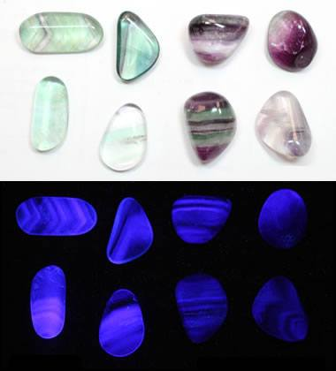
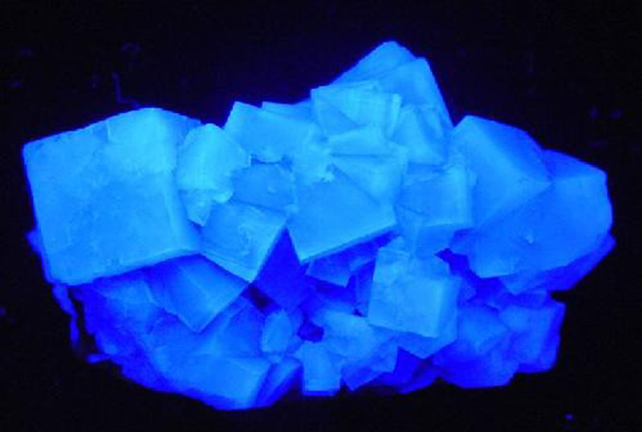
Optical Properties
Fluorescence : Blue due to erbium, White,
Red, Pink, Cream
Isotropic
No Birefringence
RI Values: 1.433-1.448

Slide 11
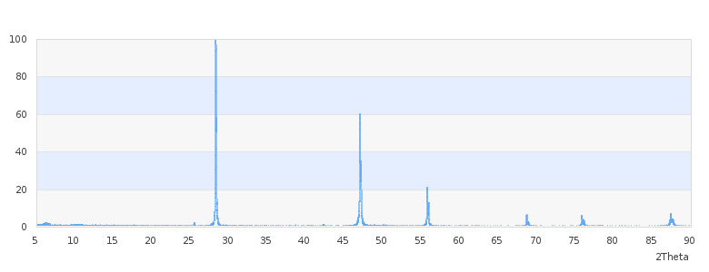
X-Ray Diffraction
X-Ray Diffraction of Fluorite from Rock Candy Mine, British Columbia, CA

Slide 12
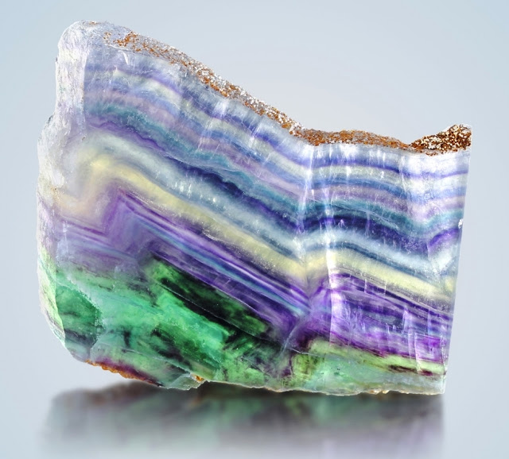
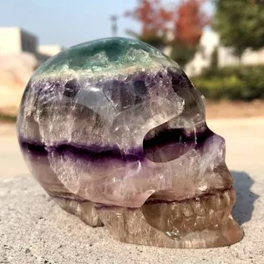
Uses
Metallurgy- fluorite is used as a flux, which promotes fluidity of smelting ores, removes oxide films, prevents reoxidation of the surfaces during heating and aids to remove objectionable impurities in the form of slag.
The purest grades of fluorite are a source for fluoride to make hydrofluoric acid
Lapidary uses- decoration, jewelry
Glass
Purify water
Fights cavities
Learning aid, stabilizer, open mind

Slide 13
Citations
https://geology.com/minerals/fluorite.shtml
https://www.britannica.com/technology/flux-metallurgy
https://www.mindat.org/min-1576.html
https://en.wikipedia.org/wiki/Carlos_Ant%C3%B4nio_Napion
http://minerva.union.edu/hollochk/halifax_pluton/stop_8.html
http://www.geologyin.com/2017/02/why-fluorite-comes-in-different-colors.html

