Slide 1
Molybdenite (MoS2)
By: Kiara Ortiz

Slide 2
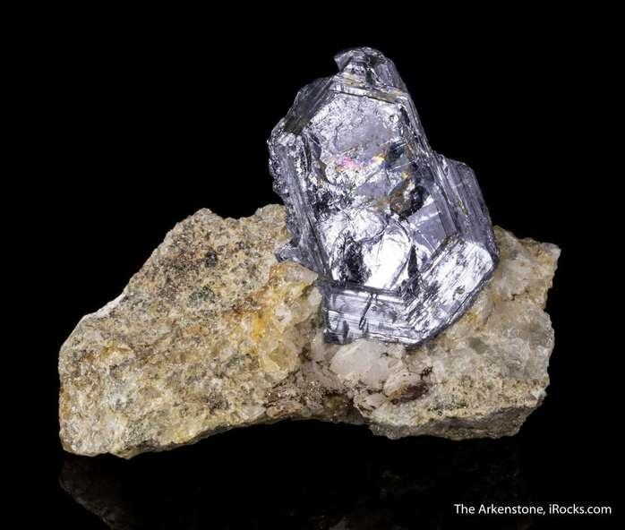
Physical Properties:
Color: Black, Lead Grey or Grey
Hardness: 1 - 1 ½
Specific Gravity: 4.62-4.73
Luster: Metallic
Transparency: Opaque
Crystal System: Hexagonal
Tenacity: Flexible
Cleavage: Perfect {0001}

Slide 3
Structure:
Sheets of Molybdenum atoms (blue) sandwiched between sulfur atoms (yellow) to form a layer
The layers are stacked on top of one another and are poorly bonded
The weak bonding gives Molybdenite it’s slippery feel

Slide 4
Optical Properties
Type: Anisotropic
Anisotropism: Very strong
Pleochroism: Strong

Slide 5
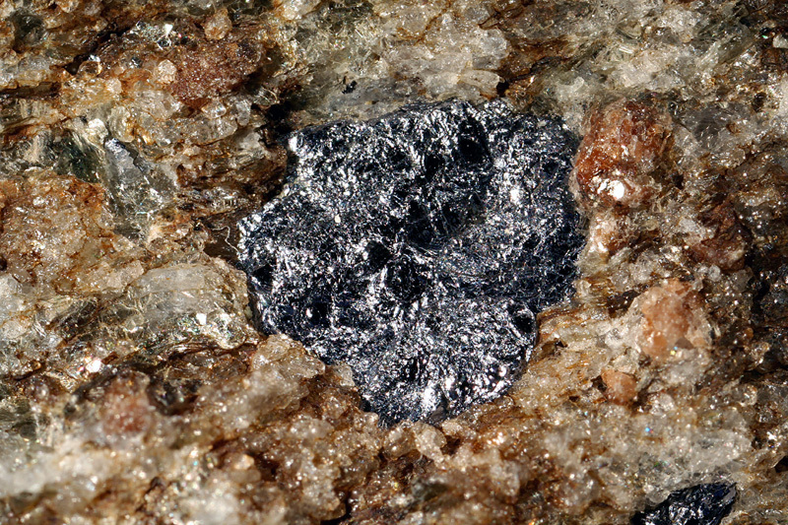
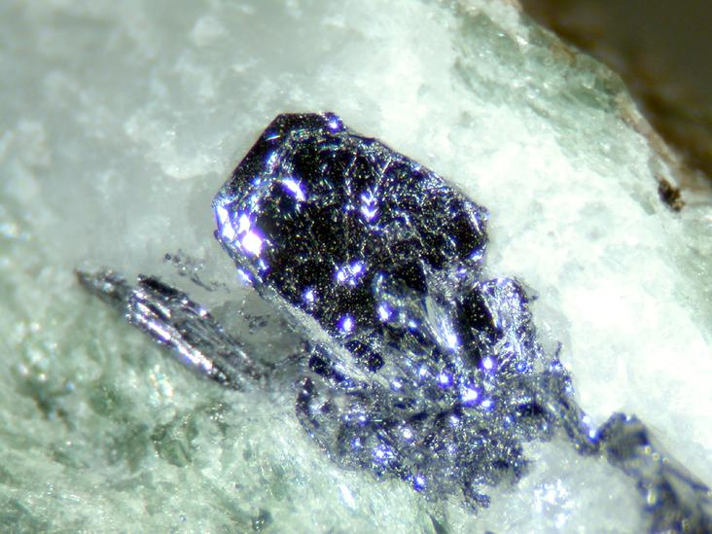
Crystallography:
Polytype: Molybdenite-2H Molybdenite-3R
Formula: MoS2 MoS2
Crystal System: Hexagonal Trigonal
Space Group: P6₃/mmc R3m

Slide 6
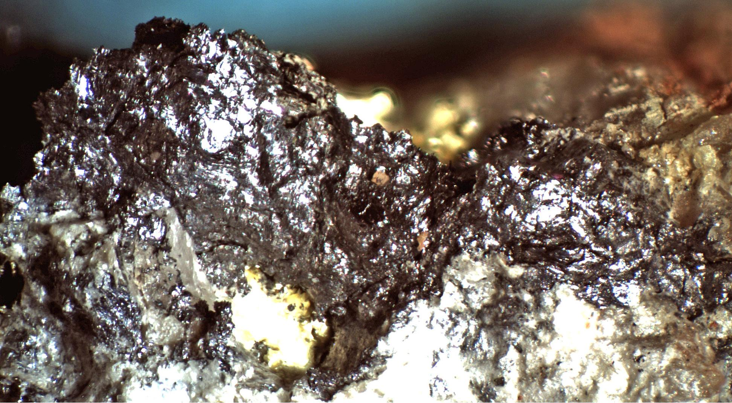
Varieties of Molybdenite:
Femolite (Mo, Fe)S2
Rhenian Molybdenite: (Mo, Re)S2

Slide 7
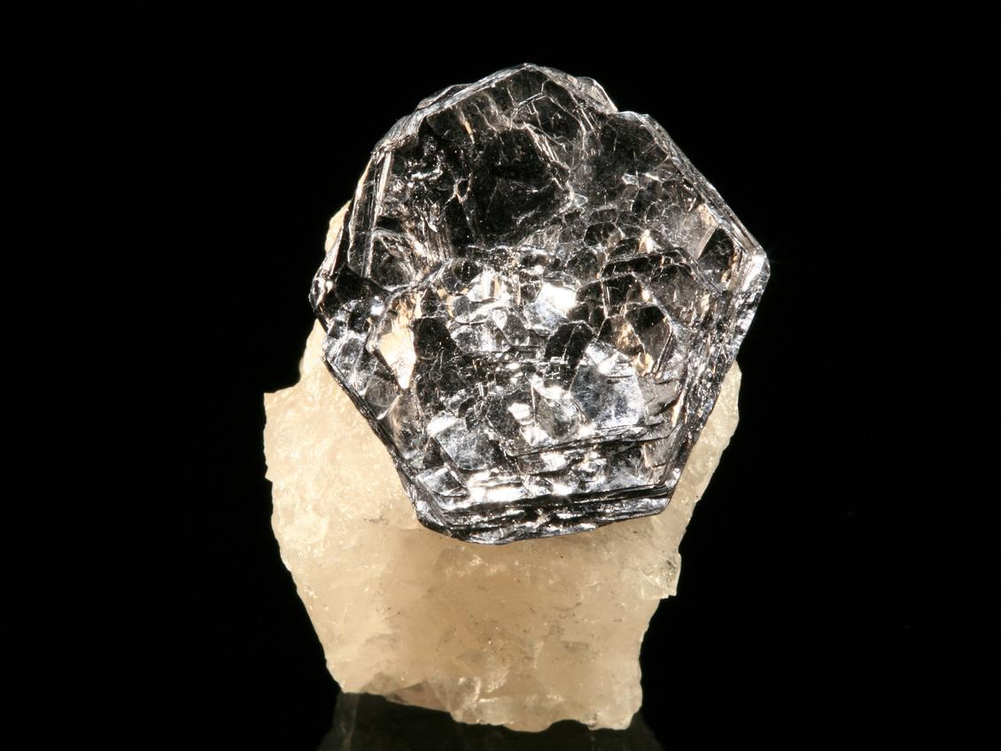
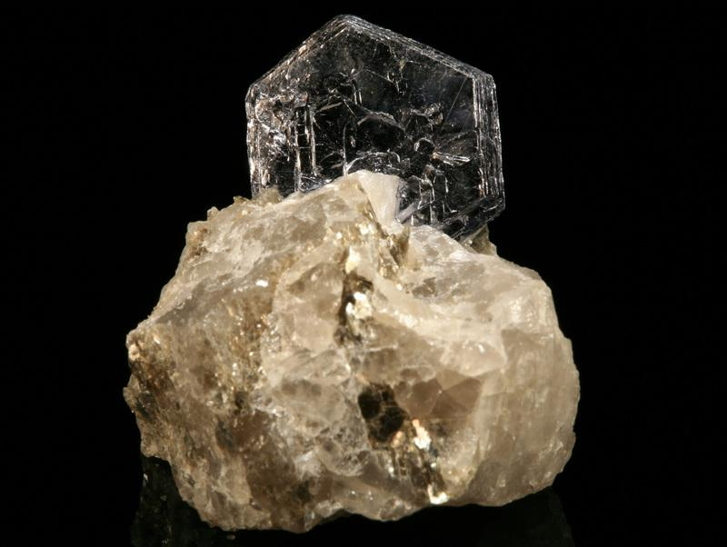
Facts:
Confused with Graphite
From the Greek word Molybdos meaning “Lead”
Environment usually is in high temperature hydrothermal veins
Found in igneous and metamorphic rock
Currently being researched as a possible replacement semiconductor for silicon in transistors in electronic chips
Essential ore of Molybdenum

Slide 8
Uses:
Used in electronics
Finely ground Molybdenite is used as a lubricant to reduce friction between sliding metal parts
Ground Molybdenite sometimes used as an additive to some types of high performance grease
Used for making speciality alloys (because Molybdenite is an essential ore of Molybdenum)

Slide 9
Locations

Slide 10
References:
Molybdenite. (n.d.). Retrieved December 1, 2019, from https://www.mindat.org/min-2746.html.
Rhenian Molybdenite. (n.d.). Retrieved December 1, 2019, from https://www.mindat.org/min-25604.html.
Barthelmy, Dave. Molybdenite Mineral Data, http://webmineral.com/data/Molybdenite.shtml#.XfCH8uhKhPY.
King, Hobart M. “ Molybdenite.” Geology, https://geology.com/minerals/molybdenite.shtml

