Slide 1
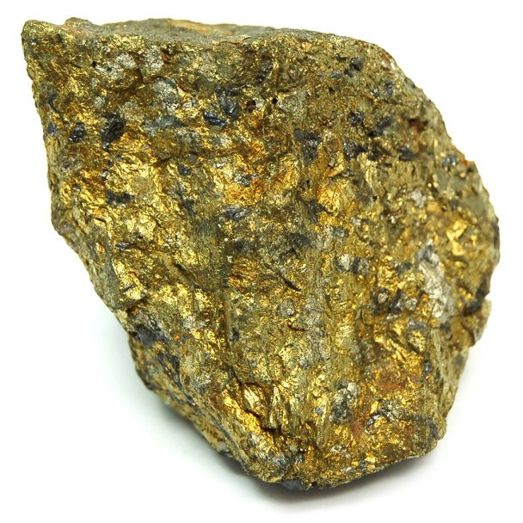
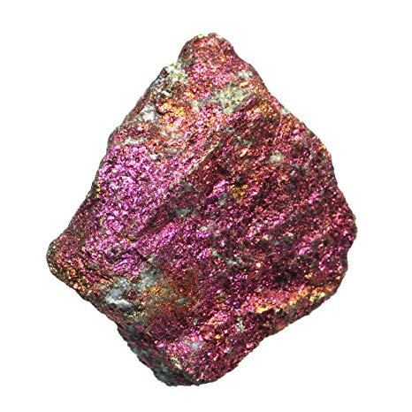
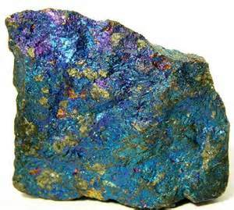
Chalcopyrite
It’s shiny and metallic and comes in different colors.
I’m Evan and this is my mineral I guess.

Slide 2
General Information
Formula: CuFeS₂
Common Impurities: Ag,Au,In,Tl,Se, and Te
Color: Brass-yellow, but often has an iridescent tarnish, Metallic Luster
Hardness: 3.5-4
Specific Gravity: 4.1-4.3
Crystal System: Tetragonal
Named in 1725 by Johann Friedrich Henckel from the Greek "chalkos", copper, and "pyrites", strike fire.

Slide 4
More information on chalcopyrite
Poor cleavage pretty much everywhere
Twins on {112} and {012}
It forms in igneous and metamorphic rocks and is common anywhere that sulfide minerals exists. It’s often found with other copper sulfide minerals
Copper can be removed by weathering and carried a short distance in solution, where it then redeposits and forms secondary minerals like malachite.
The colors of the tarnish are caused by the presence of acids

Slide 5
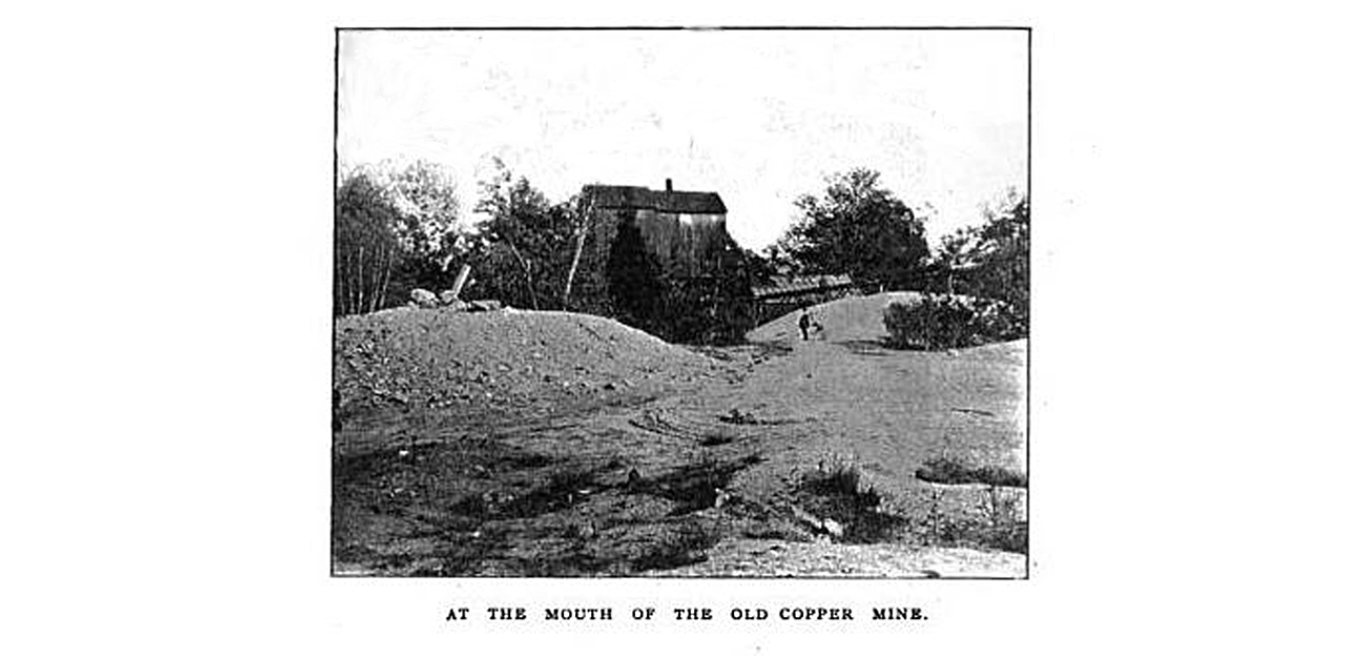
Mining for Ore
One of the primary ores mined for copper. It is only 25% copper (which is less than other ores have) but is much more abundant.
There is a now closed mine in Bristol, Connecticut that mined copper from chalcopyrite. It operated from 1837 to 1953

Slide 6
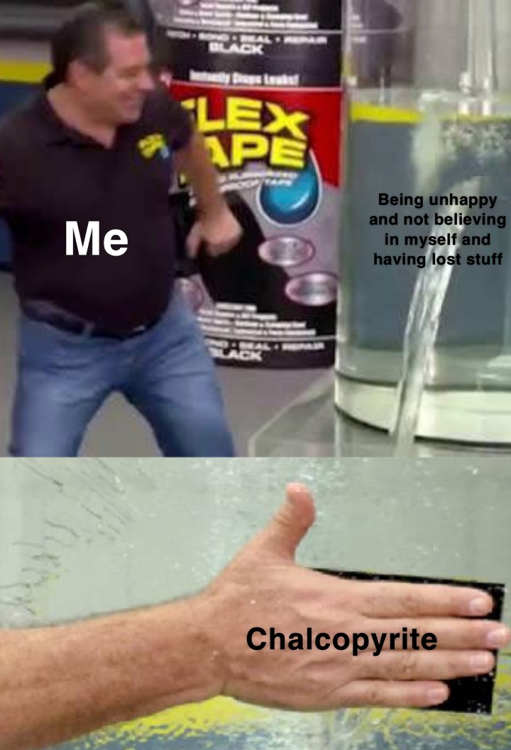
Uses of chalcopyrite
As a healing Crystal (like pretty much every other mineral is). It increases happiness, joy, and belief in yourself. It is “acknowledged” as a stone of the mystic and it’s good for meditation.
It can also be used for healing and finding lost things.
People also collect it because it looks cool

Slide 7
References
https://www.healing-crystals-for-you.com/chalcopyrite.html
https://www.mindat.org/min-955.html
https://geology.com/minerals/chalcopyrite.shtml
Shout to someone named Norman King for sponsoring the Mindat page for chalcopyrite

