Slide 1
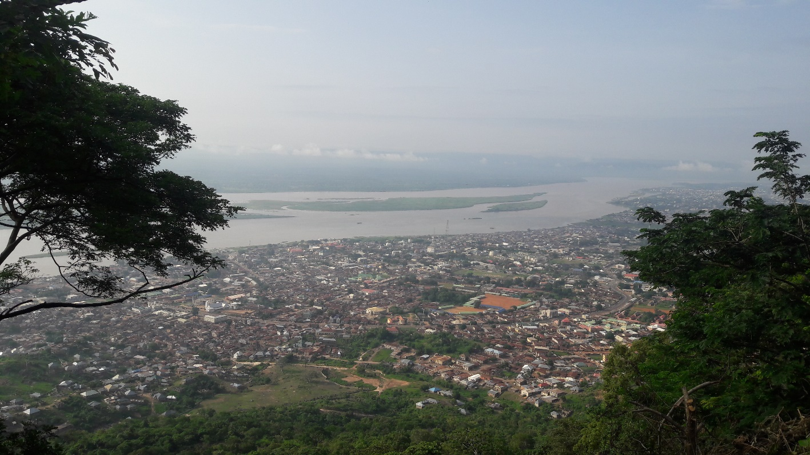
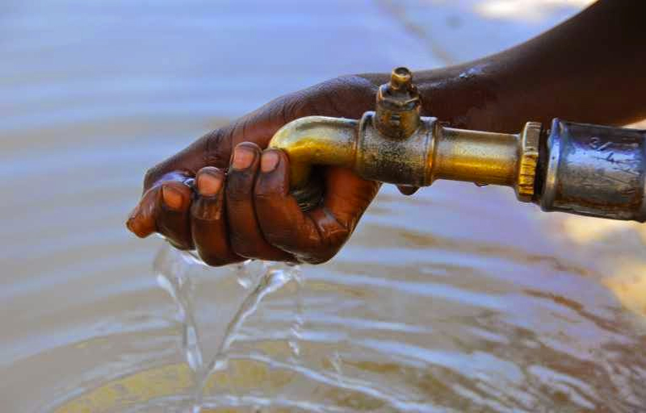
Characteristics of groundwater in lokoja, Nigeria
By Sean Casey

Slide 2
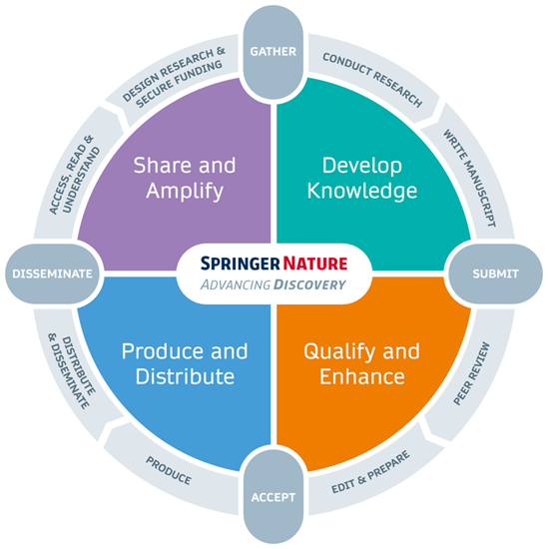
Overview
Full Article Title: Hydrochemistry and stable Isotopes (¹⁸O and ²H) characteristics of groundwater in Lokoja and its environs, Central Nigeria
Authors: Rufai Ayuba, Moshood N. Tijani, Daniel Snow
Published: September 28, 2019
Published for: Springer Nature, a global academic publishing company

Slide 3
Introduction
Purpose: To determine hydrochemical and stable isotope characteristics of groundwater in Lokoja
Groundwater is the focus of this study because:
Surface waters in the area are contaminated from anthropogenic activity, and the cost of treatment to make it potable is high
Groundwater is the most common source for drinking water in Lokoja, because government pipe-provided water is unreliable and does not reach all communities in the area
The Lokoja area receives adequate rainfall and recharge to resupply the groundwater aquifers, making it a practical drinking water supply. In addition to precipitation, these aquifers are supplied from the River Niger, River Benue, and River Mimi, made possible by permeations from underground fracturing, jointing, and shearing.

Slide 4
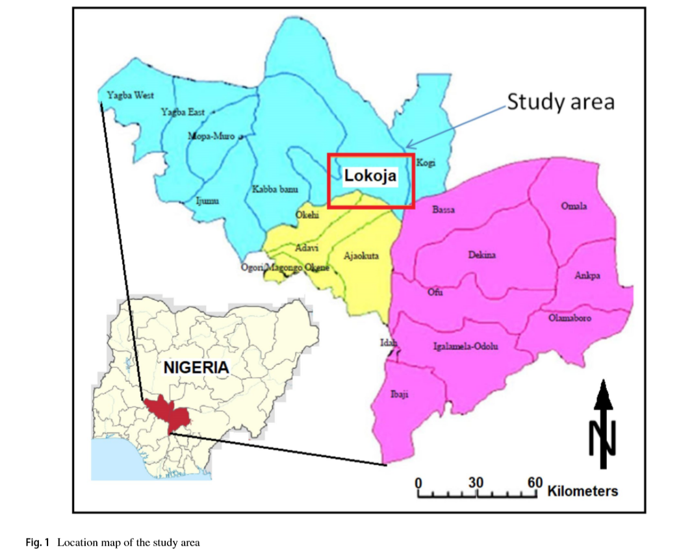
Study Area
Overview: Lokoja is the capital of Kogi state in central Nigeria
Geology: Primarily part of the Precambrian basement complex of southwestern Nigeria, consisting of migmatite-biotite gneiss, and granite with quartz and pegmatite intrusions.

Slide 5
Methods
Sampling: 39 sites were sampled, two samples were collected at each site
Samples were collected in cleaned 120mL plastic bottles
One sample was collected for cation analysis, the other for anion analysis
Cation samples were acidified to less than 2 pH to prevent precipitation of ions
Analysis: Multiple testing methods were used to determine pH, TDS, and ion concentrations of the collected samples
Hanna pen used for pH, TDS, and electrical conductivity (EC)
Atomic absorption spectrophotometry (AAS) used for Ca²⁺, Mg²⁺ , Na⁺ and K⁺ (major cation) concentrations
Ion chromatography (IC) used for NO₃⁻ ,SO₄²⁻ , and Cl⁻ (major anion) concentrations
Mass Spectrometry used for determining ¹⁸O and ²H (stable isotope) concentrations
Titration used for alkalinity (HCO₃⁻ )

Slide 6
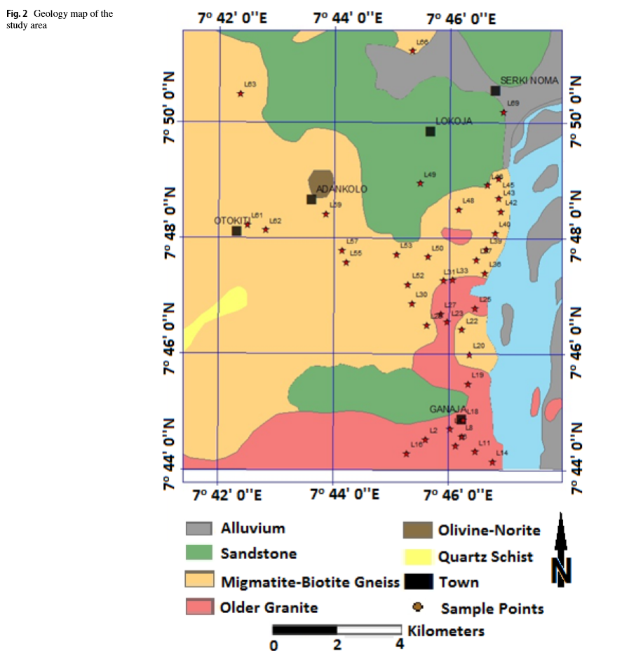
Sample Locations

Slide 7
Results
pH: Ranged from 5.9 to 8.4, all but three samples were within the neutral 6.5-8.5 range
TDS: Excluding three, all samples were classified as fresh with less than 1000 TDS
Total Hardness: Varied from 1.21 to 360mg/L, with 15.5% classified as soft water, 51.3% as moderately hard, 28.2% as hard, and 5.1% as very hard.
The high hardness levels of the samples is attributed to the geology of the groundwater aquifers, which contains high levels of Calcium and Magnesium from weathering of igneous and metamorphic rocks
Cations & Anions: All concentration values for cations were within WHO limits for drinking water. One sample had a high concentration of NO₃⁻ (above WHO limits for drinking water)
Alkalinity: Eight samples had elevated levels of HCO₃⁻

Slide 8
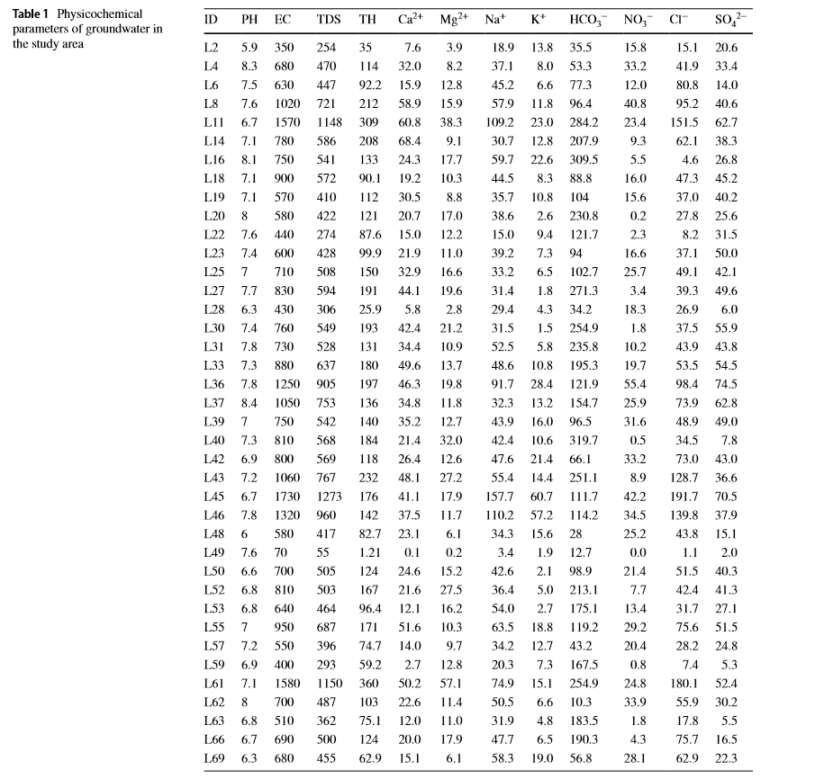
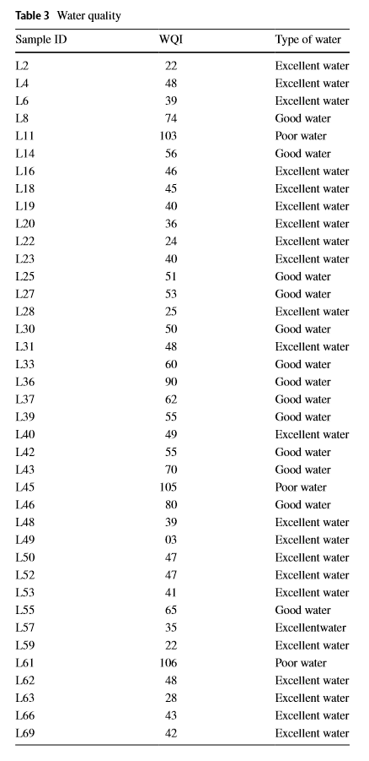

Slide 9
Conclusions
For Drinking: 59% of samples represent excellent water, 33.3% represent good water, and 7.7% represent poor water
Suitability is determined using the WQI (water quality index) technique
WQI is calculated by weighting certain variables based on their importance to drinking water and producing a rating that considers the influences on water quality in the area
For Irrigation: 69.2% suitable, 20.8% unsuitable
Suitability is determined using sodium adsorption ratio (SAR) and sodium percentage
High SAR and Na% can increase compaction and decrease porosity in soils, undesirable for irrigation

Slide 10
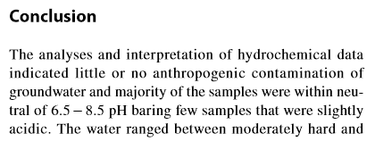
Parting Note
Just because it’s published doesn’t mean it’s perfect: While the substance of the paper is sound, it does contain a few small grammatical and formatting errors
Missing Space
Incorrect Legend
Typos

Slide 11
Questions?

