Slide 1
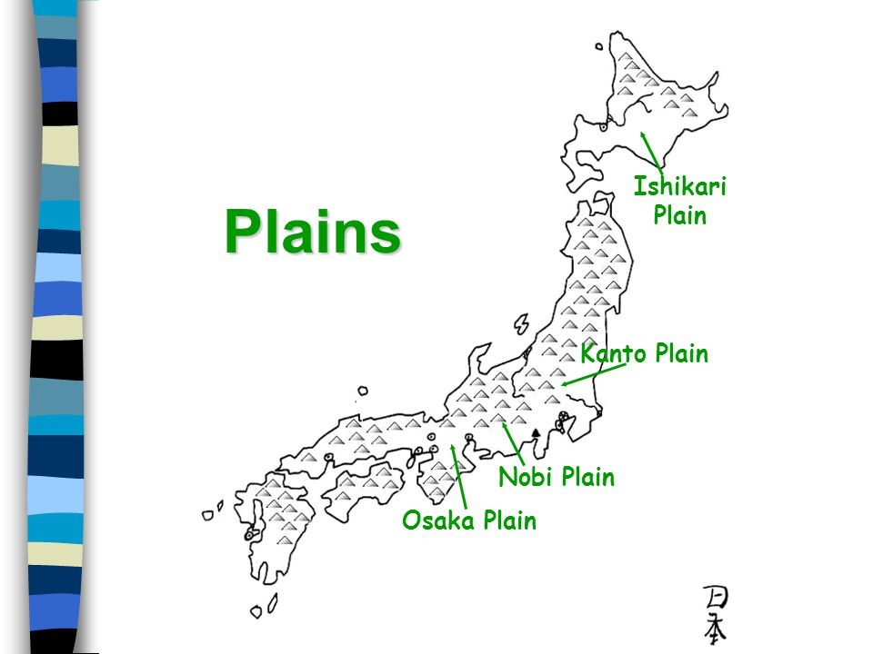
Leaching Characteristics of Naturally Derived Toxic Elements in the Alluvial Marine Clay Layer Beneath Osaka Plain, Japan
Alex Kimball

Slide 2
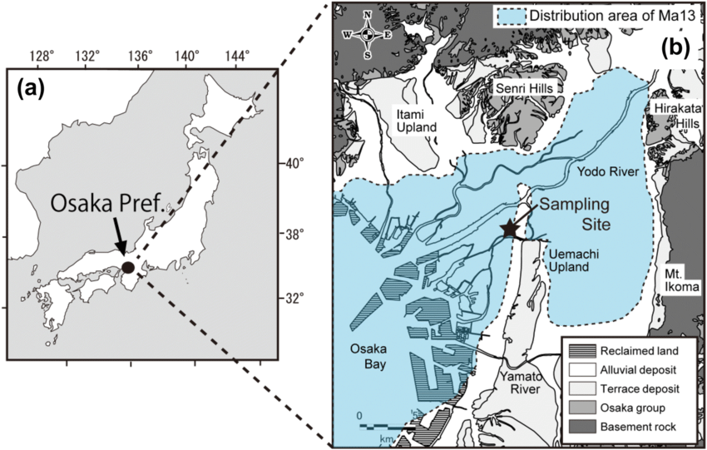
Abstract
Marine clay layer "Ma13" analyzed beneath Osaka Plain
0 to 25 meters deep. Groundwater present
Examining factors in groundwater pollution associated with excavated soil

Slide 3
Abstract Continued
Concentrations of arsenic, lead, boron, chromium analyzed. Looking at potential detriment to health and age of samples
"Fractions" of toxic elements compared to results of "sample batch leaching data"

Slide 4
Introduction
Clay and silt most abundant between 5 and 20 meters. Sand common between 0 and 6 meters and 19 and 25 meters.
"Single step partial extraction methods" allow quick analysis of presence of toxic elements and impact on humans if ingested
Aim is to determine long-term risks of pollutants from soils

Slide 5
Methods
Sediment samples cored using "thin-walled tube sampler," put into larger tube for chemical analysis
Sample packed with de-oxygenizer to prevent oxidation of minerals
Becomes difficult to assess if oxidation occurs

Slide 6
Methods Continued
Refractive indices of volcanic samples determined with refractometer.
Allowed ages of sediments to be found
Bulk sediment chemical analyses, sequential chemical extraction experiment (SCEE) and batch leaching tests
Bulk sediment analysis conducted through x-ray powder diffraction

Slide 7
Results
Refractive indices shows Kikai Caldera eruption 7,300 years ago
Deposition in seawater began 7,000 years ago
Boron and Chromium: 25-75 ppm
Lead: 18-28 ppm
Arsenic: 5-12 ppm

Slide 8
Results Continued
Boron water soluble. Derived from seawater
Arsenic in sulfides indicates volcanic and hydrothermal activity
0.1 vs. 0.45 micrometer filter for lead in groundwater

Slide 9
Conclusions
Concentrations much higher in experimental solutions compared to standard limits
Leaching of Pb, As and B should be "accelerated"
Effect on health of groundwater soluble elements has been "underestimated"
Need 0.1 micrometer width filter for drinking water

