Slide 1
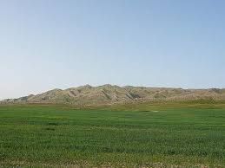
Distribution and Health Risk Assessment of Organochlorine Pesticides in Agricultural Soils of the Aghili Plain, Southwest Iran
By Brennan Masucci

Slide 2
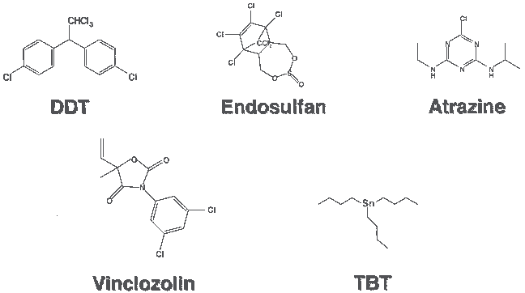
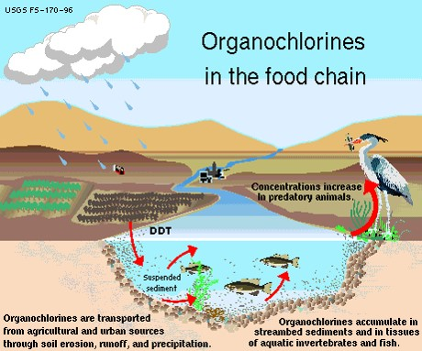
Background Information
Organochlorine pesticides (OCPs) are a group of persistent man-made chemicals that are extremely harmful to humans and wildlife.
OCPs are strongly retained by soil due to their insolubility in water. Therefore, they decompose through environmental factors into more complex and toxic compounds.
The Aghili Plain is one of the most important agricultural centers in Khuzestan province, southwest of Iran. Some industries located on the plain include paper and pulp manufacturing, metallurgical industries, and cane factories.

Slide 3
Goal of Scientific Study
Soil samples (55) were collected from the Aghili plain and analyzed for 20 different OCPs with the goal of determining contamination profiles, spatial distribution, influencing factors, and carcinogenic risks.

Slide 4
Procedure and Analytical Tests
ILCR_{ingest} = ((C_{Soil}× IngR × EF × ED)/(BW × AT))× CSF_{oral}× CF,
ILCR_{dermal} = ((C_{Soil}× SA × FE × AF_{Soil}× ABS × EF × ED)/(BW × AT))× CF × CSF_{oral}× ABS_{GI},
ILCR_{inhale} = ((CSoil× InhR × AF_{inh}× EF × ED)/(PEF × AT))× CSF_{inh},
Total CR = ∑(ILCR_{ingest}+ ILCR_{dermal}+ ILCR_{inhale})
C_{soil} = Contaminant conc. In soil (mg/kg)
CSF = Carcinogen slope factor (mg/kg/day)⁻¹
IngR = soil ingestion rate (mg/day)
EF = frequency of exposure (day/year)
ED = Exposure duration (year)
BW = average body weight (kg)
AT = average lifespan (day)
CF = convention factor (10⁻⁶ kg/mg)
SA = surface area of the skin (cm²)
FE = fraction of dermal exposure ration to soil
AF_{Soil} = skin adherence factor for soil (mg*cm²)
ABS = dermal absorption factor (chemical-specific)
ABS_{GI} = fraction of contaminant absorbed in the gastrointestinal tract
InhR = inhalation rate (m³/day)
PEF = particle emission factor
Soil samples collected from the Aghili plain.
The samples where analyzed qualitatively and quantitatively using analytical grade instruments and materials.
Extraction and analysis of soil samples.
Soils were tested for size distribution of soil particles, electrical conductivity (EC), and acidity (pH).
Samples were tested for quality control and quality assurance. Followed by a statistical analysis of original concentration data, and correlation among OPCs. These values were related to the detection limit of standard analytical grade materials/samples. Lastly, a risk assessment was done with the given equations.

Slide 5
Results
Mean St. deviation for pH and EC of samples were 7.85 ± .31 and 2.20 ± 1.51 ms/cm.
16 of 20 analyzed compounds were below the detection limit in all samples.
OCPs detected above the detection limit include:
- Aldrin→(ND) to 1.52 ng/g with mean value of .54 ng/g.
- Dieldrin→ (ND) to .27 ng/g with a mean of .15 ng/g.
- 4,4-DDE→ (ND) to 2.08 ng/g with mean of .31 ng/g.
- 4,4-DDD→ (ND) to 1.29 ng/g with mean of .54 ng/g.

Slide 6
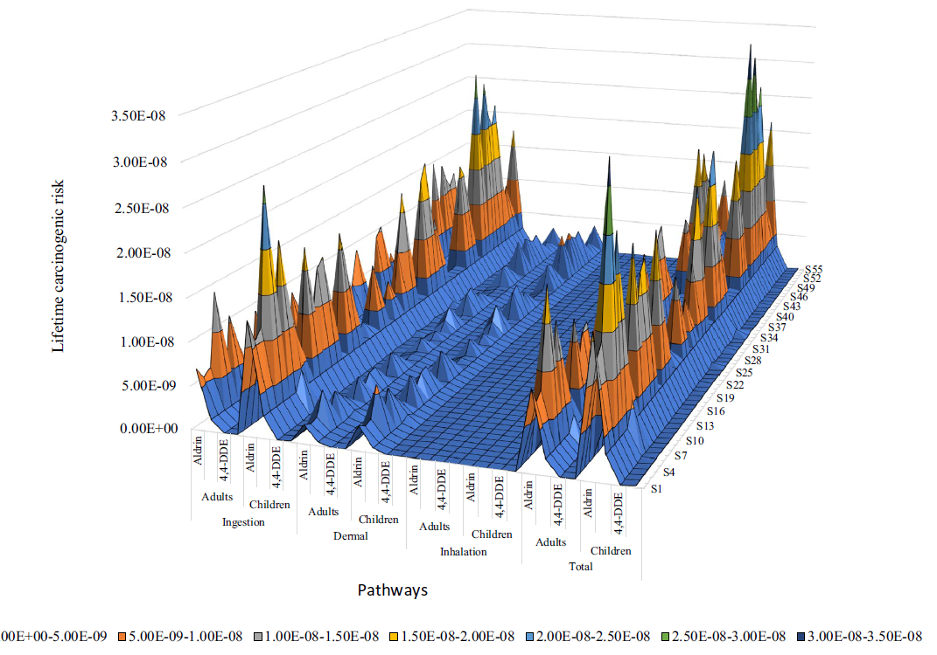
Conclusion
Agricultural soils were contaminated with OCPs and recent application of OCPs was highly unlikely.
Aldrin was the most used OCP in the study area.
Residual compounds of dieldrin, 4,4-DDE, and 4,4-DDD were detected in the soil.
Carcinogenic risk assessment revealed very low level risk (value < 10⁻⁶) for residence living in the study area.

Slide 7
References
http://pakagrifarming.blogspot.com/2013/08/88-organochlorines-history-use-and-toxicity.html
https://www.researchgate.net/figure/Examples-of-organochlorine-pesticides-associated-with-endocrine-disruption_fig2_228702441
http://trip-suggest.com/iran/Khuzestan/kursharan/
http://faculty.uml.edu/nelson_eby/89.315/Professional%20Papers/Jorfi2019_ArticleDistributionAndHealthRiskAsses.pdf

