Slide 1
Heavy Metal Contamination History of Renuka Lake
Sarah Perkins

Slide 2
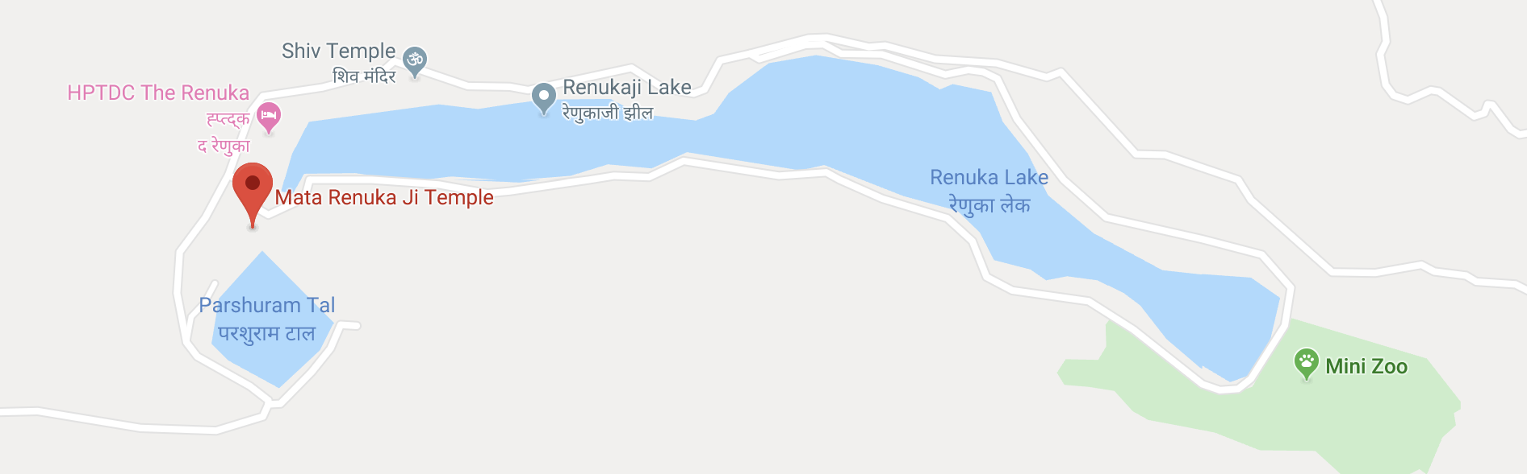
About the Lake
Between the Lesser Himalaya sedimentary rocks
Dolomitic limestone, slate, quartzite, calcareous, carbonate, shale, sericite, etc.
150-200 cm of rainfall annually
Main sources of water are from monsoon rain and underground seepage

Slide 3
Introduction
Purpose- Determine the heavy metal contamination history of Renuka Lake from 1893-2003
Reason- Himalayan lakes are facing an acute problem of survival due to an increase in toxic elements in the water and sediments
Goal- To understand the heavy metal load and possible sources

Slide 4
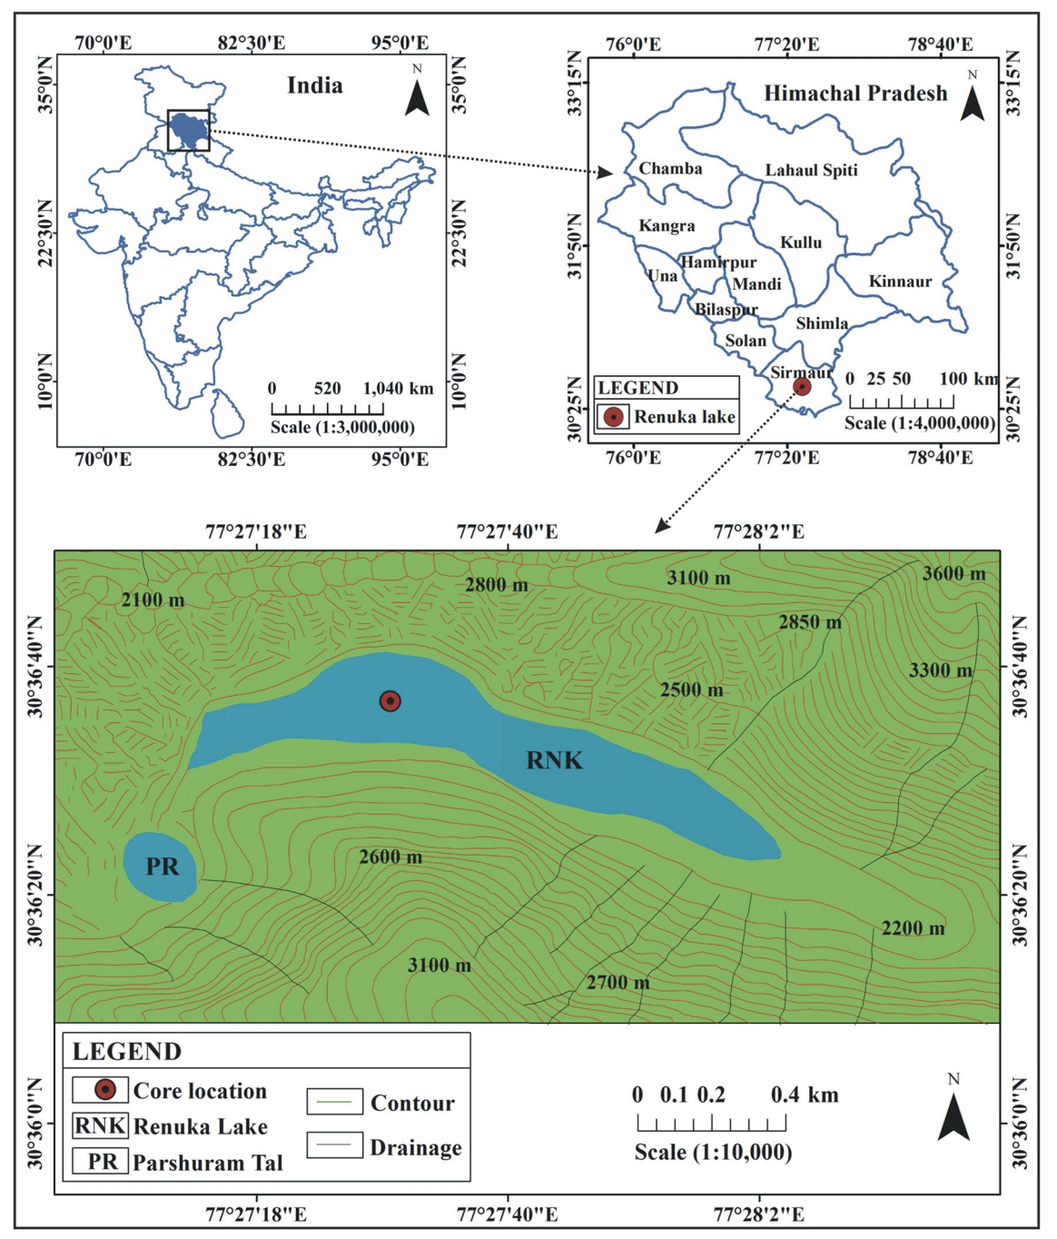
Materials and Methods
Sampling
ICP-MS analysis

Slide 5
Dating
²¹⁰Pb
Half life of 22.26 years
Supported ²¹⁰Pb from surrounding rocks
Unsupported ²¹⁰Pb from atmosphere
¹³⁷Cs
Half life of 30 years
Maximum fallout in 1963

Slide 6
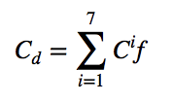
Statistical Analysis
Contamination factor
Degree of contamination

Slide 7
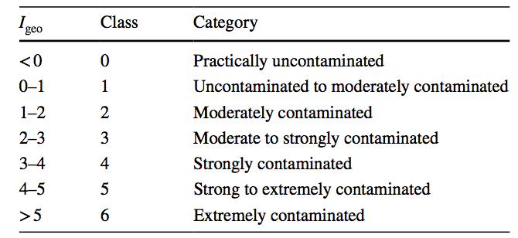
Statistical Analysis
Geo-accumulation Index
Pollution load index

Slide 8
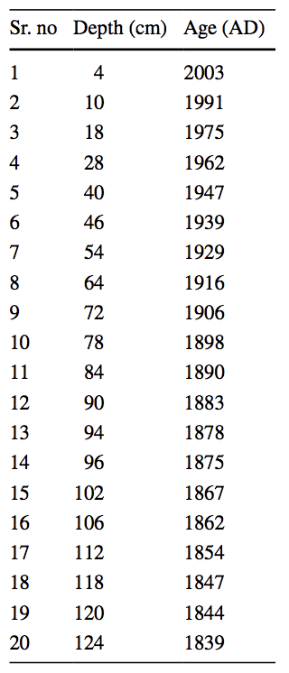
Results
²¹⁰Pb
Top 0-19 cm → 2011-1974
Sedimentation rate= 0.51 cm/yr
19-37 cm → 1974-1950
Sedimentation rate= 0.78 cm/yr
Average sedimentation rate= 0.64 cm/yr
¹³⁷Cs
Highest concentration at 37.5 cm →1963
Sedimentation rate= 0.79 cm/yr

Slide 9
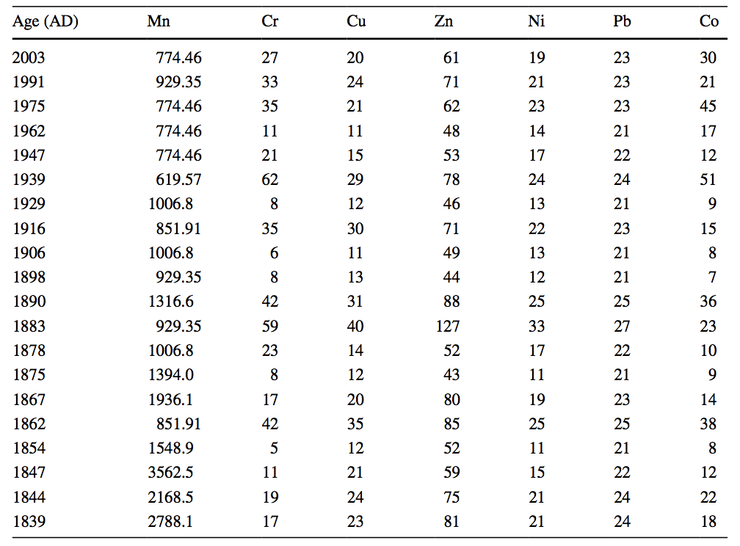
Results
Lead, chromium, cobalt, copper, zinc, and nickel all showed similar trends from 2003-1839 but with different amplitudes

Slide 10
Results- Lead (Pb)
Natural sources
Detrital quaternary sediments (K-feldspar, plagioclase, carbonates)
Shale
Lake based sulfide minerals
Anthropogenic sources
Vehicle emissions
Acid batteries
Paints
Sewage

Slide 11
Results- Chromium (Cr)
Natural sources
Quartzite
Chlorite
Anthropogenic sources
Stock farms
Industries
Agro-chemicals

Slide 12
Results- Cobalt (Co)
Natural sources
Olivine
Pyroxine
Mica
Garnet
Anthropogenic sources

Slide 13
Results- Copper (Cu)
Natural sources
Silicates
Carbonates
Copper sulfides
Other evaporate minerals
Enriched in shale
Anthropogenic sources
Coal burning
Atmospheric deposition
Vehicle emissions
Gas, diesel, and lubricant combustion

Slide 14
Results- Zinc (Zn)
Natural sources
Anthropogenic sources
Metal plating and related works

Slide 15
Results- Nickel (Ni)
Natural sources
Mafic and ultra mafic rocks
Anthropogenic sources
1975- metallic waste dumping

Slide 16
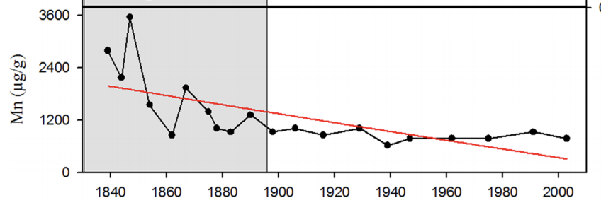
Results- Manganese (Mn)
Natural sources
Shale
Dolomite
Anthropogenic sources
Burning fossil fuels
Sewage
Mining

Slide 17
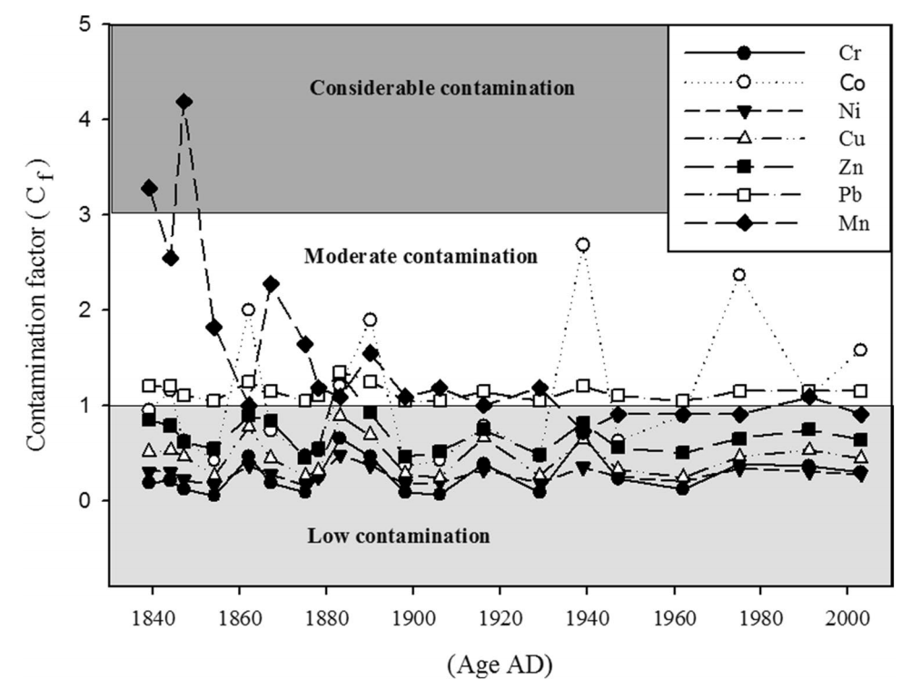
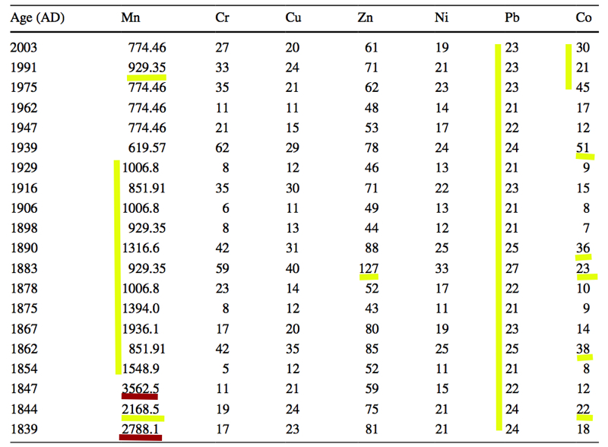
Results- Contamination Factors

Slide 18
Results- Positive Correlation
Strong
Cr- Cu, Ni, Pb
Cu- Zn, Ni, Pb
Zn- Ni, Pb
Ni- Pb
Moderate
Cr- Zn
Co- Cr, Cu, Ni, Pb

Slide 19
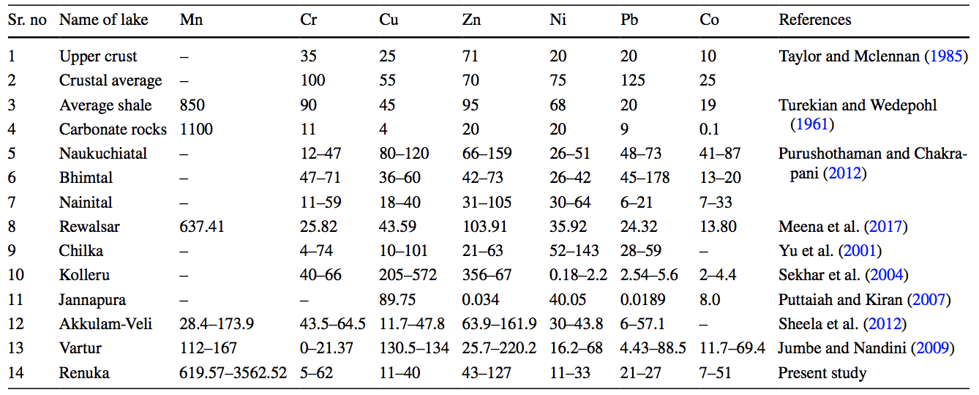
Results- Comparison

Slide 20
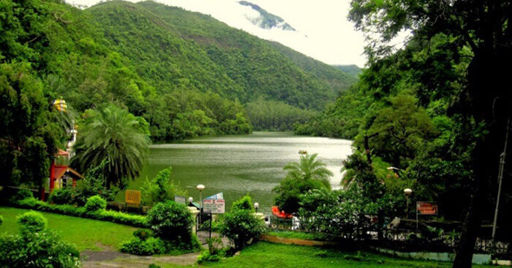
Conclusion

