Slide 1
Road Deicing, Upper Passaic River Basin (UPRB), New Jersey
Michael A. Turner

Slide 2
About the Author
Dr. Duke U. Ophori
Professor at Montclair State University, New Jersey
Geo-Environmental Scientist and Specialist, with extensive experience in the mapping and modeling of large-scale groundwater flow and contaminant transport for application to the solution of environmental problems.

Slide 3
“Impact of road deicing salts on the Upper Passaic River Basin, New Jersey: a geochemical analysis of the major ions in groundwater”
Contents of the Study
Ions observed and their concentrations in groundwater. (USGS data)
Statistical analysis of major ion concentration in groundwater. (USGS data)
Study Area: Water Management Area 6 UPRB
Bivariate plots of ions observed in study.
Data Analysis using linear regression, averaged statistical analysis and prediction interval analysis.
Results
Limitations
Notes:
Collected data from USGS UPRB analysis of major ion concentration in ground water.
Ions include Sodium, Magnesium, Calcium, Chloride, Sulfate, Potassium, Bicarbonate, TDS

Slide 4
Objective of the Study:
Determine whether road deicing application has had a significant effect on the groundwater composition of the UPRB.
Analyze geostatistical and hydrochemical trends of groundwater samples over a 50-year time-frame to:
Determine correlations in ion to ion relationships using single linear regression.
Identify trends in major ionic concentrations over time.
Ions included Magnesium, Sodium, Chloride, Calcium and Sulfates.
Evaluate the hydrochemical composition of groundwater facies in decadal segments.
Notes:
1960 – 2010, conducting an analysis of geostatistical and hydrochemical trends of groundwater samples.

Slide 5
Study Area:
Passaic River
Bedrock Map
Notes:
Passaic river runs through bedrock transition.

Slide 6
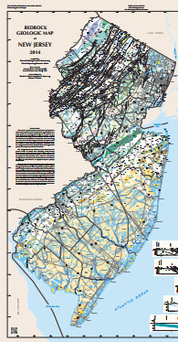
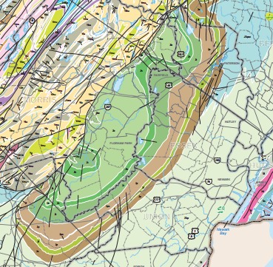
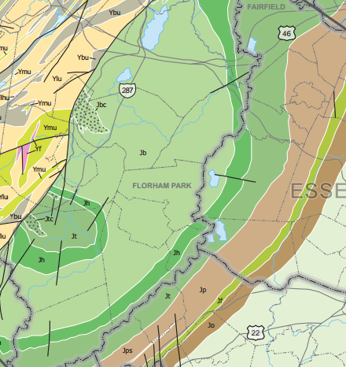
Study Area:
Upper Passaic River Basin Bedrock Map.
Metamorphic to Sedimentary west to east.
Metasedimentary, Metavolcanics (Mesoproterozoic)
Sandstone, Siltstone, Silty-Mudstone (Lower Jurassic)
Notes:
Passaic river basin along a transition in bedrock.

Slide 7
Study area:
Water Management Area 6 location.
Road Networks.
Notes:
New Jersey location in reference to geology and location of bedrock facies.

Slide 8
Study Area: Water Management Area 6
WMA6
Notes:
Watershed Management Area 6 represents the area drained by waters from the upper reaches of the Passaic River Basin including the Passaic River.
WMA 6 is characterized by extensive suburban development and reliance upon ground water sources for water supply.
WMA 6 lies in portions of 3 separate counties and includes the over 4 River Watersheds.

Slide 9
Notes:
Mean, Standard deviation and range of major ion concentration.
Note data count variations, later explained

Slide 10
Results:
Notes:
Number of well samples are different. R2 distance average from line.
Ion to Ion Relationships bivariate plots

Slide 11
Results:
Notes:
Decadal data does not us all 573 samples every decade. 573 samples used throughout the study.
Ion to Ion concentration bi

Slide 12
Results:
Notes:
Schoeller diagram shows all log concentrations of solids in solution showing further evidence of Cl concentrations in the groundwater.

Slide 13
Results:
Notes:
Sulfate is the only ion that showed a decrease in concentration over time. Points to likelihood that Na and Cl concentrations are being influenced from an outside source.

Slide 14
Results:
Notes:
Piper Plots:
6a- diagram shows “fresh” water during this period, dominated by Ca(HCO3)2 Calcium Bicarbonate
6b- diagram shows switch in domination of species with +Cl, consistent with other trends in study, TDS continues to show “fresh” water

Slide 15
Results:
Notes:
-6c- controlled by sampling area which became a larger area including the metamorphic region in the UPRB
-6d- Dominated by both bicarbonate and NaCl species, Bicarbonate presence from metamorphic area and influx of Sodium Chloride can be from high porosity and permeability of the sedimentary rock.
- Even though the TDS stayed below 1000mg/L, that of freshwater, this naturally uncontaminated water should have little to no chloride.

Slide 16
Prediction Interval Analysis
Used a 95% prediction interval plot.
The prediction intervals were derived using the results collected and tested from the USGS 1960 – 1969 collected data.
Predictions were carried out for: Mg, Na, Cl, Ca, Sulfates.
Notes:
Prediction interval plots were completed for Magnesium, Sodium, Chloride, Calcium and Sulfates.

Slide 17
95%
Statistically predicted increase was juxtaposed by the actual recorded increase.
Notes:
Predictability equation used in comparison to 1960s USGS data.

Slide 18
Limitations:
Results in this study were obtained from a spatially variable dataset of wells.
573 well samples were used but not continually sampled for each decade.
More samples taken in the 1980’s and 1990’s than 1960’s and 2000’s.
Notes:
Decadal analysis does not use all 573 wells for every decade.
Spatial distribution of the data sets varies slightly over some decades.
It is considered that the conclusions of this study will not be significantly affected by these limitations.

Slide 19
References
Montclair State University (November 20, 2019) Faculty Profile Dr. Duke U. Ophori
New Jersey DEP, (November 20, 2019) Watershed Management Area 6
Upper and Mid Passaic, Whippany, Rockaway Water Management Area 6
New Jersey Geological Survey (June 30, 1999) Bedrock Geology for New Jersey, USGS/NewJerseyBedrock
Ophori, Duke (2019/08/06) Impact of road deicing salts on the Upper Passaic River Basin, New Jersey: a geochemical analysis of the major ions in groundwater VL:78, Environmental Earth Sciences

