Slide 1
Characteristics and effects of fluorine release from shallow high-fluoride soils
Presentation by Kyle Ziemba

Slide 2
The Problem
Shallow groundwater is the main drinking source for humans
If there are high levels of fluorine in this shallow groundwater, the drinking water endemic fluorosis could affect the area
Fluorosis mainly damages dental and skeletal structures
With the decreasing groundwater level, leaching from rainfall will release large amounts of fluorine into the deep level aquifers

Slide 3
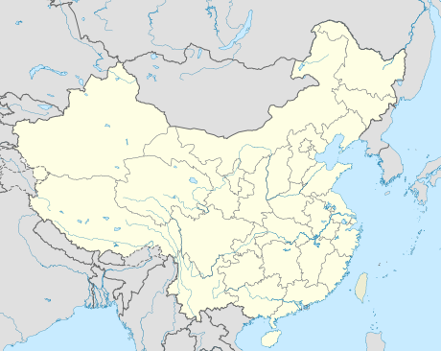
Gaomi, China
This area of China has been affected by fluorosis over the past two decades
Due to agriculture, local industry, and increased standard of living, the groundwater level has decreased
The source of the fluorine is not only chemical fertilizer, but its own fluorine-bearing minerals

Slide 4
Soil Fluorine Release Experiment
Five soil samples collected from Gaomi, China
The soil samples were air dried and sifted through 1 mm sieve
Twelve small 10 g samples were collected from each of the soil samples and placed into a bottle with 100 ml of distilled water
The bottles were put on a horizontal shaker at 200 rpm and the concentrations of fluorine ions was measured at specific time intervals
The fluorine in the soil and water are in equilibrium, if the desorption rate is higher than absorption, the fluorine is released

Slide 6
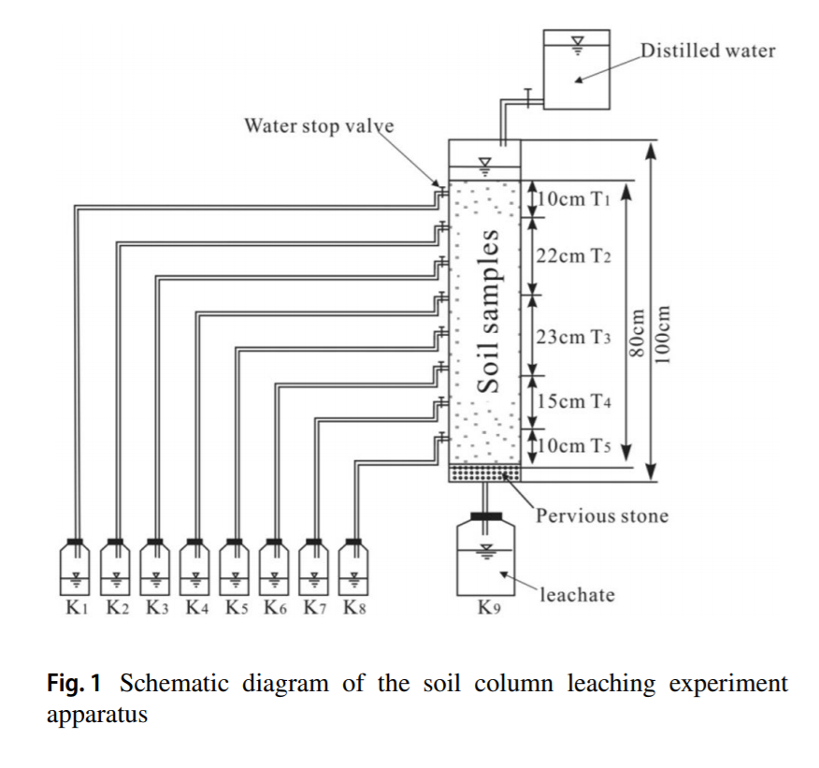
Soil Column Leaching Experiment
The samples were set up as they were when collected in the field
The soil column was saturated with distilled water
The leachates were collected from each outlet according to specific time intervals
This experiment took place over 1046 hours.

Slide 7
Measurements
In both experiments, the F⁻ concentrations were found by using an ion selective electrode
The pH of the leachate was measured by pH meters
The HCO₃⁻ concentration was measured by titration
The Ca²⁺ and Mg²⁺ concentrations were measured by using an atomic absorption spectrophotometer

Slide 8
Results for Soil Fluorine Release Experiment
During the experiment, the desorption and absorption of fluorine alternated between the soil and distilled water, but ultimately the fluorine remained desorbed and released from the soil.
The amount of fluorine released increased from T₁-T₅ or increased with depth of soil from shallow to deep.
In this study, the deeper soils contained higher levels of calcareous minerals, which promotes more desorption of the fluorine

Slide 10
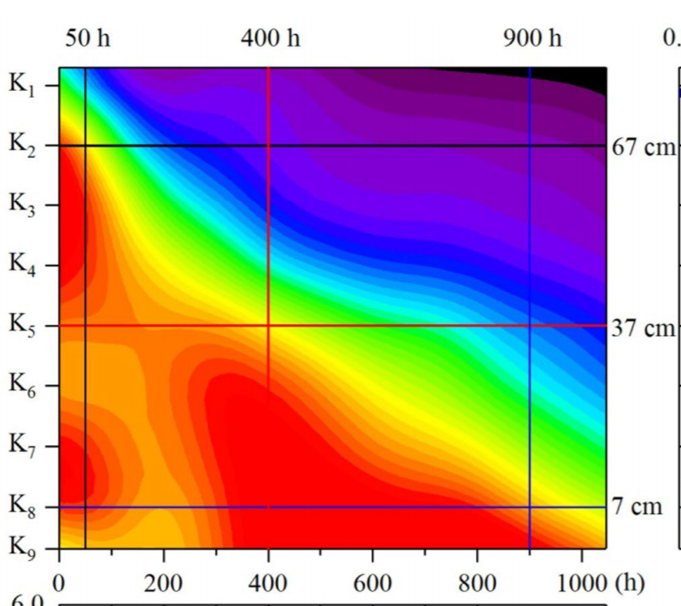
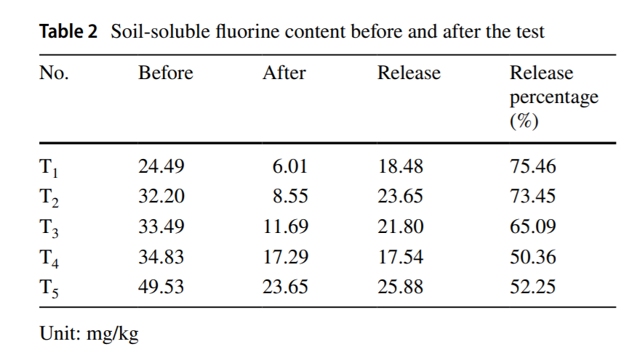
Results for Soil Column Leaching Experiment
The F⁻ concentration in the leachate from the upper soils continuously decreased while that from the lower soils increased relatively.

Slide 11
Conclusions
Fluorine release from shallow high-fluoride soils is a potential threat to groundwater safety
The release of fluorine is a slow process, and occurs in the direction of runoff
The increase in fluorine content of the shallow soil from top to bottom is a result of long-term leaching by rainfall
With increasing leaching time, the rate of release of fluorine and other ions decreased, and the pH value increased

Slide 12
References
Shi, M., Gao, Z., Feng, J., Zhang, H., Cui, Y., Fang, S., & Liu, J. (2019). Characteristics and effects of fluorine release from shallow high-fluoride soils. Environmental Earth Sciences, 78(20). doi: 10.1007/s12665-019-8618-0

