Slide 1
CO2 Ocean Storage
By Ericka Boudreau and Erin McGuire

Slide 2
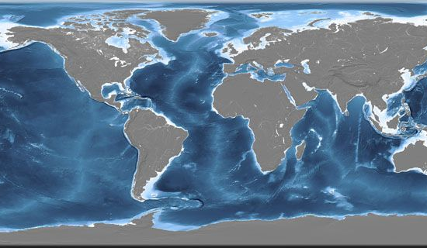
Ocean Background
The oceans cover 71% of the Earth’s surface
Has an average depth of 3,800 m
Contain roughly 50 times the quantity of carbon currently in the atmosphere
Contains roughly 20 times the quantity of carbon currently in plants and soils.
The capability of oceans to absorb CO2 in equilibrium with the atmosphere is dependant on the chemistry of sea water and ocean mixing rate.

Slide 3
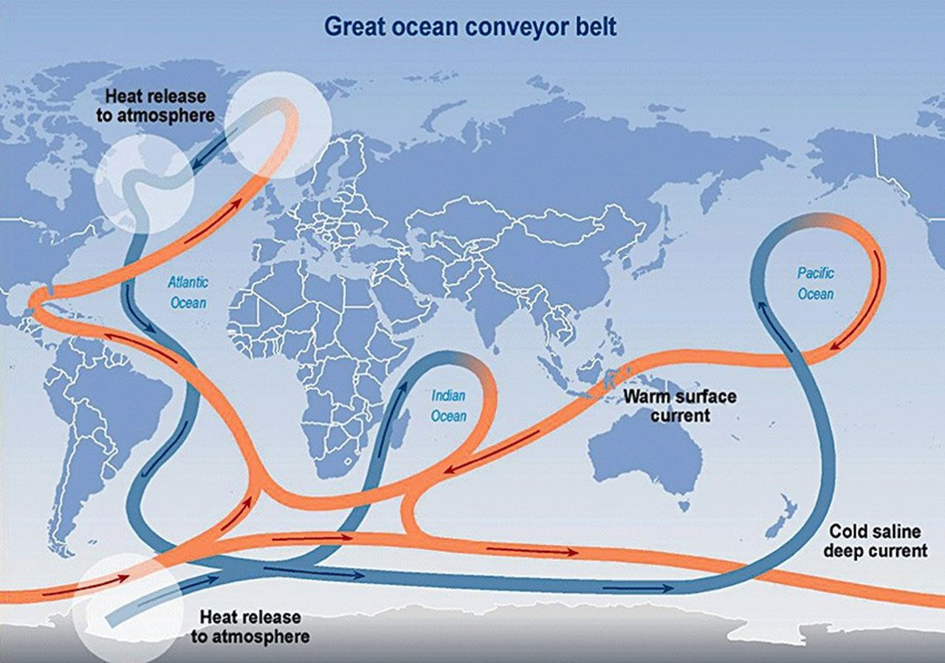
Ocean Currents
Currents in the deep ocean are produced through thermohaline circulation: differences in water density and salinity
In the poles, water becomes cold and dense and sinks to the ocean floor
Formation of sea ice causes surrounding water to become saltier and therefore more dense
Surface water flows in to replace the sinking water
https://www.noaa.gov/education/resource-collections/ocean-coasts-education-resources/ocean-currents

Slide 4
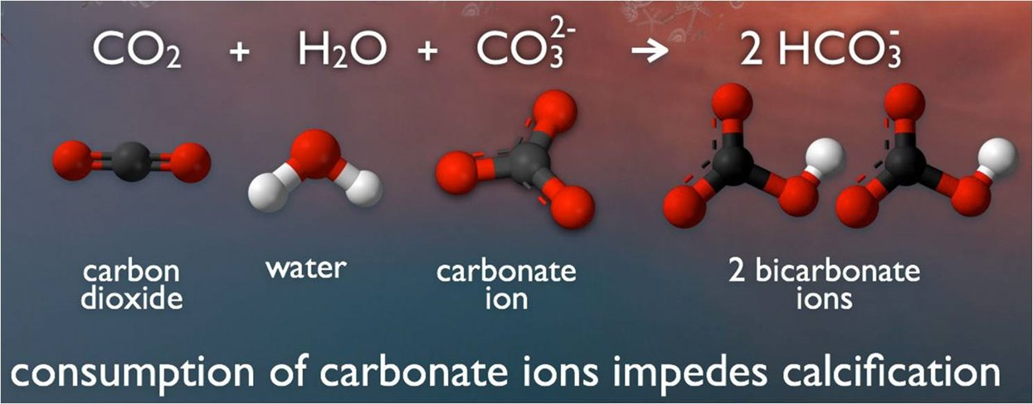
Ocean and CO2 Chemical Properties
Total dissolved inorganic carbon (DIC) is the sum of carbon contained in H₂CO₃, HCO₃⁻, and CO₃ ²⁻
Highly buffered system
Concentrations of H+ and OH – are much lower than equalibrated chemical species that control pH
Ocean alkalinity
Amount of strong acid required for sea water to contain equal concentrations of bicarbonate ion and carbonic acid
Adding CO2 to ocean water to form bicarbonate ion
CO₂ + H₂O + CO₃^{2–} → 2HCO₃–
Simple reaction of CO2 and water
CO₂ + H₂O <-> H⁺ + HCO₃–
The above reactions lower pH and carbonate ion concentration
Total alkalinity is increased during dissolution of calcium carbonate
CaCO₃ (s) <-> Ca²⁺ + CO₃²⁻

Slide 5
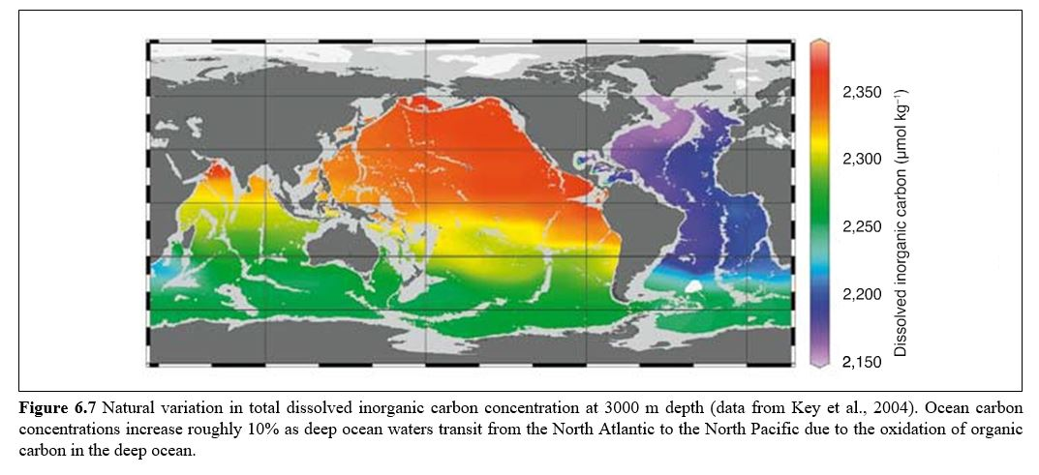

Slide 6
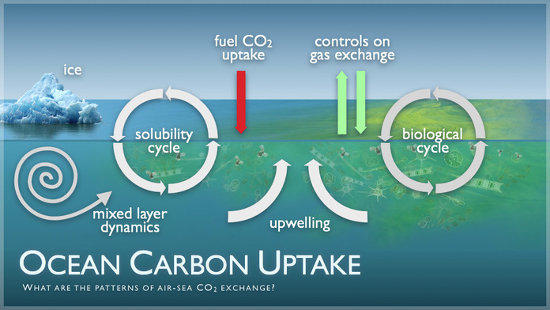
Relationship Between Ocean and Atmosphere
Exchange of atmospheric CO2 with ocean surface waters
Generated by a disequilibrium between CO2 and carbonic acid in sea water, partial pressure of CO2 in the atmosphere, and air/sea diffusion rate of CO2
Requires approximately one year for atmospheric and surface ocean CO2 to equilibrate
Oceans are a critical atmospheric CO2 sink
Uptake over the last 200 years is greater than 500 GtCO2
Average between 1980 – 2000 was 7 GtCO2 per year

Slide 7
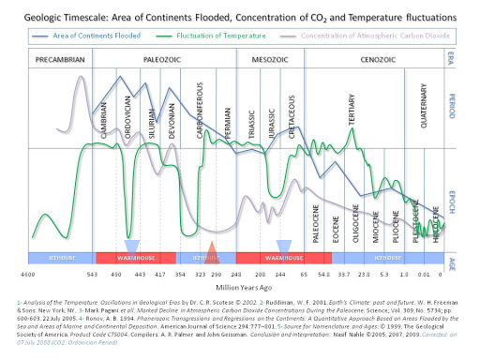
Changes in CO2 Over Geologic Time
Cambrian CO2 levels reached a maximum of 5000 ppm
Coral calcification only occurred because Ca concentrations were 3x as high as present day levels
CO2 was a major factor in the Permian-Triassic mass extinction event
High levels of CO2 have a corrosive effects on heavily calcified organisms
Changes in carbonate mineral saturation states in surface ocean during glacial-interglacial fluctuations is negatively correlated to atmospheric CO2 based on the global distribution of calcifying organisms in the geologic record
http://www.biocab.org/carbon_dioxide_geological_timescale.html

Slide 8
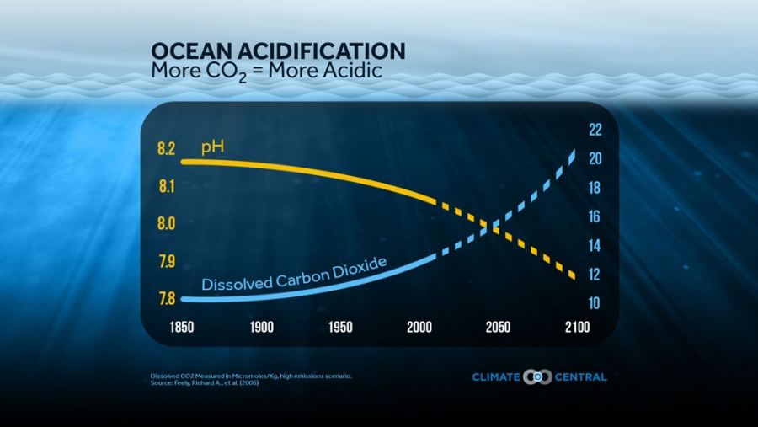
Humans and the Ocean
Average anthropogenic CO2 signature is detectable to approximately 1000 m depth; its scarcity in the deep ocean is due to the slow exchange between ocean surface and deep-sea waters
Investigation of human injection of CO2 into sea water is limited to small-scale laboratory simulations and computer generated models.
Large-scale experiments have not been carried out due to:
International Environmental Regulations
Compliance with International Marine Law

Slide 9
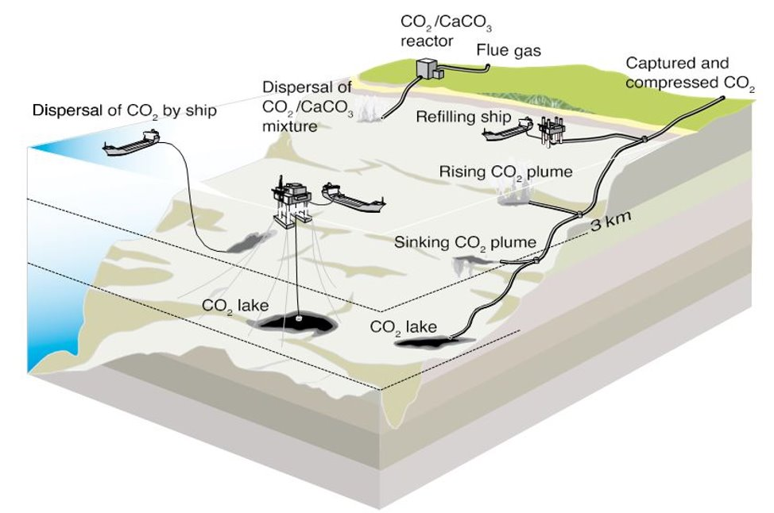
Different Forms of Injected CO2
Gas - released above 500m, less dense, would rise and dissolve, CO2 diffusers could produce gaseous CO2 bubbles that are small enough to dissolve completely before reaching the surface
Liquid - between 2500m and 500m depth, would rise, at 500m becomes gas bubble
Solid – below 3000m, tends to sink
Hydrate - can form below 400m depth, is a form of CO2 in which a cage of water molecules surrounds each molecule of CO2, would have to be made from pure solid to a "paste"

Slide 10
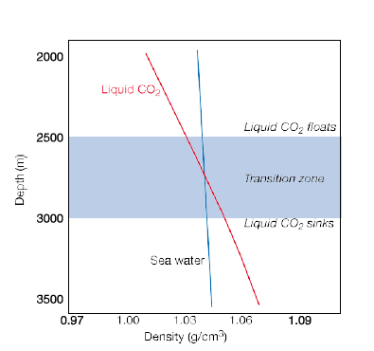
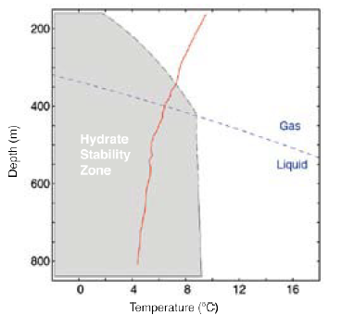
CO2 sea water phase diagram – below 10ºC reactions between CO2 and ocean water form a solid hydrate that is stable at a wide range of depths.
Behavior of liquid CO2 – in order for liquid CO2 to be stored effectively, it must be injected below 3000m. Behavior in the transition zone varies with temperature and shallower than 2500m, CO2 will float.

Slide 11
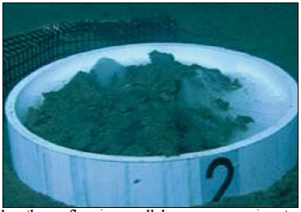
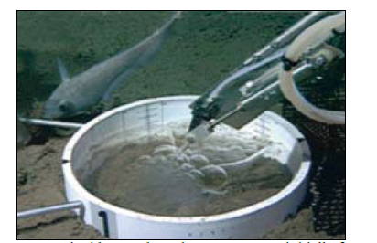
Experiment of liquid CO2 released at 3600m forming a pool and then reacting with sea water overtime to create a solid CO2 hydrate.

Slide 12
Selecting an Injection Site
Although evaluation of individual CO2 injection operation sites is necessary, in general, the yellow colored areas (0-400 km distance from land to water) would be the most cost-effective settings.

Slide 13
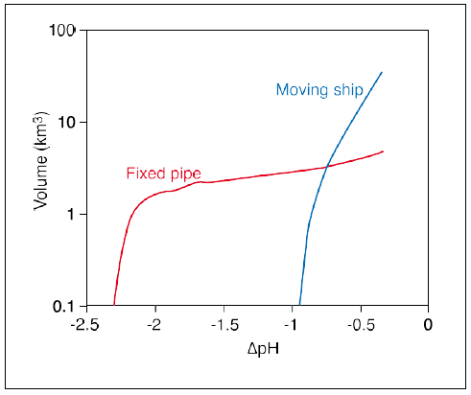
Effect of Injection Mode on pH
(Above) Visual of simulated plumes resulting from injection by fixed pipe vs. moving ship. Injection via fixed pipe is shallower and causes greater fluctuation in pH compared to the deep injection and dispersion possible by moving ship.
(Right) Injection via fixed pipe changes the pH of a specified volume of water significantly while injection by moving ship effects the pH of a large volume of sea water, but only by a small amount.

Slide 14
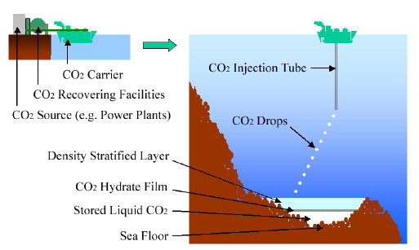
Behavior of CO2 Lakes
Has only been carried out in small scale laboratory models
Eventual dissolution of CO2 into the surrounding ocean water would occur without a physical barrier
Deposition of CO2 below 3 km would fill topographic depressions and form a hydrate layer which would impede dissolution
Time to dissolve a CO2 lake depends on its depth, complex dynamics of the ocean bottom boundary layer and its turbulence characteristics, mechanism of CO2 hydrate dissolution, and properties of CO2 in solution
https://www.researchgate.net/figure/Image-of-Ocean-Storage_fig1_267603546

Slide 15
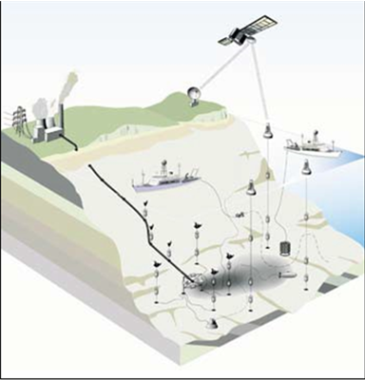
Near Field Monitoring
Fixed location injection compliance verification involves monitoring supra and sub terranean facilities
Significant contrast in density between CO2 plume and ocean water permits use of sonar for subterranean evaluation
Above ground inspection allows for complete power plant carbon audit
CO2 lake on the ocean floor is verified using acoustics, pH, and velocity measurements

Slide 16
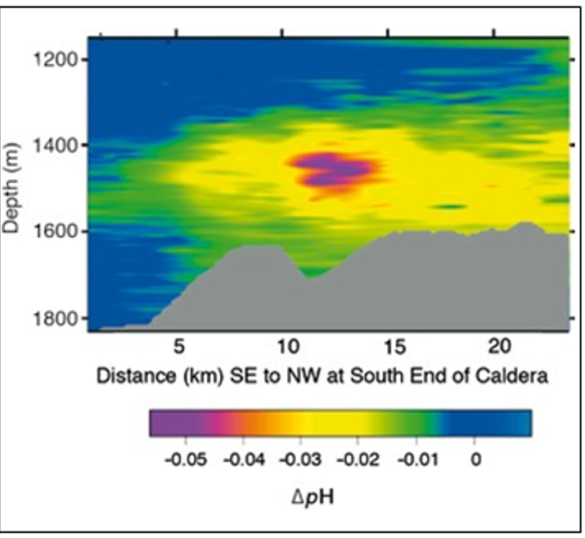
Far Field Monitoring Methods
Far field monitoring involves shipboard measurements and computer modeling
High density surveys before CO2 injection can be used to detect miniscule variations in the dispersal area
Variability in the mixed layer of the upper ocean presents difficulties monitoring small changes at depths less than 800m

Slide 17
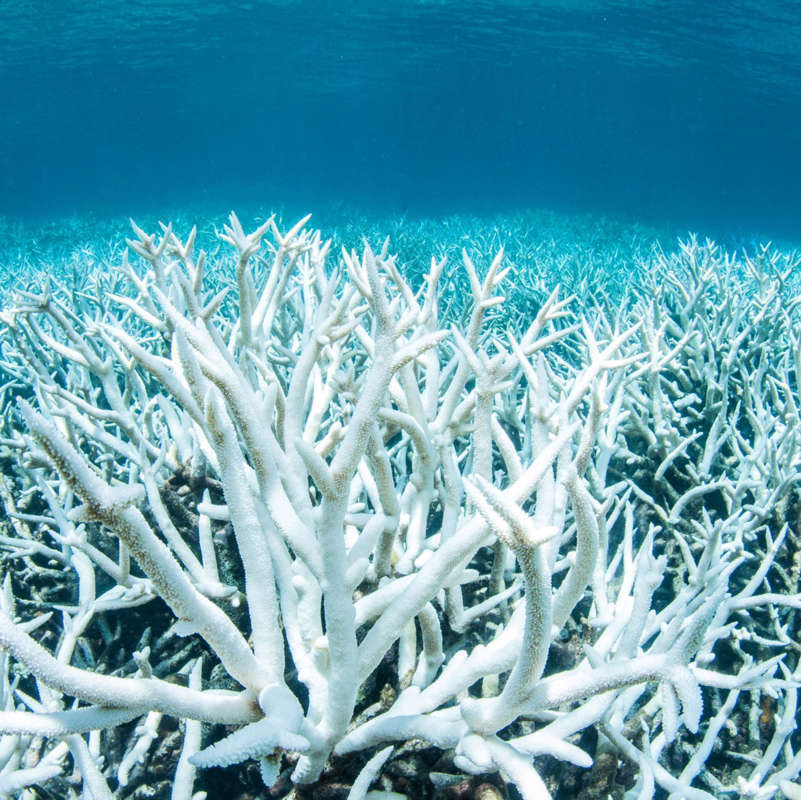
Impacts of CO2 Lake Leakage
Increase in carbonic acid causes greater stress on organisms compared to an equivalent change in pH from other acids
Tolerance of pH variation amongst species is highly variable
Duration and level of ecosystem stress plays a significant role
Small bottom dwelling organisms like sea cucumbers and stars have been shown to perish immediately after contact with liquid CO2 , and its associated higher acidity levels

Slide 18
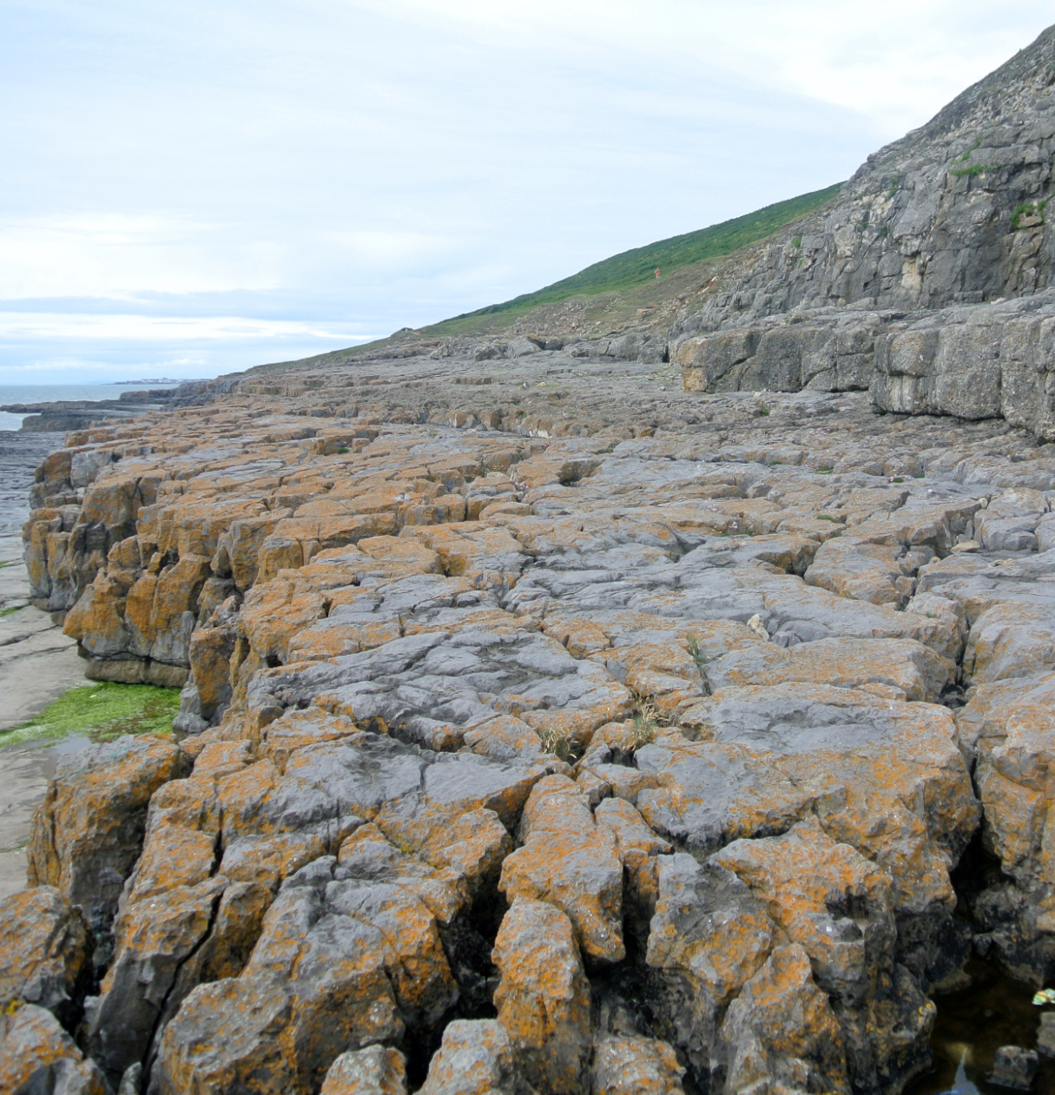
Carbonation Process
Because most Dissolved Inorganic Carbon is in the form of HCO3(–), the main effect of dissolving CaCO3 produces calcium bicarbonate
CaCO3(s) + CO2 (g) + H2O <-> Ca (2+) + 2HCO3(-)
This neutralization allows the ocean to absorb more CO2 from the atmosphere with less of a change in ocean pH, carbonate ion concentration, and pCO2.
The process for adding carbonates would need to avoid rapid re-precipitation of CaCO3.

Slide 19
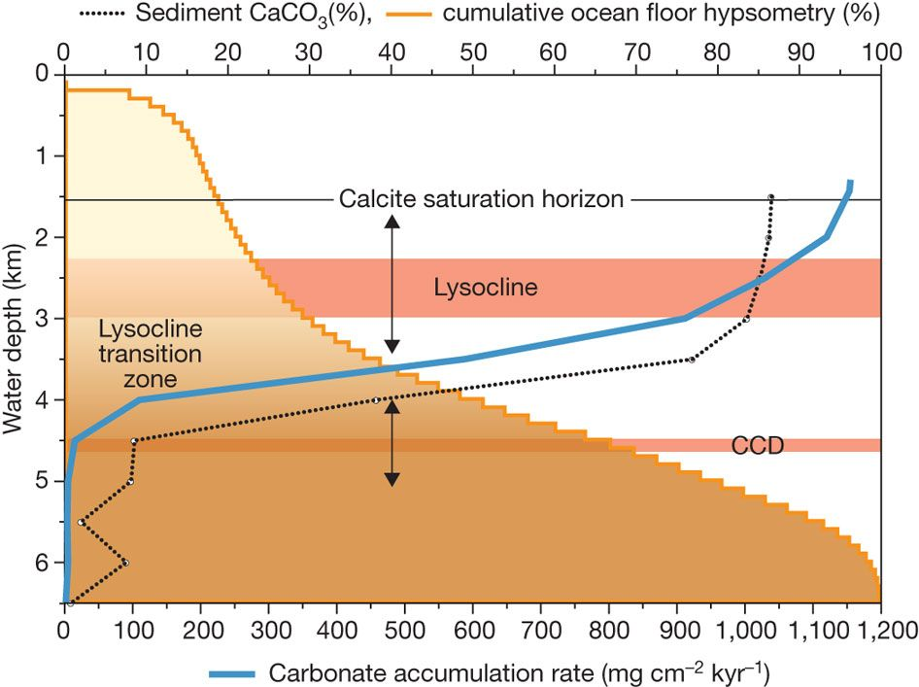
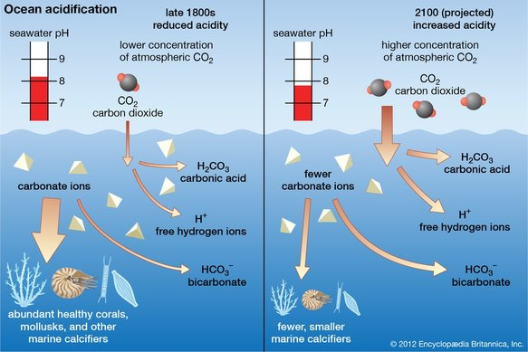
CO2 Storage and Carbonate Minerals
Carbonate neutralization approaches require large amounts of carbonate minerals. Sedimentary carbonates are abundant with estimates of 5 x 10^17 tonnes, roughly 10,000 times greater than the mass of fossil-fuel carbon
1.5 mole of carbonate mineral must be dissolved for each mole of anthropogenic CO2 permanently stored in the ocean

Slide 20
Carbonate Neutralization Impacts
Large-scale deployment of carbonate neutralization approaches would require greatly expanded mining and transport of limestone and associated environmental impacts
The addition of calcium bicarbonate, reduces acidification caused by carbon concentration that is detrimental to coral growth and shellfish

Slide 21
Cost of CO2 Ocean Storage
Estimates for transport and storage at 2 – 2.5 km depth from a moving ship (top)
Estimates for transport and storage of CO2 at 3 km depth from a floating platform (bottom)
Pipeline transport of CO2 estimates depend on the power facility's distance from the ocean
100 – 500 m on land for an injection at 3000m would range from $6/tCO2 to $31/tCO2

Slide 22
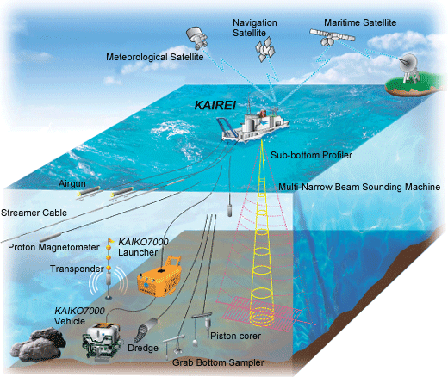
Knowledge Gaps
Extensive studies on deep sea biological systems response to the addition of CO2 – Long Term
Research facilities are needed for simulation of small-scale CO2 storage methods to assess effectiveness and impact before implementation in the open ocean
Technological advancement in deep ocean equipment (pipes, nozzles, diffusers, etc..) to enhance operation and maintenance
Development of monitoring sensors that detect CO2 plumes and track ecosystem impacts
https://www.jamstec.go.jp/e/about/equipment/ships/kairei.html

Slide 23
Works Cited
Caldeira, Ken. & Akai, Makoto. (2005) Chapter 6 – Ocean Storage.. IPCC Special Report on Carbon Dioxide Capture and Sequestration, Cambridge University Press, 278-312
https://www.sciencedirect.com/science/article/pii/S1877705816310669
https://oceancurrents.rsmas.miami.edu/ocean-gyres.html
https://www.globalminingreview.com/mining/17102018/wirtgen-surface-miners-offer-limestone-mining-without-drilling-and-blasting/
https://www.nbcnews.com/science/environment/great-barrier-reef-hit-third-major-bleaching-event-five-years-n1166676
https://coraloha.weebly.com/blog/ocean-acidification-learning-resources

Slide 24
Questions

