Slide 1
Carbon Sequestration
Johnson, Clark
Tavares, Chris

Slide 2
CO₂ as a Byproduct
Carbon dioxide is a byproduct of many industrial production lines including
Natural gas Production
Steel Production
Cement Production
Ammonia Production
Energy Production
Food/Alcohol Production (fermentation)
Is emitted through at multiple stages of production.

Slide 3
Chief Methods of CO₂ Capture and Storage
Post Combustion Capture
Oxy-Fuel Combustion Capture
Pre-combustion Capture
Separation with Sorbents/Solvents
Separation with Membranes
Distillation of a Liquified Gas Stream and refrigerated separation

Slide 4
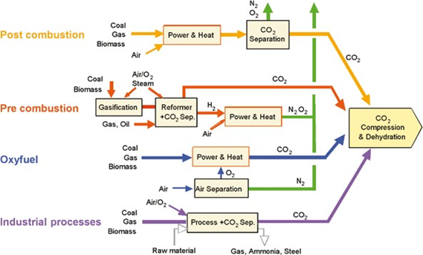
The pathways of CO2 capture & storage

Slide 5
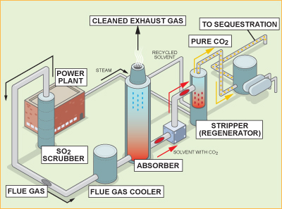
Post Combustion Capture
Employed by most power plants in the United States in some fashion
Separates flue gases after combustion and before they are released into the ambient air

Slide 6
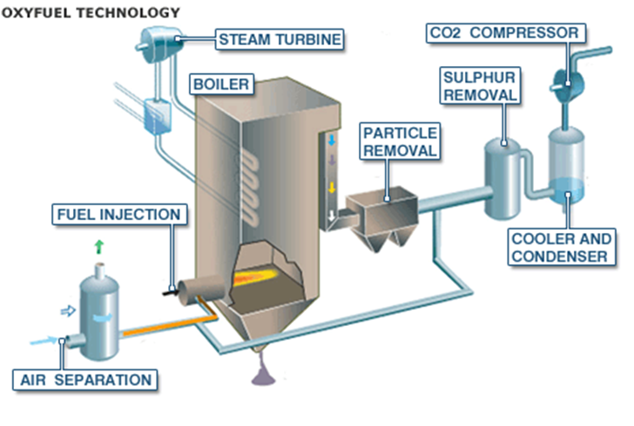
Oxy-fuel Combustion Capture
Using pure oxygen for combustion rather than ambient air
Creates water and CO2 which is readily captured

Slide 7
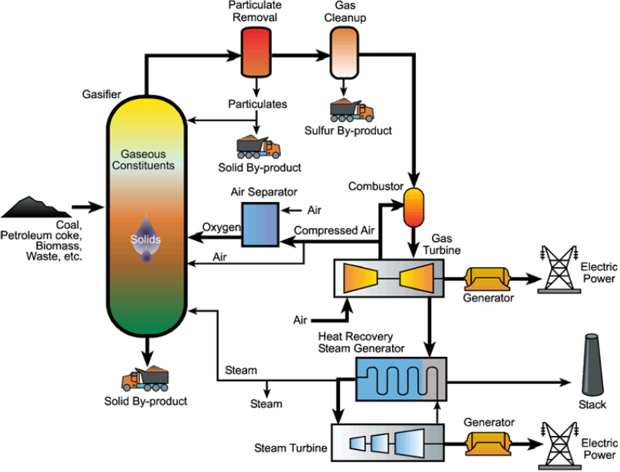
Pre-Combustion Capture
Using a catalytic reactor to separate fuel components before combustion, creating low carbon or carbon free fuel (more hydrogen rich)

Slide 8
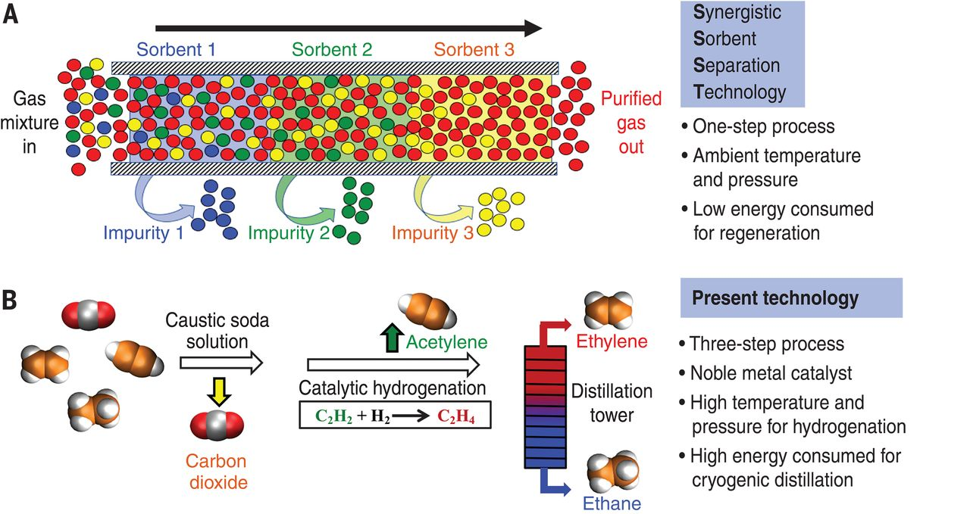
Separation with Sorbents/Solvents
Passing CO₂ over a liquid absorbent or solid sorbent where the CO₂ laden material is removed and then heated to release the CO₂ to be captured and removed

Slide 9
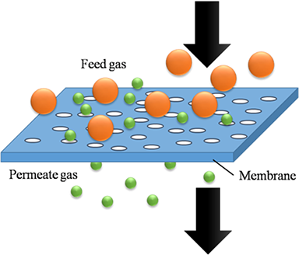
Separation with Membranes
Passing high pressure gas streams through a membrane (ceramic, metallic, etc.) which selectively allows certain gases to permeate (H₂ , O₂ ) while disallowing others (CO₂)

Slide 10
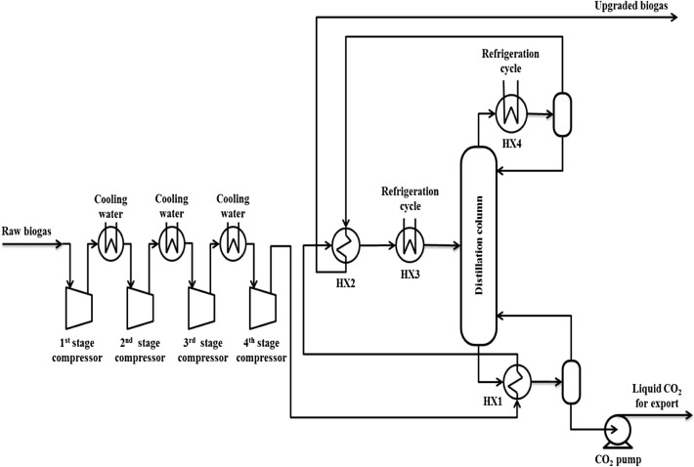
Distillation of a Liquified Gas Stream and Refrigerated Separation
Using compression, cooling, and expansion air can be liquified and separated in a distillation column. Wheen refrigerated CO₂ can be removed and stored.

Slide 11
Associated Costs
These methods are estimated to add about $0.03 per kWh (on the low end) to electric production.
Average U.S. house uses 1,000 kWh/month which equates to $30/month added to electric bills

Slide 12
Cost Increases
Current CO₂ capture systems reduce CO₂ emissions per kilowatt-hour by approximately 85-90%
The cost of electricity production attributed to CO₂ capture increases
35-70% for a natural gas combined cycle plant
40-85% for a new pulverized coal plant
20-55% for an integrated gasification combined cycle plant
COE for fossil fuel plants with capture ranges from 43-86 US$ MWh- 1,
Compared to 31-61 US$ MWh-1 for similar plants without capture
Costs include CO2 compression but not transport and storage costs

Slide 13
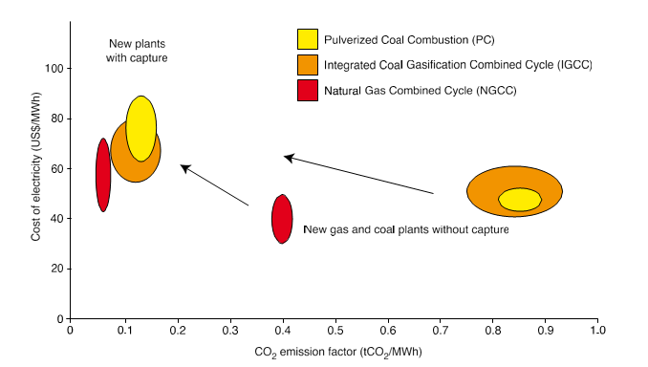
Graphical Representation

