Slide 1
Cost and Economic Potential
Maggie Hensel

Slide 2
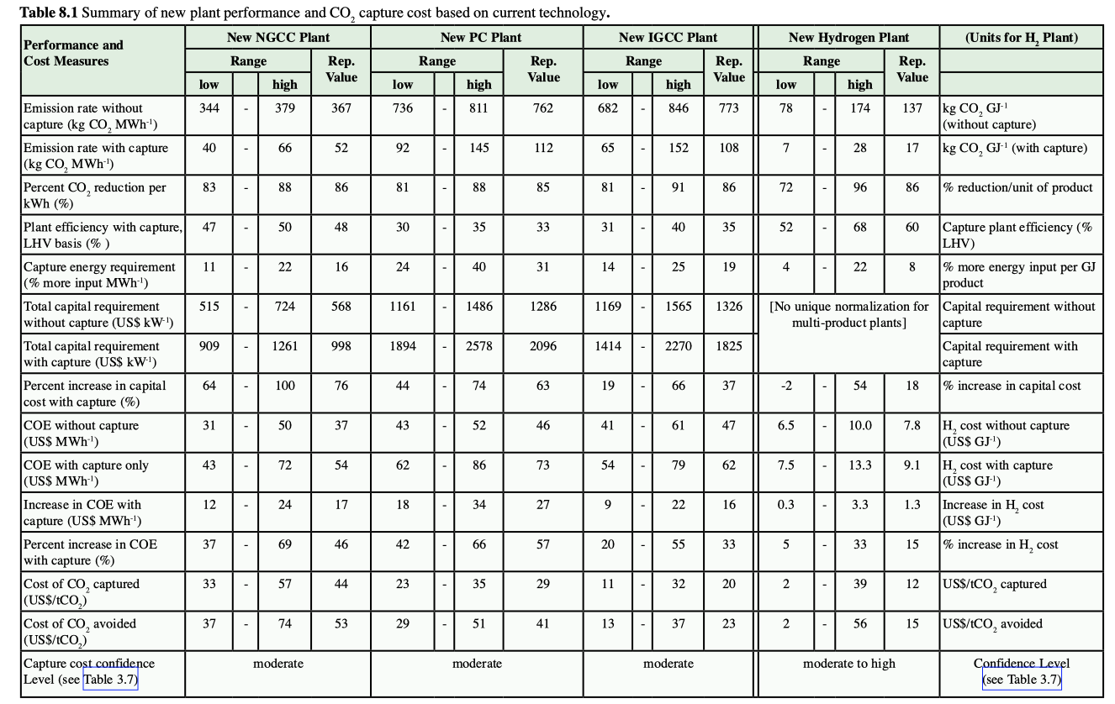

Slide 3
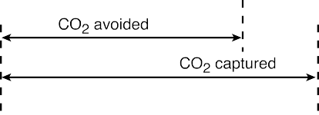
Avoided Costs
CO₂ captured ≠ CO₂ avoided
CCS requires energy and creates new emissions
Therefore, plant with CCS needs to be compared to the reference plant to calculate the avoided costs
Avoided costs = US$/tCO₂ avoided
Figure 8.2 (IPCC, SRCCS)

Slide 4
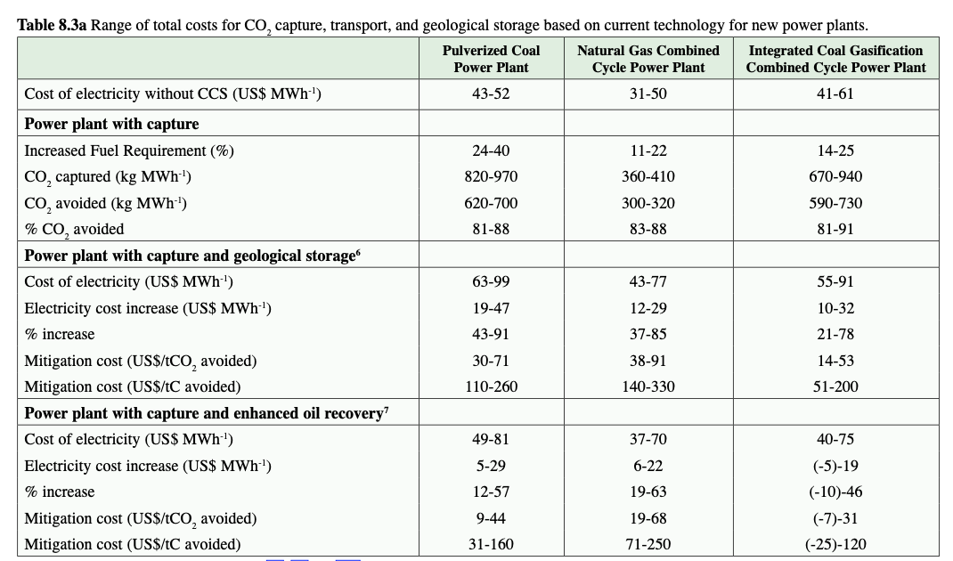

Slide 5
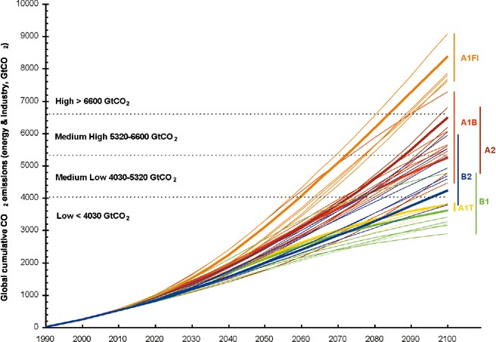
Economic Modeling
Many different types of economic modeling
Special Report on Emissions Scenarios (SRES)
SRES show there is a wide range of futures possible for the world
A1F1 (high economic growth, high carbon emissions)
Figure 8.3 (IPCC, SRCCS)

Slide 6
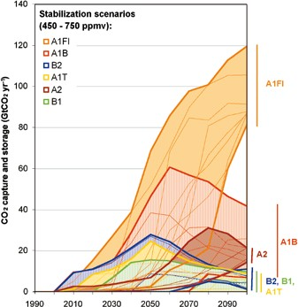
Drivers of CCS deployment
Policy
Baseline
Carbon Intensity
Emissions Trading
Rate of technological improvements
Figure 8.7 (IPCC, SRCCS)

Slide 7
Impacts of China's emissions trading schemes on deployment of power generation with carbon capture and storage (Morris et al. 2019)
China’s pledge by 2030
60 - 65% reduction of CO₂ intensity of GDP (2005 baseline)
Stopping increases in CO₂ emissions
This is a global issue and we need all in - China’s decisions alone could lead to a 1.1 - 1.3 deg C difference in global surface temperature
IPCC recommends emissions trading as a means to reduce CO₂ emissions
Goal of this study is to understand how different economic conditions influence feasibility of energy producing technologies
MIT Economic Projection and Policy Analysis (EPPA) model

Slide 8
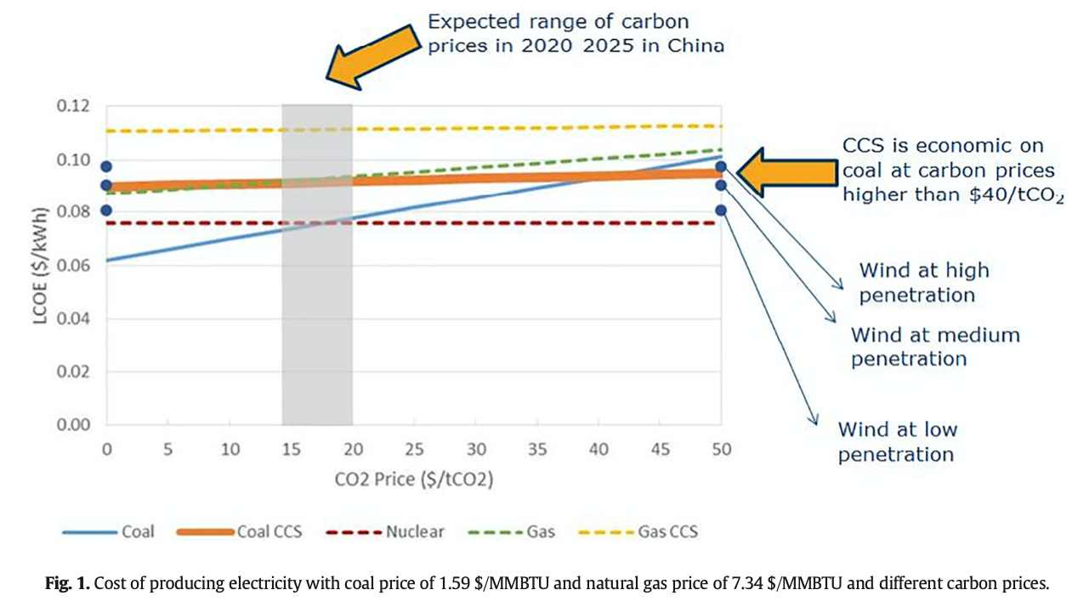
Results: Morris et al. 2019

Slide 9
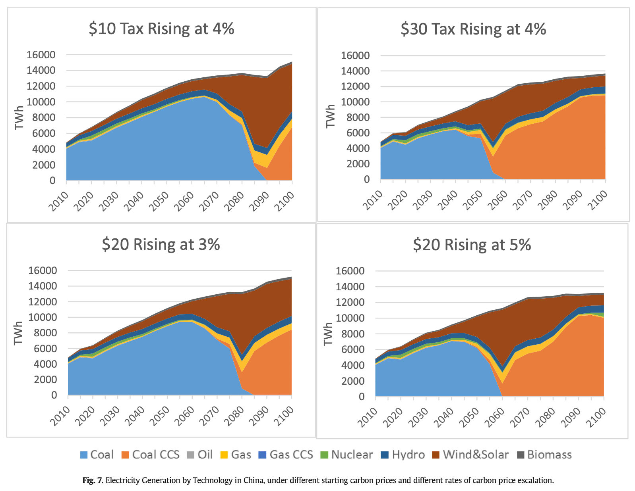
Results: Morris et al. 2019

Slide 10
Conclusions
Without proper policies in place CCS will not be deployed
The market for CCS not only depends on policies, but also the energy mix
There are still many unknowns about CCS deployment and cost of different technologies
Recommendations include that policymakers should focus on reducing CO₂ emissions, instead of technologies, which will allow the market to determine the energy mix

Slide 11
What are your thoughts on the recommendation of imposing emissions reductions and allowing the market to figure out the best way to meet those requirements?

Slide 12
Do you think CCS will play a major role in carbon reductions?

Slide 13
References
Herzog, H et al. Cost and Economic Potential. IPCC Special Report on Carbon Dioxide Capture and Storage. https://www.ipcc.ch/site/assets/uploads/2018/03/srccs_chapter8-1.pdf.
Morris, J., Paltsev, S., & Ku, A. Y. (2019). Impacts of China’s Emissions Trading Schemes on Deployment of Power Generation with Carbon Capture and Storage. Energy Economics, 81, 848–858.
Paltsev, S., et al. (2005). The MIT Emissions Prediction and Policy Analysis (EPPA) Model: Version 4, Report 125, MIT Joint Program on the Science and Policy of Global Change. MA, Cambridge http://globalchange.mit.edu/publication/14578.
Størset, S. Ø., et al. (2019). Profiting from CCS innovations: A study to measure potential value creation from CCS research and development. International Journal of Greenhouse Gas Control, 83, 208–215. https://doi-org.umasslowell.idm.oclc.org/10.1016/j.ijggc.2019.02.015.

