Slide 1
Brazil: The current and future state of energy
Michael Spaulding, Alison Pelletier, Devin Resnik, Tim Richards

Slide 2
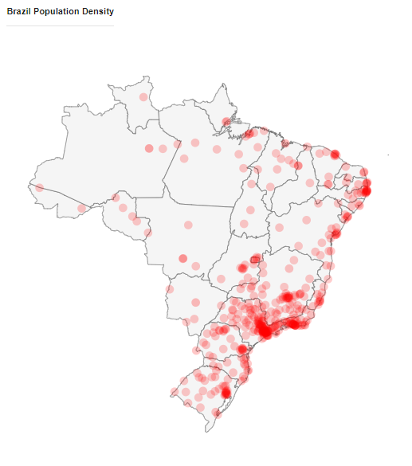
Brazil Overview
Population: 210 million
Growth Rate of 0.75%
Positive trade Balance
Notes:
Population source http://worldpopulationreview.com/countries/brazil-population/
Flag : https://en.wikipedia.org/wiki/Flag_of_Brazil#/media/File:Flag_of_Brazil.svg

Slide 3
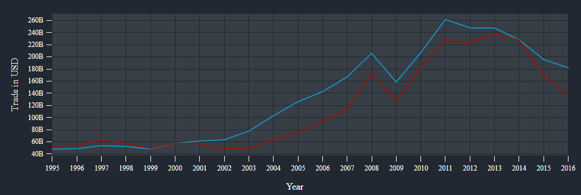
International Trade
Blue line = exports
Red line = imports
Export Destinations: China 19%, U.S. 13%, Argentina 7.4%
Import Origins: China147%, U.S. 18%, Germany 6.7%, Argentina 6.7%

Slide 4
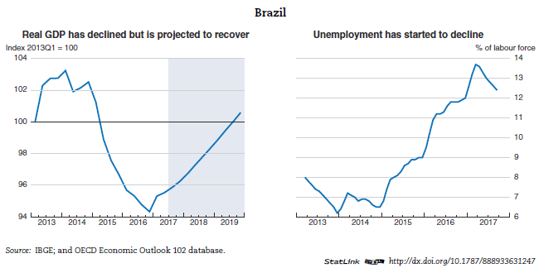
Economic overview
Ranked 8th in global GDP
Nominal GDP $2.14 trillion economy
Economic growth returned after two year decline
http://www.oecd.org/eco/outlook/brazil-economic-forecast-summary.htm

Slide 5
Imports and Exports
$182 Billion USD in exports
Main exports
Iron ore - 9.1% $20.5B
Soybeans - 8.6% $19.5B
Raw Sugar - 5.2% $11.7B
21st Largest Exporting country
$135 Billion USD in imports
Main Imports
Petroleum (Refined 4.8%, Crude 1.6%, Gas 1.5%)
Machinery 27%
Misc. Chemicals 19%
Imports have decreased from 2011-2016 at an annual rate of 19%
https://atlas.media.mit.edu/en/profile/country/bra/

Slide 6
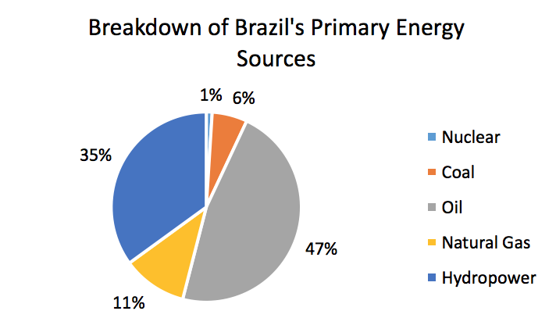
Current Energy Sources: Non-Renewables
^{Oil}
^{Natural Gas}
^{Coal}
^{Nuclear}

Slide 7
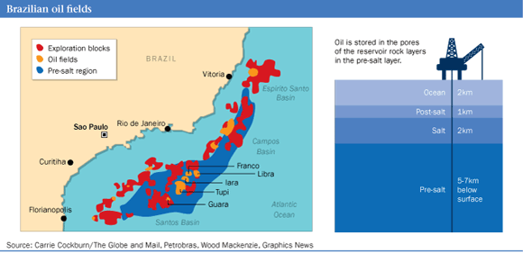
Oil
As of 2016 end:
47% of primary energy consumption
1.8 thousand million tonnes proven
Production: 136.7 million tonnes
Consumption: 138.8 million tonnes
Decrease of 5.6%
Refinery rate of 216.7 thousand barrels/day
Capacity of 270.9 thousand barrels/day
Notes:
BP. (2017). BP Statistical Review of World Energy June 2017. Retrieved April 16 from https://www.bp.com/content/dam/bp/en/corporate/pdf/energy-economics/statistical-review-2017/bp-statistical-review-of-world-energy-2017-full-report.pdf

Slide 8
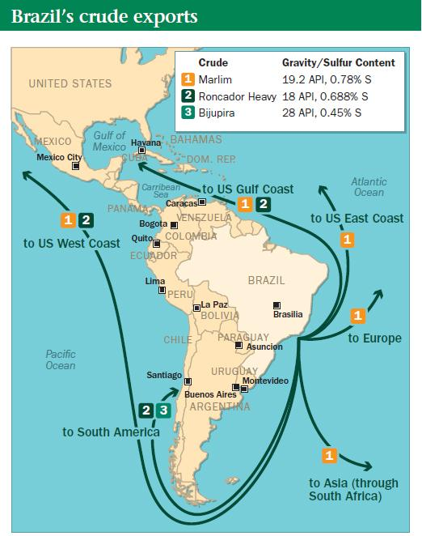
Oil Continued
As of 2016 end:
Ninth largest producer
Exported 34.5 million tonnes
Fifteenth largest exporter
8% increase from 2015
Imported 21.1 million tonnes
Top importer is China: 12.8 million tonnes
Second is Uruguay: 4.3 million tonnes

Slide 9
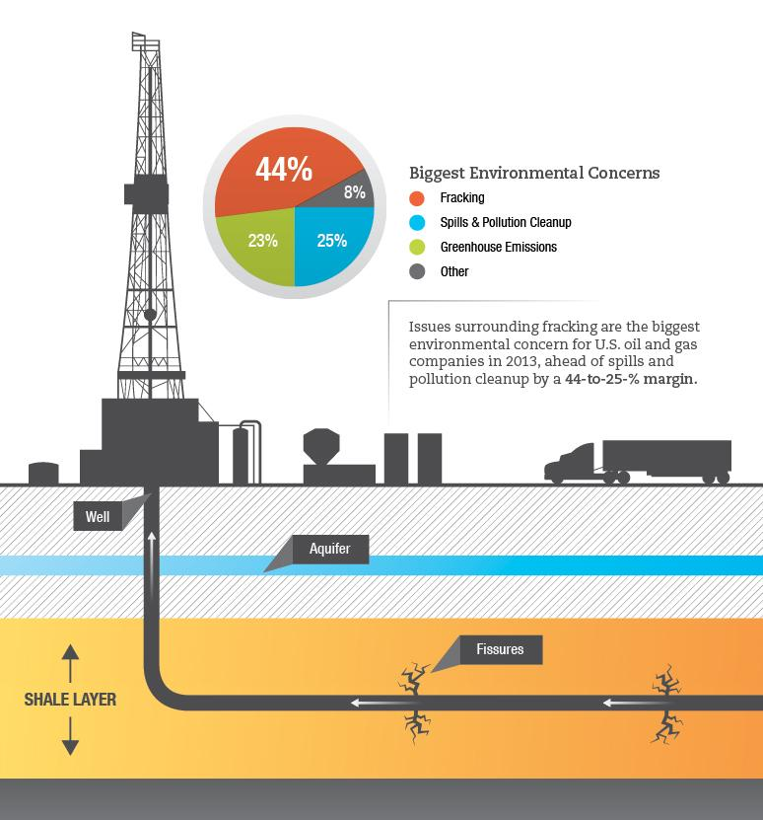
Natural Gas
As of 2016 end:
11% of primary energy consumption
10.4 Bcm imported by pipeline from Bolivia
3.0 Bcm imported by liquified natural gas
0.4 trillion cubic metres proven
Production: 23.5 Bcm
Equal to 21.1 million tonnes of oil
Consumption: 36.6 Bcm
Equal to 32.9 million tonnes of oil
Decrease of 12.5%

Slide 10
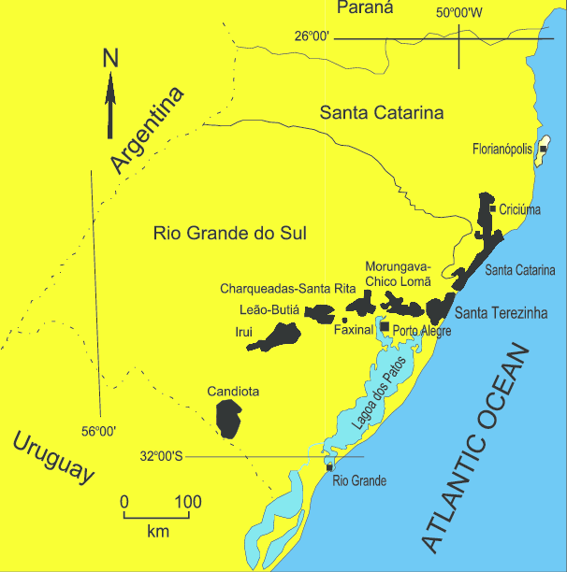
Coal
As of 2016 end:
6% of primary energy consumption
6596 million tonnes proven
Production: 3.5 million tonnes oil equivalent
Consumption: 16.5 million tonnes oil equivalent
Decrease of 6%

Slide 11
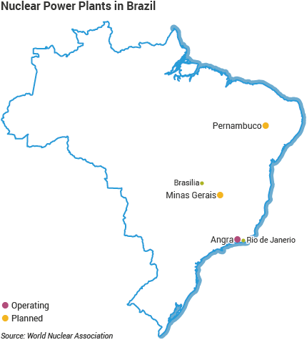
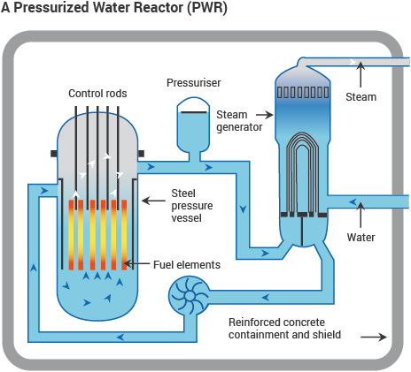
Nuclear
3% of primary energy consumption
Consumption:
3.6 million tonnes oil equivalent
Produced by pressurized water reactors

Slide 12
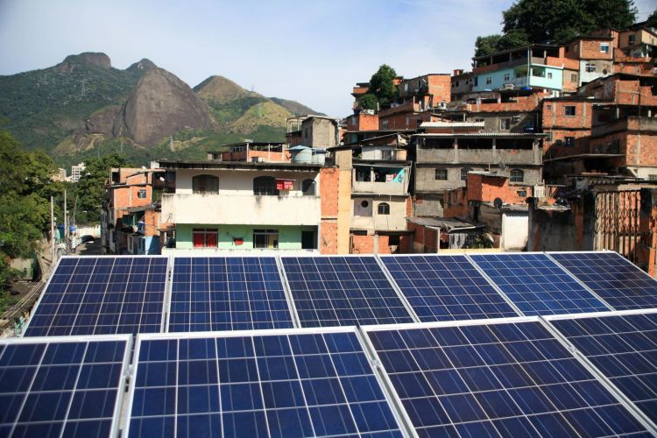
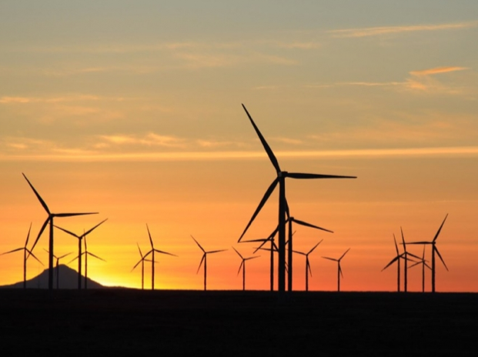
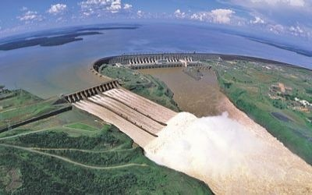
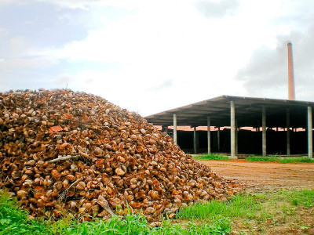
Current Renewable Energy Sources
Solar
Wind
Renewable energy consumption accounts for 21% of total energy consumption and consumption increased by 18.4% in 2016
Hydro
Biomass
https://www.elp.com/content/dam/elp/online-articles/2014/09/wind%20energy%20turbines%20ELP.png
Itaipu Dam
Notes:
https://aemstatic-ww1.azureedge.net/content/elp/en/articles/2015/08/germany-to-invest-in-brazil-infrastructure-renewable-energy-projects/_jcr_content/leftcolumn/article/headerimage.img.jpg/1440199825287.jpg

Slide 13
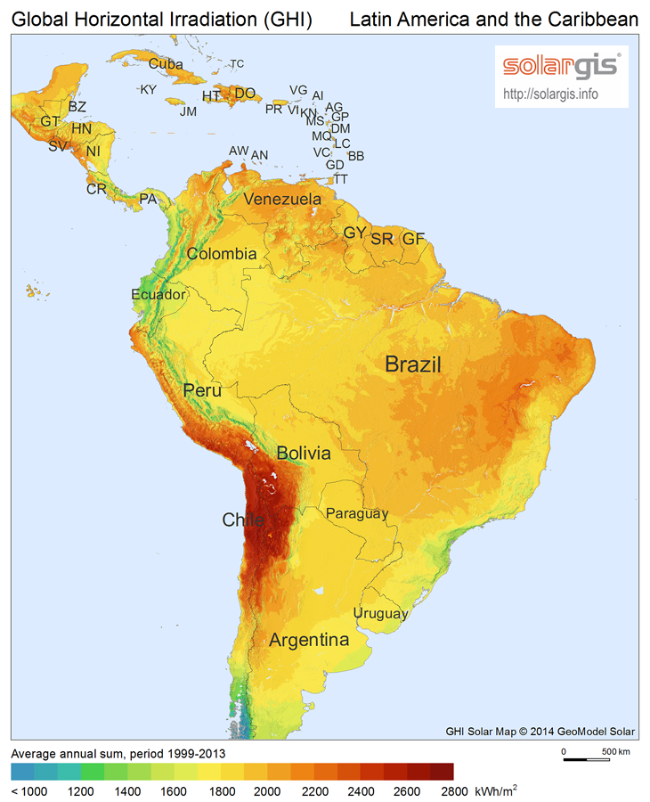
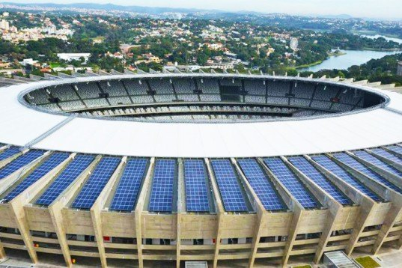
Solar
Consumption increased by 50.5% in 2016
Less than 0.05 MTOE of solar energy consumed
US consumed 12.8 MTOE
High solar incidence, large potential to increase
4.5-6.5 sun hrs/day
50% telecom systems/50% rural energy systems
Notes:
https://en.wikipedia.org/wiki/Solar_power_in_Brazil

Slide 14
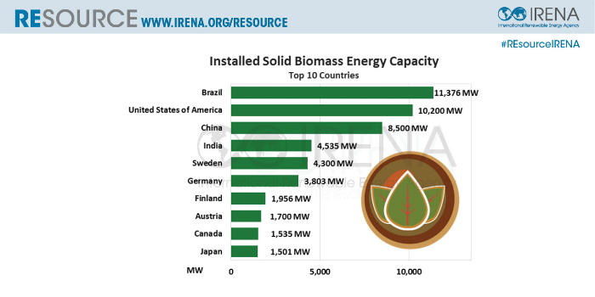
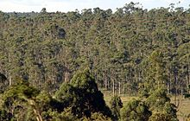
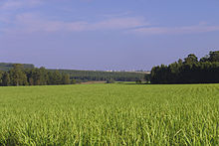
Biomass
Involves use of organic garbage, agricultural remains, wood shavings, vegetable oil, refuse sugarcane, eucalyptus
Represents 27% of Brazil’s energy matrix
Potential as a low-cost, indigenous supply of power

Slide 15
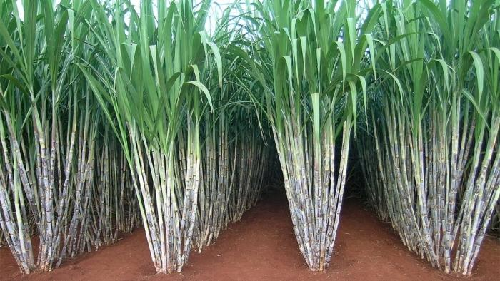
Ethanol
Government backed Alcohol fuel program phased out (1975-2003)
Alcohol fuel demand is now market dirven
Production of ethanol
Low additional cost
Sugarcane crops efficient
Efficient crop effluent treatment and reuse (98% reclamation)
Notes:
https://www.sciencedirect.com/science/article/pii/S0305750X11000611
FF logo: http://www.autoguide.com/gallery/d/664215-4/Flex-Fuel-Logo.jpg
Sugarcane : http://us-east.ln.thebrazilbusiness.com/www/images/media/700_394/586.jpg also attached article has good info http://thebrazilbusiness.com/article/brazilian-sugarcane-industry

Slide 16
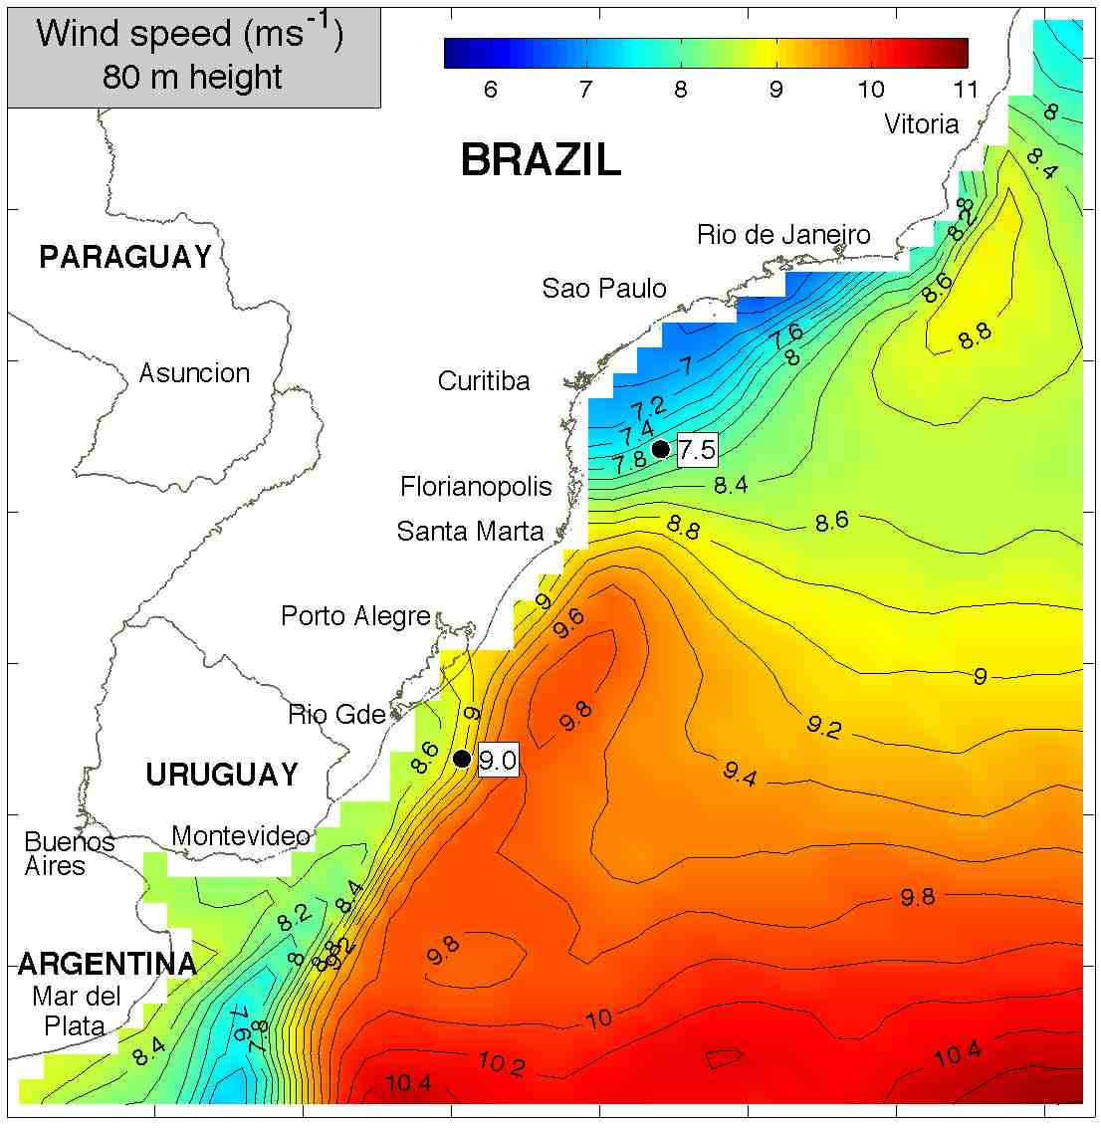
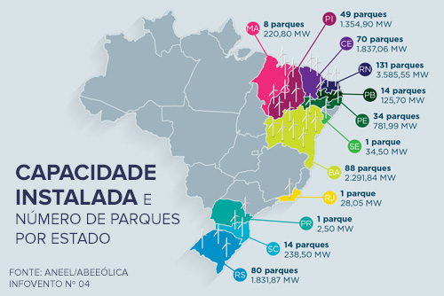
Wind
Wind energy consumption increased by 51.8% in 2016
Consumption = 7.4 MTOE
US = 19.1 MTOE
Current installed capacity = 12.5 GW (2018)
Highest capacity in Latin America
Large potential for offshore wind farms
Wind strength is greater during low-rainfall months
Wind is a complementary source to hydro
Notes:
https://techieibrazil.wordpress.com/2011/10/11/wind-power-in-brazil-great-potential-even-better-opportunities/

Slide 17
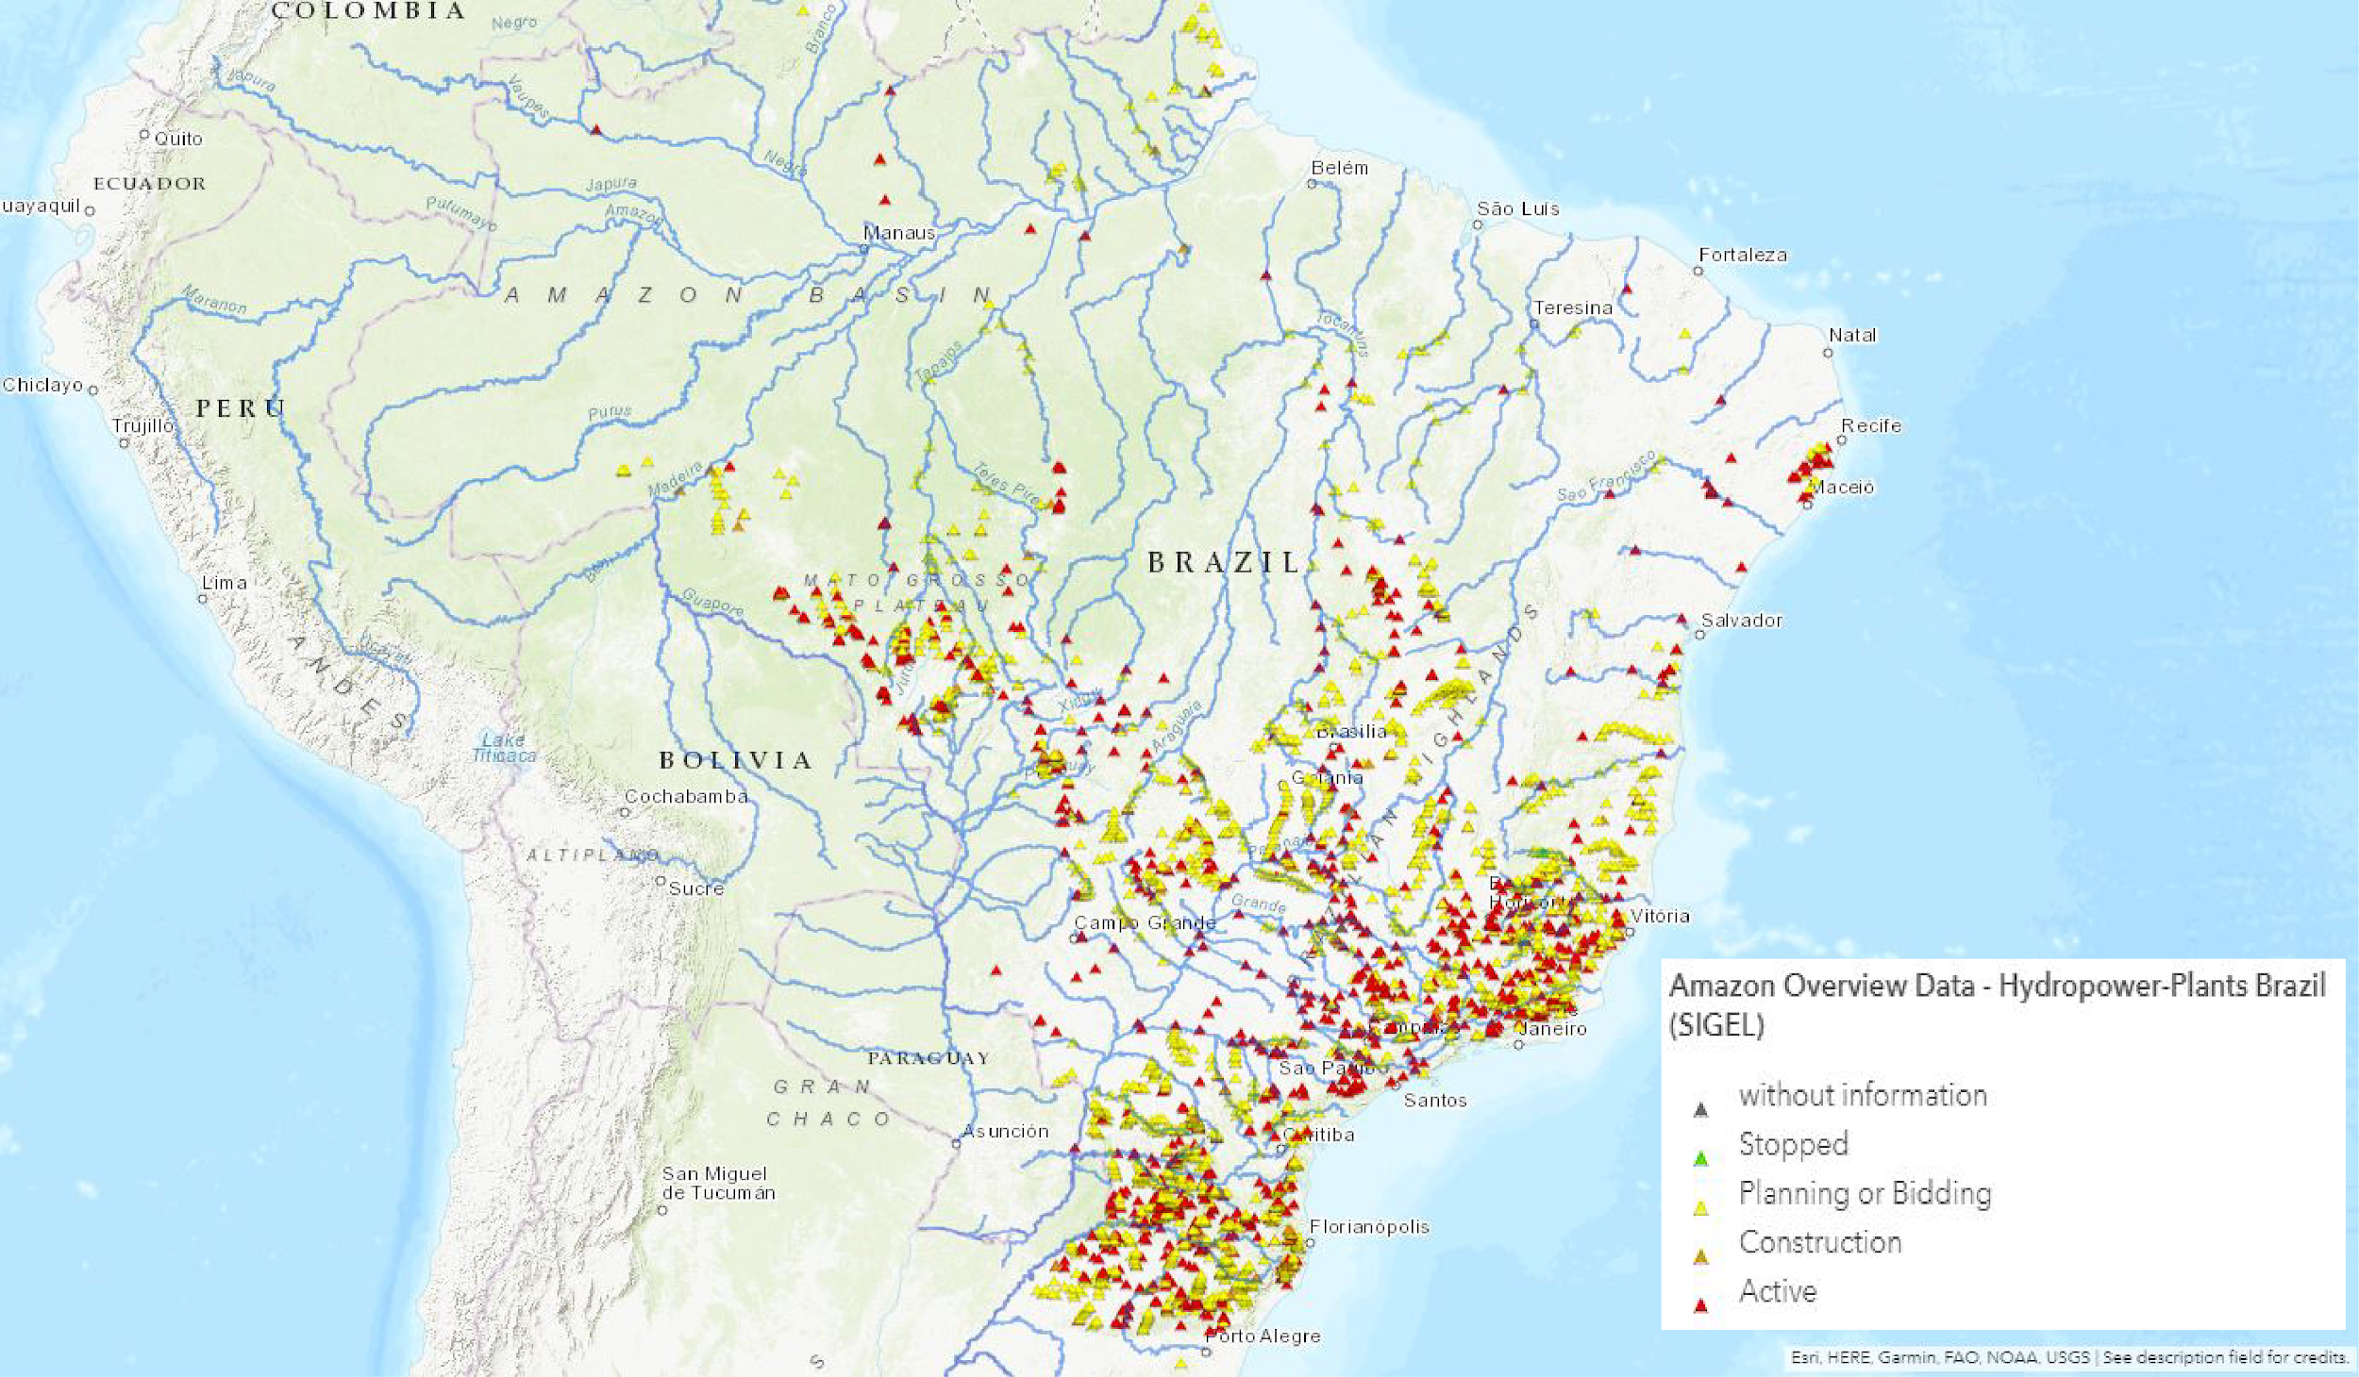
Hydropower
Largest hydropower resources in South America
Installed capacity = 98,015 MW
Current generation = 410.24 TWh
Current consumption = 86.9 MTOE
US = 59.2 MTOE
China = 263.1 MTOE
Brazil is the 2nd largest consumer of hydropower in the world
https://www.hydropower.org/country-profiles/brazil
Notes:
Capacity = the maximum electric output under specific conditions
Generation = the amount of electricity a generator produces over a certain period of time
https://www.hydropower.org/country-profiles/brazil

Slide 18
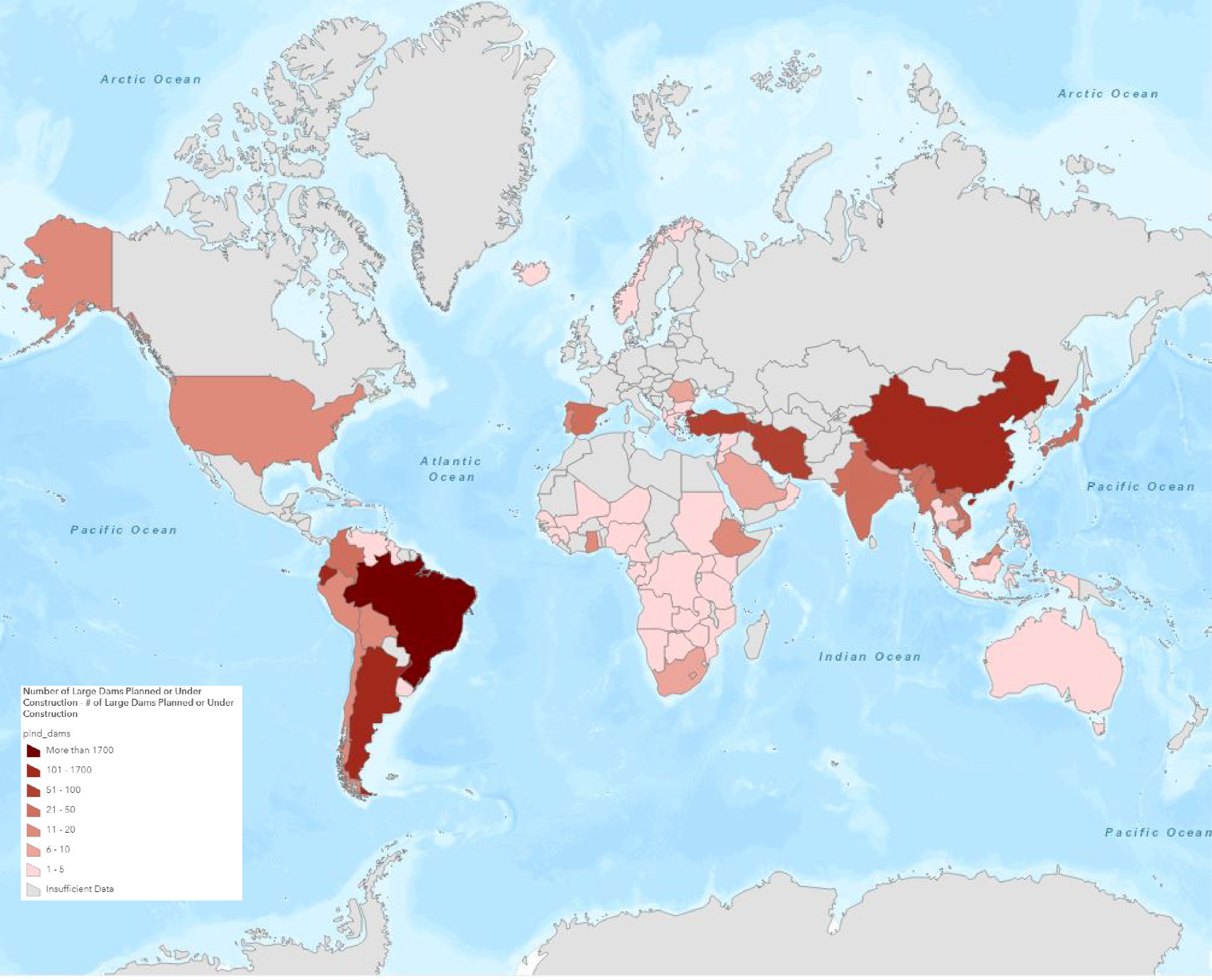
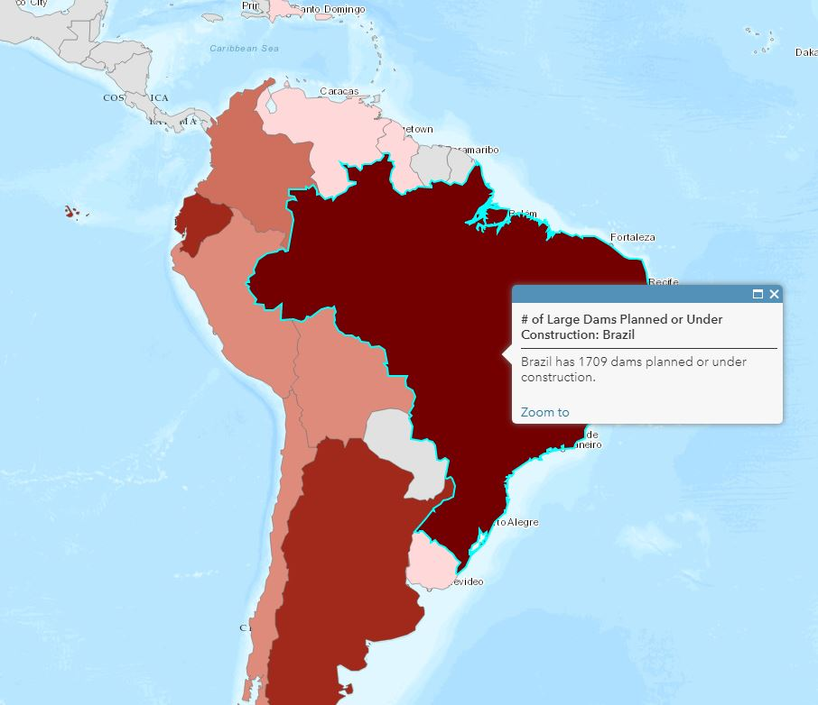
Number of Large Dams Planned or Under Construction
Brazil has 1709 dams planned or under construction

Slide 19
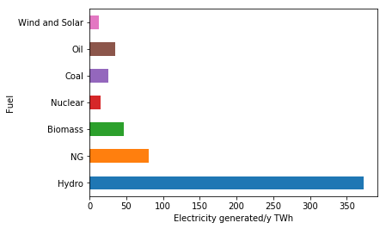
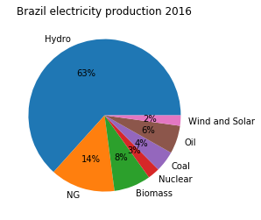
Current Electricity Production
In 2016, Brazil produced 581.7 TWh (2.3% of world’s electricity generation)
Notes:
Source: BP Energy Statistics (2016)

Slide 20
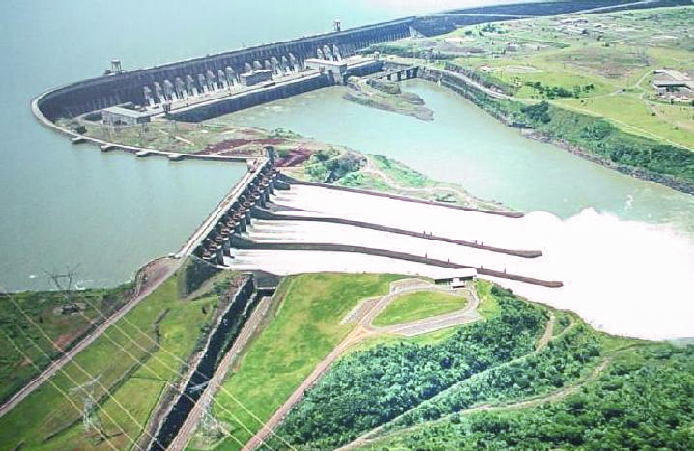
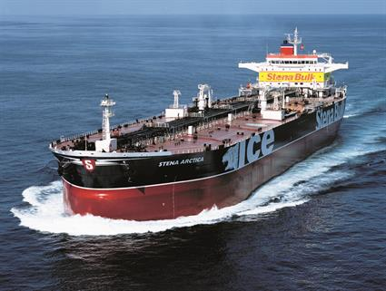
Potential issues with current sources
Hydropower:
Decrease in water quality
Relocation
Increased seismicity
Oil and Gas:
Refined oil and gas need to be imported
Itaipu Dam
Notes:
Positives and negatives of hydro: https://www.sciencedirect.com/science/article/pii/S187661021200793X
Biomass: https://www.sciencedirect.com/science/article/pii/S0305750X11000611
Oil tanker: https://www.wartsila.com/encyclopedia/term/oil-tanker
Itaipu Dam: https://en.wikipedia.org/wiki/Itaipu_Dam#/media/File:ItaipuAerea2AAL.jpg

Slide 21
Future energy/projections
BP Energy Outlook
60% growth in Brazil’s energy consumption to 2040
2.0% p.a. energy consumption growth
3% share of global energy (2040)
By 2040, 47% energy use from renewable source
42% in 2016
4% share of global oil production in 2040
https://www.bp.com/en/global/corporate/energy-economics/energy-outlook/country-and-regional-insights/brazil-insights.html

Slide 22
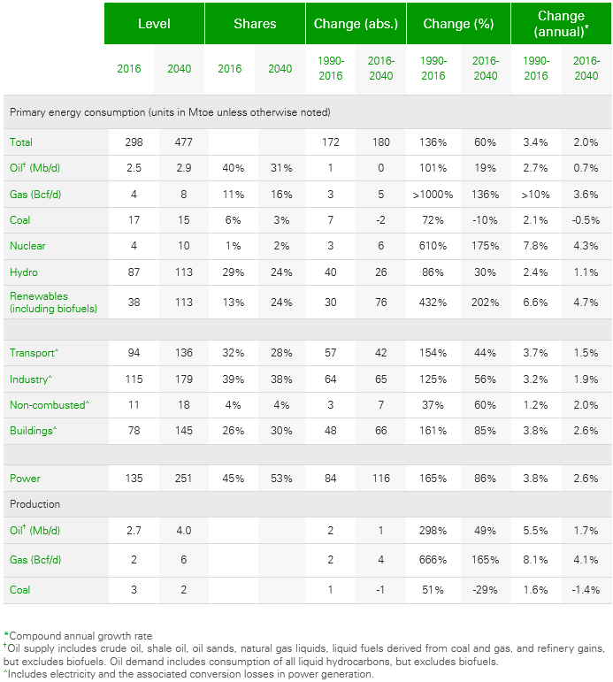
BP Energy Outlook - Brazil
Energy consumption shares by 2040
Reduced
Oil
Coal
Hydro
Increased
Gas
Nuclear
Renewable (incl. biofuels)
Production by 2040
Oil and gas increase
Coal decreases
https://www.bp.com/en/global/corporate/energy-economics/energy-outlook/country-and-regional-insights/brazil-insights.html

Slide 23
Climate Action Plan
First major developing country to put forward a climate pledge
37% cut in greenhouse gas (GHG) emissions from 2005 levels by 2025
43% cut by 2030
Plans Include: Reforestation, limiting illegal deforestation in the Amazon, and increasing shares in non-hydropower renewables
https://www.nrdc.org/experts/han-chen/implementing-paris-agreement-first-year-progress-report

Slide 24
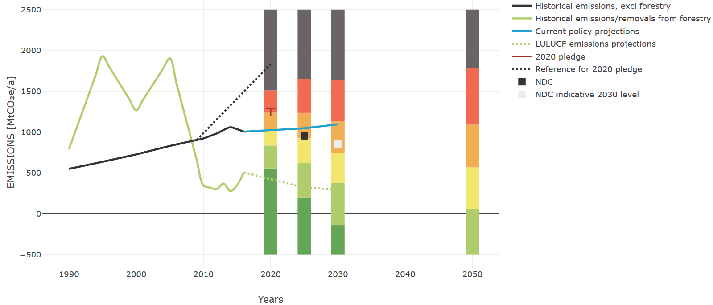
Notes:
CAT is an independent scientific analysis produced by three research organisations tracking climate action since 2009. They track progress towards the globally agreed aim of holding warming well below 2°C, and pursuing efforts to limit warming to 1.5°C.

Slide 25
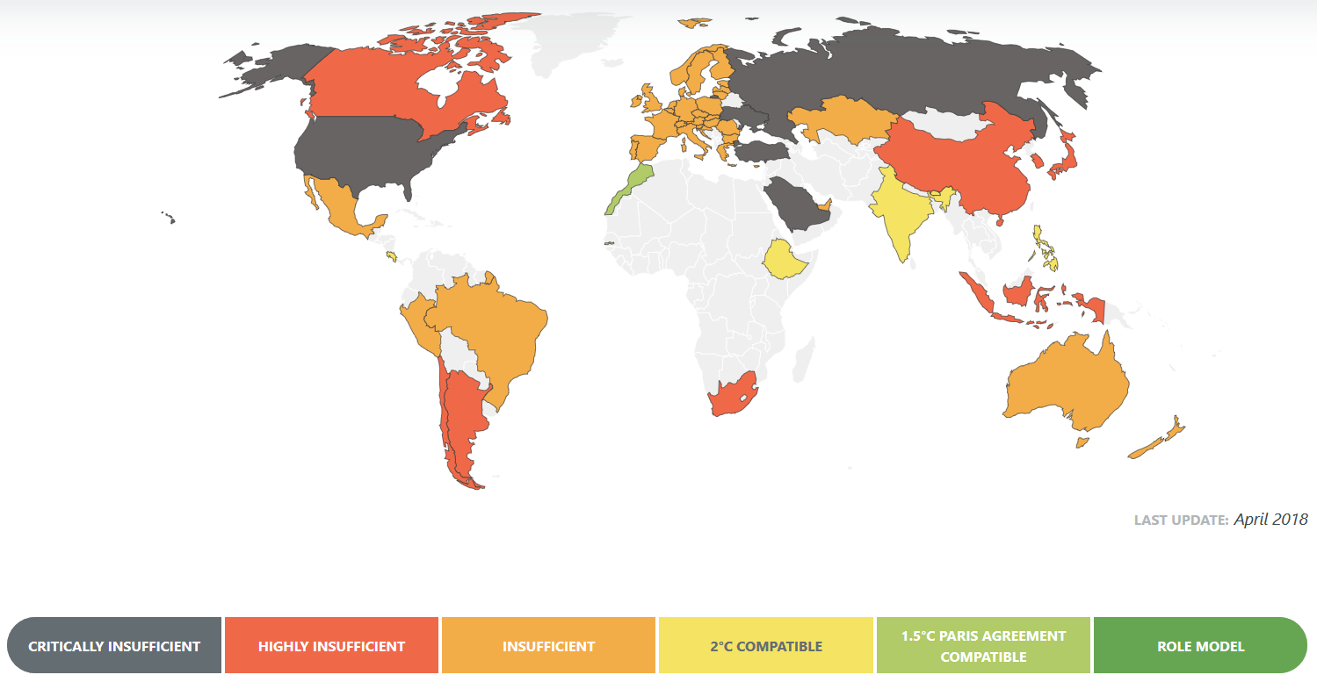
http://climateactiontracker.org/

Slide 26
Sources
Non-Renewables:
BP. (2017). BP Statistical Review of World Energy June 2017. Retrieved April 16 from
https://www.bp.com/content/dam/bp/en/corporate/pdf/energy-economics/statistical-review-2017/bp-statistical-review-of-world-energy-2017-full-report.pdf
U.S. Energy Information Administration. (2017). Country Analysis Brief: Brazil. Retrieved April 16 from https://www.connaissancedesenergies.org/sites/default/files/pdf-pt-vue/brazil_2017.pdf
Population
"Brazil Population 2018." worldpopulationreview, worldpopulationreview.com/countries/brazil-population/. Accessed 2018.
Economic information:
"Brazil - Economic forecast summary (November 2017)." , OECD, www.oecd.org/eco/outlook/brazil-economic-forecast-summary.htm
"OEC Brazil ." The Observatory of Economic Complexity, https://atlas.media.mit.edu/en/profile/country/bra/.
Ethanol:
La Rovere, Emilio L., André S. Pereira, and André F. Simões. "Biofuels and Sustainable Energy Development in Brazil." World Development, vol. 39, no. 6, June 2011.
Wind:
"Wind Power in Brazil: great potential, even better opportunities!." Engineering & Development in Brazil, https://techieibrazil.wordpress.com/2011/10/11/wind-power-in-brazil-great-potential-even-better-opportunities/. Accessed 2018.
Hydropower:
"Brazil ." International Hydropower Association, International Hydropower Association, https://www.hydropower.org/country-profiles/brazil. Accessed 2018.
Sperling, Eduardo. "Hydropower in Brazil: Overview of Positive and Negative Environmental Aspects." Energy Procedia, vol. 18, 2012.
Outlook/Projections:
“Country Insight – Brazil.” Bp.com, www.bp.com/en/global/corporate/energy-economics/energy-outlook/country-and-regional-insights/brazil-insights.html.
Chen, Han. “Implementing the Paris Agreement: 1st Year Progress Report.” NRDC, 2 Nov. 2017, www.nrdc.org/experts/han-chen/implementing-paris-agreement-first-year-progress-report.
“Brazil.” Brazil | Climate Action Tracker, 30 Apr. 2018, climateactiontracker.org/countries/brazil/.
Notes:
Not used(i think) but good articles:
Electricity supply security and the future role of renewable energy sources in Brazil
https://www.sciencedirect.com/science/article/pii/S1364032116000290
Relationships among carbon emissions, economic growth, energy consumption and population growth: Testing Environmental Kuznets Curve hypothesis for Brazil, China, India and Indonesia
https://www.sciencedirect.com/science/article/pii/S1470160X16303685

Slide 27
Image Sources
Flag: https://en.wikipedia.org/wiki/Flag_of_Brazil#/media/File:Flag_of_Brazil.svg
Trade graph: https://atlas.media.mit.edu/en/profile/country/bra/
Economic growth: http://www.oecd.org/eco/outlook/brazil-economic-forecast-summary.htm
FF logo: http://www.autoguide.com/gallery/d/664215-4/Flex-Fuel-Logo.jpg
Sugarcane: http://us-east.ln.thebrazilbusiness.com/www/images/media/700_394/586.jpg
Oil tanker: https://www.wartsila.com/encyclopedia/term/oil-tanker
Itaipu Dam: https://en.wikipedia.org/wiki/Itaipu_Dam#/media/File:ItaipuAerea2AAL.jpg

