Slide 1
Evaluation of the German Energy Industry
By: Andrew Horton, Sean Crawford, & Joe Fontaine

Slide 2
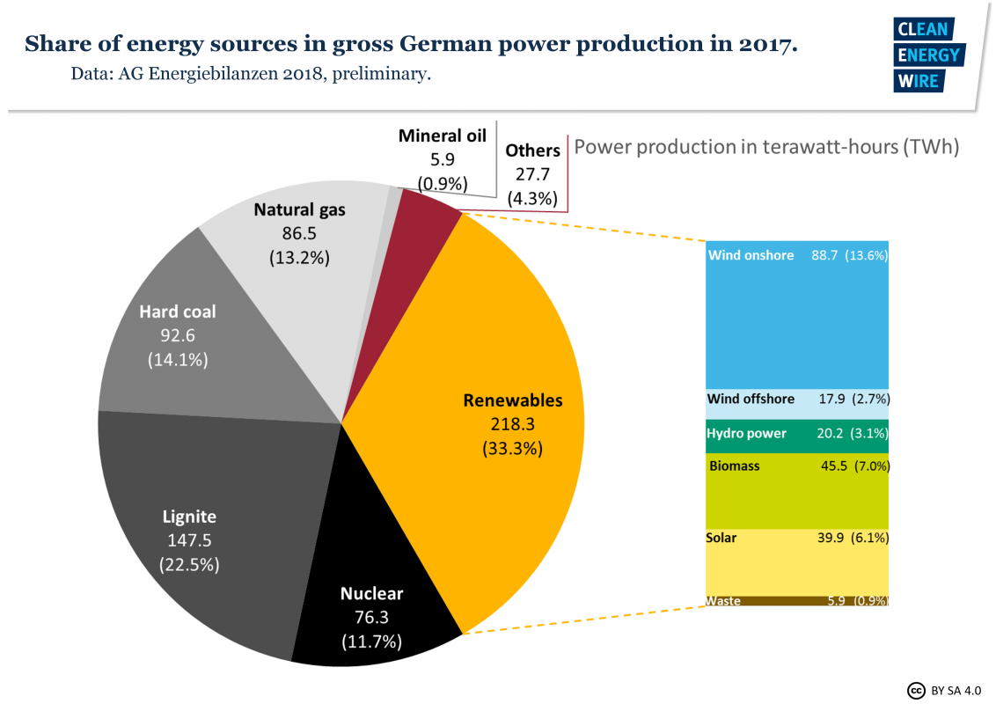

Slide 3
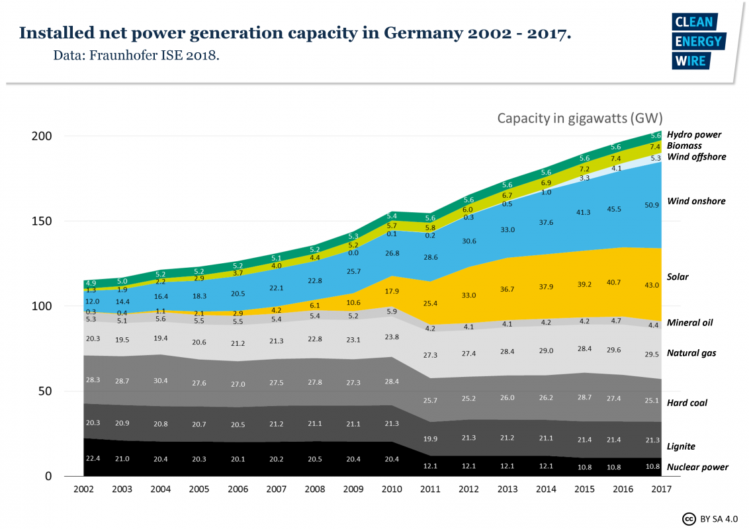
German Energy: Past to Present

Slide 4
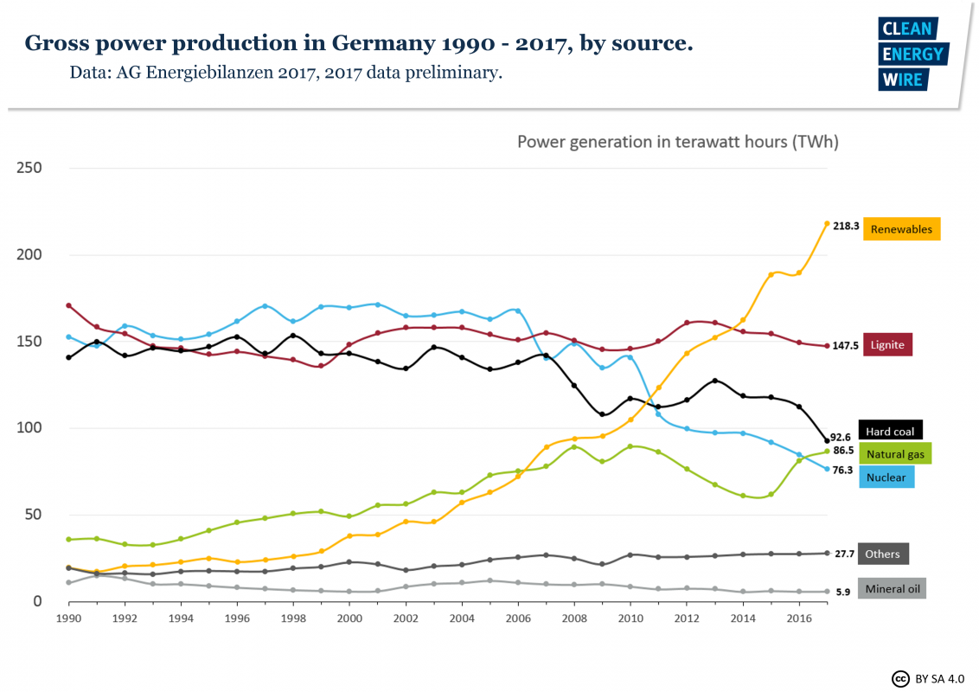

Slide 5
Installed Capacity vs Energy Produced
Total installed power capacity in Germany in 2014 was 192 GW.
43.7% Renewable
25.7% Coal with 11% being Lignite
610.3 TWh of energy produced in 2014
Renewables produced 157.3 TWh or 25.8%
Lignite produced 156 TWh or 25.6%
Combined coal production was 265.9 TWh or 43.6%

Slide 6
Energiewende - “Energy Revolution”
Energy
Nuclear phase out by 2022
No defined date of coal phase out
Major investments: solar & onshore wind
Energy Goals
Gross Power Consumption: 80%-95% renewables by 2050
Increased incorporation of renewables beyond electricity sector
Emission Goals (relative to 1990)
40 % reduction by 2020 (Currently on track to hit 37%)
95 % reduction by 2050

Slide 7
Climate Action Plan 2050
Published in 2016, the plan sets out the German government’s climate policy.
Germany sees the Climate Action Plan 2050 as a way to modernize their economy and provide guidance, particularly through 2030.
It is believed that the document will help to avoid bad investments and structural breaks during the transition to a decarbonized world.

Slide 8
Climate Action Plan 2050 Goals
Reduce CO2 emissions by 55%-56% of 1990 levels by 2030.
The reduction goal for the energy sector is 61%-62% from 1990 levels.
The reduction from the energy sector is planned to be met through increased renewable energy and increasing energy efficiency.
By 2050 energy production is to be almost entirely decarbonized.

Slide 9
Climate Action Plan 2050 Challenges
Acknowledges necessity of coal and gas plants during the transition to renewables and need for gas plants to remain as backup to meet surges.
Admits that in order to phase out the coal plants the areas producing the coal and hosting the plants need replacement investments and jobs.
40% of German emissions are from energy production.
Claims renewables are the current principal form of energy production with 32% in 2015. (33% by 2017). However, only true when the different types of coal are seperated. Coal provides 36% with lignite accounting for over half of that production.

Slide 10
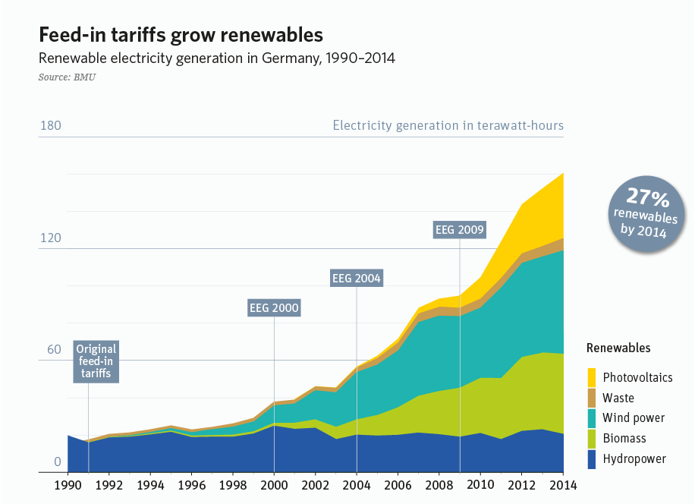
Erneuerbare Energien Gesetz
EEG or Renewable Energy Law
Passed in 1991 with the goal of stimulating growth in renewable energy sector
EEG obligated power companies to buy power put onto the grid by renewable sources at above market rate prices
This allowed new power companies to form, as they had guaranteed prices and a market for their energy

Slide 11
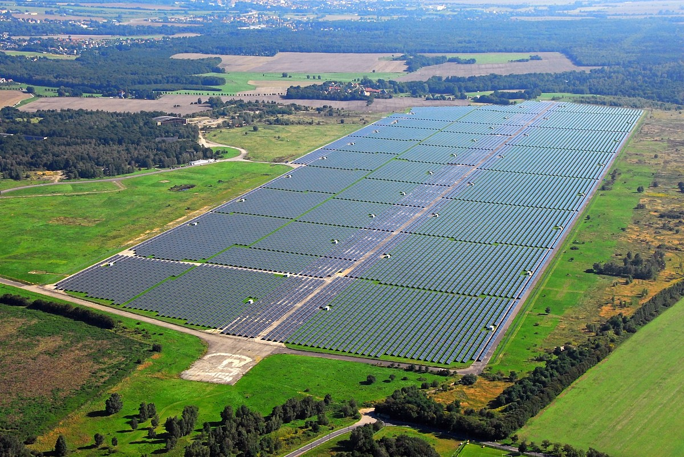
German Solar Power
Germany already has invested heavily in solar power
PV power has increased significantly since the implementation of EEG
PV accounted for 4.2 GW in 2007, increased 10-fold by 2017 to 43 GW
PV panels can be distributed on buildings, which is an advantage over other power sources which usually need dedicated locations

Slide 12
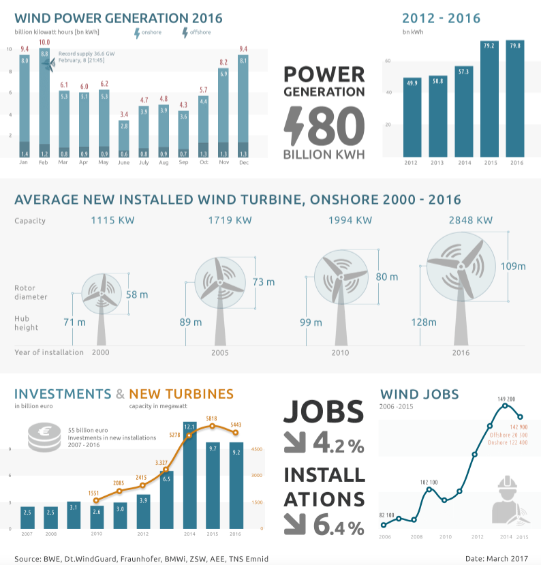
German Wind Power
Wind power makes up a significant portion of total power generation in Germany
Total wind power accounted for 17% of total production in 2017
Most is onshore generation (~14%) offshore (~3%)
Revised EEG regulation implemented an auction system for energy prices
Uncertain prices my slow the growth of wind power industry and research into offshore technologies

Slide 13
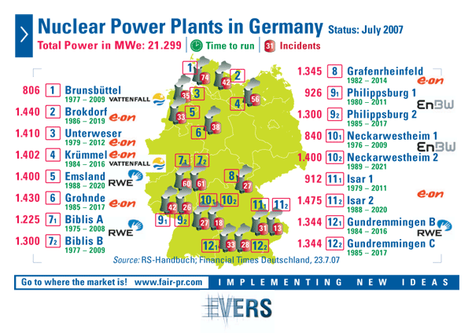
German Nuclear Power
Nuclear power plants in Germany are planned to be completely shut down by 2022
Decision to close plants following Fukushima disaster and public perception of them being unsafe
Nuclear power provided about 20 GW of power in 2010
Down to 12 GW in 2011 following plant closings, was down to 10 GW in 2017
Gaps in generation left by nuclear filled mostly by non renewable sources like coal

Slide 14
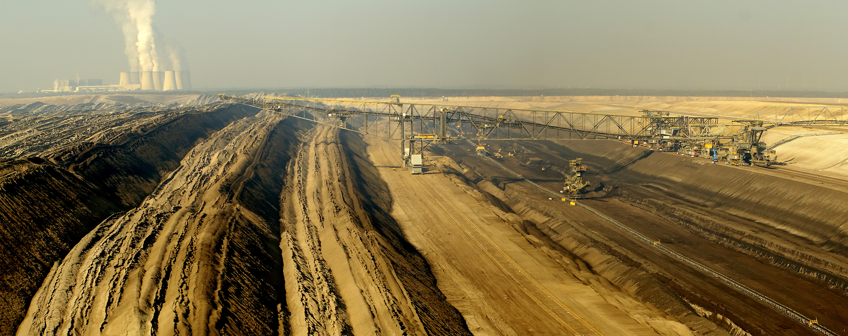
German Coal Power
Germany is still heavily reliant on coal to fulfill its energy requirements
Coal accounts for about 2/5ths of German power production
Germany has ‘hard’ coal seams, but the cost to extract is about 180 euros per tonne, compared to about 70 to import foreign hard coal
Germany is the world’s largest ‘brown coal’ (lignite) producer, but it is a dirtier fuel to burn
Lusatia open pit Lignite mine

Slide 15
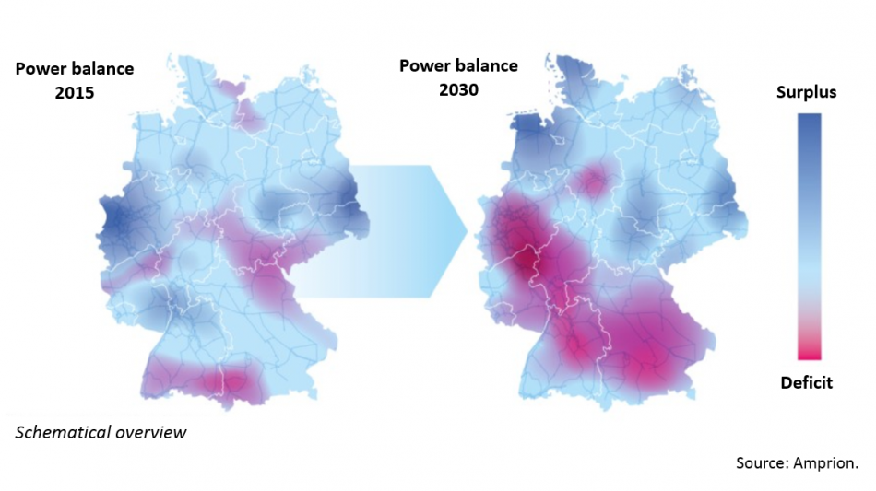
Complications - Infrastructure
North - South Divide
Lacking high voltage transmission lines
Lacking technology for increasingly decentralized grid
Clean Energy Wire

Slide 16
Costs of Lacking infrastructure:
Re-dispatch
Flood of cheap renewable electricity → clogs current grid → forces south/west Germany to produce at above market value
Feed - in management
Power produced by renewables reduced
Could impede production of more renewables
$
$
880 million euros in 2015

Slide 17
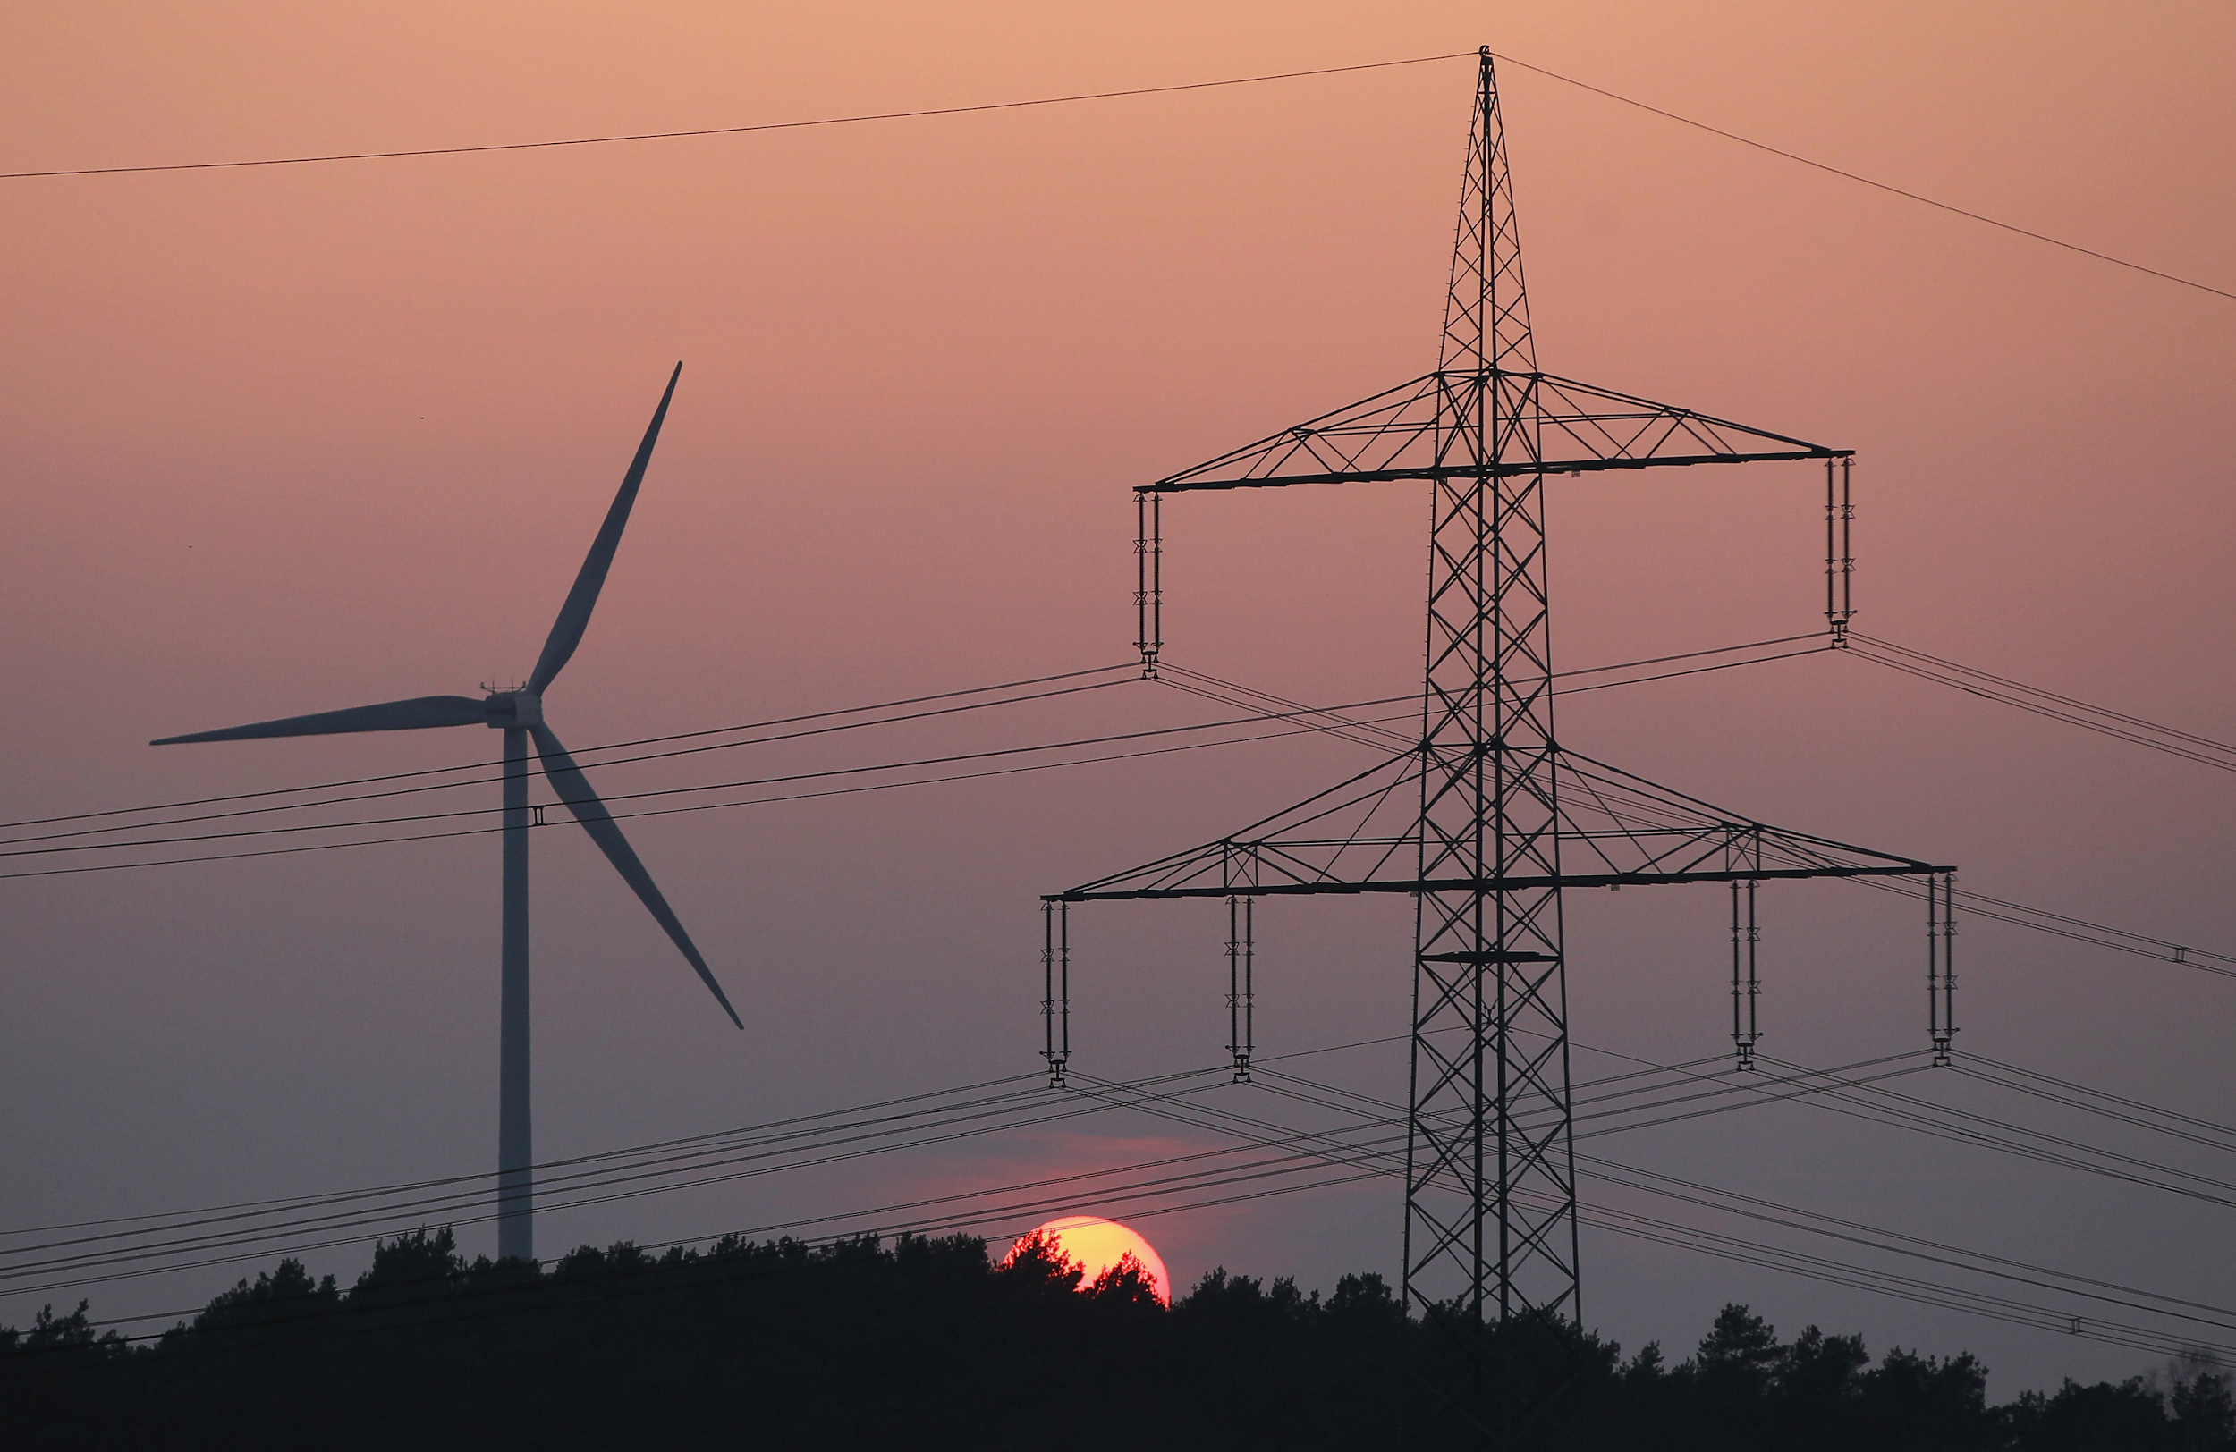
Pressure on the Grid:
Energy & GHG goals call for:
Continual implementation of more renewables
Lower dependence of fossil fuel
Nuclear phase out
Which means....
Grid must account for nuclear power
Grid must account for partial decrease in fossil fuel
Increased renewables
Electric grid needs updates...fast.
Pietruszkiewicz, Jon. “Utilities Should Avoid Over-Investing When Integrating Renewable Energy Into Their Grid” Breaking Energy, 2015, Accessed May 1, 2018.

Slide 18
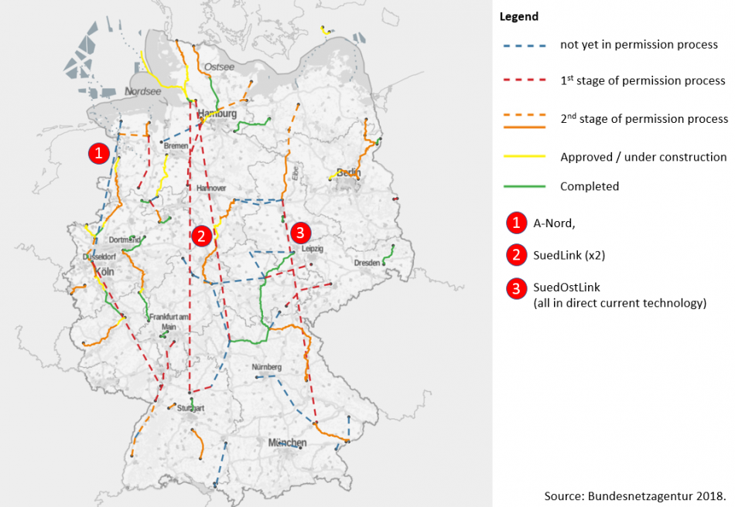
Partial Solution: Grid Expansion
4650 km of high voltage north-south transmission lines
Planned: 2025; expected: up to 2027
Clean Energy Wire

Slide 19
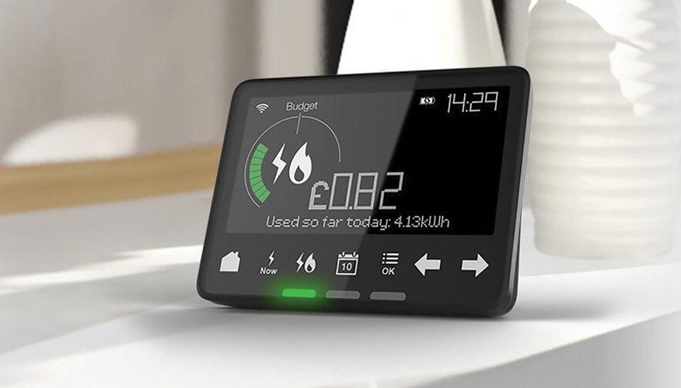
Solution - Digitalization
“Smarter” grid; increase flexibility
“Smart meters”; fast response and management of supply and demand for electricity
Local substation distributors & management tech
Especially important for decentralized power to grid
Increasing local & municipal PV & wind farms
Grothaus, Michael.“How Smart Meters Like NEST Save You Money: What You Need To Know”. 2017. Accessed May 1 2018.

Slide 20
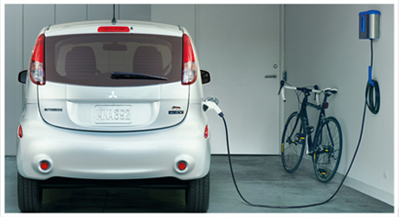
Solutions - Sector Coupling
Renewables powering transport, vehicles, heat
Heat: renewable power → synthetic methane, hydrogen
Critical to emission and climate-neutral targets
100% renewable power in energy sector not sufficient
Pros: Excess power outlet
Cons: Increased demand from grid (more pressure on grid)
“CARREGAMENTO DE VIATURAS ELÉCTRICAS NAS GARAGENS COMUNS PARTICULARES”. Prado Condominios, 2017, Accessed May 1, 2018.

Slide 21
German Energy: Future
Germany is moving aggressively towards a decarbonized future and the share of renewables in energy production is increasing rapidly. (34% increase in renewable TWh generation between 2014-2017)
Germany will likely come close to achieving their targets if they do not actually reach them.
To increase the chances of meeting them Germany should strongly reconsider the planned closing of their nuclear plants to avoid relying on CO2 producing coal and gas for backup.
In terms of increasing renewable energy, Germany does not appear to need to change its course of action due to the rapid increase that is already occurring.

Slide 22
References:
Federal Ministry for the Environment, Nature Conservation, Building and Nuclear Safety. Climate Action Plan 2050, http://www.bmu.de/fileadmin/Daten_BMU/Pools/Broschueren/klimaschutzplan_2050_en_bf.pdf. Accessed 5/1/2018
Clean Energy Wire. Clean Energy Wire CLEW, https://www.cleanenergywire.org/. Accessed 5/1/2018.
Angora. Report on the German Power System, https://www.agora-energiewende.de/fileadmin/downloads/publikationen/CountryProfiles/Agora_CP_Germany_web.pdf. Accessed 5/1/2018

