Slide 1

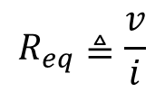




L5
Today, we learn some tools derived from the 3 basic laws:
Equivalent resistance
Voltage division
Current division
They help you develop intuition about circuits:
  To see relationship between variables
  To see several steps ahead
  To plan a solution to a circuit
Two terminal circuit
with all resistors
$$i$$
$$i$$
$$+$$
$$v$$
$$−$$
$$+$$
$$v$$
$$−$$
Behaves like a
single resistor
$$R_{eq}$$
$$R_{eq}≜\frac{v}{i}$$

Slide 2
L5
Ways of connection
Series connection:
Two or more elements are in series if every connected pair
exclusively share a single node, i.e., one node connects only two elements.
i₁
i₂
i₃
i₁= i₂= i₃
By KCL, same current flows through elements in series
R₁ and R₂ are not in series because the node
connecting them also connects a third element.
R₁
R₂
Parallel connection:
Two or more elements are in parallel if they are connected
between the same two nodes.
Node 1
By KVL, same voltage across
parallel elements:
v₁=v₂=v₃
Node 2

Slide 3



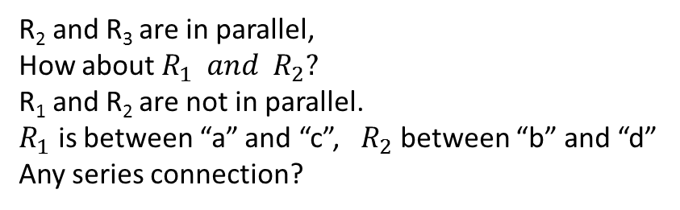





Determine series and parallel connection:
R₂ and R₃ are in parallel,
How about $R_{1} and R_{2}?$
R₁ and R₂ are not in parallel.
$R_{1}$ is between “a” and “c”, $R_{2}$ between “b” and “d”
Any series connection?
$$i$$
$$+$$
$$v$$
$$−$$
$$a$$
R₄
$$b$$
R₁
R₂
R₃
$R_{1} and R_{5}$ are not in series
$R_{1} and R_{4}$ are not in series
$$c$$
R₅
$$d$$
No series connection between any two elements.
These wires cannot be thrown away.
They must be connected to somewhere to draw power

Slide 4









Which pair of resistors are in series? Which pair in parallel?
Node 1
Node 4
$$10Ω and 5Ω?$$
Not parallel, Not series
$$Is$$
4Ω
$$4Ω and 9Ω?$$
Not parallel, Not series
10Ω
5Ω
$4Ω and 5Ω$?
In Series
+
−
$$− v_{9} +$$
$9Ω and 18Ω$?
In parallel
Node 2
30V
9Ω
How many nodes in the circuit?
$$+ \\ v_{18} \\ −$$
18Ω
Only 4 nodes
$$Is$$
4Ω
Node 3
10Ω
5Ω
$$v_{9}=v_{18}$$
+
−
30V
9Ω
18Ω

Slide 5

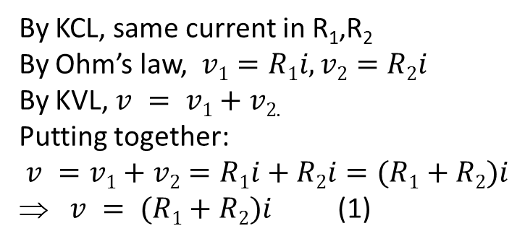

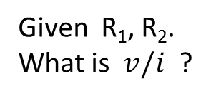



§ 2.5 Series resistors and voltage division
L5
Given R₁, R₂.
What is $v/i$ ?
R₁
By KCL, same current in R₁,R₂
By Ohm’s law, $v1=R1i, v2=R2i$
By KVL, $v = v1+v2$.
Putting together:
$v =v1+v2=R1i+R2i=(R1+R2)i$
⇒ $v = (R1+R2)i$(1)
R₂
$v = Reqi$(2)
$$R_{eq}=?$$
$$v$$
$$Req$$
Compare (1) and (2):
$$Req=R1+R2$$

Slide 6
L5
In general:
R₁
R₂
R_{k}
R_{eq}
R_{N}
If R_{eq}=R₁+R₂+….+R_{N}, same v∼ i relationship.
R_{eq} is called the equivalent resistance.
R_{eq}=R₁+R₂+….+R_{N}

Slide 7
Voltage division
L5
R₁
R₂
R_{k}
R_{N}
Voltage division: Total voltage v is divided among the resistors in direct
proportion to the resistances. Larger resistance takes more voltage.
Special case with two resistors:
R₁
R₁
R₂
R₂

Slide 8
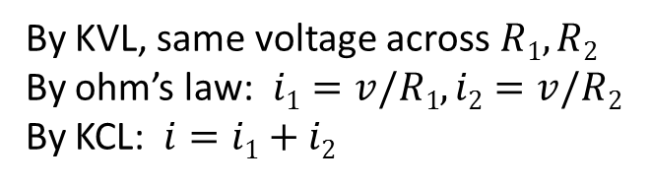


§ 2.6 parallel resistors and current division
L5
What is $R_{eq}=v/i$ ?
R₁
R₂
By KVL, same voltage across $R1, R2$
By ohm’s law: $i1=v/R1, i2=v/R2$
By KCL: $i=i1+i2$
Put together:
R_{eq}
$$R_{eq}=?$$

Slide 9
L5
In general
R₁
R₂
…..
R_{N}
R_{eq}

Slide 10




L5
Equivalent resistance for parallel resistors:
Notation:
Special cases:
N=2:
R₁=R₂=…=R_{N}=R:
Simple combinations:
Simple rule:
3//6=
12//6=
15//10=
20//5=
2
4
$αR_{1}$//$αR_{2}=\frac{αR_{1}×αR_{2}}{αR_{1}+αR_{2}}=\frac{αR_{2}R_{2}}{R_{1}+R_{2}}=α{(R}_{1}$//$R_{2} )$
6
4
$27$//54$=$
$9$(3//6)
$$=9×2=18$$

Slide 11
L5
Common sense:
Adding more resistor to existing parallel ones reduces R_{eq}:
Equivalent resistance for parallel connection is less than any individual resistance
Equivalent conductance:

Slide 12

Current division: Given total $i$, what is $i1,i2$ ?
R_{eq}
L5
R₁
R₂
The other resistance on top
The current is shared by resistors in inverse
proportion to resistance.
Larger resistor takes less current.

Slide 13
L5
Two extreme cases:
Case 1: A resistor in parallel with a short circuit
R₁
R₂=0
Case 2: A resistor in parallel with an open circuit
R₂=∞
R₁

Slide 14
Equivalent resistance Examples
L5
6Ω
4Ω
2Ω
1Ω
R_{eq}
5Ω
8Ω
3Ω
6Ω
2Ω
4Ω
2Ω
R_{eq}
6Ω
2Ω
8Ω
4Ω
2.4Ω
R_{eq}=4+2.4+8=14.4Ω
R_{eq}
8Ω

Slide 15
Equivalent resistance Examples
L5
1
1
1
1
10Ω
10Ω
6
12
6
3
5
3
4
5
R_{eq}
4
R_{eq}
12
1
10Ω
R_{eq}
2
6
3
10Ω
1
R_{eq}=10+2//(1+2)
=10+2//3
=10+1.2
=11.2Ω
R_{eq}
2
2

Slide 16



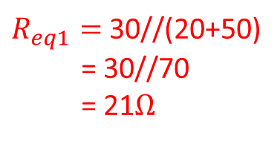





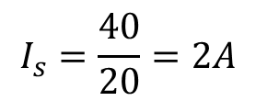

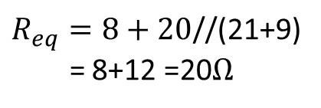
Example: Compute $I_{s}$
$$I_{s}$$
9Ω
$R_{eq1}=$30//(20+50)
= 30//70
= 21$Ω$
$$R_{eq1}$$
8Ω
50Ω
14Ω
$$+$$
$$−$$
40V
30Ω
20Ω
$R_{eq2}=$ 14+9//18
= 14 + 6
= 20$Ω$
9Ω
18Ω
$$R_{eq2}$$
Need to find the equivalent resistance with respect to 40V
$$I_{s}$$
9Ω
$R_{eq}=8+20$//(21+9)
= 8+12 =20$Ω$
40V
8Ω
$$+$$
$$−$$
$$R_{eq}$$
20Ω
21Ω
$$I_{s}=\frac{40}{20}=2A$$

Slide 17
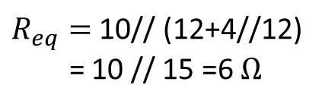

Example: Compute $R_{eq}$
12Ω
12Ω
10Ω
4Ω
R_{eq}
R_{eq}
4Ω
12Ω
10Ω
12Ω
$R_{eq}=$ 10// (12+4//12)
= 10 // 15 =6 $Ω$
12Ω
R_{eq}
10Ω
4Ω
12Ω

Slide 18


R5
Practice 6: Find $R_{eq}$
3Ω
20Ω
4Ω
4Ω
5Ω
15Ω
R_{eq}
18Ω
R_{eq}
15Ω
9Ω
6Ω
8Ω
Practice 7: Find $I_{s}$
$$Is$$
4Ω
10Ω
5Ω
+
−
30V
9Ω
18Ω

Slide 19








Practice 8: Find $vs$
R5
Practice 8: Find $vs$
15Ω
10Ω
15Ω
10Ω
30Ω
14Ω
2A
14Ω
3Ω
30Ω
2A
3Ω
Practice 9: Find $v_{1}, v_{2}$
Practice 10: Find $i_{1}, i_{2}$
$$+ v_{1} −$$
$$+ v_{2} −$$
$$i_{1}$$
4Ω
4Ω
6Ω
4Ω
2Ω
$$3A$$
15V
+ −
$$i_{2}$$

Slide 20



L6
Three useful tools derived from basic laws:
Equivalent resistance
Voltage division
Current division
Used together to solve
circuit problems
Voltage division:
R₁
R₁
R₂
R₂
Current Division:
R₁
R₂
$$i$$
$$R_{1}$$
$$R_{2}$$

Slide 21

L6
Example: Find i₀ and v₁.
4Ω
6Ω
3Ω
Approach 1: Assign auxiliary variable $I$.
Use equivalent resistance with respect to 12V to find
I, then v₁=4I, and i₀ can be computed by current division.
R_{eq}= 4 + 6//3 =4+2=6Ω
By Ohm’s Law, I=12/R_{eq}=12/6=2A
Thus v₁= 4I=8V.
R_{eq}
By current division:
Be Careful: In this equivalent circuit, only I is the same as in the
original circuit. Neither v₁ nor i₀, can be found in it. You need
to go back to the original circuit to find v₁ and i₀.

Slide 22

L6
a
4Ω
6Ω
3Ω
b
Approach 2: Use equivalent resistance of 6//3, denoted as R’_{eq}.
R’_{eq}=3//6=2Ω. By voltage division,
a
4Ω
R’_{eq}
Be careful, i₀ cannot be found in the
equivalent circuit. i₀≠ I. You have to use the
original circuit to find i₀.
b
Where is $v_{2}$ in the original circuit?
Since the voltage across 3Ω is v₂, by Ohm’s Law, i₀=v₂/3=4/3A

Slide 23



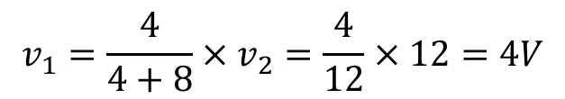

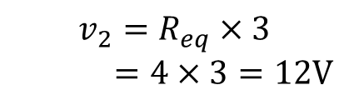






L6
Example: Find v₁, v₂,
3A
$$4+8=$$
$$R_{1}$$
$=15$//10
8Ω
$$R_{2}$$
4Ω
3A
15Ω
10Ω
3A
$$R_{1}$$
$$R_{2}$$
Approach 1: Which is the voltage across 3A ?
$$v_{1} or v_{2}?$$
It is $v_{2}.$If you know the Req w.r.t 3A, you can obtain $v_{2}$ by ohm’s law.
$R_{eq}=R_{1}$//$R_{2}$
$$v_{2}=R_{eq}×3$$
$=4×3=12V$
3A
$R_{eq}$= (4+8)//15//10
How to find $v_{1}?$
$$R_{eq}$$
= 12//6
Need the original circuit.
By voltage division,
= 4$Ω$
$$v_{1}=\frac{4}{4+8}×v_{2}=\frac{4}{12}×12=4V$$

Slide 24




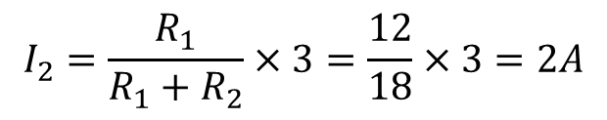




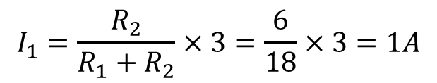
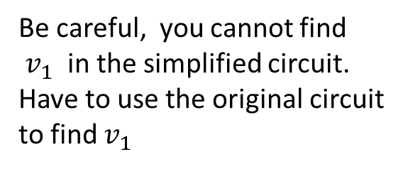


L6
$$I_{1}$$
$$I_{2}$$
Be careful, you cannot find
$v_{1}$ in the simplified circuit.
Have to use the original circuit
to find $v_{1}$
8Ω
4Ω
3A
15Ω
10Ω
Approach 2: Use current division. Assign $I_{1}, I_{2}.$
$$R_{1}=4+8=12Ω$$
$$I_{1}$$
$$I_{2}$$
$R_{2}=$15//10=6$Ω$
3A
$$+ \\ v_{2} \\ −$$
By current division,
$$R_{1}$$
$$R_{2}$$
$$I_{1}=\frac{R_{2}}{R_{1}+R_{2}}×3=\frac{6}{18}×3=1A$$
$$I_{2}=\frac{R_{1}}{R_{1}+R_{2}}×3=\frac{12}{18}×3=2A$$
By ohm’s law, $v_{1}=4I_{1}=4V; v_{2}=R_{2}I_{2}=6×2=12V.$

Slide 25









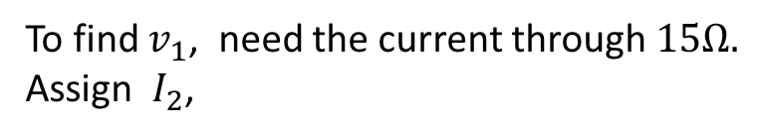
Example: Find ${I_{s}, I}_{1}, v_{ab}$
$$I_{1}$$
8Ω
25Ω
$$I_{2}$$
$$− \\ v_{2} \\ +$$
$I_{s}$
$$+ \\ v_{1} \\ −$$
15Ω
3Ω
a
$$+ v_{ab}−$$
b
10Ω
20Ω
+
−
25Ω
27V
15Ω
12Ω
Outline of the solution:
Find $I_{s}$ first, then use current division to find $I_{1}.$
To find $v_{ab}$, need to find $v_{1}, v_{2}, then use KVL$
${ v}_{2}+v_{ab}+v_{1}=0⇒ v_{ab}={−v}_{2}−v_{1}$
To find $v_{1}$, need the current through $15Ω.$
Assign $I_{2}$,
$I_{2}$can be computed by current division on $I_{1}$

Slide 26

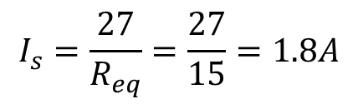

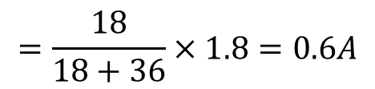





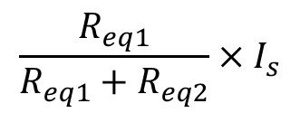







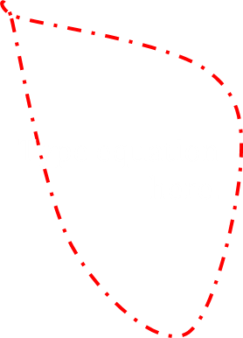

S$tep 1: Compute I_{s}$
$$I_{1}$$
8Ω
$$R_{eq1}$$
25Ω
$I_{s}$
15Ω
$$R_{eq2}$$
3Ω
20Ω
10Ω
+
−
$$R_{eq1}=10+8=18Ω$$
25Ω
27V
15Ω
12Ω
$$R_{eq2 }=12+(15+25)\backslash \backslash (25+20+15)$$
$=12+40\backslash \backslash$ 60 $=12+24=36Ω$
$$I_{1}$$
$R_{eq}$w.r.t. 27V:
$I_{s}$
$R_{eq}=3+R_{eq1}\backslash \backslash$ $R_{eq2}$= 3 + 36\\18
3Ω
$$=3+6\left(6\backslash \backslash 3\right)=3+6×2=15Ω$$
$$R_{eq2}$$
$$R_{eq1}$$
$$I_{s}=\frac{27}{R_{eq}}=\frac{27}{15}=1.8A$$
+
−
$$\frac{R_{eq1}}{R_{eq1}+R_{eq2}}×I_{s}$$
Step 2: By current division: $I_{1}=$
27V
$$=\frac{18}{18+36}×1.8=0.6A$$

Slide 27
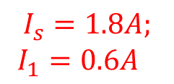


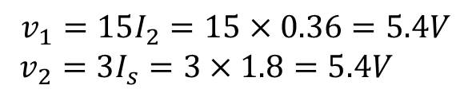

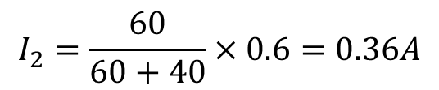

Step 3: Go back to the original circuit to find $v_{ab}$:
$$I_{1}$$
8Ω
25Ω
$$I_{2}$$
$$+ \\ v_{1} \\ −$$
$$− \\ v_{2} \\ +$$
$I_{s}$
15Ω
3Ω
a
$$+ v_{ab}−$$
b
10Ω
20Ω
$$I_{s}=1.8A;$$
$I_{1}=0.6A$
+
−
25Ω
27V
15Ω
12Ω
$I_{1}$ is divided by $15Ω+25Ω=40Ω$ and $25Ω+20Ω+15Ω=60Ω$
$$I_{2}=\frac{60}{60+40}×0.6=0.36A$$
$$v_{1}=15I_{2}=15×0.36=5.4V$$
$v_{2}=3I_{s}=3×1.8=5.4V$
$$v_{ab}+v_{1}+v_{2}=0$$
$$v_{ab}=−v_{1}−v_{2}=−5.4−5.4=−10.8V$$

Slide 28


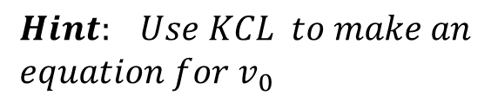











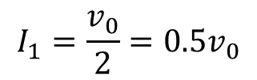
Example: Find $v_{0}$ and the power absorbed by the dependent current source.
+ −
$$Hint: Use KCL to make an \\ equation for v_{0}$$
2Ω
4.5V
3Ω
$$+ \\ v_{0} \\ −$$
1.8A
$$0.2v_{0}$$
2Ω
5Ω
4Ω
Solution:
Assign current $I_{1}$
$$I_{1}$$
$I_{1}$ is the same current through $2Ω$
$$a$$
+ −
2Ω
4.5V
$$I_{1}$$
By Ohm’s Law,
$$I_{1}=\frac{v_{0}}{2}=0.5v_{0}$$
3Ω
$$+ \\ v_{0} \\ −$$
1.8A
2Ω
KCL at node $a:$
$$0.2v_{0}$$
$$1.8+0.2v_{0}=I_{1}=0.5v_{0}$$
$⇒$ $1.8=0.3v_{0}$
5Ω
4Ω
$$⇒ v_{0}=6V$$

Slide 29






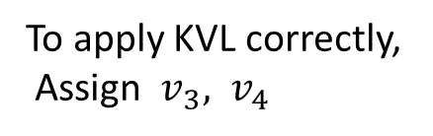






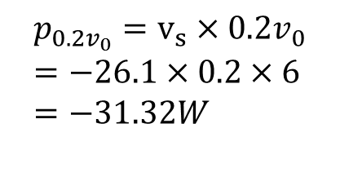


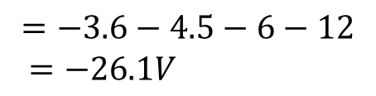

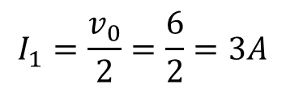




$$We have : v_{0}=6V$$
Power absorbed by the
dependent current source?
$$I_{1}$$
$$a$$
+ −
2Ω
$$− \\ v_{3} \\ +$$
4.5V
$$I_{1}$$
3Ω
Need voltage across $0.2v_{0}$
$$+ \\ v_{0} \\ −$$
1.8A
$$− \\ v_{s} \\ +$$
2Ω
$$0.2v_{0}$$
Assign $v_{s}$
$$− v_{4} +$$
To apply KVL correctly,
Assign $v_{3}, v_{4}$
5Ω
4Ω
KVL around right side loop:
$$v_{3}=?$$
$$v_{3}=3×0.2v_{0}$$
$$v_{s}+v_{3}+4.5+v_{0}+v_{4}=0$$
$$=3×0.2×6=3.6V$$
$$I_{1}=\frac{v_{0}}{2}=\frac{6}{2}=3A$$
$$v_{s}=−v_{3}−4.5 −v_{0}−v_{4}$$
$$v_{4}=?$$
$v_{4}=4I_{1}$,
$$=−3.6−4.5−6−12$$
$=−26.1V$
$$v_{4}=4×3=12V$$
$$p_{0.2v_{0}}=v_{s}×0.2v_{0} \\ =−26.1×0.2×6 \\ =−31.32W$$

Slide 30



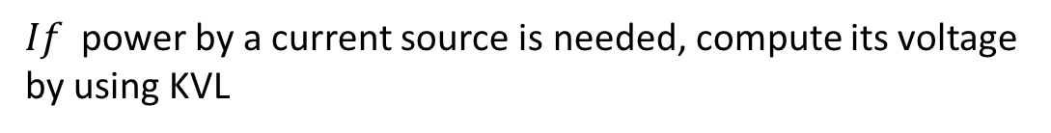

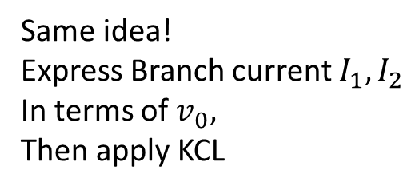


Variations of the circuit
+ −
2Ω
4.5V
3Ω
$$+ \\ v_{0} \\ −$$
2Ω
4.5V
1.8A
$$0.2v_{0}$$
2Ω
+
−
3Ω
1.8A
2Ω
$$+{ v}_{0}−$$
5Ω
4Ω
$$0.2v_{0}$$
$$I_{1}$$
7Ω
2Ω
5Ω
4Ω
+
−
99V
1.8A
$$I_{2}$$
$$0.8v_{0}$$
$$+ \\ v_{0} \\ −$$
2Ω
Same idea!
Express Branch current $I_{1}, I_{2}$
In terms of $v_{0},$
Then apply KCL
+ −
5Ω
15V
$If$ power by a current source is needed, compute its voltage
by using KVL

Slide 31
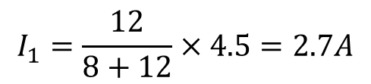





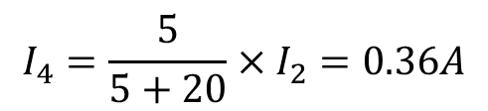










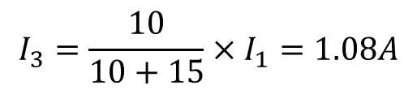


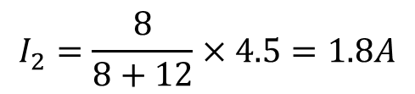


Example: Find v₁ and v₂.
Alternatively:
12Ω
Ohms Law:
$$v_{x}=6I_{1}=16.2V$$
2Ω
8Ω
Voltage division:
$$+ \\ v_{1} \\ −$$
$$+ \\ v_{2} \\ −$$
8Ω
$v_{1}=\frac{9}{9+6}×v_{x}=$9.72V
9Ω
10Ω
4.5A
5Ω
6Ω
More current division:
$$I_{3}=\frac{10}{10+15}×I_{1}=1.08A$$
$$I_{1}$$
$$I_{2}$$
12Ω
$$I_{3}$$
$$I_{4}$$
$$v_{1}=9I_{3}=9.72V$$
$$+ \\ v_{1} \\ −$$
$$+ \\ v_{x} \\ −$$
2Ω
8Ω
$$+ \\ v_{2} \\ −$$
$$I_{4}=\frac{5}{5+20}×I_{2}=0.36A$$
9Ω
10Ω
5Ω
8Ω
4.5A
$$v_{2}=8I_{4}=2.88V$$
$$R_{eq2}$$
$$R_{eq1}$$
6Ω
$$I_{1}$$
$$I_{2}$$
Current division:
$$I_{1}=\frac{12}{8+12}×4.5=2.7A$$
8Ω =
$$R_{eq1}$$
4.5A
$$R_{eq2}$$
= 12Ω
$$I_{2}=\frac{8}{8+12}×4.5=1.8A$$

Slide 32
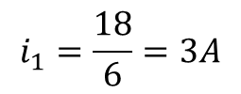

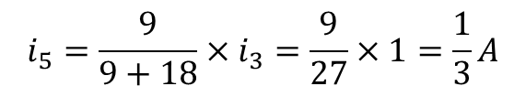
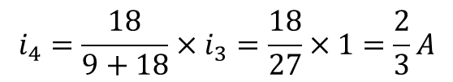

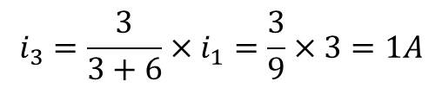
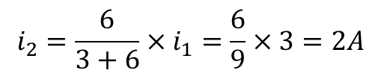
Example: Find the currents i₁, …, i₅
L6
i₁
Approach1: Use equivalence resistance
and current division.
4Ω
+
−
i₃
$$i_{1}$$
i₂
$R_{eq}=4+$3//9//18=6Ω
18V
i₄
i₅
3Ω
9Ω
18Ω
R_{eq}
$$i_{1}=\frac{18}{6}=3A$$
i₁
$$i_{2}=\frac{6}{3+6}×i_{1}=\frac{6}{9}×3=2A$$
4Ω
+
−
i₃
$$i_{3}=\frac{3}{3+6}×i_{1}=\frac{3}{9}×3=1A$$
i₂
18V
3Ω
6Ω
$$i_{4}=\frac{18}{9+18}×i_{3}=\frac{18}{27}×1=\frac{2}{3}A$$
$$i_{5}=\frac{9}{9+18}×i_{3}=\frac{9}{27}×1=\frac{1}{3}A$$

Slide 33
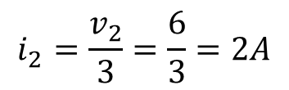
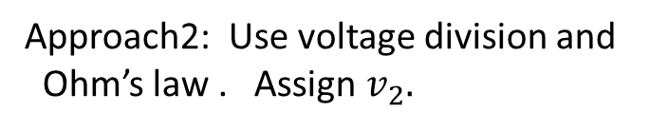


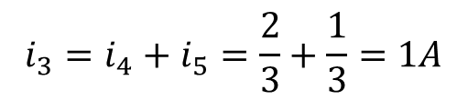
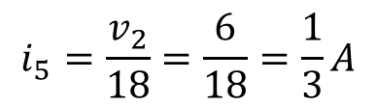
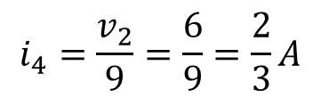
Example: Find the currents i₁, …, i₅
L6
i₁
Approach2: Use voltage division and
Ohm’s law . Assign $v_{2}.$
4Ω
+
−
i₃
i₂
18V
i₄
i₅
3Ω
9Ω
18Ω
By voltage division $v_{2}=\frac{2}{4+2}×18=6V$
i₁
By Ohm’s law, $i_{1}=\frac{v_{2}}{2}=\frac{6}{2}=3A$
4Ω
+
−
$$i_{2}=\frac{v_{2}}{3}=\frac{6}{3}=2A$$
3//9//18=2Ω
18V
$$i_{4}=\frac{v_{2}}{9}=\frac{6}{9}=\frac{2}{3}A$$
$$i_{5}=\frac{v_{2}}{18}=\frac{6}{18}=\frac{1}{3}A$$
$$i_{3}=i_{4}+i_{5}=\frac{2}{3}+\frac{1}{3}=1A$$

Slide 34




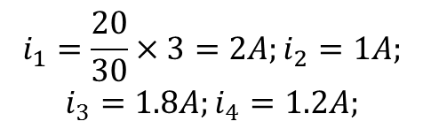


















Example: Find ${i_{1}, i_{2}, i_{3},i_{4}, I}_{x}$
$$i_{1}$$
$$i_{2}$$
$$i_{2}$$
10Ω
20Ω
$$i_{1}$$
10Ω
20Ω
3A
extend
3A
Shrink to one
point
$$Ix$$
20Ω
30Ω
20Ω
$$i_{3}$$
$$i_{4}$$
30Ω
$$i_{3}$$
$$i_{4}$$
$$i_{2}$$
$$i_{1}$$
In all three circuits, $i_{1}, i_{2}, i_{3}, i_{4}$ are the same
10Ω
20Ω
How about $I_{x}, I_{0}?$
By KCL, $I_{0}=i_{1}+i_{2}$=?
$$I_{0}=i_{1}+i_{2}=i_{3}+i_{4}=3A$$
3A
$$I_{0}$$
$$I_{x}=i_{1}−i_{3}=i_{4}−i_{2}$$
By current division:
20Ω
30Ω
$$i_{1}=\frac{20}{30}×3=2A;i_{2}=1A;$$
$$i_{3}=1.8A;i_{4}=1.2A;$$
$$I_{x}=i_{1}−i_{3}=0.2A$$
$$i_{3}$$
$$i_{4}$$
$$I_{x}=i_{4}−i_{2}=0.2A$$

Slide 35
Test 1 will be given on Sept 30 (Monday), 11-11:50am.
In Ball Hall 210 There will be two versions in different colors.
Please arrive 5-10 minutes earlier
A practice exam will be given on 9/25/2019(Wednesday), 11-11:50am
in Ball Hall 210
Solution to practice exams will be posted at website
Solution to all practice problems in lecture note will be posted.

Slide 36






R6
$$I_{1}$$
15Ω
Practice 12: Find $I_{1}, I_{2}, v_{4}$
6Ω
4Ω
+
−
$$+ v_{4} −$$
3Ω
30V
$$I_{2}$$
6Ω
Practice 13: Find $I_{0}, v_{4}$
$$I_{0}$$
5Ω
8Ω
12Ω
6Ω
4Ω
3.5A

Slide 37



R6
Practice 14: Find $I_{0}, v_{2}$
6Ω
6Ω
$$I_{0}$$
$$20V$$
+
−
6Ω
15Ω
10Ω

Slide 38



R6
Practice 15: Find the voltage $vx$
Practice 16: Find $v0, I_{x},$
30V
+ −
4Ω
10Ω
6Ω
15Ω
6Ω
12Ω
+
−
$$I_{x}$$
30V
6Ω
12Ω
12Ω
18Ω

Slide 39
R6
Practice 16a: Find v₁, I₀,
20Ω
5Ω
15Ω
5A
I₀
9Ω
18Ω

Slide 40



R7
Practice 17: Find $v_{x}, I,$
14Ω
6Ω
24Ω
15Ω
+
−
$$+ v_{x} −$$
36V
16Ω
12Ω
$$I$$

Slide 41
R7
8Ω
Practice 18: Find i₀
i₀
4Ω
4Ω
3Ω
3A
8Ω
24V
+ −
Practice 19: Find i₀
4Ω
4Ω
i₀
3Ω

Slide 42

R7
Practice 20: Find R for the circuit
R
6Ω
+
−
+
−
30V
20V
4Ω
Practice 21: Find V_{s} for the circuit
6Ω
I₁=2A
4Ω
+
−
$$V_{s}$$
10Ω
9Ω

Slide 43


R7
Practice 22: Find R so that $I_{s}$ is 10A
I_{s}=10A
10Ω
4Ω
+
−
$$64V$$
8/3Ω
R

