Slide 1
L12
Chapter 4 Circuit Theorems
From Chapter 2: Basic laws -- Foundations.
From Chapter 3: Mesh analysis, Nodal analysis.
Systematic tools, can be used for complex circuits.
More useful tools to be learned in Chapter 4:
Linearity
Superposition
Source transformation
Thevenin’s Theorem
Norton’s Theorem
Maximum power transfer
Could be more tricky than Chapters 2,3.
There may exist several solutions to one problem
Need to develop insight to plan solutions ahead and identify the simplest solution

Slide 2
L12
§4.2 Linearity
Basic concepts:
Input, output
v_{s}
I_{s}
Input: the cause, or excitation,
+ −
Output: voltage or current of any element
i
Example:
i₀
6Ω
Two inputs
V_{s}, I_{s}
Two outputs:
i₀, v₀
4Ω
4Ω
V_{s}
+
−
I_{s}
2Ω
5Ω
12Ω
7Ω
You can imagine pulling out the inputs, outputs and put the rest inside a box

Slide 3
L12
Pull out the inputs, outputs and put the rest inside a box
More abstract form
Resistive circuit
i₀
V_{s}
+
−
V_{s}
i₀
Circuit System
I_{s}
6Ω
I_{s}
v₀
Input
output
First consider a circuit with one input, one output:
Circuit System
Input output relationship can be described by a function
$x$
$y$
Input
output
$$y = f ( x)$$

Slide 4
L12
Input output relationship: $y = f(x):$
Circuit System
Input $x$: can be $Vs$, $Is$
Output $y$: can be $vo, io$of any element
$x$
$y$
Input
output
The input output relationship is said to be linear if $y = k x$for a certain constant $k$.
Linearity:
Two implications:
Linearity = homogeneity + additivity
Homogeneity:
If x₁ ⇒ y₁,
then αx₁ ⇒ α y₁
Additivity:
If x₁ ⇒ y₁,
then x₁+ x₂ ⇒ y₁+ y₂
x₂ ⇒ y₂,

Slide 5
L12
Linear circuit:
the input-output relationship of a resistive circuit is linear.
Resistive circuit
i₀
i₀
Resistive circuit
V_{s}
+
−
I_{s}
+ −
+ −
v_{o}=k₁V_{s}
i₀=k₂V_{s}
v_{o}=k₃I_{s}
i₀=k₄I_{s}
Linearity is the simplest relationship between input and output
It is predictable: double efforts → double results
If $V_{S}=5V → v_{0}=3V$
Then $V_{S}=10V → v_{0}=6V$
$V_{s}=2.5V → v_{0}=1.5V$
We first use one example to demonstrate linearity
Later on, we use this linear property to analyze circuits

Slide 6
L12
Example:
Input: V_{s}
Output: I₀
$$(x)$$
2Ω
$$(y)$$
8Ω
$$+ v_{x} −$$
A resistive circuit.
There exists a $k$ such that
I₀=$k$V_{s}
I₀
4Ω
i₁
i₂
+
−
$$3v_{x}$$
$(y=kx$)
6Ω
V_{s}
+
−
What is $k$?
Use mesh analysis to find $k$.
4Ω
(1)*5+(2)*6 ➔ $76i_{2}=V_{s}$
Assign mesh currents i₁, i₂.
v_{x}=2i₁
⇒ 3v_{x}= 6i₁
I₀= i₂
I₀ = i₂= $\frac{1}{76}$V_{s}
Compare with
I₀=$k$V_{s}
KVL along mesh 1:
2i₁+4(i₁-i₂)+V_{s}+6i₁=0
⇒ 12i₁-4i₂= -V_{s} (1)
$k=\frac{1}{76}$
KVL along mesh 2:
8i₂- 3v_{x}+4i₂-V_{s}+4(i₂-i₁) = 0
$$V_{s}=1V → I_{0}=\frac{1}{76}A$$
8i₂- 6i₁ +4i₂-V_{s}+4(i₂-i₁) = 0
$$V_{s}=4V → I_{0}=\frac{4}{76}A$$
⇒ -10i₁+16i₂ = V_{s} (2)

Slide 7
L12
For this circuit, the input output relationship is derived by solving the output from the input
Given input ⇒ find output,
The direct approach
For some circuit, it is more convenient to find the input from the output.
Given output ⇒ find input,
The backward approach
In general,
$x$
Linear Circuit
$y$
$y = kx$for a certain $k$
Input
output
How to find $k$?
Just need one pair $\left(x_{0},y_{0}\right)$
to determine $k$
If you know any pair of input and output,
$(x,y) = (x0, y0)$
Then $y0= kx0$
Direct approach:
Assume $x=x_{0}$, find $y=y_{0}$
$$k=\frac{y_{0}}{x_{0}}$$
Backward approach:
Assume $y=y_{0}$, find $x=x_{0}$

Slide 8
R7
A practice problem from Chapter 2:
Practice 20: Find V_{s} for the circuit
6Ω
I₁=2A
4Ω
$V_{s}$ is the input, the cause
$I_{1}$ is the output, the result
Assume $I_{1}=2A, V_{s}=?$
+
−
$$V_{s}$$
10Ω
9Ω
$$20V$$
$$5A$$
6Ω
I₁=2A
$$V_{s}=50V$$
$$+ −$$
4Ω
$$3A$$
$$+ 12V−$$
+
−
$$+$$
$$−$$
$$+$$
$$−$$
$$V_{s}$$
$$30V$$
10Ω
$$18V$$
9Ω

Slide 9
L12
Example:
Input: $x=I_{s}$
Output: $y=I0$
6Ω
3Ω
$$I0$$
2Ω
Find $k$ such that
$I0= kIs$
$$Is$$
7Ω
4Ω
5Ω
Use backward method
Assume $I0=1A$,
$$Is= ?$$
You may assume $I0$ to be any number.
$$k=\frac{y}{x}=\frac{I_{0}}{I_{s}}$$
With $Is$ solved, you have

Slide 10
L12
Solution: Assign additional variables as in the following circuit:
I_{s}
I₂
v₂, v₃ are node voltages
6Ω
3Ω
I₀
I₃
2Ω
I₁
I_{s}
7Ω
4Ω
5Ω
I₀=1A
Conclusion:
The input-output relationship is
Starting with I₀=1A
By Ohm’s law: v₀=5I₀=5V; v₁=3I₀=3V
By KVL: v₂=v₀+v₁=5+3=8V
By Ohms Law: I₁=v₂/4=2A
By KCL at v₂: I₂=I₀+I₁=1+2=3A
By (*): v₃=v₂+2I₂=8+2*3=14V
By Ohms Law: I₃=v₃/7=14/7=2A
By KCL at v₃: I_{s}=I₂+I₃=3+2=5A
I₀=$k$I_{s}= 0.2I_{s}
If I_{s}=15A, then
I₀=0.2*15=3A
If I_{s}=10A, then
I_{s}=5A
I₀=0.2*10=2A
With I₀=0.2I_{s}, you can find output I_{o} for any input I_{s}
You can also find the input $I_{s}$ for any output $I_{0}$

Slide 11
L12
A simple demonstration:
Suppose $I_{0}=1A, I_{s}=?$
$$5A$$
$$14V$$
$$+ 6V −$$
$$8V$$
$$+ 3V −$$
$$I_{0}=1A$$
For $I_{0}=1A,$
$$I_{s}=5A,$$
$$k=\frac{I_{0}}{I_{s}}=0.2$$
6Ω
$$3A$$
2Ω
$$2A$$
3Ω
$$2A$$
$$+$$
$$5V$$
$$−$$
I_{s}
7Ω
4Ω
5Ω
What if $I_{s}$ is replaced by $V_{s}?$
$$5A$$
$$+ 30V −$$
$$14V$$
$$+ 6V −$$
$$8V$$
$$+ 3V −$$
$$I_{0}=1A$$
For $I_{0}=1A,$
$V_{s}=44V,$
$$k=\frac{I_{0}}{V_{s}}=\frac{1}{44}$$
$$44V$$
$$3A$$
3Ω
6Ω
$$2A$$
2Ω
$$2A$$
$$+$$
$$5V$$
$$−$$
$$+$$
$−$
V_{s}
7Ω
4Ω
5Ω

Slide 12
L12
§4.3 Superposition
-- About the relationship between one output and several inputs
Superposition principle:
the voltage across (or current through) an element in a
linear circuit, is the sum of voltage/current due to each independent source alone.
V_{s}
+ −
i₀
I_{s}
v₀= v₁+v₂
i₀= i₁+ i₂
+ −
Due to V_{s} alone: turn off $I_{s}$
Set I_{s}= 0 ⇔ replace current source with open circuit
Due to I_{s} alone: turn off $V_{s}$
Set V_{s}= 0 ⇔ replace voltage source with short circuit
V_{s}
+ −
i₁
i₂
I_{s}
+ −
+ −

Slide 13
L12
Key points: when you examine the effect due to one source,
turn off the other sources
Turn off voltage source with short circuit
Turn of current source with open circuit

Slide 14
L12
Example : Find the output v.
Step 1: Due to 6V alone
– turn off 3A with open circuit
8Ω
8Ω
+
−
+
−
6V
4Ω
3A
6V
4Ω
v = v₁+v₂ = 2+8=10V
By voltage division:
Step 2: Due to 3A – turn off 6V with short circuit
8Ω
By equivalent resistance and ohm’s law
4Ω
3A
Superposition breaks down a circuit into several circuits with only one independent
source – typically can be solved with simple methods in Chapter 2.

Slide 15
R12
Practice 1: Find v₀ for V_{s}=27V by linearity
2Ω
4Ω
4Ω
+
−
V_{s}
3Ω
3Ω
2Ω
Step 1: Find k such that v₀=kV_{s} by assuming v₀= some value
Step 2: For V_{s}=27V, v₀= k V_{s}

Slide 16
R12
Practice 2: Find i using linearity
8Ω
4Ω
i
4Ω
3Ω
3A

Slide 17
R12
Practice 3: Find i using superposition.
24V
8Ω
+ −
4Ω
i
4Ω
+
−
12V
3Ω
3A

Slide 18
R12
Practice 4: Find i using superposition.
+
−
1Ω
6A
24V
i
3Ω
4Ω
4Ω

Slide 19
Example: Find I₀ using superposition.
Due to 7V:
L13
6Ω
6Ω
I₀
I₁
8Ω
4Ω
8Ω
4Ω
+
−
+
−
3Ω
7V
7V
7A
3Ω
Due to 7A:
6Ω
Due to 7V: replace 7A with open circuit
Due to 7A: replace 7V with short circuit
I₂
8Ω
4Ω
$$I_{0}=I_{1}+I_{2}$$
3Ω
7A

Slide 20
L13
Due to 7A:
6Ω
6Ω
I₂
I₂
8Ω
4Ω
8Ω
4Ω
3Ω
3Ω
7A
7A
8Ω
8Ω
I₂
I₂
4Ω
4Ω
7A
3Ω
6Ω
3Ω
6Ω
7A
10Ω
I₂
$$I_{2}=\frac{10}{10+4}×7=5A$$
7A
4Ω

Slide 21
L13
Due to 7V:
6Ω
$R_{eq}$with respect to $7A:$
I₁
$R_{eq}=3+6/$/$\left(8+4\right)=7Ω$
8Ω
4Ω
$$I_{s}$$
$$I_{s}=1A$$
+
−
3Ω
7V
By current division:
$$I_{1}=−\frac{6}{8+4+6}I_{s}=−0.333A$$
Going back to the original circuit: $I_{0}=I_{1}+I_{2}=5−0.333=4.667A$

Slide 22
L13
Superposition with dependent sources:
For circuit with dependent sources, keep the dependent sources.
They cannot be turned off . They are not input
Example: Find v_{ab} using superposition:
+ −
10Ω
3v_{ab}
$v_{ab}=v_{1}+v_{2}=1+5=6V$
+
−
4V
2A
$$− v_{10} +$$
$$− v_{10} +$$
+ −
10Ω
3v₁
+ −
+
−
10Ω
3v₂
4V
Due to 4V
Due to 2A
2A
By KVL: $3v_{1}+v_{1}=4+v_{10}$,
$$3v_{2}+v_{2}=v_{10}$$
$$=2×10=20V$$
$$v_{10}=0,$$
$$v_{2}=5V$$
$$v_{1}=1V$$

Slide 23
L13
§ 4.4: Source transformation
A general situation:
you can separate a circuit as the connection of two parts.
i
You may need to make change to one part,
Circuit A
Circuit C
But want to ensure this change does not affect the other part
For circuit A, you can obtain a function v = f (i)
If there is another circuit B, with the same v∼i relationship,
You can replace Circuit A with Circuit B without affecting Circuit C
i
All variables in Circuit C are unchanged,
But the variables in Circuit A may not exist in Circuit B.
Circuit B
Circuit C
Sometimes you need to replace a complex circuit with a simpler one; as with Thevenin’s equivalent
Sometimes with one which is more convenient for analysis as with source transformation

Slide 24
L13
Compare the two connections:
Circuit A:
Circuit B:
i
i
What is the v∼i relationship for each circuit?
How to express $v$ in terms of $i$?
R₁
i_{R}
+
−
i_{s}
R₂
v_{s}
By KVL,
v = v_{s}-v_{R}= v_{s}-R₁i
By KCL, i_{R}= i_{s}-I
v = R₂i_{R}= R₂i_{s}- R₂i
v = v_{s}-R₁i
v = R₂i_{s}- R₂i
To have the same v∼i relationship:
R₁=R₂, V_{s}=R₂i_{s}

Slide 25
L13
Conclusion:
The following two connections are equivalent
i
i
R
v_{s}= Ri_{s}
i_{R}
+
−
i_{s}
v_{s}
R
If you replace one with another, the rest of the circuit will not be affected.
However, be careful:
The voltages across resistor R in the two circuits are different;
The currents through R in the two circuits also different.

Slide 26
L13
Extension to dependent sources:
The following two connections are equivalent
i
i
+
−
R
v_{s}= Ri_{s}
i_{s}
v_{s}
R
For example, if i_{s}= kv_{x}, then v_{s}=Ri_{s}=Rkv_{x}
If v_{s}= ki₀, then i_{s}=ki₀/R
The rule: if you put the two sources side by side, the arrow of the current source points
from – to + of the voltage source

Slide 27
L13
i
i
R
v_{s}= Ri_{s}
i_{s}
+
−
v_{s}
R
All equivalent
i
i
+ −
v_{s}
i_{s}
R
R

Slide 28
Example: Find the voltage v₀
using source transformation
L13
a
2Ω
3Ω
4Ω
+
−
Caution:
Need to keep the two nodes “a” and “b” so that v₀ is kept after every change
8Ω
3A
12V
b
After these transformations,
4Ω and 2Ω can be combined,
3Ω and 8Ω can be combined.
Reducing the number of elements
a
4Ω
2Ω
$$4A$$
$$− \\ +$$
$$12V$$
8Ω
3Ω
b
When everything in parallel, you can rearrange the elements without changing the voltage and branch current.
a
2A
4A
6Ω
8Ω
3Ω
b

Slide 29
L13
a
When everything in parallel, you can rearrange the elements without changing the voltage and branch current.
2A
4A
6Ω
8Ω
3Ω
a
b
a
2A
v₀=3.2V
2A
4A
3Ω
1.6Ω
8Ω
6Ω
b
b

Slide 30
Example: Find v_{x}
L13
4Ω
0.25v_{x}
Approach 1:
6V
2Ω
+
−
+
−
Convert to a circuit with one loop.
2Ω
18V
4Ω
v_{x}
+ −
3A
+
−
2Ω
Express $v_{x}:$
$$v_{x}=3−I$$
2Ω
18V
KVL around loop:
4Ω
v_{x}
$$I+4I+v_{x}+18−3=0$$
+ −
Plug in $v_{x}=3−I$
1Ω
$$I$$
$$I+4I+3−I+18−3=0$$
3V
+
−
+
−
$$4I=−18$$
$$I=−4.5A$$
18V
$$v_{x}=3−I=3−\left(−4.5\right)=7.5V$$

Slide 31
Approach 2: Convert to a circuit with two nodes.
L13
4Ω
0.25v_{x}
6V
2Ω
Combine parallel resistors
+
−
+
−
2Ω
18V
4Ω//2Ω//2Ω=0.8Ω
Combine parallel current sources
4Ω
v_{x}
+ −
3A
+
−
2Ω
2Ω
18V
0.8Ω
3A
2Ω
4Ω
2Ω
v_{x}=7.5V

Slide 32
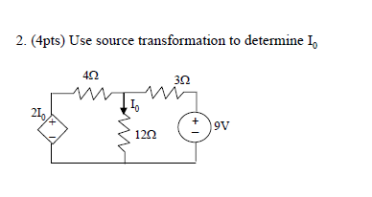
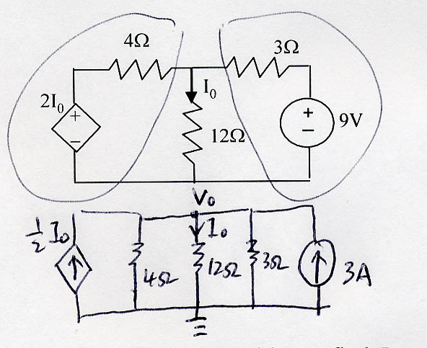
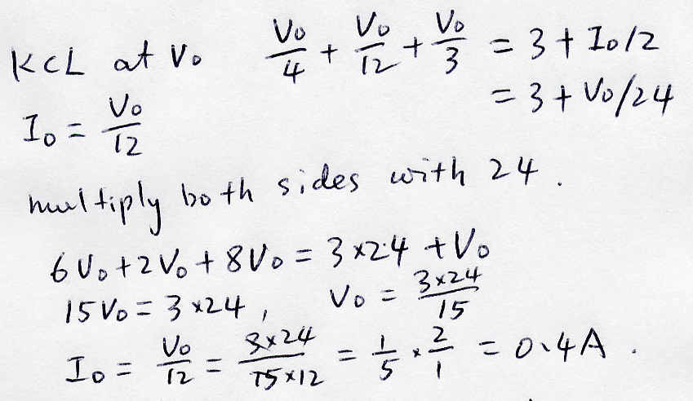

Slide 33
R13
Practice 5: Find v₀ using source transformation
6Ω
5Ω
+
−
+
−
3Ω
9V
9v₀
2Ω

Slide 34
R13
Practice 6: Find v₀ using source transformation
3A
2Ω
3Ω
4A
2Ω
2A
2Ω
10V
+ −

Slide 35
R13
Practice 7: Find I₀ using source transformation
I₀
4Ω
1Ω
+
−
v₀/3
8V
6Ω

