Slide 1
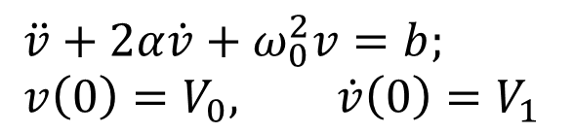
L20
Chapter 8 Second-order circuits
A circuit with two energy storage elements:
One inductor, one capacitor
Two capacitors, or
Two inductors
Such a circuit will be described with
second-order differential equation:
$$\ddot{v}+2α\dot{v}+ω_{0}^{2}v=b; \\ v\left(0\right)=V_{0}, \dot{v}\left(0\right)=V_{1}$$
+ −
C
+
−
Equivalently:
i_{L}
L
We first learn how to solve 2nd-order diff equ.

Slide 2





Solving 2nd-order differential equations
L20
Consider a second-order differential equation
$$\ddot{v}+2α\dot{v}+ω_{0}^{2}v=b$$
with initial condition: $v(0)=V0$,
$$\dot{v}\left(0\right)=V_{1}$$
Need to find v(t) for all t.
In chapter 8, b=0 corresponds to source free case, b≠0 for step response.
Let $v(∞)$= b/ω₀²
(Assume $α>0.$Then as $t → ∞, v\left(t\right)$goes to a constant . )
Let the roots to s²+2αs+ω₀²= 0 (not =b) be s₁, s_{2,}
For example:
$$j=\sqrt{−1}$$
The solution will be constructed using the roots.
Three cases:
Case 1: α > ω₀,
two distinct real roots
Case 2: α = ω₀,
two identical real roots
Case 3: α < ω₀,
two distinct complex roots

Slide 3



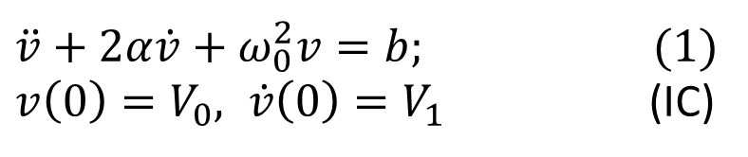







$\ddot{v}+2α\dot{v}+ω_{0}^{2}v=b;$ (1)
$v\left(0\right)=V_{0}, \dot{v}\left(0\right)=V_{1}$ (IC)
L20
Case 1: α > ω₀,
two distinct real roots for s²+2αs+ω₀² = 0
The solution to (1) is not unique.
For any real numbers A₁, A₂, the following function satisfies (1),
$$v\left(t\right)=v\left(∞\right)+A_{1}e^{s_{1}t}+A_{2}e^{s_{2}t}$$
Where $v\left(∞\right)=b/ω_{0}^{2}$
This is called the general solution.
To verify,
$$\dot{v}\left(t\right)=$$
$$s_{1}A_{1}e^{s_{1}t}+s_{2}A_{2}e^{s_{2}t}$$
$$\ddot{v}\left(t\right)=$$
$$s_{1}^{2}A_{1}e^{s_{1}t}+s_{2}^{2}A_{2}e^{s_{2}t}$$
$$\ddot{v} + 2α\dot{v} + ω_{0}^{2}v$$
$$=s_{1}^{2}A_{1}e^{s_{1}t}+s_{2}^{2}A_{2}e^{s_{2}t}+2α\left(s_{1}A_{1}e^{s_{1}t}+s_{2}A_{2}e^{s_{2}t}\right)+ω_{0}^{2}(v\left(∞\right)+A_{1}e^{s_{1}t}+A_{2}e^{s_{2}t})$$
$$0$$
$$0$$
$$=A_{1}e^{s_{1}t}\left(s_{1}^{2}+2αs_{1}+ω_{0}^{2}\right)+A_{2}e^{s_{2}t}\left(s_{2}^{2}+2αs_{2}+ω_{0}^{2}\right)+ω_{0}^{2}v(∞)$$
$$=ω_{0}^{2}v(∞)$$
v(t) satisfies (1)
for any A₁, and A₂
The solution will be uniquely determined by the initial conditions (IC)

Slide 4

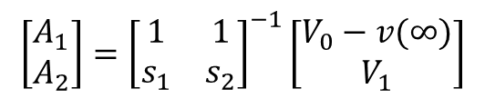

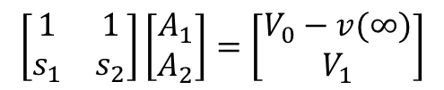
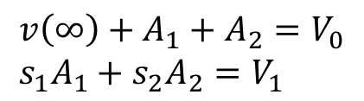




$\ddot{v}+2α\dot{v}+ω_{0}^{2}v=b;$ (1)
$v\left(0\right)=V_{0}, \dot{v}\left(0\right)=V_{1}$ (IC)
L20
The general solution
$$v\left(t\right)=v\left(∞\right)+A_{1}e^{s_{1}t}+A_{2}e^{s_{2}t}$$
Where $v\left(∞\right)=b/ω_{0}^{2}$
There is only one pair of A₁, A₂ that satisfy the IC
To find A₁, A₂, use IC to form two equations.
Recall:
$${\dot{v}\left(t\right)=s}_{1}A_{1}e^{s_{1}t}+s_{2}A_{2}e^{s_{2}t}$$
Evaluate $v$(t) and $\dot{v}$(t) at t=0:
$$v\left(0\right)=v\left(∞\right)+A_{1}+A_{2}$$
$$\dot{v}(0)=s_{1}A_{1}+s_{2}A_{2}$$
To satisfy the IC, we obtain
$$v\left(∞\right)+A_{1}+A_{2}=V_{0} \\ s_{1}A_{1}+s_{2}A_{2}=V_{1}$$
$$\left[\begin{matrix}1 & 1 \\ s_{1} & s_{2}\end{matrix}\right]\left[\begin{matrix}A_{1} \\ A_{2}\end{matrix}\right]=\left[\begin{matrix}V_{0}−v(∞) \\ V_{1}\end{matrix}\right]$$
$$\left[\begin{matrix}A_{1} \\ A_{2}\end{matrix}\right]={\left[\begin{matrix}1 & 1 \\ s_{1} & s_{2}\end{matrix}\right]}^{−1}\left[\begin{matrix}V_{0}−v(∞) \\ V_{1}\end{matrix}\right]$$
You may use other methods to solve for A₁ and A₂.

Slide 5





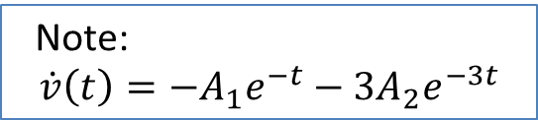

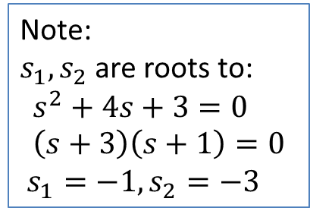

$\ddot{v}+2α\dot{v}+ω_{0}^{2}v=b$ (To compare )
L20
Example: Solve
$$\ddot{v}+4\dot{v}+3v =6, v\left(0\right)=1; \dot{v}\left(0\right)=−1$$
$s^{2}+2αs+ω^{2}=0$.
Case 1, two distinct real roots for $s^{2}+4s+3=0$.
Step 1: Find s₁, s₂, $v(∞)$
Note:
$s_{1},s_{2}$are roots to:
$$s^{2}+4s+3=0 \\ \left(s+3\right)\left(s+1\right)=0$$
$s_{1}=−1, s_{2}=−3$
$v\left(∞\right)=b/ω_{0}^{2}$ =6/3 =2
The general solution:
$$v\left(t\right)=v(∞)+A_{1}e^{s_{1} t}+A_{2}e^{s_{2}t}$$
Step 2: Find A₁,A₂, use initial condition
$$v\left(0\right)=2+A_{1}+A_{2}=1 (∗)$$
$$\dot{v}\left(0\right)=−A_{1}−3A_{2}=−1 (∗∗)$$
Note:
$$\dot{v}\left(t\right)=−A_{1}e^{−t}−3A_{2}e^{−3t}$$
Solve (*) and (**) to obtain A₁=-2; A₂=1
Finally,

Slide 6



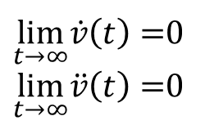

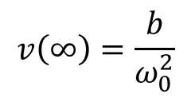


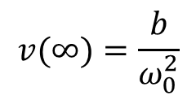

$\ddot{v}+2α\dot{v}+ω_{0}^{2}v=b;$ (1)
$v\left(0\right)=V_{0}, \dot{v}\left(0\right)=V_{1}$ (IC)
L20
An Example:
$$\ddot{v}+4\dot{v}+3v =6, v\left(0\right)=1; \dot{v}\left(0\right)=−1$$
$$v(∞)=\frac{b}{ω_{0}^{2}}$$
The general solution:
$v\left(t\right)=v(∞)+A_{1}e^{s_{1} t}+A_{2}e^{s_{2}t}$,
Since $s_{1}, s_{2}$are negative,
$$\lim_{t→∞}v\left(t\right)=2=v(∞)$$
Another way to see $v\left(∞\right)=b/ω_{0}^{2}$
$\dot{v}\left(t\right)=A_{1}s_{1}e^{s_{1} t}+A_{2}{s_{2}e}^{s_{2}t}$,
$\lim_{t→∞}\dot{v}\left(t\right)=$0
$\lim_{t→∞}\ddot{v}\left(t\right)=$0
$\ddot{v}\left(t\right)=A_{1}s_{1}^{2}e^{s_{1} t}+A_{2}{s_{2}^{2}e}^{s_{2}t}$,
From (1) , $\lim_{t→∞}\left(\ddot{v}\left(t\right)+2α\dot{v}\left(t\right)+ω_{0}^{2}v\left(t\right)\right)=ω_{0}^{2}v(∞)$
$$=b$$
$$v\left(∞\right)=\frac{b}{ω_{0}^{2}}$$

Slide 7





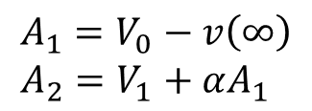
L20
Case 2: α= ω₀
$$s^{2}+2αs+α^{2}={\left(s+α\right)}^{2}$$
Two identical roots, s₁=s₂= -α to s²+2αs+ω₀²=0
The general solution:
$$v\left(t\right)=v\left(∞\right)+\left(A_{1}+A_{2}t\right) e^{−αt}$$
$$v\left(∞\right)=b/ω_{0}^{2}$$
Its derivative:
$$\dot{v}\left(t\right)=A_{2}e^{−αt}−α\left(A_{1}+A_{2}t\right)e^{−αt}$$
Use IC to find A₁, A₂.
At t = 0,
$$v\left(0\right)=v\left(∞\right)+A_{1}=V_{0}$$
$$A_{1}=V_{0}−v\left(∞\right) \\ A_{2}=V_{1}+αA_{1}$$
$\dot{v}\left(0\right)=$ $A_{2}−αA_{1}=V_{1}$

Slide 8
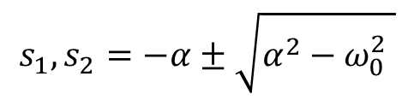
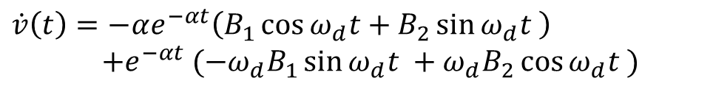


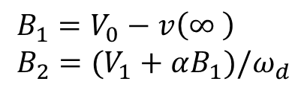



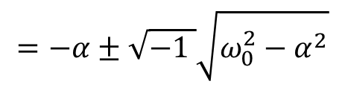

Case 3: α < ω₀
L20
Two complex roots to s²+2αs+ω₀²=0
$$j=\sqrt{−1}$$
$$s_{1}, s_{2}=−α±\sqrt{α^{2}−ω_{0}^{2} }$$
$$=−α±\sqrt{−1 }\sqrt{ω_{0}^{2}−α^{2}}$$
$$=−α±j ω_{d}$$
$$s_{1}, s_{2}=−α±j ω_{d}$$
The general solution:
$$v\left(t\right)=v\left(∞\right)+e^{−αt}(B_{1}\cos{ω_{d}t }+B_{2}\sin{ω_{d}t})$$
$$v\left(∞\right)=b/ω_{0}^{2}$$
Its derivative:
$\dot{v}\left(t\right)=−αe^{−αt}\left(B_{1}\cos{ω_{d}t}+B_{2}\sin{ω_{d}t }\right)$
$+e^{−αt} (−ω_{d}B_{1}\sin{ω_{d}t }+ω_{d}B_{2}\cos{ω_{d}t })$
Use IC to find B₁, B₂.
$$v\left(0\right)=v\left(∞\right)+B_{1}=V_{0}$$
$$B_{1}=V_{0}−v\left(∞ \right) \\ B_{2}=(V_{1}+αB_{1})/ω_{d}$$
$$\dot{v}\left(0\right)=−αB_{1}+ω_{d}B_{2}=V_{1}$$

Slide 9



L20
$$v\left(t\right)=v\left(∞\right)+e^{−αt}(B_{1}\cos{ω_{d}t }+B_{2}\sin{ω_{d}t})$$
$$v\left(∞\right)+A_{M}e^{−αt}$$
Case 3: α < ω₀
$$v(∞)$$
$$v\left(∞\right)−A_{M}e^{−αt}$$

Slide 10





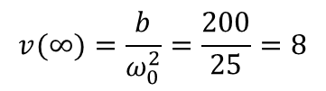













Example: Solve $\ddot{v}+8\dot{v}+25v=200, \dot{v}\left(0\right)=0, v\left(0\right)=12$
Compare with $\ddot{v}+2α\dot{v}+ω_{0}^{2}v=b$
Solution:
$$α=?ω_{0}=?, b=? which case?$$
$$α=4, ω_{0}=5, b=200,$$
$α<ω_{0}$ →
case 3, two complex roots : $−α±jω_{d}$
Step 1: Form general solution using roots and $v(∞).$
$v\left(t\right)=v(∞)+e^{−αt}(B_{1}\cos{ω_{d}t }+B_{2}\sin{ω_{d}t })$,
$$v(∞)=? ω_{d}=?$$
Imaginary part of the roots:
$ω_{d}=\sqrt{ω_{0}^{2}−α^{2}}$ =
$\sqrt{25−16}$=3
Complex roots: $−α±jω_{d}^{2}=−4±j3$
$$v(∞)=\frac{b}{ω_{0}^{2}}=\frac{200}{25}=8$$
$$0$$
$$0$$
$$v(∞)=?$$
$$\ddot{v}(∞)+8\dot{v}(∞)+25v(∞)=200$$
$v\left(t\right)=8+e^{−4t}(B_{1}\cos{3t }+B_{2}\sin{3t })$, ← General solution
Step 2: Find $B_{1}, B_{2},$using initial conditions, $\dot{v}\left(0\right)=0, v\left(0\right)=12$
$$\dot{v}\left(t\right)=−4e^{−4t }(B_{1}\cos{3t}+B_{2}\sin{3t)+e^{−4t }(−3B_{1}\sin{3t+3B_{2}\cos{3t )}}}$$
$$\dot{v} \left(0\right)=−4B_{1}+3B_{2}=0$$
$$B_{1}=4;B_{2}=\frac{16}{3}$$
$$v\left(0\right)=8+B_{1}=12$$
Final solution:
$v\left(t\right)=8+e^{−4t }$(4cos3t+$\frac{16}{3}\sin{3t ) V}$

Slide 11
R20
Practice 1: Solve
$$\ddot{v}+5 \dot{v}+6v=18, v\left(0\right)=0; \dot{v}\left(0\right)=4$$
Practice 2: Solve
$$\ddot{v}+4 \dot{v}+4v=8, v\left(0\right)=1; \dot{v}\left(0\right)=−1$$
Practice 3: Solve
$$\ddot{v}+4 \dot{v}+13v=39, v\left(0\right)=1; \dot{v}\left(0\right)=−1$$

Slide 12




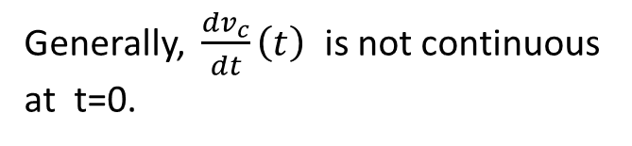


Example : Find $i_{L}(t), v_{c}(t)$for t > 0.
L21
Second-order RLC circuits
General circuit:
6Ω
6Ω
6Ω
$i_{L}$
+ −
C
t = 0
0.5H
+
−
i_{L}
+
−
+
−
L
30V
10V
As always, $i_{L}\left(t\right), v_{c}\left(t\right)$are continuous function of time.
Use the circuit before switch to find $i_{L}\left(0\right), v_{c}\left(0\right).$
For t>0, $v_{c}\left(t\right)$ satisfies
We also need $\frac{dv_{c}}{dt}\left(0\right).$
Generally, $\frac{dv_{c}}{dt}\left(t\right)$ is not continuous
at t=0.
H$ow to find \frac{dv_{c}}{dt}\left(0\right)$?

Slide 13





Converting a circuit problem to a math problem
L21
To solve a second order circuit, we need to
1. Derive the differential equation:
2. Find the initial condition
$\ddot{v}+2α\dot{v}+ω_{0}^{2}v=b;$
$v\left(0\right)=V_{0}, \dot{v}\left(0\right)=V_{1}$
§ 8.2. Finding initial values
We need to find
1. Capacitor voltage and inductor current don’t jump
Key points:
Use circuit before switch (t<0) to find these two.
Recall:
$v_{L}=L\frac{di_{L}}{dt}$, $i_{c}=C\frac{dv_{c}}{dt}$
Consider the circuit right after switch, i.e., at t = 0⁺
Apply KVL to find $vL$(0⁺), then
Apply KCL to find $iC$(0⁺), then

Slide 14




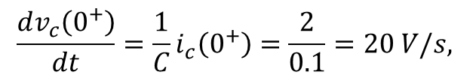


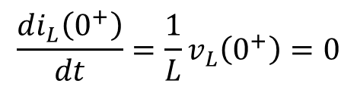





To find $\frac{dv_{c}\left(0^{+}\right)}{dt}, \frac{di_{L}\left(0^{+}\right)}{dt}$
Example: Find
L21
$$iL$$
0.25H
$$+ v_{R}−$$
4Ω
4Ω
$$iL$$
0.25H
$$iC$$
+
−
2Ω
12V
+
−
$$i_{L}=2A; \\ V_{c}=4V$$
0.1F
t=0
12V
0.1F
Use circuit before switch to find
At t = 0⁻
Consider t = 0⁺
$$v_{L}\left(0^{+}\right)$$
4Ω
$$iL$$
+
−
$$\frac{di_{L}\left(0^{+}\right)}{dt}=\frac{1}{L}v_{L}\left(0^{+}\right)=0$$
2Ω
12V
$i_{c}\left(0^{+}\right)=i_{L}(0^{+})$=2A
$${i_{L}\left(0^{−}\right)=2A; v}_{c}\left(0^{−}\right)=2×2=4V$$
$$\frac{dv_{c}\left(0^{+}\right)}{dt}=\frac{1}{C}i_{c}\left(0^{+}\right)=\frac{2}{0.1}=20 V/s,$$
By continuity, $i_{L}\left(0^{+}\right)=2A, v_{C}\left(0^{+}\right)=4V$

Slide 15
L21
Chapter 8 circuits
1). Source free series RLC circuits
2). Source free parallel RLC circuits
3). Step response of series RLC circuits
4). Step response of parallel RLC circuits
5). Other second order circuits
We will focus on 1) and 3).
We study 3) first.
1) is a special case of 3).

Slide 16
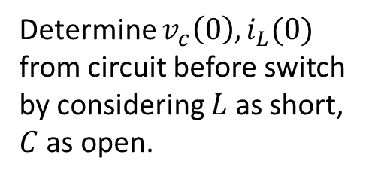


§ 8.5 Step response of series RLC circuits
L21
A general circuit
Before switch (t<0),
L and C may not be in series.
+ −
C
+
−
Determine $v_{c}\left(0\right), i_{L}(0)$
from circuit before switch
by considering $L$ as short,
$C$ as open.
$$iL$$
L
After switch ( t>0 ), L and C in series
$$Ve$$
+ −
By Thevenin’s theorem,
the two terminal circuit
can be replaced by a
voltage source and a resistor
L
R₀
+ −
C
+
−

Slide 17

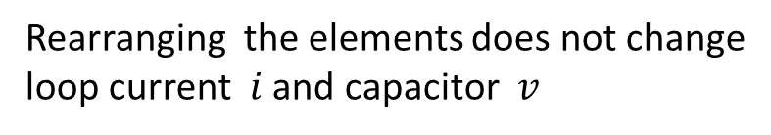







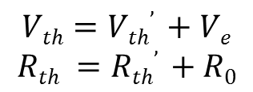

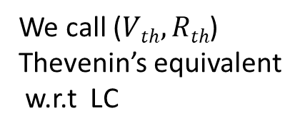
By Thevenin’s theorem, the two terminal circuit can be
replaced by a voltage source and a resistor
L21
$$Ve$$
+ −
$$Rth’$$
L
$i$
R₀
+
−
$$Vth’$$
C
$$Vth=Vth’ +Ve$$
$$Rth =Rth’ +R0$$
Rearranging the elements does not change
loop current $i$ and capacitor $v$
${+ v}_{R} −$
${+ v}_{L} −$
We call ($Vth, Rth$)
Thevenin’s equivalent
w.r.t LC
$$i$$
L
$$Rth$$
+
−
$$Vth$$
C
Given

Slide 18

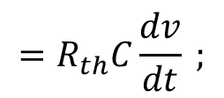



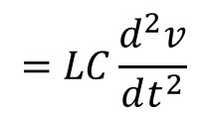

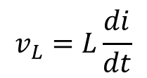
The equivalent circuit:
L21
${+ v}_{R} −$
${+ v}_{L} −$
(V_{th}, R_{th}) :
Thevenin’s equivalent w.r.t LC
$i$
L
R_{th}
+
−
C
Given
V_{th}
Choose $v$ as key variable. We derive diff. equation for $v$
Express other variables in terms of $v$:
$$=R_{th}C\frac{dv}{dt} ;$$
$$v_{L}=L\frac{di}{dt}$$
$$=LC\frac{d^{2}v}{dt^{2}}$$
$$v_{R}=R_{th}i$$
By KVL,
Normalize:

Slide 19
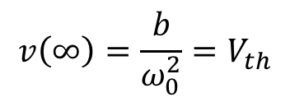

Step response of series RLC circuit:
L21
$i$
R_{th}
L
+
−
C
As compared with
general form
V_{th}
$$v\left(∞\right)=\frac{b}{ω_{0}^{2}}=V_{th}$$
If V_{th}= 0,
source free RLC,
⇒ A special case
The solution:
Case 1:
Case 2:
Case 3:
A₁,A₂,or B₁,B₂ will be determined by initial conditions

Slide 20
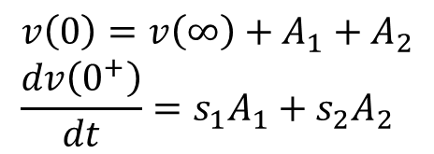
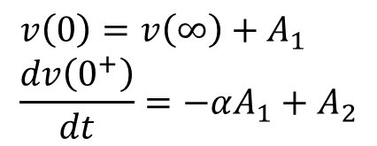
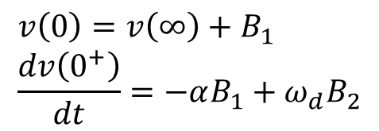
L21
Case 1:
Find A₁,A₂ from
$$v\left(0\right)=v\left(∞\right)+A_{1}+A_{2} \\ \frac{dv\left(0^{+}\right)}{dt}=s_{1}A_{1}+s_{2}A_{2}$$
Case 2:
Find A₁,A₂ from
$$v\left(0\right)=v\left(∞\right)+A_{1} \\ \frac{dv\left(0^{+}\right)}{dt}=−αA_{1}+A_{2}$$
Case 3:
Find B₁,B₂ from
$$v\left(0\right)=v\left(∞\right)+B_{1} \\ \frac{dv\left(0^{+}\right)}{dt}=−αB_{1}+ω_{d}B_{2}$$

Slide 21
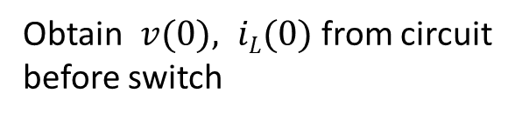

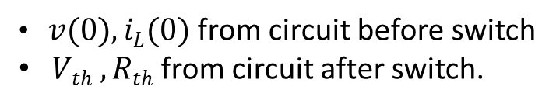



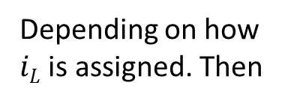

Key points for step resp. of series RLC circuits:
L21
For circuit after switch, obtain Thevenin’s
equivalent (V_{th},R_{th}) w.r.t LC
+ −
C
$iL$
+
−
$iL$
L
$iC$
R_{th}
$$iL$$
L
+
−
V_{th}
C
Obtain $v(0), iL(0)$from circuit
before switch
Assign $iC$ by passive sign convention
Depending on how
$iL$ is assigned. Then
Then follow straightforward math computation on previous slide
$v(0), iL(0)$from circuit before switch
$Vth , Rth$from circuit after switch.
Key parameters to obtain:

Slide 22

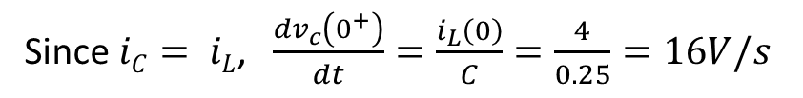

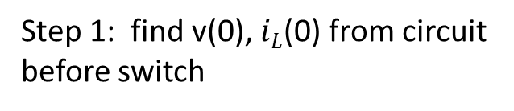






L21
Example 1: Find v(t) for t > 0.
$iL$
t = 0
1H
$iC$
+
−
5Ω
0.25F
1Ω
24V
Step 1: find v(0), $iL$(0) from circuit
before switch
Step 2: Find V_{th}, R_{th}, w.r.t LC from
circuit after switch
$iL$
$iL$
1H
$iC$
+
−
5Ω
+
−
5Ω
1Ω
0.25F
24V
24V
$iL(0)$=24/6=4A
V_{th}=24V, R_{th}=5Ω
v($∞$) = 24V
$v(0)$= 4V
Since $iC= iL$, $\frac{dv_{c}\left(0^{+}\right)}{dt}=\frac{i_{L}\left(0\right)}{C}=\frac{4}{0.25}=16V/s$

Slide 23
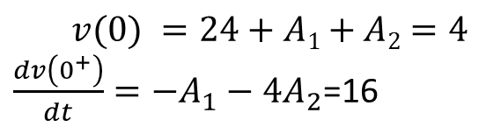


Step 3: Math computation
L21
The general solution:
Note:
$$v\left(t\right)=v\left(∞\right)+A_{1}e^{s_{1}t}+A_{2}e^{s_{2}t}$$
Find A₁, A₂ from initial condition: v(0) = 4V; dv(0⁺)/dt=16
$v(0) =24+A1+A2=4$
$\frac{dv\left(0^{+}\right)}{dt}=−A_{1}−4A_{2}$=16
$A1=−64/3, A2=4/3$
Final solution:

Slide 24
R21
Practice 4: Find
4Ω
i_{L}
0.5F
2Ω
3u(t)A
+
−
0.6H
20V

Slide 25
R21
Practice 5: Find v(t) for t > 0.
t = 0
6Ω
i_{C}
+
−
4Ω
30V
0.02F
0.5H
4Ω

Slide 26
Practice 6: The switch is at position a for a long time before
swinging to position b at t = 0. Find i_{L}(t), v_{C}(t) for t > 0.
R21
a
b
t = 0
10Ω
10Ω
+
−
60V
16mF
0.5H
i_{L}

Slide 27


Example 2: Find i(t), v(t) for t > 0.
Step 1: find v(0), i(0) from circuit
before switch
L22
6Ω
6Ω
6Ω
6Ω
6Ω
6Ω
i
1/8F
$$+ 20V −$$
$$+ v_{1} −$$
t = 0
0.5H
i
+
−
+
−
+
−
+
−
30V
10V
30V
10V
A simple circuit in Chapter 2.
By voltage division,
By KVL, v(0)=20V

Slide 28

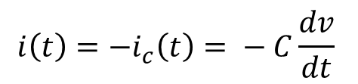





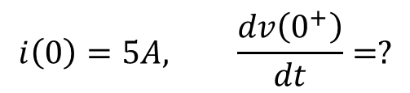
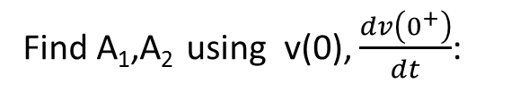

Step 2: After switch
Step 3: math
L22
$α=?ω_{0}=?$Which case?
6Ω
i_{C}
6Ω
6Ω
i
Case 2.
1/8F
General solution:
v(t) = 10+(A₁+A₂t)e^{-4t}
0.5H
Find A₁,A₂ using v(0), $\frac{dv\left(0^{+}\right)}{dt}$:
$$i\left(0\right)=5A \\ v\left(0\right)=20V$$
+
−
10V
A₁=10, A₂=0
$$i\left(0\right)=5A, \frac{dv\left(0^{+}\right)}{dt}=?$$
Final solution:
$v(t)$ = 10 + 10 e^{-4t}V
Since $iC=−i, iC(0+) = −5A$
Find inductor current,
$\frac{dv\left(0+\right)}{dt}= −5/(1/8)=−40V/s$
$$i\left(t\right)=−i_{c}\left(t\right)= − C\frac{dv}{dt}$$
R_{th}=?, V_{th}=?
$i(t)$= - (1/8)*10(-4)e^{-4t} = 5 e^{-4t}A
R_{th}=(6+6)//6=4Ω, V_{th}=10V = v($∞$)

Slide 29
For parallel RLC circuit
L22
i_{L}
i_{R}
i_{L}
i_{C}
+ −
By Norton’s
Theorem
I_{N}
R
L
L
C
C
+
−
Choose i_{L} as key variable. Derive diff equ. with KCL
Normalize:
Same math problem.
No parallel RLC circuits in homework or Final Exam.

Slide 30
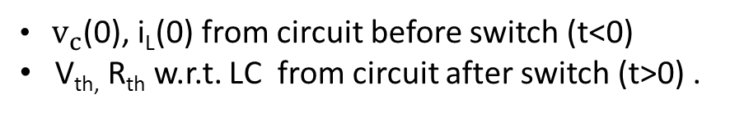

Example 3: Find v_{C}(t) for t > 0.
L22
Recall:
3u(t)A
+
−
12V
6Ω
Thus for t<0, 3u(t)A=0A
0.5H
12Ω
6Ω
The current source is
turned off.
16mF
Replace it with open
circuit for t<0
Key parameters to obtain:
$v_{c}$(0), i_{L}(0) from circuit before switch (t<0)
V_{th,} R_{th} w.r.t. LC from circuit after switch (t>0) .
Step 1: Find $v_{c}\left(0\right), i_{L}\left(0\right)$from circuit for t<0

Slide 31

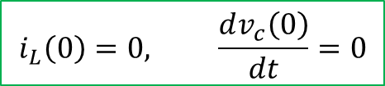
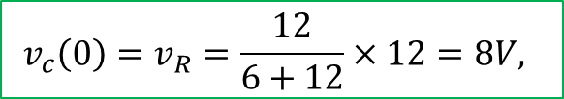

Step 1: Find $v_{c}\left(0\right), i_{L}\left(0\right)$from circuit for t<0
L22
For t < 0, 3u(t)A=0, current source open, C open , L short
+
−
12V
6Ω
$$i_{L}=0$$
12Ω
6Ω
16mF
Since $i_{L}$=0, 12V, 6$Ω and 12Ω$in the outer loop are in series
By voltage division:
$$v_{c}\left(0\right)=v_{R}=\frac{12}{6+12}×12=8V,$$
$$i_{L}\left(0\right)=0, \frac{dv_{c}\left(0\right)}{dt}=0$$

Slide 32
Step 2: For t>0, 3u(t)A=3A. Need to find $V_{th}=v_{c}\left(∞\right), R_{th}$w.r.t LC
L22
3A
+
−
12V
6Ω
0.5H
12Ω
6Ω
16mF

Slide 33





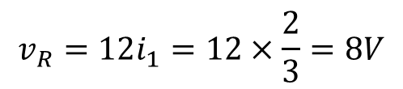

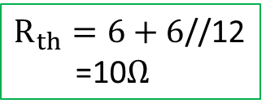
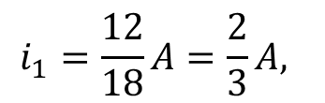



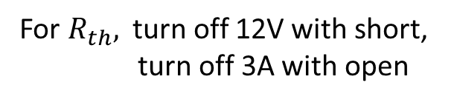
Step 2: Fot t>0, 3u(t)A=3A. Need to find $V_{th}=v_{c}\left(∞\right), R_{th}$w.r.t LC
L22
For $v\left(∞\right)$
$$i_{1}$$
3A
$$i_{1}$$
3A
12V
+
−
3A
12V
+
−
6Ω
6Ω
0.5H
12Ω
6Ω
12Ω
6Ω
16mF
$$i_{1}$$
$$i_{1}$$
For $R_{th},$ turn off 12V with short,
turn off 3A with open
By KVL, $v_{c}\left(∞\right)=v_{6}+v_{R}$
$v_{6}=3×6=18V,$ by ohms law
$R_{th}=6+6$//12
=10$Ω$
$$i_{1}=\frac{12}{18}A=\frac{2}{3}A,$$
6Ω
6Ω
$$v_{R}=12i_{1}=12×\frac{2}{3}=8V$$
12Ω
$$R_{th}$$
$$v_{c}\left(∞\right)=18+8=26V$$
Step 3: Math

Slide 34
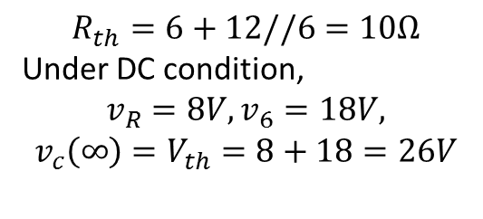


Step 2: Another way to look at the circuit for t>0
L22
To see connection better, move 12 $Ω$ to the left
12V
+
−
3A
6Ω
3A
$$− \\ v_{6} \\ +$$
+
−
12V
6Ω
0.5H
6Ω
12Ω
12Ω
0.5H
16mF
6Ω
16mF
$$R_{th}=6+12//6=10Ω$$
Under DC condition,
$$v_{R}=8V, v_{6}=18V,$$
$$v_{c}\left(∞\right)=V_{th}=8+18=26V$$

Slide 35
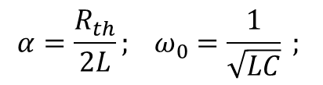
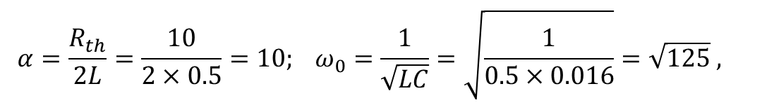





Step 3: math
From step 1, step 2, found
$R_{th}=10Ω$, $v_{c}\left(∞\right)=V_{th}=8+18=26V, v_{c}\left(0\right)=8V, \frac{dv_{c}\left(0^{+}\right)}{dt}=0$
Also note: $L=0.5H; C=16mF=0.016F$
$$α=?, ω_{0}=? which case?$$
$$α=\frac{R_{th}}{2L}; ω_{0}=\frac{1}{\sqrt{LC}} ;$$
$$α=\frac{R_{th}}{2L}=\frac{10}{2×0.5}=10; ω_{0}=\frac{1}{\sqrt{LC}}=\sqrt{\frac{1}{0.5×0.016}}=\sqrt{125} ,$$
$α<ω_{0}, case 3$, $ω_{d}=\sqrt{125−100}=5$
The general solution:
$$v_{c}\left(t\right)=26+e^{−10t}\left(B_{1}cos 5t+B_{2}sin 5t\right)$$
$$v\left(0\right)=v\left(∞\right)+B_{1} \\ \frac{dv\left(0^{+}\right)}{dt}=−αB_{1}+ω_{d}B_{2}$$
To satisfy initial condition:
$$v_{c}\left(0\right)=26+B_{1}=8 \\ {\dot{v}}_{c}\left(0\right)=−10B_{1}+5B_{2}=0$$
Solving equations to get $B_{1}=−18;B_{2}=−36$
Step response:
$$v_{c}\left(t\right)=26+e^{−10t}(−18\cos{5t −36\sin{5t)V}}$$

Slide 36
Practice 7: Find i_{L}(t), v_{C}(t), v_{R}(t) for t > 0.
R22
20mF
4Ω
6Ω
+
−
4Ω
60V
2A
i_{L}
t = 0
1H
2Ω

Slide 37
Practice 8: Find v_{C}(t) and v_{R}(t) for t > 0.
R22
2u(-t)A
2H
2Ω
3A
4Ω
250mF
4Ω

Slide 38
Chapter 7, Chapter 8 Review
Final exam: 12/16/19 (Monday),
8-11am,
BL210
One page one-sided note allowed,
Calculators allowed
Don’t include the solution to any circuit problem
in the note!

Slide 39


Step response of general RC circuit
L23
i
One or more switches changes
structure of circuit at t = 0.
+ −
$For t>0$, step response:
C
+ −
Three key parameters:
Initial condition v(0)=V₀,
Established from circuit before switch. Obtained by solving
a DC circuit, t < 0 (capacitor = open circuit)
2. Final condition v($∞)$
Established from circuit after switch. Obtained by solving
another DC circuit, t > 0 (capacitor = open circuit)
Equivalent resistance R_{th}, or R_{eq}
with respect to capacitor for circuit after switch
Since v($∞$) = V_{th}, (V_{th}, R_{th}) can be together considered as the Thevenin’s equivalent, with respect to the capacitor, from circuit after switch.

Slide 40

L23
Step response of RL circuits
Step response – For t > 0,
i
+ −
L
+ −
Three key parameters:
i(0), initial condition, from the DC circuit for t < 0. (inductor =short)
i($∞$)=I_{N}, final value, from DC circuit for t > 0. (inductor =short)
R_{N}=R_{th}, equivalent resistance w.r.t inductor from circuit for t > 0
(I_{N}, R_{N}) together as Norton’s equivalent, w.r.t inductor, for t > 0.

Slide 41

Key points for step resp. of series RLC circuits:
L23
For circuit after switch, obtain Thevenin’s
equivalent (V_{th},R_{th}) w.r.t LC
+ −
C
i_{L}
+
−
i_{L}
i_{C}
R_{th}
i_{L}
L
L
+
−
V_{th}
C
Obtain v(0), i_{L}(0) from circuit
before switch
Assign i_{C} by passive sign convention
Depending on how
i_{L} is assigned. Then
Then follow straightforward math computation on next slide
v(0), i_{L}(0) from circuit before switch
V_{th,} R_{th} from circuit after switch.
$R_{th}$ is the total equivalent resistance in the loop
Key parameters to obtain:

Slide 42
L23
Case 1:
Find A₁,A₂ from
Case 2:
Find A₁,A₂ from
Case 3:
Find B₁,B₂ from

Slide 43


Problem 1: The switch in the circuit has been open for a long time before closed at t = 0.
Find $iL(t) and vR(t)$ for t ≥ 0. ($i_{L}\left(1\right)=1.2231A, v_{R}\left(1\right)=1.3388V)$
2Ω
4H
$iL$
$$+$$
$$vR$$
$$−$$
+
−
10V
t =0
6Ω
1A

Slide 44



Problem 2: The switch in the circuit has been closed for a long time
before opening at t = 0. Find $v_{c}\left(t\right), v_{R}(t)$ for t ≥ 0.
t =0
4Ω
$$+ \\ v_{c} \\ −$$
+
−
0.05F
$$+ \\ v_{R} \\ −$$
24V
24Ω
8Ω
10Ω

Slide 45


Problem 3: The switch in the circuit has been closed for a long time before opening at t = 0.
Find $v_{R}(t) and vC(t)$for t ≥ 0. ${(v}_{c}\left(1\right)=−17.78V, v_{R}\left(1\right)=5.91V)$
6Ω
25mF
$$+ vC −$$
$$+ \\ v_{R} \\ −$$
1.5A
−
+
12V
4Ω
t =0

Slide 46


Problem 4: The switch has been in position “b” for a long time before moving to
position “a” at t = 0. Find $iL(t) and vR(t)$for t ≥ 0. ($i_{L}\left(1\right)=0.2917A, v_{R}\left(1\right)=2.0102V)$
$$+$$
$$vR$$
$$−$$
1A
6Ω
2A
4Ω
$iL$
15Ω
3H
b
a
t =0

Slide 47



Problem 5: The switch has been closed for a long time before open at t = 0.
Find v_{c}(t) and v₁(t) for t > 0. ${(v}_{c}\left(0.1\right)=74.0827V, v_{1}\left(0.1\right)=72.8574V)$
10Ω
1H
20Ω
3Ω
70Ω
$$+$$
$$vc$$
$$_$$
8Ω
10A
$$+$$
$$v1$$
$$_$$
5mF
8Ω
t =0

Slide 48
Problem 6: The switch is open for a long time before closed at t = 0. Find $vc(t)$ for t > 0.
$$(v_{c}\left(1\right)=−4.1762V)$$
32V
20Ω
4V
− +
− +
30Ω
30Ω
2H
4Ω

Slide 49



















Problem 1: The switch in the circuit has been open for a long time before closed at t = 0.
Find $iL(t) and vR(t)$ for t ≥ 0. ($i_{L}\left(1\right)=1.2231A, v_{R}\left(1\right)=1.3388V)$
Step 2): For t > 0 (After switch):
2Ω
4H
4H
2Ω
$iL$
$$+$$
$$vR$$
$$−$$
$$i_{R}$$
+
−
1A
$iL$
$$+$$
$$vR$$
$$−$$
10V
t =0
6Ω
+
−
1A
10V
6Ω
Step 1) Find $i_{L}\left(0\right)$from circuit before switch
$$i_{L}\left(∞\right)=?$$
2Ω
2Ω
$iL$
$iL$
$$+$$
$$vR$$
$$−$$
At t =$∞$
+
−
10V
6Ω
1A
$$+$$
$$vR$$
$$−$$
+
−
10V
6Ω
1A
6$Ω$ is short circuited. $v_{R}=0.$
$No current through 6Ω.$ $i_{L}=1A .$
$(10V and 2Ω$have no effect )
$$i_{L}\left(∞\right)=1A$$
Use source transformation:
2Ω
6Ω
$R_{th}$w.r.t inductor?
$$\frac{R_{th}}{L}=\frac{6}{4}=1.5$$
$$i_{L}\left(0\right)=\frac{16}{8}=2A$$
$R_{th}=6Ω$,
$i_{L}$
$$i_{L}\left(t\right)=i_{L}\left(∞\right)+\left(i_{L}\left(0\right)−i_{L}\left(∞\right)\right)e^{ −\frac{R_{th}}{L}t }$$
+
−
10V
+
−
6V
$$i_{L}\left(t\right)=1+e^{−1.5t} A$$
$$v_{R}\left(t\right)=6i_{R}=6\left(i_{L}\left(t\right)−1\right)=6e^{−1.5t}V$$
Also, ${ v}_{R}\left(t\right)=−L\frac{di_{L}}{dt}$

Slide 50
























Problem 2: The switch in the circuit has been closed for a long time
before opening at t = 0. Find $v_{c}\left(t\right), v_{R}(t)$ for t ≥ 0.
t =0
Step 1: $v_{c}\left(0\right)$from circuit for t < 0:
$$v_{10}=0,$$
4Ω
$$+ \\ v_{c} \\ −$$
By voltage division:
4Ω
$$+ \\ v_{c} \\ −$$
$$\frac{24}{24+8}×24=18V$$
+
−
$$+ \\ v_{R} \\ −$$
+
−
$$+ \\ v_{R} \\ −$$
$$v_{R}=$$
24V
0.05F
24V
24Ω
$$+ \\ v_{10} \\ −$$
24Ω
8Ω
10Ω
$$v_{c}\left(0\right)=v_{R}=18V$$
8Ω
10Ω
Step 2: At $t=∞, v_{c}\left(∞\right)=?$
Step 3: $R_{eq}$ w.r.t. C = ?
4Ω
$$+ \\ v_{c} \\ −$$
4Ω
$$R_{eq}$$
$R_{eq}=10+(8+4)$//24
= 18$Ω$
+
−
$$+ \\ v_{R} \\ −$$
24V
24Ω
8Ω
24Ω
$$R_{eq}C=18×0.05=0.9s$$
$$+ \\ v_{10} \\ −$$
10Ω
8Ω
10Ω
$v_{c}\left(t\right)=16+\left(18−16\right)e^{−\frac{1}{0.9}t}=16+2e^{−1.11t}$ V
$$v_{c}\left(∞\right)=v_{R}=\frac{24}{12+24}×24=16V$$
$$v_{c}\left(t\right)+10i_{c}\left(t\right)=v_{c}\left(t\right)+10C\frac{dv_{c}}{dt}$$
$$v_{R}\left(t\right)=$$
$=16+0.89e^{−1.11t}$V

Slide 51
















Problem 3: The switch in the circuit has been closed for a long time before opening at t = 0.
Find $v_{R}(t) and vC(t)$for t ≥ 0. ${(v}_{c}\left(1\right)=−17.78V, v_{R}\left(1\right)=5.91V)$
6Ω
25mF
Step 2: For t > 0, switch is open
$$+ vC −$$
6Ω
$iC$
$$+ \\ v_{R} \\ −$$
1.5A
−
+
12V
4Ω
t =0
$$+ vC −$$
$$+ \\ v_{R} \\ −$$
1.5A
−
+
12V
4Ω
Always find $v_{c}\left(t\right)$ first, then derive other
variables from $v_{c}\left(t\right)$ using basic laws and
property of capacitor
$$v_{c}\left(∞\right)=?$$
$$v_{c}\left(∞\right)=−12−v_{R}\left(∞\right)=−12−6=−18V$$
Step 1) Find $v_{c}\left(0\right)$ from circuit before switch
6Ω
$R_{th}$ w.r.t. Capacitor?
$$R_{th}=10Ω$$
$$\frac{1}{RC}=\frac{1}{10×0.025}=4$$
$$+ vC −$$
$$+ \\ v_{R} \\ −$$
1.5A
−
+
$$v_{c}\left(t\right)=v_{c}\left(∞\right)+(v_{c}\left(0\right)−v_{c}\left(∞\right))e^{− \frac{1}{R_{th}C}t}$$
12V
4Ω
$$v_{c}\left(t\right)=−18+12e^{−4t}V$$
$$v_{c}\left(0\right)=−v_{R}=4×1.5=−6V$$
$$v_{R}\left(t\right)=4\left(i_{c}+1.5\right)=4(C\frac{dv_{c}}{dt}+1.5)$$
$$v_{R}\left(t\right)=4\left(0.025×12×\left(−4\right)e^{−4t}+1.5\right) \\ =−4.8e^{−4t}+6 V$$

Slide 52














Problem 4: The switch has been in position “b” for a long time before moving to
position “a” at t = 0. Find $iL(t) and vR(t)$for t ≥ 0. ($i_{L}\left(1\right)=0.2917A, v_{R}\left(1\right)=2.0102V)$
$$+$$
$$vR$$
$$−$$
Step 2: For t > 0
1A
6Ω
2A
$$+$$
$$vR$$
$$−$$
4Ω
6Ω
2A
$iL$
1A
4Ω
15Ω
3H
b
a
$iL$
$$+ \\ v_{L} \\ −$$
15Ω
3H
b
a
t =0
Step 1: Find $i_{L}\left(0\right)$ from circuit before switch
t =0
$$i_{L}\left(∞\right)=?$$
$$R_{th}=?$$
$$+$$
$$vR$$
$$−$$
6Ω
1A
6Ω
2A
1A
6Ω
4Ω
4Ω
4Ω
$iL$
$iL$
15Ω
$$R_{th}$$
15Ω
b
a
$$i_{L}\left(∞\right)=\frac{4}{4+6 }×1=0.4A$$
$$R_{th}=15//\left(6+4\right)=6Ω$$
6Ω
1A
$i_{L}\left(t\right)=i_{L}\left(∞\right)+\left(i_{L}\left(0\right)−i_{L}\left(∞\right)\right)e^{−\frac{R_{th}}{L}t}$,
$$\frac{R_{th}}{L}=\frac{6}{3}=2$$
4Ω
$iL$
$$i_{L}\left(t\right)=0.4−0.8e^{−2t}A$$
b
$$v_{R}\left(t\right)=6\left(i_{L}+\frac{v_{L}}{15}\right)=6(i_{L}+\frac{L}{15}\frac{di_{L}}{dt})$$
$$i_{L}\left(0\right)=−\frac{4}{4+6}×1=−0.4A$$
$$v_{R}\left(t\right)=2.4−2.88e^{−2t}V$$

Slide 53




















Problem 5: The switch has been closed for a long time before open at t = 0.
Find v_{c}(t) and v₁(t) for t > 0. ${(v}_{c}\left(0.1\right)=74.0827V, v_{1}\left(0.1\right)=72.8574V)$
Step 2: For t > 0
10Ω
10Ω
1H
1H
70Ω
20Ω
20Ω
$$i_{L}$$
3Ω
$$i_{c}$$
3Ω
70Ω
$$i_{c}=i_{L}$$
$$+$$
$$vc$$
$$_$$
8Ω
$$+$$
$$vc$$
$$_$$
10A
$$+$$
$$v1$$
$$_$$
$$i_{c}\left(0^{+}\right)=i_{L}\left(0\right)=2A$$
5mF
10A
$$+$$
$$v1$$
$$_$$
5mF
8Ω
8Ω
t =0
$$v_{c}(∞)=?R_{th}=?$$
$$α=?ω_{0}=? Which case$$
Step 1: Find $i_{L}\left(0\right), v_{c}\left(0\right).$ Consider t < 0:
$v\left(∞\right)=80V, R_{th}=$11+10//90=20$Ω$
10Ω
1H
$α=\frac{R_{th}}{2L}=10, ω_{0}=\frac{1}{\sqrt{LC}}= \sqrt{200}$, Case 3
$$ω_{d}=\sqrt{200−100}=10$$
20Ω
3Ω
$$i_{L}$$
70Ω
$$i_{20}$$
$$+$$
$$vc$$
$$_$$
General solution:
8Ω
$$v_{c}\left(t\right)=80+e^{−10t}(B_{1}\cos{10t }+B_{2}\sin{10 t })$$
+
−
8Ω
$$\frac{dv_{c}\left(0^{+}\right)}{dt}=\frac{i_{c}\left(0^{+}\right)}{C}=\frac{2}{0.005}=400V/s$$
80V
$$44=80+B_{1} \\ 400=−10B_{1}+10B_{2}$$
$$B_{1}=−36, B_{2}=4$$
$$i_{L}\left(0\right)=\frac{80}{11+70//30+8}=2A$$
$$v_{c}\left(t\right)=80+e^{−10t}\left(−36\cos{10t }+4\sin{10t}\right) V$$
$$i_{20}=\frac{70}{100}×2=1.4A$$
$$v_{1}\left(t\right)=8\left(10−C\frac{dv_{c}}{dt}\right)=80−e^{−10t}(16\cos{10t}+12.8\sin{10t )} V$$
$$v_{c}\left(0\right)=8i_{L}+20i_{20}=16+28=44V$$

Slide 54












Problem 6: The switch is open for a long time before closed at t = 0. Find $vc(t)$ for t > 0.
$$(v_{c}\left(1\right)=−4.1762V)$$
20Ω
4V
Step 2: For t > 0
32V
− +
− +
32V
4V
− +
− +
20Ω
30Ω
30Ω
30Ω
30Ω
2H
4Ω
2H
4Ω
Step 1: Find $v_{c}\left(0\right), i_{L}\left(0\right)$ from circuit before switch
$$v_{th}=v_{c}\left(∞\right)=? R_{th}=?$$
32V
20Ω
4V
Since 32V and 30$Ω$ are short circuited, no effect.
− +
− +
$v_{c}\left(∞\right)=−4V, R_{th}=4+20/$/30=16$Ω$
$$+ \\ v_{30} \\ −$$
$$α=?ω_{0}=? Which case?$$
30Ω
30Ω
$$i_{L}$$
$α=\frac{R_{th}}{2L}=\frac{16}{4}=4, { ω}_{0}=\frac{1}{\sqrt{LC}}=5,$ Case 3
4Ω
$$ω_{d}=\sqrt{ω_{0}^{2}−α^{2} }=3$$
$$v_{c}\left(0\right)=v_{30}−4, i_{L}\left(0\right)=i_{c}\left(0\right)=0$$
The general solution?
Since $i_{L}=0,$ 20$Ω, 30Ω, 30Ω$ are in series.
By voltage division,
$$v_{30}=\frac{30}{30+20+30}×32=12V$$
$$v_{c}\left(t\right)=−4+e^{−4t}(B_{1}\cos{3t+B_{2}\sin{3t )}}$$
Use initial conditions to find coefficients
$$8=−4+B_{1} \\ 0=−4B_{1}+3B_{2}$$
$$B_{1}=12, B_{2}=16$$
$$v_{c}\left(0\right)=12−4=8V$$
$\frac{dv_{c}\left(0^{+}\right)}{dt}$=$\frac{i_{c}\left(0^{+}\right)}{C}$ =0
$v_{c}\left(t\right)=−4+e^{−4t}(12\cos{3t }+16\sin{3t )V}$

