Slide 1
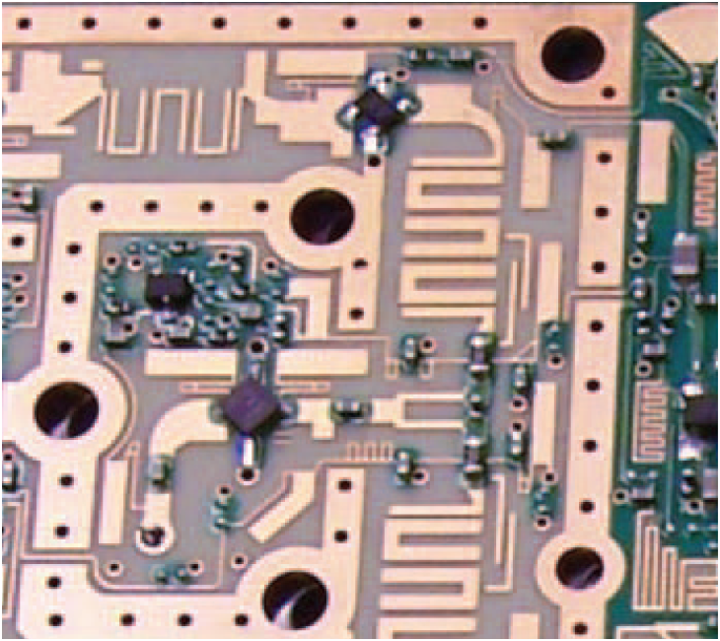
2. Transmission Lines
7e Applied EM by Ulaby and Ravaioli

Slide 2
Chapter 2 Overview

Slide 3
Transmission Lines
A transmission line connects a generator to a load
Transmission lines include:
Two parallel wires
Coaxial cable
Microstrip line
Optical fiber
Waveguide
etc.

Slide 4
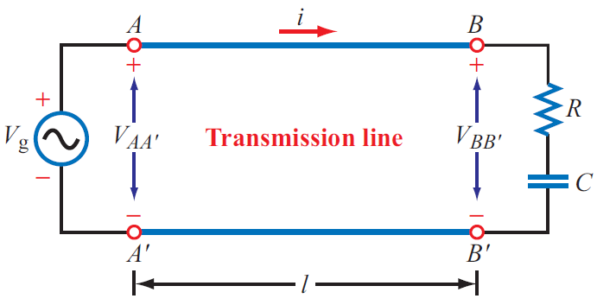
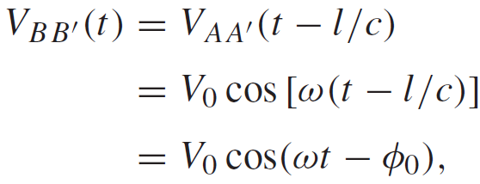
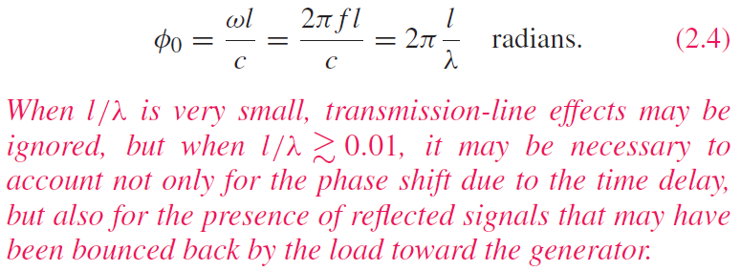
Transmission Line Effects
Is the pair of wires connecting the voltage source to the RC load a transmission line? Yes.
The wires were ignored in circuits courses. Can we always ignore them? Not always.
Delayed by l/c
(2) But if l = 20 km:
At t = 0, and for f = 1 kHz , if:
(1) l = 5 cm:

Slide 5
Dispersion

Slide 6
Types of Transmission Modes
TEM (Transverse Electromagnetic): Electric and magnetic fields are orthogonal to one another, and both are orthogonal to direction of propagation

Slide 7
Example of TEM Mode
Electric Field E is radial
Magnetic Field H is azimuthal
Propagation is into the page

Slide 8
Transmission Line Model

Slide 9
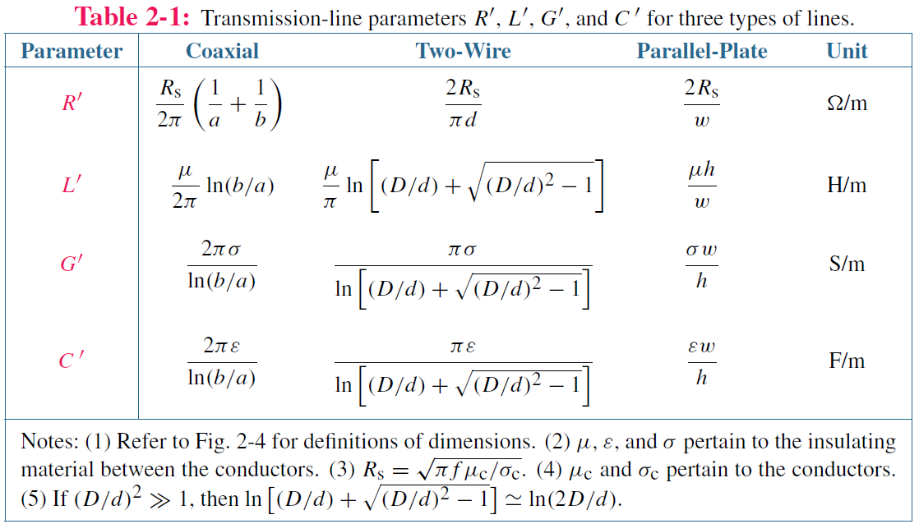
Expressions will be derived in later chapters

Slide 10
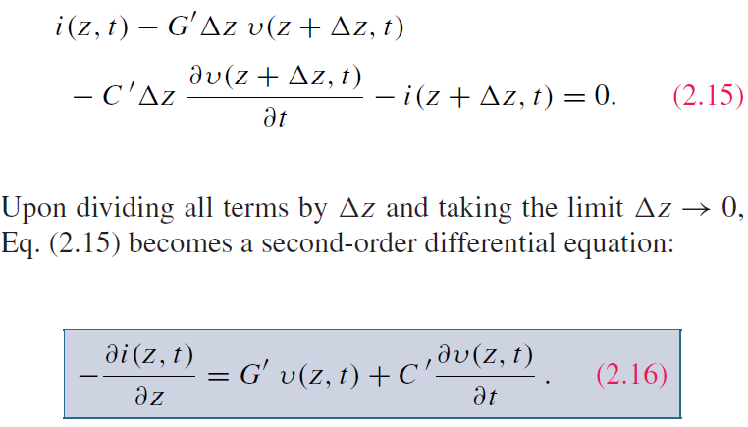
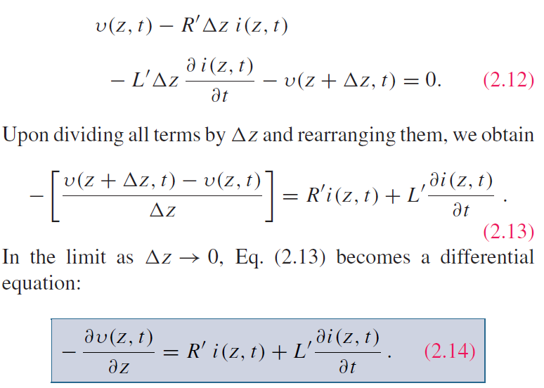
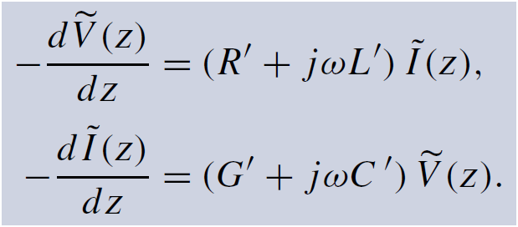
Transmission-Line Equations
ac signals: use phasors
Telegrapher’s equations

Slide 11
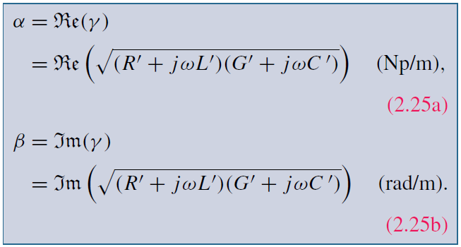
Derivation of Wave Equations
attenuation constant
complex propagation constant
Phase constant
Combining the two equations leads to:
Second-order differential equation

Slide 12
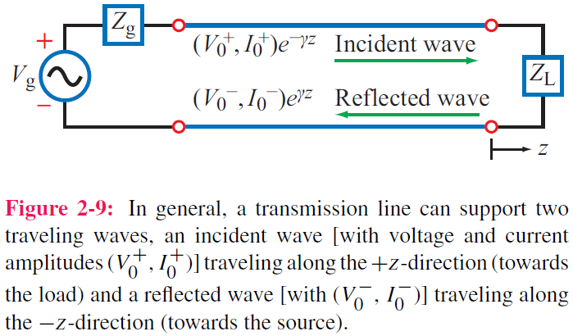
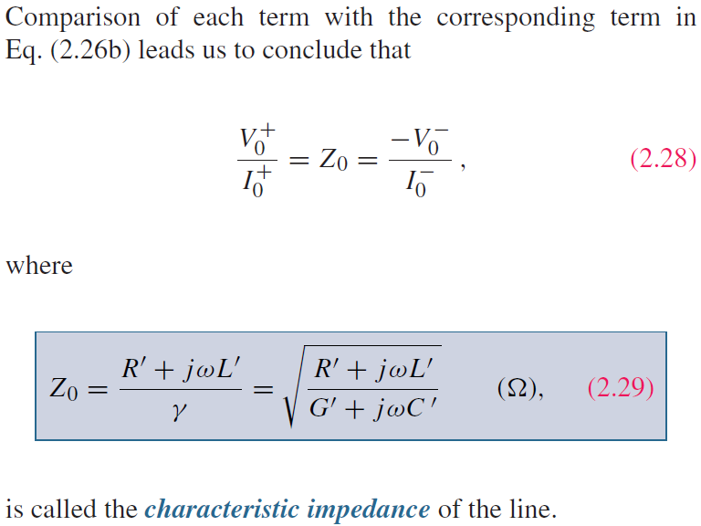
Solution of Wave Equations (cont.)
Proposed form of solution:
Using:
It follows that:

Slide 13
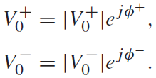
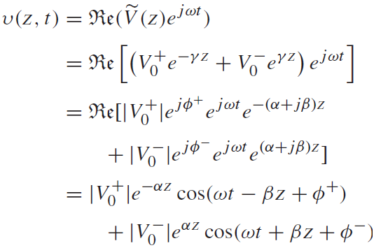
Solution of Wave Equations (cont.)
In general:
wave along +z because coefficients of t and z have opposite signs
wave along –z because coefficients of t and z have the same sign

Slide 14
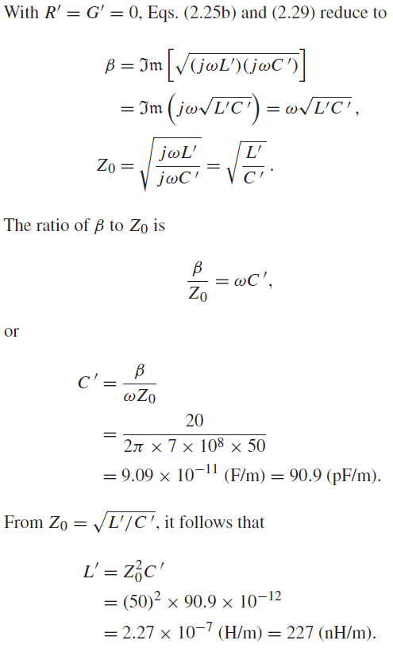
Example 2-1: Air Line

Slide 17
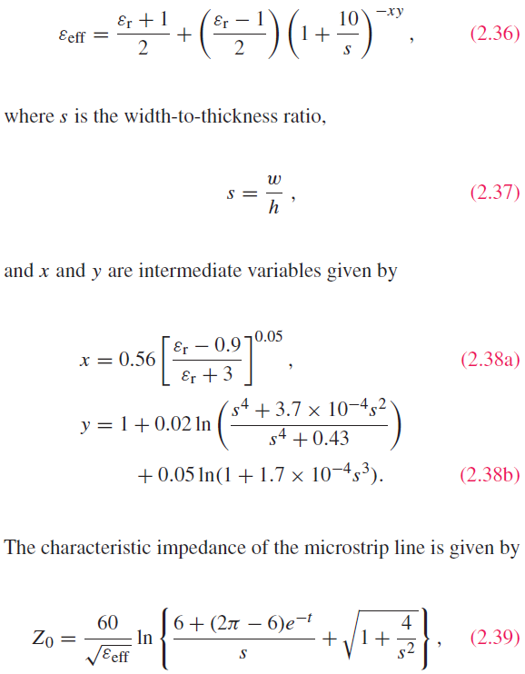
Lossless Microstrip Line
Phase velocity in dielectric:
Phase velocity for microstrip:
Quasi-TEM

Slide 18
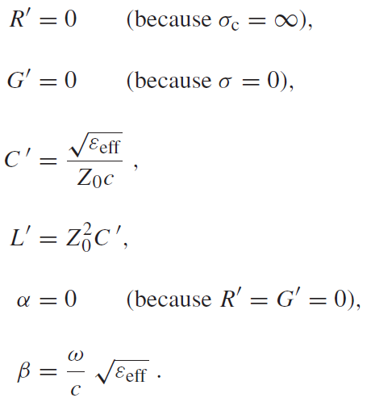
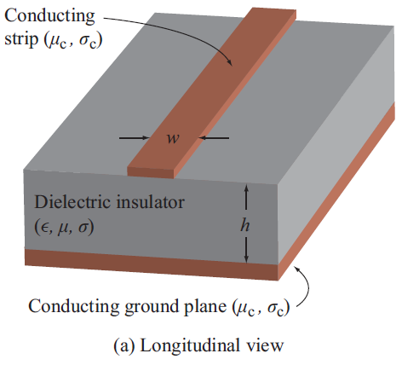
Microstrip (cont.)

Slide 19
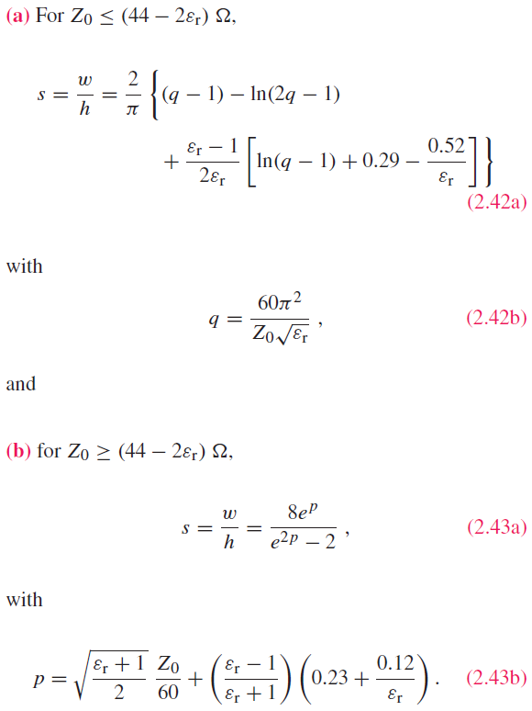
Microstrip (cont.)
Inverse process:
Given Z₀, find s
The solution formulas are based on
two numerical fits, defined in terms
of the value of Z₀ relative to that
of the effective permittivity.

Slide 20
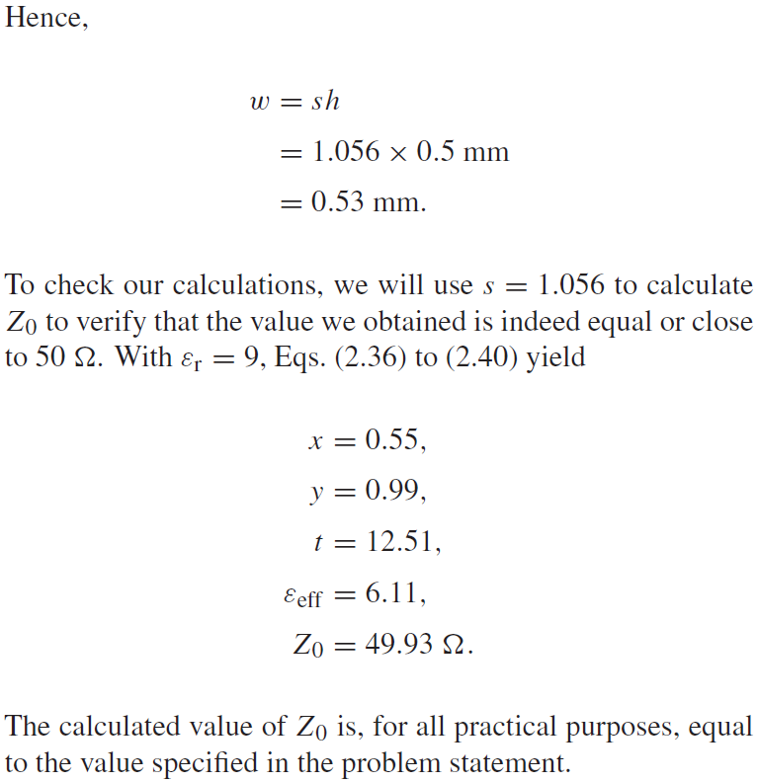

Slide 22
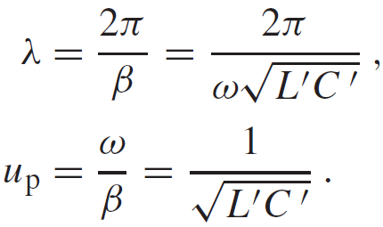
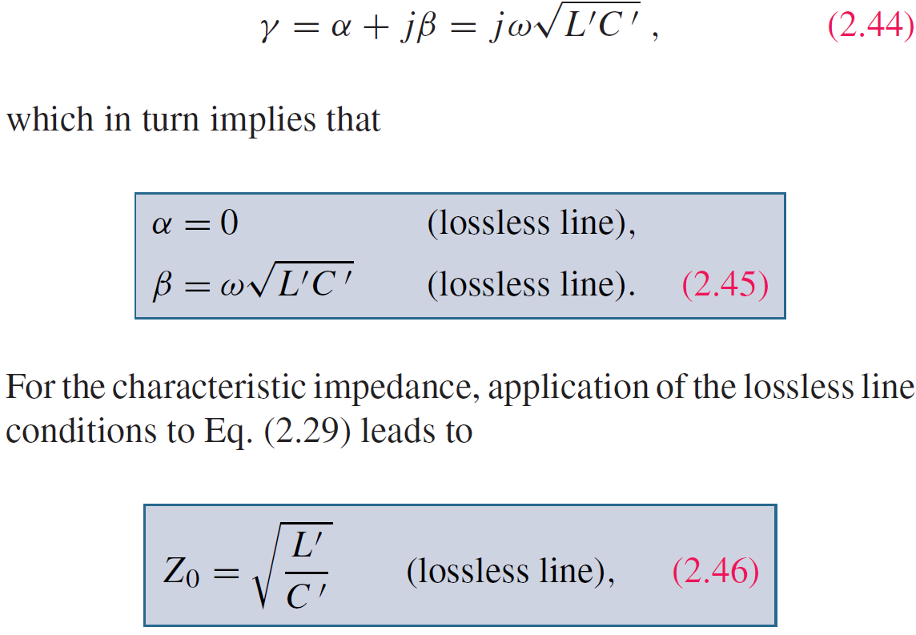
Lossless Transmission Line
If
Then:

Slide 24
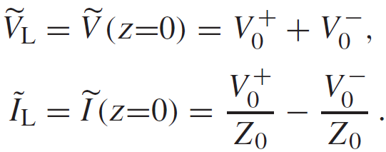
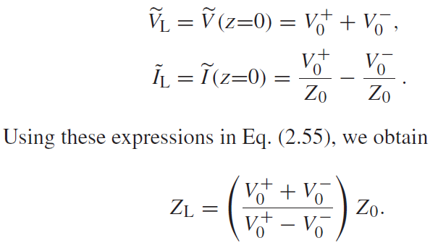
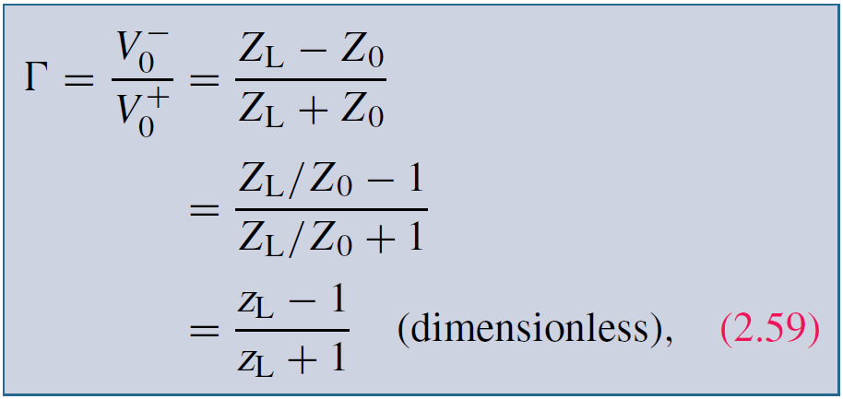
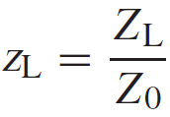
Voltage Reflection Coefficient
At the load (z = 0):
Reflection coefficient
Normalized load impedance

Slide 25
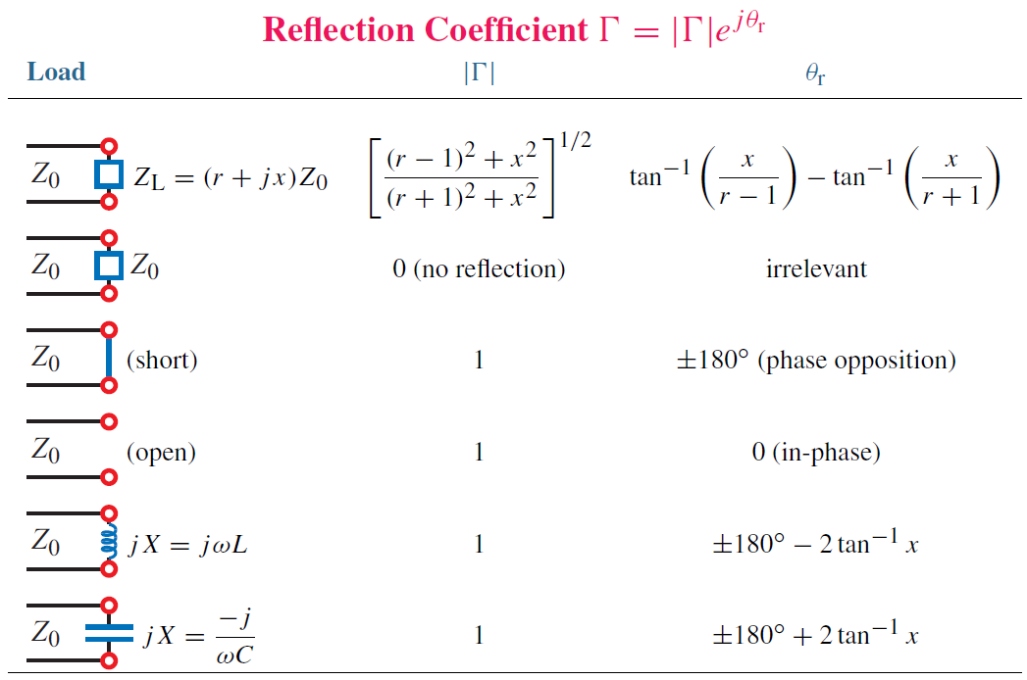
Voltage Reflection Coefficient

Slide 26
Current Reflection Coefficient

Slide 27
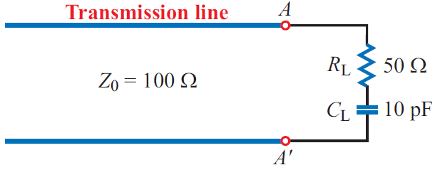
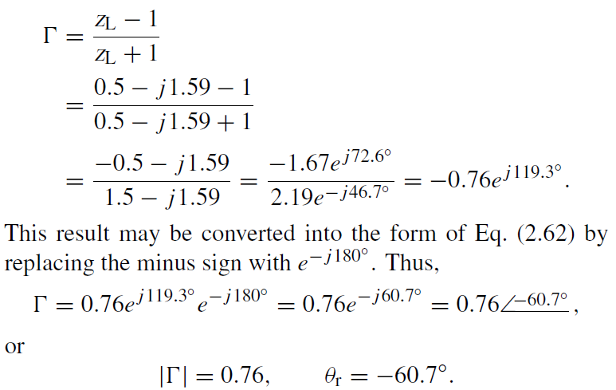

Slide 28
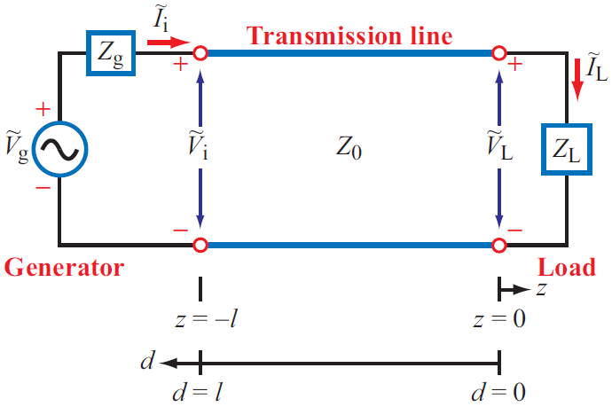
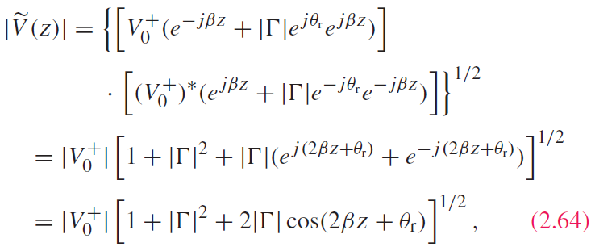
Standing Waves
voltage magnitude
current magnitude

Slide 29
Standing-Wave Pattern
Voltage magnitude is maximum
When voltage is a maximum, current is a minimum, and vice versa

Slide 30
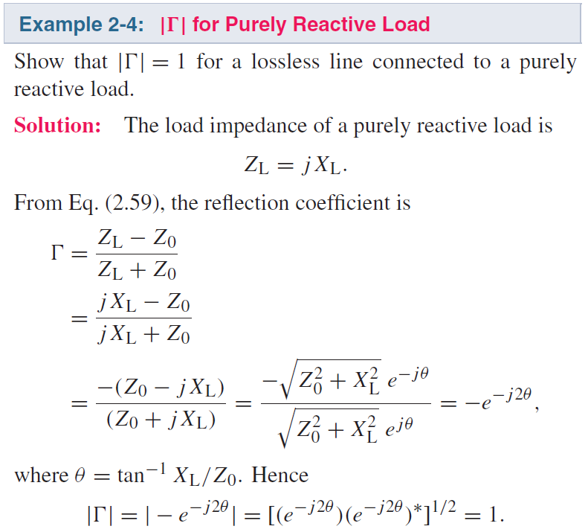
Standing Wave Patterns for 3 Types of Loads

Slide 31
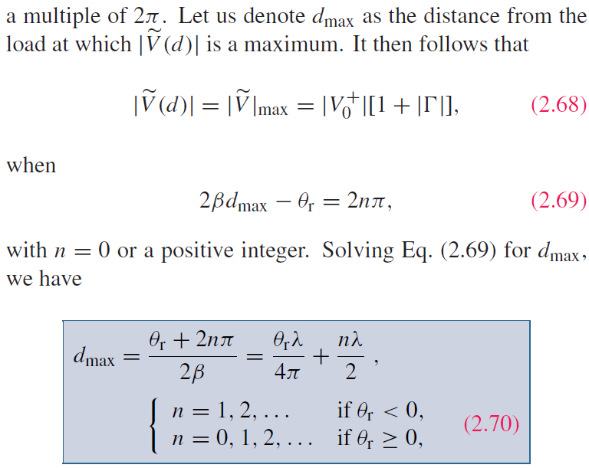
Maxima & Minima
Standing-Wave Pattern

Slide 32
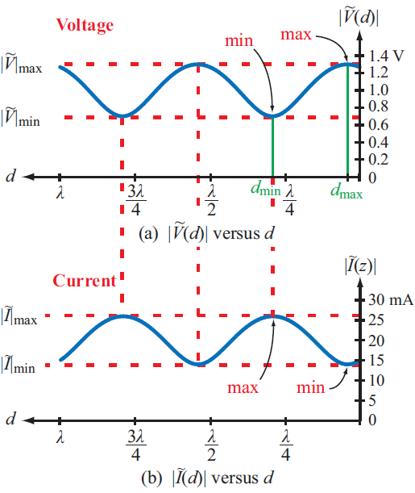
Maxima & Minima (cont.)
S = Voltage Standing Wave Ratio
For a matched load: S = 1
For a short, open, or purely reactive load:

Slide 34
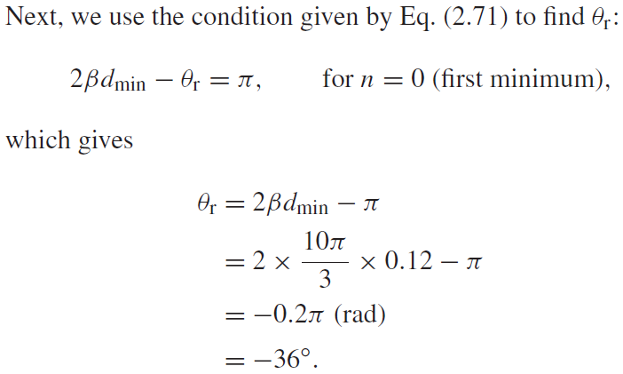
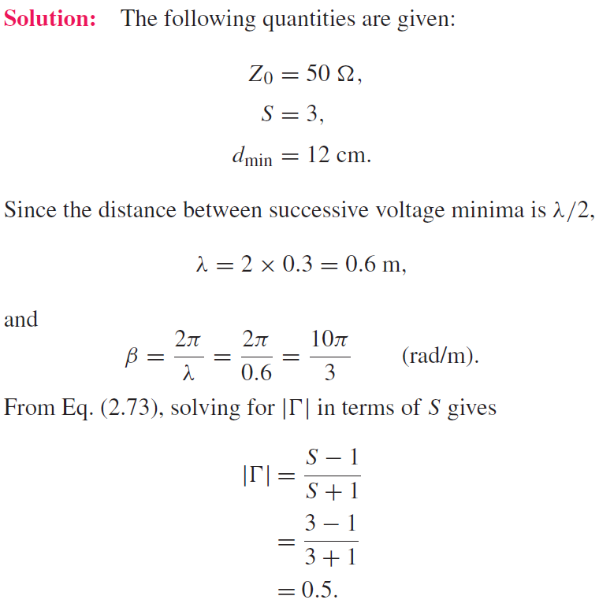
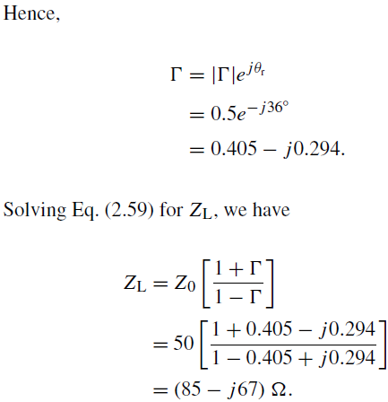
Example 2-6: Measuring Z_{L} with a Slotted Line

Slide 35
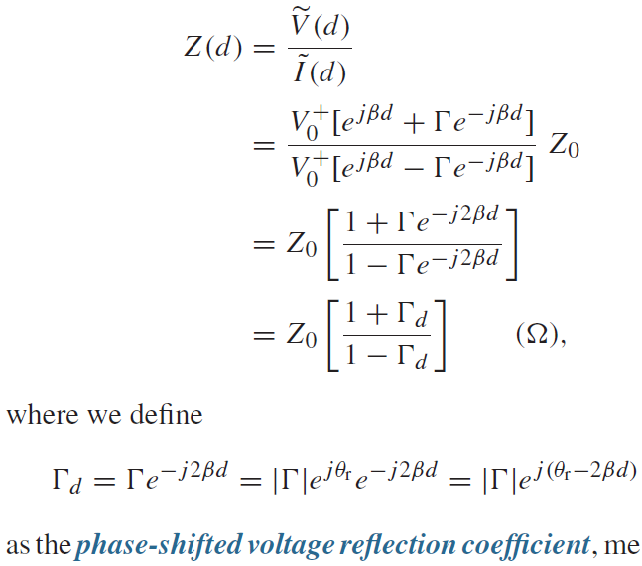
Wave Impedance
At a distance d from the load:

Slide 36
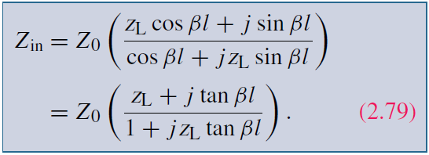
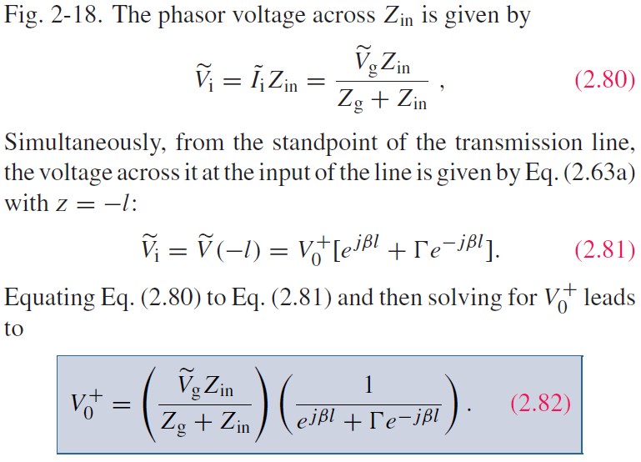
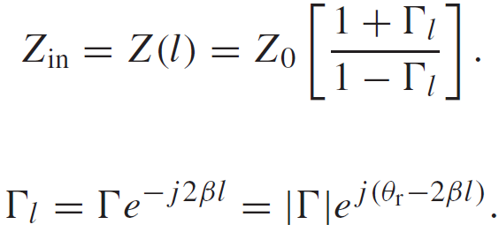
Input Impedance
At input, d = l:

Slide 37
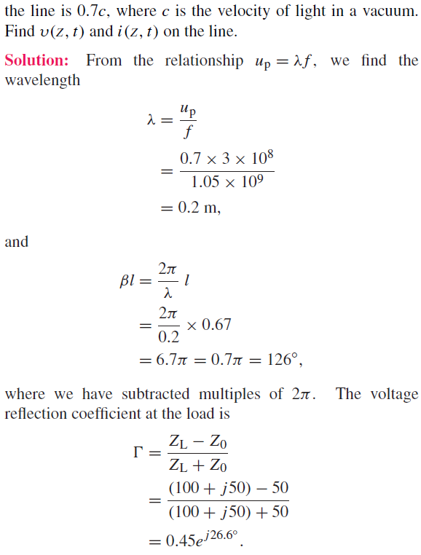
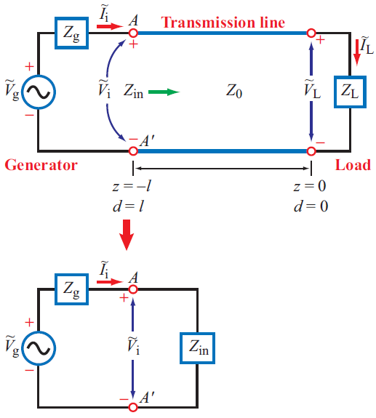
Cont.

Slide 38
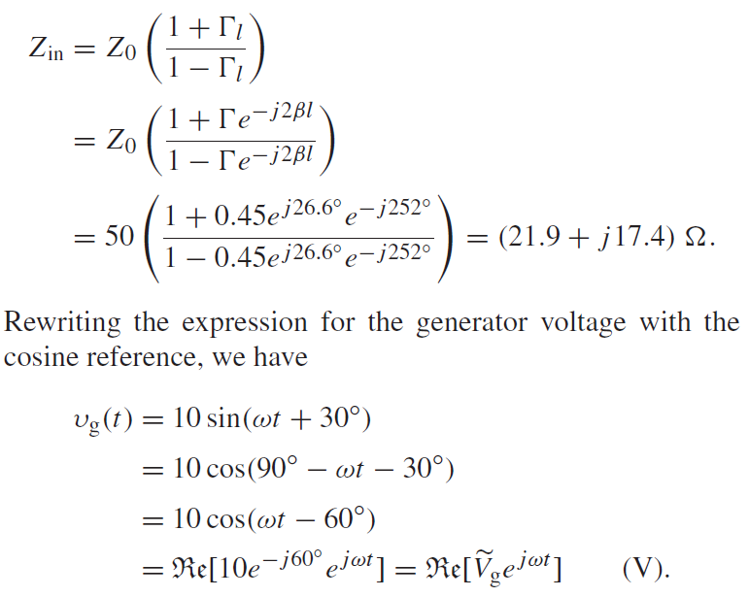
(cont.)
Cont.

Slide 39
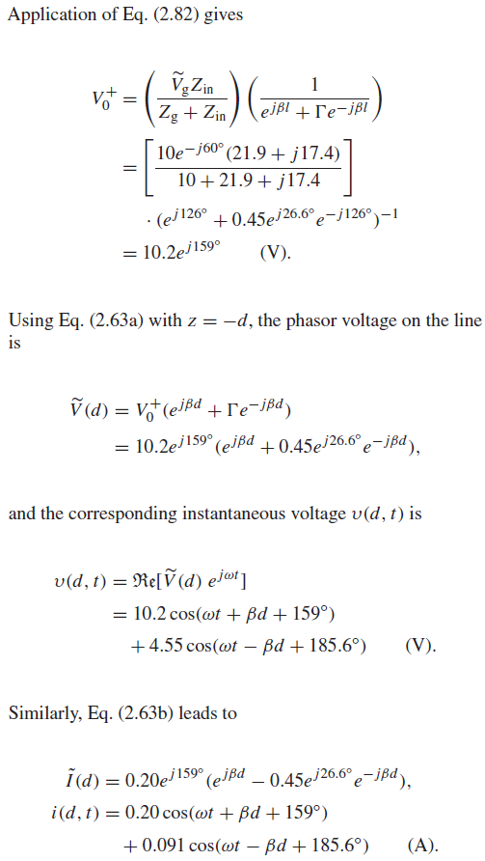
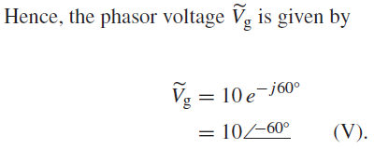
(cont.)

Slide 41
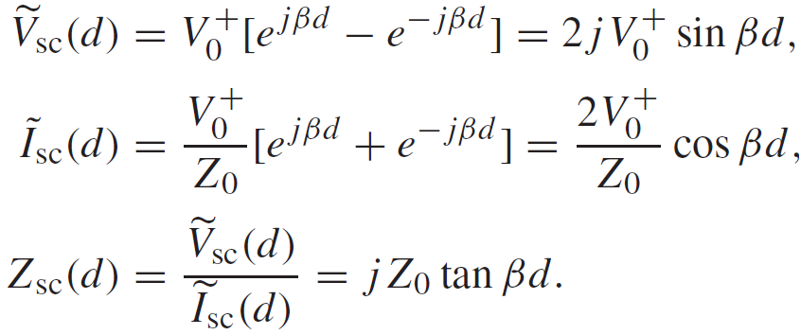
Short-Circuited Line
For the short-circuited line:
At its input, the line appears like an inductor or a capacitor depending on the sign of

Slide 42
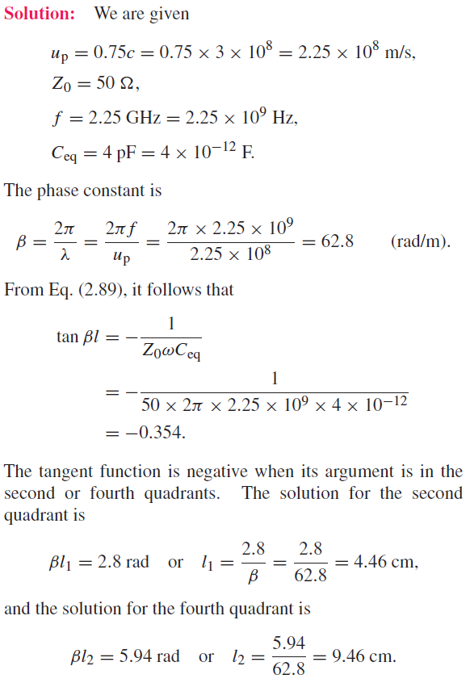
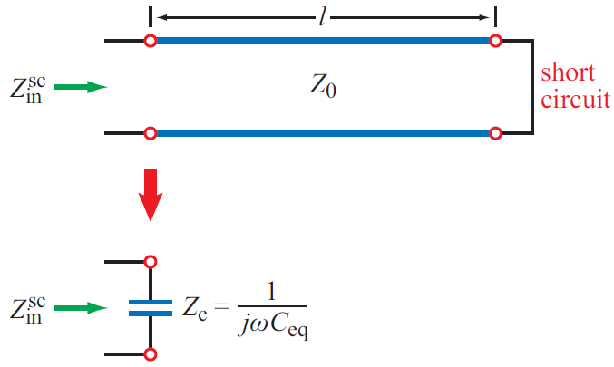
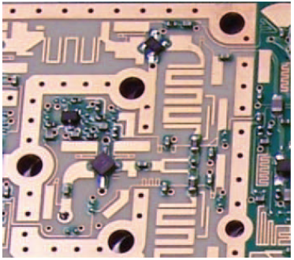

Slide 43
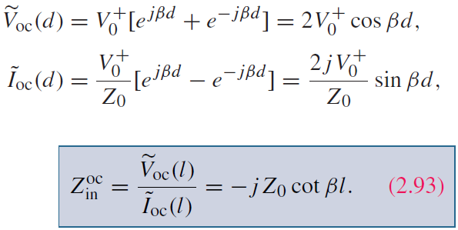
Open-Circuited Line

Slide 44
Short-Circuit/Open-Circuit Method
For a line of known length l, measurements of its input impedance, one when terminated in a short and another when terminated in an open, can be used to find its characteristic impedance Z₀ and electrical length

Slide 47
Instantaneous Power Flow

Slide 48
Average Power

Slide 49
Tech Brief 3: Standing Waves in Microwave Oven
The stirrer or rotation of the food platform is used to constantly change the standing wave pattern in the oven cavity

Slide 50
Tech Brief 3: Role of Frequency
At low frequencies, absorption rate is small, so it would take a long time for the food to cook
At very high frequencies, the food cooks fast, but only its the surface layer

Slide 51
The Smith Chart
Developed in 1939 by P. W. Smith as a graphical tool to analyze and design transmission-line circuits
Today, it is used to characterize the performance of microwave circuits

Slide 52
Complex Plane

Slide 53
Smith Chart Parametric Equations
Equation for a circle

Slide 54
Smith Chart Parametric Equations
r_{L} circles
r_{L} circles are contained inside the unit circle
x_{L} circles
Only parts of the x_{L} circles are contained within the unit circle

Slide 55
Complete Smith Chart
Positive xL Circles
rL Circles
Negative xL Circles

Slide 56
Reflection coefficient at the load

Slide 57
Input Impedance

Slide 58
Maxima and Minima

Slide 59
Impedance to Admittance Transformation

Slide 60
(c)
(d)
(a)
(b)

Slide 61
Given:
S = 3
Z₀ = 50 Ω
first voltage min @ 5 cm from load
Distance between adjacent minima = 20 cm
Determine: Z_{L}

Slide 62
Matching Networks

Slide 63
Examples of Matching Networks

Slide 64
Lumped-Element Matching
Choose d and Ys to achieve a match at MM’

Slide 66
Cont.

Slide 67
Single-Stub Matching

Slide 72
Transients
Rectangular pulse is equivalent to the sum of two step functions

Slide 73
Transient Response
Initial current and voltage
Reflection at the load
Load reflection coefficient
Second transient
Generator reflection coefficient

Slide 74
Voltage Wave
T = l/u_{p} is the time it takes the wave to travel the full length of the line

Slide 75
Current Wave
Reflection coefficient for current is the negative of that for voltage

Slide 76
Steady State Response

Slide 77
Bounce Diagrams

Slide 80
Technology Brief 4: EM Cancer Zapper

Slide 81
Technology Brief 4: High Voltage Pulses

Slide 82
Summary

