Slide 1
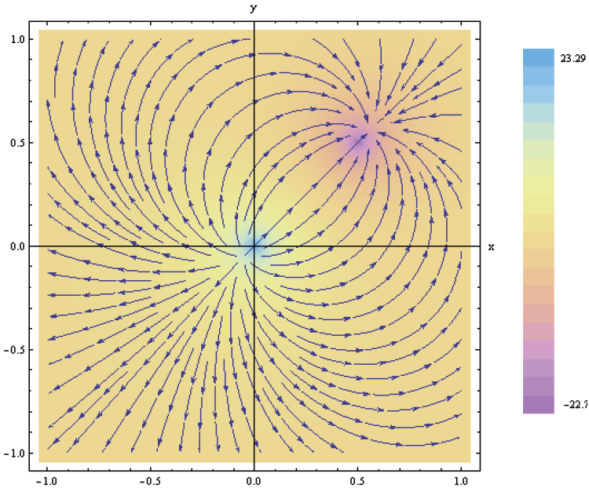
3. Vector Analysis
7e Applied EM by Ulaby and Ravaioli

Slide 2
Chapter 3 Overview

Slide 3
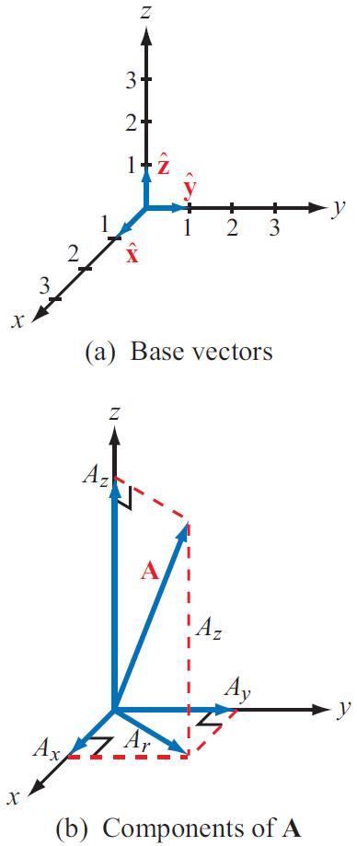
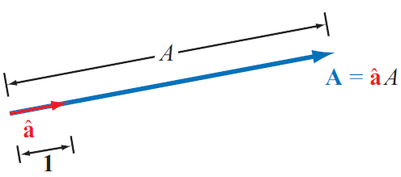
Laws of Vector Algebra

Slide 4
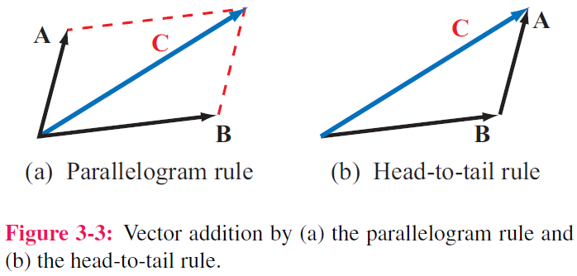
Properties of Vector Operations
Equality of Two Vectors
Commutative property

Slide 6
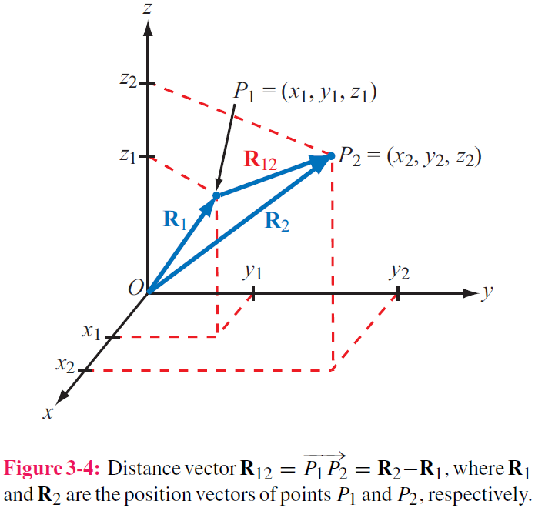
Position & Distance Vectors
Position Vector: From origin to point P
Distance Vector: Between two points

Slide 7
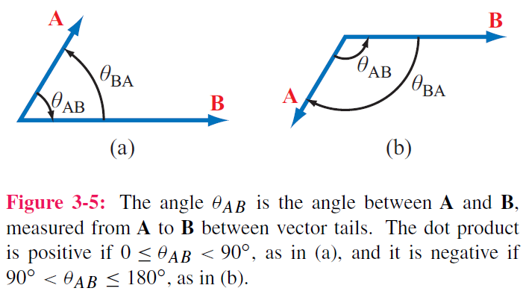
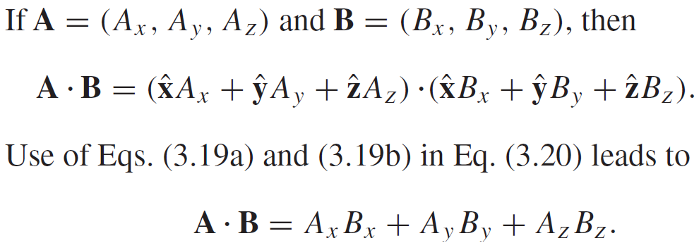
Vector Multiplication: Scalar Product or ”Dot Product”
Hence:

Slide 8
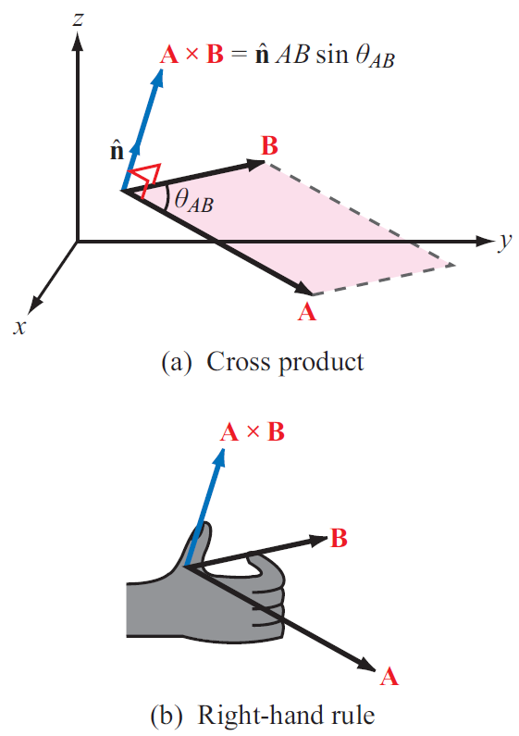
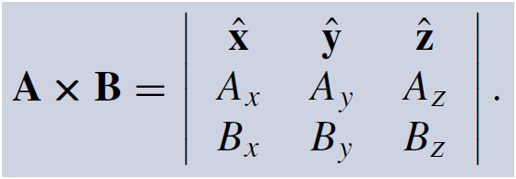
Vector Multiplication: Vector Product or ”Cross Product”

Slide 9
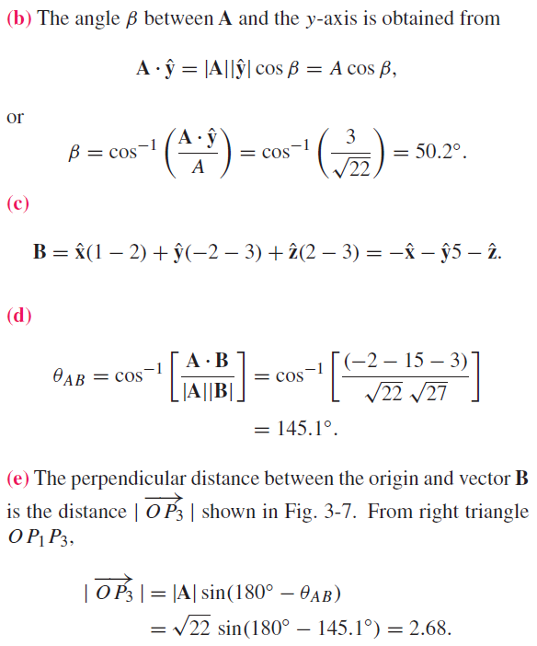
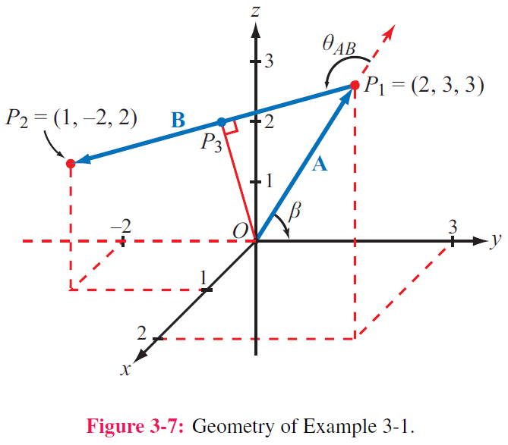

Slide 10
Triple Products
Scalar Triple Product
Vector Triple Product
Hence:

Slide 11
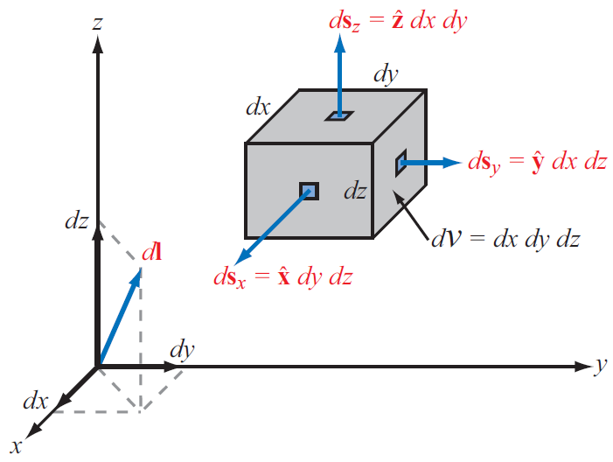
Cartesian Coordinate System
Differential length vector
Differential area vectors

Slide 12
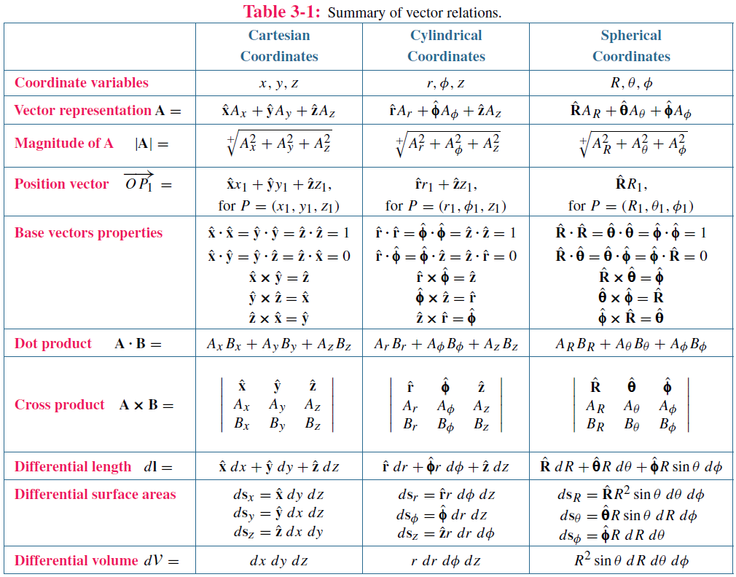

Slide 13
Cylindrical Coordinate System

Slide 14
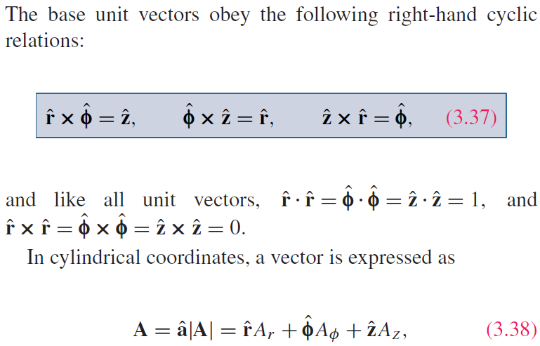
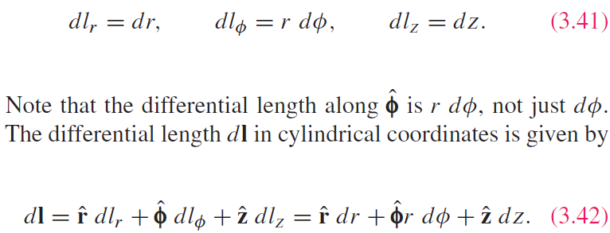
Cylindrical Coordinate System

Slide 15
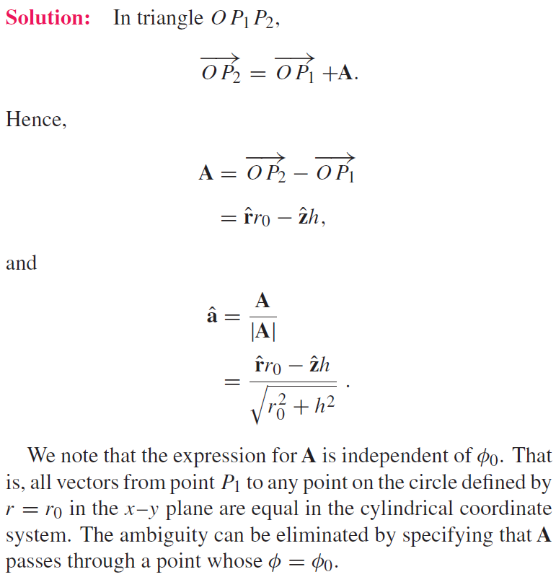

Slide 16
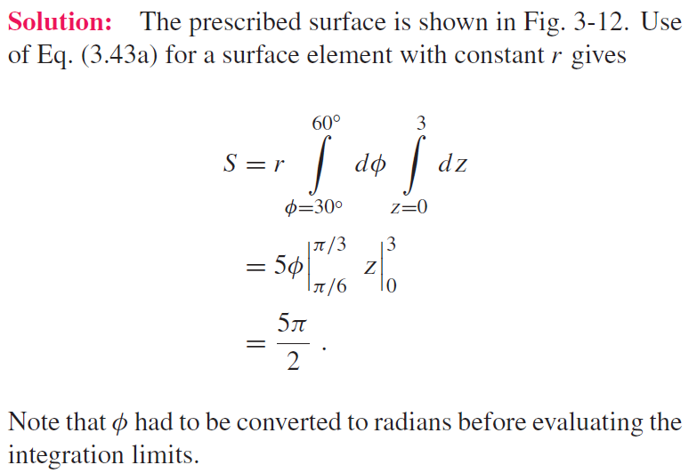

Slide 17
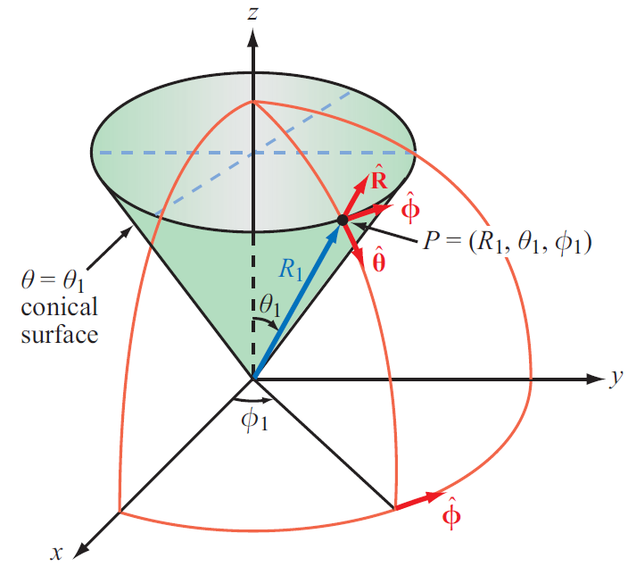
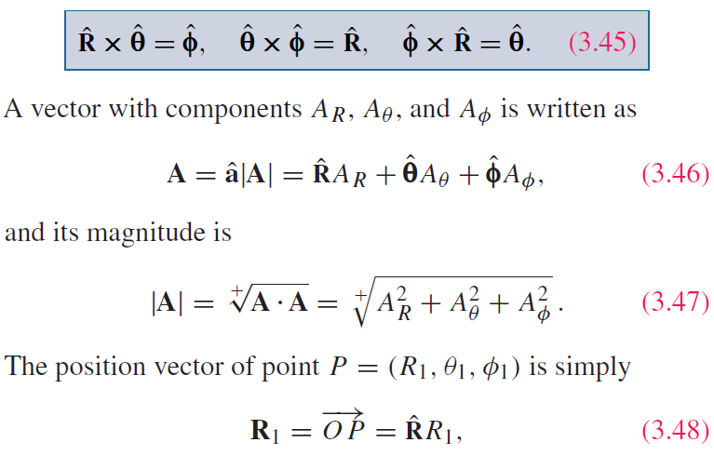
Spherical Coordinate System

Slide 18
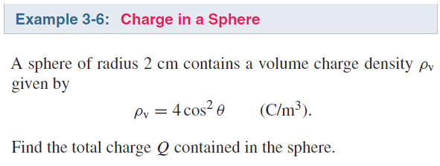
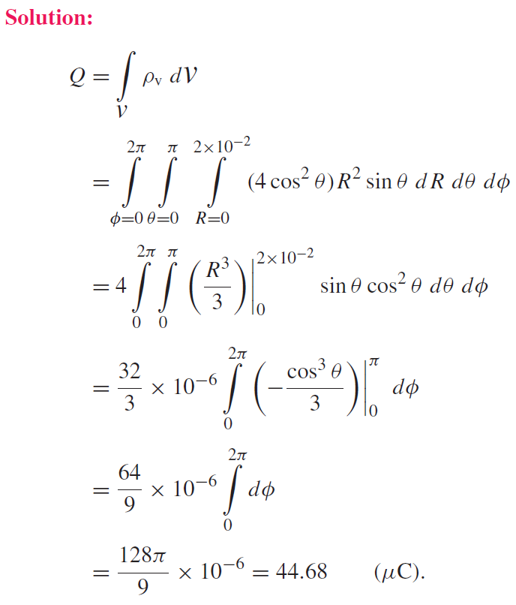

Slide 19
Technology Brief 5: GPS
How does a GPS receiver determine its location?

Slide 20
GPS: Minimum of 4 Satellites Needed
Unknown: location of receiver
Also unknown: time offset of receiver clock
Quantities known with high precision: locations of satellites and their atomic clocks (satellites use expensive high precision clocks, whereas receivers do not)
Solving for 4 unknowns requires at least 4 equations ( four satellites)

Slide 21
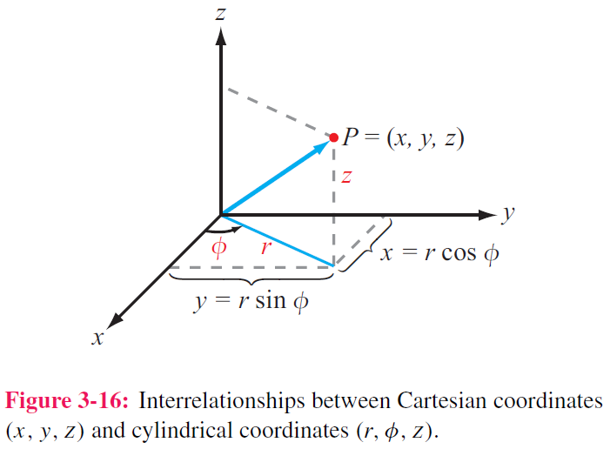
Coordinate Transformations: Coordinates
To solve a problem, we select the coordinate system that best fits its geometry
Sometimes we need to transform between coordinate systems

Slide 22
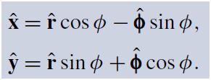
Coordinate Transformations: Unit Vectors

Slide 25
Using the relations:
leads to:

Slide 26
Distance Between 2 Points

Slide 27
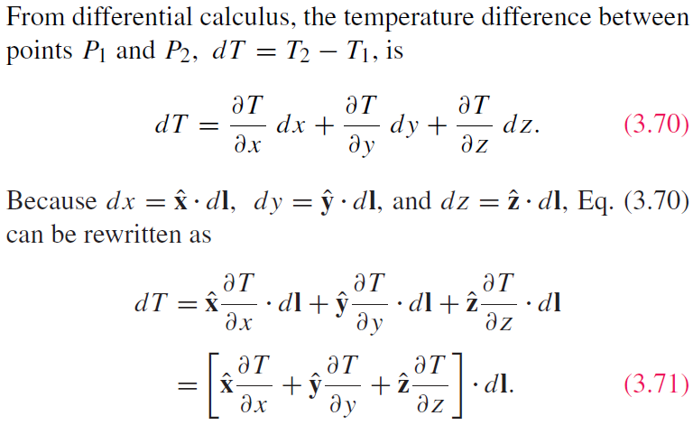
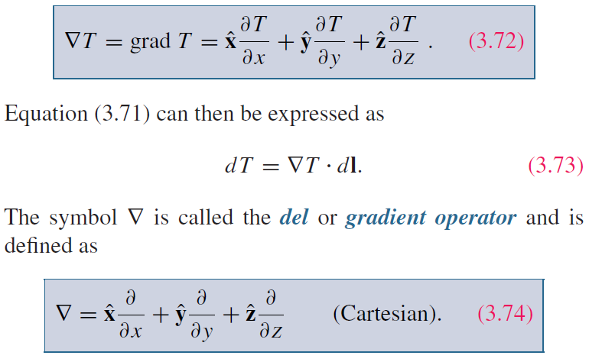
Gradient of A Scalar Field

Slide 28
Gradient ( cont.)

Slide 30
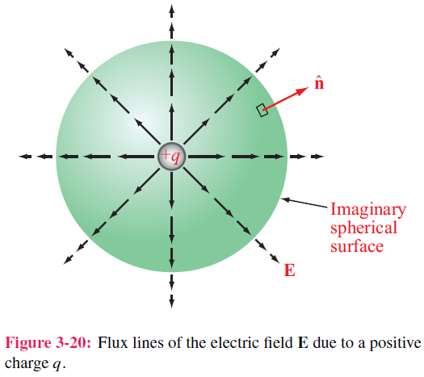
Divergence of a Vector Field

Slide 31
Divergence Theorem
Useful tool for converting integration over a volume to one over the surface enclosing that volume, and vice versa

Slide 32
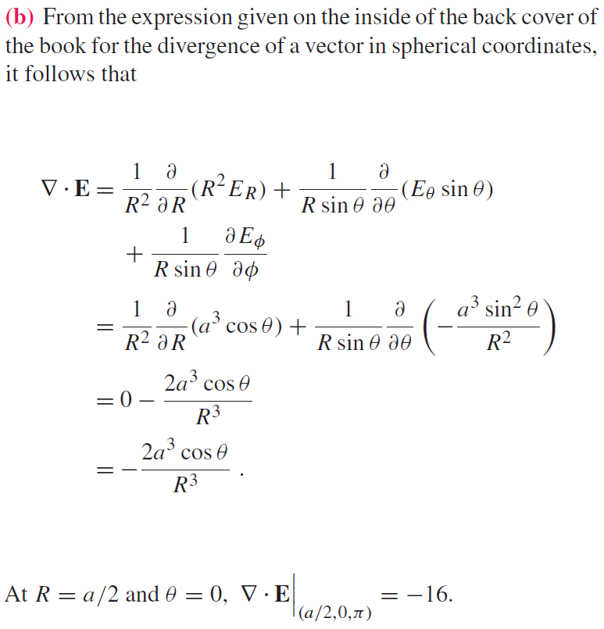

Slide 34
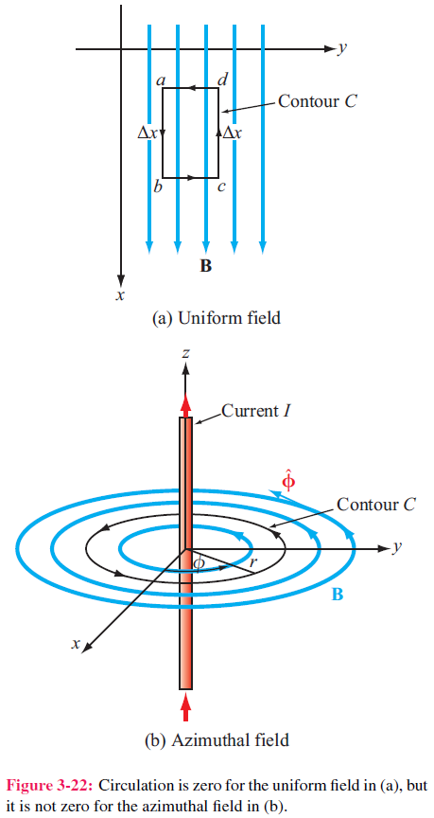
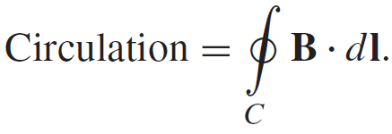
Curl of a Vector Field

Slide 35
Stokes’s Theorem

Slide 37
Laplacian Operator
Laplacian of a Scalar Field
Laplacian of a Vector Field
Useful Relation

Slide 38
Tech Brief 6: X-Ray Computed Tomography
How does a CT scanner generate a 3-D image?

Slide 39
Tech Brief 6: X-Ray Computed Tomography
For each anatomical slice, the CT scanner generates on the order of 7 x 10⁵ measurements (1,000 angular orientations x 700 detector channels)
Use of vector calculus allows the extraction of the 2-D image of a slice
Combining multiple slices generates a 3-D scan

