Slide 1
4. Electrostatics
7e Applied EM by Ulaby and Ravaioli

Slide 2
Chapter 4 Overview

Slide 3
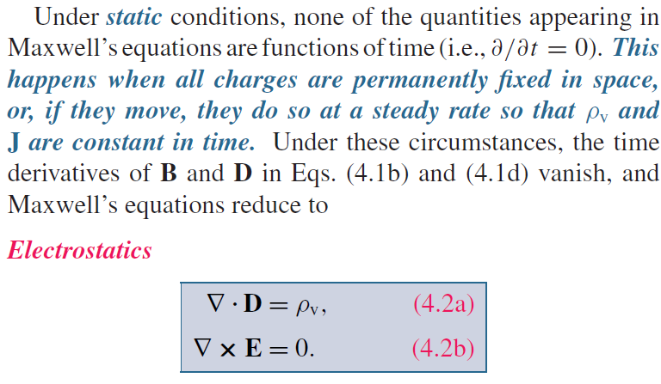
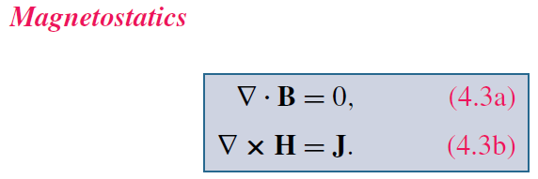
Maxwell’s Equations
God said:
And there was light!

Slide 4
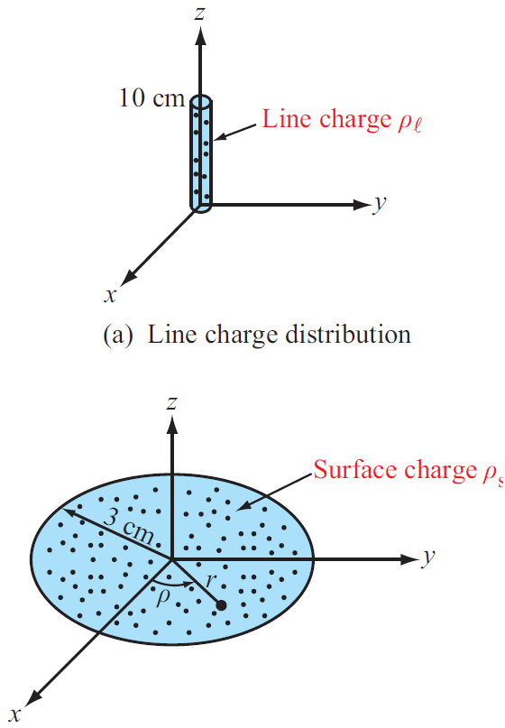
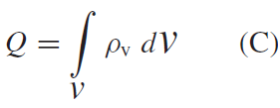
Charge Distributions
Volume charge density:
Total Charge in a Volume
Surface and Line Charge Densities

Slide 5
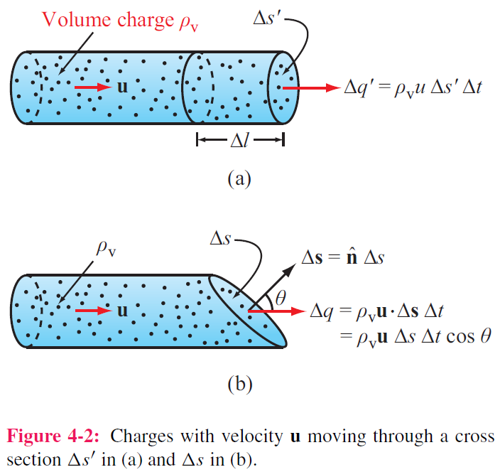
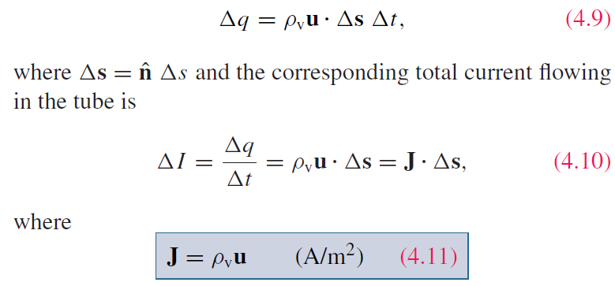
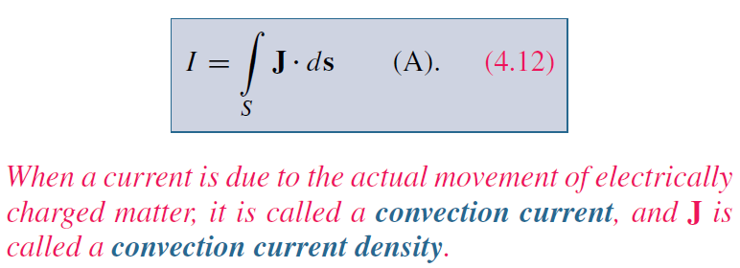
Current Density
For a surface with any orientation:
J is called the current density

Slide 6
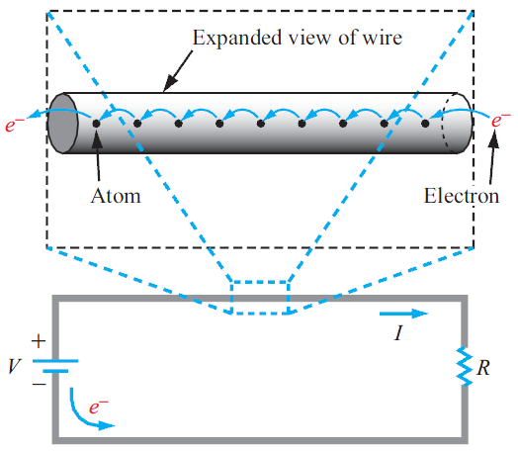
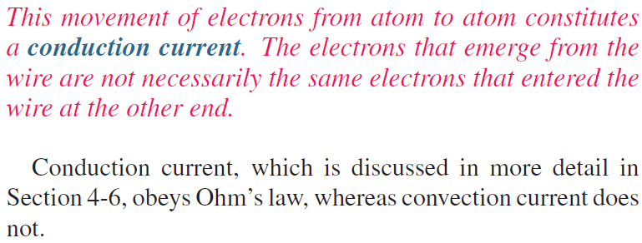
Convection vs. Conduction

Slide 7
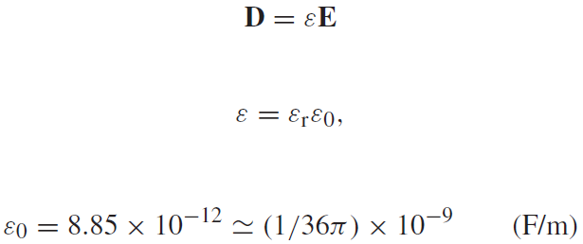
Coulomb’s Law
Electric field at point P due to single charge
Electric force on a test charge placed at P
Electric flux density D

Slide 8
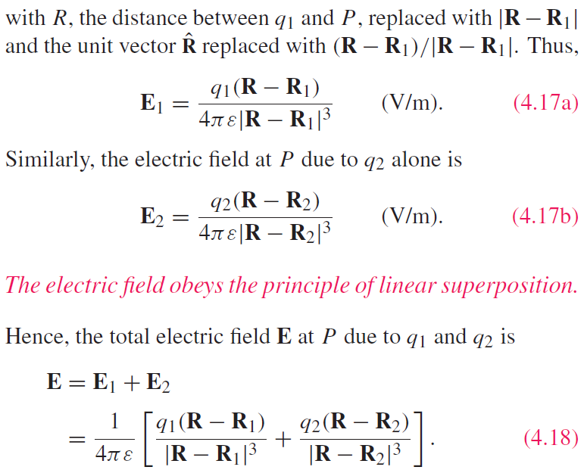
Electric Field Due to 2 Charges

Slide 9
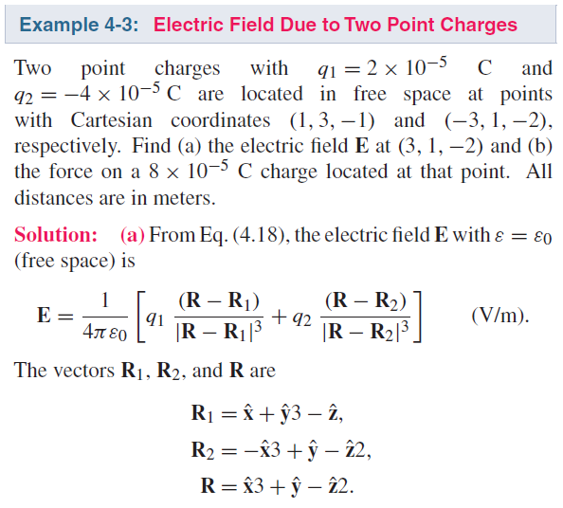
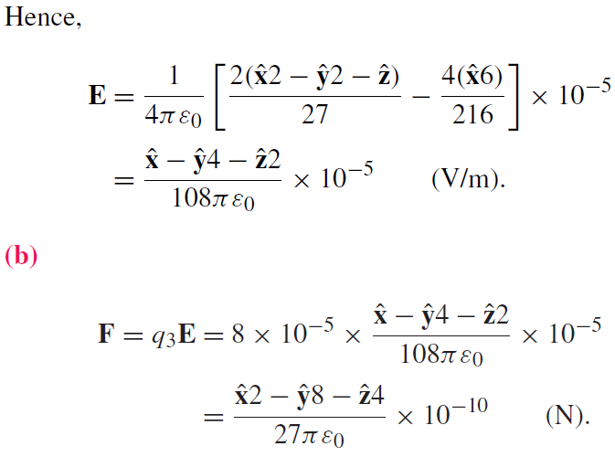
Electric Field due to Multiple Charges

Slide 10
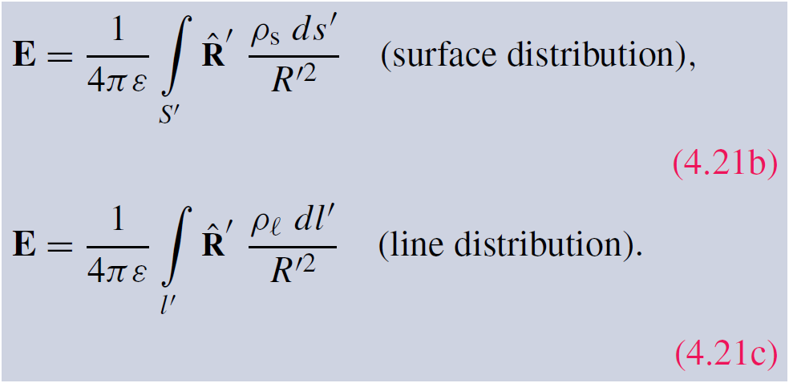
Electric Field Due to Charge Distributions
Field due to:

Slide 11
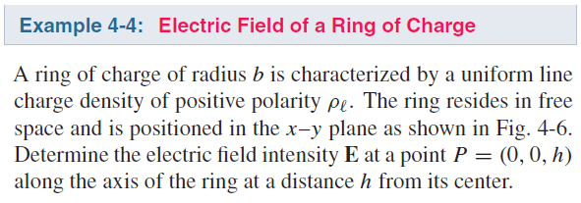
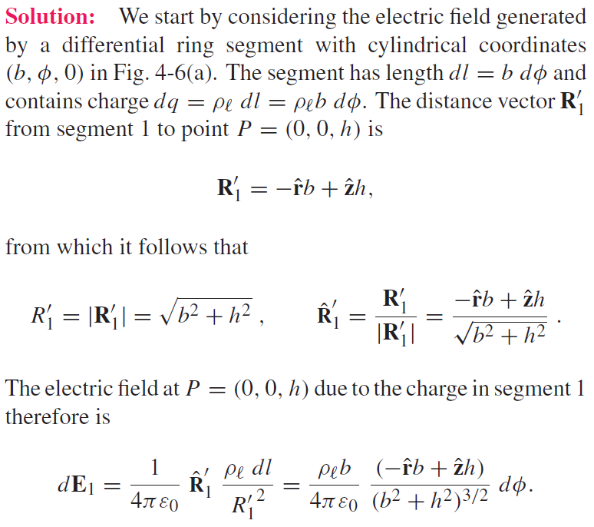
Cont.

Slide 12
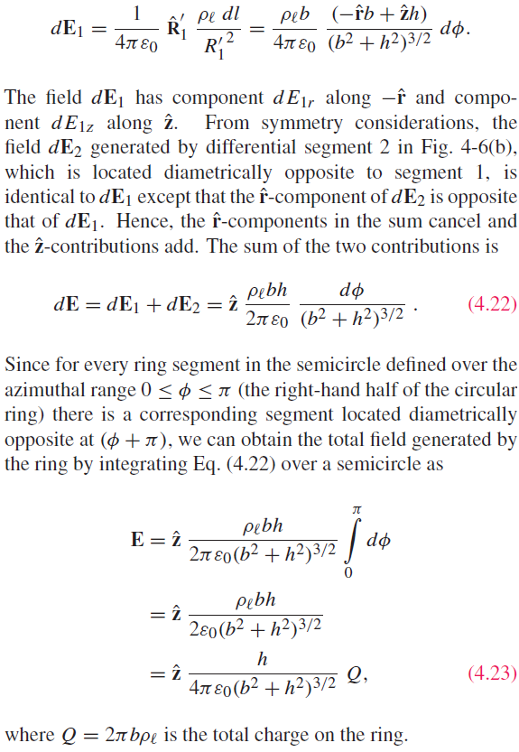
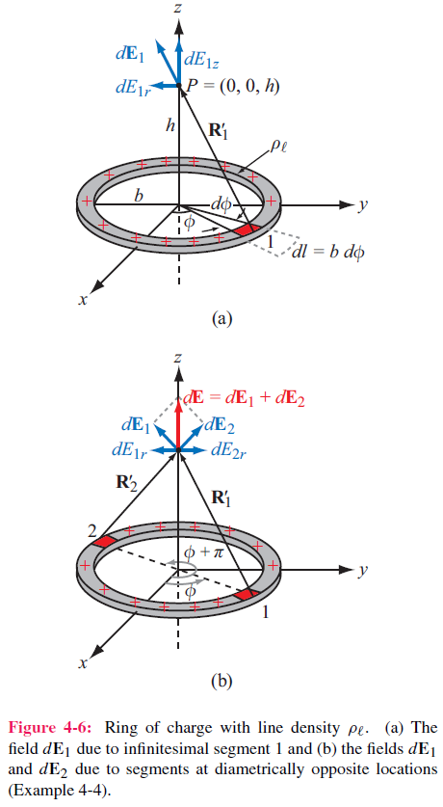

Slide 13
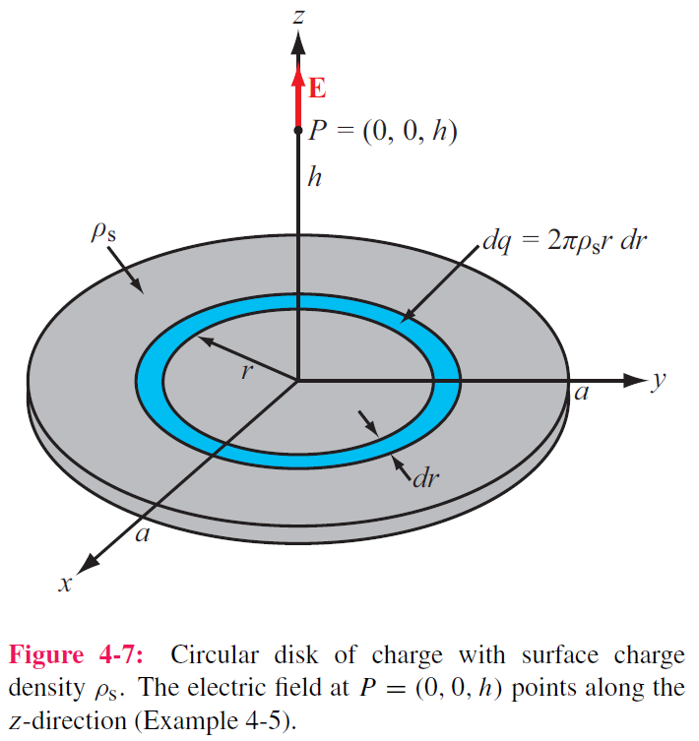
Cont.

Slide 14
Example 4-5 cont.

Slide 15
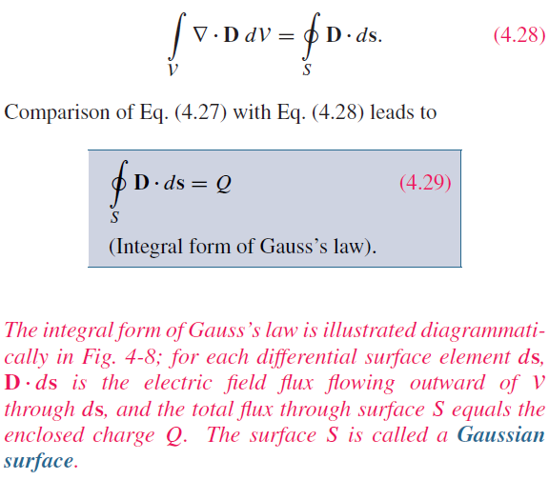
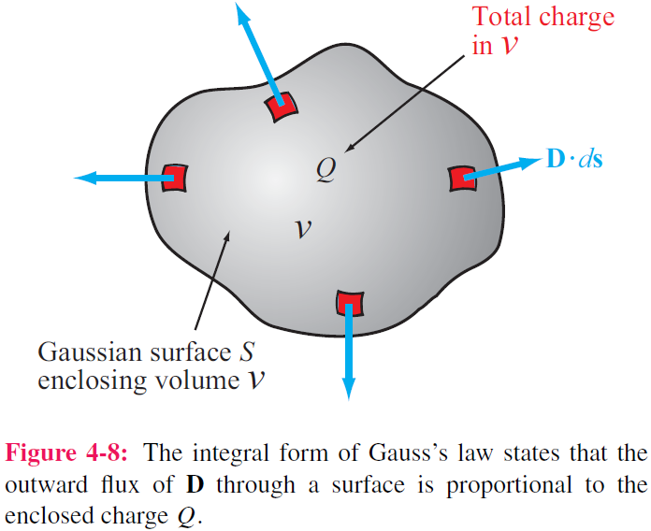
Gauss’s Law
Application of the divergence theorem gives:

Slide 16
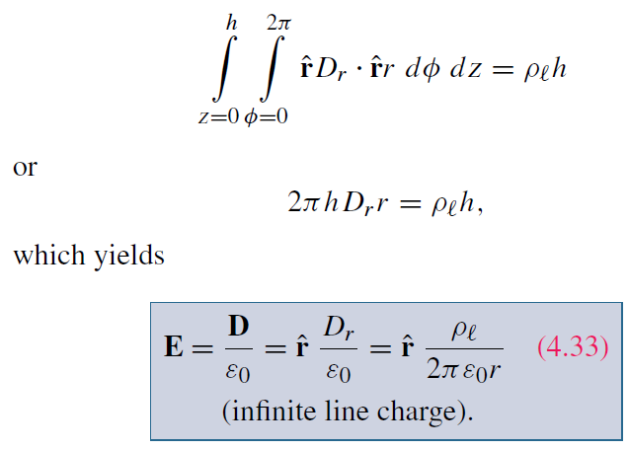
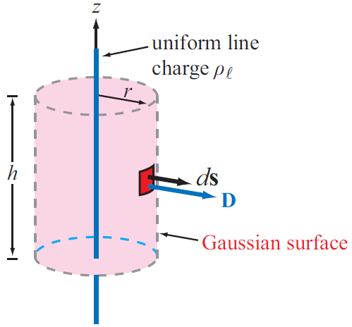
Applying Gauss’s Law
Construct an imaginary Gaussian cylinder of radius r and height h:

Slide 17
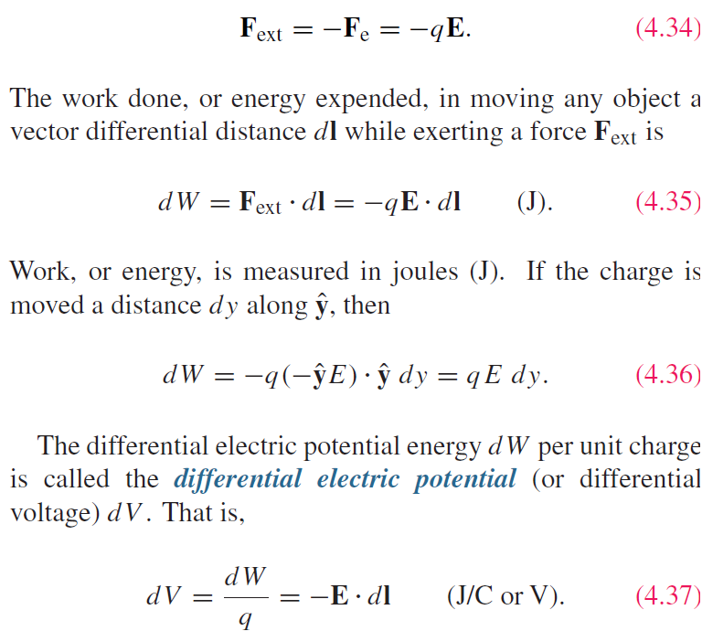
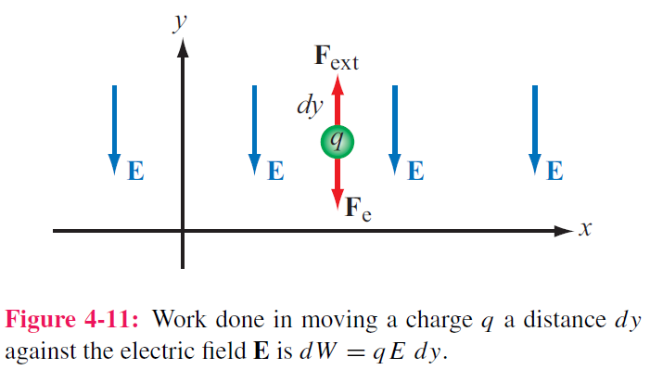
Electric Scalar Potential
Minimum force needed to move charge against E field:

Slide 18
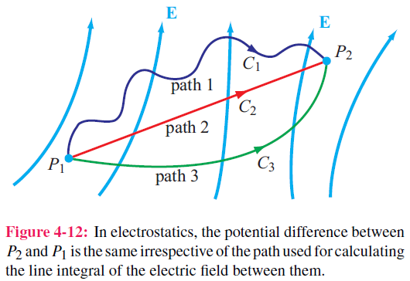
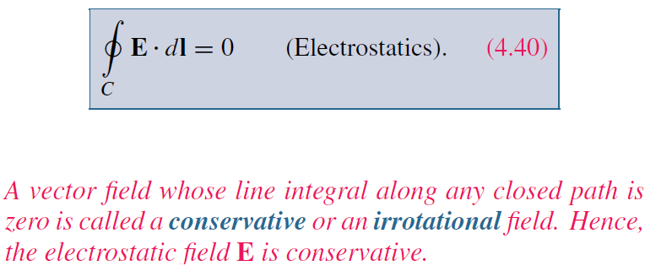
Electric Scalar Potential

Slide 19
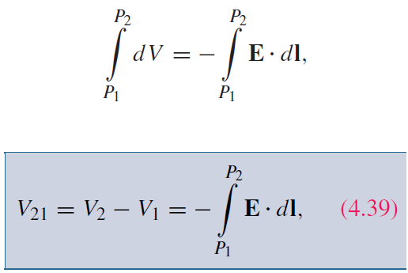
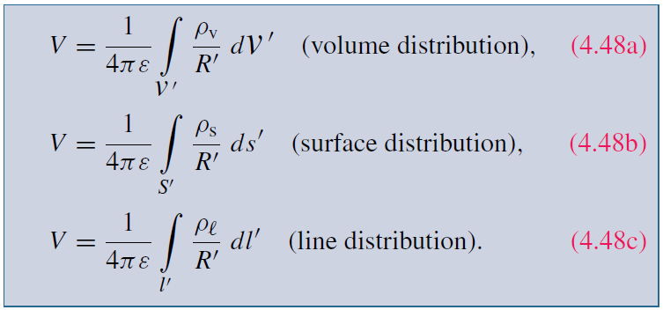
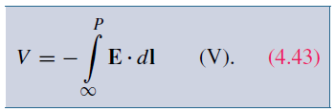
Electric Potential Due to Charges
For a point charge, V at range R is:
In electric circuits, we usually select a convenient node that we call ground and assign it zero reference voltage. In free space and material media, we choose infinity as reference with V = 0. Hence, at a point P
For continuous charge distributions:

Slide 20
Relating E to V

Slide 21
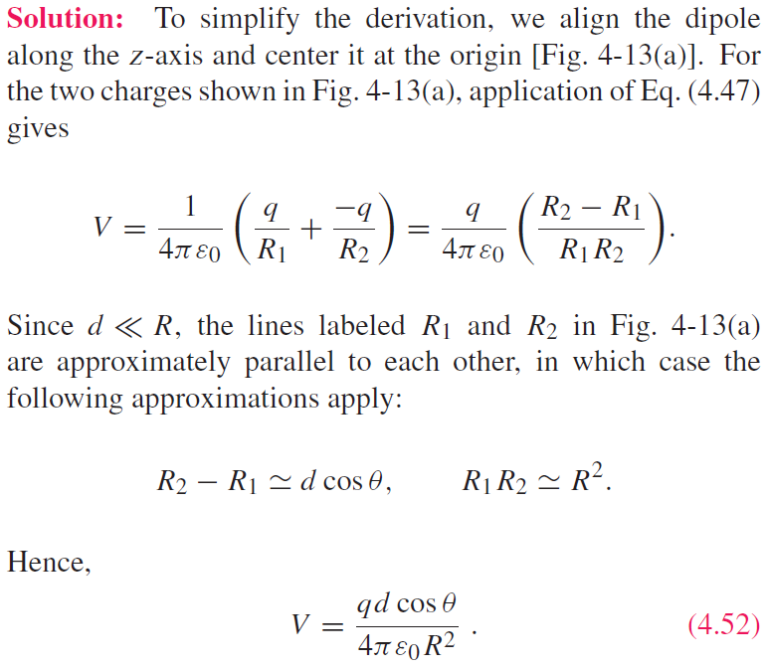
Cont.

Slide 22
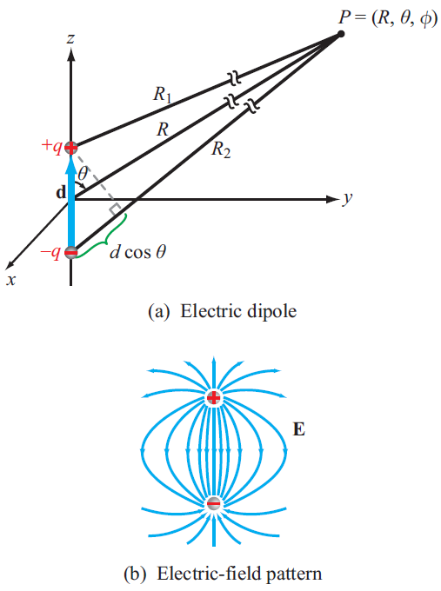
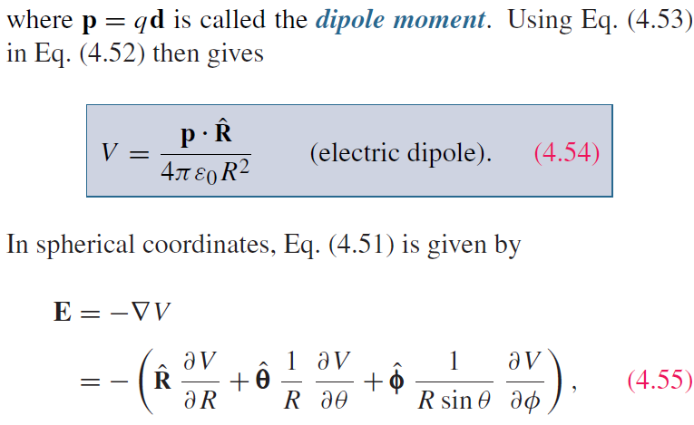
(cont.)

Slide 23
Poisson’s & Laplace’s Equations
In the absence of charges:

Slide 25
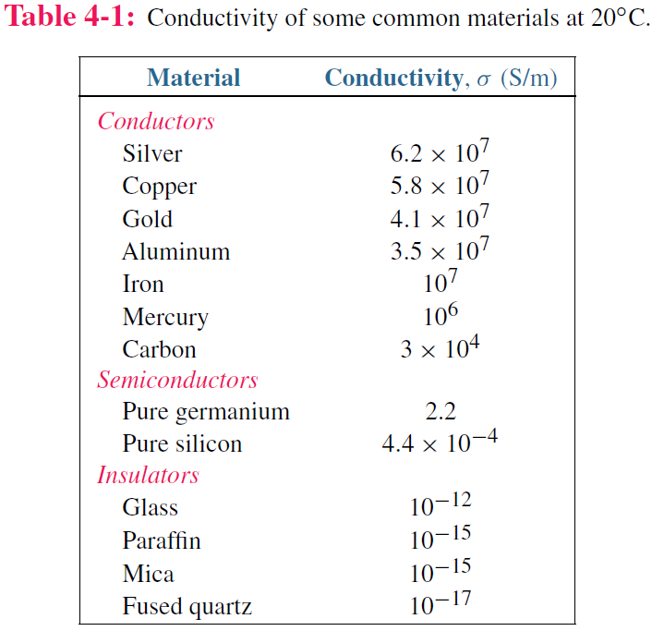
Conduction Current
Conduction current density:
Note how wide the range is, over 24 orders of magnitude

Slide 26
Conductivity
ρ_{ve} = volume charge density of electrons
ρ_{he} = volume charge density of holes
μ_{e} = electron mobility
μ_{h} = hole mobility
N_{e} = number of electrons per unit volume
N_{h} = number of holes per unit volume

Slide 27
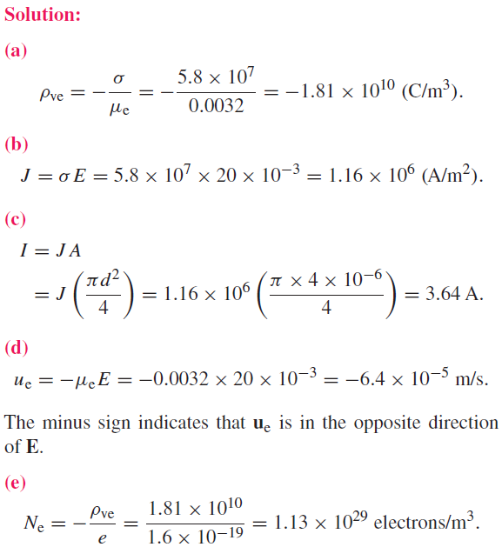

Slide 28
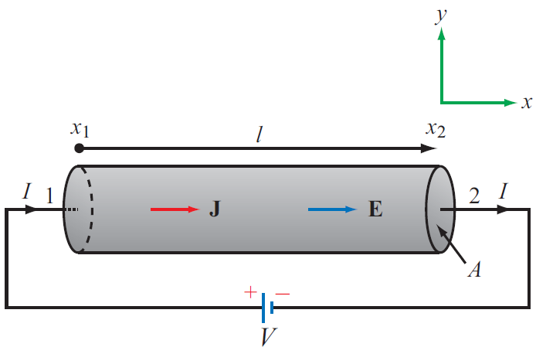
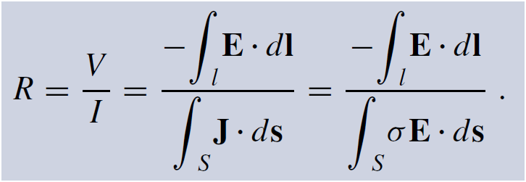
Resistance
Longitudinal Resistor
For any conductor:

Slide 29
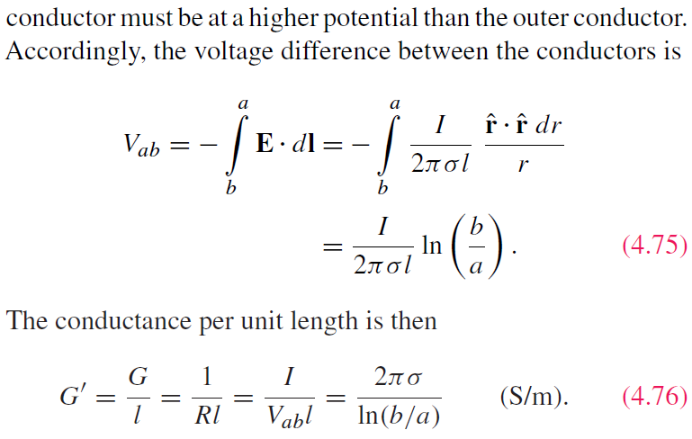
G’=0 if the insulating material is air or a perfect dielectric with zero conductivity.

Slide 30
Joule’s Law
The power dissipated in a volume containing electric field E and current density J is:
For a coaxial cable:
For a resistor, Joule’s law reduces to:

Slide 31
Tech Brief 7: Resistive Sensors
An electrical sensor is a device capable of responding to an applied stimulus by generating an electrical signal whose voltage, current, or some other attribute is related to the intensity of the stimulus.
Typical stimuli : temperature, pressure, position, distance, motion, velocity, acceleration, concentration (of a gas or liquid), blood flow, etc.
Sensing process relies on measuring resistance, capacitance, inductance, induced electromotive force (emf), oscillation frequency or time delay, etc.

Slide 32
Piezoresistivity
The Greek word piezein means to press
R₀ = resistance when F = 0
F = applied force
A₀ = cross-section when F = 0
α = piezoresistive coefficient of material

Slide 33
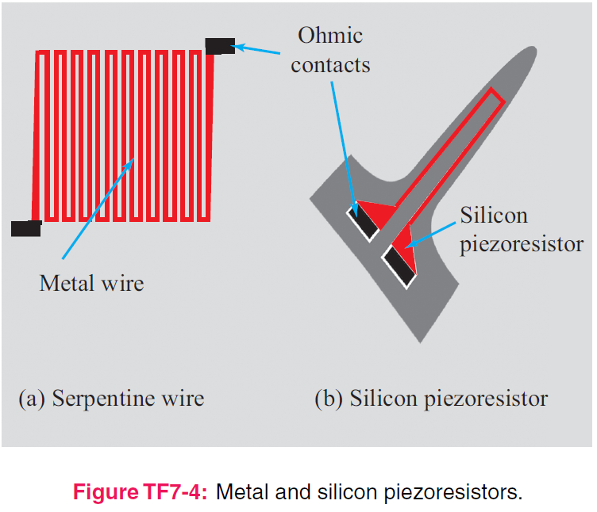
Piezoresistors

Slide 34
Wheatstone Bridge
Wheatstone bridge is a high sensitivity circuit for measuring small changes in resistance

Slide 35
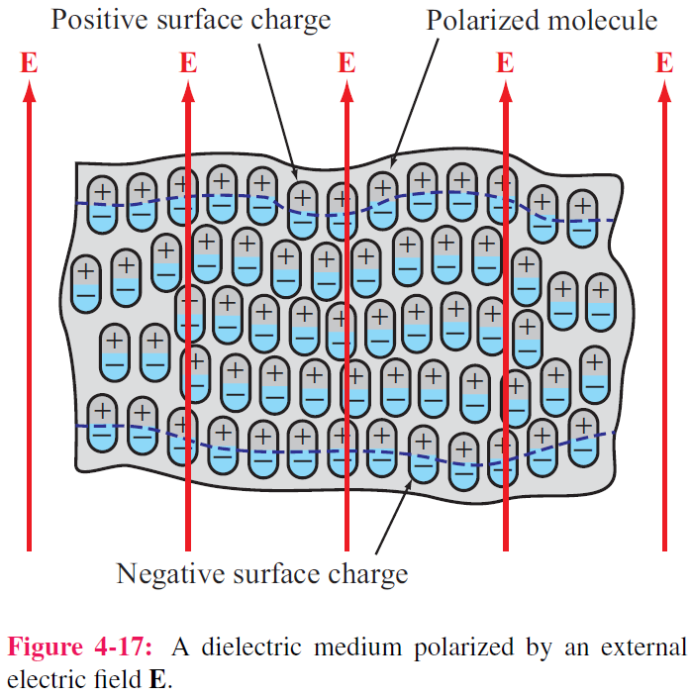
Dielectric Materials

Slide 36
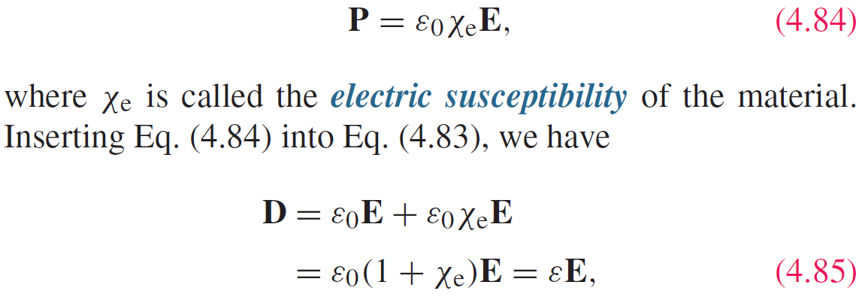
Polarization Field
P = electric flux density induced by E

Slide 37
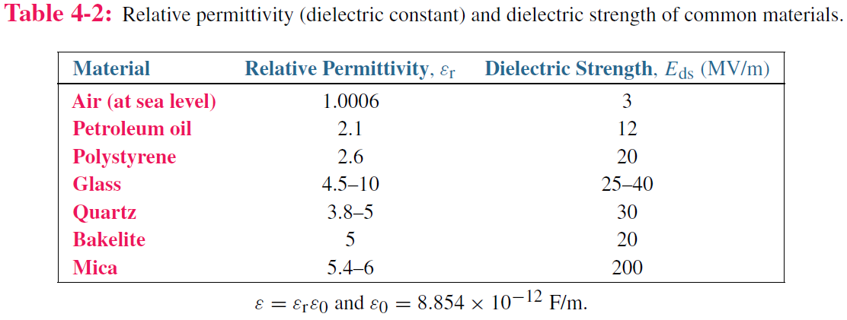
Electric Breakdown
Electric Breakdown

Slide 38
Boundary Conditions

Slide 39
Summary of Boundary Conditions
Remember E = 0 in a good conductor

Slide 41
Conductors
Net electric field inside a conductor is zero

Slide 42
Field Lines at Conductor Boundary
At conductor boundary, E field direction is always perpendicular to conductor surface

Slide 45
Capacitance

Slide 46
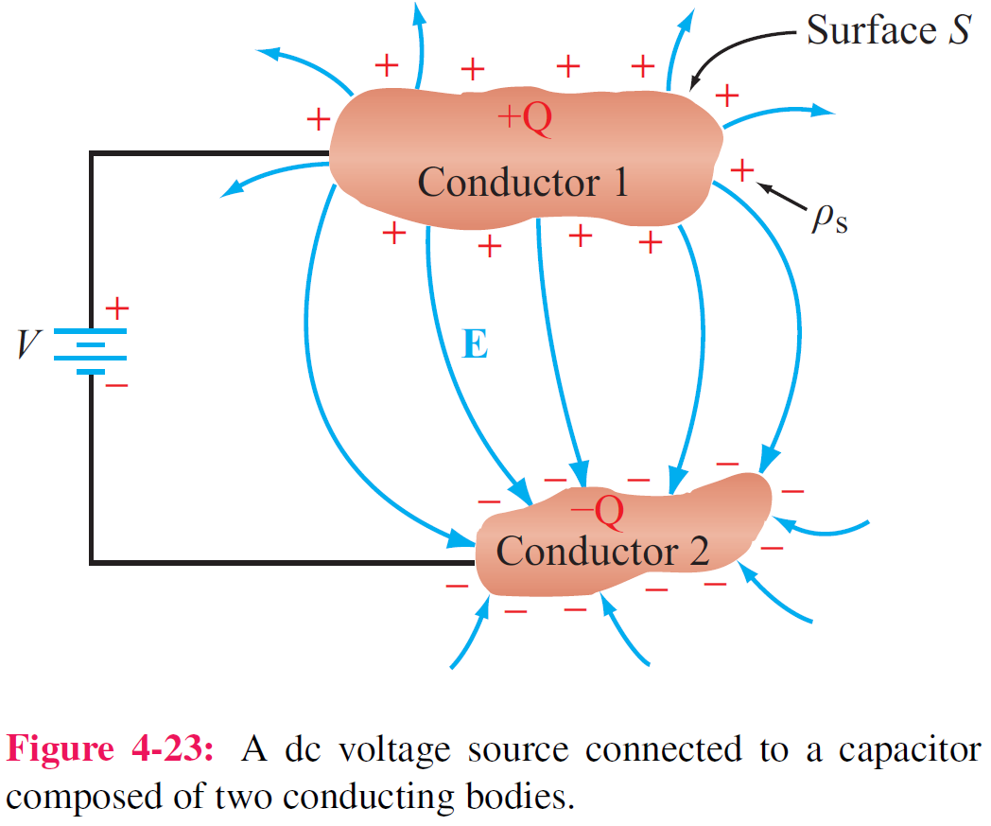
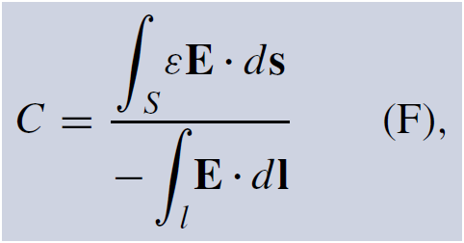
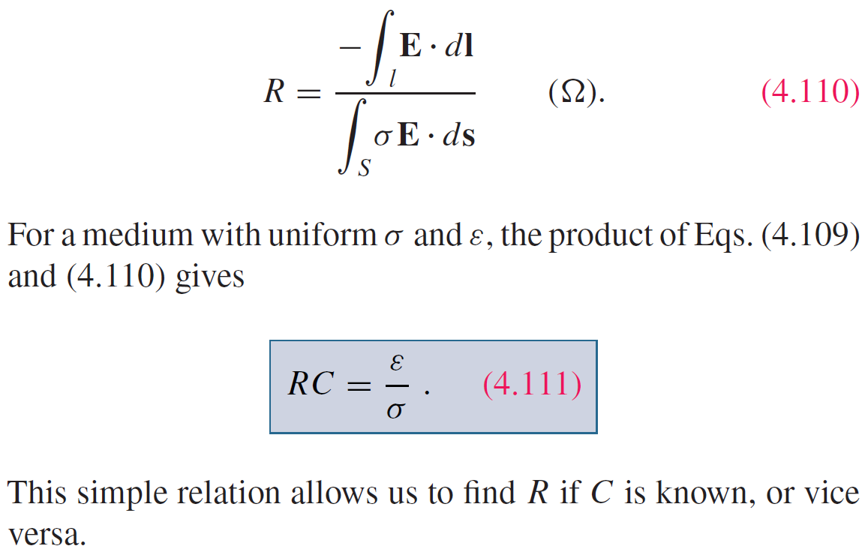
Capacitance
For any two-conductor configuration:
For any resistor:

Slide 47
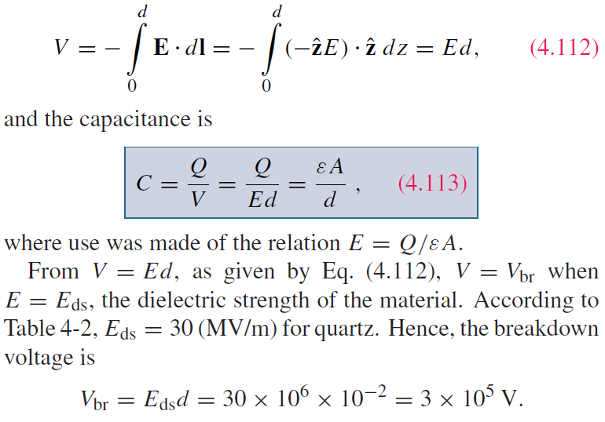

Slide 48
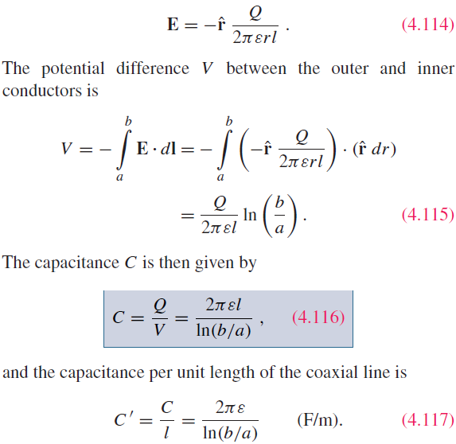
Application of Gauss’s law gives:
Q is total charge on inside of outer cylinder, and –Q is on outside surface of inner cylinder

Slide 49
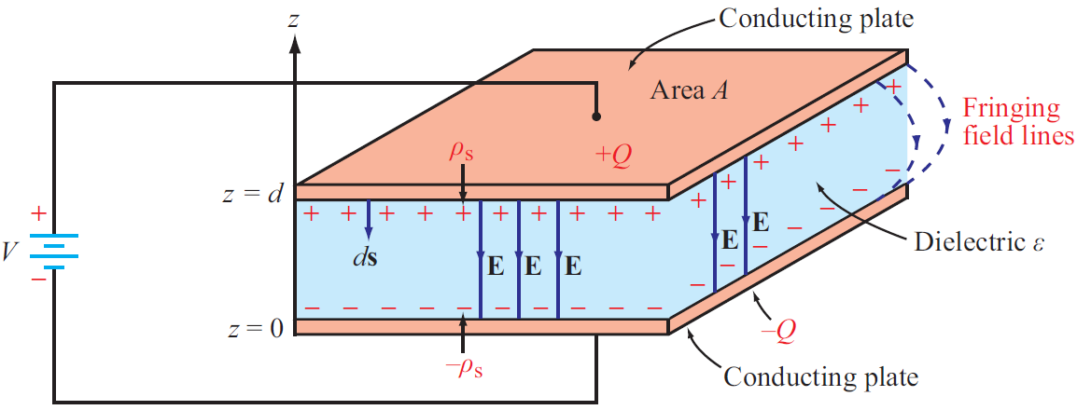
Tech Brief 8: Supercapacitors
For a traditional parallel-plate capacitor, what is the maximum attainable energy density?
Mica has one of the highest dielectric strengths ~2 x 10**8 V/m.
If we select a voltage rating of 1 V and a breakdown voltage of 2 V (50% safety), this will require that d be no smaller than 10 nm.
For mica, ε = 6ε₀ and ρ = 3 x 10**3 kg/m³ .
Hence:
W′ = 90 J/kg = 2.5 x10**‒2 Wh/kg.
By comparison, a lithium-ion battery has
W′ = 1.5 x 10**2 Wh/kg, almost 4 orders of magnitude greater
Energy density is given by:
ε = permittivity of insulation material
V = applied voltage
ρ = density of insulation material
d = separation between plates

Slide 50
A supercapacitor is a “hybrid” battery/capacitor

Slide 51
Users of Supercapacitors

Slide 52
Energy Comparison

Slide 53
Electrostatic Potential Energy
Electrostatic potential energy density (Joules/volume)
Energy stored in a capacitor
Total electrostatic energy stored in a volume

Slide 54
Image Method
Image method simplifies calculation for E and V due to charges near conducting planes.
For each charge Q, add an image charge –Q
Remove conducting plane
Calculate field due to all charges

Slide 55
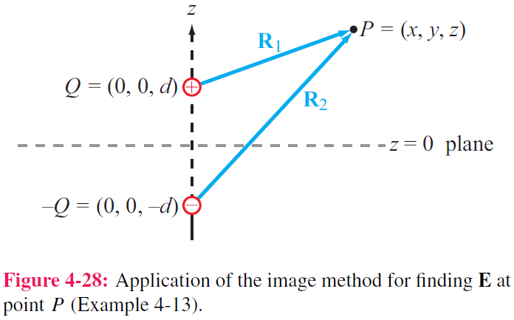

Slide 56
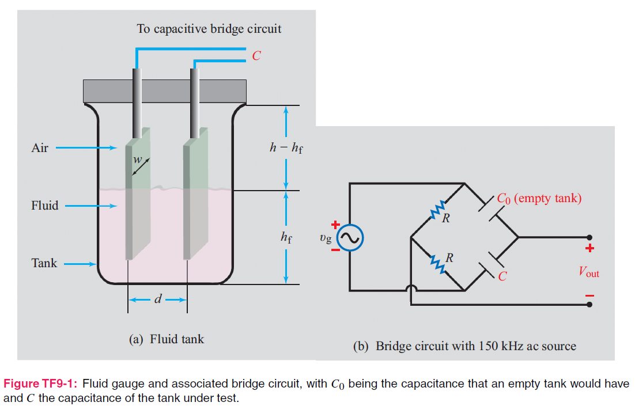
Tech Brief 9: Capacitive Sensors

Slide 57
Humidity Sensor

Slide 58
Pressure Sensor

Slide 59
Planar capacitors

Slide 60
Fingerprint Imager

