Slide 1
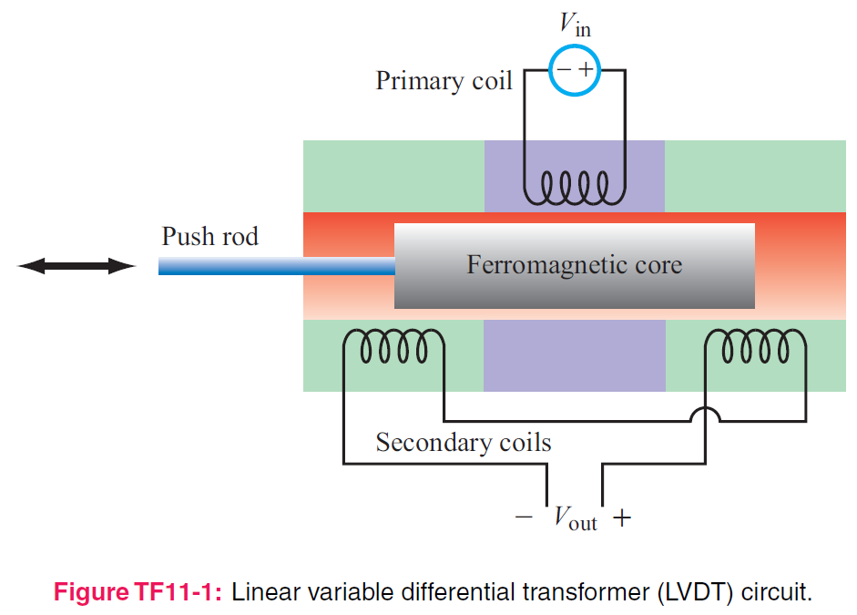
5. Magnetostatics
7e Applied EM by Ulaby and Ravaioli

Slide 2
Chapter 5 Overview

Slide 3
Electric vs Magnetic Comparison

Slide 4
Electric & Magnetic Forces
Magnetic force
Electromagnetic (Lorentz) force

Slide 5
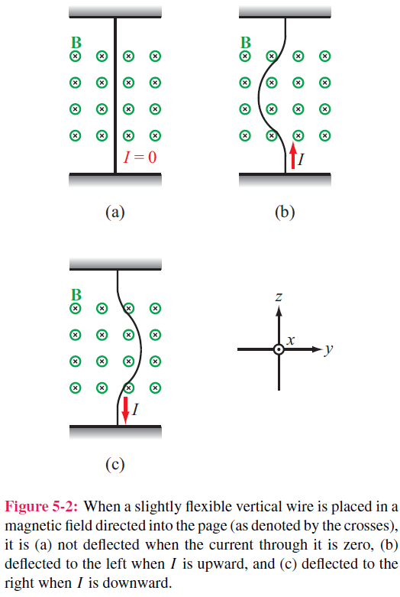
Magnetic Force on a Current Element
Differential force dFm on a differential current I dl:

Slide 6
Torque
d = moment arm
F = force
T = torque

Slide 7
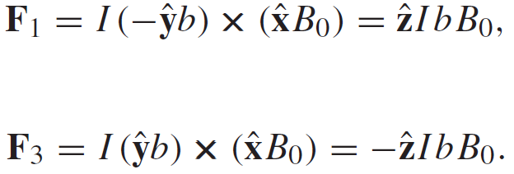
Magnetic Torque on Current Loop
No forces on arms 2 and 4 ( because I and B are parallel, or anti-parallel)
Magnetic torque:
Area of Loop

Slide 8
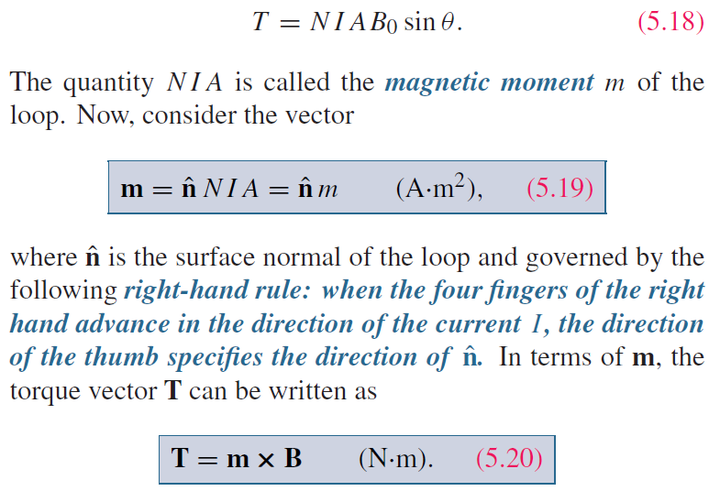
Inclined Loop
For a loop with N turns and whose surface normal is at angle theta relative to B direction:

Slide 9
Biot-Savart Law
Magnetic field induced by
a differential current:
For the entire length:

Slide 10
Magnetic Field due to Current Densities

Slide 11
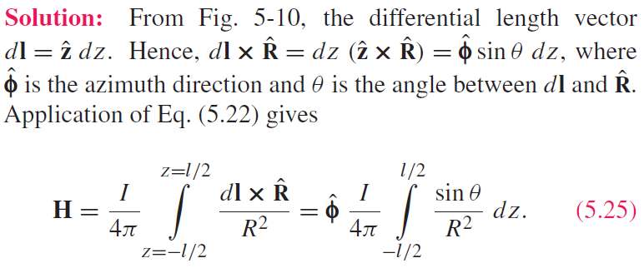
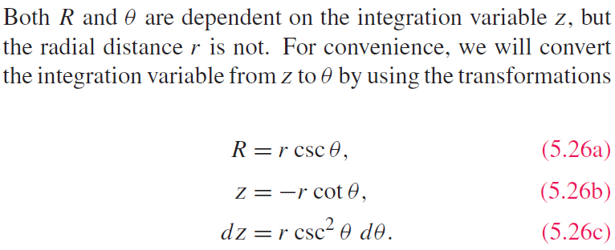
Example 5-2: Magnetic Field of Linear Conductor
Cont.

Slide 12
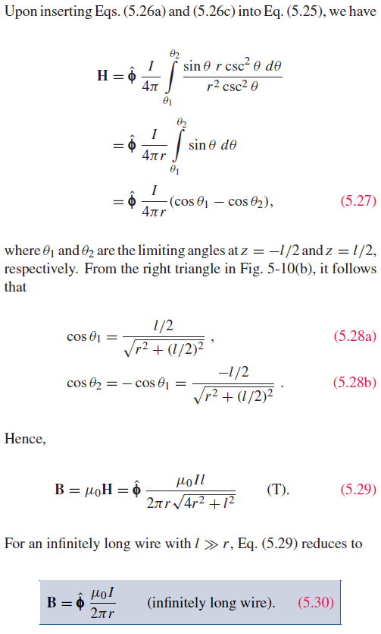
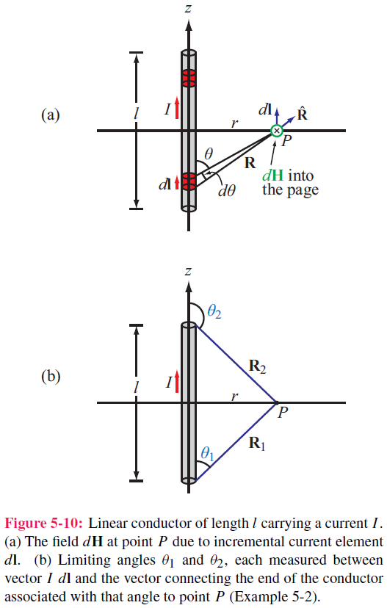
Example 5-2: Magnetic Field of Linear Conductor

Slide 13
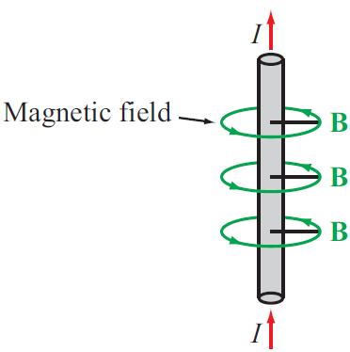
Magnetic Field of Long Conductor

Slide 15
Example 5-3: Magnetic Field of a Loop
Magnitude of field due to dl is
dH is in the r–z plane , and therefore it has
components dHr and dHz
z-components of the magnetic fields due to dl and dl’ add because they are in the same direction,
but their r-components cancel
Hence for element dl:
Cont.

Slide 16
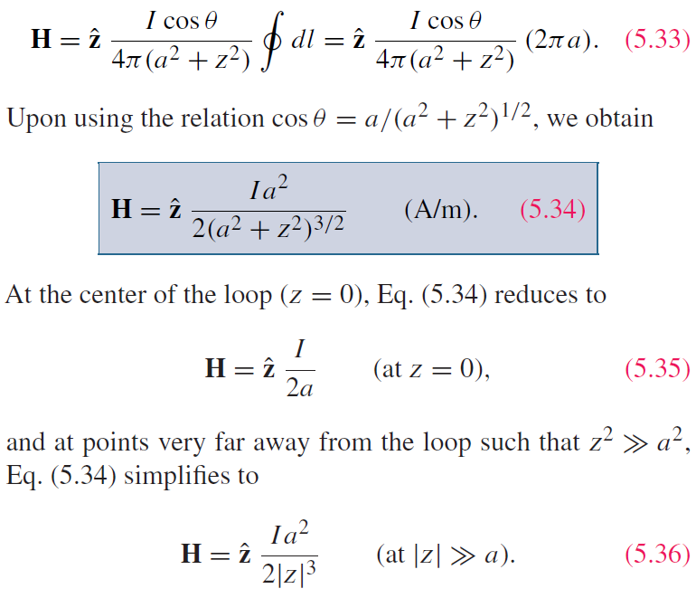
Example 5-3:Magnetic Field of a Loop (cont.)
For the entire loop:

Slide 18
Magnetic Dipole
Because a circular loop exhibits a magnetic field pattern similar to the electric field of an electric dipole, it is called a magnetic dipole

Slide 19
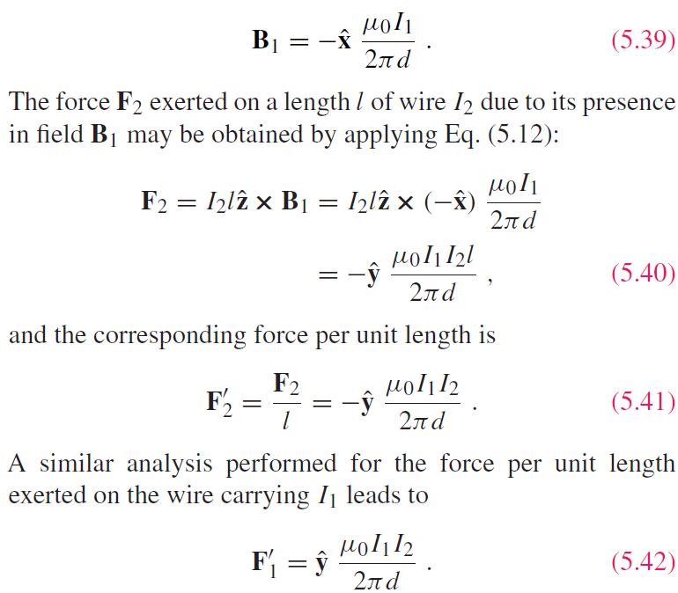
Forces on Parallel Conductors
Parallel wires attract if their currents are in the same direction, and repel if currents are in opposite directions

Slide 21
Tech Brief 10: Electromagnets

Slide 22
Magnetic Levitation

Slide 23
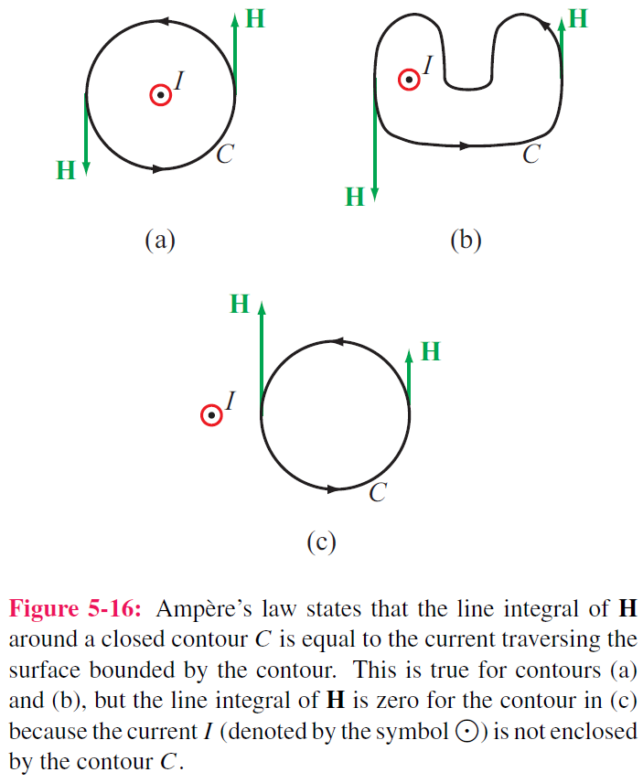
Ampère’s Law

Slide 24
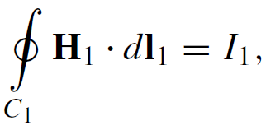
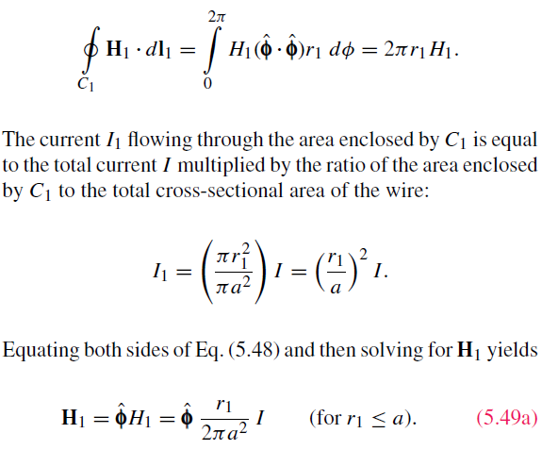
Internal Magnetic Field of Long Conductor
For r < a
Cont.

Slide 25
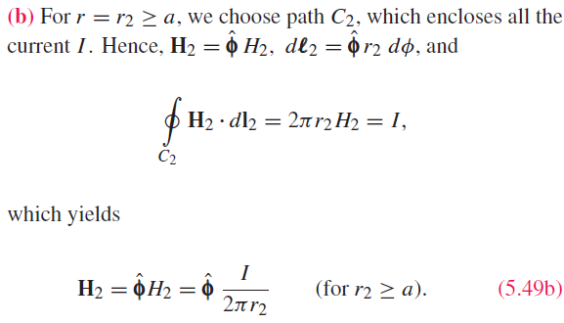
External Magnetic Field of Long Conductor
For r > a

Slide 26
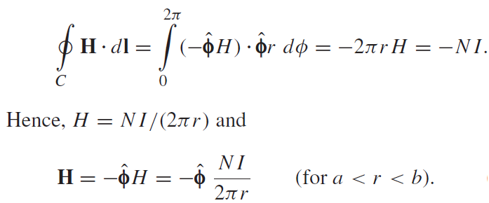
Magnetic Field of Toroid
Applying Ampere’s law over contour C:
Ampere’s law states that the line integral of H around a closed contour C is equal to the current traversing the surface bounded by the contour.
The magnetic field outside the toroid is zero. Why?

Slide 27
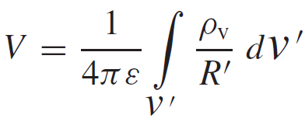
Magnetic Vector Potential A
Electrostatics
Magnetostatics

Slide 28
Magnetic Properties of Materials

Slide 30
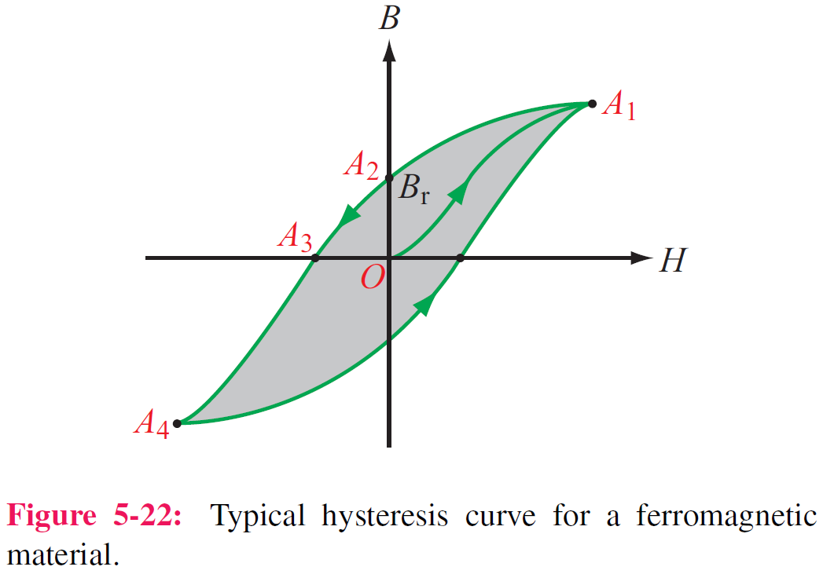
Magnetic Hysteresis

Slide 31
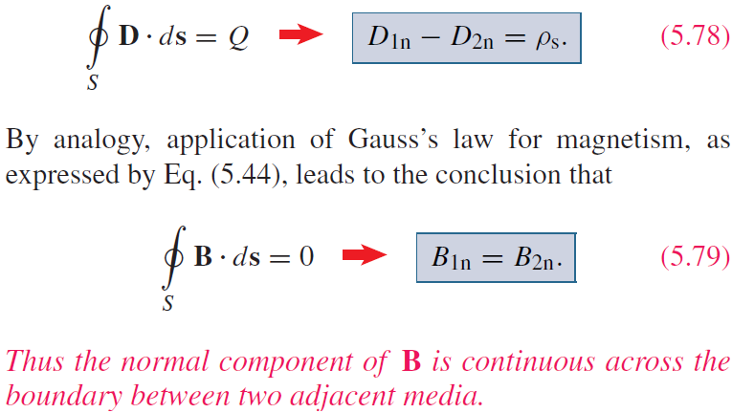
Boundary Conditions

Slide 32
Solenoid
Inside the solenoid:

Slide 33
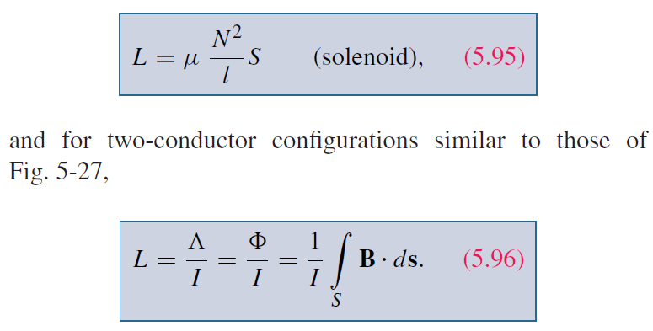
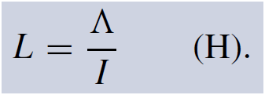
Inductance
Magnetic Flux
Flux Linkage
Inductance
Solenoid

Slide 34
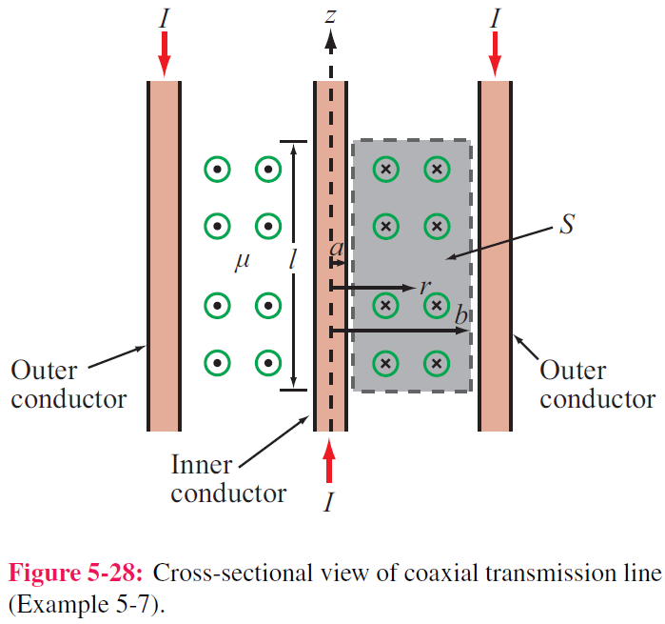
Example 5-7: Inductance of Coaxial Cable
The magnetic field in the region S between the two conductors is approximately
Total magnetic flux through S:
Inductance per unit length:

Slide 35
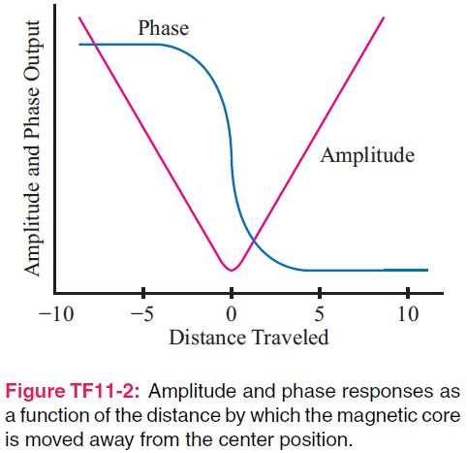
Tech Brief 11: Inductive Sensors
LVDT can measure displacement with submillimeter precision

Slide 36
Proximity Sensor

Slide 37
Magnetic Energy Density
Magnetic field in the insulating material is
The magnetic energy stored in the
coaxial cable is

Slide 38
Summary

