Slide 1
6. Maxwell’s Equations In Time-Varying Fields
7e Applied EM by Ulaby and Ravaioli

Slide 2
Chapter 6 Overview

Slide 3
Maxwell’s Equations
In this chapter, we will examine Faraday’s and Ampère’s laws

Slide 4
Faraday’s Law
Electromotive force (voltage) induced by time-varying magnetic flux:

Slide 5
Three types of EMF

Slide 6
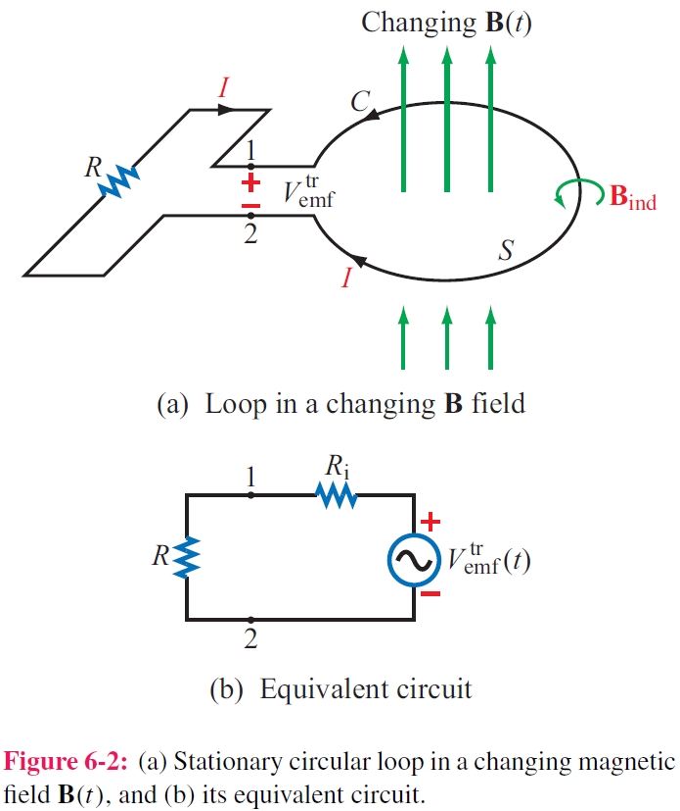
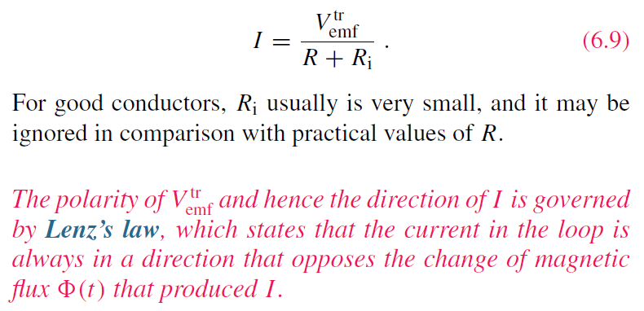
Stationary Loop in Time-Varying B

Slide 7
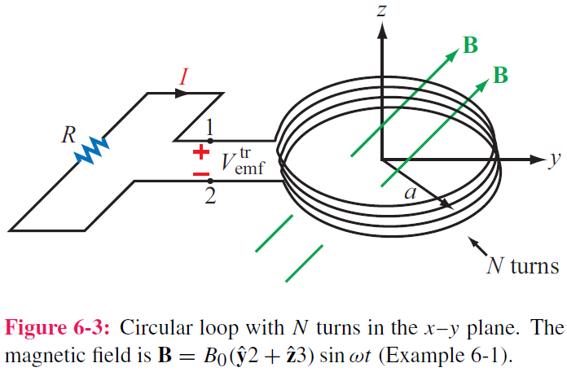
cont.

Slide 8
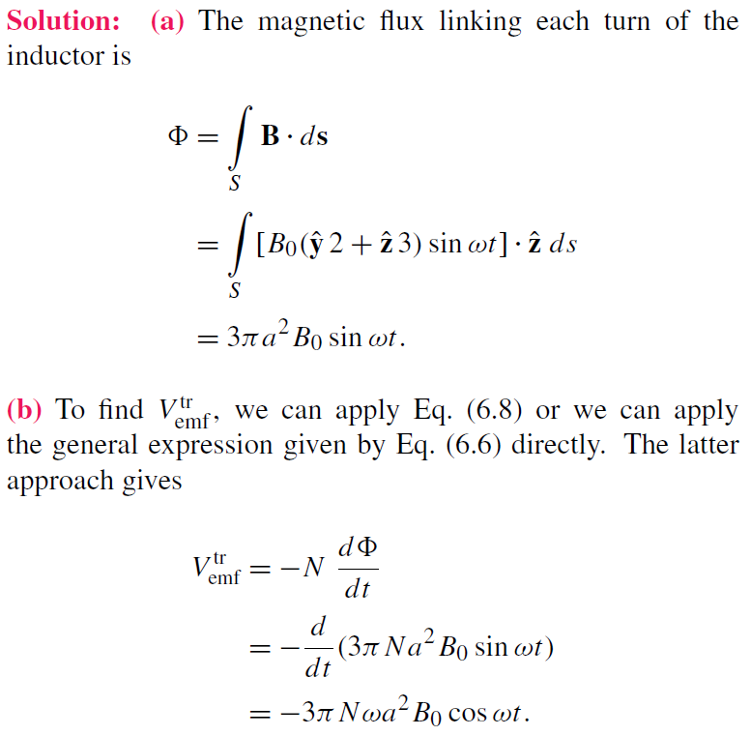
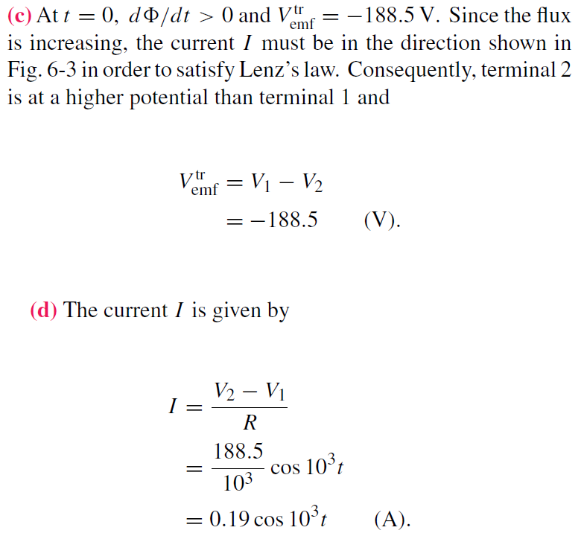
Example 6-1 Solution

Slide 10
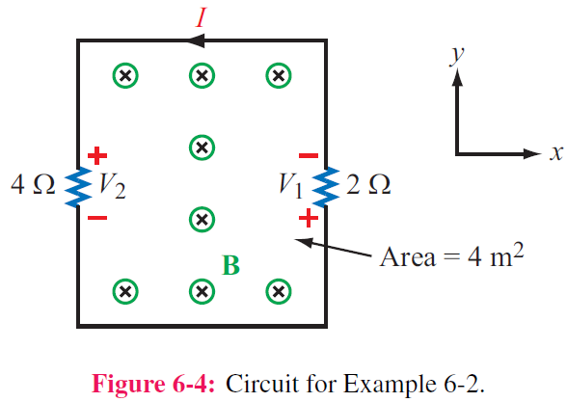
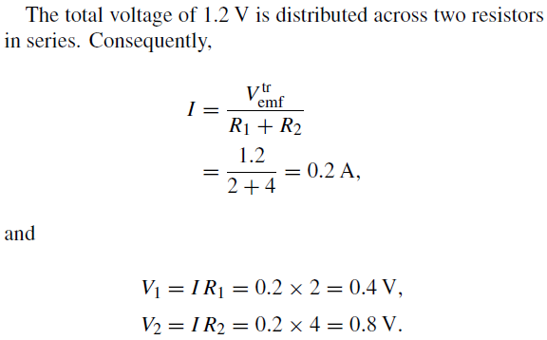

Slide 11
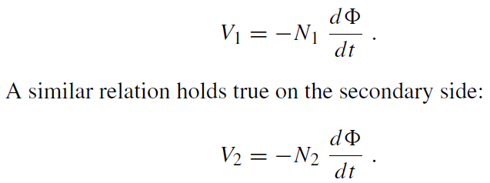
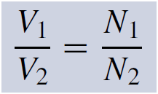
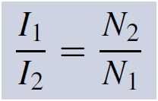
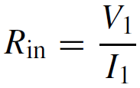
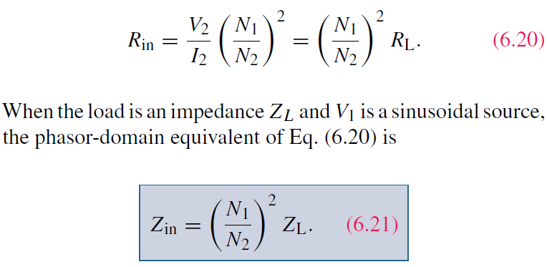
Ideal Transformer

Slide 12
Motional EMF
Magnetic force on charge q moving with velocity u in a magnetic field B:
This magnetic force is equivalent to the electrical force that would be exerted on the particle by the electric field Em given by
This, in turn, induces a voltage difference between ends 1 and 2, with end 2 being at the higher potential. The induced voltage is called a motional emf

Slide 13
Motional EMF

Slide 14
Example 6-3: Sliding Bar
Note that B increases with x
The length of the loop is related to u by x0 = ut. Hence

Slide 16
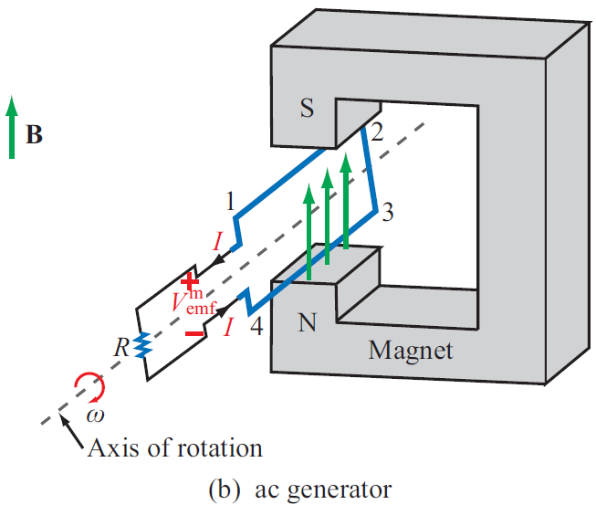
EM Motor/ Generator Reciprocity
Motor: Electrical to mechanical energy conversion
Generator: Mechanical to electrical energy conversion

Slide 17
EM Generator EMF
As the loop rotates with an angular velocity ω about its own axis, segment 1–2 moves with velocity u given by
Also:
Segment 3-4 moves with velocity –u. Hence:

Slide 19
Tech Brief 12: EMF Sensors
Piezoelectric crystals generate a voltage across them proportional to the compression or tensile (stretching) force applied across them.
Piezoelectric transducers are used in medical ultrasound, microphones, loudspeakers, accelerometers, etc.
Piezoelectric crystals are bidirectional: pressure generates emf, and conversely, emf generates pressure (through shape distortion).

Slide 20
Faraday Accelerometer
The acceleration a is determined by differentiating the velocity u with respect to time

Slide 21
The Thermocouple
The thermocouple measures the unknown temperature T₂ at a junction connecting two metals with different thermal conductivities, relative to a reference temperature T₁.
In today’s temperature sensor designs, an artificial cold junction is used instead. The artificial junction is an electric circuit that generates a voltage equal to that expected from a reference junction at temperature T₁.

Slide 22
Displacement Current
This term is conduction current I_{C}
This term must represent a current
Application of Stokes’s theorem gives:
Cont.

Slide 23
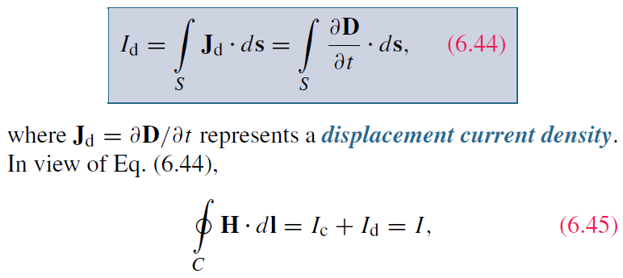
Displacement Current
Define the displacement current as:
The displacement current does not involve real charges;
it is an equivalent current that depends on

Slide 24
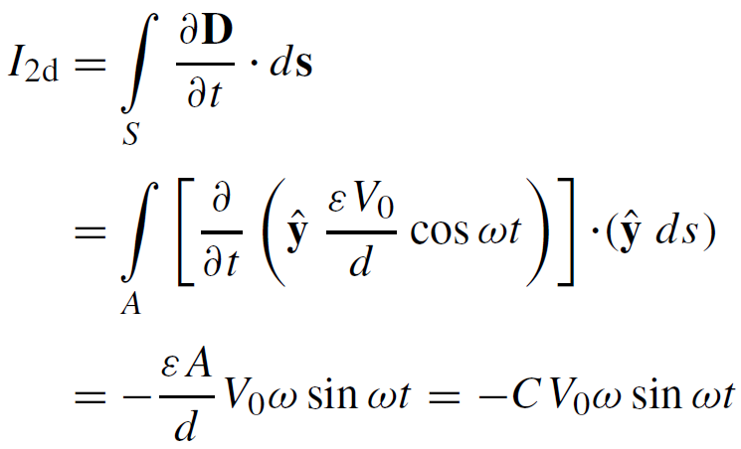
Capacitor Circuit
Given: Wires are perfect conductors and capacitor insulator material is perfect dielectric.
For Surface S₂:
I₂ = I_{2c} + I_{2d}
I_{2c} = 0 (perfect dielectric)
For Surface S₁:
I₁ = I_{1c} + I_{1d}
(D = 0 in perfect conductor)
Conclusion: I₁ = I₂

Slide 26
Boundary Conditions

Slide 27
Charge Current Continuity Equation
Current I out of a volume is equal to rate of decrease of charge Q contained in that volume:
Used Divergence Theorem

Slide 28
Charge Dissipation
Question 1: What happens if you place a certain amount of free charge inside of a material?
Answer: The charge will move to the surface of the material, thereby returning its interior to a neutral state.
Question 2: How fast will this happen?
Answer: It depends on the material; in a good conductor, the charge dissipates in less than a femtosecond, whereas in a good dielectric, the process may take several hours.
Derivation of charge density equation:
Cont.

Slide 29
Solution of Charge Dissipation Equation
For copper:
For mica:
= 15 hours

Slide 30
EM Potentials
Static condition
Dynamic condition
Dynamic condition with propagation delay:
Similarly, for the magnetic vector potential:

Slide 31
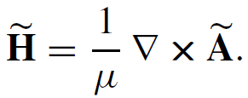
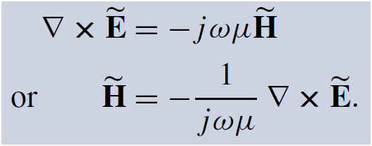
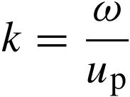
Time Harmonic Potentials
If charges and currents vary sinusoidally with time:
Also:
we can use phasor notation:
with
Maxwell’s equations become:
Expressions for potentials become:

Slide 32
Cont.

Slide 33
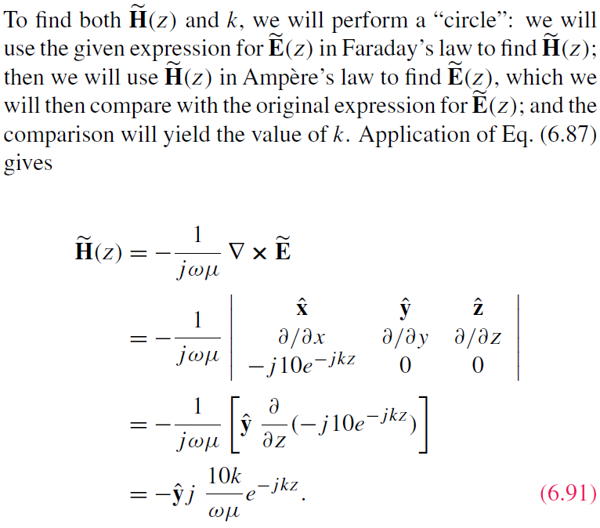
Cont.

Slide 34
Example 6-8 cont.
Cont.

Slide 35
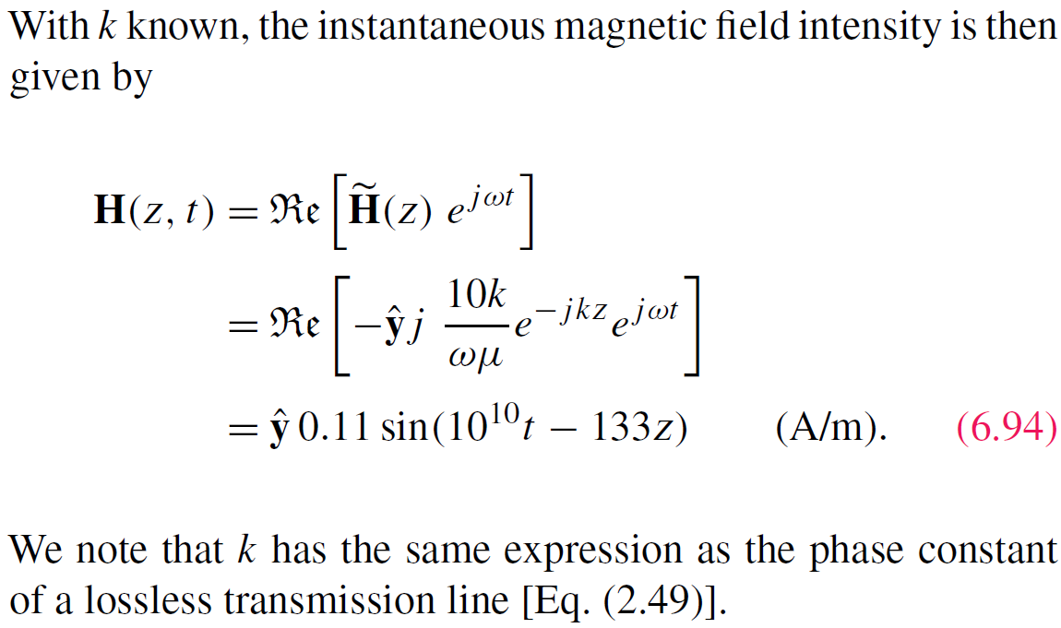
Example 6-8 cont.

Slide 36
Summary

