Slide 1
Notebook
Xingwei Wang

Slide 2

Lab. Notebook

Slide 3
Lab. Notebook
Hard Cover Official Lab Notebook
Numbered Pages
1st Page ,Table of Contents
Name & ID number
Section number

Slide 4
Lab. Notebook
about $ 20.oo
300 Numbered Pages
Lots of 4 books 19.95 X 4 + $6.00
Office Supplies & Equip. Co.
1 800 636-3403
Ask for Bonny (all credit cards)

Slide 5
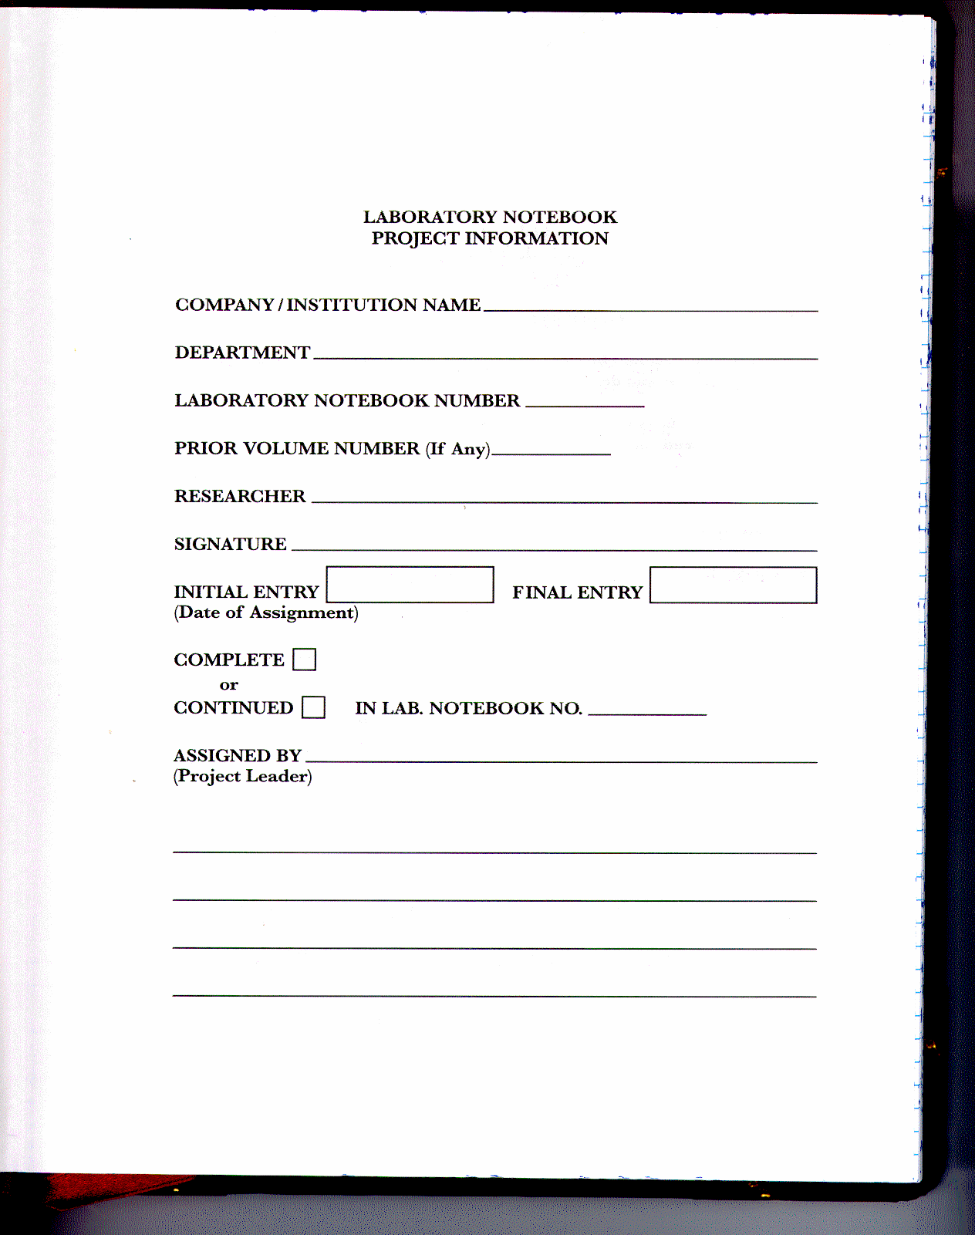
PUT YOUR NAME IN THE BOOK

Slide 6
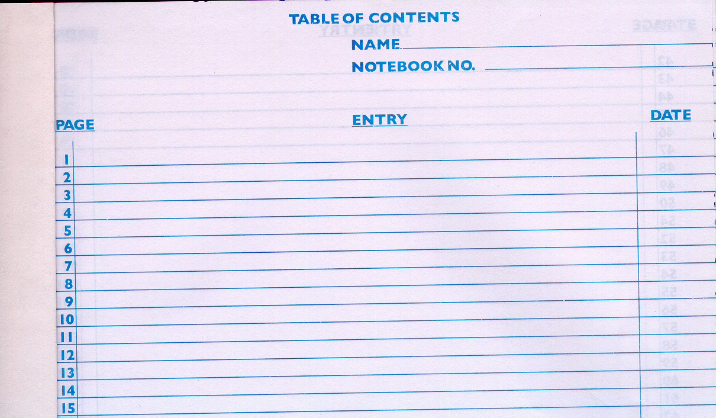
Table of Contents

Slide 7
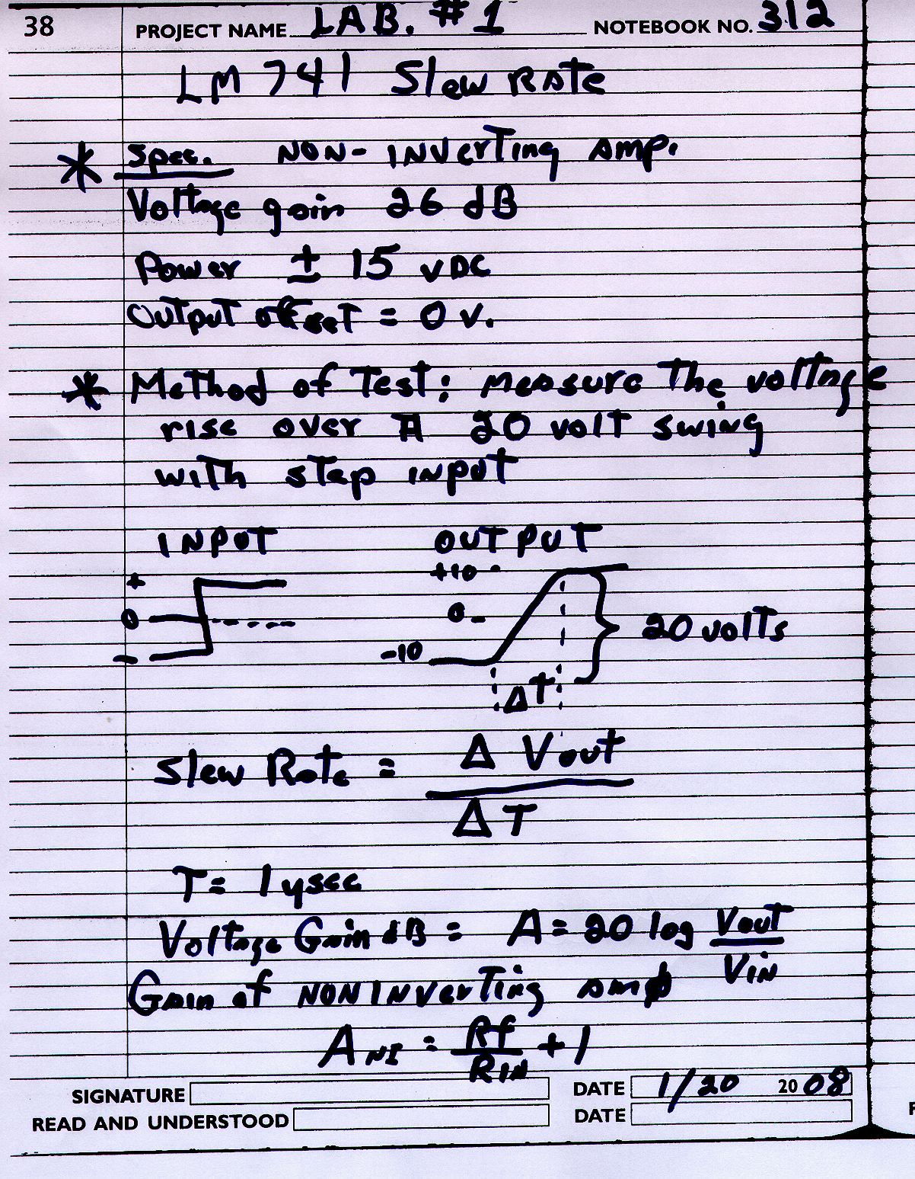
Put everything you do in the book

Slide 8
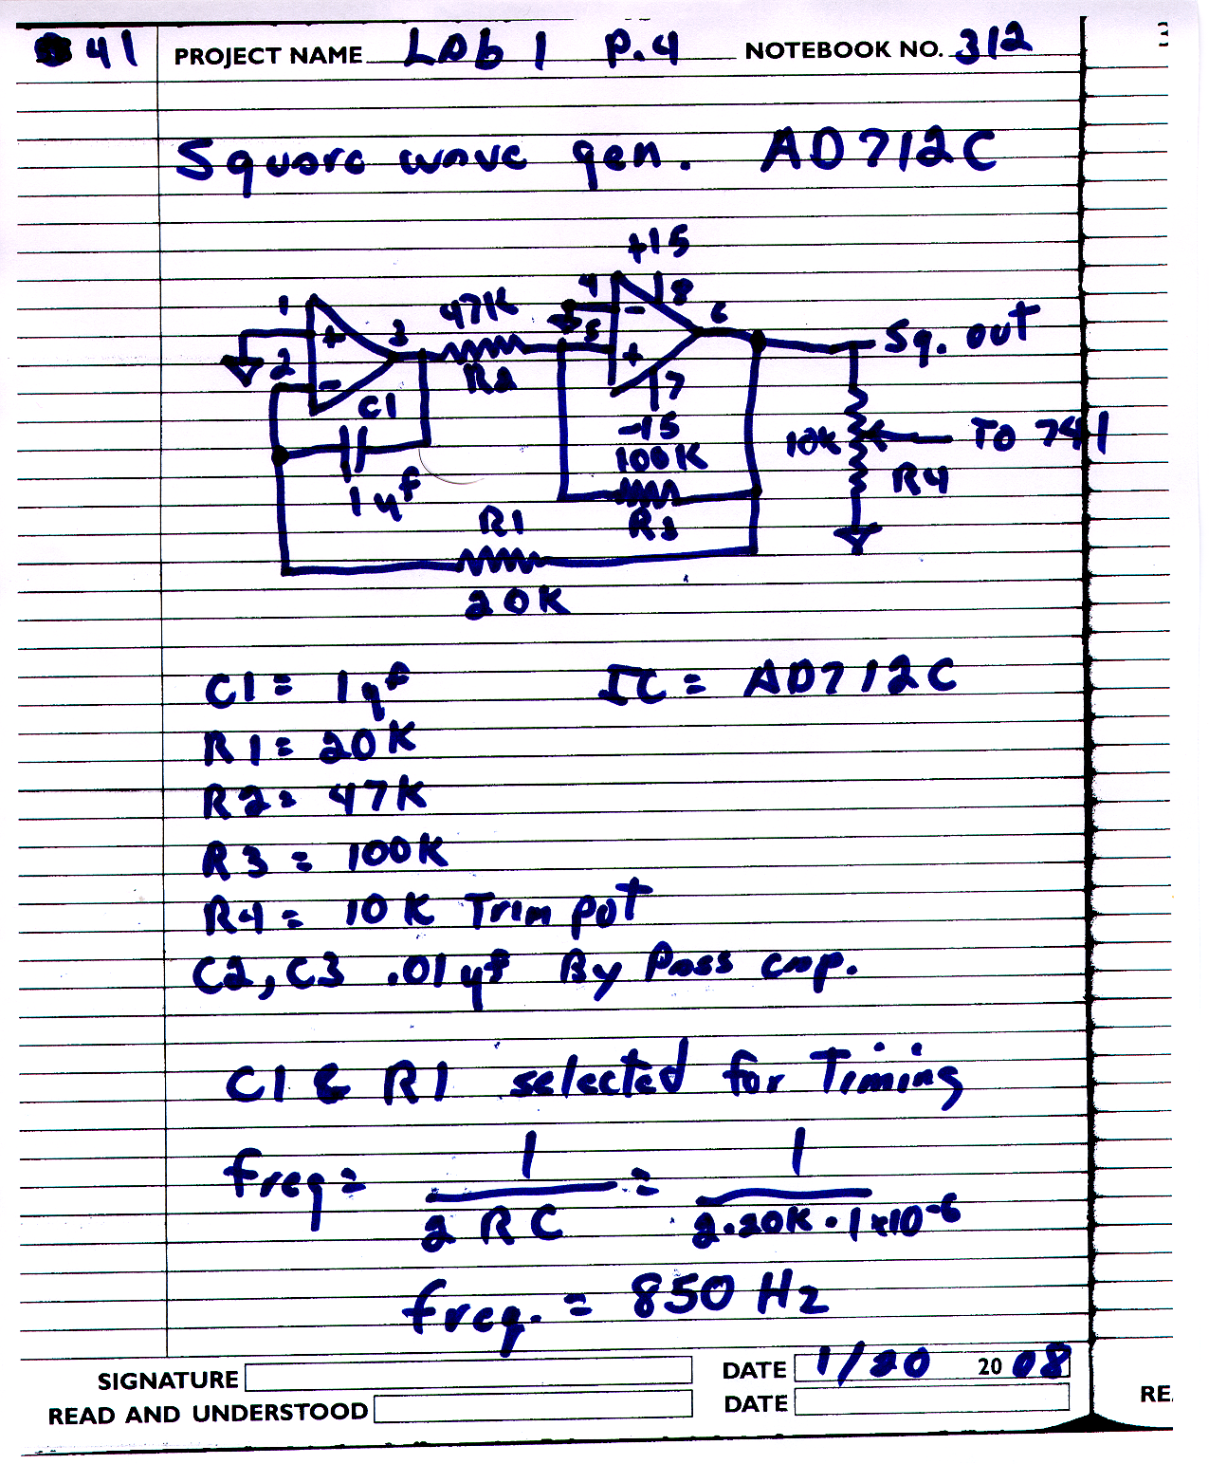
Schematic with pin numbers, part values ID’ed, formals used to get results

Slide 9
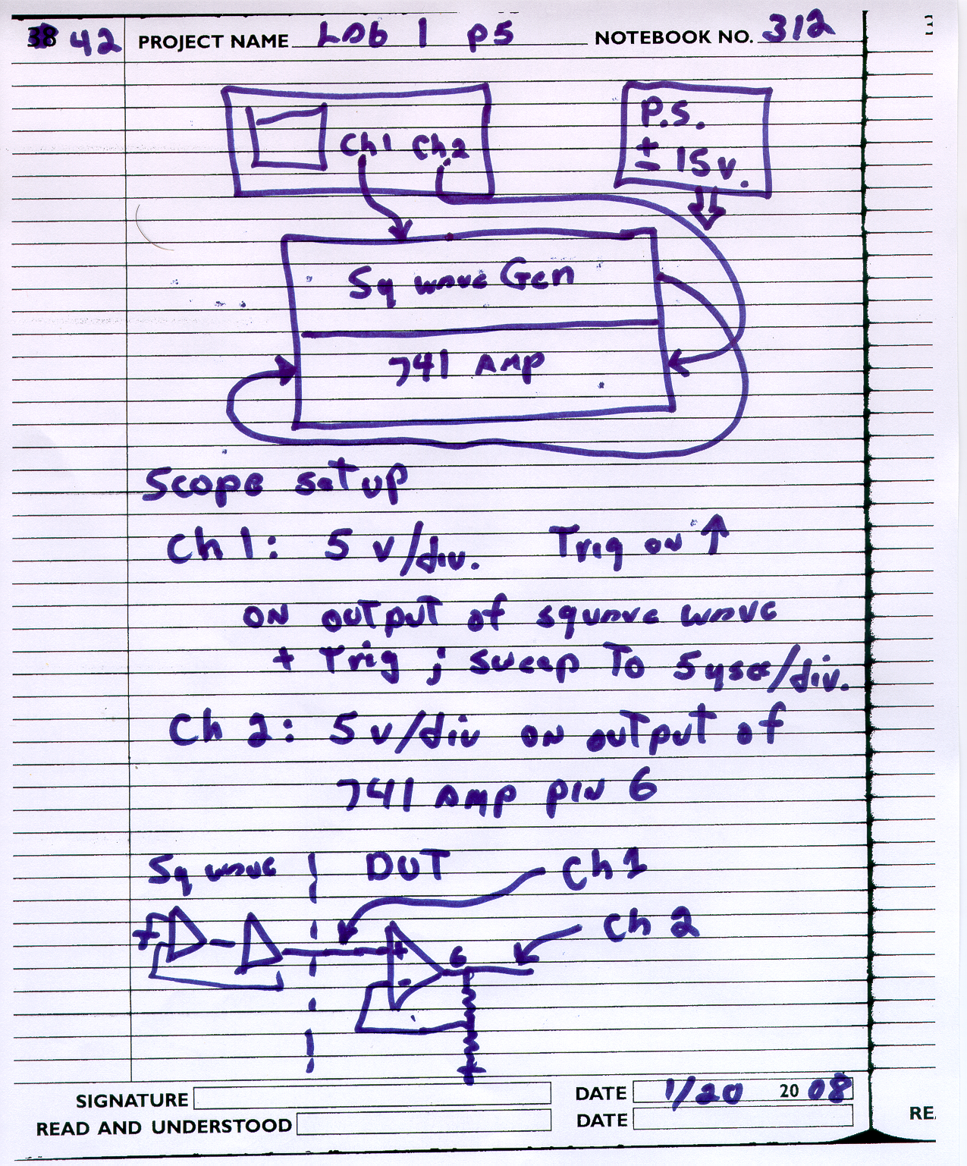
Test Setup
& settings of equipment

Slide 10
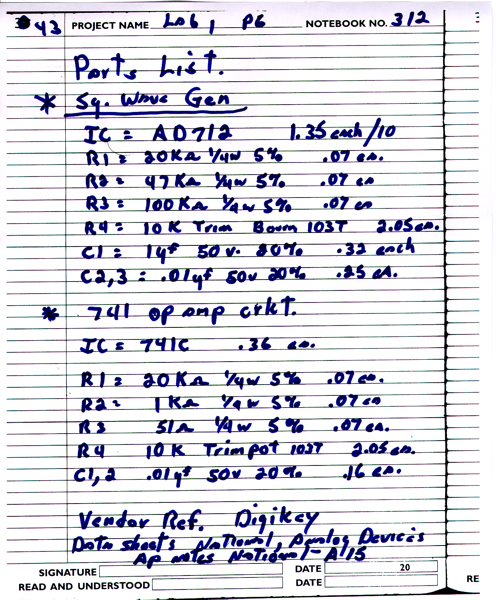
Parts List with price & Reference of price data

Slide 11
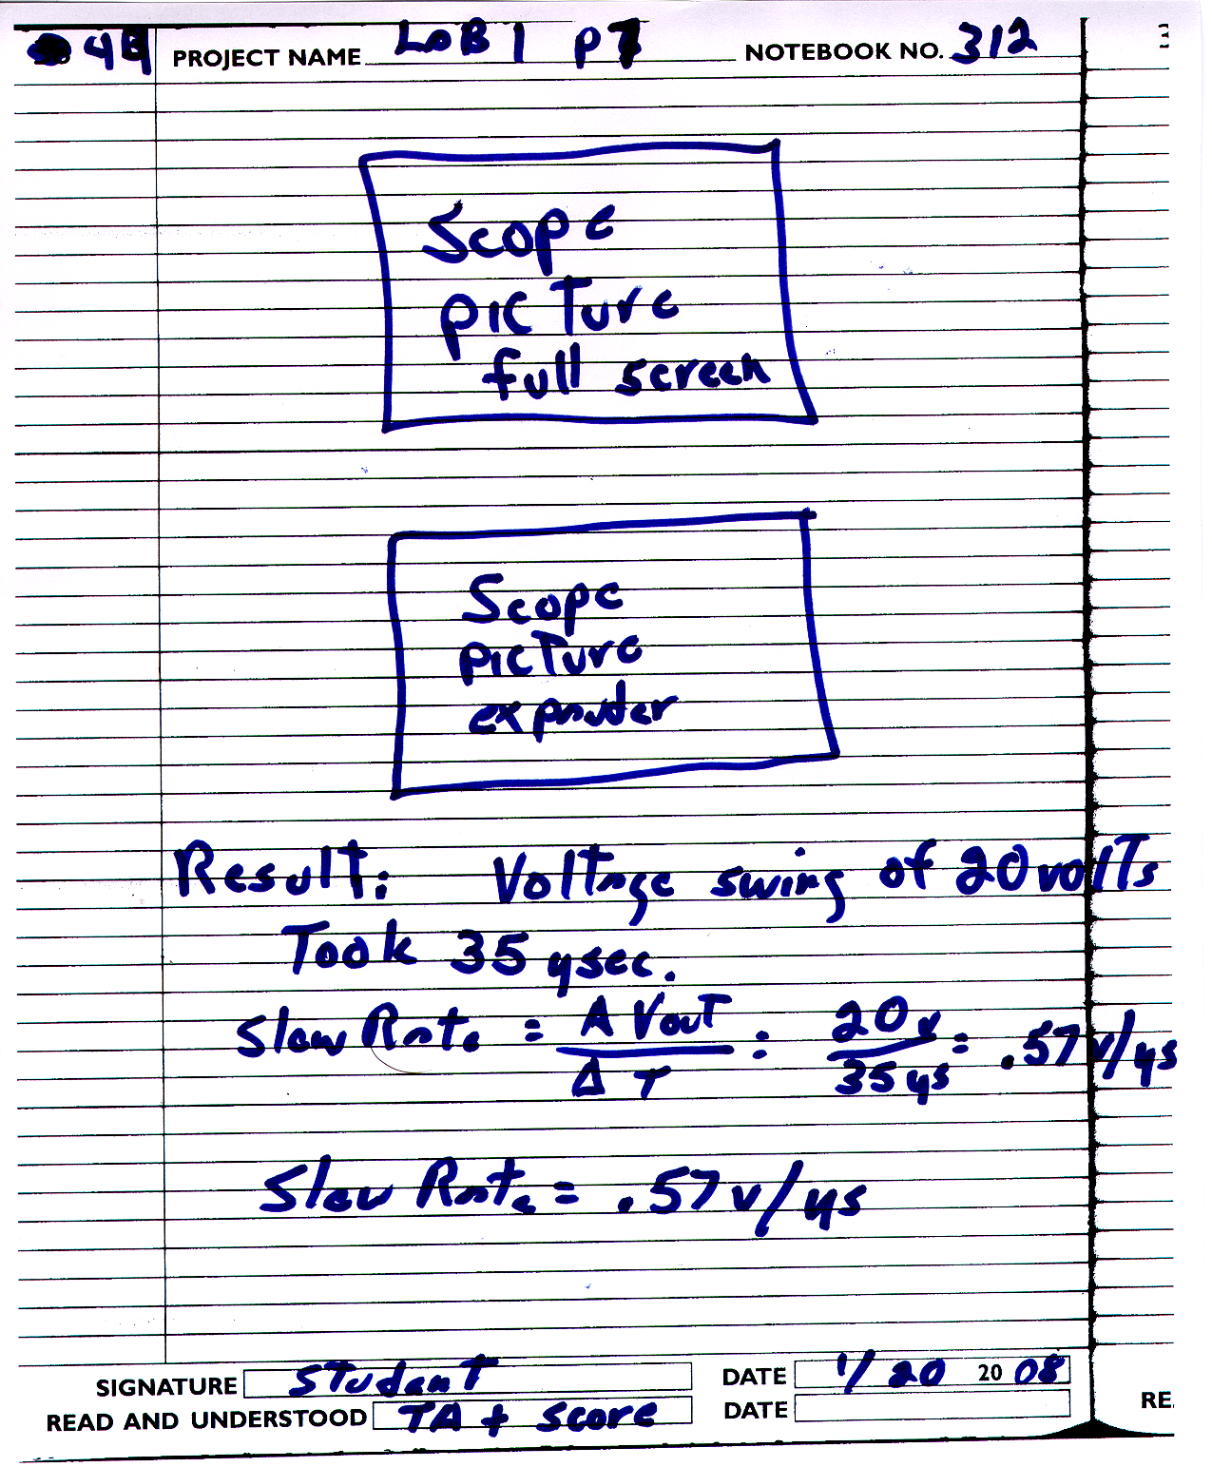
Scope Pictures
& Results

Slide 12
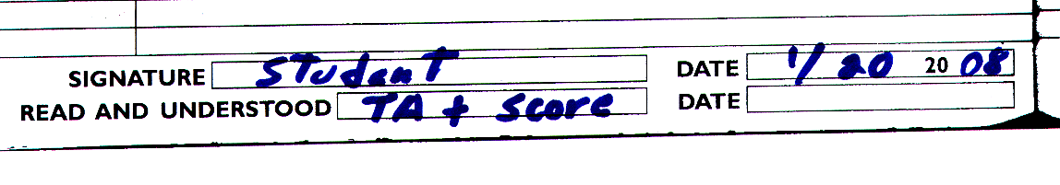
The LAST page of the experiment will have the date, your name, and the TA’s signoff with the point value earned
100 points / exp.

Slide 13
Laboratory Notebook Guidelines
INTRODUCTION Using a Laboratory Notebook to record ideas, inventions, experimentation records, observations and all work details is a vital part of any laboratory process. Careful attention to how you keep your Laboratory Notebook can have a positive impact on the patent outcome of a pending discovery or invention.
Following are some overall recommendations to help you keep more efficient and accurate Laboratory Notebook entries. Remember, however, that these are simply a suggested set of guidelines. Only your attorney can supply the exact guidelines she would like you to follow to satisfy specific legal requirements. That is why we recommend that you consult your legal counsel.

Slide 14
Laboratory Notebook Guidelines
RECORDING DATA Your Laboratory Notebook is a vital record of your work whether it is for patent purposes, legal records or documenting drug research under FDA guidelines. The Laboratory Notebook can help you prove:

Slide 15
Laboratory Notebook Guidelines
Exact details and dates of conception
Details and dates of reduction to practice
Diligence in reducing your invention to practice
Details regarding the structure and operation of your invention
Experimentation observations and results
A chronological record of your work
Other work details

Slide 16
Laboratory Notebook Guidelines
Follow a few simple rules of thumb
Always record entries legibly, neatly and in permanent ink.
Immediately enter into your notebook and date all original concepts, data and observations, using separate headings to differentiate each.
Record all concepts, results, references and other information in a systematic and orderly manner. (Language, charts and numbering systems should be maintained consistently throughout.)
It is acceptable to make your entries brief. Always, however, include enough details for someone else to successfully duplicate the work you have recorded.
Label all figures and calculations.
Never, under any circumstances, remove pages from your notebook.

Slide 17
Laboratory Notebook Guidelines
Start entries at the top of the first page, and always make successive, dated entries, working your way to the bottom of the last page.
After completing a page, sign it before continuing to the next page.
Make sure that you record the date of each entry clearly and unambiguously.
Never let anyone other than yourself write in your Notebook (excluding witness signatures, discussed later).

Slide 18
Laboratory Notebook Guidelines
Remember to treat your Laboratory Notebook as a legal document:
It records the chronological history of your activities. The following guidelines should help you maintain the consistent and accurate entries needed for future legal purposes.
Never leave blank spaces, and never erase or remove material you have added. Simply draw lines through any blank spaces at the same time you are making your entries.

Slide 19
Laboratory Notebook Guidelines
Do not erase errors. Just draw a single line through any erroneous entry, then add your initials. Enter the correct entry nearby.
You can supplement your entries with supporting material (e.g., test-result printouts and other documentation). But you must permanently affix the material onto a page in its proper chronological location.
Never rely solely on any supplemental attachment. Always include your own entry describing the attachment and add any conclusions that you might draw from its substance.
Occasionally, secondary sources might be too large or inappropriate to attach directly to your notebook. In this case, you can add all secondary sources to an ancillary record maintained precisely for this purpose. However, always remember to write a description of these secondary sources, clearly and unambiguously, in your notebook.

Slide 20
Laboratory Notebook Guidelines
DOCUMENTING PATENT ACTIVITIES
A primary purpose of a Laboratory Notebook is the support of documenting work that may be patentable. To support patent activities, it is necessary to provide clear, concise, chronological entries with specific dates. To rely on these dates, you must have at least one non-inventor corroborate that the events actually happened and that he or she understood your invention by signing and dating the "Disclosed to and Understood by" signature blocks.

Slide 21
Laboratory Notebook Guidelines
Your Laboratory Notebook should help you document and prove:
Conception Date--The date that you knew your invention would solve the problem.
Date of reduction to practice--The moment that you made a working embodiment of your invention. Diligence in reducing your invention to practice--Diligence refers to your intent and conscious effort to make a working embodiment. You are not required to rush, or even to take the most efficient development strategy. But your Notebook must include details relating to your diligent activities. These are dates and facts that show what activities you have conducted to reduce the invention to practice, and when such activities were conducted.

Slide 22
Laboratory Notebook Guidelines
How to make and use your invention--provide documentation details sufficient to teach a colleague how to make and use your invention.
The best mode of practicing your invention--document the best way to practice your invention.
A non-inventor colleague should corroborate each of these events/facts by signing the "Disclosed to and Understood by" on the relevant pages.

