Slide 1

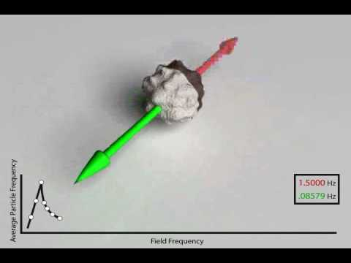
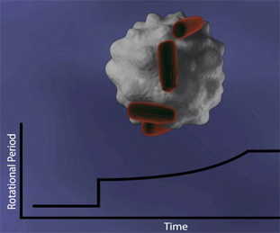
Magnetic Bead Technology
University of Massachusetts-Lowell
Introduction to Biosensors
Shiv Sharma
George Chahwan
Zachary Nicoll
Garo Yessayan
Jason Tarantino

Slide 2
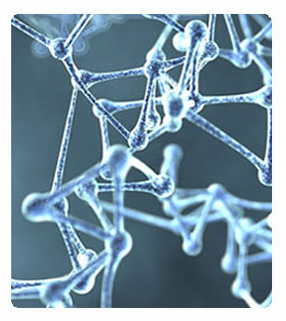
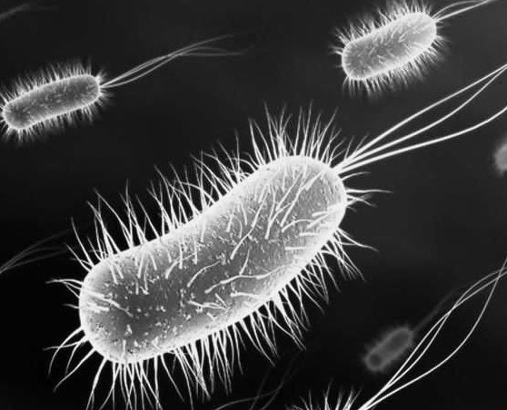
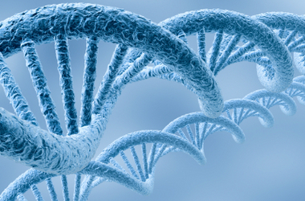
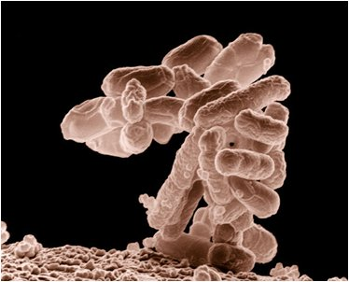
Abstract:
To track the ongoing progress and evolution of the biotechnology field through the experimentation with magnetic bead technology and its applications to modern society.

Slide 3
Overview, History, Needs

Slide 4
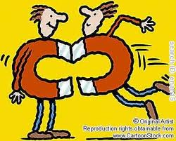
Magnetism
Magnetism offers a simple yet powerful means of separating objects.
Magnetic Bead Technology uses the basic principle of magnetism at the smallest level.

Slide 5
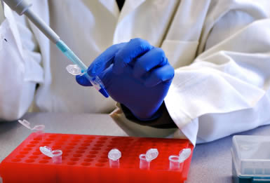
Overview
Magnetic Beads are used in a wide range of biosensor applications, mainly dealing with the separation of biological materials.
The largest area they are currently involved with is the accurate detection of specific, individual biomarkers.
Advantages:
Cheaper to experiment with
Requires less labor
Widely Applicable
Easily attached and separated from biomarkers

Slide 6
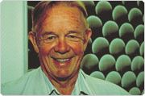
History
John Ugelstad
Dynal Technology
Use of magnetic beads started in the 1980’s when they revolutionized separation methodologies.
They were inspired by the Norwegian invention of magnetic bead-based separation technology.
It was in 1976 when Norwegian professor John Ugelstad first succeeded in making spherical, polystyrene beads of exactly the same size. A feat only previously achieved by NASA in the weightless conditions of space.
At first they allowed for previously unattainable lab results
They became standardized with the invention of Dynabeads.

Slide 7
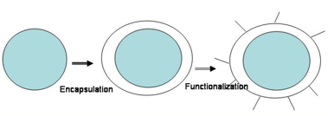
What is a magnetic bead?
Magnetic beads are polymer encapsulated shells with a magnetic pigment
They are a superparamagnetic particle, meaning they exhibit magnetic properties when placed in a magnetic field with no residual magnetism once removed from the magnetic field
The magnetic material is mostly made up of iron oxide
This combination is what makes these beads functional:
  Polymer surface of the beads permits chemical derivatization of magnetic particles, allowing for conversion of magnetic particles into a binding agent for tests (such as ones using immunoassays)

Slide 8
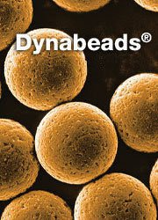
Dynabeads
The early use of magnetic beads was less effective because the beads varied in size, shape and texture.
Dynabeads were created as a standardized version of all magnetic beads so results could be reproduced
The main advantage is that bioreactive molecules can be absorbed or coupled to their surface and then separated from the biological materials.
Separation is gentle and based on liquid-phase kinetics.
They have a unique batch-to-batch reproducibility

Slide 9
The Needs and Opportunities
People want improved medical care for lower-costs and scientists were looking for an easier way to identify and detect harmful disease.
This lead to the development of the magnetic bead
In the last few years, magnetic beads have become a staple in the clinical markets
The beads ability to cut out any human error allows for biomedical processes and tests to be more precise.
As a result, less tests need to be carried out = lower cost of clinical diagnostics
They allow for a much quicker analysis of biomarkers

Slide 10
Instrumentation

Slide 11
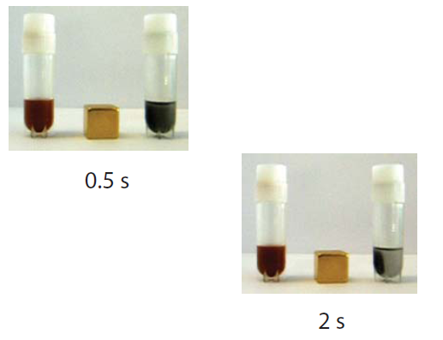
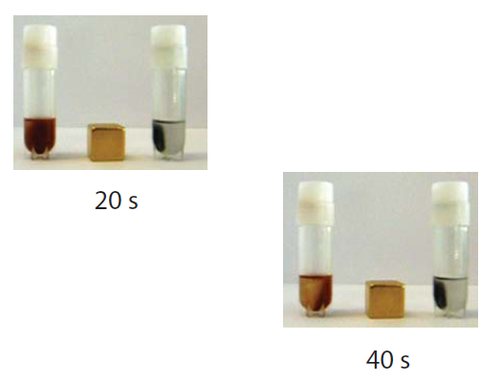
Turbo Beads
Made from highly reactive metal nano-magnetics that are coated in graphene Carbon
The combination of the metal core with the carbon shell displays a large increase in magnetic properties; allowing for faster separation.

Slide 12
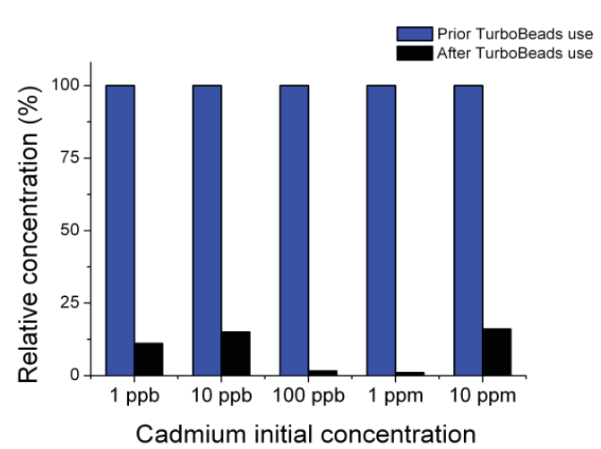
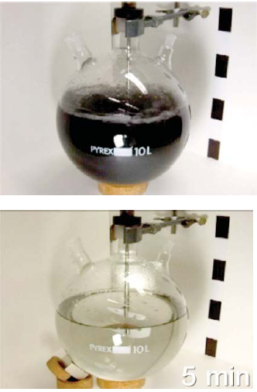
Turbo Beads Continued
Provide faster and more efficient way of separating various compounds from one another
Due to the Carbon the beads can be used in areas that have low pH or high temperatures without oxidation of the core
Example:
Allow for swift removal of toxins that contaminate water

Slide 13
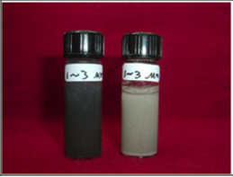
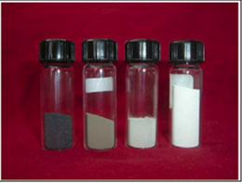
CardioGenics Magnetic Beads
80% of light generated in a generic magnetic bead is lost, causing low sensitivity
Coated with a thin layer of silver before being covered by a polymer shell to improve testing sensitivity
Coating allows for a lighter color making it more sensitive to light
Size can vary from 1-50 microns and it’s 7 times more sensitive to light.

Slide 14
Applications

Slide 15
DNA Extrusion
Previous methods are tedious and look to remove all parts of the cell one by one.
  Cell membrane
  Cytoplasm
  Nuclear membrane
  Proteins

Slide 16
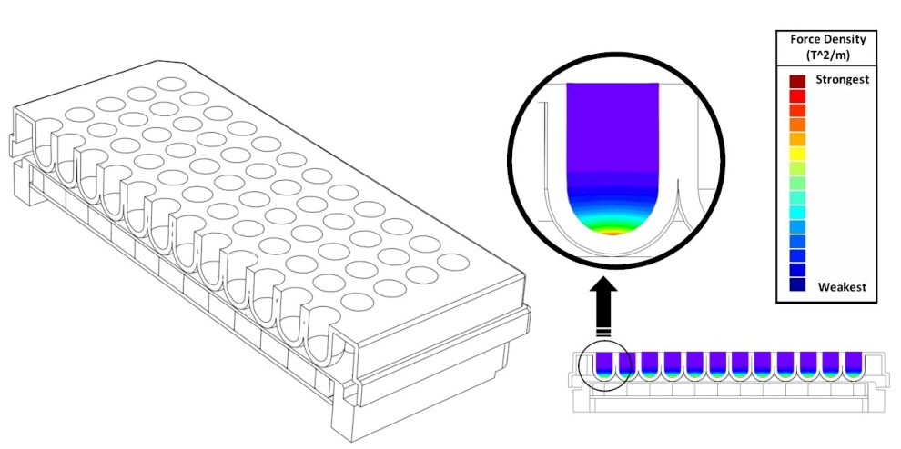
Biomagnetic Separators
What they do:
Used to separate magnetic materials:
  Magnetic Beads
  Magnetic Mediums
Magnetic separators are used for
magnetic bead separation units for
work in:
  DNA separation and mRNA
purification
  Cell isolation and rare cell detection
  Development of immunoassays
  Capture of biomolecules
  Protein purification

Slide 17
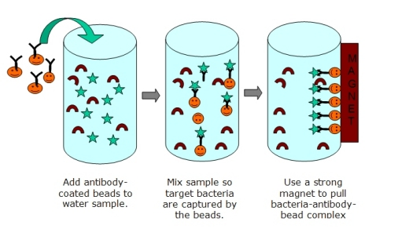
Biomagnetic Separators
How they work:
Magnets in the separators are
used to pull magnetic materials
towards the magnet; the
medium can then be removed-
allowing for separation
In more detail:
  Magnetic separation works through the use of affinity coatings attached to magnetic beads.
  Beads are mixed with a sample containing biomolecules/cells that a given target has the opportunity to bind together with.
  Once the target and affinity coating are bound, they can be separated using magnetism.

Slide 18
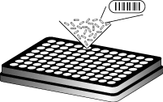
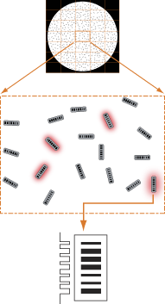
Bar-coded Magnetic Bead Technology
How they work:
Combination of photolithographic barcodes with molecular chemistry
Optical bar coded beads are functionalized with:
  Nucleic Acids
  Proteins
  Probe molecules
Two analyzers from an imaging-based system are used to decode the beads

Slide 19
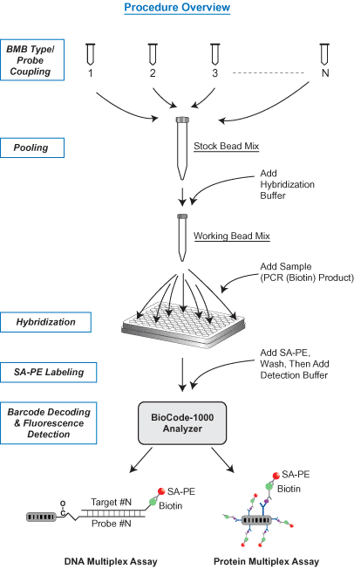
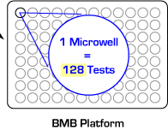
Bar-coded Magnetic Bead Technology
What they do:
Designed to improve the isolation and identification capacity of in-vitro diagnostics
Barcode patterns transmit a high-contrast signal for nearly 100% decoding accuracy
Cause variation of florescence signal to be minimal (essential for analysis on proteins.)
Allow for highly multiplexed assays to be carried out in homo/heterogeneous media

Slide 20
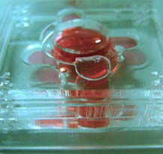
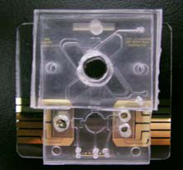
Magnetic Bead Based 3D Micro-Incubator
Mixing micro-electro-mechanical-systems (MEMS) and magnetic beads together leads to the ability to rapidly detect and purify tumor cells inside the incubator
Magnetic beads can be specifically coded to identify tumor cells by conjugating the antibodies onto their surface.
These magnetic beads are able to detect the tumor cells and bind to them
Catching tumor cells before they metastasize can help protect against cancer forming so a rapid means of detection and purification is essential.

Slide 21
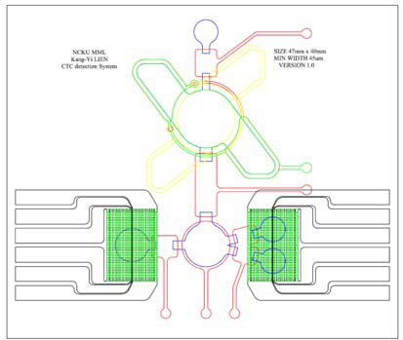
3D Incubator Theory of Operation
The first step of the process is to extract a large amount of body fluid then re-suspending them in a phosphate buffered saline solution.
The samples are then placed inside the incubator, which rapidly mixes the fluid with the magnetic beads.
The beads are then able to adhere to specifically targeted tumor cells.
A key feature of the magnetic beads is the fact that they are only magnetic in the presence of a magnet and by using this they are able to magnetize the mixture, leaving only the unwanted material free.
Using a large vacuum tube they suck out all of the unwanted material
The tumor cells can then be reverse transcripted and amplified for observation

Slide 22
Applications
Routine clinical diagnostics
Gene mutation analysis
Infectious diseases studies
Biomarkers validation
Drug resistance genotyping
Pharmaceutical drug discovery

Slide 23
Magtration Filtration
The Filtration of DNA from cells using Magnetic Bead Technology
The much faster, cheaper and most pure way to filter DNA from cells comes from the use of Magnetic Bead Technology

Slide 24
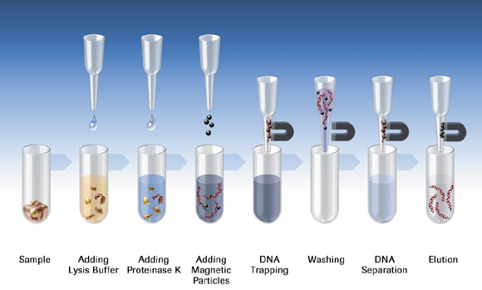
Magtration Filtration

Slide 25
Applications of Magtration Filtration
Isolation of cells directly from blood or any fluid samples
Protein Isolation
Isolation of nucleic acids
Used to help research studies all around
  Making fruit bigger & seedless
  Study of human development from birth, diseases, and potential cures for our future.

Slide 26
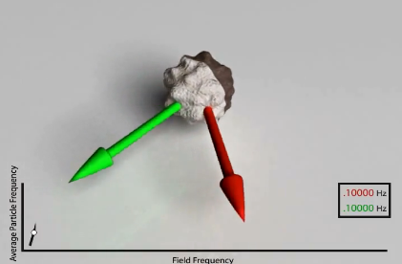
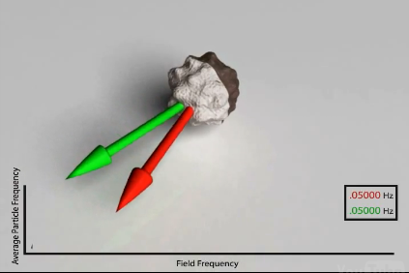
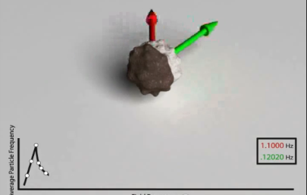
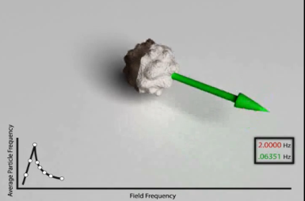
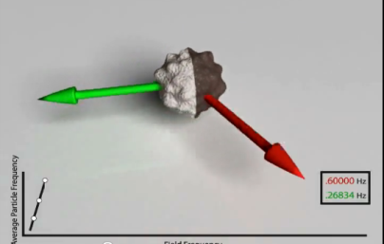
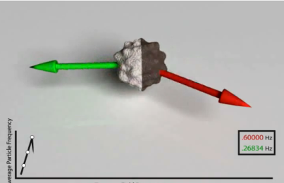
Applications: Asynchronous Magnetic Bead Rotation
How they work:
Sensor uses spherical magnetic bead that spins in a magnetic field
The attachment of bacteria causes change in the speed of bead

Slide 27
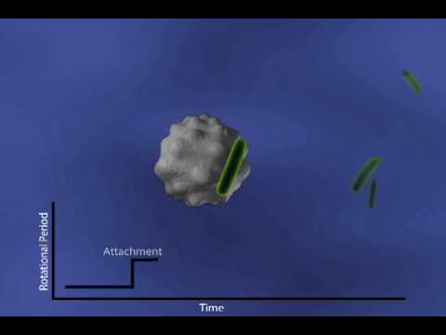
Applications: Asynchronous Magnetic Bead Rotation
What they do:
Detect growth of bacteria at the microscopic level
Monitor the growth of a single bacterium throughout its life cycle over multiple generations

Slide 28
Current Progression of the Technology
Trying to achieve a higher frequency
- more averaging
- higher resolution
- higher bandwidth studies
Which will allow:
Real time single bacterium growth monitoring
Single virus detection

Slide 29
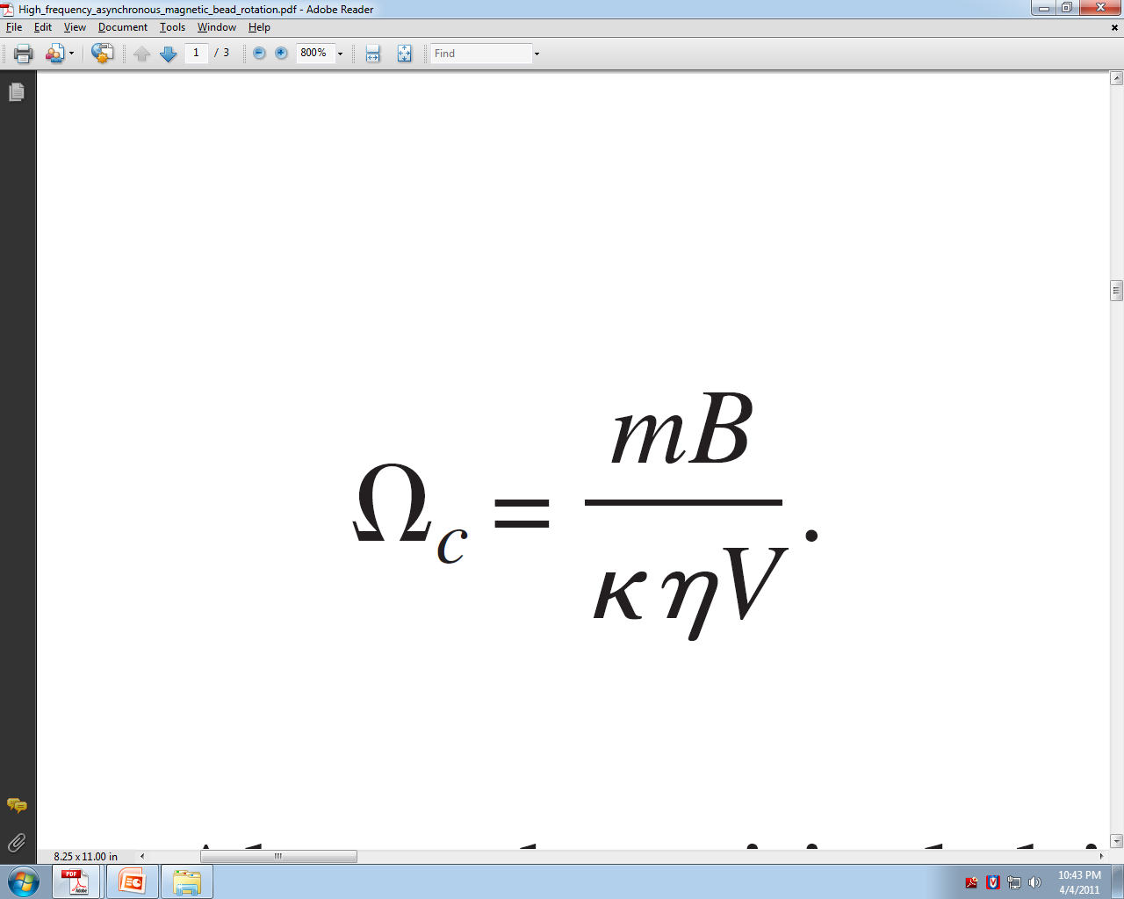
Critical Frequency
A ferromagnetic bead becomes asynchronous with the rotating magnetic field above a critical driving frequency Ωc
m (magnetic moment of the bead)
B (magnetic field strength)
K (shape factor)
η (kinetic viscosity)
V (volume of the bead)

Slide 30
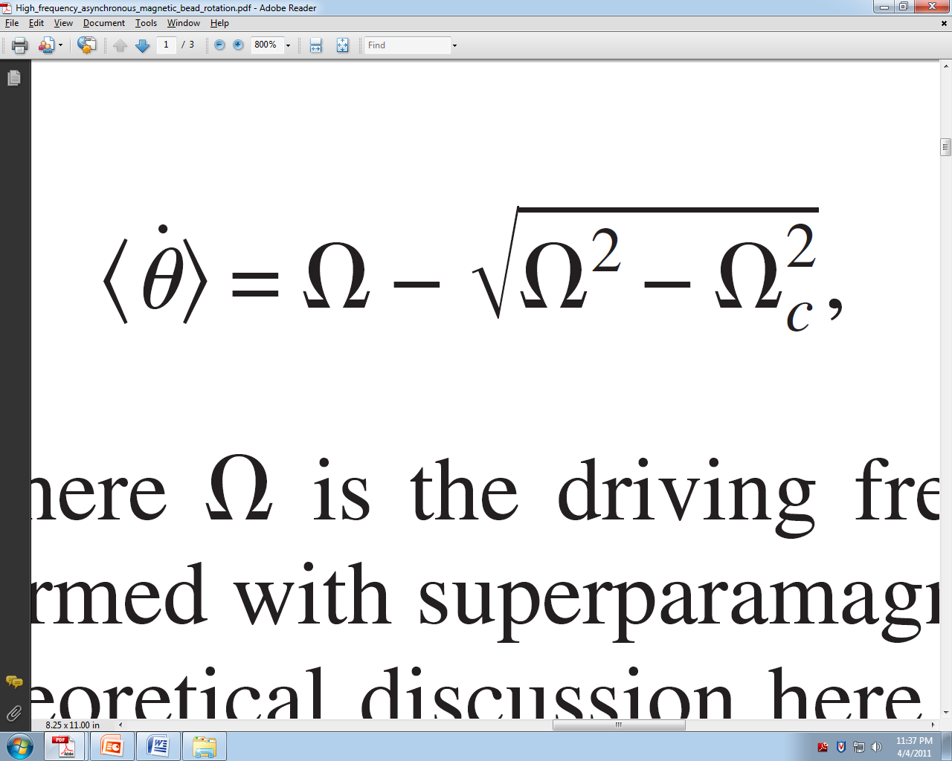
Rotation Frequency
where Ω Is the driving frequency
In 2007 the reported rotational frequencies:
0.2 to 29 Hz
Applications that would benefit from higher rotational frequency:
- micro-mixing
- pathogen detection
- growth studies

Slide 31
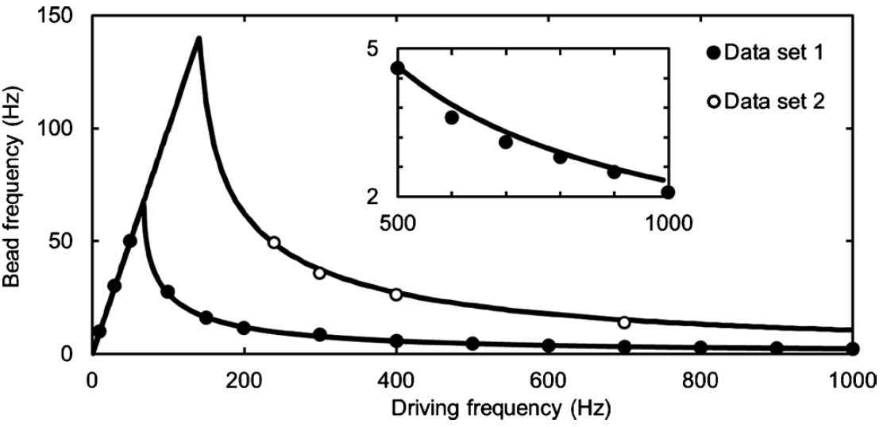
Higher Frequency
In 2010:
- Rotational frequency of 145 Hz
- Which will allow a calculated limit
as little as 59nm

Slide 32
Testing
Monitoring the growth of an E.coli cell and it’s response to the antibiotic ampicillin
Observed changes as little as 80nm
While the demonstrated AMBR sensor has been optimized for bacteria, preliminary work has extended the method to studies on other individual cells, such as yeast and cancer cells.

Slide 33
Marketability

Slide 34
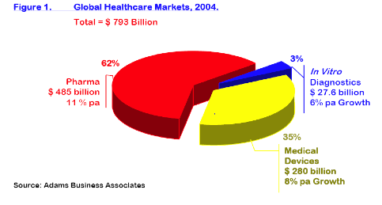
Current Market Value
As mentioned earlier, magnetic beads are the golden staple in today’s biomedical market.
This includes various markets:
  Immunoassay Testing: $42 Billion
  DNA & RNA Purification: $2.3 Billion
  Magnetic beads themselves are a $1 Billion market!

Slide 35
Conclusion
Magnetic Beads have numerous applications across the biosensor field
  Speed up treatment of bacterial infections (such as finding anti-microbials in minutes instead of days)
  Cutting costs/saving lives
  Heavily used in early detection and treatment of cancerous cells
Besides being a progressive technology that will soon change the biomedical field, the beads are also extremely marketable

Slide 36
Sources:
Invitrogen
http://www.invitrogen.com/site/us/en/home/brands/Dynal/The-History-of-Dynabeads.html
http://www.invitrogen.com/site/us/en/home/brands/Dynal/dynabeads_technology.html
Dexter Magnetic Technologies
http://www.dextermag.com/Separators
Aplied BioCode
http://www.apbiocode.com/
http://www.apbiocode.com/technology.htm
To Bead or Not To Bead: Applications of Magnetic Bead Technology
The Scientist 1998
http://f1000scientist.com/article/display/18094/bead_980622.pdf
BioMagnetic Research and Technology
http://groups.google.com/group/intro-to-biosensors/browse_thread/thread/342bffb80f38c126
Walk-away Magnetic Bead-based DNA Purification Using the JANUS Automated Workstation
Authors:
Lois Tack, Ph.D.,
Gary Reznik, Ph.D.
http://las.perkinelmer.com/content/ApplicationNotes/APP_DNAMagBeadApr09FINAL.pdf
Dynabeads Products and Technology
http://www.invitrogen.com/site/us/en/home/brands/Dynal/dynabeads_technology.html

