Slide 1

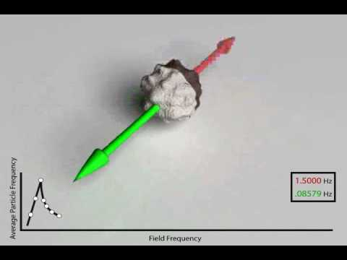
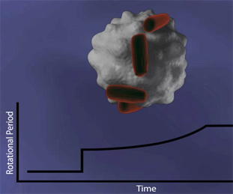
Magnetic Bead Technology
University of Massachusetts-Lowell
Introduction to Biosensors
Shiv Sharma
George Chahwan
Zachary Nicoll
Garo Yessayan
Jason Tarantino

Slide 2
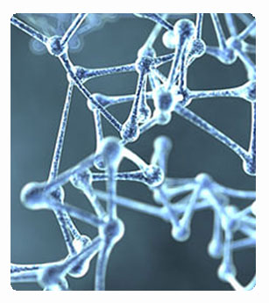
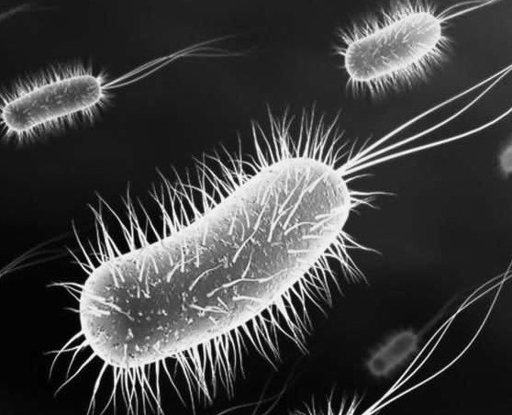
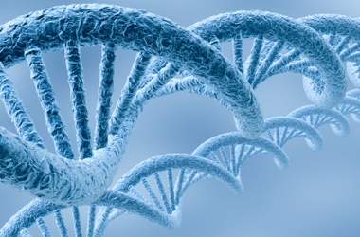
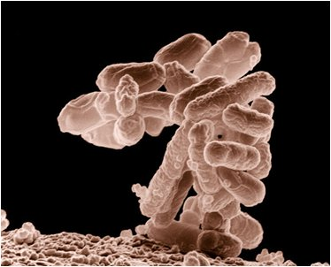
Abstract:
To track the ongoing progress and evolution of the biotechnology field through the experimentation with magnetic bead technology and its applications to modern society.

Slide 3
Overview, History, Needs

Slide 4
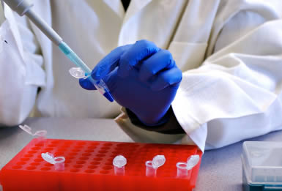
Overview
Magnetism technology became popular in the early 1980s
Using super-paramagnetic beads and magnetic fields, the process of biomedical separation of assays is performed
Advantages:
Price-Cheaper to experiment with
Requires less labor
Widely Applicable

Slide 5
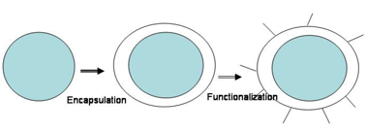
What is a magnetic bead?
Magnetic beads are polymer encapsulated shells with a magnetic pigment
The magnetic material is mostly made up of iron oxide
This combination is what makes these beads functional:
  Polymer surface of the beads permits chemical derivatization of magnetic particles, allowing for conversion of magnetic particles into a binding agent for tests (such as ones using immunoassays)

Slide 6
The Needs and Opportunities
People want improved medical care for lower-costs
Causing In Vitro Diagnostic to look for newer technologies such as magnetic bead technology
In the last few years, magnetic beads have become a staple in the clinical markets
The beads ability to cut out any human error allows for biomedical processes and tests to be more precise.
As a result, less tests need to be carried out = lower cost of clinical diagnostics

Slide 7
Instrumentation

Slide 8
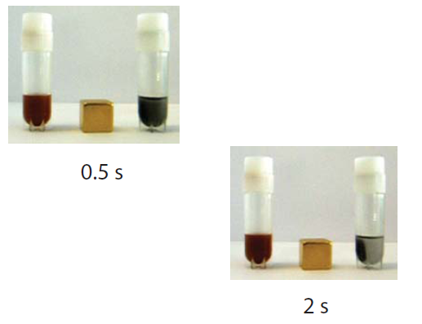
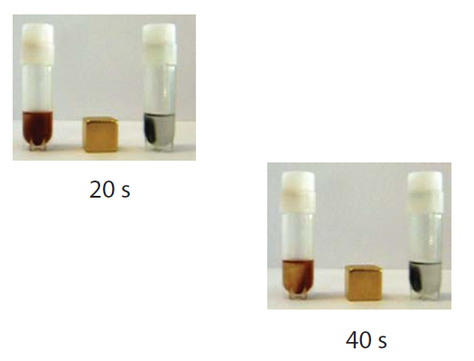
Turbo Beads
Provide faster and more efficient way of seperating various compounds from one another
Made from highly reactive metal nanomagnetics that are coated in graphene Carbon
Combination of the metal core with the carbon shell displays a large increase in magnetic properties; allowing for faster separation.

Slide 9
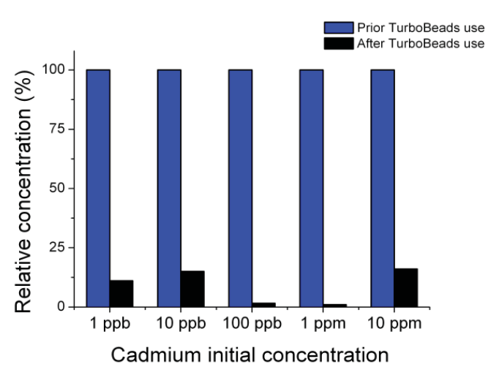
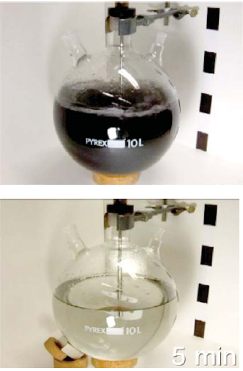
Turbo Beads Continued
Due to the Carbon the beads can be used in areas that have low pH or high temperatures without oxidation of the core
The compounds that create the beads are reagents for swift removal of toxins that contaminate water

Slide 10
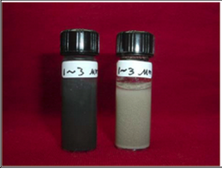
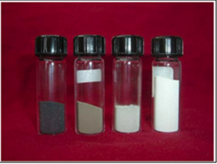
CardioGenics Magnetic Beads
Developed to improve testing sensitivity
80% of light generated in a generic magnetic bead is lost, causing low sensitivity
Coated with a thin layer of silver before being covered by a polymer shell
Coating allows for a lighter color making it more sensitive to light
Size can vary from 1-50 microns and it’s 7 times more sensitive to light.

Slide 11
Applications

Slide 12
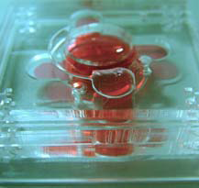
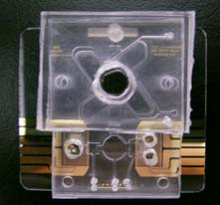
Magnetic Bead Based 3D Micro-Incubator
Mixing micro-electro-mechanical-systems (MEMS) and magnetic beads together leads to the ability to rapidly detect and purify tumor cells inside the incubator
Magnetic beads can be specifically coded to identify tumor cells by conjugating the antibodies onto their surface.
These magnetic beads are able to detect the tumor cells and bind to them
Catching tumor cells before they metastasize can help protect against cancer forming so a rapid means of detection and purification is essential.

Slide 13
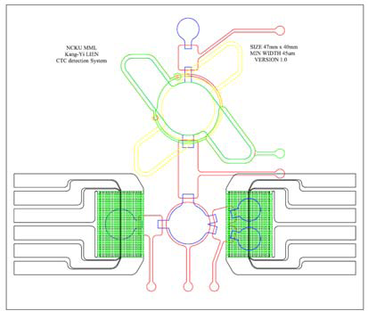
3D Incubator Theory of Operation
The first step of the process is to extract a large amount of body fluid then re-suspending them in a phosphate buffered saline solution.
The samples are then placed inside the incubator, which rapidly mixes the fluid with the magnetic beads.
The beads are then able to adhere to specifically targeted tumor cells.
A key feature of the magnetic beads is the fact that they are only magnetic in the presence of a magnet and by using this they are able to magnetize the mixture, leaving only the unwanted material free.
Using a large vacuum tube they suck out all of the unwanted material
The tumor cells can then be reverse transcripted and amplified for observation

Slide 14

Risks of Cell Phone Radiation
Damages Blood Brain Barrier which could lead to Parkinson's disease and Alzheimer's disease
Smaller risks include
  constant headaches
  Sleep disturbances
  Small memory loss
  Learning disabilities

Slide 15
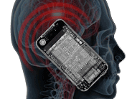
Controversy
Radiation has not been 100% proven to be the cause of these types of risks.
    Takes decades to develop bad
    symptoms.
Many believe there is no clear link between radiation and the illnesses.
Most symptoms of radiation exposure are normal human discomforts we get everyday.

Slide 16
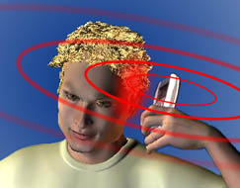
Stopping cell phone radiation
Magnetic Beads carefully placed in the antenna and wiring of the phone will suppress the magnetic waves from leaving the phone.
Creates a electromagnetic
radiation free
environment
around the cell
phone.

Slide 17
Magtration Filtration
The Filtration of DNA from cells using Magnetic Bead Technology
How?

Slide 18
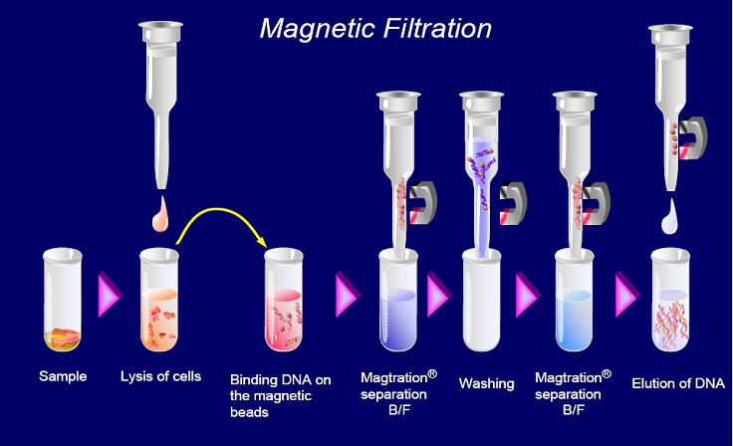
Magtration Filtration

Slide 19
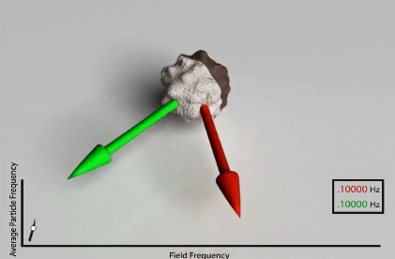
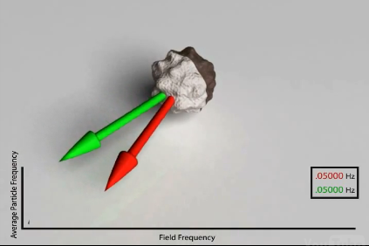
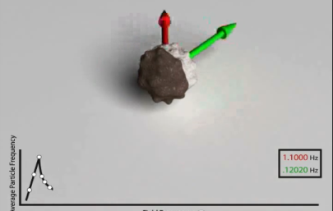
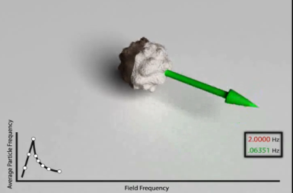
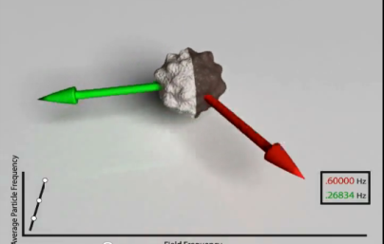
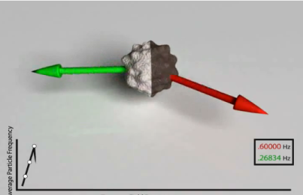
Applications: Asynchronous Magnetic Bead Rotation
How they work:
Sensor uses spherical magnetic bead that spins in a magnetic field
The attachment of bacteria causes change in the speed of bead

Slide 20
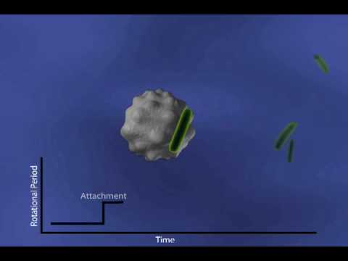
Applications: Asynchronous Magnetic Bead Rotation
What they do:
Detect growth of bacteria at the microscopic level
Monitor the growth of a single bacterium throughout its life cycle over multiple generations

Slide 21
Current Progression of the Technology
Trying to achieve a higher frequency
- more averaging
- higher resolution
- higher bandwidth studies
Which will allow:
Real time single bacterium growth monitoring
Single virus detection

Slide 22
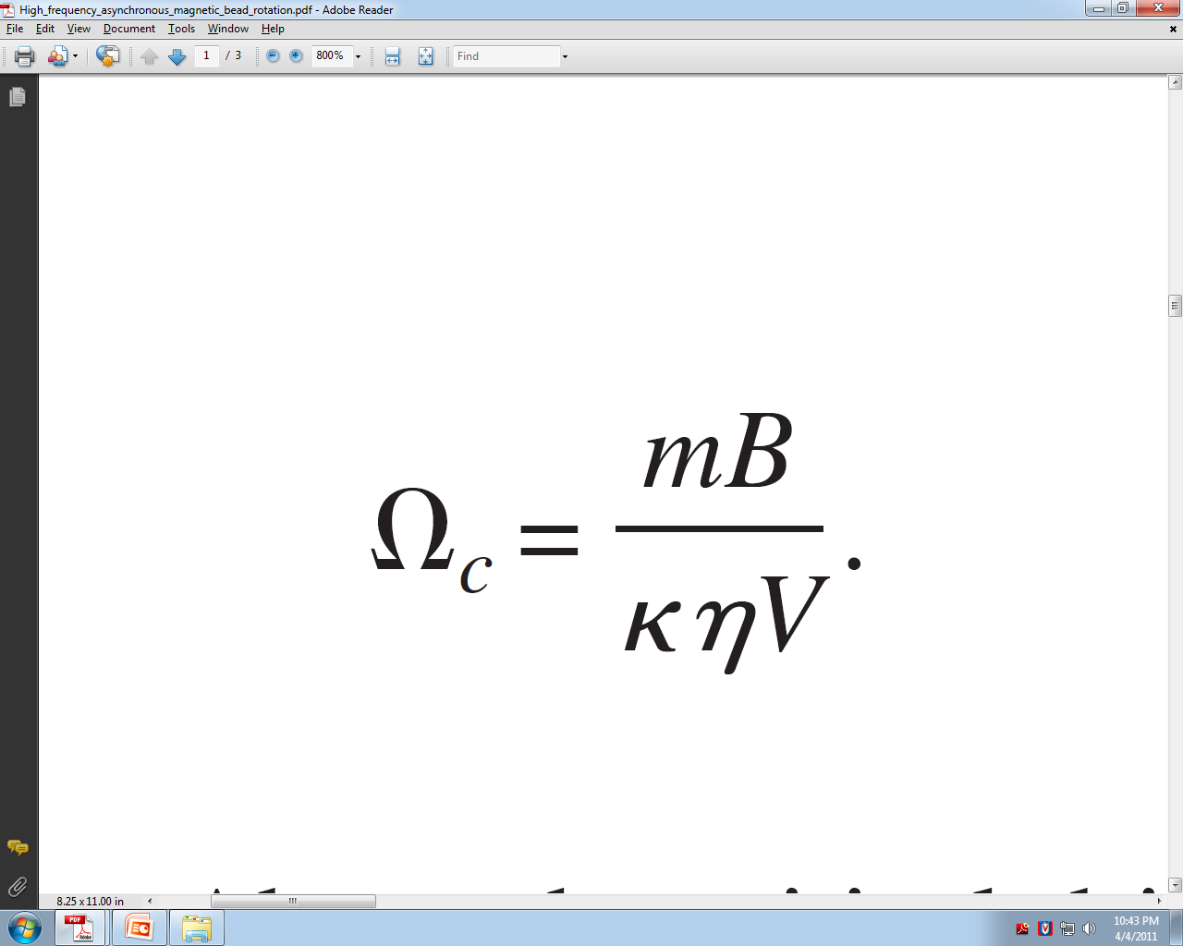
Critical Frequency
A ferromagnetic bead becomes asynchronous with the rotating magnetic field above a critical driving frequency Ωc
m (magnetic moment of the bead)
B (magnetic field strength)
K (shape factor)
η (kinetic viscosity)
V (volume of the bead)

Slide 23
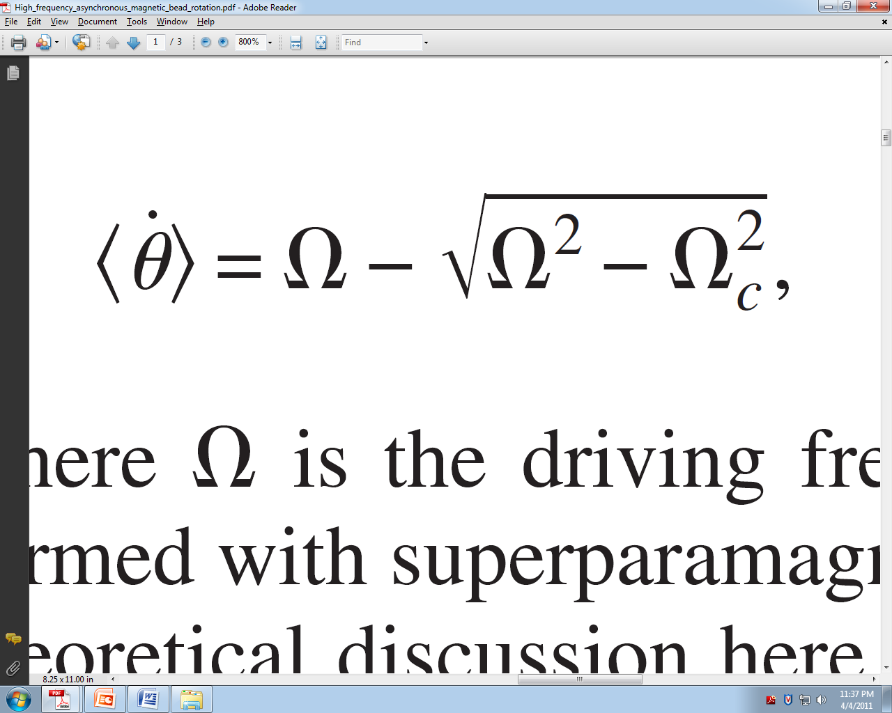
Rotation Frequency
where Ω Is the driving frequency
In 2007 the reported rotational frequencies:
0.2 to 29 Hz
Applications that would benefit from higher rotational frequency:
- micro-mixing
- pathogen detection
- growth studies

Slide 24
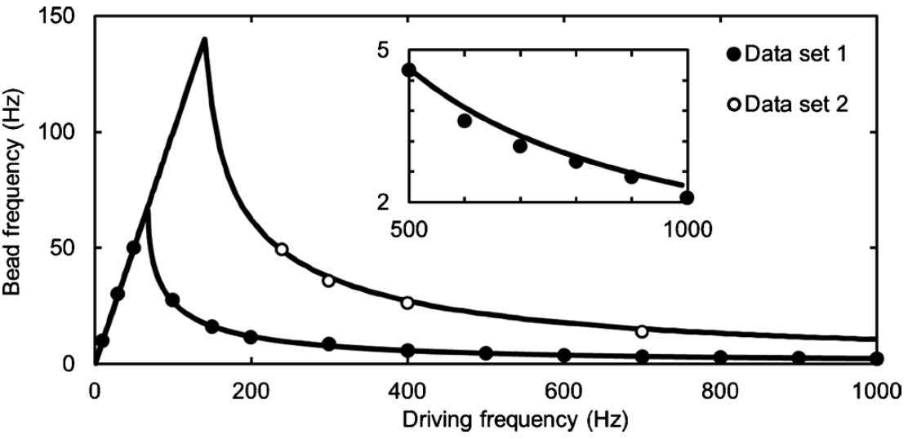
Higher Frequency
In 2010:
- Rotational frequency of 145 Hz
- Which will allow a calculated limit
as little as 59nm

Slide 25
Testing
Monitoring the growth of an E.coli cell and it’s response to the antibiotic ampicillin
Observed changes as little as 80nm
While the demonstrated AMBR sensor has been optimized for bacteria, preliminary work has extended the method to studies on other individual cells, such as yeast and cancer cells.

Slide 26
Marketability

Slide 27
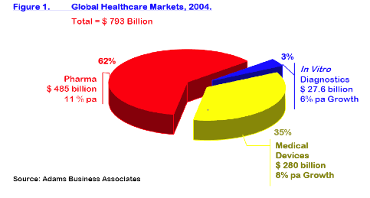
Current Market Value
As mentioned earlier, magnetic beads are the golden staple in today’s biomedical market.
This includes various markets:
  Immunoassay Testing: $42 Billion
  DNA & RNA Purification: $2.3 Billion
  Magnetic beads themselves are a $1 Billion market!

Slide 28
Conclusion
Magnetic Beads have numerous applications
  Speed up treatment of bacterial infections (such as finding anti-microbials in minutes instead of days)
  Cutting costs/saving lives
  Cancer drug development and treatment
Besides being a progressive technology that will soon change the biomedical field, the beads are also extremely marketable

Slide 29
Sources:
Invitrogen
http://www.invitrogen.com/site/us/en/home/brands/Dynal/The-History-of-Dynabeads.html
http://www.invitrogen.com/site/us/en/home/brands/Dynal/dynabeads_technology.html
Dexter Magnetic Technologies
http://www.dextermag.com/Separators
Aplied BioCode
http://www.apbiocode.com/
http://www.apbiocode.com/technology.htm
To Bead or Not To Bead: Applications of Magnetic Bead Technology
The Scientist 1998
http://f1000scientist.com/article/display/18094/bead_980622.pdf
BioMagnetic Research and Technology
http://groups.google.com/group/intro-to-biosensors/browse_thread/thread/342bffb80f38c126
Walk-away Magnetic Bead-based DNA Purification Using the JANUS Automated Workstation
Authors:
Lois Tack, Ph.D.,
Gary Reznik, Ph.D.
http://las.perkinelmer.com/content/ApplicationNotes/APP_DNAMagBeadApr09FINAL.pdf

