Slide 1
Commercially Available Biosensors
Applications, Availability, and Marketability
Benjamin Babineau
Matthew Best
Sean Farrell

Slide 2
Outline
Why This Project?
Background
Types of Biosensors
Applications
Commercially Available Biosensors
Marketability
Work Breakdown
Schedule

Slide 3
Why This Project?
There is a great need to create biosensors that are mass-producible
In the health field, it is imperative that the maximum amount of people have access to early warning diagnoses
This project will attempt to bring understanding as to why companies struggle with manufacturing biosensors on a large, inexpensive scale
By examining and employing effective methods that have been used to date, commercial biosensors can become more prolific

Slide 4
Background
What is a biosensor?
Analytical device for the detection of an analyte that combines a biological component with a physicochemical detector component
Components
Sensitive biological element
Transducer or detector element
Electronics and signal processors

Slide 5
Background
Detection Methods
Photometric
Optical biosensors use the phenomenon of surface plasmon resonance (SPR)
Surface plasmons are surface electromagnetic waves that propagate in direction parallel to metal/dielectric interface.
Excitation by light
Electrochemical
Electrochemical biosensors use a reaction that produces or consumes electrons

Slide 6
Background
Ion Channel Switch
Ion channel used to offer highly sensitive detection of target biological molecules
Piezoelectric
Uses crystals which undergo an elastic deformation when an electrical potential is applied
Detects changes in the resonance frequency
Other Methods
Thermometric
Magnetic

Slide 7
Types of Biosensors (Analytes)
Enzyme Electrode
Enzymes
Enzymes are immobilised on the surface of an electrode
Current is generated when enzyme catalyses
Immunosensor
Antibodies
Detects change in mass when antibody binds to antigen
DNA Sensor
DNA
Microbial Sensor
Microbial Cells

Slide 8
Types of Biosensors (Detection Mode)
Electrochemical
Potentiometric
Amperometric
Voltametric
Optical
Floresence
Adsorption
Reflection
Electrical
Surface conductivity
Electrolyte conductivity

Slide 9
Types of Biosensors (Detection Mode)
Mass sensitive
Resonant frequency of piezocrystals
Thermal
Heat of reaction
Heat of adsorption

Slide 10
Applications
Medical
Glucose monitoring in diabetes patients
Detection of pathogens
In-home medical analysis and diagnosis
Environmental
Detection of pesticides and water contaminates
Determining levels of toxic substances before and after bioremediation
Detection of metabolites such as molds
Remote sensing of airborne bacteria
Food Industry
Detection of drug residues, such as antibiotics and growth promoters, in food

Slide 11
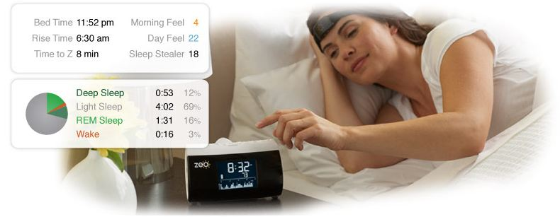
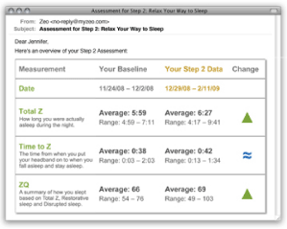
Commercially Available Biosensors
Zeo
Designed to analyze and improve sleep

Slide 12
Commercially Available Biosensors
Zeo (Continued)
Composed of a wireless headband, bedside
display, online analytical tools, and email-
based personalized coaching program
Zeo will calculate your “ZQ”, a number that summarizes your sleep quality and quantity
Headband uses patent-pending SoftWave sensor to measure sleep patterns using the electrical signals naturally produced by the brain

Slide 13
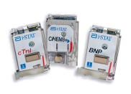
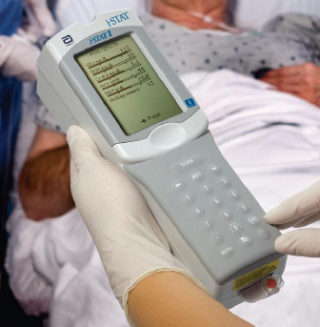
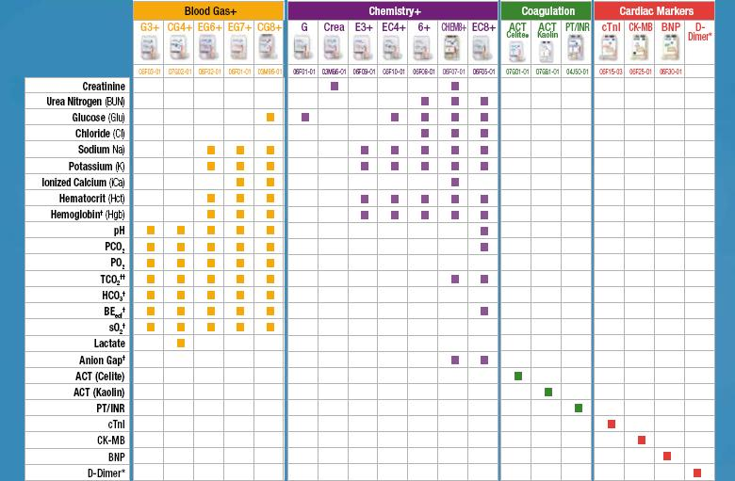
Commercially Available Biosensors
i-STAT Portable Clinical Analyzer
Handheld blood analyzer system

Slide 14
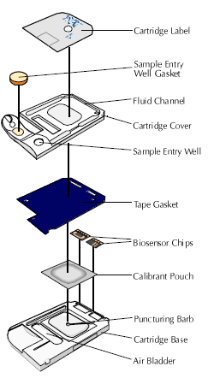
Commercially Available Biosensors
i-STAT (Continued)
Provides fast, accurate, and lab-quality results
within minutes to accelerate decision making
process
How It Works
Uses Si in the sensor cartridge as a substrate and a
conducting base; electronics are housed in the
handheld device
Sensors are micro-fabricated thin film electrodes
Depending on particular assay the electrical signals
produced are measured by the i-STAT’s amperometric, potentiometric, or conductometric circuits.

Slide 15
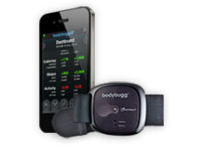
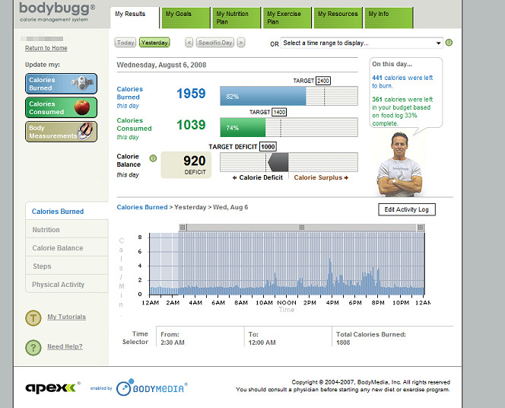
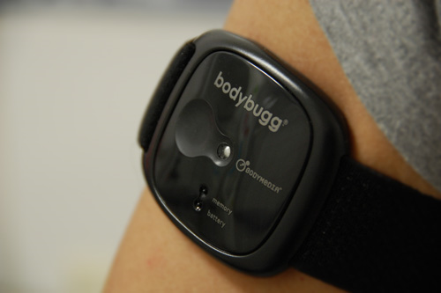
Commercially Available Biosensors
bodybugg
Personal calorie management system

Slide 16
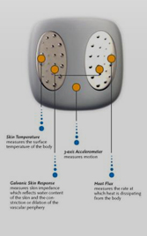
Commercially Available Biosensors
bodybugg (Continued)
Uses multiple physiological sensors for “sensor fusion”
Accelerometer
Tri-axis micro-electro mechanical sensor that
measures motion
Heat Flux
Sensor that measures heat being dissipated by
the body via a thermally resistant material
Galvanic Skin Response
Measures skin conductivity
Skin Temperature
Skin temperature measured using a thermistor-based sensor

Slide 17
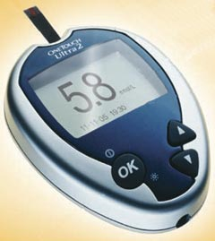
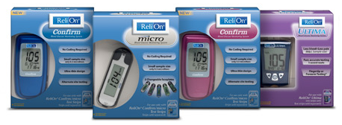
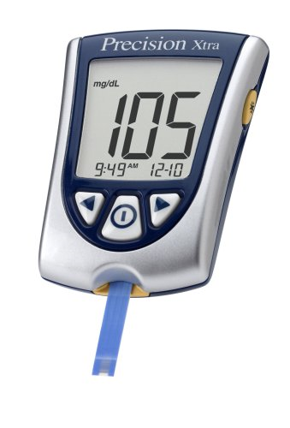
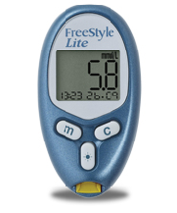
Commercially Available Biosensors
Home Blood Glucose Monitors
ReliOn
FreeStyle
Lite
OneTouch Ultra
Precision Xtra

Slide 18
Commercially Available Biosensors
Home Blood Glucose Monitors (Continued)
Determines approximate concentration of glucose in the blood
Used mainly with people who have diabetes or hypoglycemia
How They Work
Today, most glucose monitors use an electrochemical method
Glucose in blood reacts with an enzyme electrode containing glucose oxidize
The enzyme is reoxidized with an excess of mediator reagent
The mediator is reoxidized by a reaction at the electrode and a current is created
The charge passing the electrode is proportional to glucose level

Slide 19
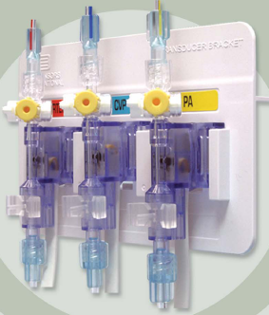
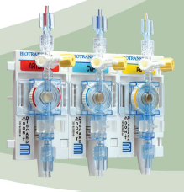
Commercially Available Biosensors
ACCUTRANS
Disposable blood pressure transducer
BIOTRANS
Reusable blood pressure transducer

Slide 20
Marketability
The Biosensor Market
The biosensor market is dominated by only a few products
For medical diagnostics, 90% of biosensors are glucose monitors, blood gas monitors, and electrolyte or metabolite analyzers
Half of all biosensors produced worldwide are glucose monitors
Sales are projected at $1.28 billion in the US in 2012

Slide 21
Marketability
The Biosensor Market (Continued)
The United States and Europe captured 68.73% of the biosensor market in 2008
Due to large development and manufacturing costs, devices tend to be specialized into areas the will receive the most response from the market
Miniaturization has reduced the price of the fabrication of the sensors
Makes products more marketable

Slide 22
Marketability
R&D of Commercial Sensors
R&D of commercial biosensors tends to focus on the creation of new sensors and the miniaturization of new sensors
Research takes place at both universities and private business
Because of the high cost to manufacture biosensors, miniaturization allows more sensors to be made with less material, energy, and effort
New research keeps companies and universities at the head of this quickly changing field

Slide 23
Work Breakdown
Ben
Research available commercial biosensors
Obtain technical information of these biosensors
Matt
Marketability of biosensors
Techniques used in industry
Sean
Availability of biosensors
Miniaturization of biosensors
Techniques and benefits

Slide 24
Schedule
Gantt Chart
Commercially Available Biosensors | Week of | 1-Mar | 8-Mar | 15-Mar | 22-Mar | 29-Mar | 5-Apr | 12-Apr | 19-Apr | 26-Apr | 3-May | 10-May
Activity
Presentation 1
Report 1 Due
Report 1 Review Due
Report 2 Due
Presentation 2
Report 2 Review Due
Final Presentation
Final Report Due
Find Additional Commercial Biosesnors
Technical Information on Biosensors
Marketability of Biosensors
Availability of Biosensors

