Slide 1

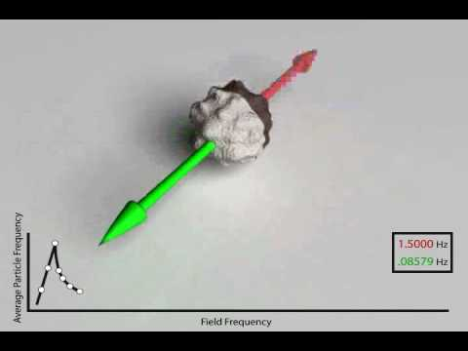
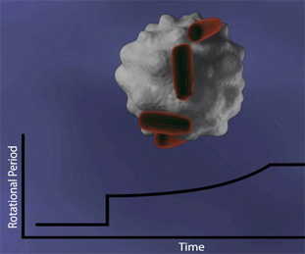
Magnetic Bead Technology
University of Massachusetts-Lowell
Introduction to Biosensors
Shiv Sharma
George Chahwan
Zachary Nicoll
Garo Yessayan
Jason Tarantino

Slide 2
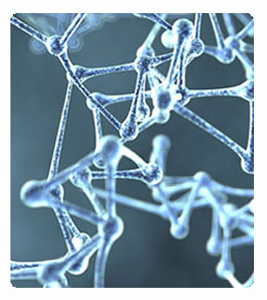
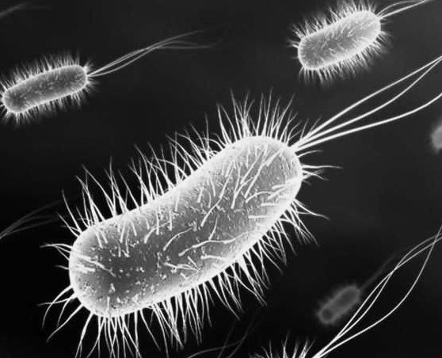
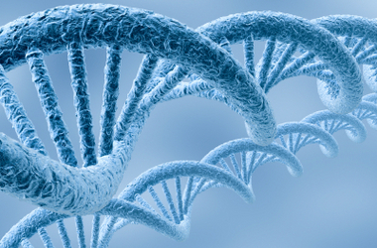
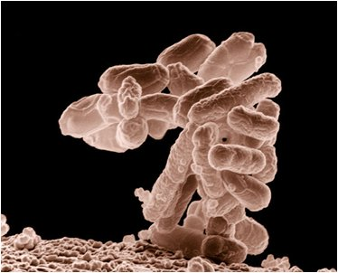
Objective:
To track the ongoing progress and evolution of the biotechnology field through the experimentation with magnetic bead technology and its applications to modern society.

Slide 3
Division of Labor
Zachary Nicoll
  Writing the main reports
  Research on Asynchronous Magnetic Bead Rotation
Shiv Sharma
  Creating PowerPoint
  Research on Bead Separation and History
Garo Yessayan
  Research on Dynabeads
  In charge of peer evaluations
  Reference list
Jason Tarantino
  Research on Barcoded Magnetic Bead Technology
  Research the history and development of Magnetic Bead Technology
  Reviewing and finalizing projects
George Chahwan
  Research on Metabolic Markers
  Time table layout and division of labor
  Research on the current progression of the technology

Slide 4
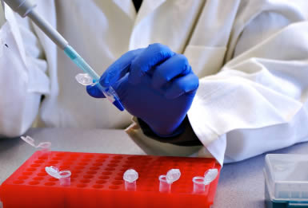
Overview
Magnetism technology became popular in the early 1980s
Using super-paramagnetic beads and magnetic fields, the process of biomedical separation of assays is performed
Advantages:
Price-Cheaper to experiment with
Requires less labor
Widely Applicable

Slide 5
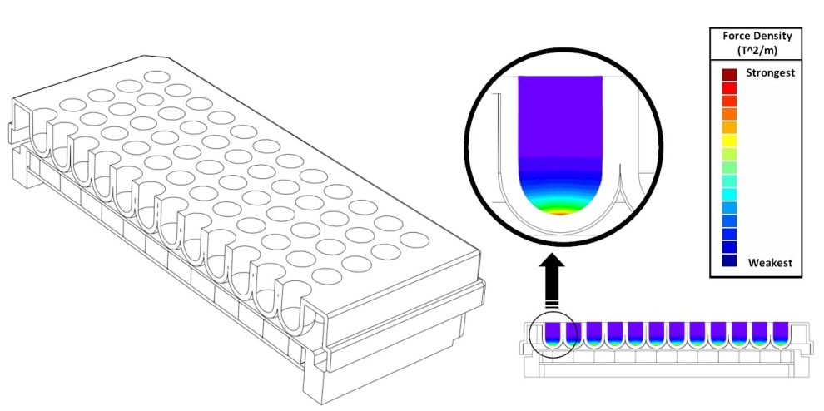
Applications: Biomagnetic Separators
What they do:
Used to separate magnetic materials:
  Magnetic Beads
  Magnetic Mediums
Magnetic separators are used for
magnetic bead separation units for
work in:
  DNA separation and mRNA
purification
  Cell isolation and rare cell detection
  Development of immunoassays
  Capture of biomolecules
  Protein purification

Slide 6
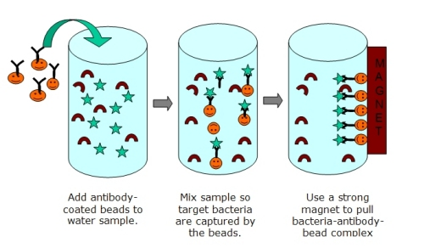
Applications: Biomagnetic Separators
How they work:
Magnets in the separators are
used to pull magnetic materials
towards the magnet; the
medium can then be removed-
allowing for separation
In more detail:
  Magnetic separation works through the use of affinity coatings attached to magnetic beads.
  Beads are mixed with a sample containing biomolecules/cells that a given target has the opportunity to bind together with.
  Once the target and affinity coating are bound, they can be separated using magnetism.

Slide 7
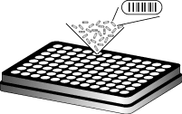
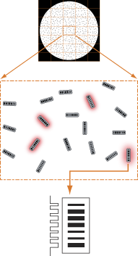
Applications: Barcoded Magnetic Bead Technology
How they work:
Combination of photolithographic barcodes with molecular chemistry
Optical bar coded beads are functionalized with:
  Nucleic Acids
  Proteins
  Probe molecules
Two analyzers from an imaging-based system are used to decode the beads

Slide 8
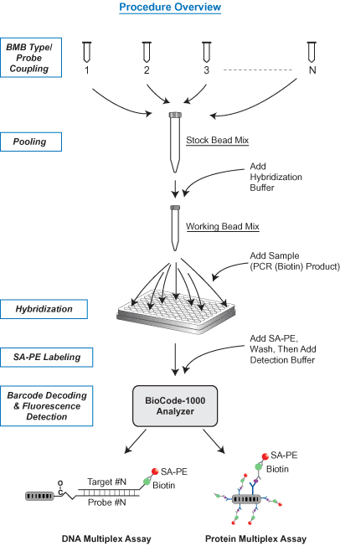
Applications: Barcoded Magnetic Bead Technology
What they do:
Designed to improve the isolation and identification capacity of in-vitro diagnostics
Barcode patterns transmit a high-contrast signal for nearly 100% decoding accuracy
Cause variation of florescence signal to be minimal (essential for analysis on assays such as proteins.
Allow for highly multiplexed assays to be carried out in homo/heterogeneous media

Slide 9
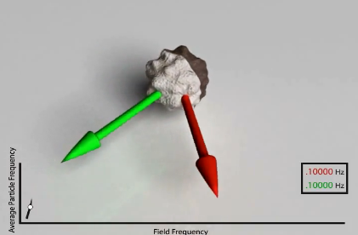
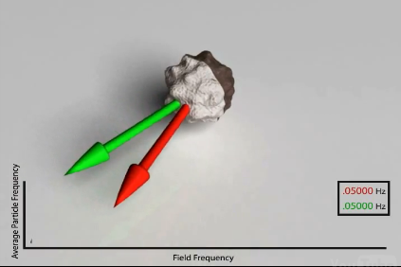
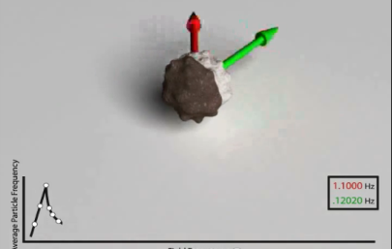
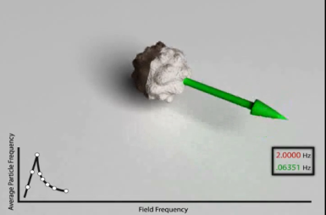
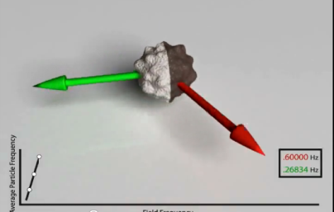
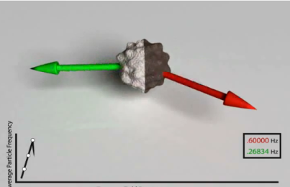
Applications: Asynchronous Magnetic Bead Rotation
How they work:
Sensor uses spherical magnetic bead that spins in a magnetic field
The attachment of bacteria causes change in the speed of bead

Slide 10
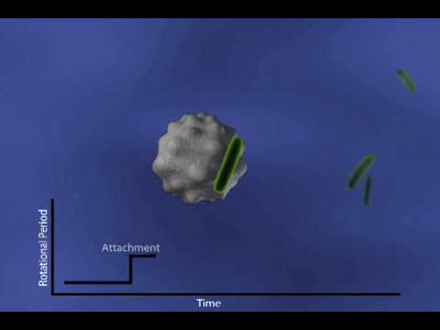
Applications: Asynchronous Magnetic Bead Rotation
What they do:
Detect growth of bacteria at the microscopic level
Monitor the growth of a single bacterium throughout its life cycle over multiple generations

Slide 11
Sources:
Invitrogen
http://www.invitrogen.com/site/us/en/home/brands/Dynal/The-History-of-Dynabeads.html
http://www.invitrogen.com/site/us/en/home/brands/Dynal/dynabeads_technology.html
Dexter Magnetic Technologies
http://www.dextermag.com/Separators
Aplied BioCode
http://www.apbiocode.com/
http://www.apbiocode.com/technology.htm
To Bead or Not To Bead: Applications of Magnetic Bead Technology
The Scientist 1998
http://f1000scientist.com/article/display/18094/bead_980622.pdf
BioMagnetic Research and Technology
http://groups.google.com/group/intro-to-biosensors/browse_thread/thread/342bffb80f38c126
Walk-away Magnetic Bead-based DNA Purification Using the JANUS Automated Workstation
Authors:
Lois Tack, Ph.D.,
Gary Reznik, Ph.D.
http://las.perkinelmer.com/content/ApplicationNotes/APP_DNAMagBeadApr09FINAL.pdf

